Slide 1
ELECTRONIC FORMS SYSTEM (EFS)
Guide to Using EFS to Prepare Simplified Reports

Slide 2
ELECTRONIC FORMS SYSTEM (EFS) Simplified Reports
EFS is a web-based system for completing and filing Simplified Reports.
This tutorial demonstrates basic features and functionality of the EFS Simplified Reports. It does not contain instructions for what information should be provided on your report.
You can view the simplified report instructions at 29 CFR §403.4.

Slide 3
System Requirements and Settings
To access and use EFS, OLMS recommends that you use one of the following browsers:
Microsoft Edge
Google Chrome –Version 7.0 or higher

Slide 4
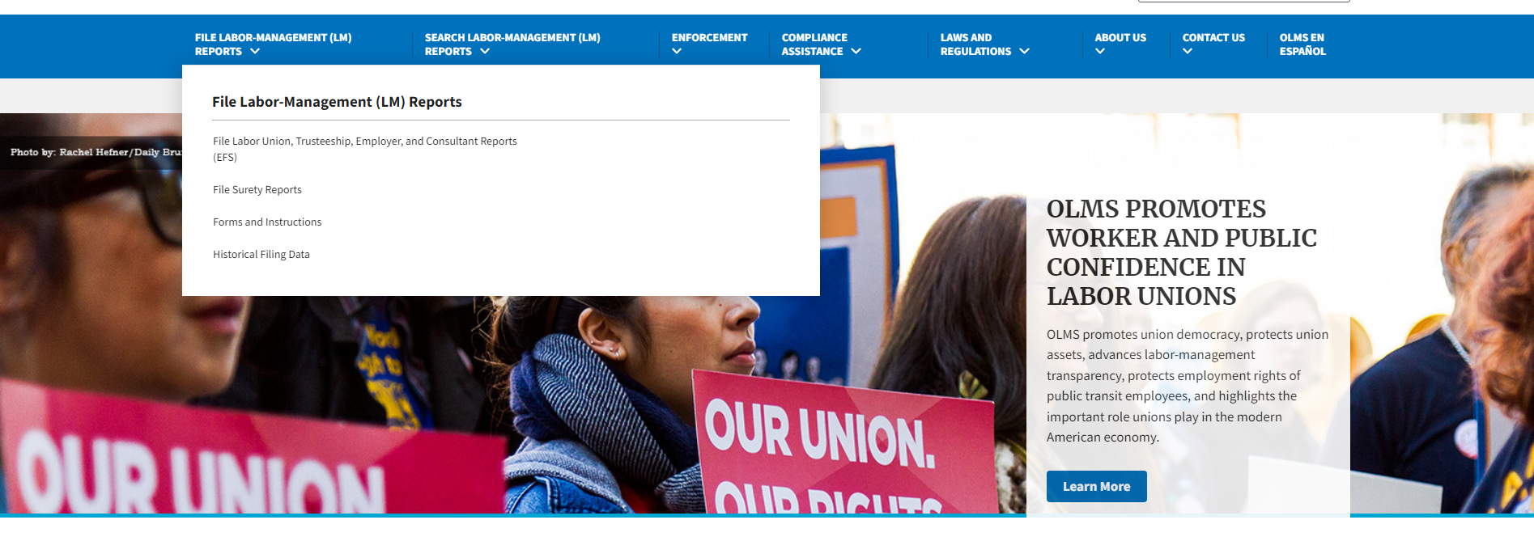
Accessing the System
Navigate to the OLMS Website and select FILE LABOR-MANAGEMENT LM REPORTS., then from the drop down menu, select the “FILE LABOR UNION, TRUSTEESHIP,EMPLOYER, AND CONSULTANT REPORTS”.

Slide 5
Access the OLMS EFS
From the EFS Introduction page, select on the “Access the OLMS EFS” link.

Slide 6
Access Simplified Report in EFS
Only the union NHQ has access to the Simplified Report in EFS.
Log into EFS using your user ID and password and the filing union’s six-digit file number and unique union PIN.

Slide 7
First Time Simplified Report Filers
First time filers will get the following screen.
Select Simplified from the dropdown
Select the Fiscal Year

Slide 8
Returning Simplified Report Filers
Returning filers will get the following screen.

Slide 9
Accessing the Form – Returning Filers
The filer needs to select one of the three options.
Prepopulate with current OLMS data
Export current OLMS data
Proceed to a new Form

Slide 10
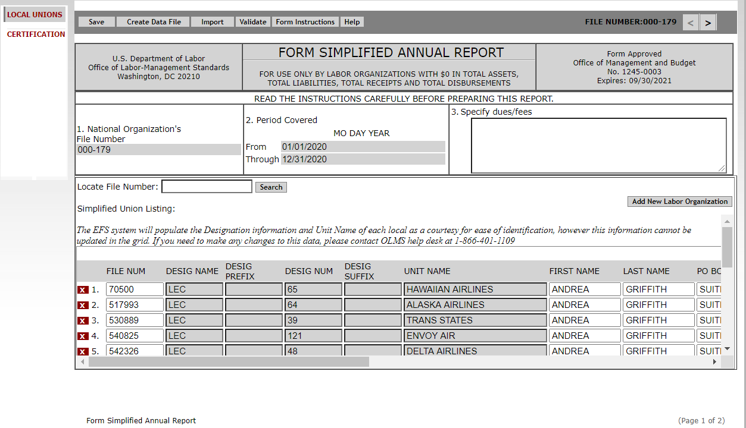
Prepopulated Data
By selecting Prepopulate with current OLMS data, from the previous window, the system will prepopulate with local unions under the Simplified Union Listing.
The system will populate details for each Simplified local union under the Simplified Union Listing section

Slide 11
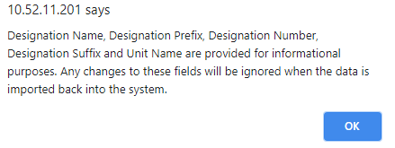
Export Current OLMS Data Option
By selecting “Export current OLMS data” the system will generate a pop-up warning regarding changes information provided
The system will provide the following warning message when the filer chooses the Export option

Slide 12
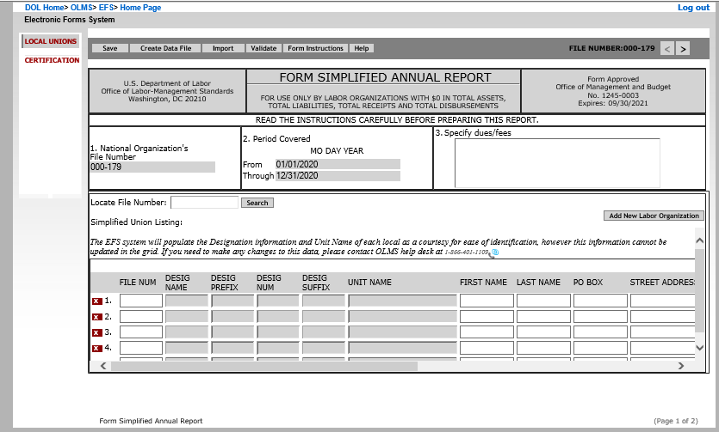
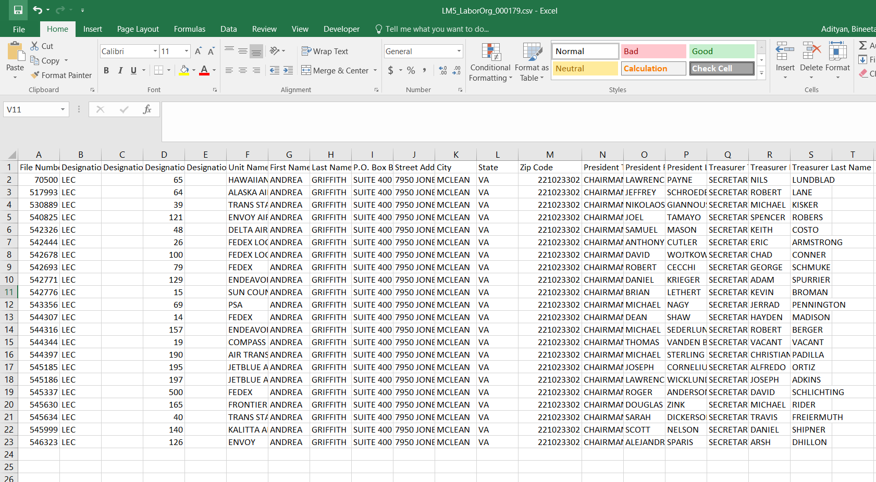
Export Current OLMS Data Option
When the filer selects the "Export current OLMS data” option, the system will download the data file and will also open a new form.
CSV file listing all local unions

Slide 13
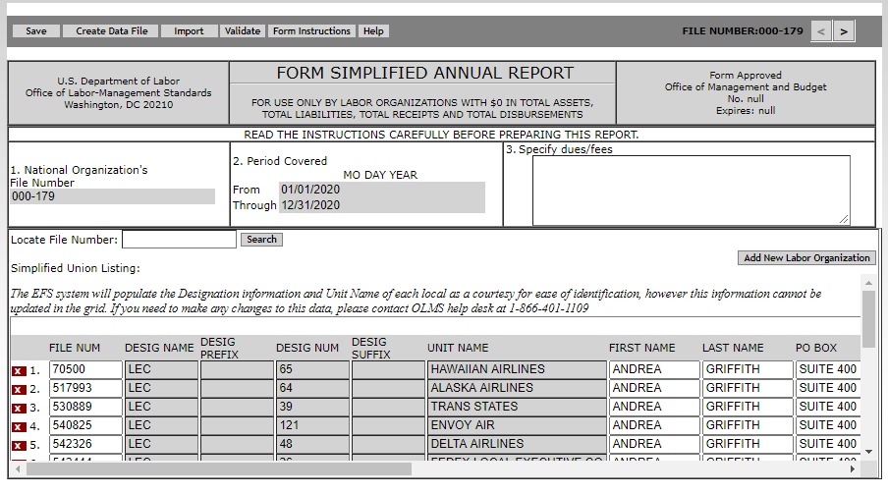
Importing Updated Data
The filer will use the import option to import the updated data file back into the system.
The data from csv will be populated on the form

Slide 14
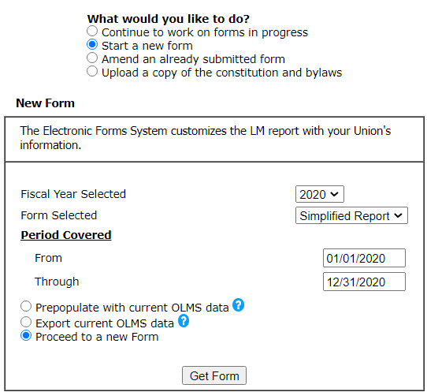
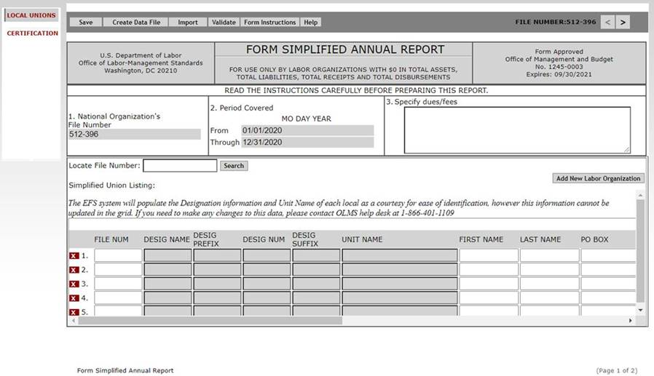
Proceed to a New Form
If the filer selects “Proceed to a new Form,” then selects “Get Form,” a new blank form will open
Select “Proceed to a new Form,” then “Get Form”

Slide 15
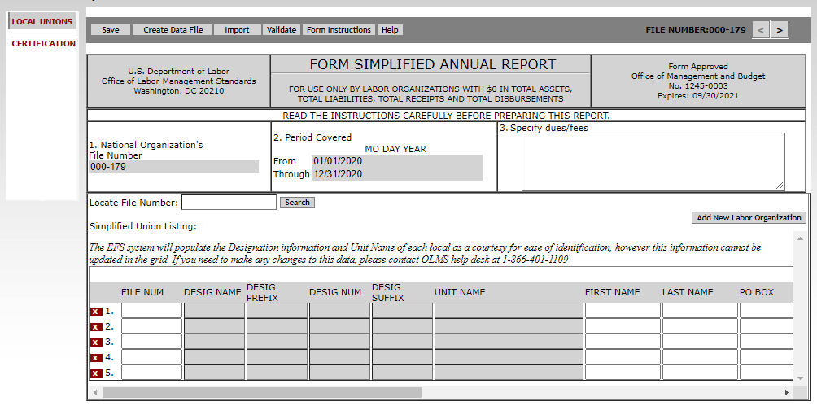
Creating a New Form on the Local Unions Page
Once the system opens a new form, only the date will be prepopulated
The date will be populated based on the year selected
Specify dues, initiation fees, fee required from transfer members, and work permit fees, as applicable.

Slide 16
Create Data File
The filer will have the option to create the data file within the form.
Selecting the “Create Data File” button will open the download option to create the CSV file.
CSV file listing all local unions

Slide 17
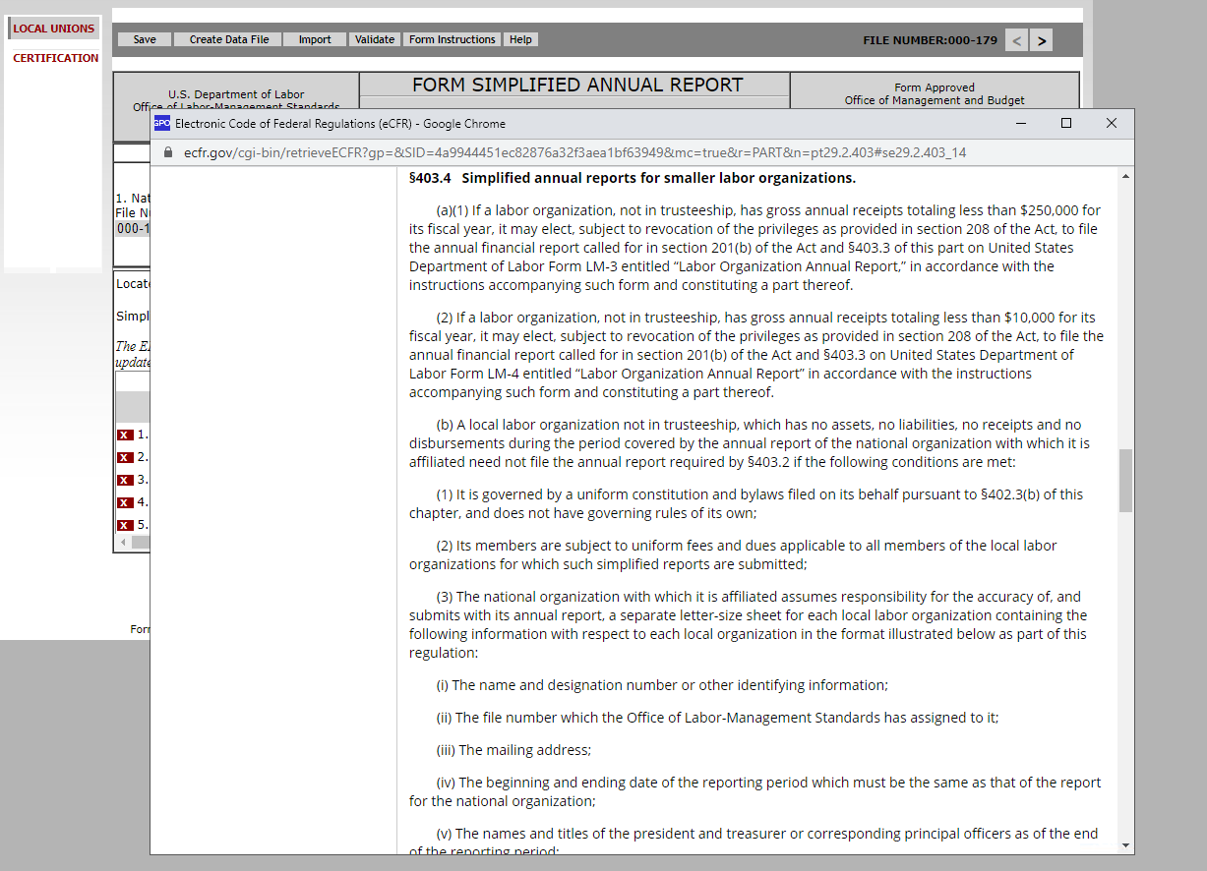
Form Instructions
Selecting the Form Instructions button will open the Electronic Code of Federal Regulations Simplified Annual Reports for smaller labor organizations section.

Slide 18
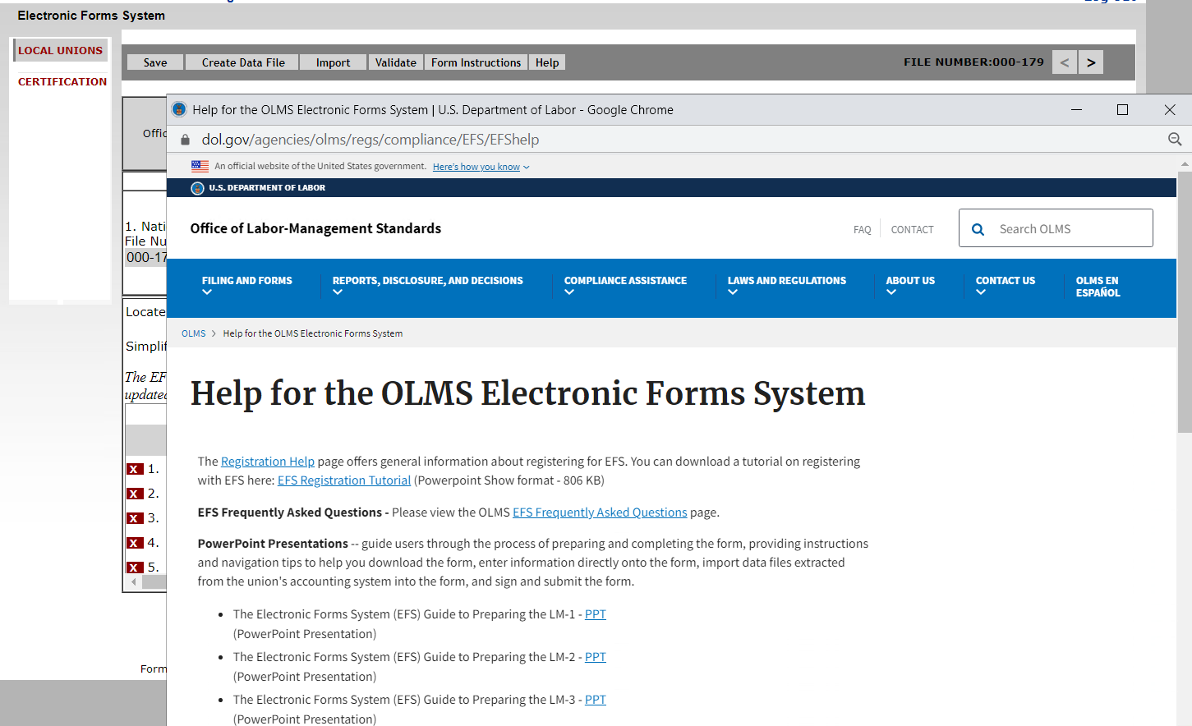
Help
Selecting the Help button will open the Help for OLMS Electronic Forms System page.

Slide 19
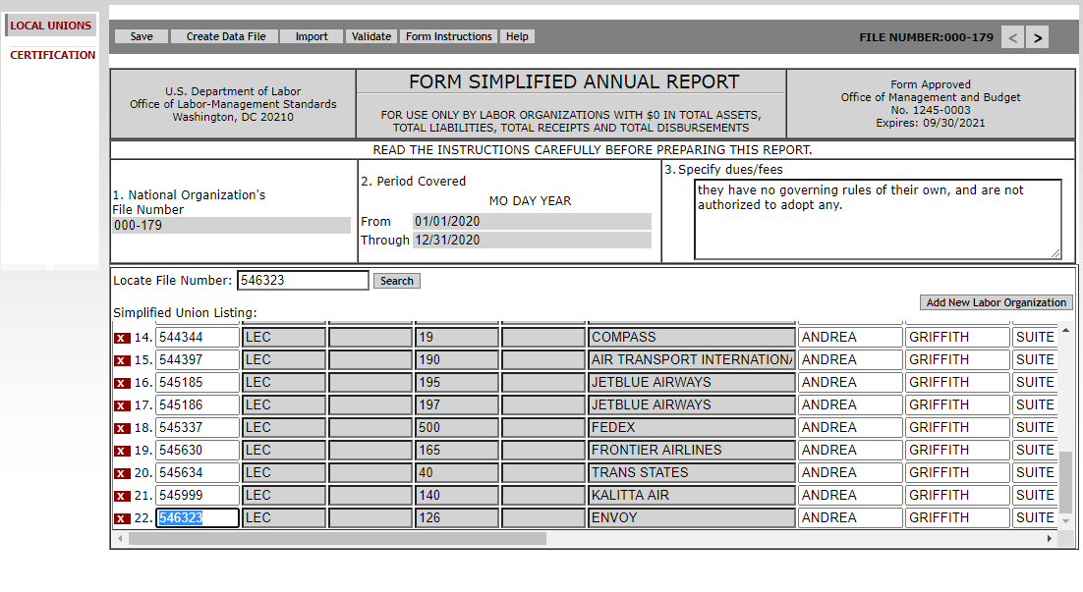
Searching for a Local Union
This page has a search feature to locate a local union from the list.
Use this search feature to search for any local union added to the list.

Slide 20
Local Union Information
Enter any dues/fees that need to be reported in Item 3.
Enter the dues/fees

Slide 21
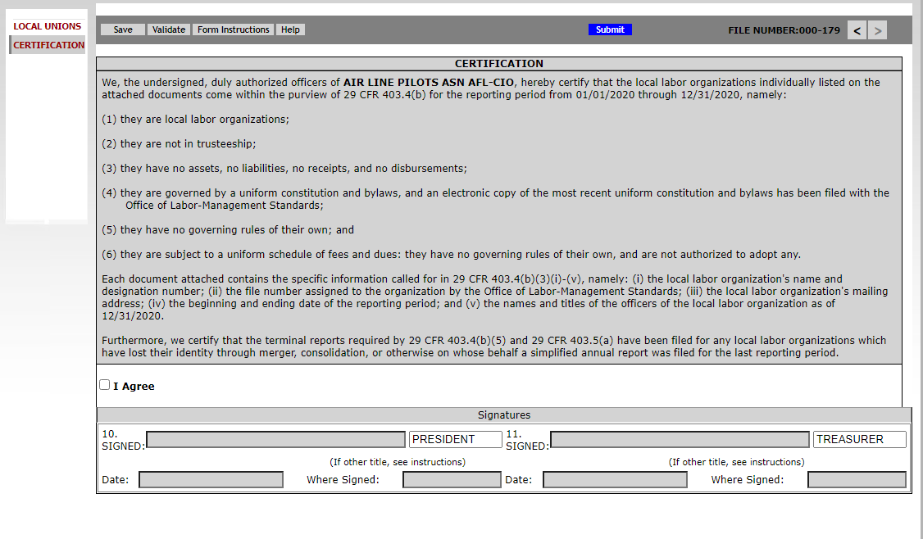
Certification Page
The system will generate the Certification page adding the data from the Local Unions page.
The Name of the organization submitting the simplified report will be added here
Period covered entered in Item 2 will be added here
Period end date will be populated here
Dues and fees entered in Item 3 will be added here.

Slide 22
Validating the Report
The Simplified Report can be validated from either the Local Unions page or Certification page.
To validate from the Local Unions page the filer must:
Review the validation summary
Upon successful validation, from the Certification page, “I Agree” must be selected
Then the report can be signed and submitted.
To validate from the Certification page the filer must:
Select “I Agree”
Then the system checks for validation errors
Once all errors are correct, the report can be signed and submitted.
Both validation methods are detailed on the slides below.

Slide 23
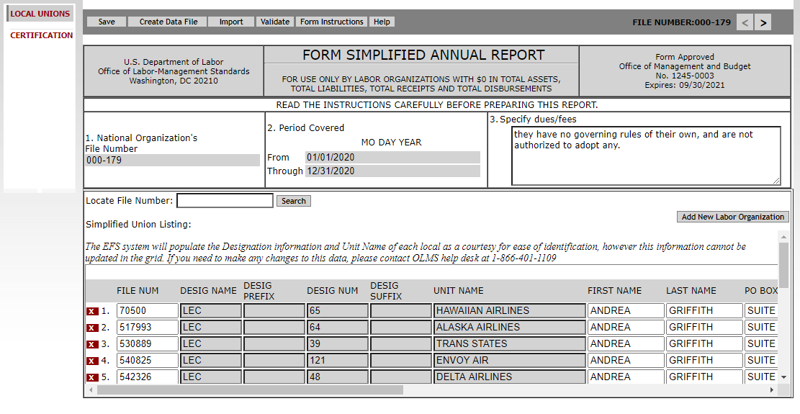
Validate from the Local Unions Page
On the Local Unions page, select Validate to validate the form

Slide 24
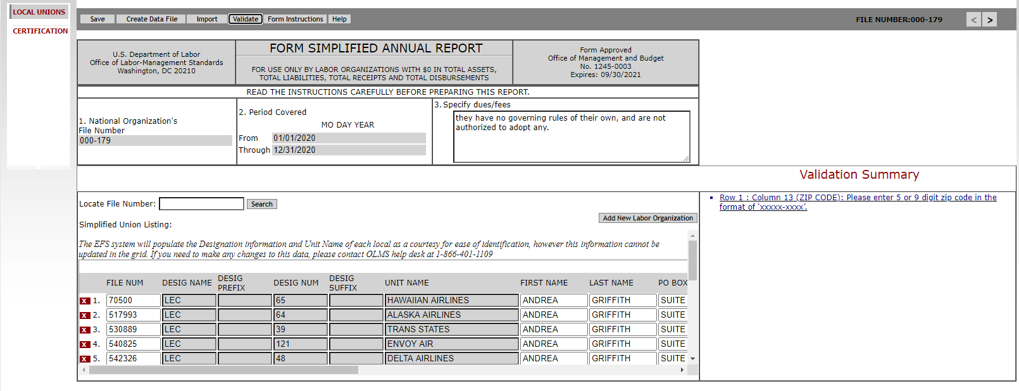
Validation Summary – Local Unions Page
After selecting Validate, the Validation Summary will be provided. Any error messages from the validation will be listed.
The validation error will be listed on the side. Selecting this link will take you to the field that needs correction.

Slide 25
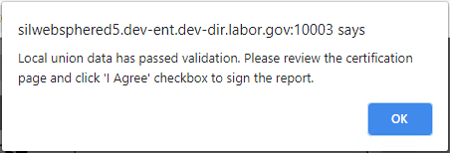
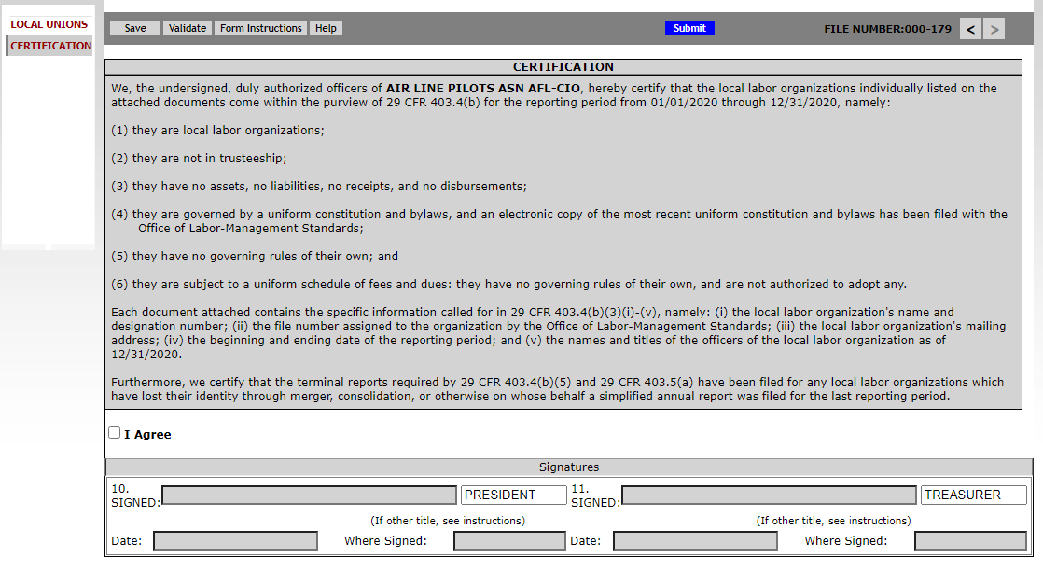
Successful Validation – Local Unions page
Upon passing the validation, the system will display this message
Selecting OK on this message will navigate the user to the Certification screen

Slide 26
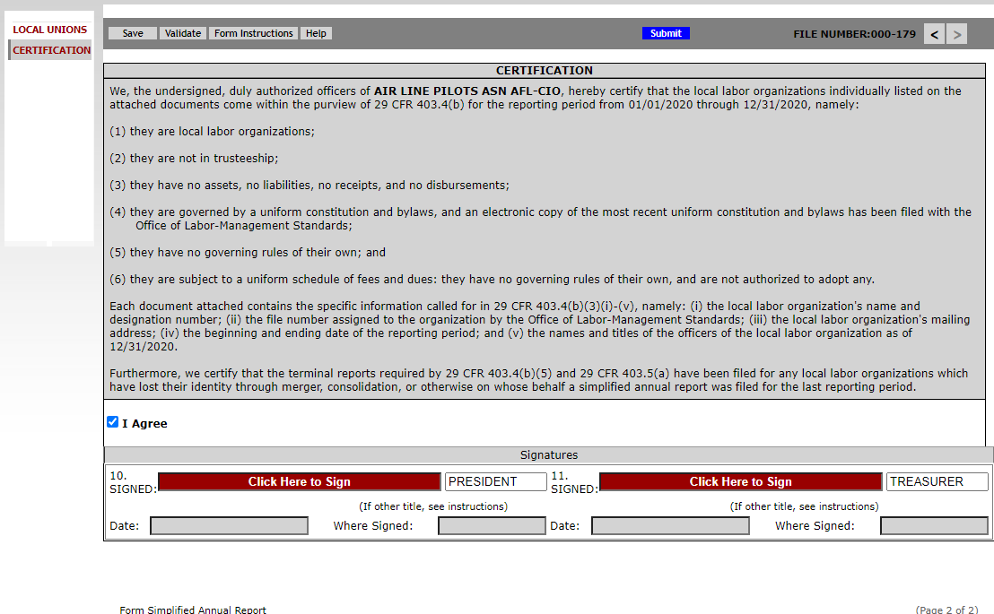
Enabling the Signature Fields
(from Local Unions page)
After selecting the “I Agree” checkbox, it will enable the signature fields.

Slide 27
Validate from the Certification Page
On the Certification Page, select Validate to validate the Form

Slide 28
Validation - from Certification page
After selecting the “Validate” button, the system will check if the “I Agree” box is checked or not. If not, the system will display this message:

Slide 29
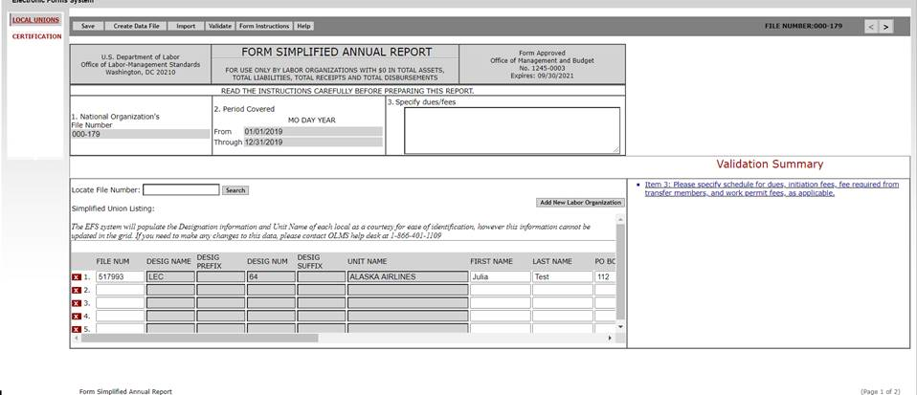
Validation Summary – from Certification Page
If the “I Agree” box is selected when running the validation, the system will check for any other validation errors. If it finds any error, the following message will be displayed:
After selecting “Ok,” the system will navigate the user to the Validation Summary section on the “Local Unions” page.

Slide 30
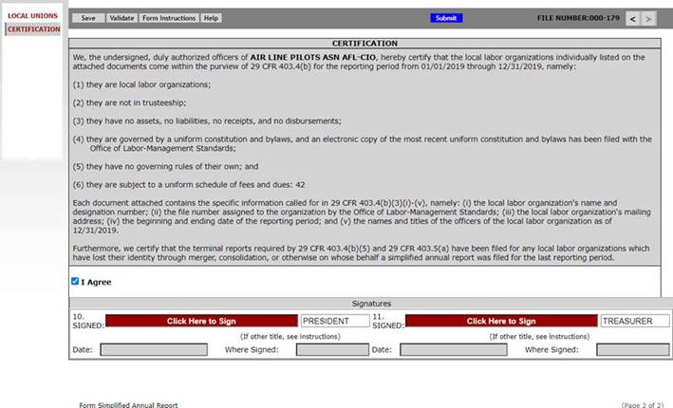
Enabling Signature Fields
(from Certification page)
If there are no validation errors, the system will enable the Signature fields.

Slide 31
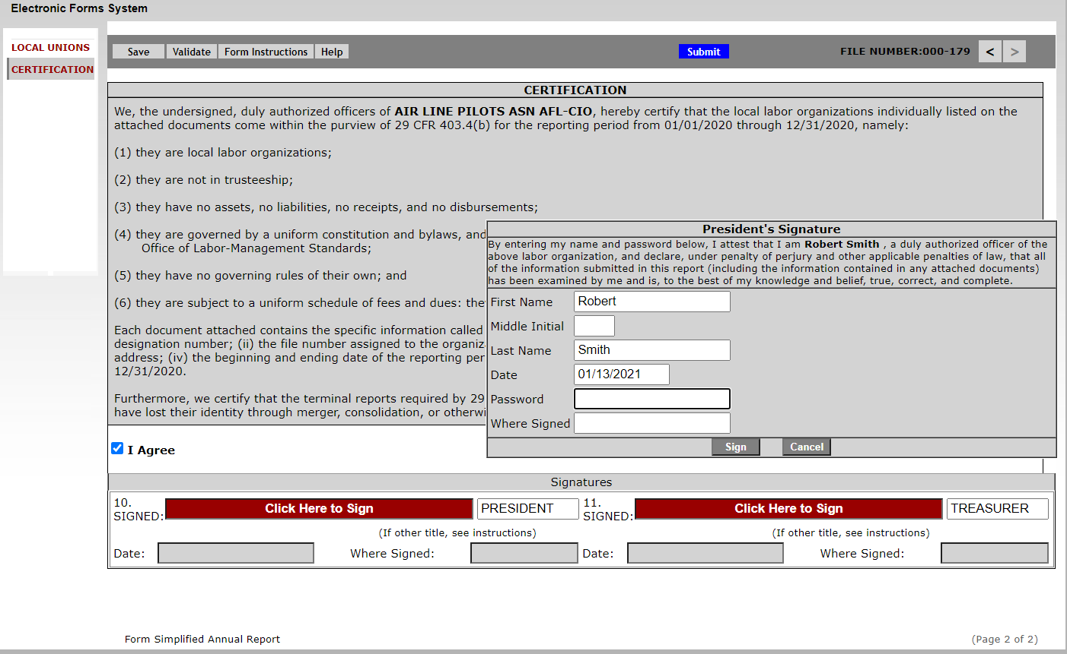
Signing the Form
Selecting the signature box will open the following pop-up box.
Enter the Password and Where Signed

Slide 32
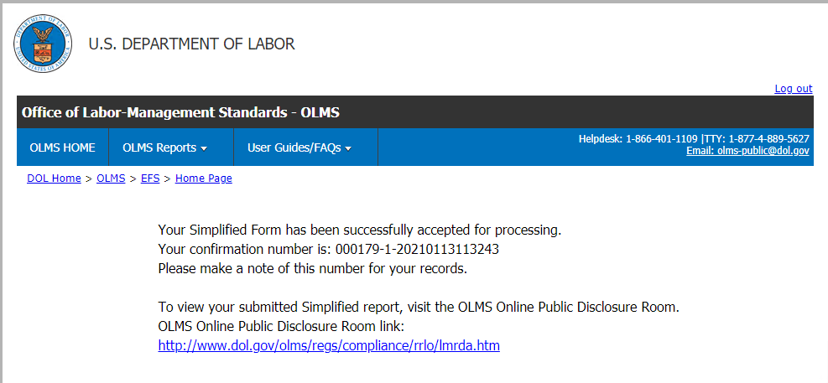
Confirmation Page
Selecting the Submit button will display the following confirmation page.

Slide 33
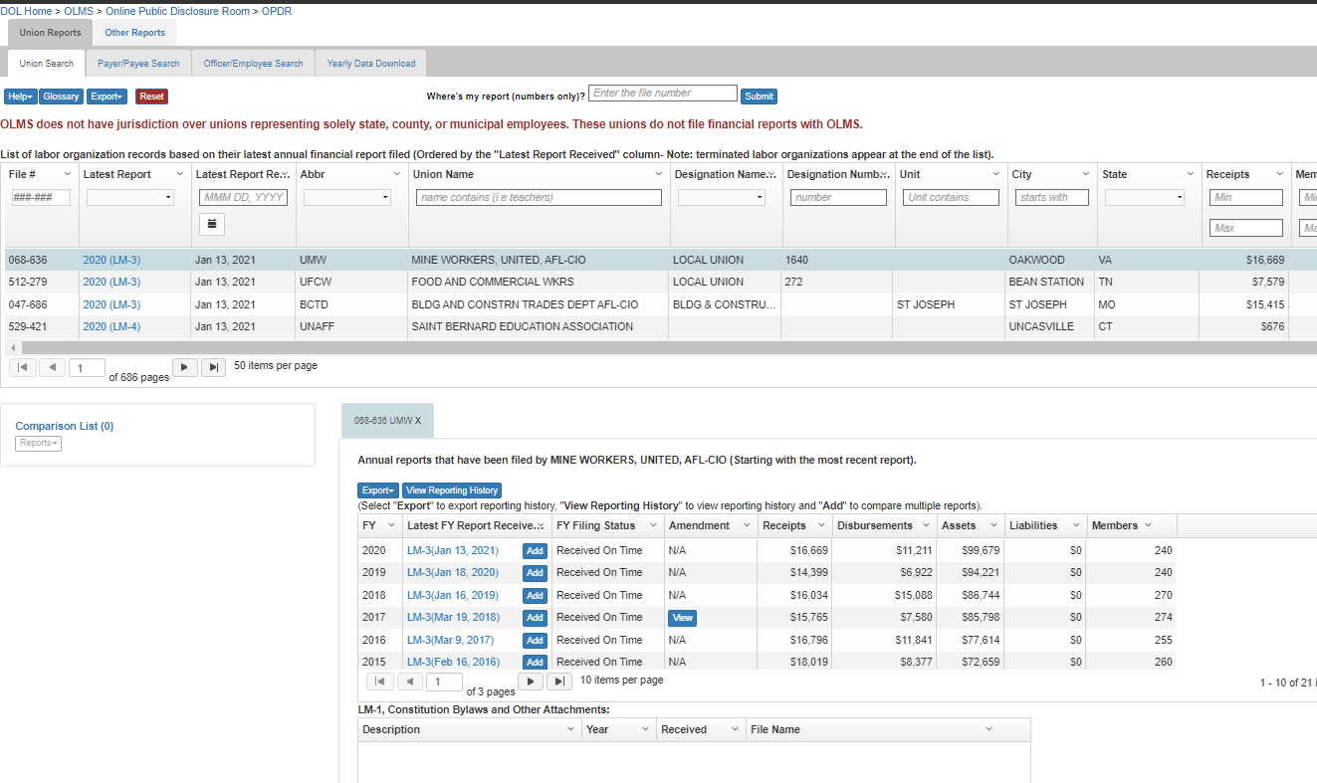
Disclosure Page
Upon successful submission, the report will be listed on the OLMS Online Disclosure Page - https://olmsapps.dol.gov/olpdr/

Slide 34
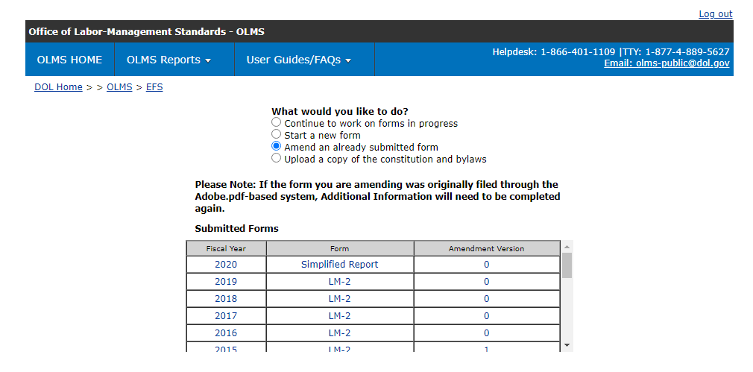
Amending A Report
To amend a report, select “Amend an already submitted form.” Select the report that needs amending from the list.
(Please note that the only forms that you can amend in EFS are ones that were filed using EFS.)

Slide 35
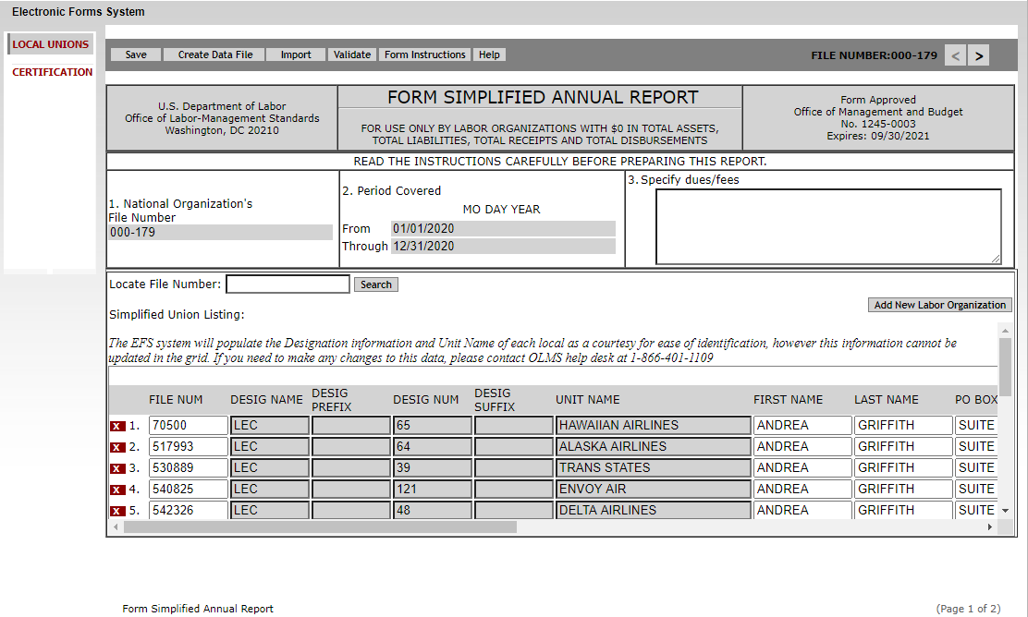
Amending A Report (cont’d)
EFS will open the selected report with the union listing populated. The filer will modify the data and will re-submit it.

Slide 36
Getting Help
If you experience difficulty using EFS, please contact OLMS Technical Support toll-free at: 1-866-401-1109
This PowerPoint presentation and other information regarding EFS can be found on our website at the following URL:
http://www.dol.gov/olms/regs/compliance/efs/efspreview.htm
If you have additional questions or comments, please contact OLMS: E-mail OLMS at olms-public@dol.gov or contact your local OLMS district office at: https://www.dol.gov/agencies/olms/contact/regions.

