Slide 1
Working Group on “Significant”

Slide 2
“Significance” as Specified in EEOICPA*
*https://www.dol.gov/sites/dolgov/files/owcp/energy/regs/compliance/law/EEOICPAALL.pdf

Slide 3
“Significant” in Procedure Manual
“Significant” appears 99 times in the DEEOIC Procedure manual (ver 7.1 accessed on 3/15/23)
Two different technical contexts in manual
Assessment of exposure
Determination of causation
Word has different meanings and use may be misinterpreted

Slide 4
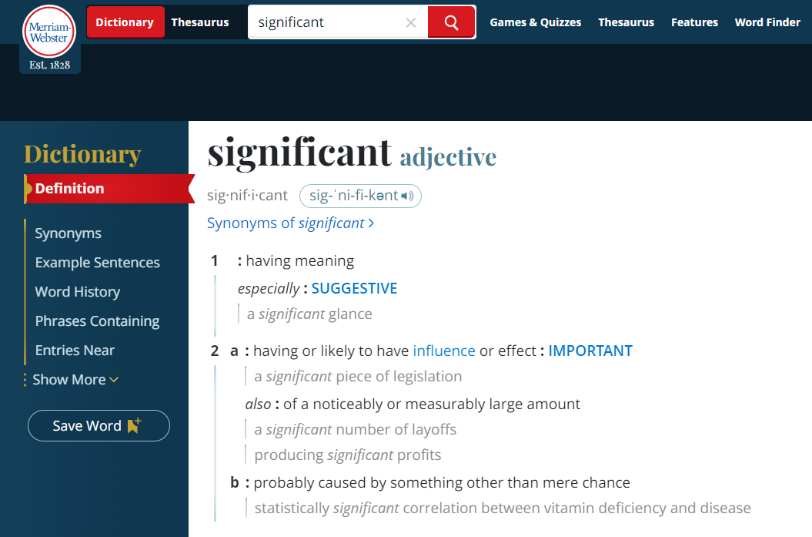
Causation
Exposure
EEOICPA
https://www.merriam-webster.com/dictionary/significant

Slide 5
Current Procedural Guidance
Characterize the exposure as one of the following:
1) Significant High
2) Significant Moderate
3) Significant Low
4) Between Incidental and Significant
5) Incidental
6) No exposure

Slide 6
Complexity of Characterizing Exposure
Type of exposure (direct, bystander, or area)
Route of exposure (inhalation, ingestion, skin absorption)
Intensity of exposure (concentration)
Frequency of exposure
Duration of exposure
Calendar timing of exposure and disease onset (appropriate latency)
Use of PPE, engineering controls or other mitigating factors
These details may be important to causation determination and may be obscured when applying the current categories of exposure.

Slide 7
Proposed Recommendations
IH exposure assessments refer to the basic metrics of exposure science, as these details can have distinct value in determining causation:
Intensity
Route
Frequency
Duration
These metrics may further be divided by the facility and job under which they occurred for a claimant as relevant.
DOL should define what is meant by the 6 different categories of exposure significance in the context of these four basic metrics of exposure.
DOL should clarify how a single metric of exposure (e.g., “significant low”) can be applied when a claimant has more than one medical condition for which different basic metrics have varying importance.

Slide 8
Proposed IH Exposure Assessment Form
Medical condition(s) for which compensation is being considered should be identified by the diagnostic term used in the claim
Exposures #1, #2, etc. should be identified by name as listed in the SEM
*Direct, bystander, or area
** Inhalation, ingestion, skin absorption
*** High, medium, low
^ Daily, 2 or 3 X/week, a few times a month, 1/month or less
^^ Usually, occasionally, never
Include claim file page number(s) reference for data used in each colored cell, when applicable
Claimed condition: | Facility | Dates | Expos #1 | Expos #2 | Expos #3 | Expos #4 | Expos #5
Job #1:
Type of exposure*
Route of exposure**
Intensity***
Frequency^
Duration (# years)
Calendar years
Use of PPE^^

Slide 9
Proposed IH Exposure Assessment Form - Example
Claimed condition = COPD | Facility | Dates | Expos #1 | Expos #2 | Expos #3 | Expos #4
Job #1: Pipefitter | Hanford | 1/1987- 9/1997 | Asbestos | Cement | Silicon dioxide, crystalline | Welding fumes
Type of exposure* |  |  | Direct | Direct | Direct | Direct and bystander
Route of exposure** |  |  | Inhalation | Inhalation | Inhalation | Inhalation
Intensity*** |  |  | Low | Medium | Low (p 120) | Medium
Frequency^ |  |  | A few times/mo (p 180) | Daily (p 181) | < Monthly (p 120) | 2-3 X/week (p 180)
Duration (# years) |  |  | 10 | 10 | 10 | 10
Calendar years |  |  | 1987-1997 | 1987-1997 | 1987-1997 | 1987-1997
Use of PPE^^ |  |  | Usually (p 180) | Never (p 181) | Occasionally (p 181) | Occasionally (p 181)

