Slide 1
SEM Work Group Update
Working group members: Manijeh “Mani” Berenji, Rose Goldman, Duronda Pope, George Friedman-Jimenez
April 15, 2020

Slide 2
Tasks for the SEM Work Group
Review IARC 2A most recent list of chemicals (2016-2019) [Note: DOL currently in progress of incorporating this based on update from Board meeting on 11/20/19]
Review other sources: National Toxicology Program (NTP), HazMap
Look at current exposure links in SEM

Slide 3
Work Group Meetings
Virtual meetings on Feb 18, April 7

Slide 4
SEM Website
Current site: https://www.sem.dol.gov/
Last updated: 11/15/19 (last checked on 4/14/20)
To id relationship between toxic substance and illness: SEM uses Haz-Map database (haz-map.com)
Everything approved in SEM must be pre-approved by DOE

Slide 5
IARC
https://monographs.iarc.fr/agents-classified-by-the-iarc/
Since 2016: 90 chemicals updated:
Group 1: 11
Group 2A: 22
Group 2B: 47

Slide 6
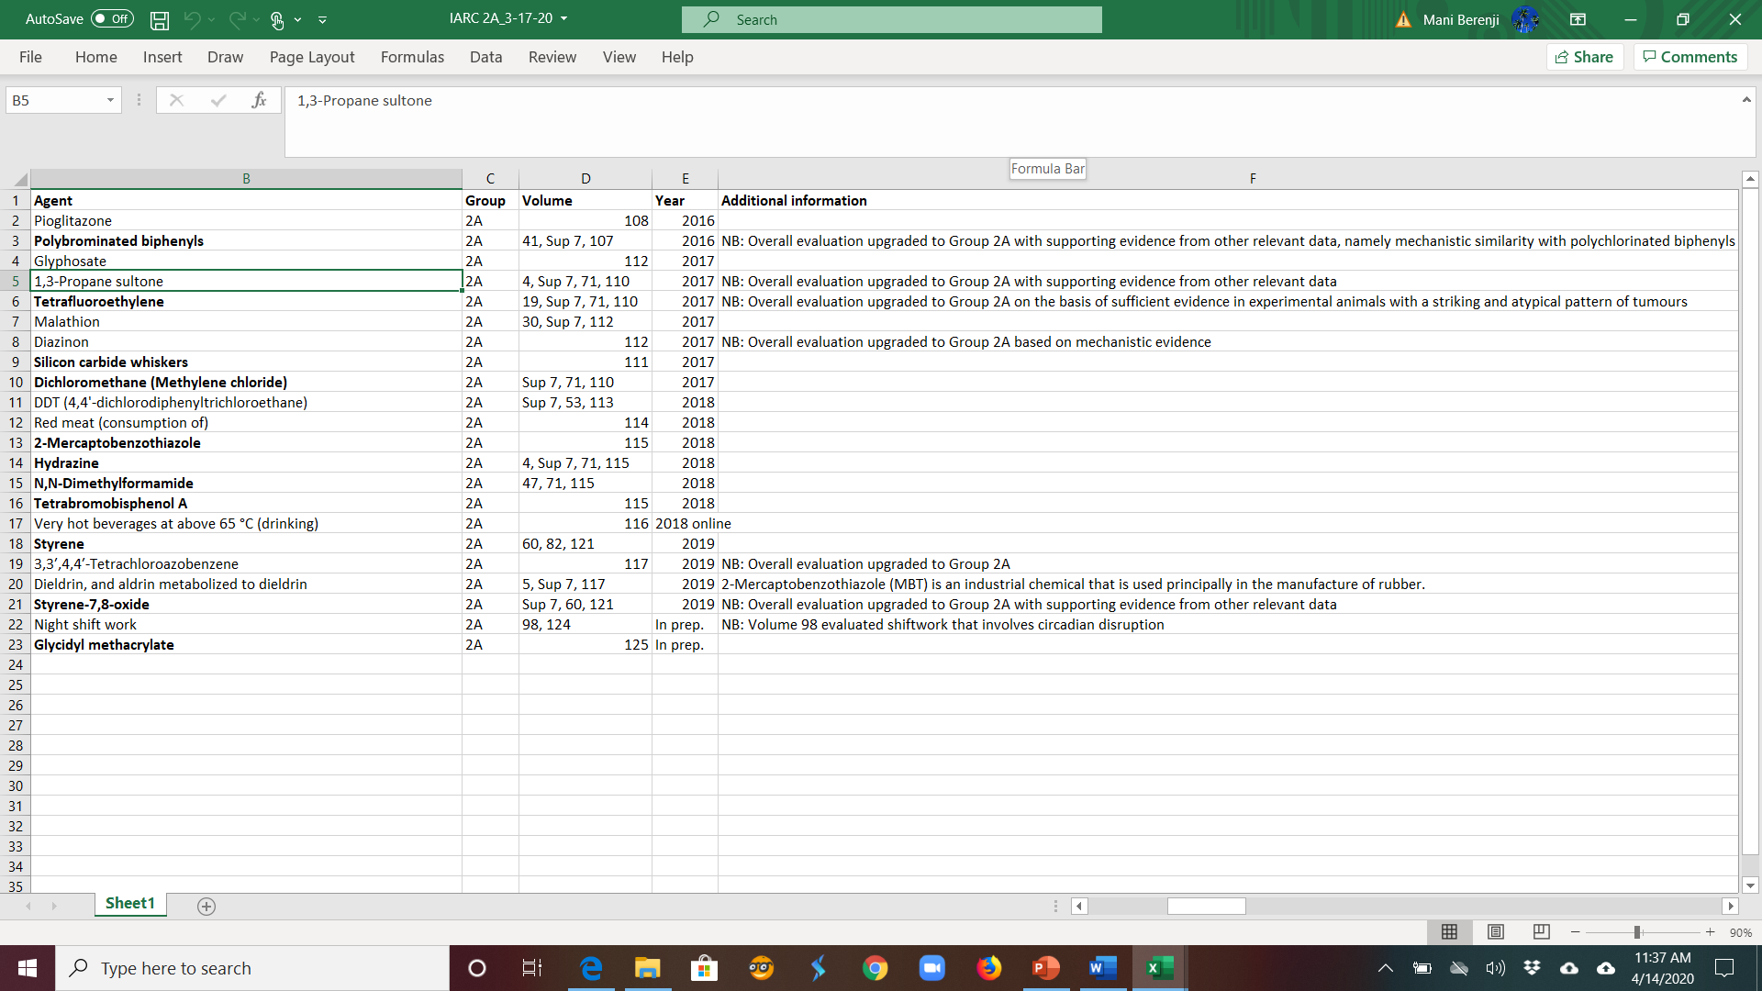

Slide 7
Polybrominated biphenyls (PBBs)
PBBs are highly lipophilic, bioconcentrate and bioaccumulate, and are environmental contaminants worldwide.
FireMaster FF-1, the most widely used commercial PBB product, consistently induced benign and malignant hepatocellular tumours in rats and mice, and cholangiocarcinomas in rats.
Limited human epidemiological studies.
On the basis of these similarities with PCBs, and together with inadequate evidence for carcinogenicity in humans and suﬃcient evidence in experimental animals, PBBs were upgraded to Group 2A, probably carcinogenic to humans.
Published Online March 15, 2013 http://dx.doi.org/10.1016/ S1470-2045(13)70104-9

Slide 8
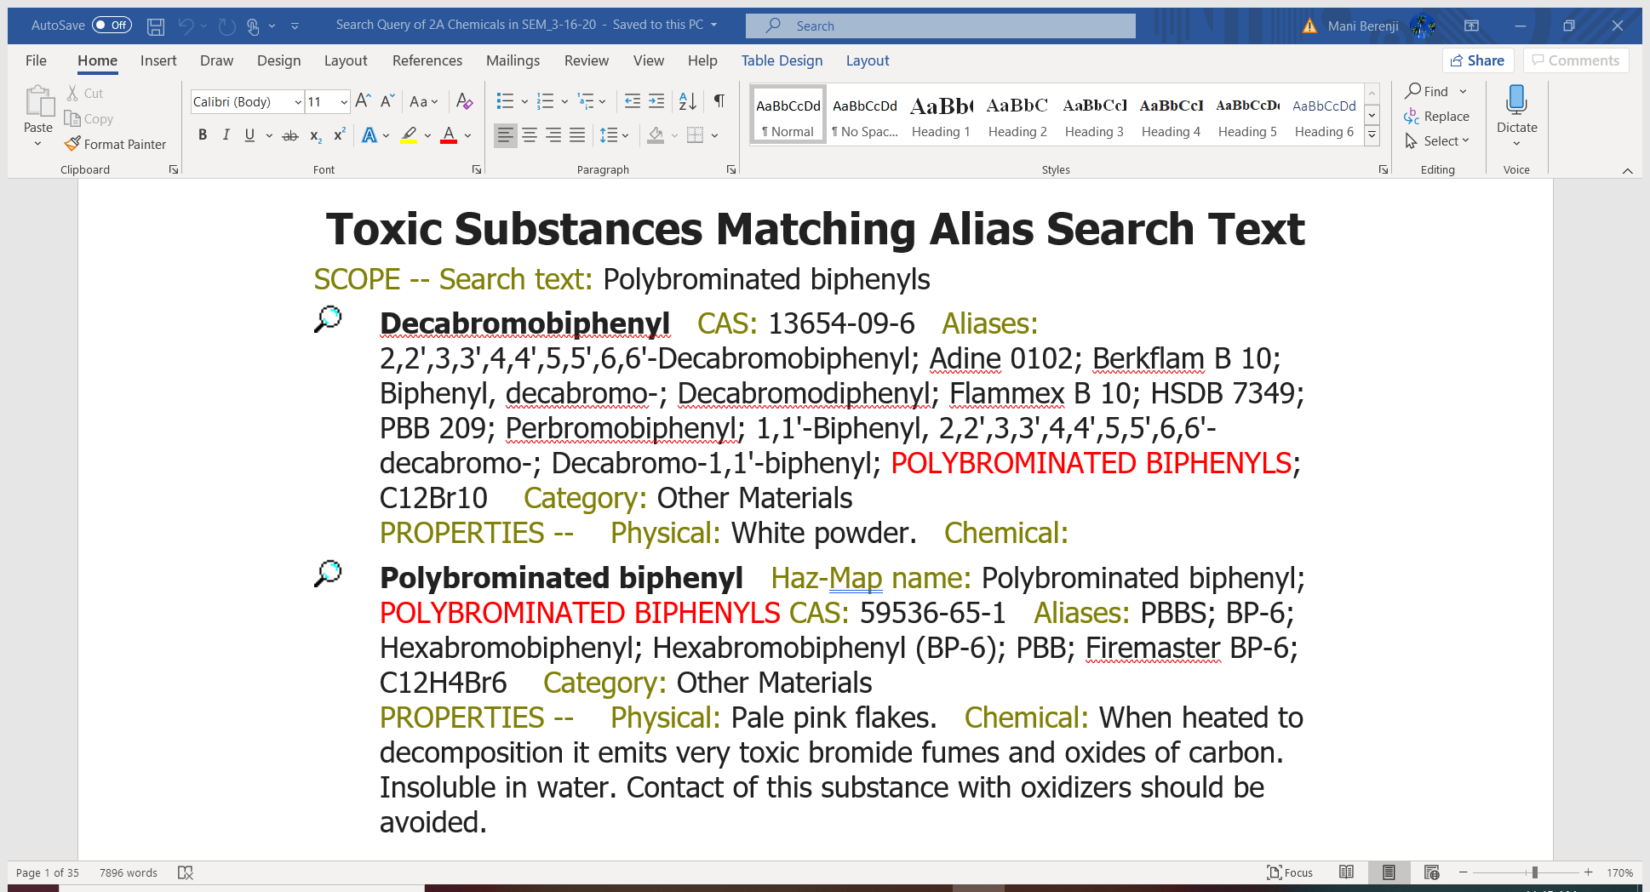

Slide 9
Tetrafluoroethylene
Occupational exposure occurs in the primary manufacture of tetrafluoroethylene and during the subsequent polymerization process.
Only one cohort study analysing cancer risk in relation to exposure to tetrafluoroethylene: Consonni et al. (2013) studied mortality from cancer and from selected non-malignant diseases...cohort including workers in six polytetrafluoroethylene-production sites.
In the overall analysis, elevated risks were seen for all cancer sites of a-priori interest: liver, 1.27 (95% CI, 0.55–2.51); kidney, 1.44 (95% CI, 0.69–2.65); and leukaemia, 1.48 (95% CI, 0.77–2.59).
https://monographs.iarc.fr/wp-content/uploads/2018/06/mono110-02.pdf

Slide 10
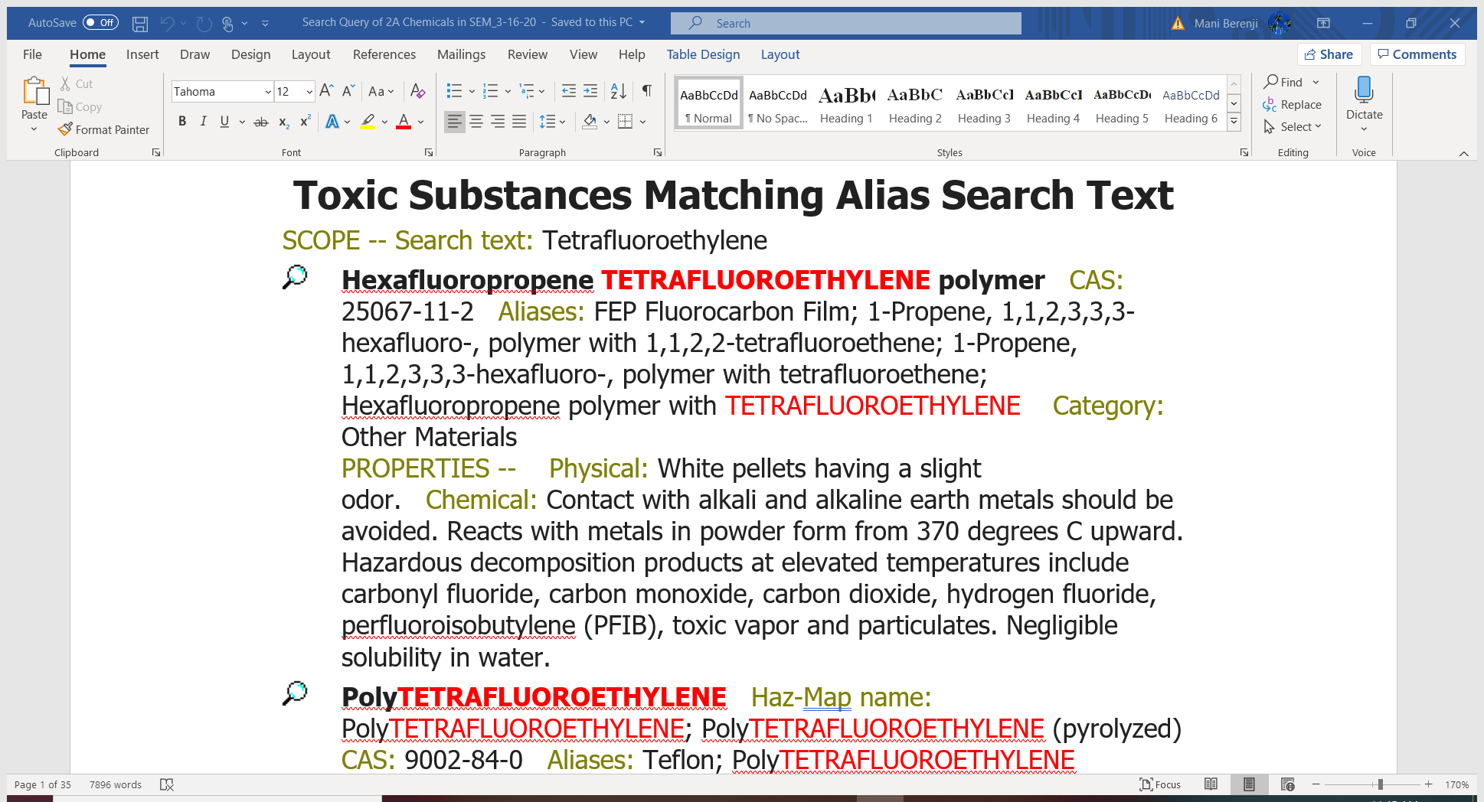

Slide 11
Silicon carbide whiskers
Exposure to silicon carbide whiskers may occur during the manufacture of the whiskers or during the production, machining, and finishing of composite materials. Silicon carbide in fibrous and non-fibrous forms has been detected in occupational environments.
“silicon carbide whiskers” specifically refers to monocrystalline forms produced at high cost for targeted high technology use. Inhalation is the primary route of exposure to fibrous silicon carbide in occupational settings,
In Bugge et al. (2012), the standardized incidence ratio (SIR) for lung cancer in long-term workers (≥ 3 years of employment) was 1.6 (95% CI, 1.3–2.1).
Only a few studies that refer directly to exposure to silicon carbide fibres have been published....and concerned workers were engaged in the production of silicon carbide, using the Acheson production process, where exposure to silicon carbide fibres was combined with exposure to a range of other dusts and gases, including non-fibrous silicon carbide. The Acheson process remains the dominant method of producing silicon carbide.
https://www.iarc.fr/news-events/iarc-monographs-volume-111-evaluation-of-of-fluoro-edenite-silicon-carbide-fibres-and-whiskers-and-carbon-nanotubes/

Slide 12
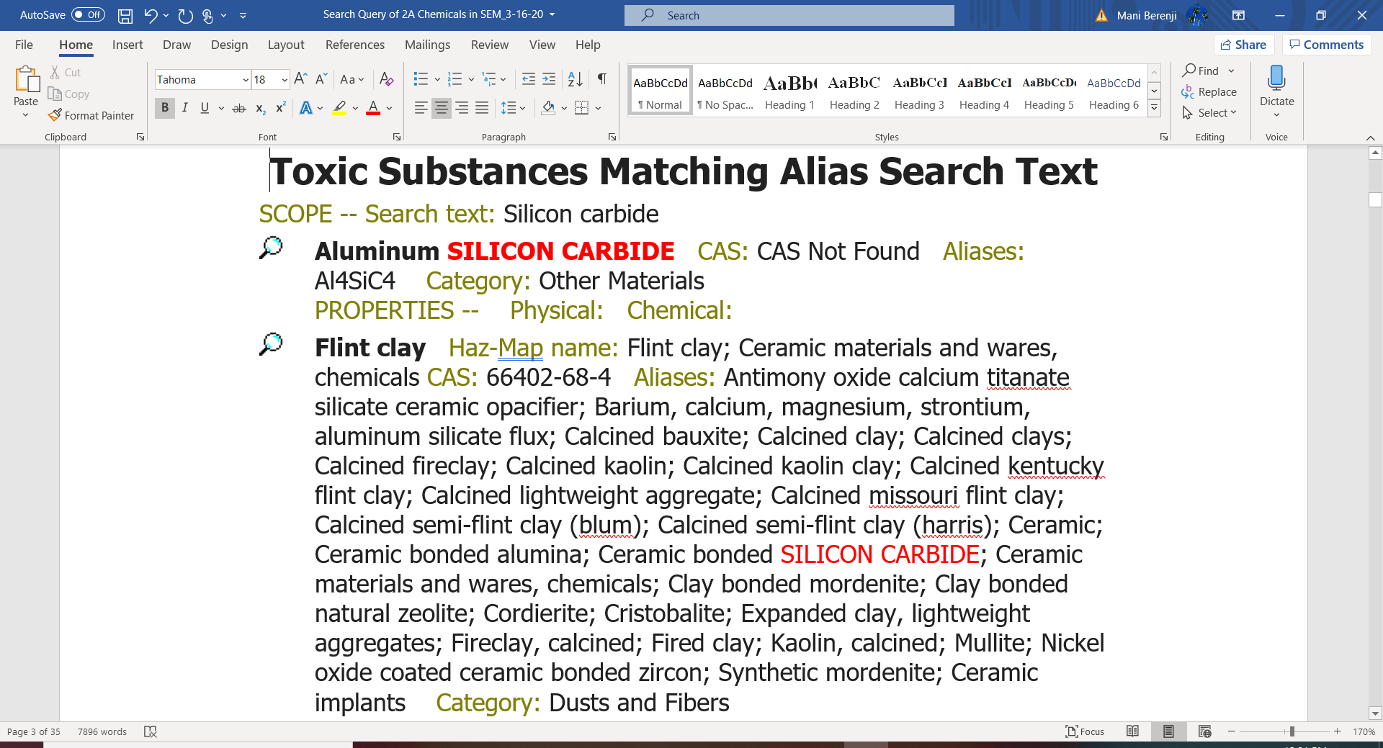

Slide 13
Dichloromethane (Methylene chloride)
In chemical processing, dichloromethane is used in the manufacture of polycarbonate plastic, the manufacture of photoresist coatings, and as a solvent carrier for the manufacture of insecticides and herbicides.
Dichloromethane is a major ingredient of cleaning solvent used to remove printer ink during the offset printing process.
Two cohort studies of workers exposed to dichloromethane (as well as acetone and methanol, but not 1,2-dichloropropane) in the USA reported findings for cancers of the liver and biliary tract, based on small numbers.
https://monographs.iarc.fr/wp-content/uploads/2018/06/mono110-04.pdf

Slide 14
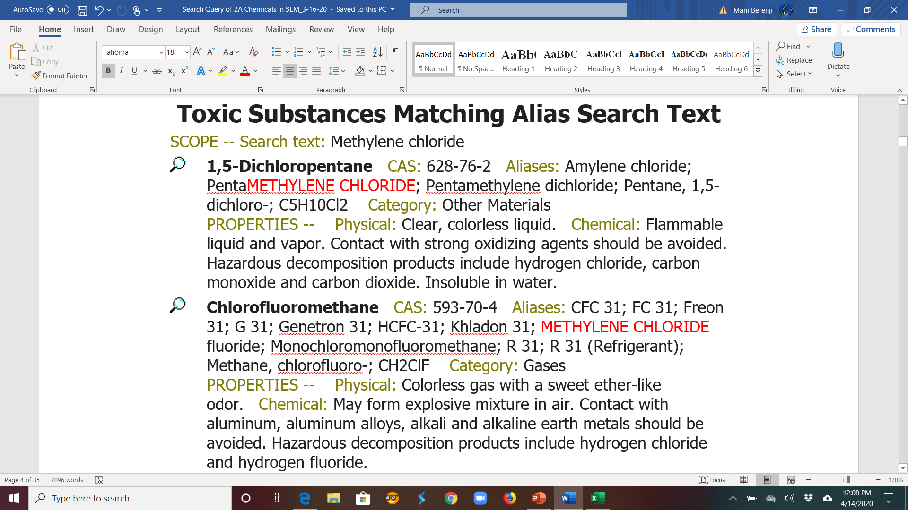

Slide 15
2-Mercaptobenzothiazole
2-Mercaptobenzothiazole is principally used as a reactant in the manufacture of rubber products, but is also used as a corrosion inhibitor in oils, greases and cooling fluids
Due to its use as an accelerant in rubber vulcanization, 2-mercaptobenzothiazole can be found as a contaminant in rubber products.
A series of studies of workers at a chemical production plant in north Wales, United Kingdom, provided most of the pertinent evidence pertaining to associations between occupational exposure to 2-mercaptobenzo- thiazole and cancer. focused on morbidity and mortality from cancer of the urinary bladder in the cohort exposed to 2-mercaptobenzothiazole and found an excess in mortality (8 deaths; standardized mortality ratio [SMR], 3.74; 95% CI, 1.62–7.37) and incidence (12 cases; standardized relative risk [SRR], 2.53; 95% CI, 1.31–4.41) compared with national rates (population of England and Wales).
2-mercaptobenzothiazole relative to unexposed workers found excesses for cancers of the large intestine, lung and multiple myeloma (Sorahan, 2009).
https://monographs.iarc.fr/wp-content/uploads/2018/06/mono115.pdf

Slide 16
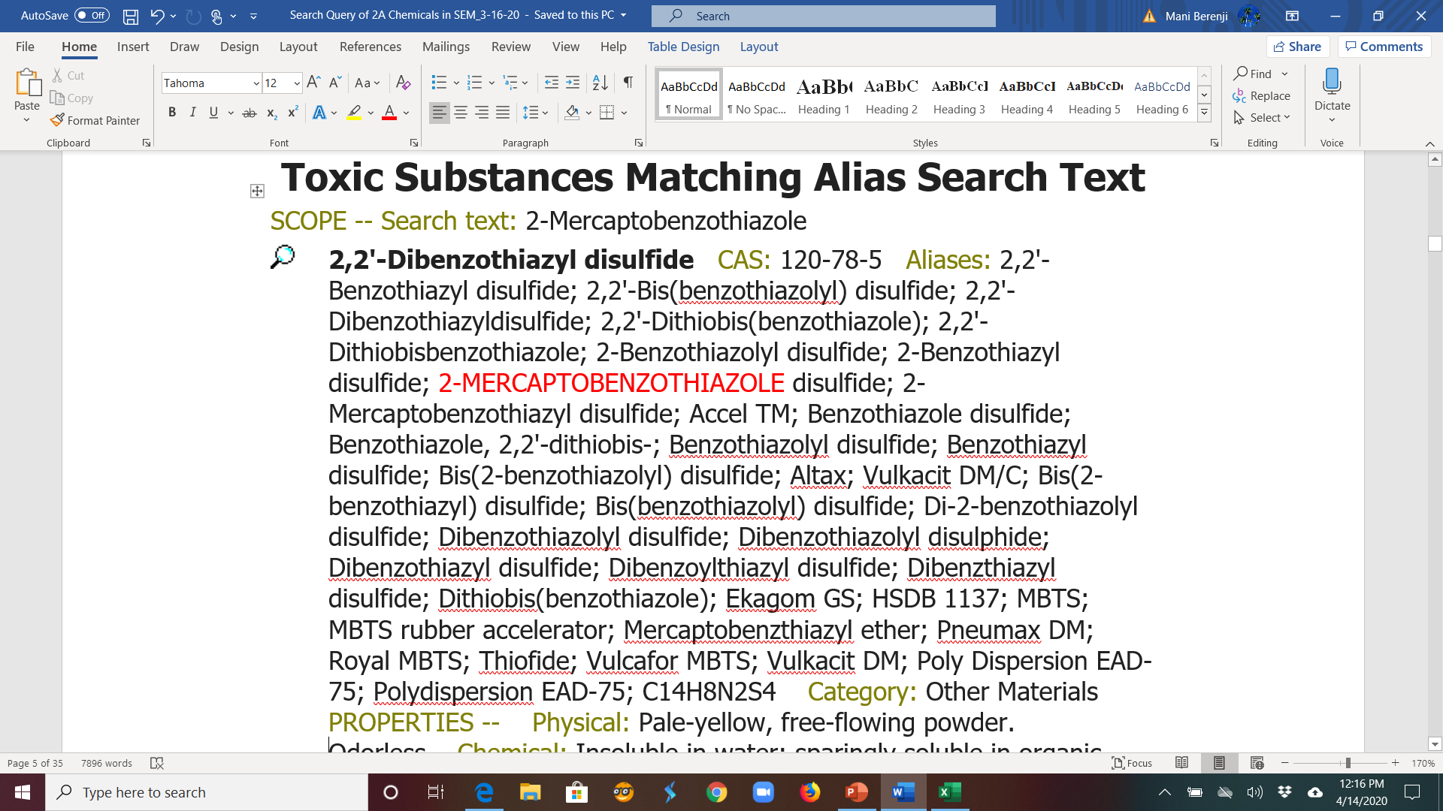

Slide 17
Hydrazine
In its hydrated form, hydrazine (solutions with concentrations ranging from 0.01% to 100%) and as a reagent for the treatment of nuclear reactor waste.
Ritz et al. (1999) studied a cohort of 6107 male workers who worked at the Santa Susana Field Laboratory rocket testing facility (Rocketdyne) near Los Angeles, California, USA. Workers had to have been employed before 1980 and worked at least 2 years, and not to have been exposed to radiation Groups (HYD-6, n = 1053; HYD-24, n = 827).
Relative risks for cancer of the lung for high exposure with a 15-year lag were 1.93 (95% CI, 1.27–2.93) or 2.10 (95% CI, 1.36–3.25) for high exposure.
Cancer mortality analyses of all rocket- testing workers compared with California population rates were unremarkable
https://monographs.iarc.fr/wp-content/uploads/2018/06/mono115-06.pdf

Slide 18
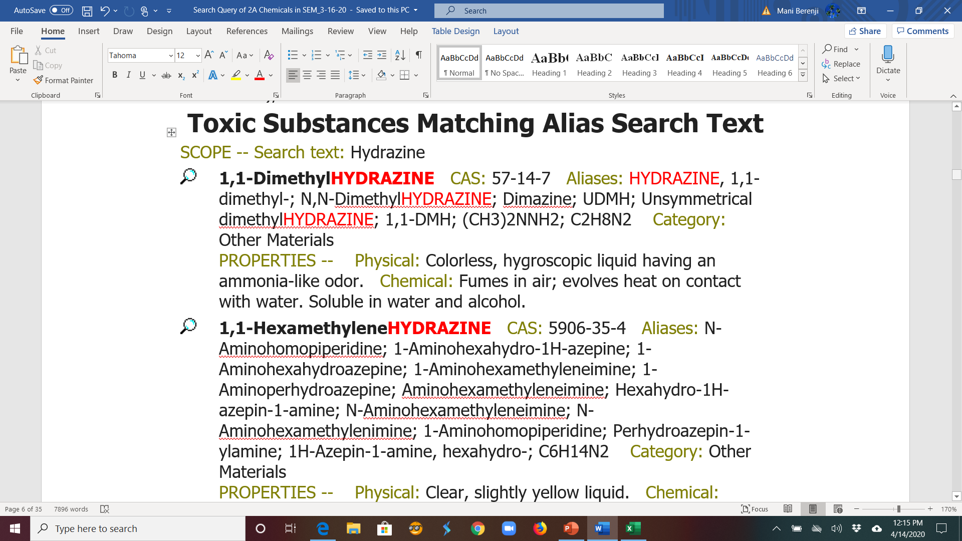

Slide 19
N,N-Dimethylformamide
N,N-Dimethylformamide is used predominantly as an aprotic solvent in the manufacture of polyacrylonitrile fibres, and trends in its production parallel those of the polyacrylic fibre industry.
The human carcinogenicity of N,N-dimethyl- formamide was questioned by Ducatman et al. (1986) beginning with an investigation of a cluster of three cases of testicular germ cell cancer that occurred between 1981 and 1983.
Naval air rework facilities (dedicated to military aircraft repair) presented opportunities for repair workers to be exposed to surface coatingsand associated emulsifiers and surfactants including “Teflon” paints and dyes, solvents and metals (Ducatman et al., 1986).
https://monographs.iarc.fr/wp-content/uploads/2018/06/mono115-04.pdf

Slide 20
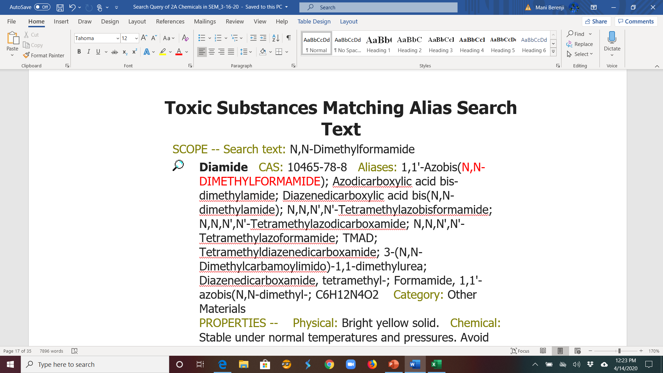

Slide 21
Tetrabromobisphenol A
Approximately 58% of tetrabromobisphenol A is used as a reactive brominated flame retardant in epoxy, polycarbonate and phenolic resins in printed circuit boards.
Occupational exposure of workers to tetrabromobisphenol A at a Chinese printed circuit-board plant via ingestion, dermal absorption, and inhalation of dust varied widely by process, with the greatest estimated exposures being 1930, 431, and 96.5 pg/kg body weight (bw) per day.
Cancer in Humans No data were available to the IARC Working Group.
https://publications.iarc.fr/Book-And-Report-Series/Iarc-Monographs-On-The-Identification-Of-Carcinogenic-Hazards-To-Humans/Some-Industrial-Chemicals-2018

Slide 22
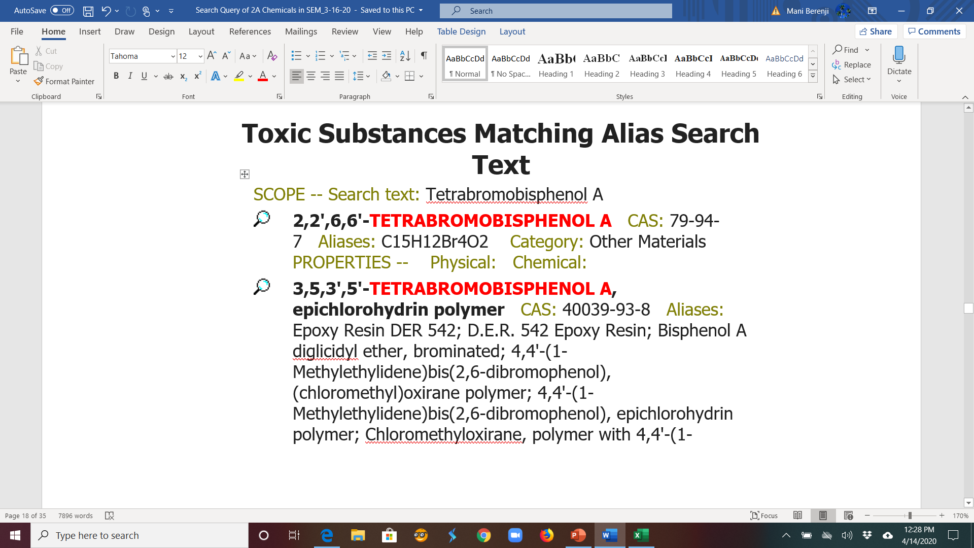

Slide 23
Styrene
Worldwide, styrene is one of the most important monomers for polymers and copolymers that are used in an increasingly wide range of applications. The major uses for styrene are in plastics, latex paints and coatings, synthetic rubbers, polyesters and styrene-alkyd coatings.
Cases of leukemia and lymphoma were identified among workers engaged in the production of styrene–butadiene rubber, in the manufacture of styrene–butadiene, in the manufacture of styrene and polystyrene, in the production/polymerization/processing of styrene at a plant in UK, & in boat-building facilities in the US
https://www.iarc.fr/news-events/iarc-monographs-meetings-volume-121-styrene-styrene-78-oxide-and-quinolone/

Slide 24
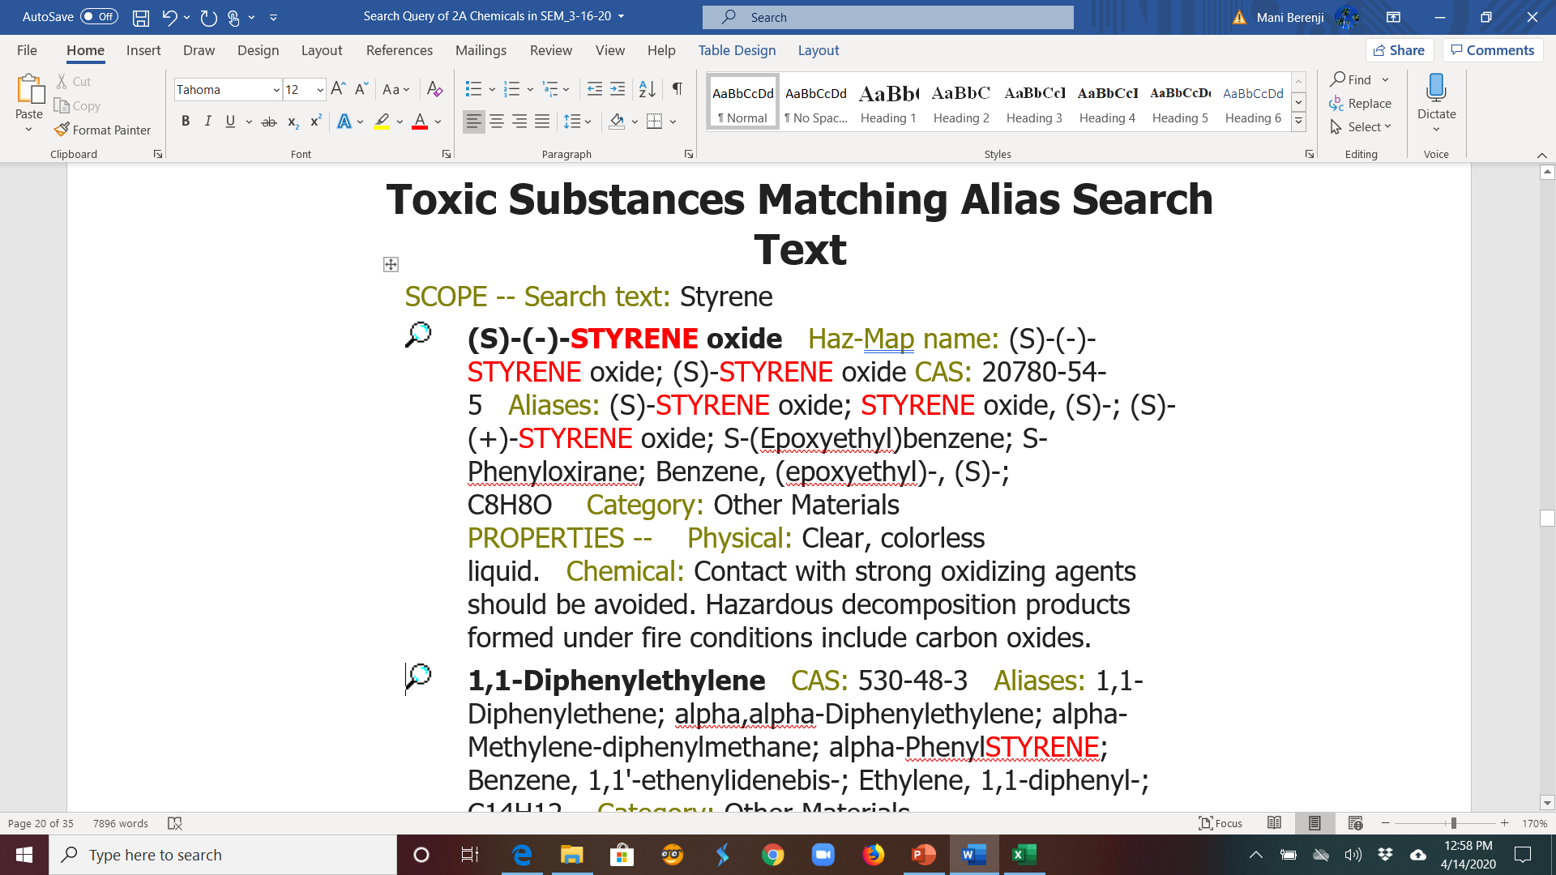

Slide 25
Styrene-7,8-oxide
Styrene-7,8-oxide is used as a reactive plasticizer or diluent for epoxy resins and in the production of phenethyl alcohol (2-phenylethanol) and styrene glycol, and their derivatives (PubChem, 2017).
Occupational exposure to styrene-7,8-oxide occurs in industries manufacturing or using styrene and styrene polyester resins due to its formation from styrene as an oxidation product. S
tyrene-7,8-oxide has been detected in association with styrene, but at much lower levels, in industries where unsaturated polyester resins are used.
Occupational cohort studies have found increased risk of cancers of the lymphohematopoietic system, kidney, pancreas, and esophagus.
https://www.iarc.fr/news-events/iarc-monographs-meetings-volume-121-styrene-styrene-78-oxide-and-quinolone/

Slide 26
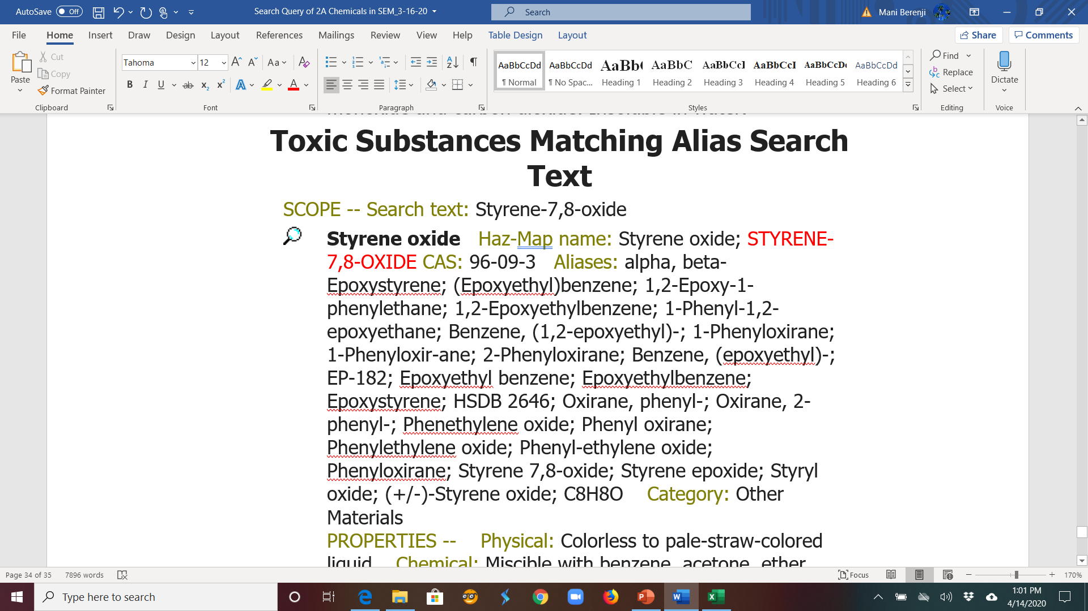

Slide 27
Glycidyl methacrylate
Glycidyl methacrylate is mainly used in the production of epoxy polymers and vinyl and acrylic resins. These polymers are subsequently used in dental sealants, composites and adhesives, bone composite materials, powder coatings, hydrogel lenses, and food contact material.
Exposure to glycidyl methacrylate as a monomer is not expected from use of the polymerised products.
There was “sufficient” evidence in experimental animals for the carcinogenicity of glycidyl methacrylate, with increased incidence of malignant neoplasms in mice and rats including: haemangiosarcoma, bronchioloalveolar carcinoma, uterine histiocytic sarcoma, nasal cavity neuroepithelial carcinoma and peritoneal mesothelioma.
Potential short-term exposure might occur during the preparation of dental or bone composite materials, but no exposure data were available in these settings.
One study reported occupational exposures for chemical production workers.
https://www.thelancet.com/action/showPdf?pii=S1470-2045%2819%2930779-X

Slide 28
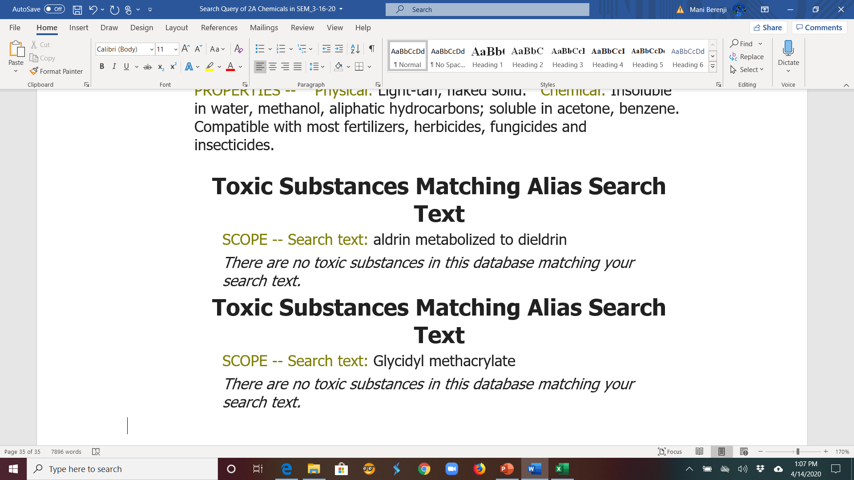

Slide 29
National Toxicology Program (NTP)
Website: https://ntp.niehs.nih.gov/whatwestudy/assessments/cancer/roc/index.html?utm_source=direct&utm_medium=prod&utm_campaign=ntpgolinks&utm_term=roc14
14th Report on Carcinogens released 11/3/2016
248 substances updated (see report), 273 listed (see Excel spreadsheet):
Known carcinogens: 62
Reasonably Anticipated to be a Human Carcinogen: 186

Slide 30
Haz-Map
Haz-Map
New website launched 12/20/19
https://haz-map.com/
Go to “References” tab
Go to “Archived Site” tab

Slide 31
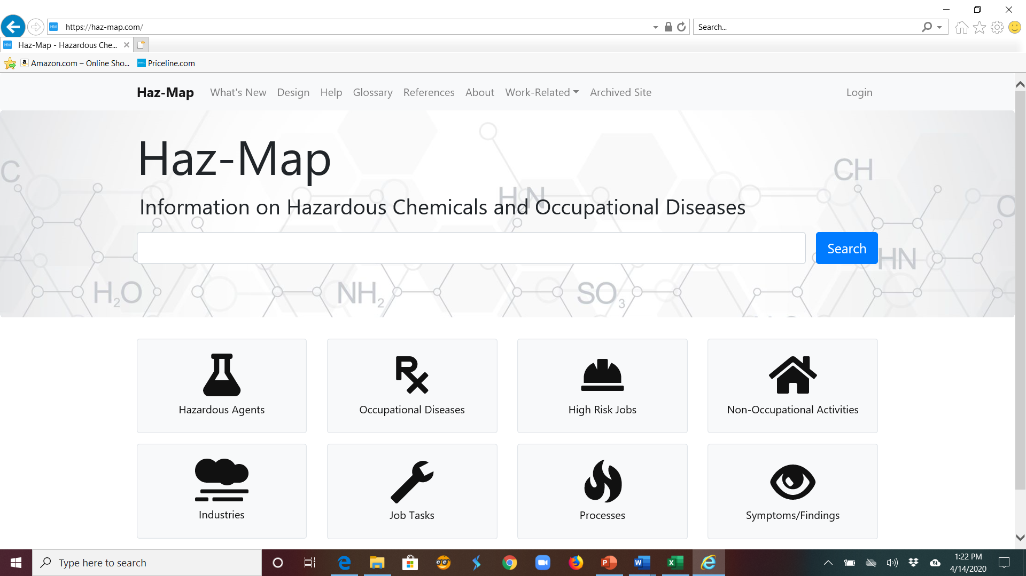

Slide 32
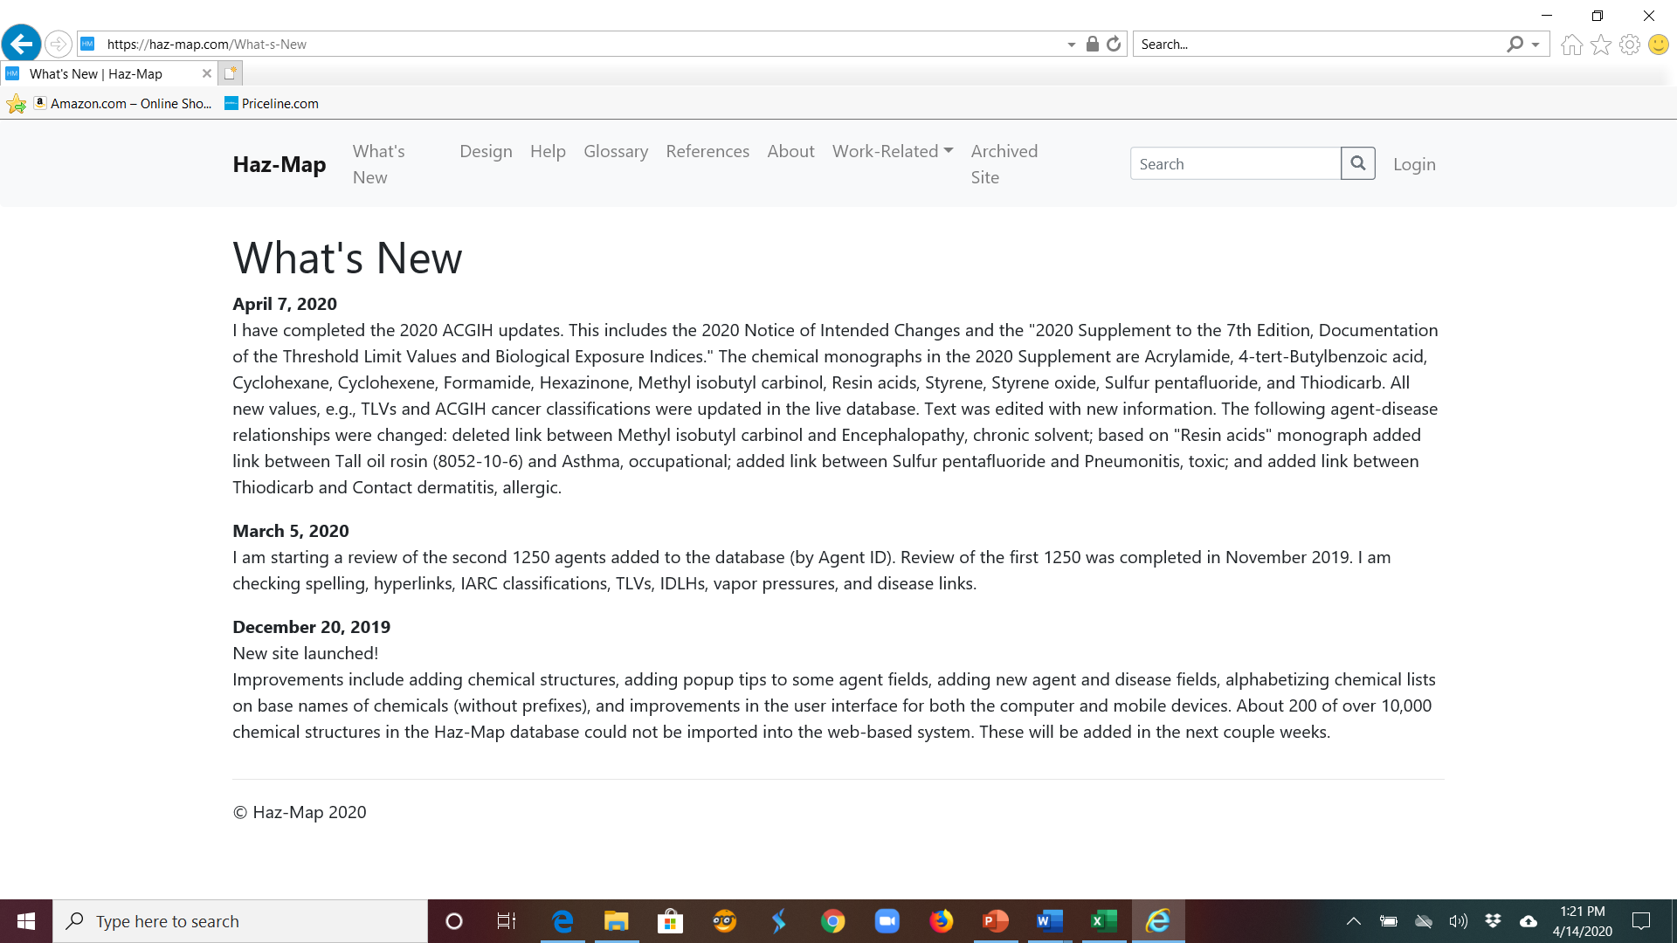

Slide 33
Reviewing SEM Process and Triggers (Rose)
Which ones are flawed
Which ones being used/not used
Are they being properly attributed
Which exposures are currently not in SEM.

Slide 34
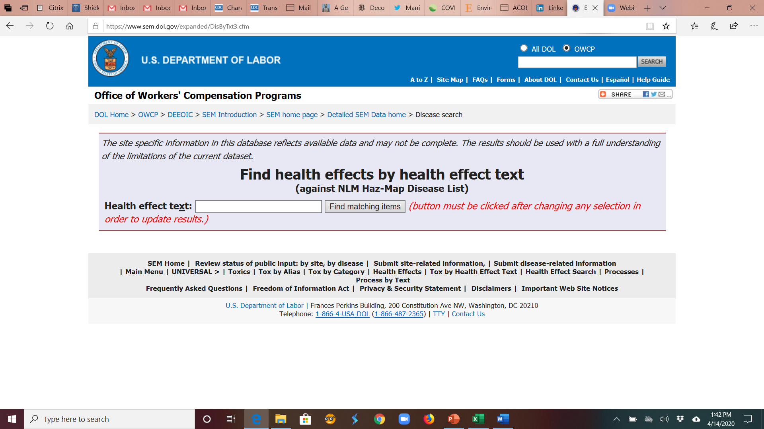

Slide 35
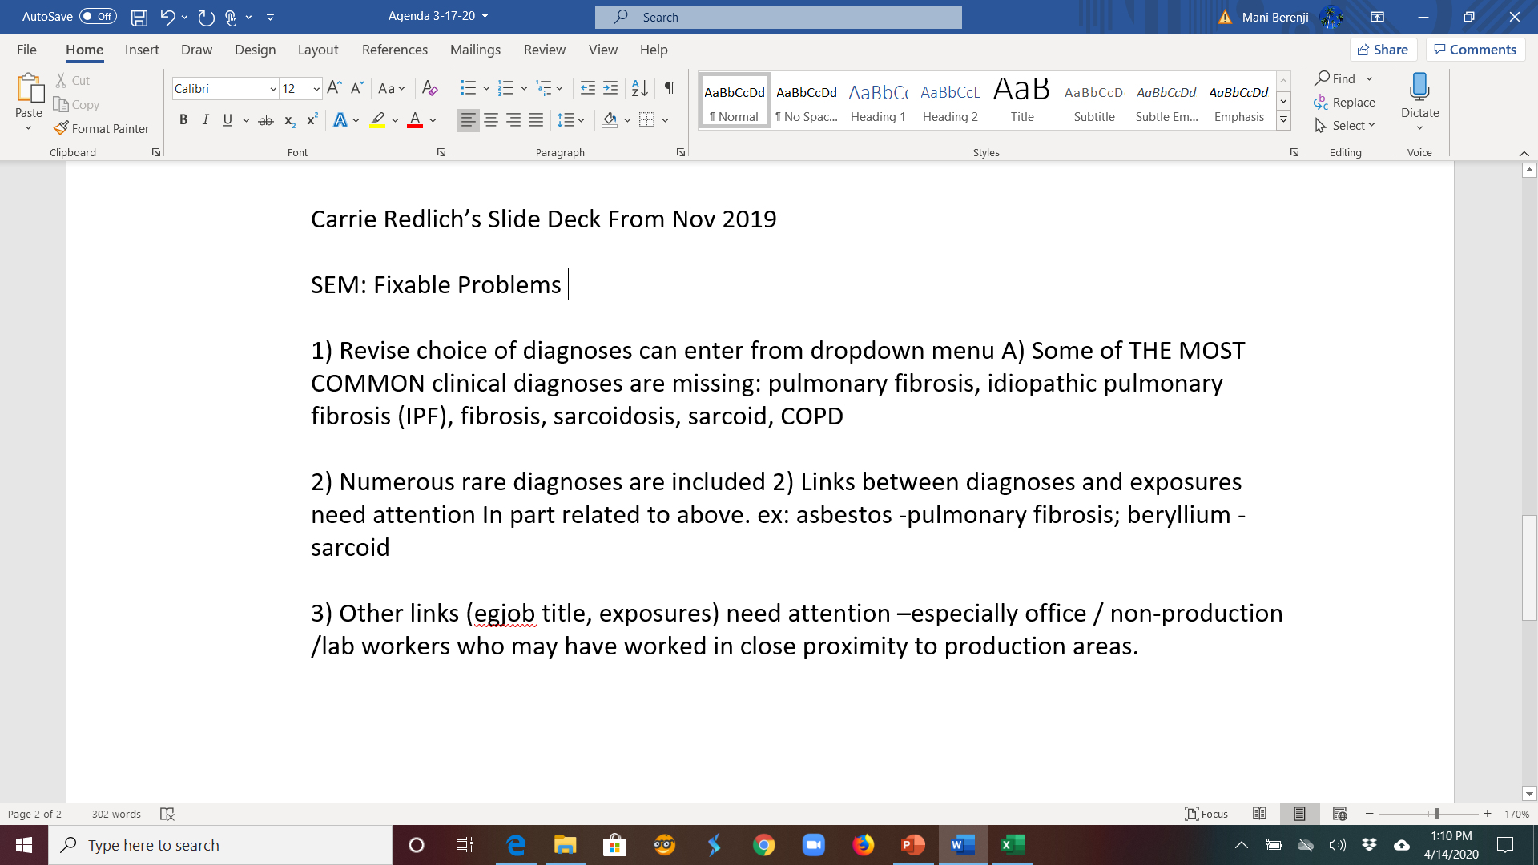

Slide 36
Summary
SEM is not user-friendly
Should make it easier to use for (i) claimants and (ii) CEs
Continue to advocate for direct communication with claimants re: exposures.
"During the evaluation of the CE’s IH referral, DEEOIC IH (federal or contractor) staff may determine if it is necessary to obtain clarification from a claimant regarding the circumstance of an employee’s work that brought the employee into contact with a particular toxic substance.”

