Slide 1
Advisory Board on
Toxic Substances and Worker Health:
Part B lung Conditions Subcommittee
Update
April 20, 2017
John M. Dement, PhD, CIH
Kirk D. Domina, Hanford Atomic Metal Trades Council
Carrie A. Redlich, MD, MPH (Chair)
James H. Turner, Rocky Flats Nuclear Weapons Facility
Laura S. Welch, MD

Slide 2
Part B Lung Conditions Subcommittee
Review of Part B Cases
Sarcoid Presumption
Clarification of Beryllium exposure
Responses to DOL (and other’s) questions
  Chronic respiratory condition
  Procedure manual (Chapter 2 is confusing
  Borderline BeLPT

Slide 3
Review of 80 Part B Cases
Materials reviewed on cases:
Statement of accepted facts, CMC referral, OHQ, IH report, Recommended decisions, final decisions, remand orders, few med records. A few cases ‘duplicates’.
BeS - 20 Cases
11 Accepted, 9 Denied
CBD - 20 Cases
11 Accepted, 9 Denied
Sarcoidosis - 15 cases
5 Accepted, 10 denied
Chronic Silicosis - 10 Cases
6 Acccepted, 4 Denied
Pneumoconiosis - 20 Cases
12 Accepted, 8 Denied

Slide 4
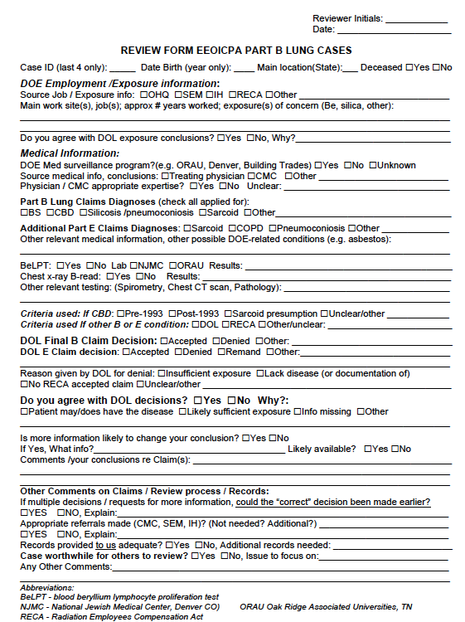

Slide 5
Review Part B Cases - Conclusions
Agreement with over 50% cases (based on available information)
Common reasons for incorrectly adjudicated cases (most fixable):
Sarcoidosis and CBD claims:
Misapplication/understanding of the Sarcoid Presumption
CMC incorrect decision – “narrow” interpretation data
Be exposure denied for unclear reasons – e.g. worked many yrs at Be facility (eg SRS) but “SEM reported to show no Be”
Eventually correct decision, but took too many years
Pneumoconiosis and Chronic Silicosis
Eligibility issues – Uranium workers – RECA denied
SEM identified limited exposure, eg only aluminum in a miner

Slide 6
Review Part B Cases – Other Issues Identified
1) Selection / Review of CMCs
30 /60 cases had CMC report, of those with CMC report
17/30 (57%) were the same CMC, a pulmonary physician with appropriate MD credentials, but who clearly had an “attitude”
2) Questions CMC were asked could be narrow
Other Part B / E conditions present but not identified by CMC
  e.g. CMC asked question about CBD. Records show asbestos disease or work-related COPD, but not commented on.
(Could ask CMC - Did you identify any other occ lung disease?)
3) It’s unclear which workers are undergoing medical surveillance for CBD. Eg Several cases involved workers from SRS site who did not appear to be undergoing CBD surveillance, and /or the clinicians involved were not aware of CBD.

Slide 7
Part B Subcommittee Recommendation
Sarcoid Presumption
We recommend a presumption of chronic beryllium disease (CBD) in situations with a diagnosis of pulmonary sarcoidosis* in an individual who meets the definition of a “covered beryllium employee” under Part E or Part B**.
*Pulmonary sarcoidosis involves the lungs and/or thoracic lymph nodes. The site biopsied can be another organ such as skin.
**This recommendation supports EEOICPA Circular No. 08-07 (Presumption of chronic beryllium disease in situations with a diagnosis of sarcoidosis and a history of beryllium exposure,) and Procedure Manual Part B, Chapter 2-1000 (Eligiblity Requirements for Non-Cancerous Conditions).

Slide 8
Part B Lung Conditions Subcommittee
Review of Part B Cases
Sarcoid Presumption
Clarification of Beryllium exposure
  Review of cases identified what appeared to be “covered beryllium employees” where someone concluded there was no Be exposure.
Responses to DOL (and other’s) questions
  Chronic respiratory condition
  Procedure manual (Chpt 2-1000) is confusing
  Borderline BeLPT

Slide 9
Part B Lung Conditions Subcommittee
Review of Part B Cases
Sarcoid Presumption
Clarification of Beryllium exposure
Responses to DOL (and other’s) questions
  Definition of Chronic respiratory condition
  Procedure manual (Chpt 2-1000) is confusing
  Borderline BeLPT

Slide 10
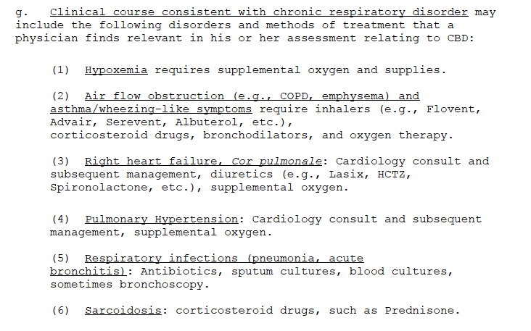
Pre-1993 CBD - “Chronic Respiratory Disorder”
Chapter 2-1000; 9/2015

Slide 11
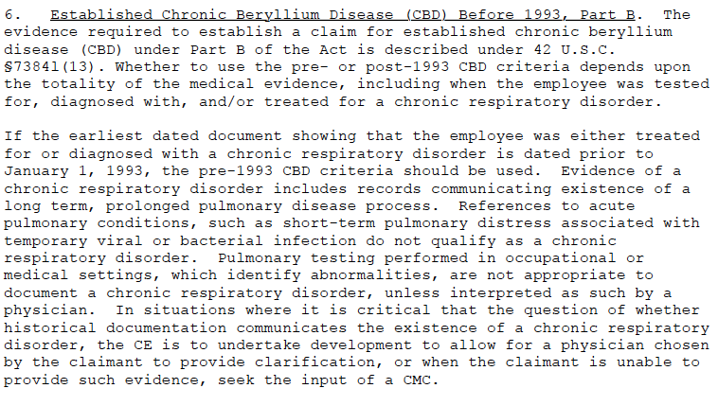
Pre-1993 CBD - “Chronic Respiratory Disorder”
Chapter 2-1000; 9/2015

Slide 12
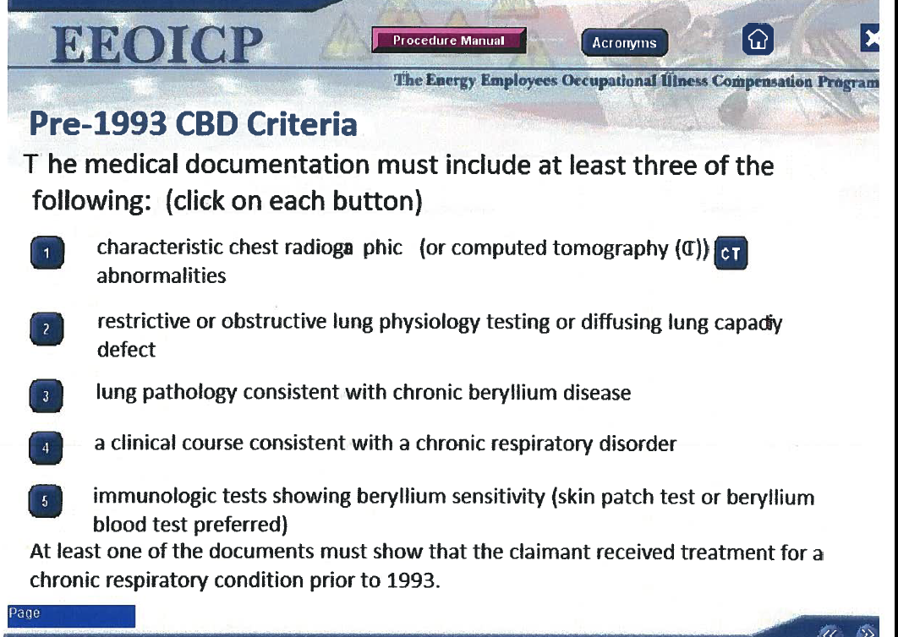

Slide 13
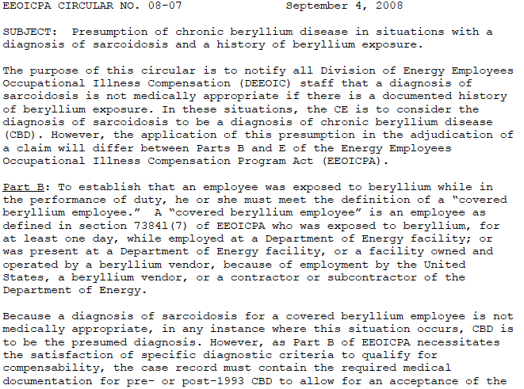
Sarcoidosis Presumption 2008

Slide 14
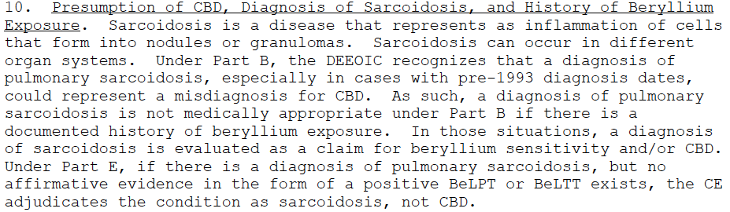
Current Sarcoidosis Presumption
Procedure Manual
Chapter 2-1000; 9/2015

Slide 15
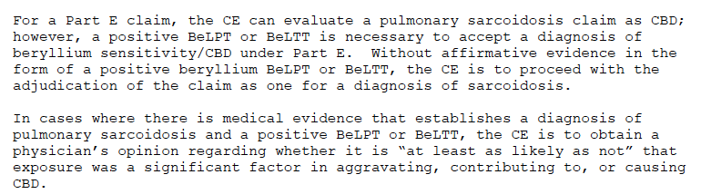
Current Sarcoidosis Presumption
Procedure Manual
Chapter 2-1000; 9/2015

Slide 16
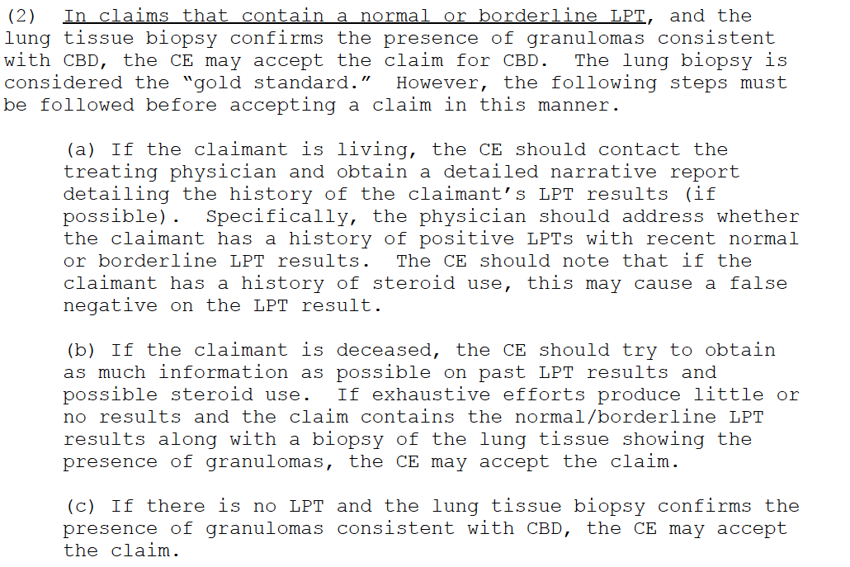
CBD On / After 1993 (=Sarcoid Presumption)
Chapter 2-1000; 9/2015

Slide 17
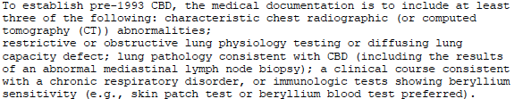
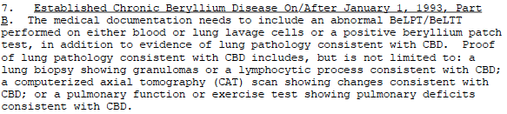
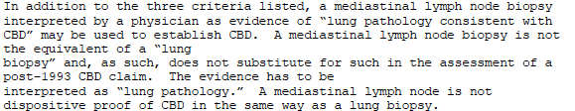
CBD - Mediastinal lymph node biopsy
Chapter 2-1000; 9/2015

Slide 18
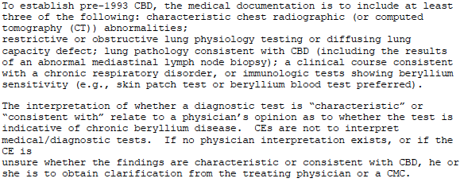
Skin Patch Testing; Characterisitic / Consistent
Chapter 2-1000; 9/2015

Slide 19
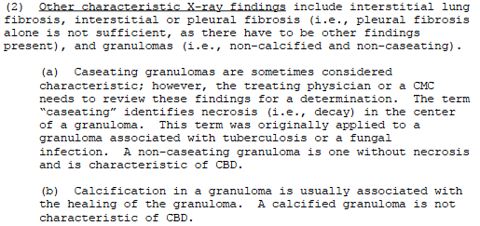
Pre-1993 CBD - granulomas, calcification
Chapter 2-1000; 9/2015

Slide 20
Recommendation:
1) The finding of two borderline BeLPT tests shall be considered the equivalent of one positive BeLPT for the purposes of claims adjudication under subpart B and subpart E of EEOICPA.

Slide 21
Advisory Board on
Toxic Substances and Worker Health:
Part B lung Conditions Subcommittee
Update
April 20, 2017
John M. Dement, PhD, CIH
Kirk D. Domina, Hanford Atomic Metal Trades Council
Carrie A. Redlich, MD, MPH (Chair)
James H. Turner, Rocky Flats Nuclear Weapons Facility
Laura S. Welch, MD
QUESTIONS ???

