Slide 1
Parkinsonism and Parkinson’s Disease
Advisory Board on Toxic Substances and Worker Health
April 2019

Slide 2
Parkinsonism
Group of progressive clinical syndromes characterized by parkinsonian symptoms:
Bradykinesia and
slowness of movement, fatigue, reduction of repetitive movements, difficulty initiating movements
Rigidity
stiffness/tightness of the limbs/trunk, facial muscles
and/or Tremor
shaking movement, upper limbs (hands - pill-rolling)
Postuma RB, Berg D, Stern M, et al. MDS Clinical Diagnostic Criteria for Parkinson’s Disease. Mov Disord 2015;30: 1591-1600.

Slide 3
Parkinsonism - Classification
Primary
Parkinson’s Disease (PD) – 70-80% of Parkinsonism cases
Idiopathic – up to 95% of all PD cases with genetic between 5-10% of cases
Secondary
Vascular (Lower Body Parkinsonism)
Drug Induced (neuroleptics (typical) ,antipsychotics (atypical) , metochlopramide, MPTP)
Infectious (postencephalitis, syphilis
Metabolic (parathyroid, postanoxic)
Structural (brain tumor, hydrocephalus)
Exposure agents (Carbon monoxide, Carbon disulfide, Manganese (Mn), methanol, pesticides
Parkinson-Plus (Atypical Parkinsonisms)
Multiple Systems Atrophy (MSA)
Progressive Supranuclear Palsy (PSP)
Corticobasal Degeneration (CBD)
Lewy Body Dementia (LBD)
Hereditary Disorders
Wilson disease
Huntington Disease
Neurodegeneration with brain iron accumulation (NBIA)
PARK1,2,6,7,8
Source:
Rizek P, Kumar N, Jog M. An update on the diagnosis and treatment of Parkinson disease. CMAJ 2016. DOI10.1503/cmaj.151179;
) Brooks D. Diagnosis and Management of Atypical Parkinsonian Syndromes. J Neurosurg Psychiatry. 2002;72 Suppl I (pp.10-16)

Slide 4
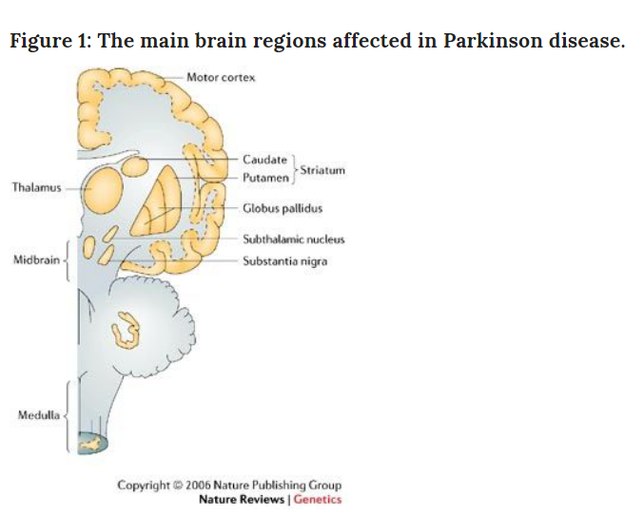
Parkinsonism - Pathology
- Pathology (neurodegenerative):
Loss of dopaminergic neurons in the substantia nigra -part of the midbrain - that controls reward seeking, muscle movement (fine movement), learning and addiction
Dopamine –neurotransmitter - chemical released by neurons
- Molecular - abnormal accumulation, cell inclusions of normal proteins within neurons:
α-synuclein (-o-pathies)
Parkinson’s Dz, MSA
tau (-o-pathies)
PSP
Source: 1) Dickson D. Parkinson’s Disease and Parkinsonism: Neuropathology.
Cold Spring Harb Perspect Med 2012;2:a009258 2) Rizek P, Kumar N, Jog M.
An update on the diagnosis and treatment of Parkinson disease. CMAJ 2016.
DOI10.1503/cmaj.151179
In: Farrer MJ. Genetics of Parkinson Disease. Paradigm Shifts and Future Prospects. Nat Rev Gernet 2006.:7(4):306-18 /

Slide 5
Parkinsonism and Parkinson’s Disease ICD-9 vs. ICD-10
ICD 9 ICD 10*
Parkinsonism 332.0 G20
Parkinson’s Disease 332.0 G20
Aliases: Paralysis Agitans, Idiopathic or Primary Parkinsonism or PD,
Secondary Parkinsonism 332.1 G21
Drug – Induced 332.1 G21.1
Neuroleptic Medication Induced 332.1 G21.11
Other Drug Induced 332.1 G21.19
Due to other external agents 332.1 G21.2
Carbon Monoxide 332.1 T58.94XS
Carbon Disulfide 332.1 982.2
Manganese 332.1 T56.894D
Vascular parkinsonism 322.1 G21.4
Other secondary parkinsonism 332.1 G21.8
Secondary parkinsonism, unsp. 332.1 G21.9
Parkinson-Plus 332.0 G20
Multiple Systems Atrophy (MSA) 333.0 G13.8
Progressive Supranuclear Palsy (PSP) 333.0 G23.1
Corticobasal Degeneration (CBD) 331.6 G31.85
Lewy Body Dementia (LBD) 331.82 G31.83
* ICD-10 - 10th Revision of the International Statistical Classification of Diseases and Related Health Problems – in use since 1999, replaced ICD-9 as of October 1, 2015

Slide 6
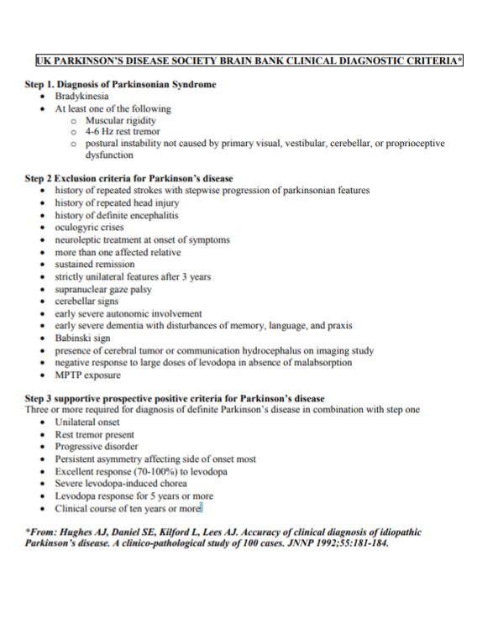
UK Parkinson’s Disease Society Brain Bank Clinical Diagnostic Criteria (UKPDSBRC), 1988
Designed for diagnosis in pathologic series, adapted by clinical community
Did not identify early stages of disease,
Diagnosis based on Parkinsonism criteria + Exclusion Criteria + Supportive Criteria
8 out of 10 patients with parkinsonism /PD diagnosed correctly (pooled diagnostic accuracy 82.7%, higher for experts in movement disorders
Rizzo et al. Accuracy of clinical diagnosis of Parkinson Disease: A systematic Review and meta-analysis. Neurology 2016: 86(6):566-76

Slide 7
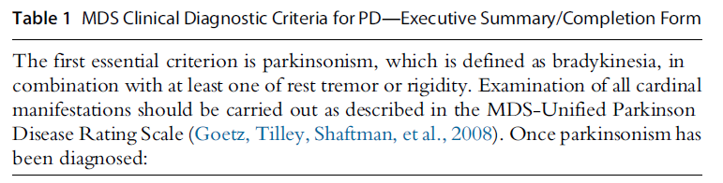
International Parkinson and Movement Disorder Society (MDS) Clinical/Research Diagnostic Criteria, 2017
Two step diagnostic process:
MDS Unified Parkinson’s Disease Rating Scale (MDS-UPDRS)
0 = normal to 4 = several, Maximum Score 199 with 2008 update to 272
65 items in four parts (to assess both motor and non-motor symptoms)
Part I, Mentation, Behavior and Mood
Part II Activities of Daily Living
Part III – Motor Examination
Part IV – Complications of Therapy
Goetz C et al. Movement Disorder Society-Sponsored Revision of the Unified Parkinson’s Disease Rating Scale (MDS-UPDRS): ScalePresentation and Clinimetric Testing Results. Mov Disord 2008;23:pp-2129-2170
Postuma RB, Berg D, Stern M, et al. MDS Clinical Diagnostic Criteria for Parkinson’s Disease. Mov Disord 2015;30: 1591-1600.

Slide 8
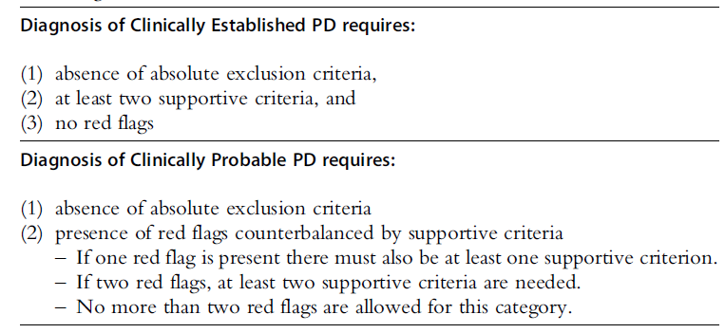
International Parkinson and Movement Disorder Society (MDS) Clinical/Research Diagnostic Criteria, 2017
Supportive Criteria: 1) Clear, beneficial response to dopaminergic therapy; 2) Rest tremor of a limb; 3) Presence of olfactory loss or cardiac denervation on MIBG scintigraphy; 4) presence off levodopa induced sykinesias
Red flags:: 1) Rapid progression of gait impairment; 2)A complete absence f of progression of motor symptoms >5 years; 3) severe dsyphnia and/or severe dysphagia ; 4) recurrent fails ; 5) absence of any non-motor symptoms despite >5 years of disease duration; 6) Bilateral symmetric parkinsonism
Postuma RB, Berg D, Stern M, et al. MDS Clinical Diagnostic Criteria for Parkinson’s Disease. Mov Disord 2015;30: 1591-1600.

Slide 9
Occupational Exposures and Risk of Parkinsonism/Parkinson’s Disease - Research
Polchorinated Biphenyls (PCBs)
Non-flammable, chemically stable, excellent electrical insulating properties - - wide industrial use, most commonly used: Aroclor 1242,1254 1260
No longer manufactured, processed and distributed in the US (1977) but still found in the environment (Aroclor 1254 – 54% Cl 54% Cl – half life 4.8 years) . On-going servicing of “enclosed PCBs”
Most common occupational exposure primarily through inhalation and/or skin
Dose Reconstruction Feasibility Study Oak Ridge Reservation (ORR) Health Studies (TN Dept .of Health, Oak Ridge Health Agreement Steering Panel)
PCBs used extensively at the Y-12, K-25 and X-10 facilities:
In electrical equipment,
as cutting fluid in machining operations
for fabrication of metal weapon parts,
as component of paints, coatings, adhesives, inks and gaskets

Slide 10
Occupational Exposures and Risk of Parkinsonism/Parkinson’s Disease - Research
- PCB mediated reductions in dopamine levels in experimental models (Seegal et al. 1986; 1989; 1990; 1991; 1994; 2002; Lee and Opanashuk 2004; Richardson and Miller 2004
- Significantly higher concentrations of PCBs in brain tissue of eight cases with PD (M/F 5/3; 70-85) compared to seven controls (M/F 7/0 50-72 (Corrigan et al. 2000)
Increased mortality from PD as an underlying COD (SMR 2.95, 95%CI 1.08-6.42) for highly exposed female workers from three electrical capacitor producing plants – retrospective mortality study with IH JEM to estimate exposure (Steenland et al. 2006)
- Increase in concentrations of PCBs in brain tissue of female subjects with dx of PD compared to controls (M/F 33/10; M/F=6/7)
(Hatcher-Martin JM (2012)

Slide 11
Occupational Exposures and Risk of Parkinsonism/Parkinson’s Disease - Research
Solvents
Industrial use as degreasing agents (cleaning parts, machining equipment) and paint thinners
Most prevalent occupational exposures through inhalation or skin
Commonly used solvents at DoE complex
Trichloroethylene (TCE)
Toluene
Acetone
Hexane
Carbon disulfide (rubber, asphalt, resins)

Slide 12
Occupational Exposures and Risk of Parkinsonism/Parkinson’s Disease - Research
Solvents
Majority of population based studies to-date with solvents exposures treated as a single entity
(Seidler et al. 1996; Smargassi et al 1998; McDonnell et al. 2003; Tanner et al. 2009)
- Case reports and reports of small clusters of PD following chronic TCE exposures (Guehl et al. 1999; Gash et al. 2008)
TCE exposure in animal models shown to result in loss of dopaminergic neurons and reduced levels of dopamine (Guehl et al 1999; Gash et al. 2008 ;Lin et al. 2010; Sauerbeck et al 2012)
- Ever-exposure to TCE associated with significantly increased risk of Parkinson’s disease (OR =6.1, 95%CI 1.2 -33) in Twin – Study (99 pairs) with lifetime solvent exposure assessment performed by IH (Goldman et al. 2012)

Slide 13
Occupational/Environmental Exposures and Risk of Parkinson’s Disease - Research
Metals
Wide industrial use with most prevalent inhalational exposures at DoE complex predominantly through metal fumes or metal dust during welding or machining operations
Iron and Copper exposures linked to reduction in dopamine levels in animal models (Oder et al. 1993; Barthel et al. 2003; Kaur et al. 2007; Yu et al. 2008)
Increased risk of PD following 20+ years of occupational exposures to copper (OR=2.49 , 95%CI 1.06-5.89), iron-copper (OR=3.89, 95%CI 1.40, 9.71) – case-control (144/464), IH assessment of job history and exposure potential (Gorell et al. 1997, 1999a;1999b; Rybicki et al. 1999)

Slide 14
Occupational/Environmental Exposures and Risk of Parkinson’s Disease - Research
Pesticides
Wide agricultural use/farming applications with potential for bystander oral, inhalational and skin routes of exposures at DoE complex due to farming operations on-sites
Insecticides (organochlorines, rotenone, organophosphates), herbicides (paraquat) and fungicides (Carbamate) linked to reduction of dopamine levels in cell lines and animal models (Sanchez-Ramos et al. 1998; Degli Esposti, 1998; Betarbet et al. 2000, Kitazawa et al. 2001; McCormack et al. 2002; Hatcher et al. 2008; Cannon and Greenamyre, 2010)
Significantly higher concentrations of organochlorines in brain tissue of eight cases with PD (M/F 5/3; 70-85) compared to seven controls (M/F 7/0 50-72 (Corrigan et al. 2000)
Increased risk of PD for insecticides (RR = 1.5, 95%CI 1.07, 2,11) and herbicides (RR = 1.4, 95%CI 1.08, 1.81) in pooled analysis for ever vs. never exposure (van der Mark et al. 2012)

Slide 15
International Parkinson and Movement Disorder Society (MDS) Clinical/Research Diagnostic Criteria, 2017
Clinicopathologic definition of PD (neuronal loss of substantia nigra with deposition of α-synuclein remained but genetic mutations present with no α-synuclein deposition (PSP) tauopathies?
Defined early stages of disease:
Pre-clinical - neurodegeneration has started but no symptoms (biomarkers not yet available)
Prodromal - presence of neurodegenerative motor symptoms but not at a clinical threshold level - a category created for clinical trials and prospective cohort studies
Clinical disease - presence of neurodegenerative motor signs - parkinsonism symptoms
Clinically Established PD diagnosis
Clinically Probable PD Diagnosis
Postuma RB, Berg D, Stern M, et al. MDS Clinical Diagnostic Criteria for Parkinson’s Disease. Mov Disord 2015;30: 1591-1600.

Slide 16
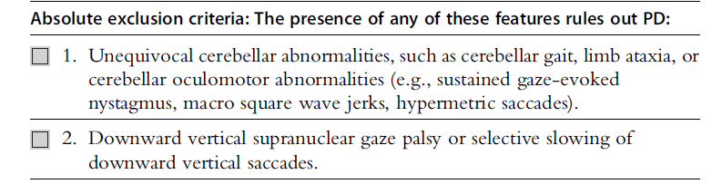
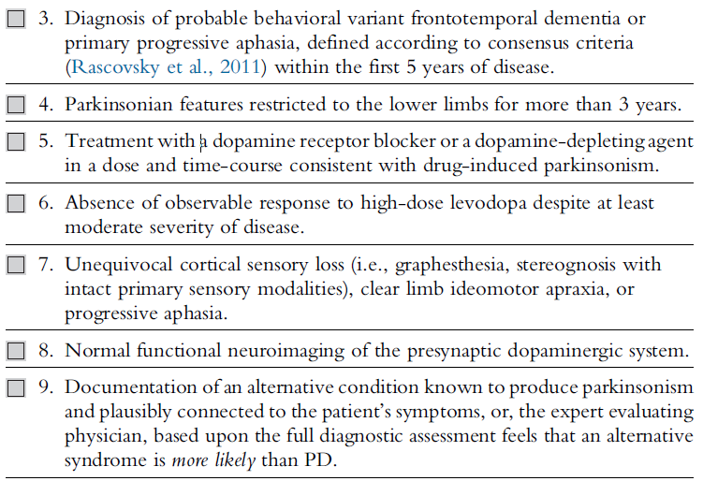
MDS Diagnostic Criteria, 2017
Postuma RB, Berg D, Stern M, et al. MDS Clinical Diagnostic Criteria for Parkinson’s Disease. Mov Disord 2015;30: 1591-1600.

Slide 17
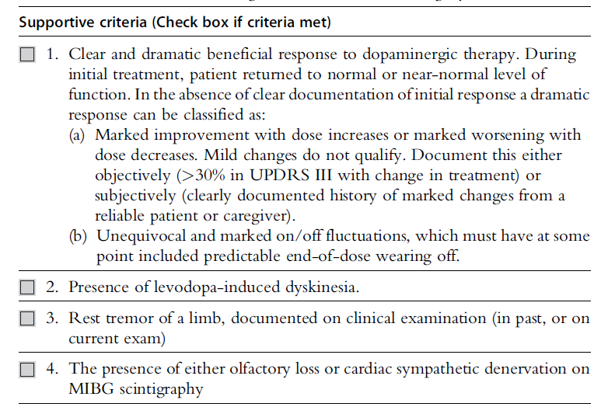
MDS Diagnostic Criteria, 2017
Postuma RB, Berg D, Stern M, et al. MDS Clinical Diagnostic Criteria for Parkinson’s Disease. Mov Disord 2015;30: 1591-1600.

Slide 18
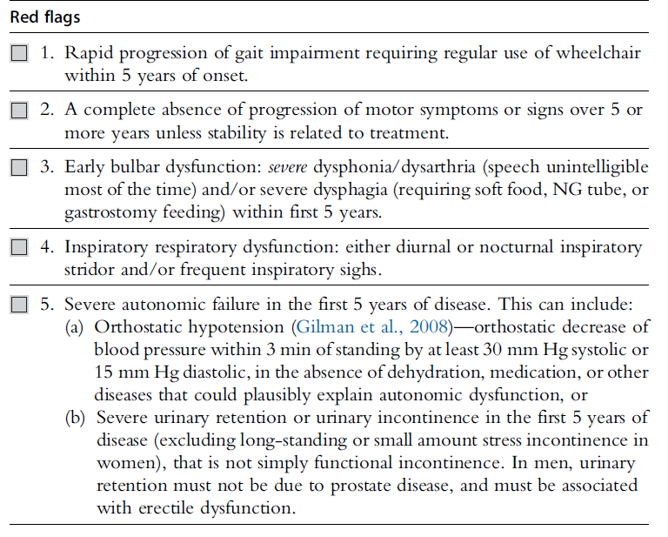
MDS Diagnostic Criteria, 2017
Postuma RB, Berg D, Stern M, et al. MDS Clinical Diagnostic Criteria for Parkinson’s Disease. Mov Disord 2015;30: 1591-1600.

Slide 19
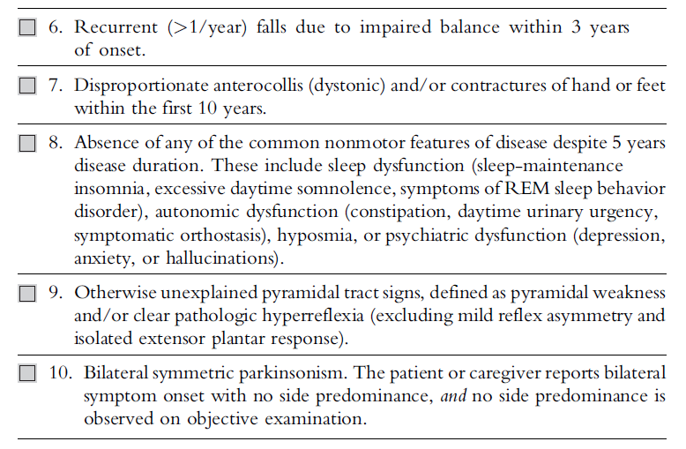
MDS Diagnostic Criteria, 2017
Postuma RB, Berg D, Stern M, et al. MDS Clinical Diagnostic Criteria for Parkinson’s Disease. Mov Disord 2015;30: 1591-1600.

Slide 20
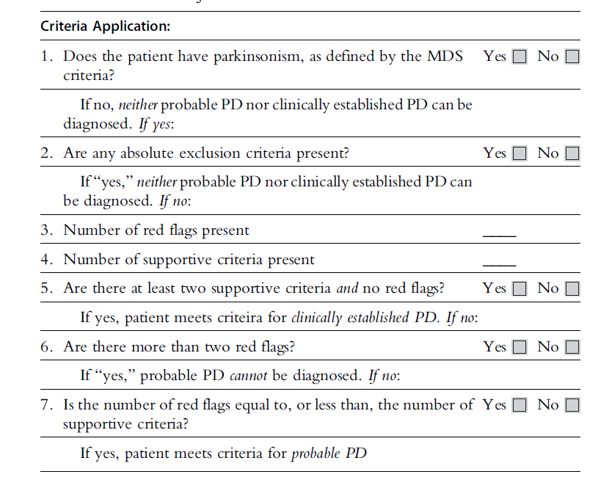
MDS Diagnostic Criteria, 2017
Postuma RB, Berg D, Stern M, et al. MDS Clinical Diagnostic Criteria for Parkinson’s Disease. Mov Disord 2015;30: 1591-1600.

