Slide 1
Parkinsonism and Parkinson Disease
Advisory Board on Toxic Substances and Worker Health
April 2020

Slide 2
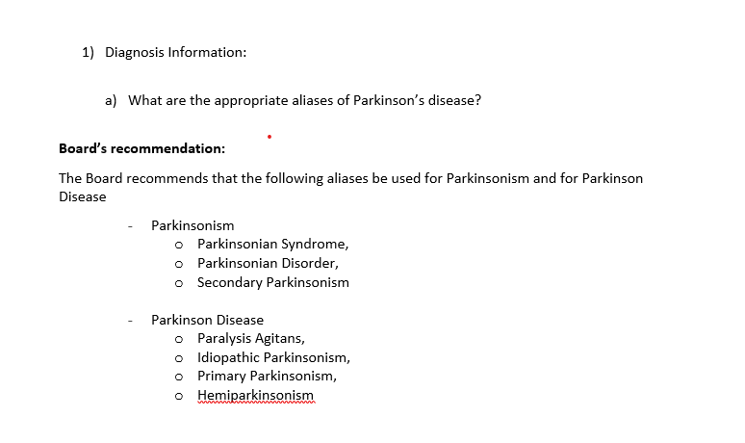

Slide 3
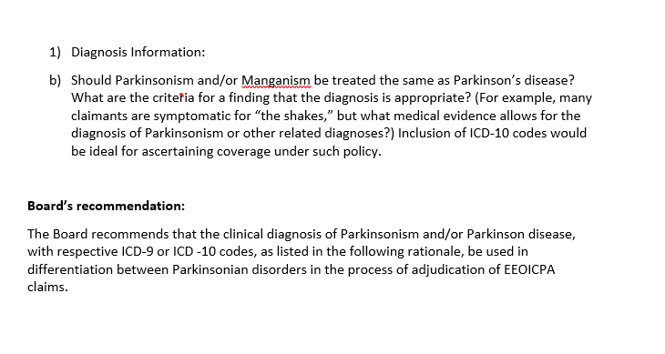

Slide 4
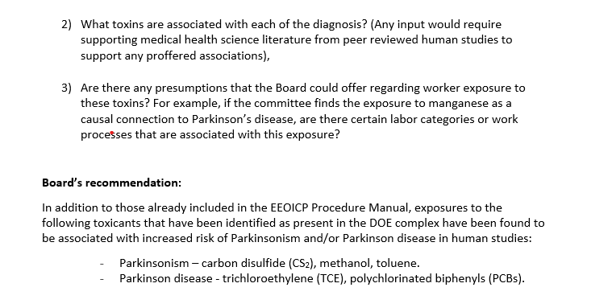

Slide 5
