Slide 1
Advisory Board on Toxic Substances and Worker Health
Steven Markowitz MD, DrPH
Meeting, April 22-23, 2021

Slide 2
Agenda item #4
Information Items from
November 5-6, 2020 ABTSWH Meeting

Slide 3
Follow-up Items from November 5-6, 2020 ABTSWH Meeting
1. Ms. Hearthway described “an increased focus on individual employee performance through case action sample reviews and the addition of a quality assurance analyst, who will conduct quality reviews on a weekly basis to help guide policy and training management.” What is the status of this effort and of any change in the QA work overall?
2. Ms. Pond said that the program refers most cases that have at least some information about exposure and conditions. What proportion and how many cases get referred to IH’s on new non-impairment claims?
3. Ms. Pond noted that ideally the program would have a research arm to evaluate claims data, but that all current resources are dedicated to adjudication. Is this an idea that the Department is considering?

Slide 4
Follow-up Items from November 5-6, 2020 ABTSWH Meeting (cont.)
4. EEOICP has begun implementing the new OHQ, and between July and November completed over 612 OHQ interviews with the new format. The Program would ask the Resource Centers for feedback. What is the feedback from the Resource Centers, claims examiners, IH’s, and CMC?
5. A public commenter requested that the Board “review Dr. Armstrong’s directives, communications, and personal opinions within the claims adjudication process and make recommendations to address issues of undue influence.” Please clarify the roles of the Medical Director and any medical personnel within EEOICP with regard to review of claims. Are their roles entirely described in the Procedure Manual? If not, what is a written description of their roles?
6. A public commenter noted that the importance of bystander exposure seems to be minimized in claims evaluations. How does the EEOICP deal with claimants’ potential bystander exposures, especially since they may not be included in the SEM?

Slide 5
OHQ Feedback
It is significantly better/more concise/useful than that previous version. It is better organized than the prior version.
It’s a lot easier to go through compared to the previous format and I think it adequately addresses everything.
Like that it’s shorter without multiple pages of no information/information we don’t use. The old format included a lot of information we never really used.
The OHQ's are fine, suggest that they should be an automatic for every new claim from the RC.
I do feel it is much more condensed as far as the toxins. I do like it MUCH better than the old format - that was just a lot of wasted pages.

Slide 6
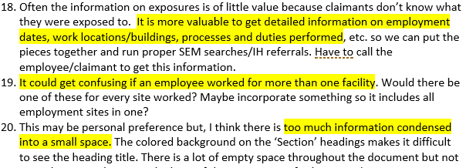
OHQ Feedback

Slide 7
OHQ Feedback

Slide 8
Agenda item #5
Update on Prior Recommendations

Slide 9
Board Recommendation: Sitewide Jobs (Adopted 11/5/20)

Slide 10
Board Recommendation: Sitewide Jobs (Adopted 11/5/20)
DOL Response (1/13/21)

Slide 11
Board Recommendation: IH and MD Evaluations (Adopted 11/5/20)

Slide 12
Board Recommendation: IH and MD Evaluations (Adopted 11/5/20)
DOL Response (1/13/21)

Slide 13
Board Recommendation: IH and MD Evaluations (Adopted 11/5/20)
DOL Response (1/13/21)

Slide 14
Agenda item #7
IARC/NTP Carcinogens

Slide 15
ABTSWH Probable Human Carcinogen Recommendation
The Advisory Board on Toxic Substances and Workers Health recommends that toxic substances that are found to be probable human carcinogens (IARC Group 2A) and that have limited human epidemiological evidence for specific human cancer sites as identified in Table 1, should be linked to those cancer sites in the SEM. The SEM should specify that IARC and NTP evaluations have been used in addition to HAZ MAP for the purpose of asserting linkages between toxic substances and human cancer sites. Future IARC Group 2A substance-cancer linkages identified by IARC or NTP should be incorporated in the SEM. Data from IARC and NTP should be used in addition to HAZ MAP for health effects and linkages of toxic substances to cancers.

Slide 16
Agenda item #8
DOL COVID Query

Slide 17
DOL COVID Query
“DEEOIC is seeking input from the Board regarding whether it is reasonable under certain defined circumstances (as supported by medical health science) to presume that a certain type of accepted work-related illness (e.g. respiratory disorder or particular diagnosed condition) will make the effect of a positive diagnosis of COVID19 worse.
Under such a presumptive scenario, DEEOIC would be able to accept that the COVID19 is a compensable consequential illness without further development. Otherwise, DEEOIC would seek out the opinion of a qualified physician to establish such a relationship, as the attached case examples document.”

Slide 18
DOL COVID Query
Consequential relationship to a previously accepted illness:
The effect of an accepted occupational illness under Part B and/or covered illness under Part E in causing, contributing to or aggravating an injury, illness, impairment, or disease is considered a consequential condition. A CE is to accept as compensable any claimed consequential condition(s) that is documented properly by substantive, well-rationalized medical evidence.

Slide 19
Draft COVID Recommendation
The Board recommends that any chronic health condition that is listed by the CDC as being associated with severe COVID-19 disease by meta-analysis, systematic reviews, cohort studies, case control studies, cross sectional studies, case cases/series or mixed evidence be considered to be presumed to lead to symptomatic COVID -19 disease. That is, the diagnosis of symptomatic COVID-19 disease is a consequence of those chronic health conditions when it follows or coincides with the onset of those conditions.

Slide 20
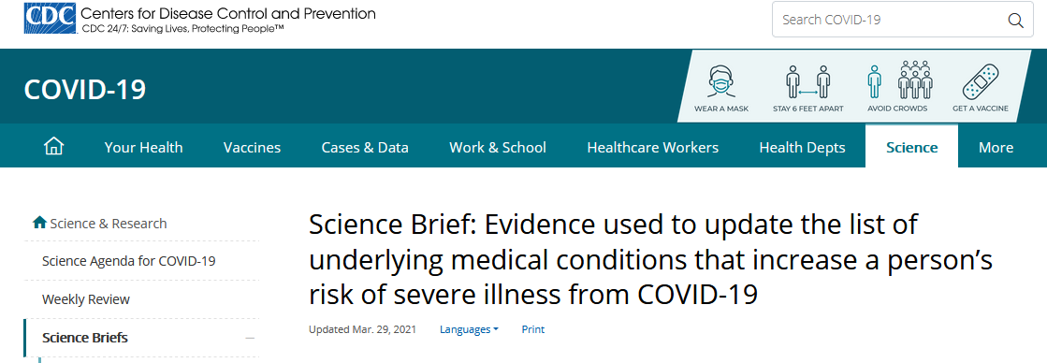
https://www.cdc.gov/coronavirus/2019-ncov/science/science-briefs/underlying-evidence-table.html

Slide 21
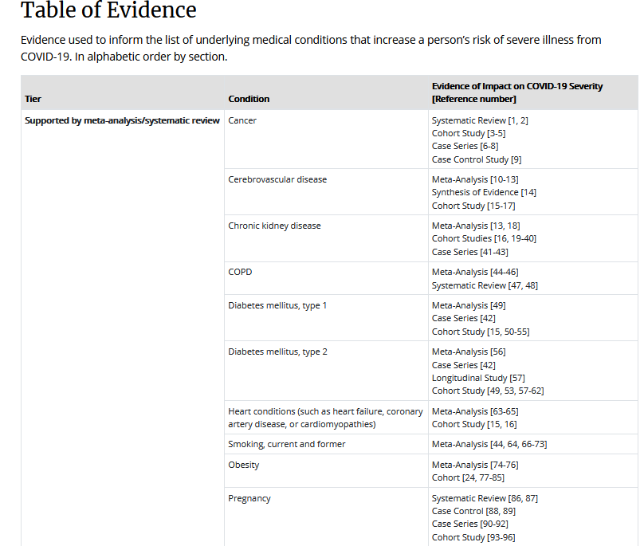
CDC
https://www.cdc.gov/coronavirus/2019-ncov/science/science-briefs/underlying-evidence-table.html

Slide 22
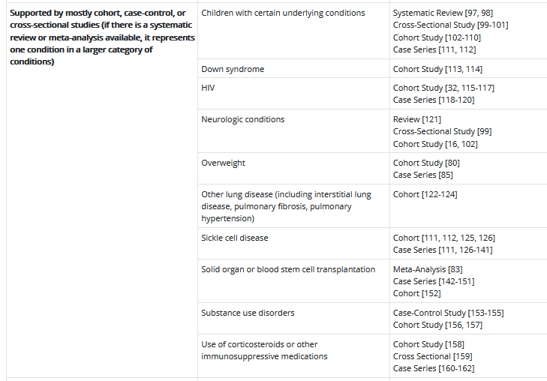
CDC
https://www.cdc.gov/coronavirus/2019-ncov/science/science-briefs/underlying-evidence-table.html

Slide 23
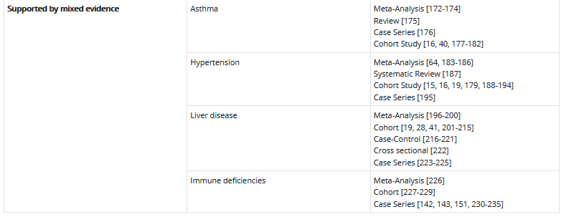
CDC
https://www.cdc.gov/coronavirus/2019-ncov/science/science-briefs/underlying-evidence-table.html

Slide 24
CDC
https://www.cdc.gov/coronavirus/2019-ncov/covid-data/investigations-discovery/hospitalization-death-by-race-ethnicity.html

Slide 25
Agenda item #9
Asbestos Recommendation
Working Group
Mike Van Dyke, Dianne Whitten,
Mark Catlin, Steven Markowitz

Slide 26
ABTSWH Response to PTS Asbestos Report for DOL
Draft Additional ABTSWH Recommendation Concerning Asbestos
We recommend that Paragon Technical Services (PTS) re-evaluate the job titles of Chemical Engineers, Industrial, Health, & Safety Engineers, and Mechanical Engineers and that these titles be added to the list of occupations presumptively exposed to the asbestos under EEOICP.
We request access to the Generic Profiles, including the Asbestos Generic profile, as cited in the PTS report.
We recommend that DOL clarify how DOE jobs that correspond to the job title “Maintenance and Repair, General Helper” are classified within the SEM and whether they are linked to asbestos exposure.

Slide 27
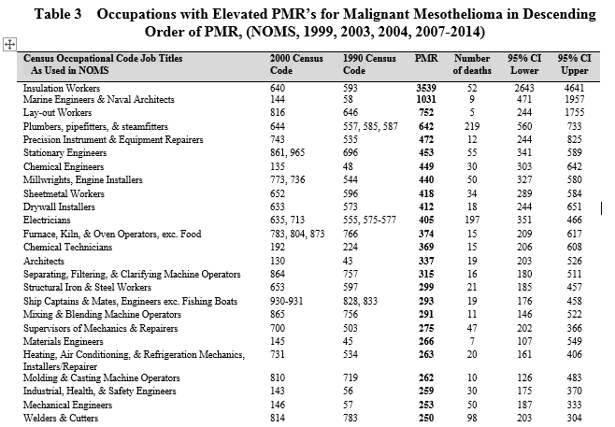
Occupations with Very Elevated Risk of Malignant Mesothelioma (PMR>250)
Source: NOMS data submitted to EEOICP by ABTSWH

Slide 28
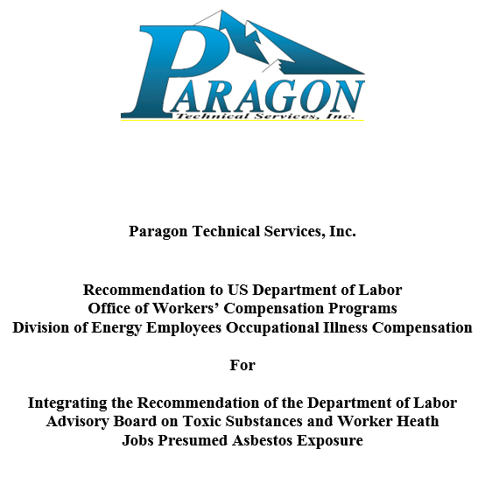
ABTSWH Response to PTS Asbestos Report for DOL

Slide 29
Paragon Technical Services, Inc. Recommendation to US Department of Labor Office of Workers’ Compensation Programs Division of Energy Employees Occupational Illness Compensation For Integrating the Recommendation of the Department of Labor Advisory Board on Toxic Substances and Worker Heath Jobs Presumed Asbestos Exposure

Slide 30
ABTSWH Response to PTS Asbestos Report for DOL
The PTS report argues against presumptive asbestos exposure for some occupations identified in the National Occupational Mortality Surveillance (NOMS) as having excess mesothelioma risk when:
Asbestos does not appear for the occupation in the SEM
2) Job titles in NOMS encompass work in diverse industries that may
have limited and uncertain relevance to work at DOE sites
3) Job titles may not have widespread exposure to asbestos across
many job settings, or
4) The occupations are infrequent at DOE.

Slide 31
ABTSWH Response to PTS Asbestos Report for DOL
These arguments are unpersuasive for occupations in NOMS with:
High Proportionate Mortality Ratio (PMR > 250)
A substantial number of mesothelioma cases (> 30 cases)
Reasonably high frequency within DOE complex

Slide 32
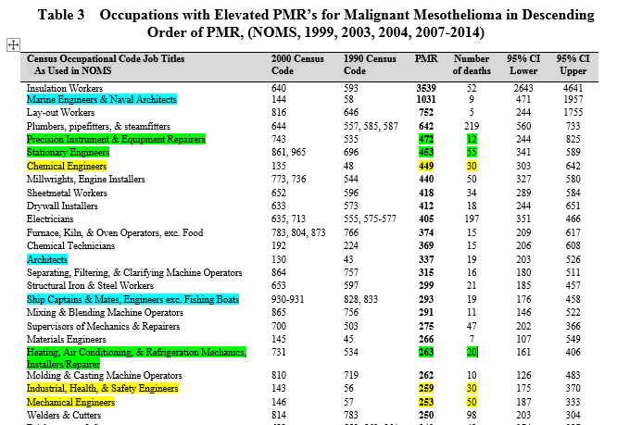
Occupations with Very Elevated Risk of Malignant Mesothelioma (PMR>250)
Source: NOMS data submitted to EEOICP by ABTSWH

Slide 33
ABTSWH Response to PTS Asbestos Report for DOL
These arguments are unpersuasive for occupations in NOMS with:
High Proportionate Mortality Ratio (PMR> 250)
A substantial number of mesothelioma cases (> 30 cases)
Reasonably high frequency within DOE complex
NOMS-identified occupations meeting these criteria include:
Chemical Engineers (PMR = 449; # MM deaths = 30)
Industrial, Health, & Safety Engineers (PMR = 259; # MM deaths = 30)
Mechanical Engineers (PMR = 250; # MM deaths = 50)

Slide 34
ABTSWH Response to PTS Asbestos Report for DOL
PTS Report, p. 2
Note: Janitorial activities, Laundry, Power/Communication line maintenance. These are not on EEOICP asbestos presumption list.

Slide 35
ABTSWH Response to PTS Asbestos Report for DOL
Draft Additional ABTSWH Recommendation Concerning Asbestos
We recommend that Paragon Technical Services (PTS) re-evaluate the job titles of Chemical Engineers, Industrial, Health, & Safety Engineers, and Mechanical Engineers and that these titles be added to the list of occupations presumptively exposed to the asbestos under EEOICP.
We request access to the Generic Profiles, including the Asbestos Generic profile, as cited in the PTS report.
We recommend that DOL clarify how DOE jobs that correspond to the job title “Maintenance and Repair, General Helper” are classified within the SEM and whether they are linked to asbestos exposure.

Slide 36
Agenda Item #7
Six Minute Walk Test

Slide 37
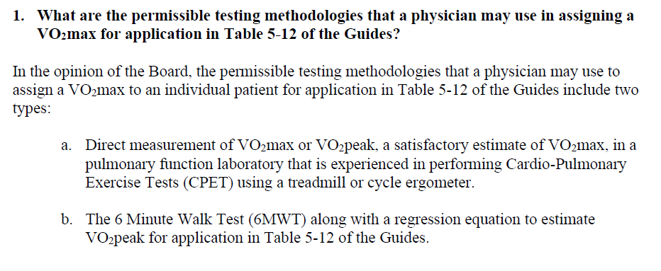
Six Minute Walk Test

Slide 38
6MWT
The 6MWT is a field test that is widely available, does not require specialized equipment, and can be performed safely in a typical medical office setting by most patients with pulmonary or cardiac compromise.
The ERS/ATS Technical Standard published by Holland et al. (2014) provides standardized instructions and quality assurance procedures for the 6MWT.

Slide 39
Six Minute Walk Test
The 6MWT has been well studied for patients with a variety of lung disorders and is reported to have acceptable repeatability, reproducibility, safety and precision to predict mean VO₂max of a group (Singh, 2014; Sood, 2014; Ross, 2010; Cahalin, 1995).
A systematic review by the European Respiratory Society / American Thoracic Society in 2014 concluded that the 6MWT is a valid, reliable, and “robust test of functional exercise capacity in adults with chronic respiratory disease” (Singh 2014).
3. The systematic review also concluded that the relationship
between 6MWD and either VO2peak or peak work on a
progressive incremental Cardiopulmonary Exercise Testing
(CPET) was moderate to strong and was consistent across
patient groups with chronic obstructive pulmonary disease and
interstitial lung disease.

Slide 40
Six Minute Walk Test
The 6MWT measures peak VO₂ (VO₂peak), which provides acceptable estimates of VO₂max when VO₂max is not clinically advisable or achievable. Both the CPET and the 6MWT would generally yield a VO₂peak rather than a VO₂max in most or all of these patients since individuals with significant lung disease can rarely achieve the maximal anaerobic level of exertion needed to generate a true VO₂max on the CPET.

Slide 41
Six Minute Walk Test
The best available method to estimate the VO₂peak in an individual patient is to use the equation published by Ross et al in 2010. This equation is:
Mean Peak VO2 (ml / kg /min) = 4.948 + 0.023*Mean 6MWD (meters)
This regression equation was derived from pooled data taken from 11 studies conducted between 1996 and 2006 including a total of 1,083 patients with diverse cardiopulmonary disorders.

Slide 42
Recommendation: 6MWT
The Board advises that the 6MWT is an entirely acceptable to measure the VO₂max for the purposes of impairment assessment.
The best valid and available method to estimate a value of VO₂max from the 6MWD for application in Table 5-12 of the AMA Impairment Guide is to use the equation derived by Ross et al (2010):
Mean Peak VO2 (ml / kg /min) = 4.948 + 0.023*Mean 6MWD (meters)

Slide 43
Agenda Item #8
Comments of DOL Impairment Evaluations

Slide 44
Medical Director's Quarterly Audits and CMC Audit Analysis, 2018 & 2019
 | 2018 |  | 2019
Type of Review | Total No. | No. that "need improvement" (%) | Total No. | No. that "need improvement" (%) | Grand Total | No. that "need improvement" (%)
Causation | 67 | 1 (1%) | 79 | 0 (0%) | 146 | 1 (0.68%)
Impairment | 67 | 25 (37%) | 71 | 19 (27%) | 138 | 44 (32%)
Other* | 63 | 12 (19%) | 47 | 3 (6%) | 110 | 15 (14%)
Total | 197 | 38 (19%) | 197 | 22 (11%) | 394 | 60 (15%)
*includes clarification of diagnosis reports, referee & second opinions, and supplemental file reviews
There are no Medical Director Quarterly Audit Reports for 2020 posted online

Slide 45
Questions on Impairment Ratings
How many Impairment Ratings have been performed in the last two years?
2. How many of those Impairment Ratings have been flagged for review by the
Medical Director?
3. How many of the Impairment Ratings that the Medical Director has flagged
have been challenged in one way or another?
4. Are there specific Impairment physicians with more challenged Impairment
Ratings than other physicians?
5. What actions has the CMC contractor taken to improve impairment ratings?

