Slide 1

Advisory Board on Toxic Substances and Worker Health
Steven Markowitz MD, DrPH
Meeting, January 28, 2020

Slide 2
Agenda item #3

Slide 3
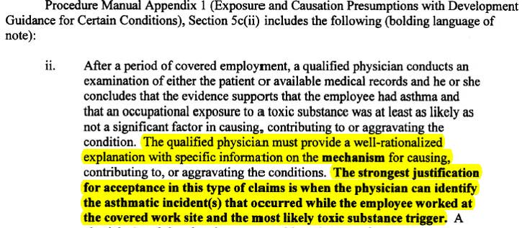
DOL Responses to Board Recommendations (12/18/19)
Occupational Asthma

Slide 4
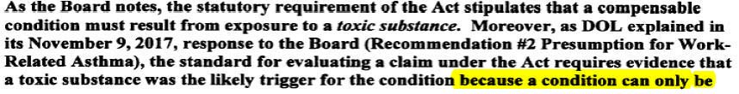
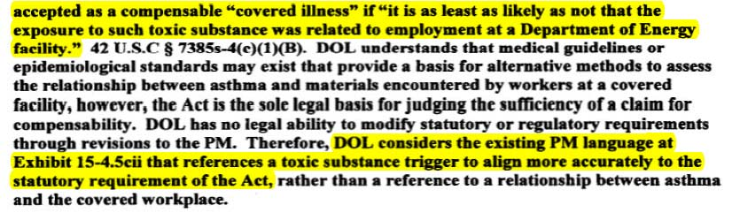
DOL Responses to Board Recommendations (12/18/19)
Occupational Asthma: DOL Response

Slide 5
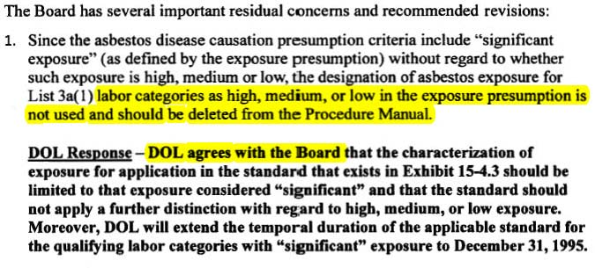
DOL Responses to Board Recommendations (12/18/19)
Asbestos

Slide 6
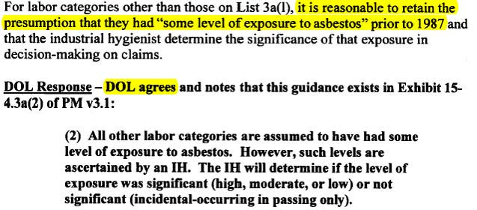
DOL Responses to Board Recommendations (12/18/19)
Asbestos

Slide 7

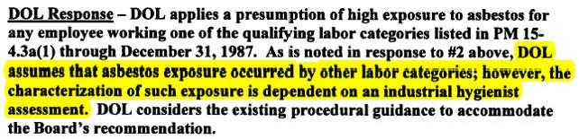
DOL Responses to Board Recommendations (12/18/19)
Asbestos

Slide 8
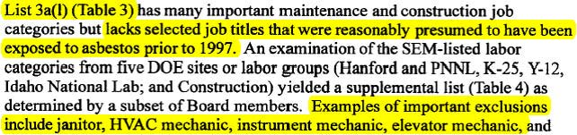
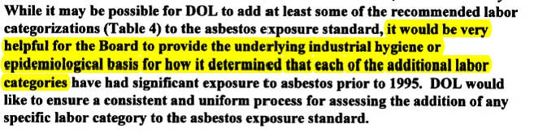
DOL Responses to Board Recommendations (12/18/19)
Asbestos

Slide 9
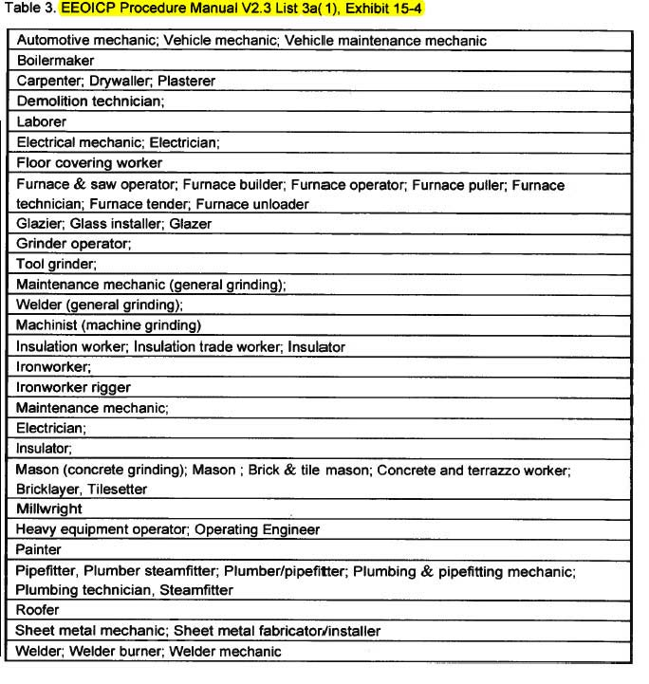
DOL Responses to
Board
Recommendations
(12/18/19)
Asbestos
Examples of missing
job titles:
Janitor
HVAC worker
Firefighter
:

Slide 10
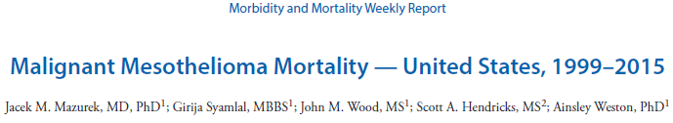
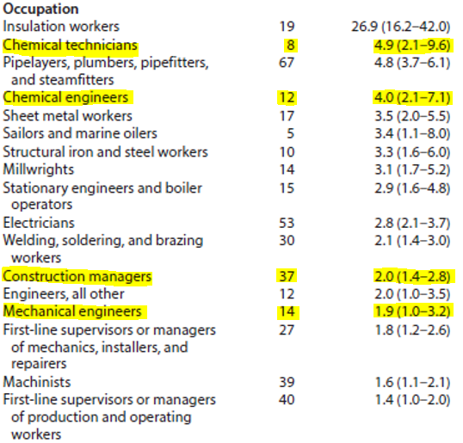
MMWR 2017

Slide 11
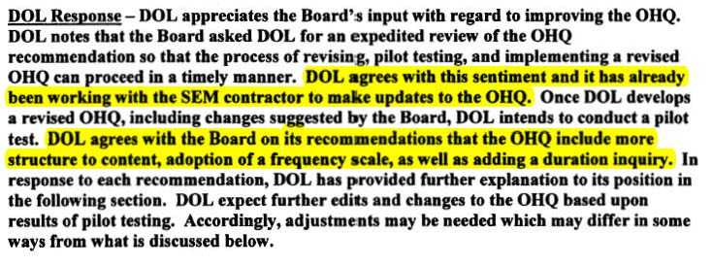
DOL Responses to Board Recommendations (12/18/19)
Occupational Health Questionnaire

Slide 12

DOL Responses to Board Recommendations (12/18/19)
Occupational Health Questionnaire

Slide 13
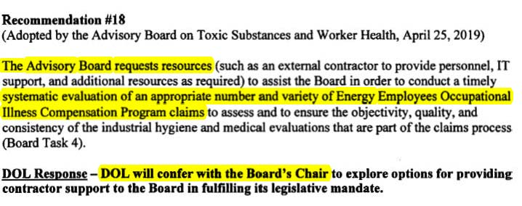
DOL Responses to Board Recommendations (12/18/19)
Resources for Board

Slide 14
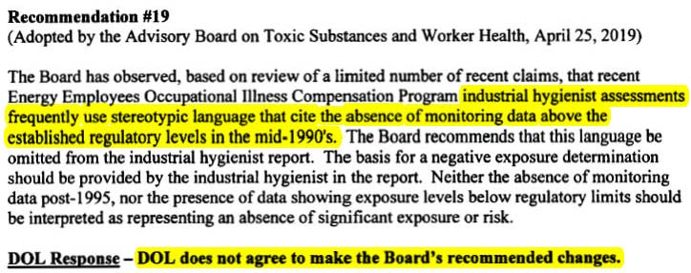
DOL Responses to Board Recommendations (12/18/19)
Industrial Hygiene Evaluation

Slide 15

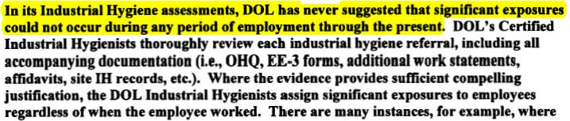
DOL Responses to Board Recommendations (12/18/19)
Industrial Hygiene Evaluation

Slide 16


DOL Responses to Board Recommendations (12/18/19)
Industrial Hygiene Evaluation

Slide 17
Agenda item #4

Slide 18
New duties, ABTSWH (December 30, 2019)
National Defense Reauthorization Act of 2020
Provide advice upon “the claims adjudication process generally, including review of procedure manual changes prior to incorporation into the manual and claims for medical benefits”
OWCP plan: OWCP will submit changes to Board and
publish changes w/i 10 days. Board’s recommendations
are “welcome…at any time.”

Slide 19
New duties, ABTSWH (December 30, 2019)
National Defense Reauthorization Act of 2020
2. Make available to Board the EEOICP medical director,
toxicologist, industrial hygienist, and contractors when
requested.
OWCP plan: Board will submit written questions and
“specialist will respond to questions.” Method to handle
follow-up questions will be determined later.

Slide 20
New duties, ABTSWH (December 30, 2019)
National Defense Reauthorization Act of 2020
3. DOL Secretary will respond to Board’s recommendations
in writing within 60 days of the date of submission.
If recommendations are accepted, a timeline of
implementation will be provided.
If recommendation is not accepted, a rationale and “all
scientific research” supportive of the decision will be
provided to Board.

Slide 21
New duties, ABTSWH (December 30, 2019)
National Defense Reauthorization Act of 2020
4. Board will advise DOL Secretary on other matters that the
Secretary considers appropriate. “OWCP may provide the
Board with directives in the future regarding specific topics
for its review and recommendations.”

Slide 22
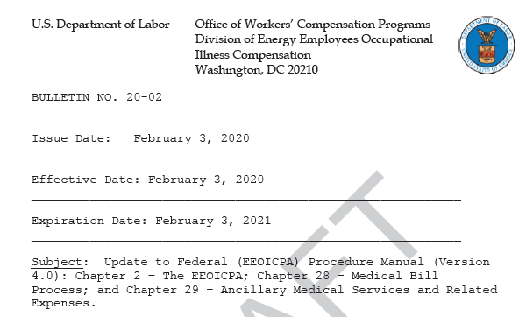
Agenda item #4a
Sent to Board 1/27/20; 69 pages

Slide 23
Agenda item #5
Public Comments

Slide 24
Agenda item #6

Slide 25
ABTSWH Requests to DOL, December 2019
Informational queries to DOL
1. Does DOL have a guide for treating physicians on how to use the SEM?
2. How many public submissions have been made to the SEM in 2019? Outcomes?
3. What changes have been made to the SEM regarding exposure- disease links, 2018-now?
4. How many CMC reports have been issued each month in 2019?
5. The Board requests an update on the status of re-opened cases, i.e., cases that were re-
opened after new or revised presumptions were adopted by the Department.
6. In the DOL Top 20 Health Conditions chart provided by the program, how old
are the “pending claims”? That is, how many were first opened in 2017, 2018, and 2019?
7. How is a quality assessment evaluation of the work of the industrial hygienists performed?
How will it be done under the new contract?

Slide 26
ABTSWH Requests to DOL, December 2019
20 lung cancer claims that were denied under Part E from
2013 to the present.
Only claims whose job position/title is a construction or
maintenance or crafts title should be included.
Only claims for whom a minimum of 15 years has elapsed
between “earliest verified employment date” and
“diagnosis date.”
We strongly prefer claims that have an index that indicates
how to find key documents.

Slide 27
Board Recommendation (11/20/19 meeting)
“The Board recommends that the Department, as part of the Site Exposure Matrices, identify job categories at DOE sites that likely have worked throughout the applicable sites and would have had potential exposure to many or all listed toxic substances at those facilities.”

Slide 28
IOM Review of SEM, 2013

Slide 29
“It is as least as likely as not that exposure to a toxic substance at the Department of Energy facility was a significant factor in aggravating, contributing to, or causing the illness”
EEOICPA

Slide 30
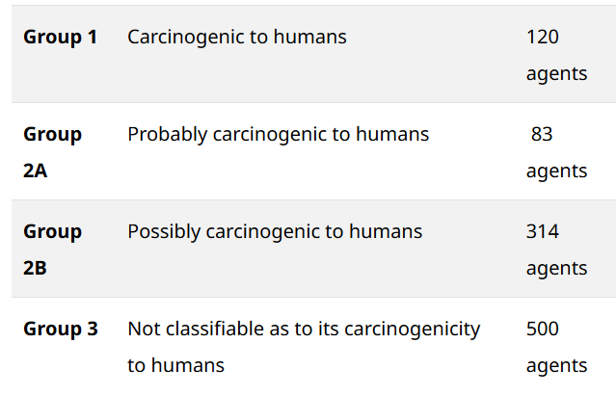
IARC Classifications

Slide 31
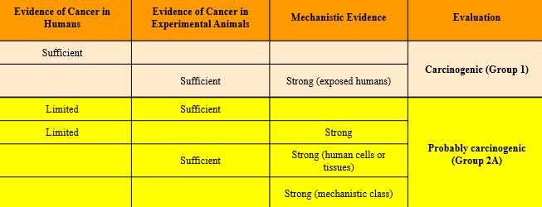
IARC classifications 1 and 2A: definitions

Slide 32
Evidence of Cancer in Humans | Evidence of Cancer in Experimental Animals | Mechanistic Evidence | Evaluation
Sufficient |  |  | Carcinogenic (Group 1)
 | Sufficient | Strong (exposed humans)
Limited | Sufficient |  | Probably carcinogenic (Group 2A)
Limited |  | Strong
 | Sufficient | Strong (human cells or tissues)
 |  | Strong (mechanistic class)
Limited |  |  | Possibly carcinogenic (Group 2B)
 | Sufficient
 |  | Strong (experimental systems)
 | Sufficient | Strong (does not operate in humans) | Not classifiable (Group 3)
 | All other situations not listed above
https://monographs.iarc.fr/wp-content/uploads/2019/07/2019-SR-001-Revised_Preamble.pdf

Slide 33
Proportion of Total Chemicals used in USA evaluated by IARC
80,000 chemicals in use in USA
~1,000 evaluated by IARC

Slide 34
Agents Classified by the IARC Monographs, Volumes 1-125
Group 1. Carcinogenic to humans
Group 3. Not classifiable as to its carcinogenicity to humans
Group 2A. Probably carcinogenic to humans
Group 2B. Possibly carcinogenic to humans

Slide 35
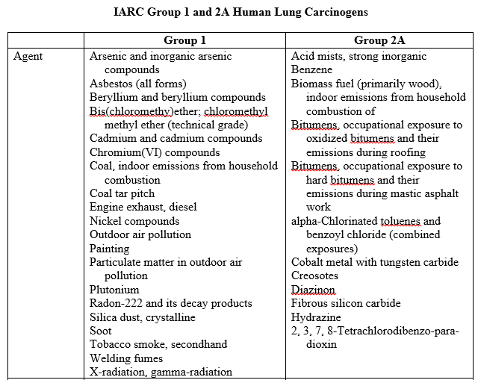
IARC 2019

Slide 36
Agenda item #7

Slide 37

Board Charter
The Board advises the Secretary with respect to:

Slide 38
MD Evaluation

Slide 39
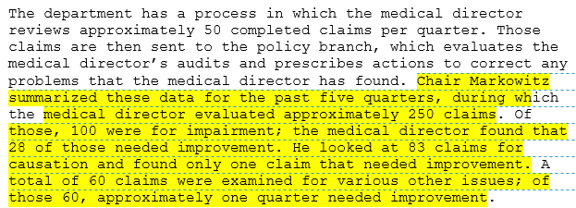
EEOICP Medical Director Review of
Contractor Medical Evaluations
Minutes, ABTSWH Meeting, November 20-21, 2019

Slide 40
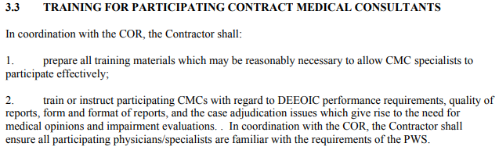
CMC Contract
https://www.dol.gov/owcp/energy/regs/compliance/advboard/teeleaong_contr_form.pdf

Slide 41
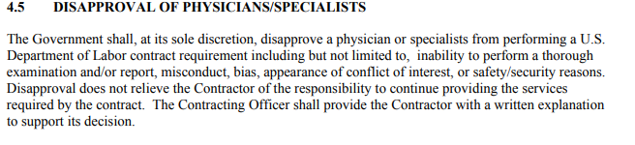
CMC Contract
https://www.dol.gov/owcp/energy/regs/compliance/advboard/teeleaong_contr_form.pdf

Slide 42
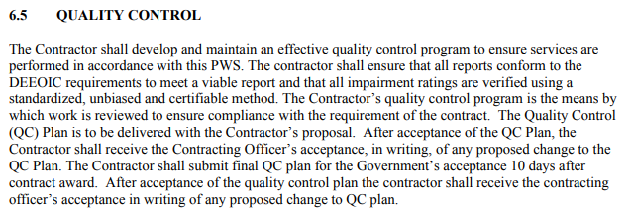

CMC Contract
https://www.dol.gov/owcp/energy/regs/compliance/advboard/teeleaong_contr_form.pdf

Slide 43

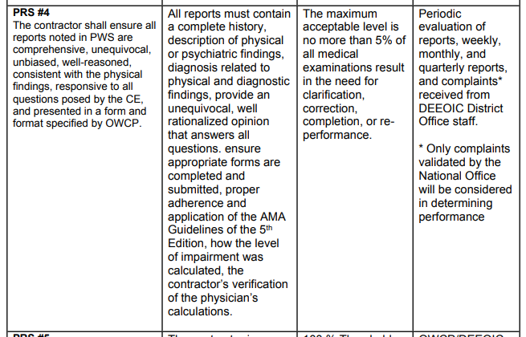
CMC Contract
https://www.dol.gov/owcp/energy/regs/compliance/advboard/teeleaong_contr_form.pdf

Slide 44
CMC Contract
https://www.dol.gov/owcp/energy/regs/compliance/advboard/teeleaong_contr_form.pdf

Slide 45
IH Evaluation

Slide 46
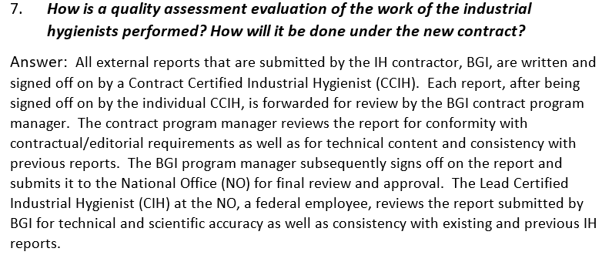
DOL Response to ABTSWH December 23, 2019 Informational Request

