Slide 1
Hearing loss and dementia
Steven Markowitz MD, DrPH
ABTSWH, May 17, 2023

Slide 2
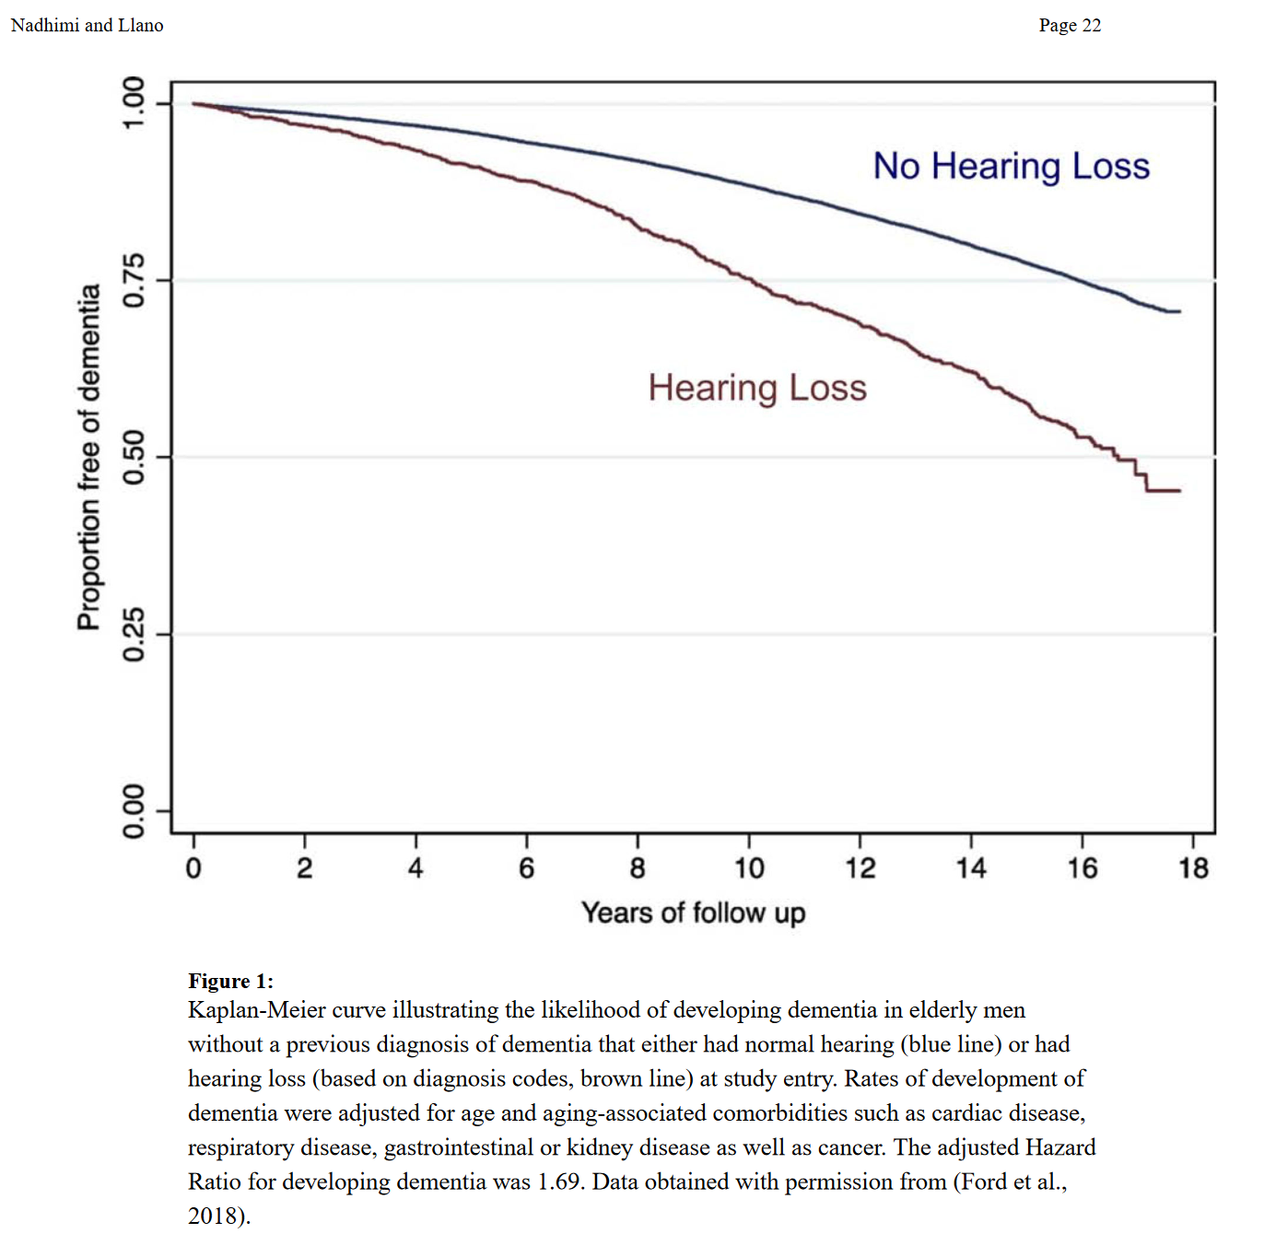
Ford et al, 2018

Slide 3
Mechanisms
Decsease in cognitive reserve
Social isolation
Microvascular disease
Changes in brain structure

