Slide 1
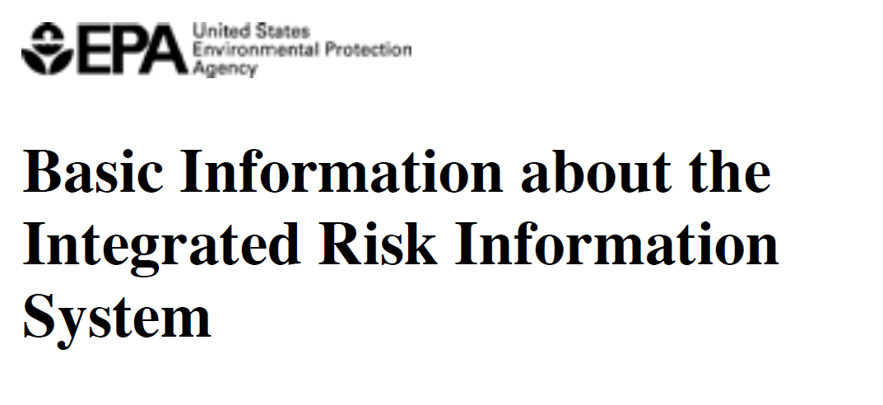

Slide 2
IRIS Process for Developing
Human Health Assessments

Slide 3
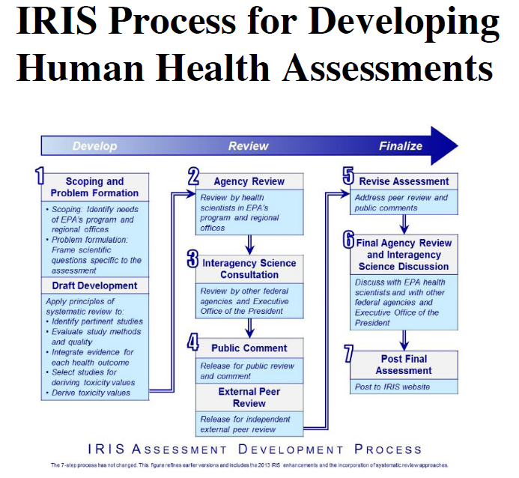

Slide 4
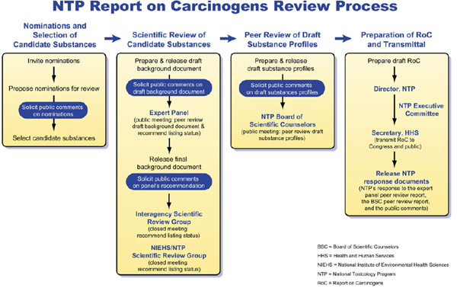

Slide 5
Report on Carcinogens, Fourteenth Edition. National Toxicology Program, Department of Health and Human Services. 2016. Available at: https://ntp.niehs.nih.gov/pubhealth/roc/index-1.html

