Slide 1
Energy Employees Occupational Illness Compensation Program

Slide 2

What is the EEOICPA?
A law administered by the Labor Department’s Division of Energy Employees Occupational Illness Compensation (DEEOIC).
Provides lump-sum compensation and medical benefits to current and former nuclear weapons workers.
Survivors of qualified workers may also be entitled to benefits.

Slide 3




Agency Administration of the EEOICPA
Department of Labor
Department of Energy
Department of Health and Human Services
Department of Justice

Slide 4

Program Eligibility
Part B (enacted 2000)
Part E (enacted 2004)
Employment
Medical
Survivors

Slide 5
Employee Eligibility
Employed By | Part B | Part E
DOE Contractors and Subcontractors | Yes | Yes
DOE Federal Employees | Yes | No
AWE Employees (Atomic Weapons Employer) | Yes | No
Beryllium Vendors | Yes | No
RECA | Yes | Yes

Slide 6
Medical Eligibility
Part B (enacted 2000) Part E (enacted 2004)
Any condition where exposure is a significant factor in causing, contributing to or aggravating the condition
Cancer
Covered Beryllium Illness
Chronic Silicosis
RECA Section 5 Awardees

Slide 7
Survivor Eligibility
Part B (enacted 2000) Part E (enacted 2004)
Spouse
Children
Parents
Grandchildren
Grandparents
Spouse (death related)
Children
Less than age 18
Less than age 23 (full time student)
Medically incapable of self support

Slide 8
Benefits
Part B | Part E
$150,000 – Employee & Survivor | $2,500 per % Impairment - Employee
$50,000 RECA – Employee & Survivor | Annual Wage Loss $10,000-$15,000 - Employee
 | $125,000 – Survivor (+ lump-sum Wage Loss if eligible)
$400,000 Lump-sum cap for B & E combined
Employee Medical Care for Accepted Conditions

Slide 9
Part B: Special Exposure Cohort (SEC)
Worker Group Designation
Presumption – occupational radiation caused cancer
Employment
Worked specific location or specific job
Work day requirement – 250 work days
Specified Cancer
22 cancers named in law

Slide 10
Specified Cancer List for Workers
To qualify for compensation as a member of an SEC class, a covered employee must have at least one of the 22 specified:
Leukemia (other than chronic lymphocytic leukemia), provided the onset was at least 2 years after first exposure
Primary or Secondary Lung Cancer. (In situ lung cancer that is discovered during or after a post-mortem exam is excluded.)
Primary or Secondary Bone Cancer.
Primary or Secondary Renal Cancers

Slide 11
Specified Cancer List for Workers (continued)
The following cancer is included (provided onset was at least 5 years after first exposure):
Multiple myeloma
Lymphomas (other than Hodgkin’s disease).
Primary cancer of the:
Bile Duct | Brain | Male or Female Breast | Urinary Bladder
Colon | Esophagus | Gall Bladder | Liver*
Ovary | Pancreas | Pharynx | Salivary Gland
Small Intestine | Stomach | Thyroid
*Liver: Exception if Cirrhosis or Hepatitis B is indicated

Slide 12
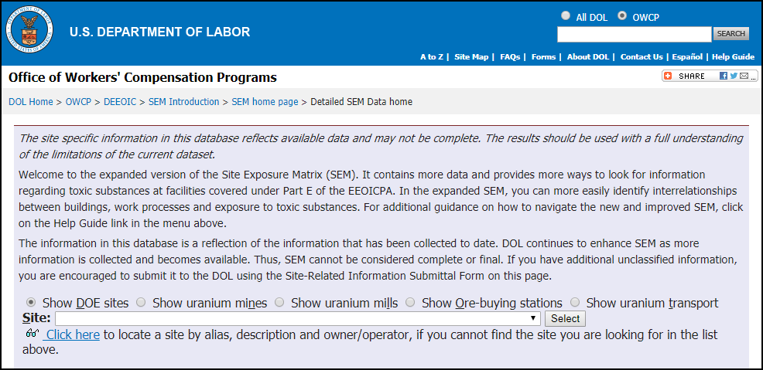
Site Exposure Matrices (SEM)
The SEM is a repository of information on toxic substances present at Department of Energy (DOE) and Radiation Exposure Compensation Act (RECA) sites covered under Part E.
Information in SEM is gathered from a variety of sources
Scientifically establishes links between toxic substances / illnesses
Training and Public access to SEM is available the DEEOIC website: https://www.dol.gov/owcp/energy/regs/compliance/seminfo.htm

Slide 13


Claimant Responsibilities
File claim
Collect / Copy / Submit relevant records for review
Respond to information requests

Slide 14
Claimant Assistance
Resource Centers – 11 locations nationwide
District Offices – 4 locations (Cleveland, Denver, Jacksonville, Seattle)
Seattle District Office toll free number: (888) 805-3401
DEEOIC web site
http://www.dol.gov/agencies/owcp/energy/
General program information
SEM website
Claimant Resources (Forms, Medical Benefits Information)
Medical Provider Resources (Enrollment, Bill Processing)

Slide 15

DOL Resource Centers
Manage Resource Center Operations
Guide Claimants through the EEOICPA Process
Comply with DOL Procedures
Maintain Highest Level of Customer Service
Claims Intake
Conduct Occupational History Interviews
Provide Medical Bill Payment Assistance
Maintain Databases
Conduct Outreach
Support DEEOIC Special Projects
Be Responsive to DEEOIC Guidance and Direction
Communicate Daily with DEEOIC Management
Ongoing Training for Staff

Slide 16
Claim Decision Process
Claim Intake
(Resource Centers/District Office)
Occupational History Questionnaire
Send employment verification request to DOE
Claim Development
(District Office)
Obtain medical evidence
Claimant’s burden
Diagnosis
Causation
Obtain employment info
DOE
Other sources
Affidavits

Slide 17
Claim Decision Process (cont.)
Exposure/Causation
Standards under Part E
Treating physicians not typically familiar with standards
Preparation of Statement of Accepted Facts (SOAF)
DEEOIC Assistance
Industrial Hygienist referrals
Contractors
Federal IH review
Extent of exposure
Contract Medical Consultants
Causation Assessment
Impairment
Wage loss
Medical diagnosis

Slide 18
Claim Decision Process (cont.)
Recommended Decision
(District Office)
Issue a Preliminary Determination
Provide claimant rights to object
Thorough discussion of facts in the case
Final Decision
(Final Adjudication Branch)
Affirm decision or remand
Claimant has right to object to RD through a Hearing or Review of the Written Record
Post FD Claimant rights:
Reconsideration
Reopen of case
District Court

Slide 19
Statutory Duties of the Board
Site Exposure Matrices
Medical guidance for claims examiners with respect to the weighing of the medical evidence of claimants
Evidentiary requirements for claims under subtitle B related to lung disease
The work of industrial hygienists & staff physicians and consulting physicians and reports of hygienists to ensure quality, objectivity, and consistency
The claims adjudication process generally, including review of procedure manual changes prior to incorporation into the manual & claims for medical benefits
Such other matters the Secretary considers appropriate

