Slide 1

Energy Employees Occupational
Illness Compensation Program
Program Overview - April 2016
Rachel P. Leiton
Director, Division of Energy Employees Occupational Illness Compensation

Slide 2
The EEOICPA
Administered by the Labor Department’s Division of Energy Employees Occupational Illness Compensation (DEEOIC)
Provides lump-sum compensation and medical benefits to current and former nuclear weapons workers
Survivors of qualified workers may also be entitled to benefits

Slide 3
Administration of the EEOICPA
Agencies:
  Department of Labor (DOL)
  Department of Energy (DOE)
  Department of Health and Human Services
    National Institute for Occupational Safety and Health (NIOSH)
  Department of Justice (DOJ)

Slide 4
Eligibility – Two Paths
Part B
(Enacted 2000)
Employment
Medical
Part E (Enacted 2004)
Employment
Medical
Survivors
Survivors

Slide 5
Employee Eligibility
Employed By | Part B | Part E
DOE Contractors and Subcontractors | Yes | Yes
DOE Federal Employees | Yes | No
AWE Employees | Yes | No
Beryllium Vendors | Yes | No
RECA | Yes | Yes
4

Slide 6
Eligibility – Medical
Part B
Cancer
Chronic Beryllium Disease
Chronic Silicosis
RECA Section 5 awardees
Part E
Any condition related to toxic substances
5

Slide 7
Eligibility – Survivors
Part B
Spouse
Adult Children
Grandchildren
Grandparents
Part E
Spouse (death related)
Children (<age 18, <age 23 if full time student, Medically incapable of self support)
6

Slide 8
Benefits
Part B | Part E
$150,000 Employee + Survivor | Impairment $2,500 per % (Employee)
$50,000 RECA Employee + Survivor | Wage Loss $10,000 -$15,000 per year (Employee)
 | $125,000 Survivor (+ lump-sum Wage Loss if eligible)
$400,000 CAP for B+E combined
7

Slide 9
Means of Verifying Employment
DOE – Earnings Records
Oak Ridge Institute for Science and Education (ORISE)
Corporate Verifiers
SSA Wage Data
Other Sources
  Affidavits
  Records/documents created by state/federal agencies
8
Notes:
8

Slide 10
Part B: Dose Reconstruction & Probability of Causation (PoC)
Part B Cancer Cases and Dose Reconstruction
  NIOSH
  Level and extent of occupational radiation dose
PoC
  Scientific calculation of likelihood that radiation exposure caused cancer
  NIOSH Computer System
  PoC - 50% or greater for award

Slide 11
Part B: Special Exposure Cohort (SEC)
Presumption of causation - cancer
Employment
  Covered in class defined by NIOSH
  Work day requirement – 250 work days
“Specified” Cancer
  22 cancers named in law
No need for dose reconstruction
10

Slide 12
Part B: Adding New SEC Classes
NIOSH designates new SEC classes
  4 statutory SEC classes; plus
  As of December 31, 2015, HHS has designated 115 additional SEC classes
DOL administers SEC cases
  No role in designation

Slide 13
Part E: Causation
Exposure to toxic substances
Causation standard different than under Part B
  Includes aggravation, contribution
DOL Tools:
  Occupational History Questionnaire (OHQ)
  Site Exposure Matrices (SEM)
  DAR records
  Former Worker Medical Screening Program (FWP) work history interviews
  Other Sources: Affidavits/facility records
12

Slide 14
Site Exposure Matrices (SEM) Website
Toxic substances present at DOE and RECA Section 5 Facilities
Information gathered from a variety of sources
Scientifically established links between certain toxic substances and certain illnesses
Available at http://192.104.4.234/

Slide 15
Part E: Employee Impairment
% permanent whole person impairment due to covered illness
AMA’s Guides to the Evaluation of Permanent Impairment, 5th Edition
$2,500 awarded for each % of impairment

Slide 16
Part E: Employee Wage Loss
Decreased capacity to work due to an accepted medical condition
Employee Compensation:
  Any year <50% of pre-disability annual wage = $15,000 compensation
  Any year > 50% but <75% of pre-disability annual wage = $10,000 compensation

Slide 17
Application – Claimant Responsibilities
File claim
Submit evidence
Respond to letters from DOL

Slide 18
DOL Responsibilities
Gather Evidence
Issue Recommended Decision
Respond to Objections
Issue Final Decision
Pay Benefits

Slide 19
Advocate Outreach (2009 – 2016)
5 In-person Meetings
  October 11, 2011
  November 8, 2012 (Training session hosted by NIOSH Ombudsman)
  February 20, 2014
  March 19, 2015
  March 30, 2016
4 Conference Calls
  2 in 2009
  2 in 2015 (Including listening session regarding proposed rulemaking under the EEOICPA)

Slide 20
Public Outreach (2010 – 2016)
80 Events Nationwide
  28 Events to inform the public about new SECs
  20 Joint Outreach Task Group (JOTG) events
  33 Events to inform claimants, providers & physicians general information about the Program and/or medical benefits covered under the Program

Slide 21
EEOICPA Compensation Nationwide
$12.4 Billion Total Compensation
$5.93 Billion Part B
$3.70 Billion Part E
$2.75 Billion Medical
Data as of April 10, 2016

Slide 22
Covered Facilities Website
https://ehss.energy.gov/Search/Facility/findfacility.aspx

Slide 23
Resources
11 Resource Centers Nationwide
4 District Offices Nationwide
DEEOIC Website
  www.dol.gov/owcp/energy/
  General program information
  Telephone & Fax Numbers
  SEM public website
  Forms
  Sample Decisions

Slide 24
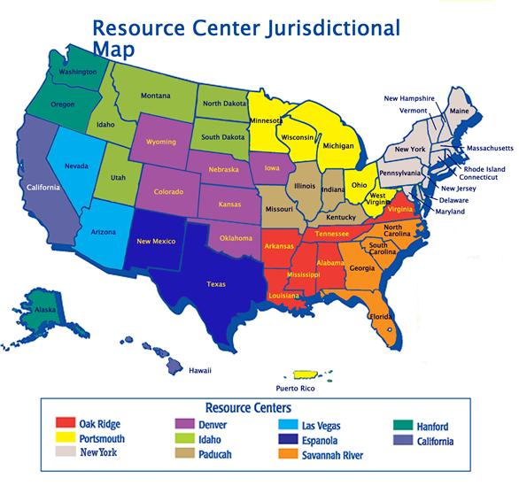

Slide 25
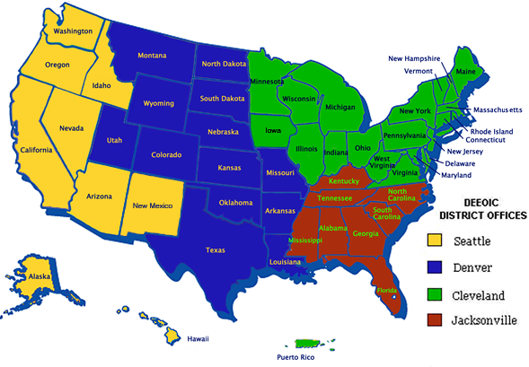
District Office Jurisdictional Map

Slide 26
The DEEOIC looks forward to working with you and welcomes your recommendations…..

