Slide 1
Advisory Board on Toxic Substances and Worker Health
Department of Labor
CMC Information and Recommendation
Steven Markowitz MD
ABTSWH Meeting
Oak Ridge, TN
May 8-9, 2024

Slide 2
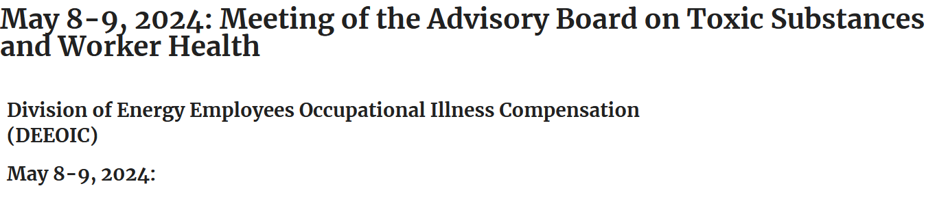
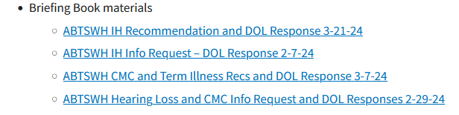

Slide 3
ABTSWH advises DOL re EEOICP on:
1. Site exposure matrices of the Department of Labor;
2. Medical guidance for claims examiners for claims under this subtitle with respect to the weighing of the medical evidence of claimants;
3. Evidentiary requirements for claims under subtitle B related to lung disease;
4. Work of industrial hygienists, staff physicians and consulting physicians of DOL and reports of such hygienists and physicians to ensure quality, objectivity, and consistency;
5. Claims adjudication process generally, including review of procedure manual changes prior to incorporation into the manual and claims for medical benefits; and
6. Such other matters as the Secretary considers appropriate.

Slide 4
DOL Contractor has 338 CMC’s actively under contract
32 specialties led by:
Occupational Medicine: #47
Oncology: #33
Ophthalmology: #20
97 CMC’s produced reports in 2022-2023

Slide 5
Type of CMC report, 2020-2023
(n= 8,860, or 2,215 per year)
Causation 6,798 (77%)
Impairment 1,202 (14%)
Diagnosis 820 (9%)
Other 40 (<1%)

Slide 6
Distribution of Reports by CMC
2020-2023
Causation (6,798 reports, 90 CMC’s)
Top 4 CMC’s > 500 reports each or 38% of all reports
Top 10 CMC’s >200 reports each or 63% of all reports

Slide 7
Distribution of Reports by CMC
2020-2023
Impairment (1,202 reports, 13 CMC’s)
1 CMC did 399 (33%) of all reports
4 CMC’s did > 100 reports each and 76% of all reports

Slide 8
DOL does not have data on CMC opinion outcome, i.e., causation (yes vs. no) for all CMC reports or by CMC
CE’s have asked for clarification in < 2% of CMC reports

Slide 9
ABTSWH CMC Recommendation, November 2023
Peer review to examine validity of quarterly sample of CMC reports
Peer review to be conducted by small panel of experts (causation, impairment)

Slide 10
DOL Response
(March 7, 2024 letter)
“committed to working with the Board to determine a process to review medical opinions”

Slide 11
DOL response: points
CMC’s are experts (board-certified); expected to produce accurate opinion
2. CE’s can judge whether medical reports
have “well-rationalized opinions”…
“offer a compelling justification”

Slide 12
DOL response: points
3. Given variation in legitimate medical
opinion, identifying “correct” opinion can
be challenging. How does expert panel
differentiate an incorrect versus normal
variant opinion?
4. DOL requests examples from Board
that a problem exists with CMC reports.

Slide 13
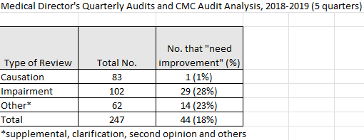
EEOICP Medical Director Quality Reviews, 2018-2019
(n= 50 per quarter)

Slide 14
Advisory Board on Toxic Substances and Worker Health
Department of Labor
Recommendation on Terminally Ill
Steven Markowitz MD
Jim Key
ABTSWH Meeting
Oak Ridge, TN
May 8-9, 2024

Slide 15
Appoint single point of contact at each claims office to expedite claims of terminally ill claimants

Slide 16
DOL Response
Current system works.
CE can designate claims for priority handling.
Claimant and AR can request to speak with supervisors.
48 hour turnaround on IH and CMC reports can be arranged.
Provide 3 examples (Feb-June 2023)

Slide 17
Old slides

Slide 18
Board Meeting, May 10-11, 2022
Board discussed new industrial hygiene
conclusions in EEOICP IH reports:
~“there is no evidence that claimant’s exposures exceeded regulatory standards”

Slide 19
Board Meeting June 29, 2022
Recommendation on IH Report Language:
The Board recommends that the Energy Employees Occupational Illness Compensation Program advise its staff and industrial hygiene contractor that claim-related industrial hygiene reports and opinions restrict comparisons of claimants’ exposures to toxic substances at Department of Energy facilities to regulatory workplace exposure standards only to cases where sufficient industrial hygiene data exist that are relevant to the claim and that support the comparisons.

Slide 20
Board Meeting June 29, 2022
Recommendation on IH Report Language:
Comparisons of exposures to regulatory standards must describe the available industrial hygiene data and the specific regulatory limit referenced, with preference for the most current standards.
In the absence of specific industrial hygiene evidence, comparisons of claimants’ workplace exposures to regulatory standards lack objective support and may be prejudicial to an appropriate resolution of the claim.

Slide 21
OWCP response – IH Report Language
DOL agrees to modify how Industrial Hygienist (IH) staff characterize toxic substance exposure to eliminate reference to exposures that occurred within regulatory standards. For all cases referred to DOL IHs, they will assign a characterization of exposure that must align to the levels that exist currently within program procedure. Toxic substance characterization will continue to be informed by the professional judgment of the IH including consideration of available employee-specific employment data. DOL will prepare a written policy directive relating to this change by the end of fiscal year 2022.

Slide 22
Board Meeting June 29, 2022
Board Feedback on DOL QA Documents:
The Board reviewed new or modified qualified assurance procedures developed by DOL EEOICP to evaluate aspects of the work of contract medical physicians (CMC) in developing reports in individual claims. These are not public documents, so the Board cannot discuss them in public.
Whether the CMC’s issue opinions that represent a faithful and accurate application of current medical literature in addition to the particular facts of the case remains a challenging task, which the Board is designated to address as part of its Charter.

Slide 23
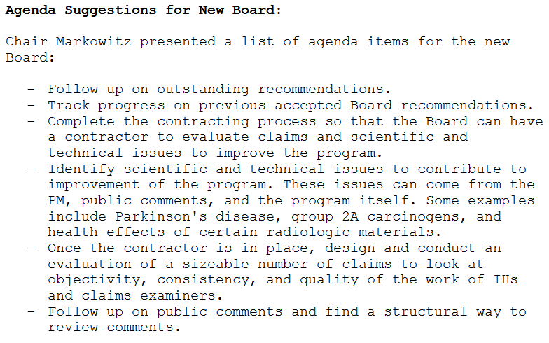
Minutes, ABTSWH Meeting, June 29, 2022

Slide 24
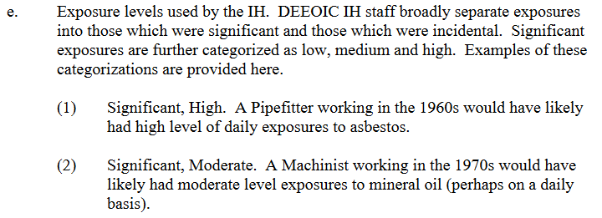
EEOICP PM 7.0, p. 124

Slide 25
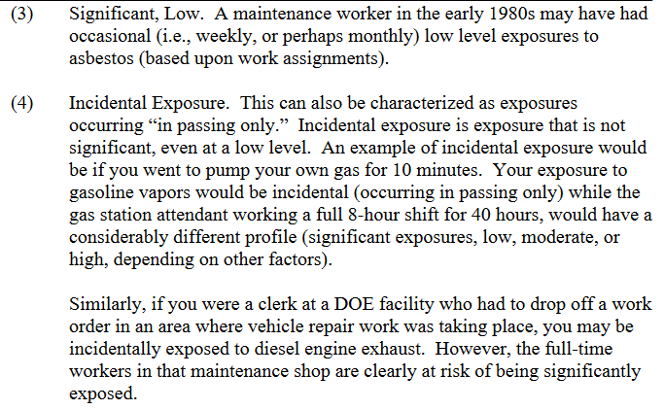
EEOICP PM 7.0, p. 125

Slide 26
Asbestos presumptions for mechanical, chemical and industrial safety engineers
How to resolve?
1. Examine mesothelioma claims?
2. Examine engineers’ claims for
asbestos-related diseases?

Slide 27
Thanks!

