Slide 1
Interacting causes in occupational causation analyses
ALT LAYOUT
Advisory Board on Toxic Substances and Worker Health
US Department of Labor, Office of Workers Compensation Programs
Presented at ABTSWH meeting in Oak Ridge, TN, May 8-9, 2024
George Friedman-Jimenez, MD, DrPH
Director, Bellevue/NYU Occupational & Environmental Medicine Clinic
Assistant Professor of Population Health, Medicine, Environmental Medicine
NYU Grossman School of Medicine
gf7@nyu.edu

Slide 2

Financial Disclosure
I have no conflict of interest in presenting
this material.

Slide 3
Outline of talk
Illustrate the challenge of 2 interacting causes with example of lung cancer, asbestos and smoking, the best understood example with the best data I could find.
Illustrate precedent of how we generally interpret and handle compensation of LC in asbestos worker who smokes
Propose an analogous approach to HL cases
Present example studies of HL, solvents and noise exposure
Conclusions
Next steps

Slide 4
  80 year old man, Mr. A.S., current 60 PY smoker with metastatic lung cancer LC
  10 year history of asbestos insulation work, ending 1973
  This case illustrates 2 potential causes of the LC and multiple possible causal mechanisms
What caused Lung Cancer in an asbestos worker who smoked cigarettes?

Slide 5
What does “Work-Related” mean?
OSHA Standard 1904.5
  “You must consider an injury or illness to be work-related if an event or exposure in the work environment either caused or contributed to the resulting condition or significantly aggravated a pre-existing injury or illness.”
    Caused
    Contributed to
    Aggravated

Slide 6
What is a Cause?
Necessary Cause
  is a condition under which, if absent, the disease cannot occur
  Also known as a “sine qua non” cause or a “but for” cause
Sufficient Cause
  is a condition under which, if present, the outcome will inevitably occur
  These are Deterministic definitions of cause, not probabilistic

Slide 7
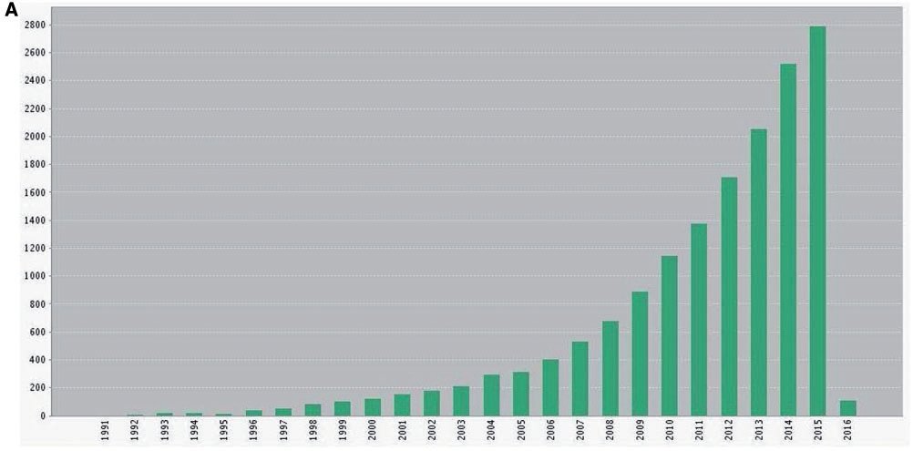
Number of published articles on causal inference in epidemiology, 1990-2015
  (Source: Krieger & Davey Smith, 2016)

Slide 8
Necessary and Sufficient Causes
  Neither concept works well as a standalone definition for causation analyses of single causes
      Many counterexamples for which they do not align with evidence
  Both concepts can be useful in understanding mechanisms of multiple contributing causes

Slide 9
Examples of known causes of specific diseases that are neither Necessary nor Sufficient
  Asbestos exposure can cause Mesothelioma
  In absence of asbestos exposure, mesothelioma can still occur
  Among all individuals with asbestos exposure, mesothelioma does not inevitably occur
  Hepatitis B carrier state can cause Hepatocellular Carcinoma
  In absence of HBV carrier state, HCC can still occur
  Many Hepatitis B carriers do not get hepatocellular carcinoma
  Smoking can cause Lung Cancer
  10-15% of people with lung cancer never smoked
  80-90% of smokers do not get lung cancer

Slide 10
Rothman (1976) proposed use of necessary and sufficient causes as Sufficient Component Causes in epidemiology
    INUS: A is a cause of B if A is an Insufficient but Necessary part of a condition that is itself Unnecessary but Sufficient for B (Mackie, 1965)
    NESS condition: A is a cause of B if A is a Necessary Element of a Sufficient Set of component causes of B (Wright 1985)
    The Sufficient Component Causes model fits well with OSHA Standard 1904.5 definition of work-related disease
      Accomodates mutually exclusive causes, contributing causes and aggravating exposures

Slide 11
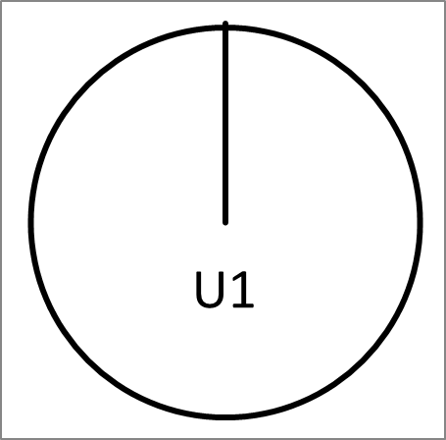
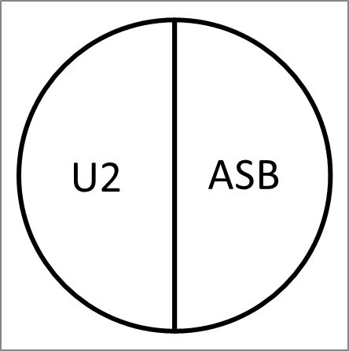
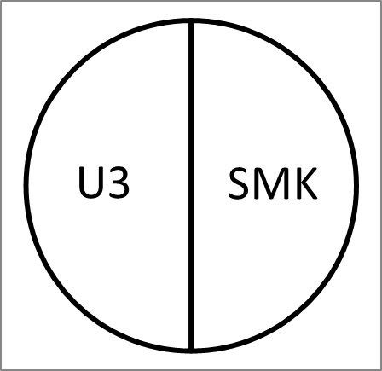
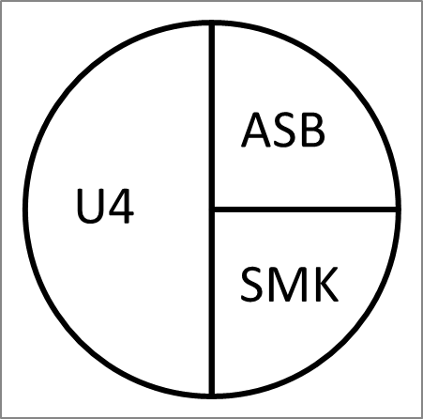
Rothman (1976) “Pie Model” of Sufficient Causes
SC1
SC2
SC3
SC4
In the simplest possible model, Mr. A.S. could have gotten LC by any one of 4 different, mutually exclusive Sufficient Causes SC1, SC2, SC3 or SC4
      Each SC is a sufficient set of Component Causes that, if and when it is completed, inevitably causes LC in Mr. A.S.
      Each SC includes all it’s necessary Component Causes; if any one of them is absent that particular SC mechanism could not have occurred
      Sufficient causes SC1, SC2, SC3 and SC4 are competing (mutually exclusive) causes, only one actually causes the LC before the others are completed

Slide 12
Rothman (1976) “Pie Model” of Sufficient Component Causes
SC1
U1 = Unmeasured set of genetic, epigenetic, temporal and environmental Component Causes sufficient to cause LC in Mr. A.S.
Mr A.S.’s LC could have been caused by SC1, a set of unmeasured factors U1 which cause LC without involving ASB or SMK

Slide 13
Rothman (1976) “Pie Model” of Sufficient Component Causes
SC2
SC2 is a different sufficient cause for which both Component Cause ASB and Component Causes U2 are necessary
U2 is different from U1, but also does not include SMK or ASB
ASB and U2 are each a Necessary Element of the Sufficient Set SC2 (NESS)

Slide 14
Rothman (1976) “Pie Model” of Sufficient Component Causes
SC3
SMK and U3 are the necessary elements of sufficient set SC3
U3 may include factors such as:
    RAS oncogene or other genetic factors
    Downregulation of tumor suppressor microRNA let-7 that targets RAS oncogene, or other epigenetic factors
    Adequate latency period for clinical manifestation of the LC has been completed

Slide 15
Rothman (1976) “Pie Model” of Sufficient Component Causes
SC4
SC4 requires both ASB and SMK as necessary Component Causes, plus unmeasured Component Causes U4
For example, an SC4 mechanism might involve ASB damaging pulmonary macrophages, which then lose their ability to eliminate carcinogens from SMK
      ASB, SMK and U4 are necessary elements of the sufficient set SC4

Slide 16
Rothman (1976) “Pie Model” of Sufficient Component Causes
SC1
SC2
SC3
SC4
Mr. A.S.’s LC could have been caused by SC4 or SC3 or SC2 or SC1
A particular SC can be completely prevented by preventing just one of its Component Causes (one necessary element)
SC3 and SC4 would both be prevented by preventing SMK
SC2 and SC4 would both be prevented by preventing ASB

Slide 17
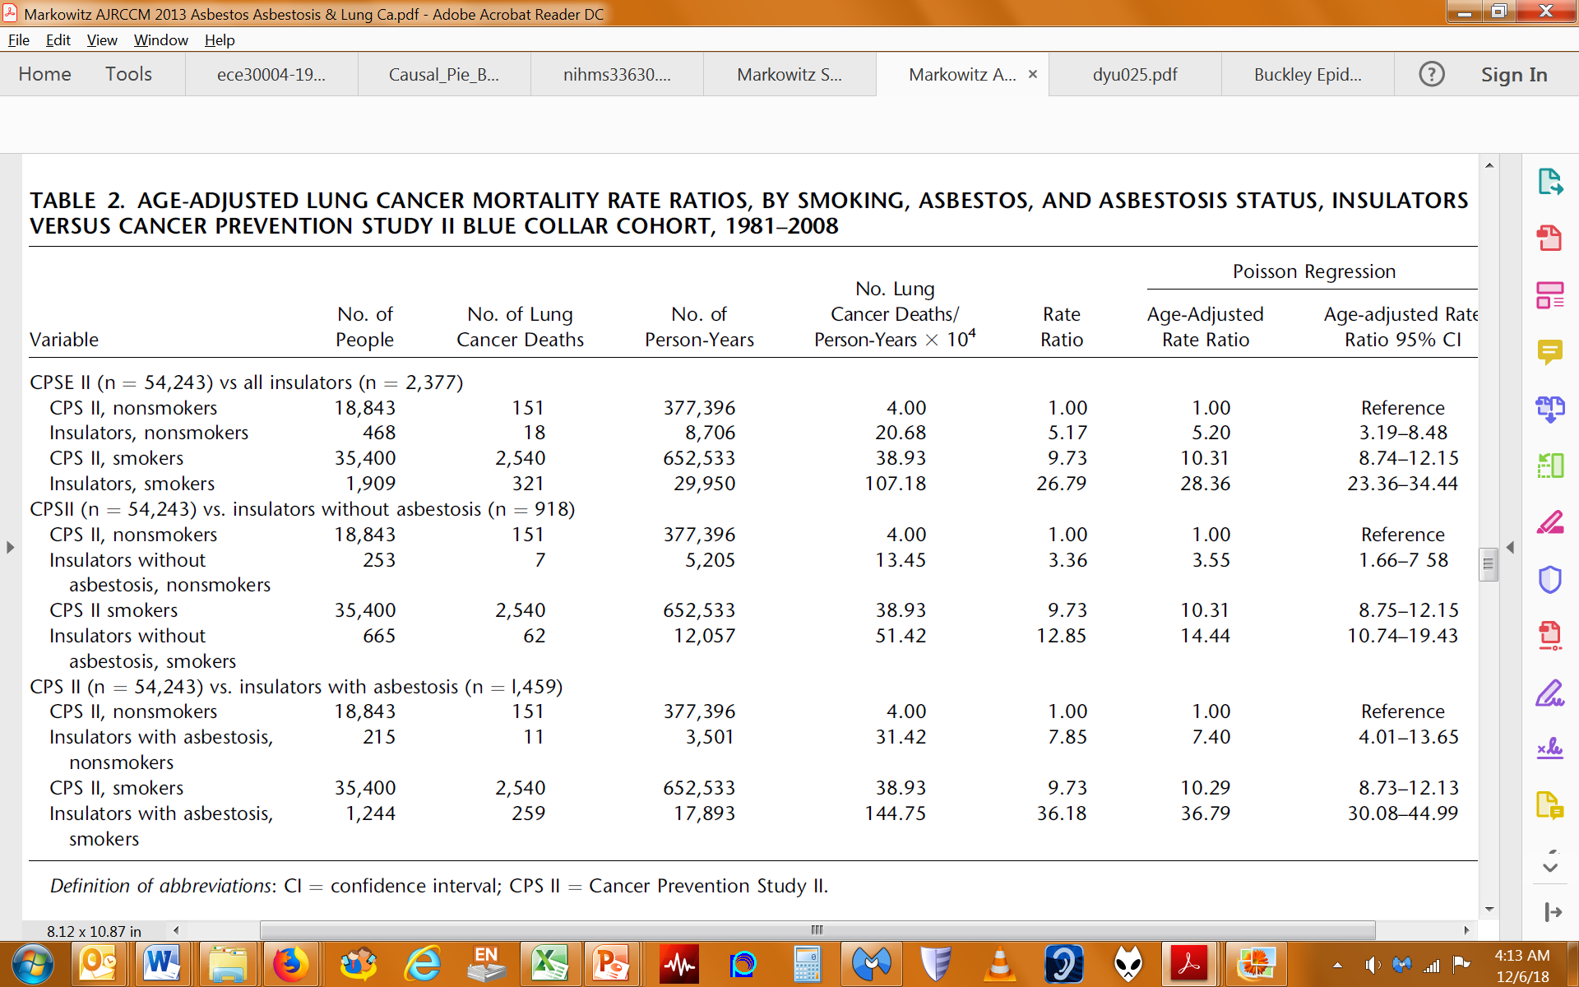
Asbestos, Smoking, and Lung Cancer, Insulators vs Blue Collar Cohort (Markowitz 2013)

Slide 18
Asbestos, Smoking, and Lung Cancer, Insulators vs Blue Collar Cohort (Markowitz 2013)

Slide 19
Lung Cancers (LC) by ASB and SMK exposure (Markowitz, 2013)
Exposure Grp => | NoASB NoSMK | ASB only | SMK only | BOTH ASB+SMK
N | 18,843 | 468 | 35,400 | 1,909
LC cases | 151 | 18 | 2,540 | 321
Person-Yrs (PY) | 377,396 | 8,706 | 652,533 | 29,950

Slide 20
Lung Cancers (LC) by ASB and SMK exposure (Markowitz, 2013)
Exp Grp => | NoASB NoSMK | ASB only | SMK only | BOTH ASB+SMK
N | 18,843 | 468 | 35,400 | 1,909
LC cases | 151 | 18 | 2,540 | 321
Person-Yrs (PY) | 377,396 | 8,706 | 652,533 | 29,950
LC cases /10⁴ PY | 4 (ie 0.0004) | 21 | 39 | 107

Slide 21
Lung Cancers (LC) by ASB and SMK exposure (Markowitz, 2013)
Exp Grp => | NoASB NoSMK | ASB only | SMK only | BOTH ASB+SMK
N | 18,843 | 468 | 35,400 | 1,909
LC cases | 151 | 18 | 2,540 | 321
Person-Yrs (PY) | 377,396 | 8,706 | 652,533 | 29,950
LC cases /10⁴ PY | 4 (SC1) | 21 (SC1+SC2) | 39 (SC1 + SC3) | 107 (SC1 + SC2 + SC3 + SC4)
SC Grp / 10⁴ PY | 4 SC1 | 17 SC2 | 35 SC3 | 51 SC4

Slide 22
SC status in each of the exposure groups
The SC numbers are approximate because the 4 groups were derived from 2 different cohorts and are not mutually adjusted for differences in distributions of age and other LC risk factors

Slide 23
Lung Cancers (LC) by ASB and SMK exposure (Markowitz, 2013)
Exp Grp => | NoASB NoSMK | ASB only | SMK only | BOTH ASB+SMK
N | 18,843 | 468 | 35,400 | 1,909
LC cases | 151 | 18 | 2,540 | 321
Person-Yrs (PY) | 377,396 | 8,706 | 652,533 | 29,950
LC cases /10⁴ PY | 4 (SC1) | 21 (SC1+SC2) | 39 (SC1 + SC3) | 107 (SC1 + SC2 + SC3 + SC4)
SC Grp / 10⁴ PY | 4 SC1 | 17 SC2 | 35 SC3 | 51 SC4
If ASB eliminated | 4 | 0 | 35 | 0

Slide 24
Compensation of LC in claimants with ASB exposure
Generally these cases are compensable in both smokers and nonsmokers
The Lung Cancer RR for asbestos among smokers or among nonsmokers (as appropriate) is used to support the claim.
RR for ASB among nonsmokers = 5.2 / 1 = 5.2
RR for ASB among smokers = 28.36 / 10.31 = 2.75
The same causation standard,”more likely than not that the LC was causally related to the ASB exposure” is applied to each claimant, whether smoker or not
Similar logic applies to other known or unknown non-occupational contributing causes of LC including genetic factors, age, gender

Slide 25
Presumption of work-related hearing loss requires meeting 2 criteria in Procedure Manual 8.0
Potential exposure to one or more of a list of 10 qualifying toxic substances for at least 10 consecutive years of verified employment in a specified list of qualifying jobs or “equivalent” as determined by an IH opinion AND
IH opinion that claimant also had concurrent daily exposure to noise above 85 decibels for those same 10 years
If 1 and 2 are not both met, claimant is required to “produce epidemiological evidence that specifically identifies or references a toxic substance, as defined by DEEOIC’s regulations, which the evidence describes as having a health effect of bilateral sensorineural hearing loss”

Slide 26
Should we use a similar approach for hearing loss that could be caused by solvents, noise or both?

Slide 27
OR for hearing loss and co-exposure to noise and workplace chemicals, adjusted for age and gender (Sliwinska-Kowalska, 2005)

Slide 28
Hearing Loss (HL) ORs for solvent exposure among non-noise exposed and noise exposed workers (Sliwinska-Kowalska, 2005)
Non-noise exposed
OR Styrene = 5.2 / 1 = 5.2
OR Styrene+Toluene = 13.1 / 1 = 13.1
Noise exposed
OR Styrene = 10.9 / 3.3 = 3.3
OR styrene+toluene = 21.5 / 3.3 = 6.5

Slide 29
Hearing Loss (HL) ORs for solvent exposure among non-noise exposed and noise exposed aviation workers (Kim, 2005)
Non-noise exposed
OR Mixed solvents = 2.6 / 1 = 2.6
Noise exposed
OR Mixed solvents = 8.12 / 4.28 = 1.9

Slide 30
Hearing Loss (HL) ORs, organic solvent and noise exposure among tire factory workers (Saraei, 2022)
Non-noise exposed
OR organic solvents = 1.86 / 1 = 1.86 (Not statistically significant)
Noise exposed
OR organic solvents = 11.72 / 4.49 = 2.6

Slide 31
Conclusions
At least these several studies in this preliminary literature review suggest that solvents can cause hearing loss both among noise-exposed and non-noise exposed workers
When there may be a non-occupational second causal exposure interacting with the occupational exposure under consideration, there is a precedent for how to approach the causation analysis:
    Use the RR for the occupational exposure among those with the second exposure for the causation standard without requiring that the second exposure occur in the workplace
OSHA standard 1904.5 definition of work-related disease fits well with current scientific understanding of causation

Slide 32
Next steps
The Hearing Loss WG is undertaking a proper literature review
    Among workers exposed to loud noise, does solvent exposure cause hearing loss?
Other relevant questions to investigate include
    Is there a threshold for duration of exposure needed for causation?
    Does the loud noise need to be concurrent with the solvent exposure?
Consider a Board recommendation to update PM if warranted

Slide 33

Thank you

