Slide 1
Alliance of Nuclear Worker Advocacy Groups
Presentation to National Academy of Sciences Institute of Medicine
January 23, 2012

Slide 2
ANWAG’S COMMENT ON INTERIM FINAL RULES
Develop a matrix of toxic substances (DOE workers were known to have had exposures
to) and all the diseases and /or conditions these toxins were known to aggravate,
contribute to or cause. Verification of these toxic substances on site should be developed
through the occupational histories already submitted by claimants or by DOE's
contribution to the claim, or by other means such as purchase orders for these toxins,
DOE “Tiger Team Reports”, and DOE Independent Investigation Health and Safety
Reports, all other federal and state monitoring agencies.
A disease list should use the MSDS of each toxic substance, medical literature, federal
monitoring agency reports and any other credible source of information. If an agency or
credible medical study shows that a toxic exposure aggravated, contributed to or caused
a disease it needs to be listed in the matrix. Waiting for a consensus between agencies or
the medical community will conflict with Congressional intent for timely compensation.
Each toxic substance should be listed with the maximum exposure effects, as monitoring
these substances was either limited or non-existent. Many of these substances have
since been banned from the work place, due to their dangerous health effects. MSDS
recommendations were not always followed. For example, TCE (trichloroethylene),
now banned was recommended as a coolant for machine tooling and diluted according to
MSDS. However, it was often used undiluted to degrease parts. Consequently, assuming
maximum concentration will be claimant friendly.
EEOICPA has adopted the policy that each worker at a facility where beryllium was
present had the potential of exposure because of dust, vapor or liquid dispersion. This
policy was developed because office workers, etc. have been diagnosed with Chronic
Beryllium Disease, in addition to the trades that worked with the metal. It has therefore
been assumed that winds and water supplies as well as workers carrying the beryllium on
the clothes and in their hair exposed the entire facility. The same policy should be used to
assume that all workers had the potential exposure to other toxins.
Anything less than an all inclusive matrix applied by well trained claims examiners
familiar with using such a matrix would not comply with the Department of Labor’s
intent for this to be a claimant-friendly program.

Slide 3
What the law says
§ 7385s-4. Determinations regarding contraction of covered illnesses
(c) OTHER CASES.—(1) In any other case, a Department of Energy contractor employee shall be determined for purposes of this part to have contracted a covered illness through exposure at a Department of Energy facility if—
(A) it is at least as likely as not that exposure to a toxic substance at a Department of Energy facility was a significant factor in aggravating, contributing to, or causing the illness; and
(B) it is at least as likely as not that the exposure to such toxic substance was related to employment at a Department of Energy facility.

Slide 4
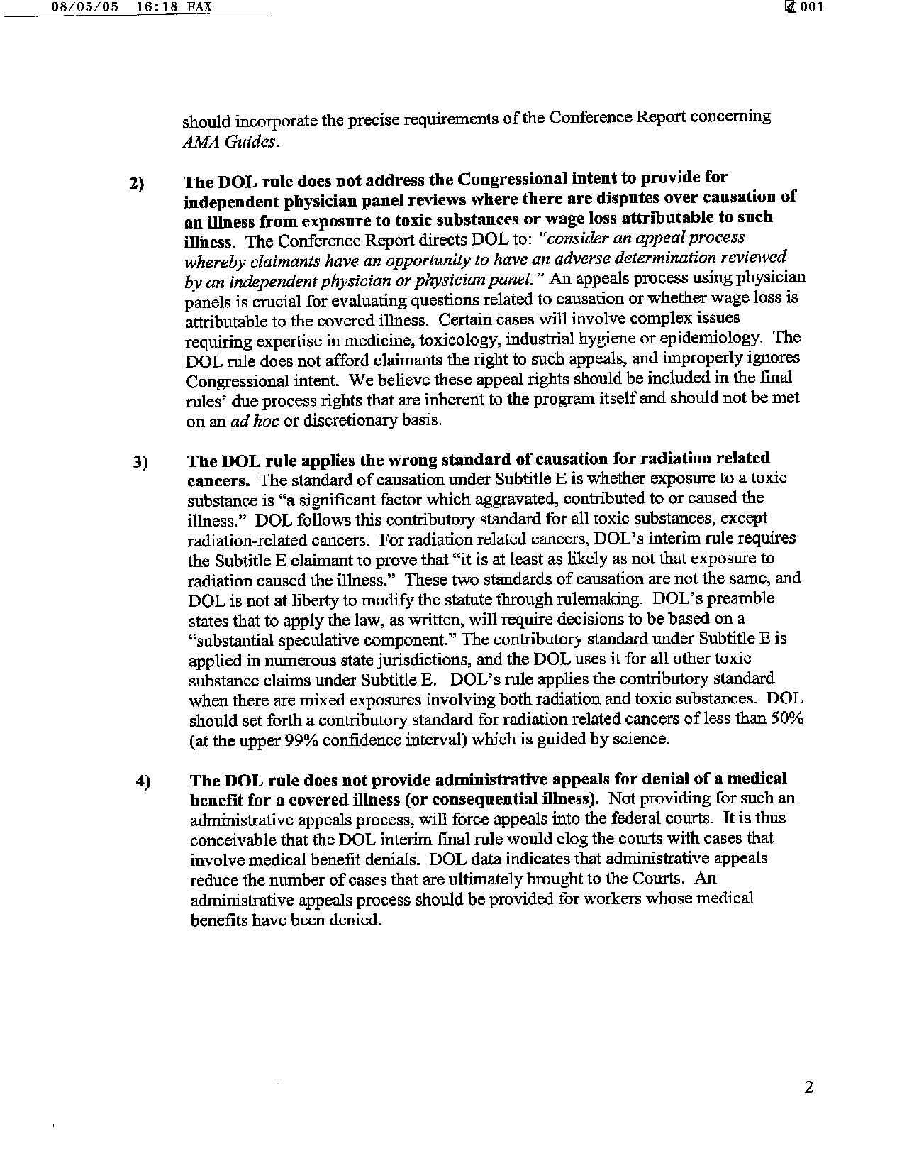

Slide 5
http://www.sem.dol.gov/Dis.cfm
Stomach cancer (also known as Cancer of stomach; Gastric cancer; Gastric neoplasms) Toxic substances with an established causal link to the diagnosed illness as accepted by NLM (Note: EEOICPA evaluates toxic substance exposure that was a significant factor in aggravating or contributing to employee illness or death and is done on a case-by-case basis.):
No toxic substances in the SEM database show an established causal link to the selected occupational disease at this time.

Slide 6
http://www.atsdr.cdc.gov/COM/cancer-fs.html
Human Carcinogenic Agent
Organ | Known | Suspected
Lung | Arsenic Asbestos Benzo(a)pyrene bis(Chloromethyl)ether Chromium Nickel subsulfide Zinc chromate Tobacco smoking Mustard gas Uranium | Acrylonitrile Beryllium Cadmium 1,2-Dibromo-3-chloropropane Polyclic aromatic hydrocarbons (PAHs)
Kidney | Coke oven emissions Zinc chromate | Tetrachloroethylene
Bladder | Benzidine Tetrachloroethylene Cyclophosphamide 4-Aminodiphenyl Tobacco smoking Chloraphazine | Tetrachloroethylene
Stomach | Zinc chromate | Ethylene oxide
Skin | Arsenic Benzo(a)pyrene Overexposure to the sun | PAHs Tetrachloroethylene
Liver | Vinyl chloride Aflatoxin Alcoholic drinks
Mouth, pharynx, larynx, esophagus | Alcoholic drinks Tobacco smoking Tobacco chewing (mouth only) Mustard gas (larynx)
Prostate | Cadmium

Slide 8
http://monographs.iarc.fr/ENG/Monographs/vol87/mono87-7.pdf
Inorganic and organic lead compounds
2.1.3 Lead chromate pigment production
Workers producing lead chromate pigments have been the subject of two cohort
studies focused on possible lung carcinogenicity resulting from exposure to hexavalent chromium, which was classified as Group 1 human carcinogen by IARC (IARC, 1990).
[It is not possible to separate the effects of chromium on the lung from those of lead in these studies, limiting their usefulness in the evaluation of the carcinogenicity of lead.]
Sheffet et al. (1982) studied mortality among 1296 white and 650 non-white men in a pigment plant producing lead and zinc chromates in the USA who were employed for at least 1 month between 1940 and 1969, and followed through 31 March 1979. Moderate exposure was defined as work in jobs with an average exposure of 0.5–2 mg/m3 airborne chromium, while high exposure was defined as > 2 mg/m3 airborne chromium; 76% of the cohort had high or moderate exposure. A statistically significant relative risk of 1.6 (95% CI, 1.1–2.2; 31 deaths) for lung cancer was found among male employees, increasing to a significant 1.9 for those exposed for at least 2 years to moderate or high
exposure. Stomach cancer had a SMR of 2.0 (95% CI, 0.9–3.6; 8 deaths). SMRs varied depending on whether or not those decedents with cause of death unknown (15%) were excluded from the observed count of lung cancers or added in proportion corresponding to the distribution of observed deaths with known causes. [SMRs for other cancers were calculated, but numbers were small and there were no significant findings.]

Slide 9
Cancer Mortality in pigment plant utilizing lead and zinc chromates
1982 Jan-Feb;37(1):44-52.
Several studies of workers exposed to various forms of chromium compounds have suggested an increased incidence of respiratory cancers. Lead and zinc chromates were among the chromium compounds implicated. The Department of Preventive Medicine and Community Health of the New Jersey Medical School undertook a detailed mortality study of a pigment plant in Newark which utilized both of these compounds. We compared observed deaths from each cause among 1296 white and 650 non-white males who were employed at the plant between January 1, 1940 and December 31, 1969, with expected deaths, as computed from cause-, age-, and time-specific standard death rates for the United States. A statistically significant relative risk of 1.6 for lung cancer among white male employees was found, as well as among the cohorts of white males employed 10 yr or more. A relative risk of 1.9 was noted for individuals employed at least 2 yr who were at least moderately exposed to chromates. An increased incidence of lung cancer among non-white males and stomach and pancreatic cancer among the total cohort was also evident

Slide 10
Why Haz-Map is inappropriate to use for EEOICPA
1 - For a toxicologist – Haz-Map has no value. Animal studies are not considered.
2 - For an epidemiologist – Haz-Map has no value. It is too selective (only depends on causation), not sensitive enough to contributing or aggravating a disease.
3 - For an evidence-based review – Haz-map does not follow the established rules of weighing evidence as outlined by IOM, https://download.nap.edu/catalog.php?record_id=13059; there is no protocol, no peer review, no grading of evidence or grading of conclusion
4 - For an occupational physician – Haz-Map does not include combinations of chemical exposure, nor does it consider the pre-existing risk of exposure to ionizing radiation or pre-existing medical conditions.
5 – For the program – Haz-Map disposes of too many cases that may have merit because only an expert can judge merit of these very complex cases.

