Slide 1
ELECTRONIC FORMS SYSTEM (EFS)
Guide to
Using EFS Preparing Form LM-1

Slide 2
ELECTRONIC FORMS SYSTEM (EFS) LM-1
EFS is a web-based system for completing and filing Form LM-1 Labor Organization Information Report.
This tutorial demonstrates basic features and functionality of the EFS LM-1 form. It does not contain instructions for what information should be provided on your report.
You can download a complete set of LM-1 Instructions
from the OLMS website.

Slide 3
System Requirements and Settings
To access and use EFS, OLMS recommends that you use one of the following browsers:
  Microsoft Internet Explorer – Version 11.0 or higher
  Google Chrome –Version 7.0 or higher
  Mozilla Firefox
Screen Resolution:
For optimal viewing, set your screen resolution to 1280 x 1024 or
greater. It is recommended that, at a minimum, you set your screen
Resolution to 1152 x 864 to avoid horizontal scrolling.

Slide 4
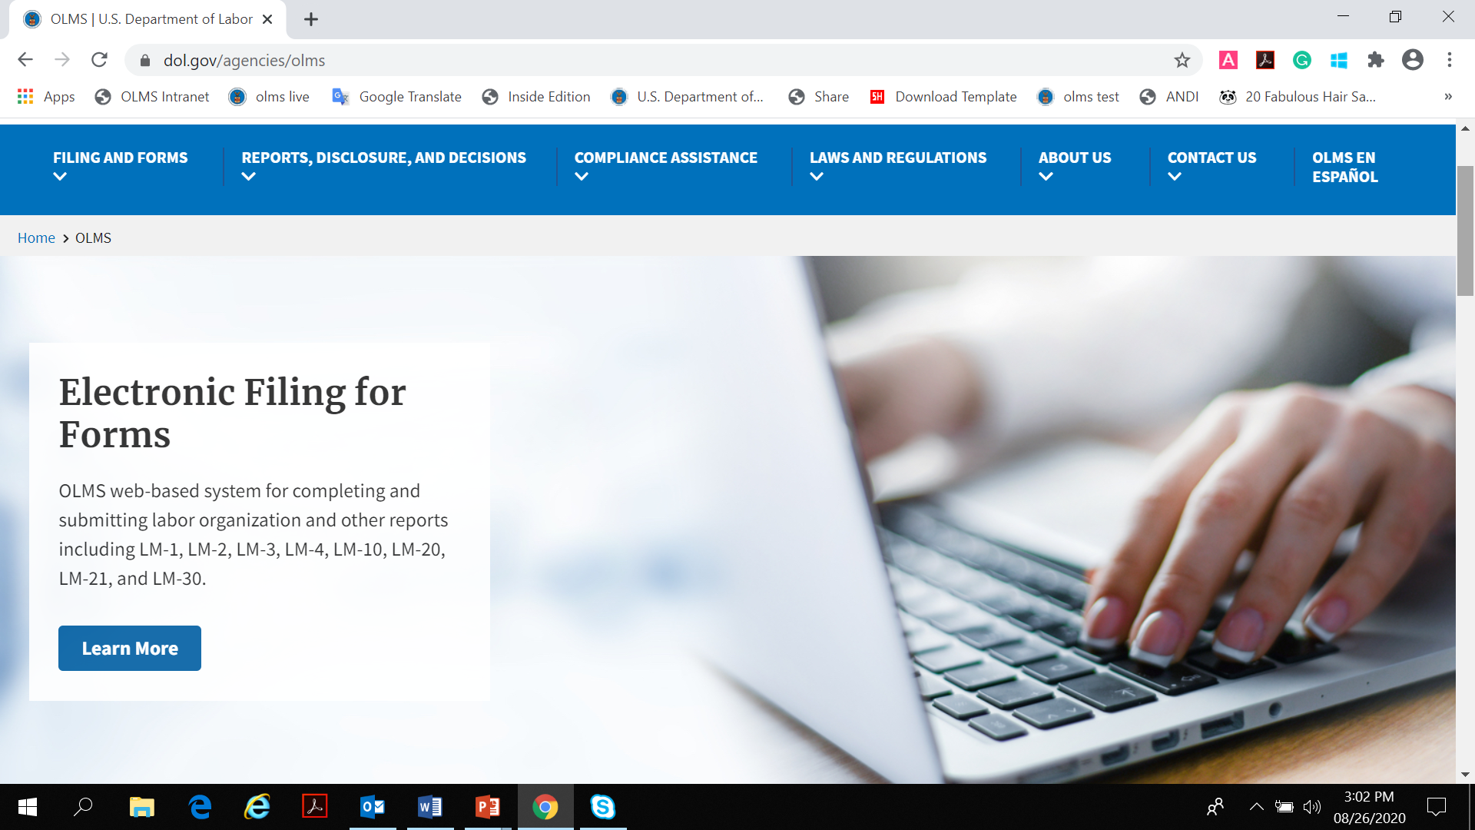
Accessing the System
Navigate to the OLMS Website and select FILING & FORMS, then from the drop down menu, select the “Electronic Filing System”

Slide 5
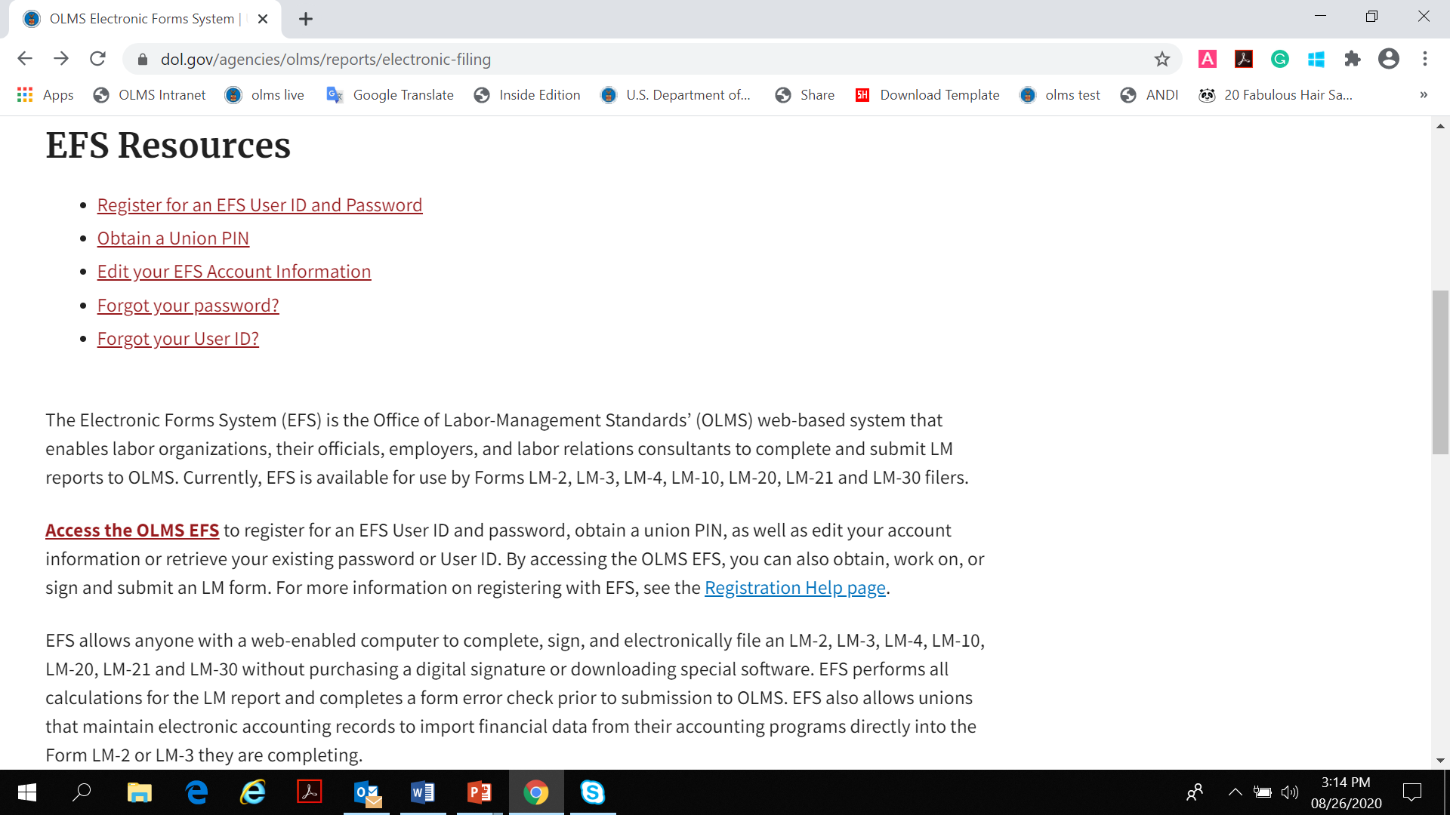
Accessing the System
From the EFS Introduction page, select on the “Access the OLMS EFS” link.

Slide 6
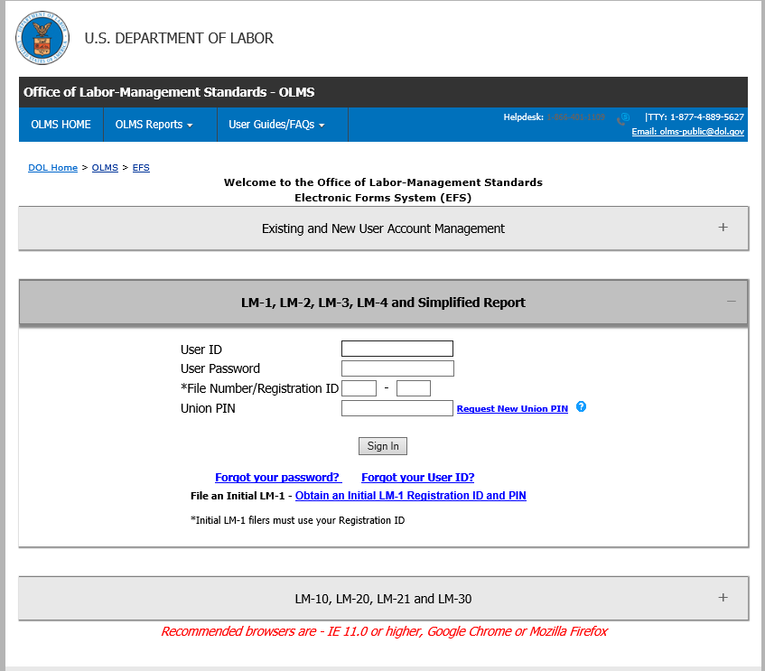
Access Form LM-1 in EFS
To access the Form LM-1 in EFS, you must first register with EFS and obtain a Registration ID and PIN

Slide 7
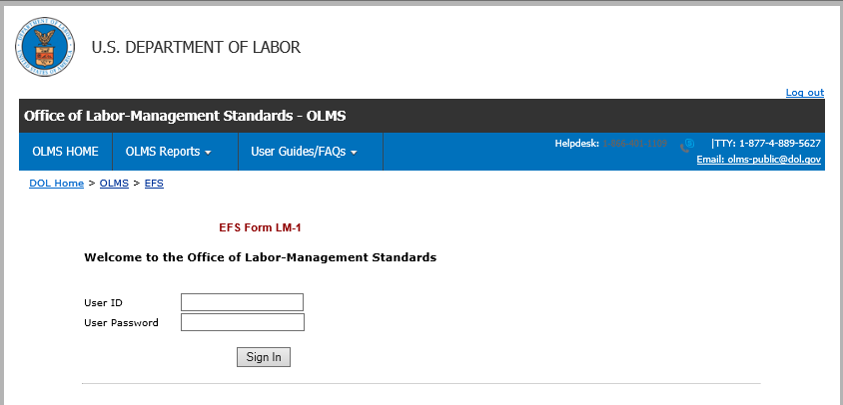
Initial LM-1 Registration ID and PIN
Clicking the “Obtain an Initial LM-1 Registration ID and PIN” link will open this page.
Only a filer (a user who is authorized to sign the form) will have access to use this page.

Slide 8
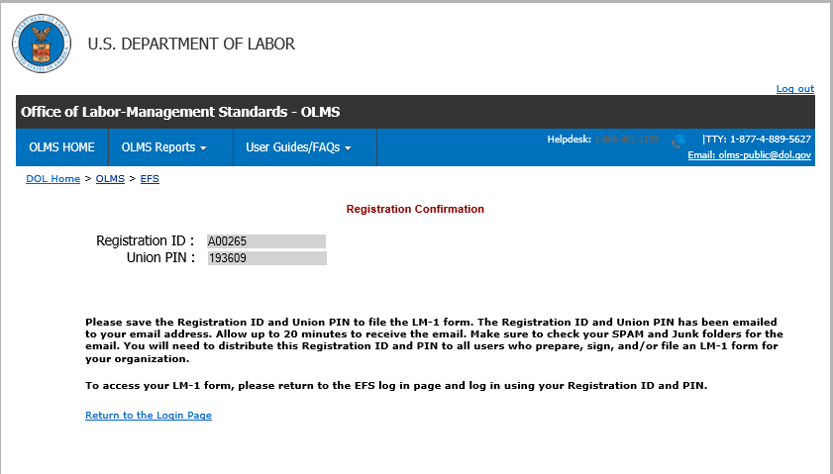
Create Registration ID and PIN
Login using his/her EFS account will generate a new Registration ID and PIN. The user will see this confirmation message on the screen and also will receive an email.

Slide 9
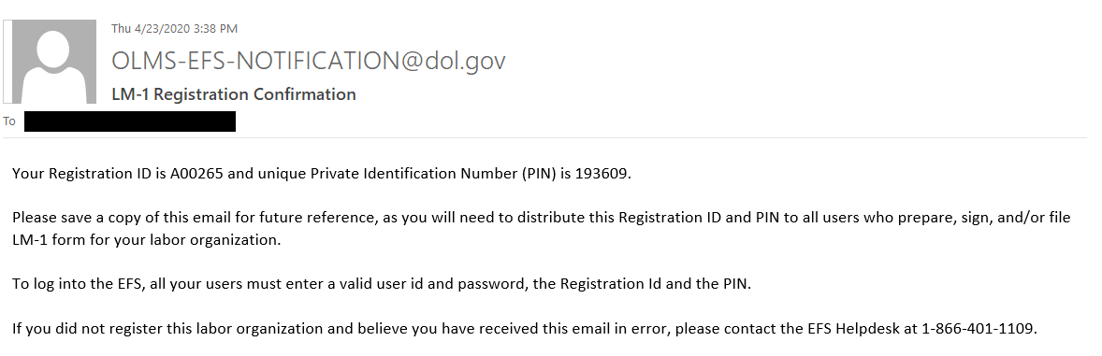
Confirmation Page

Slide 10
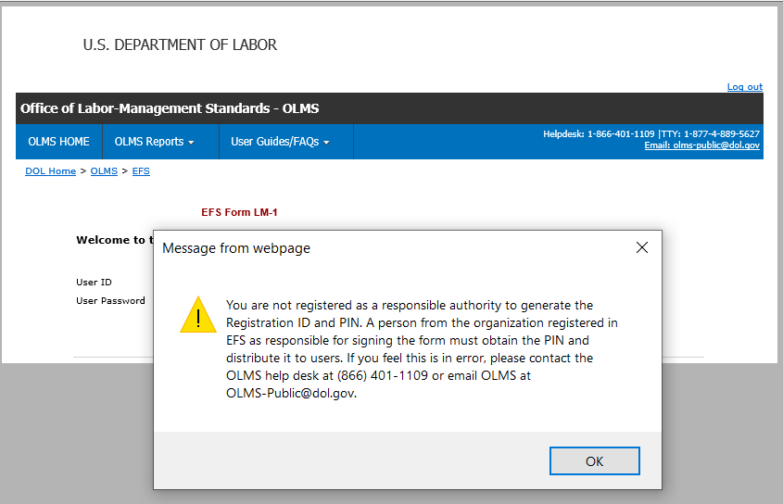
Unauthorized Users
If a form preparer (a user who is NOT authorized to sign the form) tries to generate the Registration ID and PIN the system will display this message. .

Slide 11
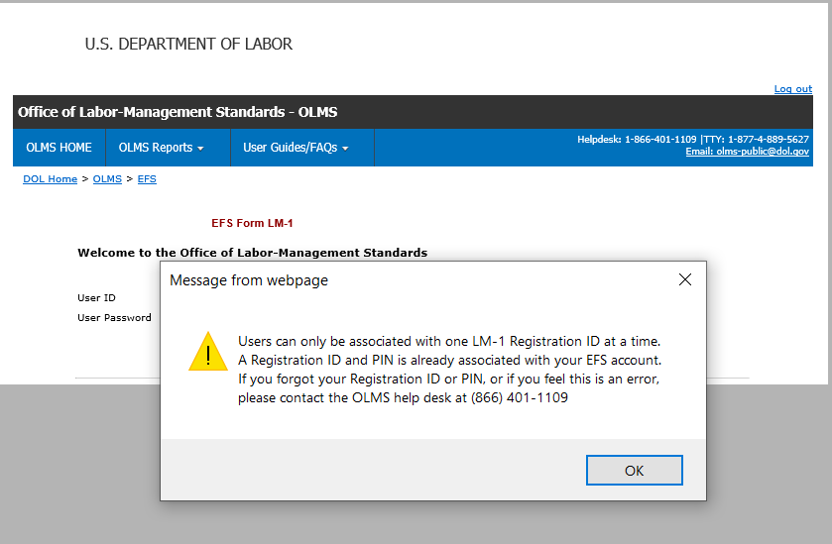
Getting Help Within the Form
A filer is not allowed to generate another Registration ID until the LM-1 form in progress is signed and submitted.
If the filer tries to generate another Registration ID while an LM-1 is in progress this message will be displayed

Slide 12
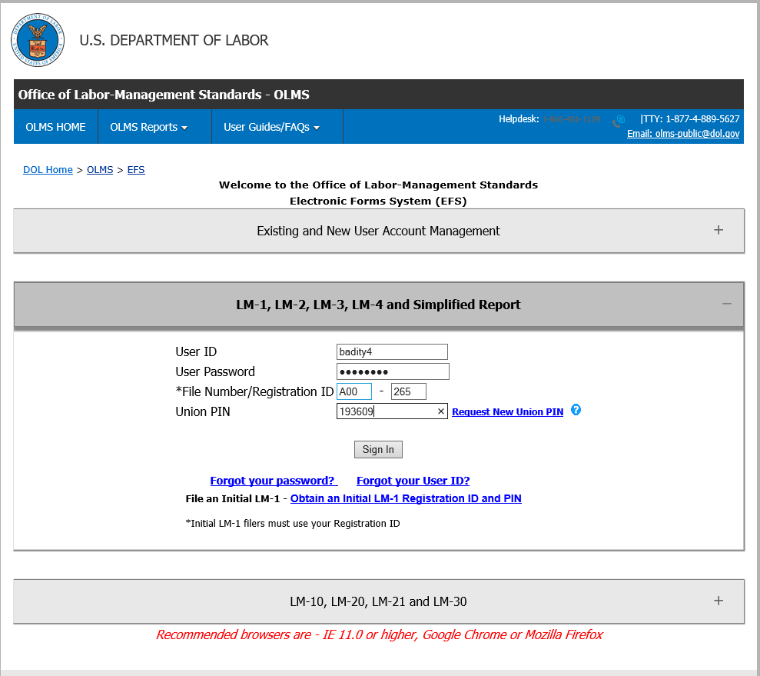
Accessing the LM-1
To access an LM-1 form, the filer or a preparer needs their user account, registration ID, and PIN.

Slide 13
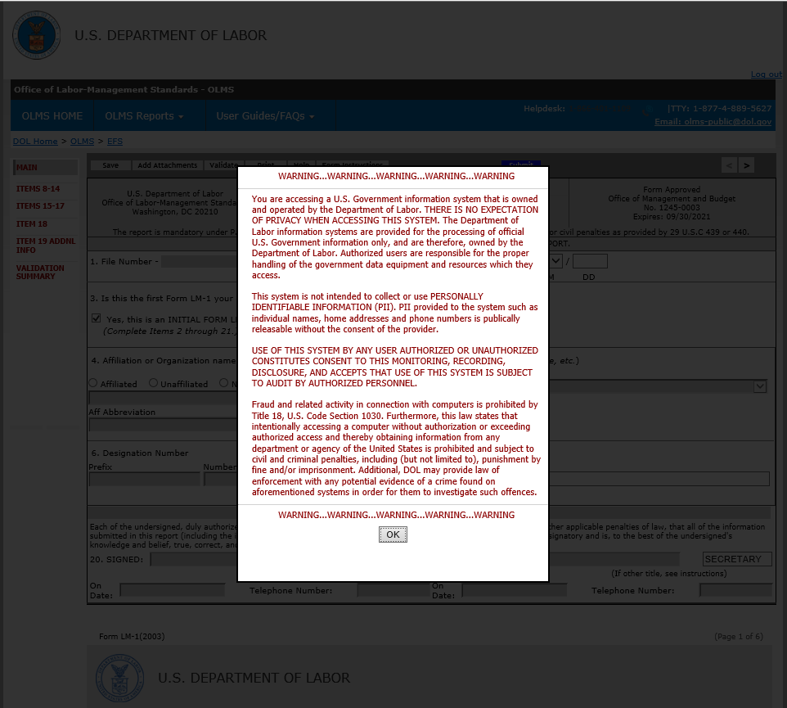
Login Granted
A successful login will navigate the user to the LM-1 form.

Slide 14
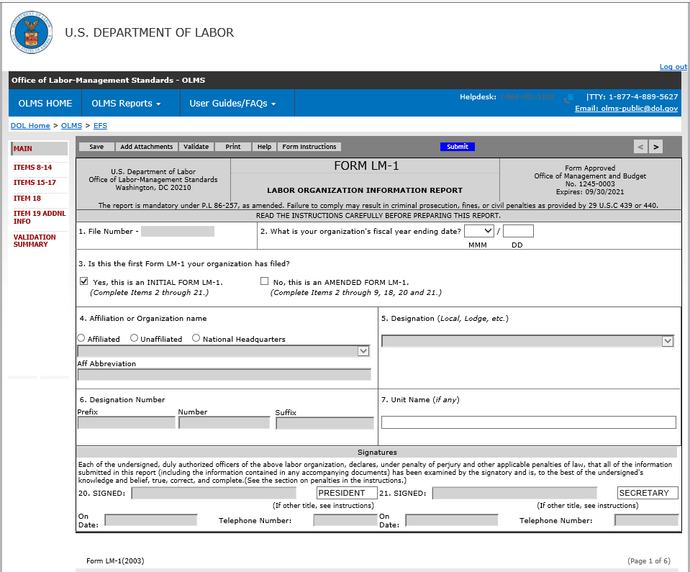
Entering Data
Item 1 - will be disabled for the data entry. When the form is successfully signed and submitted, the filer will receive the File Number.
Item 2 – month and day must be selected.
Item 3 – The item will be checked by the system.
Item 4 – The filer must select one of the three options listed.

Slide 15
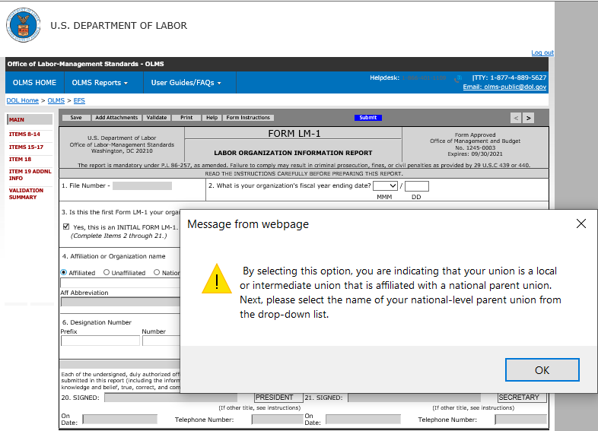
Affiliated Union
If the option Affiliated is selected, the system will display this pop-up message

Slide 16
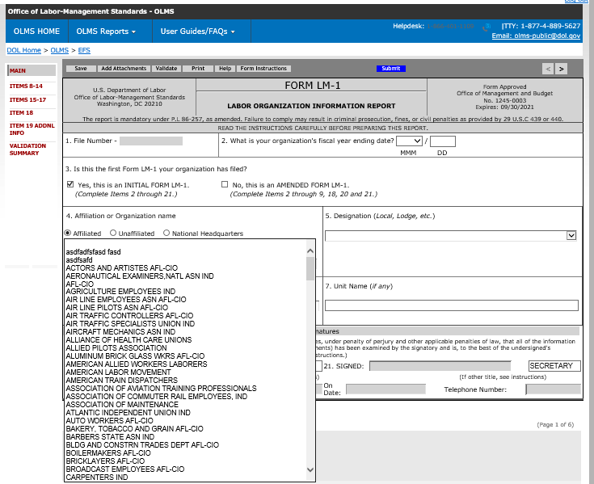
Creating an Affiliated Union
An affiliated union must select the national-level parent union from the drop-down.

Slide 17
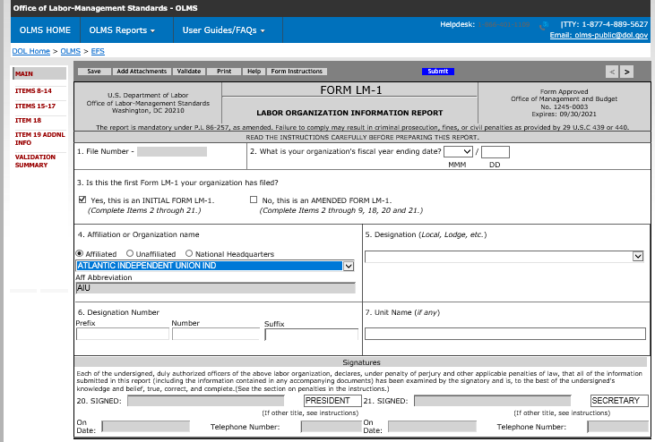
Creating an Affiliated Union
The system will populate the Aff Abbreviation of the selected parent.

Slide 18
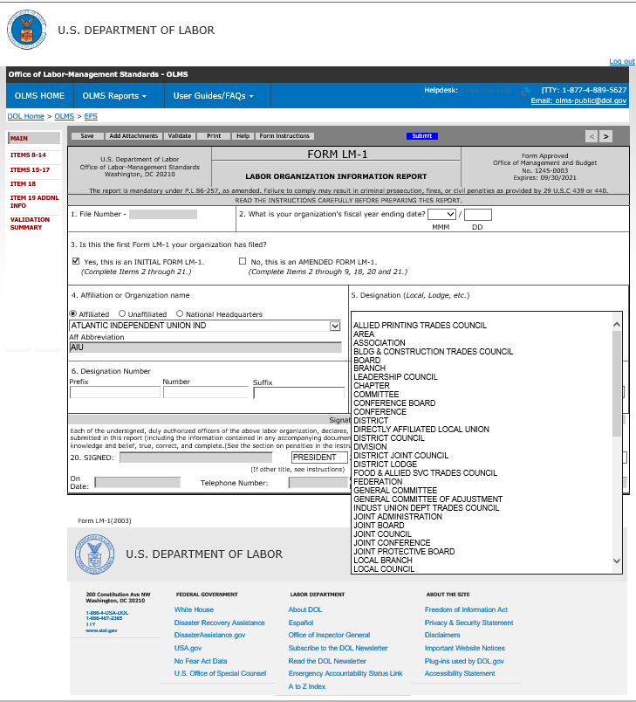
Entering Data into the Form
Enter the Union’s Designation Number and Unit Name in Item 6 and 7.
Note: Unit name is not a required field, they can leave it blank it.

Slide 19
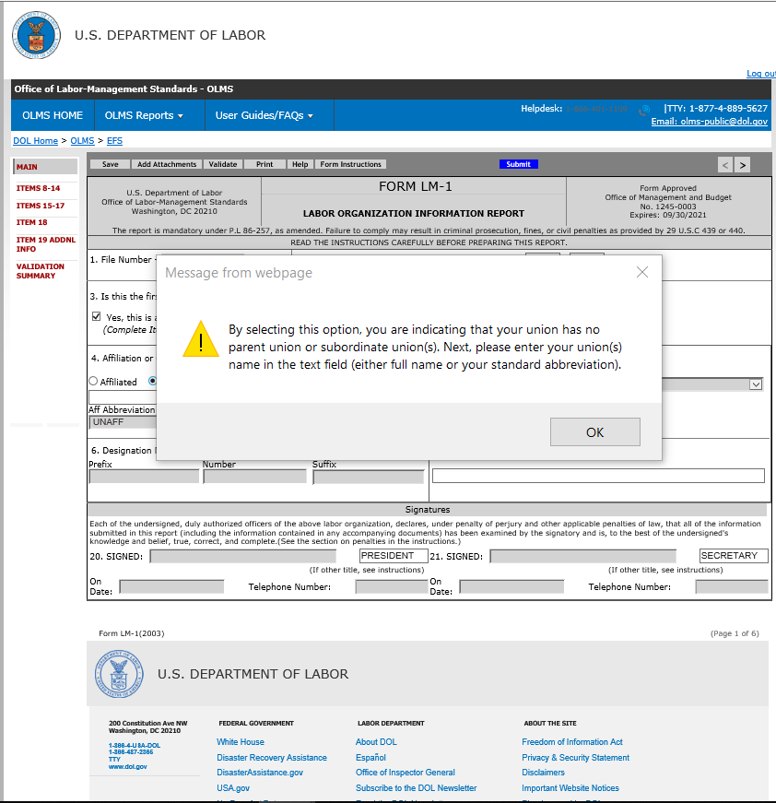
Entering Data into the Form
If the option unaffiliated is selected, the system will display this pop-up message

Slide 20
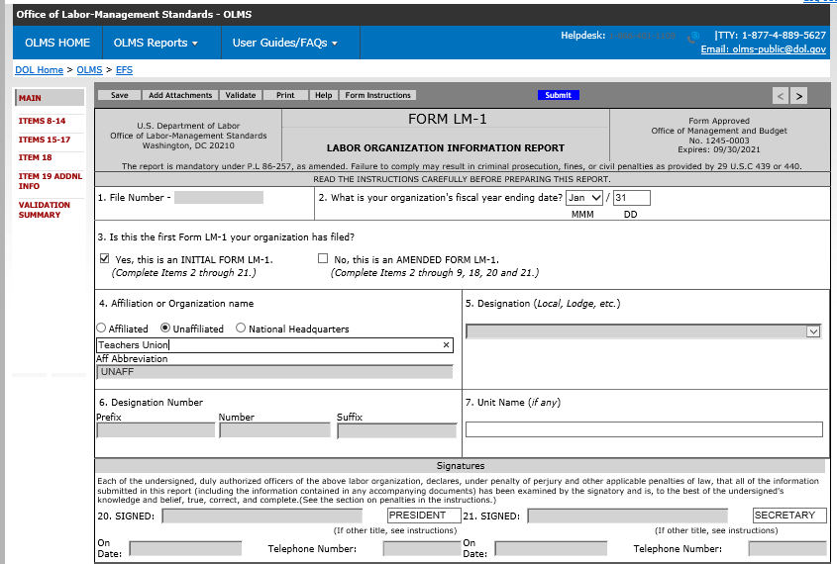
Importing Data into the Form
Enter the name of the organization in Item 4.
The abbreviation for this union type will be populated as UNAFF in the Aff Abbreviation field.
Item 5 and 6 will be disabled for this union type.
Item 7 is optional.

Slide 21
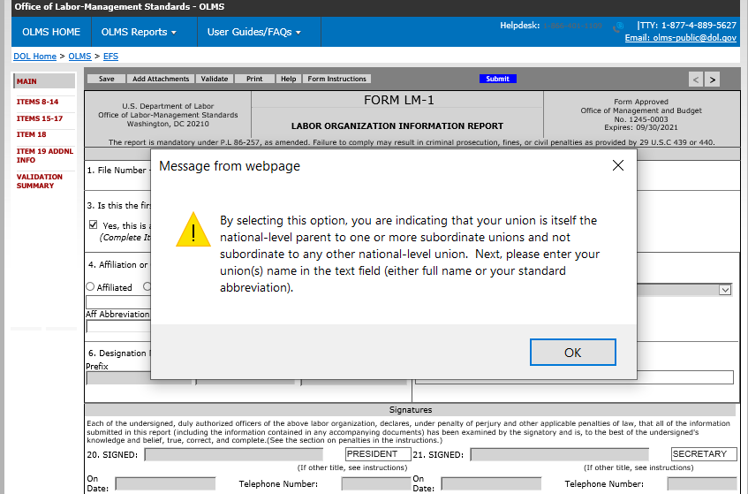
Creating a National Headquarters
If the option National Headquarters is selected, the system will display this pop-up message

Slide 22
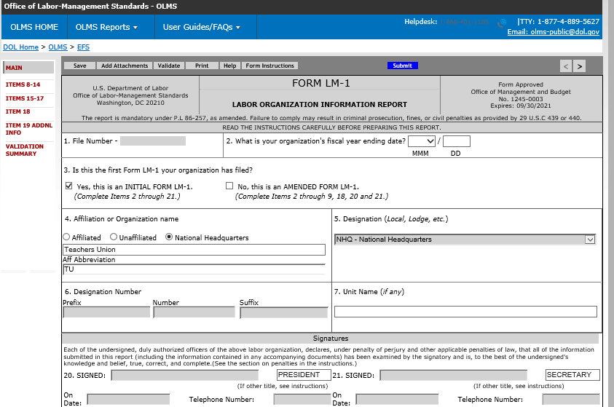
Creating a National Headquarters
Enter the name of the organization in Item 4.
The union must enter a union abbreviation in the Aff Abbreviation field
Item 5 and 6 will be disabled for this union type.
Item 7 is optional.

Slide 23
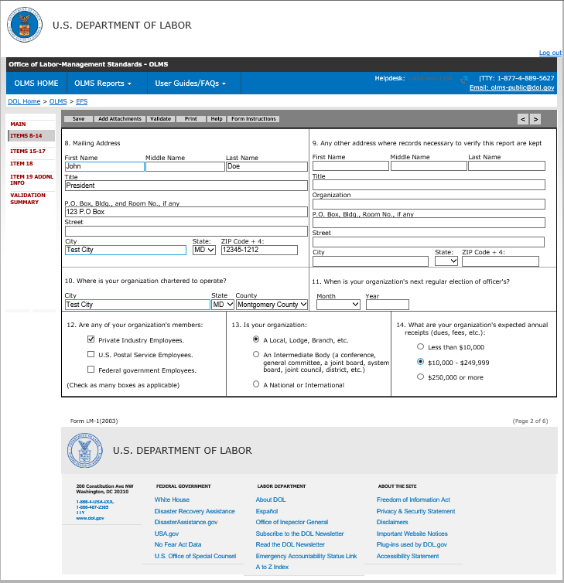
Complete Items 8-14
Note: from this slide onwards, the page level requirements are same for all union types.
Enter the mailing address in Item 8
Item 9 is optional
Enter City, State and County in Item 10
Non-US territories need to select the state ‘00’ from the State drop-down. The county is not required to be entered for this state code.
Item 12,13, and 14 are required information

Slide 24
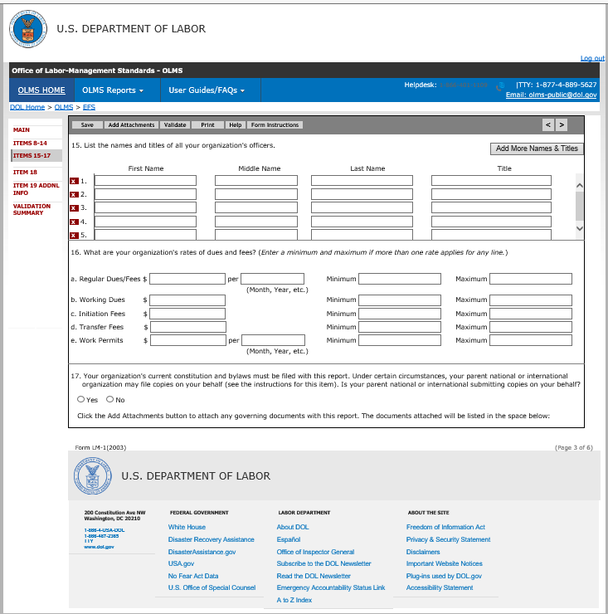
Complete Items 15-17
Item 15 - Enter the names and titles of all the officers of your organization (including the officers who sign this report).
Item 16: All information in Item 16 must be completed with either a value or N/A for Not Applicable.
Item 17 - If the parent body files a constitution and bylaws on behalf of the filing union, select YES. If your parent body does not file a constitution and bylaws, select NO.

Slide 25
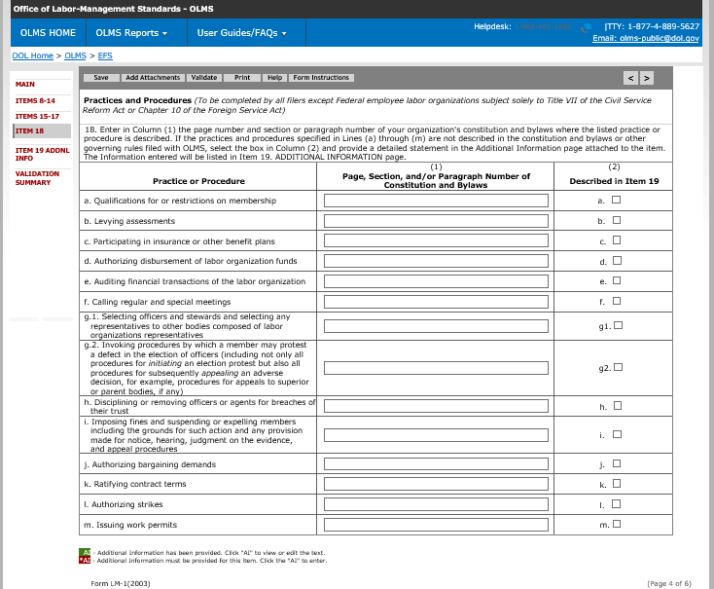
Complete Item 18
Enter in Column (1) the page number and section or paragraph number
Select the box in Column (2) to attach an additional information page

Slide 26
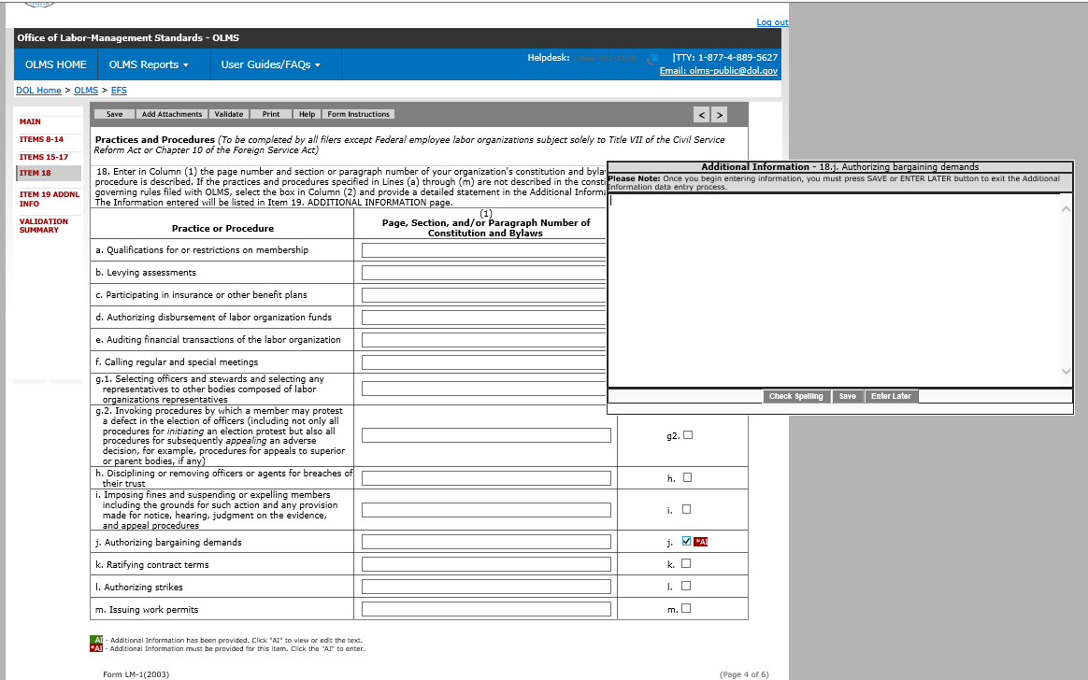
Complete Item 18 (cont’d)
Checking the checkbox on each item will open an Additional Information box.
Initially, the Additional Information box will be red.

Slide 27
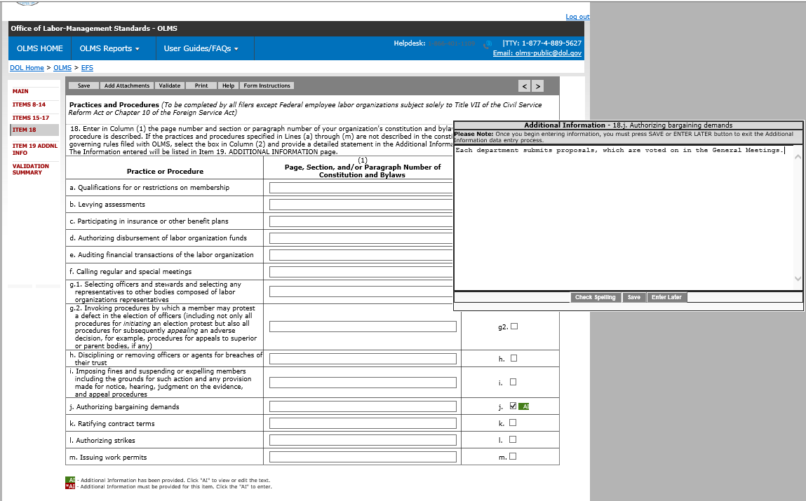
Complete Item 18 (cont’d)
Once the data is entered and saved, it will turn to green

Slide 28
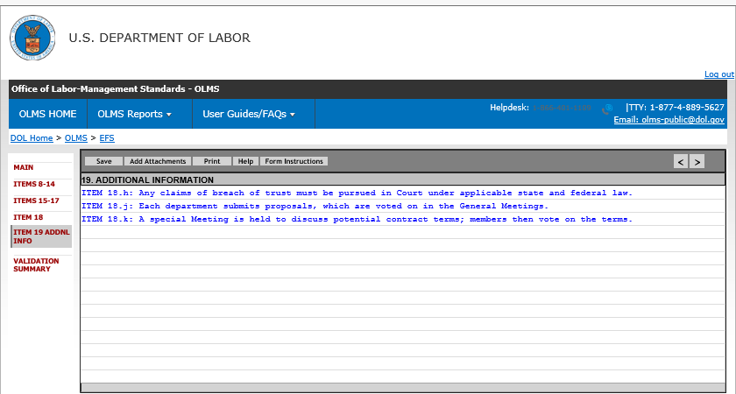
Item 19 – Additional Information
Data entered in each Additional Information page will be listed on this page

Slide 29
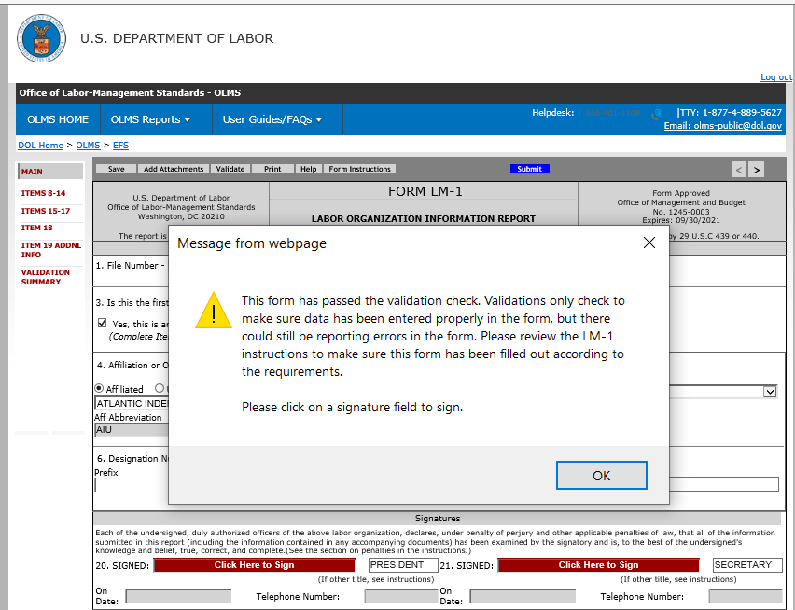
Form Validation
Once the form passes validation, the signature fields will be enabled.

Slide 30
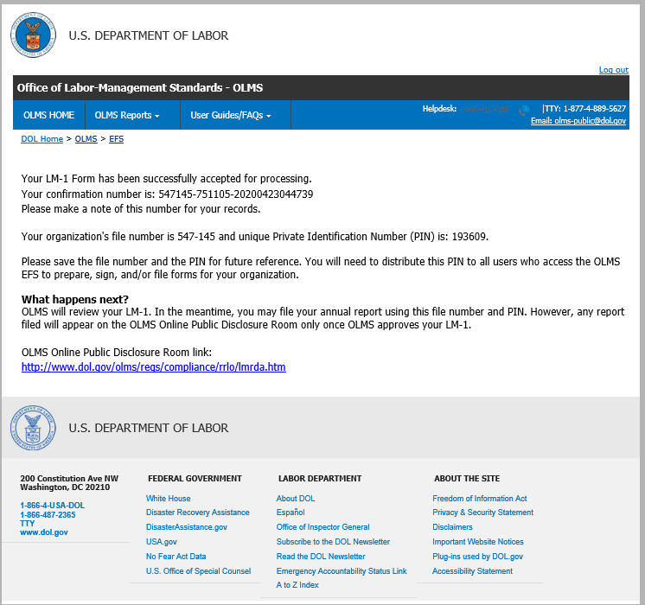
Submission confirmation
Once the form is signed and submitted, EFS will provide this confirmation message.
The confirmation message lists the file number and the PIN.
The form will not get disclosed on the OPDR page at this time.
OLMS will have to review and approve the new union.
But the user should be able to login using this new file number and PIN to submit their annual form at this time.
Once OLMS approved the union, the reports submitted by this union will get disclosed on the OPDR page.

Slide 31
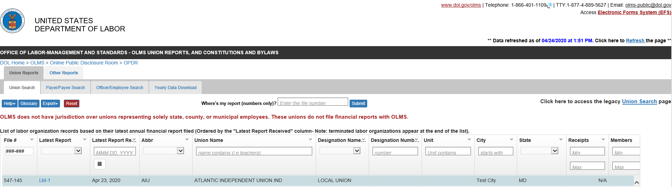
Approved LM-1
Once OLMS approved the union, the reports submitted by this union will get disclosed on the OPDR page.

Slide 32
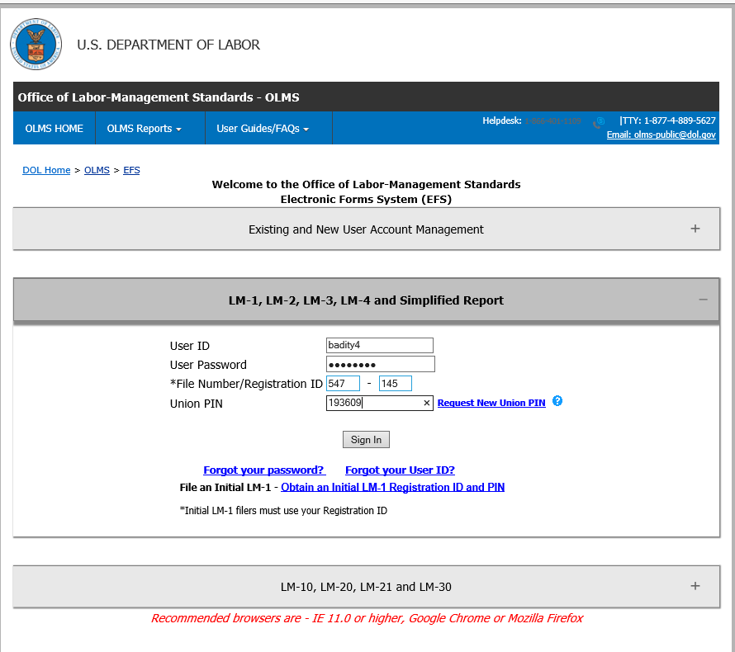
To Submit an LM-1 Amendment
To submit an Amendment, the union should use the new file number and PIN generated during the LM-1 form submission.

Slide 33
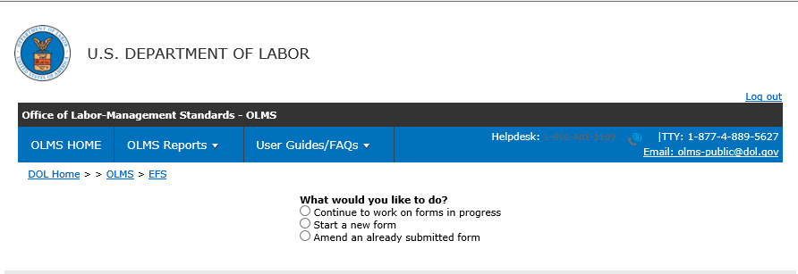
LM-1 Amendment
Upon successful login, the filer will navigate to this page.

Slide 34
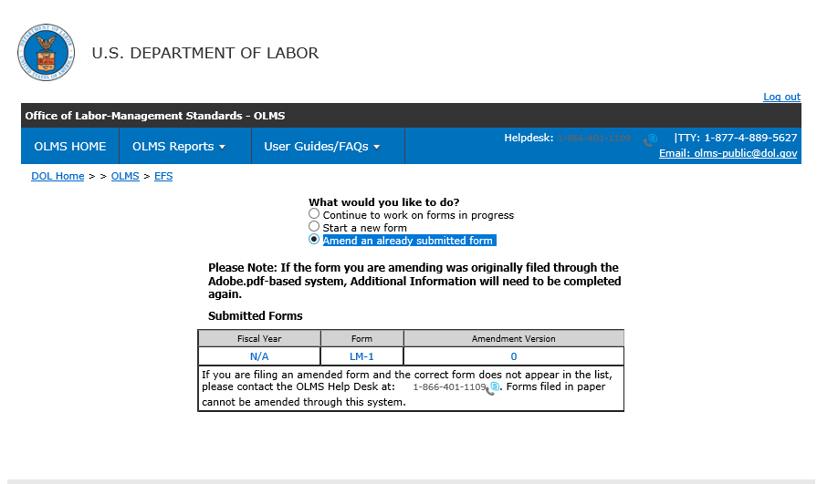
File an LM-1 Amendment
To file an amendment report, the filer needs to select the option, “Amend an already submitted form” and select the report to be amended from the list.

Slide 35
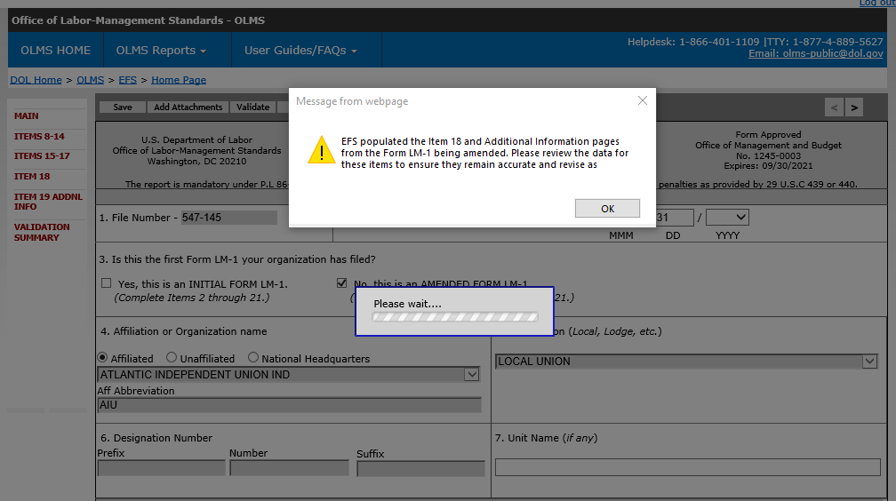
Completing an LM-1 Amendment
The system will display this message when opening an LM-1 report.
Once completing the form, the sign and submit will be the same as any other form.
The submitted amendments will be listed in the OPDR.

