Slide 1
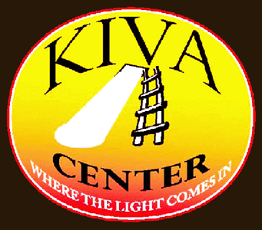
Self-Awareness and A Trauma-Informed Life:
Lived experience and building a trauma-informed workforce.
Brenda Vezina, LSW Director of Central MA Programs The Transformation Center
View our video "What Happened to You?"
Notes:
This slide contains the Kiva Center logo, the Transformation Center logo, and a hyperlink to the CMRLC-produced video “What Happened to You?”.
The Kiva Center logo depicts a ladder and a beam of light on an oval background, with the text “KIVA CENTER” and “WHERE THE LIGHT COMES IN”. This logo symbolizes the goals of the CMRLC and its Kiva Center: to be place of enlightenment in safety. The name “Kiva” is taken from the Native American tradition of the Kiva, a place of meditation and self-learning.
The Transformation Center logo depicts a group of 13 geese in flight, with the words “the TRANSFORMATION center”. The logo symbolizes how we can learn and grow together as we take flight, and—as geese do—each of us may take leadership or follow others at various times.
The hyperlink stating “View our video ‘What Happened to You?’” points to the internet address https://www.youtube.com/watch?v=dYlbAAQgP28&feature=youtu.be leading to a 12 minute, 47 second video produced by the CMRLC, that summarizes the goals of its work in creating Trauma-Informed services and communities.
More information on these logos and/or the embedded video is available by calling the CMRLC at 508-751-9600 during regular business hours.

Slide 2
I thought there would be more help coming for me. And when there wasn’t any,
I learned to be that help for myself.

Slide 3
“Blind faith in anything will get you killed.”
--Bruce Springsteen

Slide 4
I want to be in the meeting.
I want to be a part of the change from
“What’s wrong with you?”
to
“What Happened to You?”

Slide 5
Asking
“What Happened to You?”
was the beginning.
Then we began changing…
everything.

Slide 6
CMRLC strives to create a Peer workforce that sets the standard for effective support and system change.
Workforce development focuses on:
Building on existing strengths and talents
Continuous training opportunities
Supervision through mentoring
Providing opportunities for community leadership

Slide 7
Building an Empowered Workforce
“You need to do this.” “These are the things we need to accomplish.”
“This is how it should be done.” “How can we get this done?”
“What resources do you need from us?”
“How can we support your goals?”

Slide 8
This training and support model leads to the confidence of competence.
CMRLC’s Peer Workforce has ESP:
--Lived Experience and Expertise --Strength through Support
--Passion for change…
…leading to a Trauma-Informed Nation, one conversation at a time.

Slide 9
“The main thing that I learned was I’m not what happened to me. I’m still with purity and innocence. No one can take that away from me.”
--Carlos Santana

