Slide 1
Federal Application Process
Presenters:
Michelle Horst, Human Resource Specialist
and
Kristen Nathe, Human Resource Specialist
U.S. Department of Labor | Office of Human Resources | Division of Staffing Recruitment
Notes:
Good Afternoon everyone and thank you for tuning in. My name is Michelle Horst and I’m a Human Resource Specialist with U.S. Department of Labor, Division of Staffing and Recruitment.
Today, I’m going to give you a brief overview of the how the federal application process works and common pitfalls so you can be better informed when searching and applying to jobs.
If you haven't already, please mute your line in order to limit background noise. Please save all questions for the end of the presentation and we will be happy to answer them at that time.
I’m interested to learn more about your knowledge of the federal hiring process… if you could, please enter in the chat the number 1 if you’ve never heard of or been on USAJOBS.GOV, a 2 if you have an account but have never applied, and a 3 if you’ve applied for a federal position through USAJOBS.GOV.

Slide 2
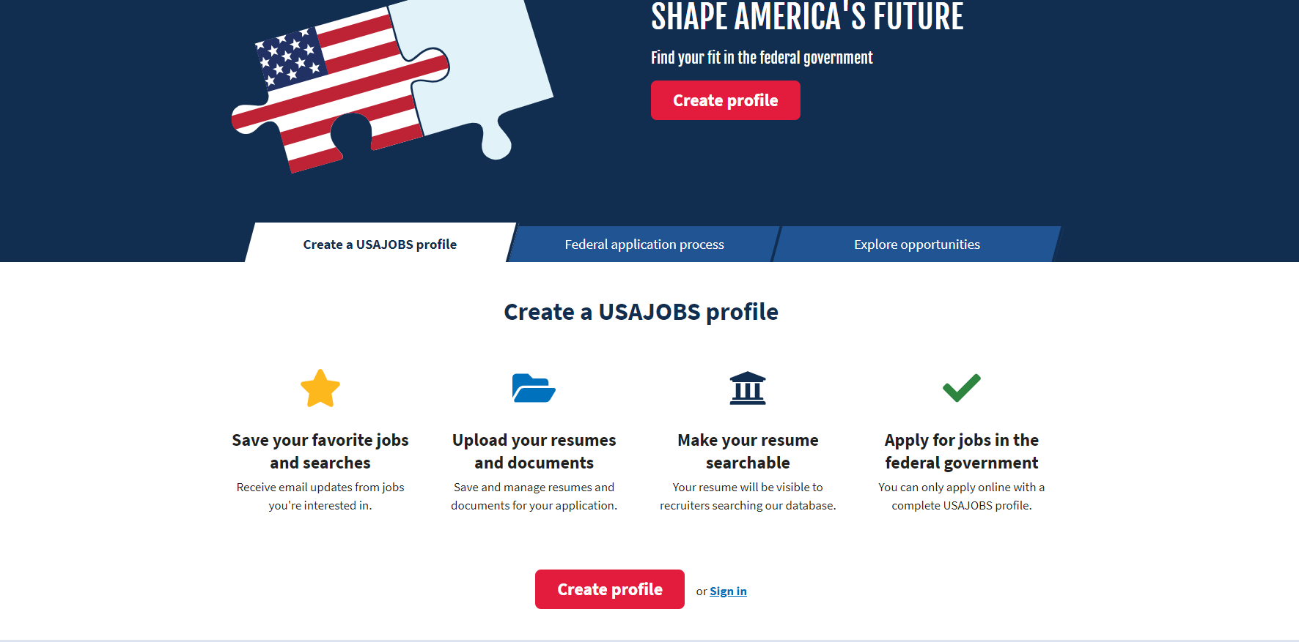
USAJOBS.gov
When an applicant clicks the button “Create profile,” the applicant will be taken to additional screens to create an email and account password.
The applicant will then be able to complete basic information – name, address, telephone numbers, etc.
Notes:
You can start your Federal Application journey by going to USAJOBS.GOV, this is the official federal government employment website where you can find and apply to jobs as well as get answers to your questions about federal employment. There ‘s a lot of great resources on the website so definitely spend some time to navigate through the site in general.

Slide 3
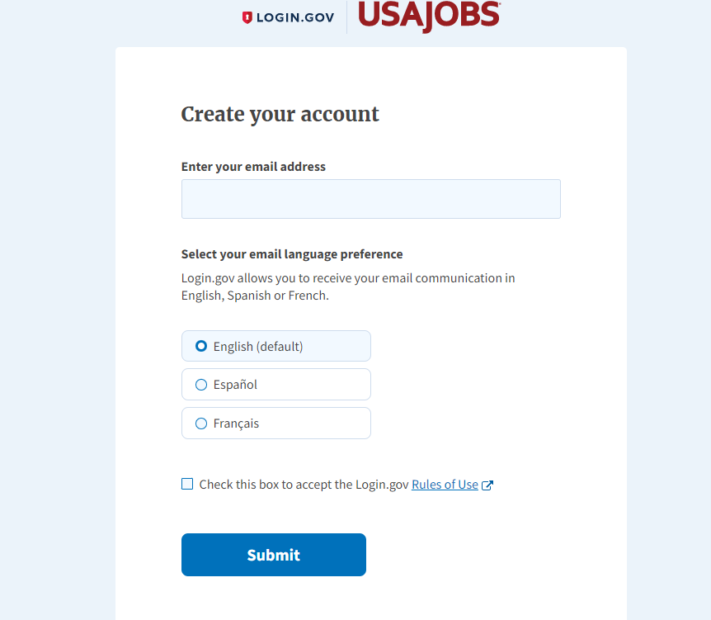
Notes:
Once on the site, I encourage you to create an account. You can certainly search for jobs without an account, however to maximize your search results and to actually apply for a position, it is required to have an account.
To do this, you’ll be directed create a LOGIN.GOV account with a valid email address, hit submit, and then you’ll be directed back to the USAJOBS.GOV.

Slide 4
Notes:
Now that you’ve created your account login, the next step is to complete your profile which is also required before you can apply to a position.
Also with your completed profile, you'll be able to save your favorite jobs and searches, receive email updates, create and edit your resume, make your resume searchable, upload required documents, and manage or track your application all in one place.

Slide 5
Notes:
In this section, simply fill in your basic contact information (full name, address, and email), Citizenship and Selective Service information, and Federal Service, Military Service, if that applies to you.

Slide 6
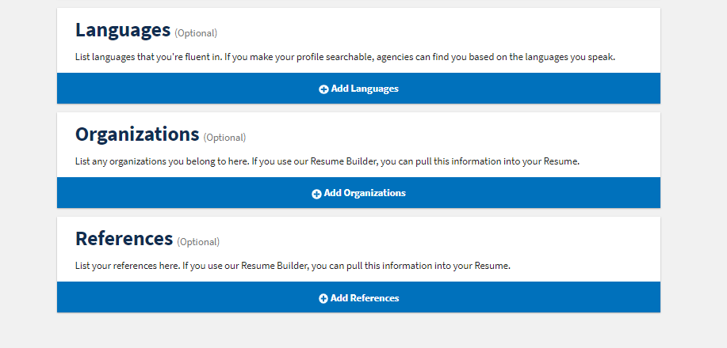
Notes:
Some additional sections to enhance your profile include work experience, education, demographics, languages, professional organizations you belong to, and references. Some of these sections are optional but completing them will help USAJOBS improve your job search results.

Slide 7
The applicant can upload documents such as a Resume, College Transcripts, Veterans Preference Documents, and Other Required Documents.
Notes:
One of the most important steps in completing your profile is the Documents section. You can upload multiple resumes, transcripts, and any other required documents stated in the job announcement.
This is also where you can also make your resume and profile searchable. Making your resume searchable adds it to the USAJOBS resume bank. HR specialists/ Recruiters from federal agencies use the resume bank to source potential candidates.

Slide 8
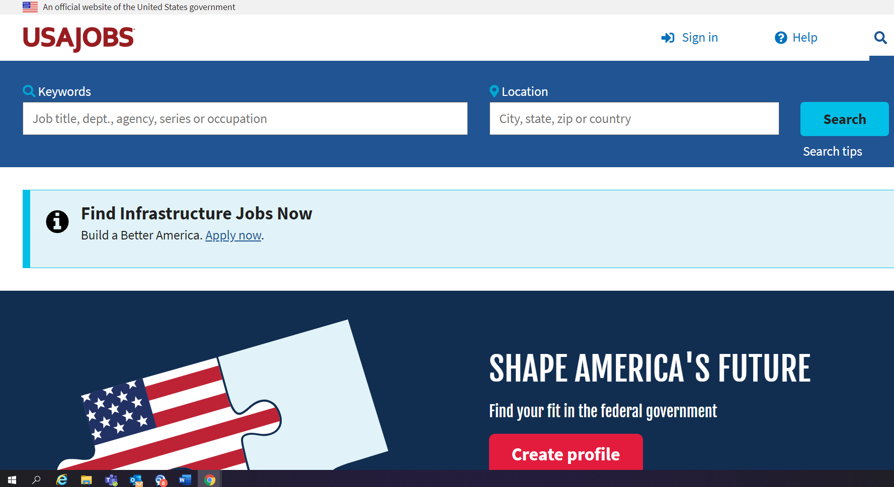
Search for Jobs – Vacancy Announcements
Notes:
Alright, so now that you have your profile completed you can now begin searching for jobs that meet your criteria and apply to them.
USAJOBS gives you the option of performing a basic job search by entering key words and/or the location, or a more advance search by clicking on the blue search button.
The refined search option allows you to filter by pay, work schedule, department, and agency to narrow the jobs that’ll best meet your criteria along with specific hiring paths that meet your eligibility.

Slide 9
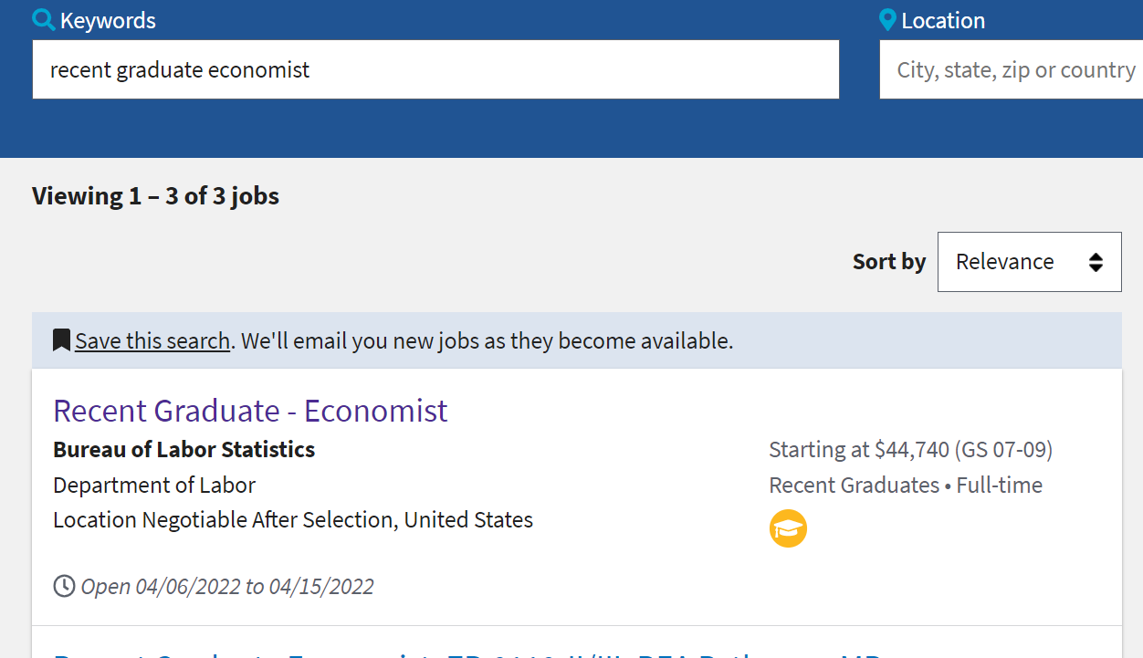
Search for Jobs – Vacancy Announcements
Notes:
Your search will result in a list of Job Opportunity Announcements, or federal job postings, that meet your criteria, and provide a snapshot of the Position Title, Agency, Location, Open Period, Salary and Grade, and Type of Appointment.
Once you have refined your search you can Save your search to receive push notifications and emails when like positions are open.
If you find a job you're interested in simply click on the title and you'll be able to review the full job opportunity announcement to ensure you are eligible and meet the basic qualifications and specialized experience which we will go more in depth here soon during a live demo.

Slide 10
Applying for Federal Jobs – Vacancy Announcements
Step 1 – Read the Entire Announcement Carefully
Position Title, Agency, Organization
Occupational Series, Grade, Pay, Duty Location
Closing Date is the Last Day to Submit Application (11:59 PM EST)
Type of Position (Permanent, Temporary, Student Intern) and Work Schedule
Position Summary and Duties
Minimum Qualification Requirements, Specialized Experience, or Education Requirements
Required Documents
Notes:
The federal application process is essentially 4 steps. The first step, is to read the entire announcement carefully.
The announcement contains all the information included in the snap shot along with a bunch of critical information for what is required and this varies from each agency and position.
Make sure that you are eligible to apply by reviewing the position title, series/grade, duty location for the position and the hiring paths or who may apply clarified by the agency.
The announcement will list the closing date, the last day to submit your application, please note that all applications close at 11:59 PM EST. Applications or documents submitted after the closing date will not be accepted.
The announcement will also have a brief position summary and include the major duties of the position.
It’ll explain how to qualify based on minimum qualification requirements and specialized experience and/or education.
Lastly, required documents- this would be any documents that are required to be submitted with your application. Please note that you could possibly lose consideration if your application is not complete, and you are missing required documents.

Slide 11
Applying for Federal Jobs – Vacancy Announcements
Step 2 – Prepare Your Resume
Standard Federal Resume – This can be edited, updated, and uploaded
Your Contact Information – Full Name, Address, Telephone Number, Email Address
Work Experience – Position Title, Organization, Address, Supervisor/Contact Information, Number of Hours Worked/Week, Salary, (If Federal, add occupational series and grade), Start Date (Month/Year), End Date (Month/Year), Description of Work Performed, Accomplishments, Awards, Recognition
Education – Degree, Major/Minor, Date Degree Obtained/Expected, Semester Hours Completed, Grade Point Average/Scale
Volunteer Experience
Academic Awards/Achievements/Memberships
Tailor Resume to Position Advertised – Highlight Duties, Accomplishments, etc.
Notes:
Step 2 is Preparing your resume. You can create your resume in two ways: Either by Uploading a resume that you already have or by Building a Resume using the USAJOBS Resume Builder Tool. Either method is fine, some use both options, but as long as the critical information is shown.
These fields here should be included in your resume to include your
Your contact information - full name, address, telephone number and your current valid email address.
Work Experience - for each position you’ve previously held – include the Position Title, Organization/Agency, location of the position, Supervisor/Contact Information, Number of hours worked per week so you may receive credit for full/part-time, Salary (if federal, add series and grade level), Start and end date in MM/YYYY format in order to give full credit for that timeframe. Also, include a description of work preformed, level of experience and highlight any special accomplishments, awards and/or recognition received.
Education – should include the degree and major, the date the degree was conferred or the expected date. The total number of semester hours completed and the grade point average (GPA) you received.
Volunteer - Be sure to also include any volunteer experience if applicable to receive credit for that experience as well.
You would also want to list any academic awards, achievements and memberships with professional affiliations.
Tailor Resume to Position Advertised by highlighting duties and accomplishments that align with the position in which you are applying rather than using the same resume for multiple applications. One resume will not fit all applications.

Slide 12
Applying for Federal Jobs – Vacancy Announcements
Step 3 – Collect Required Documents
Federal Resume – create using Resume Builder tool in USAJOBS.gov or Upload Word Version into USA Jobs account
Academic Transcripts – Unofficial to Apply, Official to Work
Veterans Preference Information – DD214, Discharge Member 4 Copy, VA Letter, SF-15
Prior Federal Employment – SF-50, Notification of Personnel Action
Schedule A letter, if applicable
Other Documents – Prior Federal Performance Appraisals, Writing Samples, Cover Letter (Only Submit Documents That are Required, List Awards in Resume)
Save Documents – Resumes, Transcripts, Etc. – Legible Format, Easy Access, Update When Needed (New Job, Degree Received, Awards, Promotions, Etc.)
Notes:
Step 3 – is to collect required documents for the application
Federal Resume – either you’re the one you created with resume builder tool or your personal uploaded resume.
Academic Transcripts – these can be unofficial transcripts at the time submitting your application, but you will need to submit your official transcripts to the HR Specialist prior to your first day of work.
Veterans Preference Documents that include DD-214 discharge member 4 copy, if you are a veteran with a qualifying disability then you would also need to submit your VA Letter and SF-15.
If you have previous government experience, then you would upload your SF-50, notification of personnel Action which provides information regarding your tenure.
If you are applying as an individual with disabilities then you would upload your Schedule A letter and ensure its on the correct leader head.
Please note for future reference its best to save documents such as resumes, transcripts, vet documents for– easy access, to use when applying for other jobs in the future. You will then be able to updated as needed if your status changes for example you get a new position or complete your degree.

Slide 13
Applying for Federal Jobs – Vacancy Announcements
Step 4 – Submit Your Application
Ensure USAJOBS.gov Profile is Complete, Update As Needed
Ensure Documents are Uploaded – Resume, Transcripts, Other Documents
Federal Agency Application – May Require Completion of Additional Profile/Questions
Eligibility Questions
Occupational Questionnaire
Other Assessments
Notes:
When your application is ready, you'll be directed from USAJOBS to the hiring agency's system to submit your application. Before you submit, you may need to complete other agency-required steps such as a questionnaire which I’ll show you how to preview those questions, and uploading additional documents.
The time it takes to submit depends on the job you are applying for and the hiring agency's requirements.

Slide 14
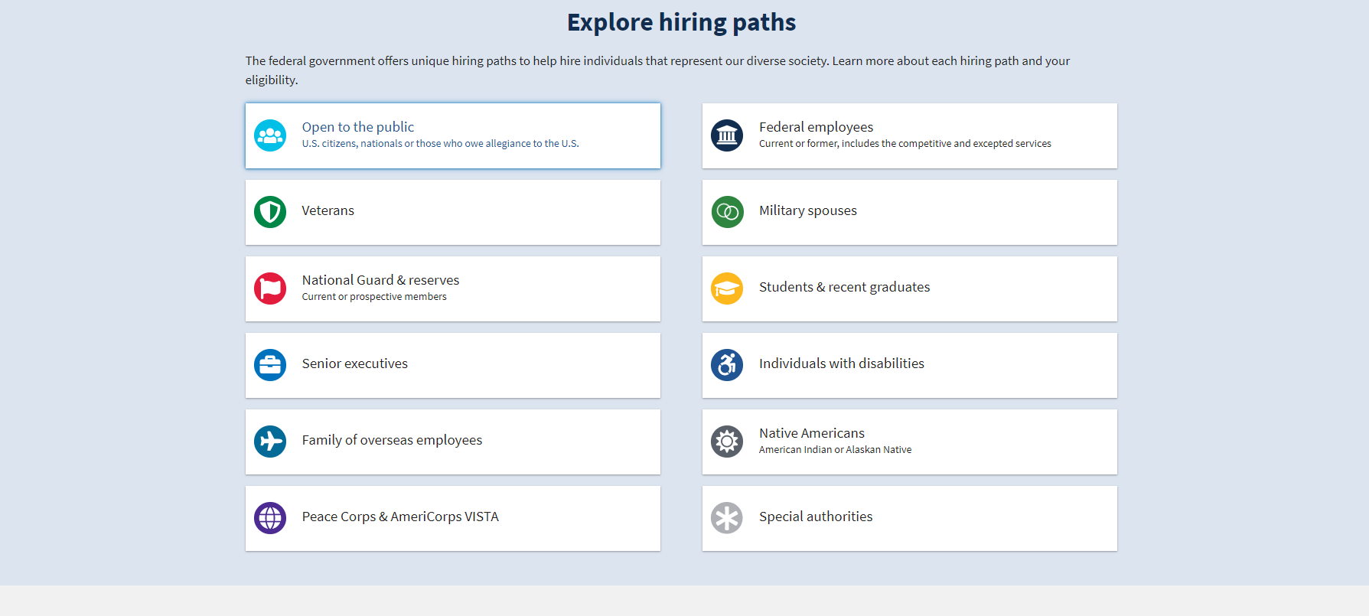
Notes:
Earlier we briefly mentioned filtering by hiring paths. Here’s a general list of hiring paths the federal government to help hire individuals that represent our diverse society.
Some specific hiring paths to pay attention to include jobs open to "Students and Recent Graduates", or those "Open to the Public" and even "Veterans" as compared to those only open to federal employees.
Many times the same job is announced multiple ways being open to the public and to internal employees only so you want to make sure you are applying to the correct job announcement.

Slide 15
Tracking Your Application
4 Touch Point Notifications
Application Received
Found Qualified/Not Qualified
Referred/Not Referred
Selected/Not Selected
Refer to USAJOBS for all status updates within your account
Notes:
Once you've applied to the positions you are interested in you will have the ability to track your application.
You should receive communication after each of these 4 touch point during the application process.
The first touch point is after your application has received by the agency. The second, is after the review of qualifications- you will be notified if you have been found qualified or not qualified based on your application. Third, you will be notified during the referral process whether you have been referred to the hiring official or not referred. Lastly, once the hiring official makes a decision you will then be notified that you were selected or not selected.
You can refer to your profile in USAJOBS at any time for status updates on all the positions you've applied to or contact the hiring agency HR Specialist listed on the job announcement via email of phone.

Slide 16
Applying for Federal Jobs
Next Steps
Prepare for the Interview:
Be Familiar With the Position
Do Research on the Agency – Why do you want the position or work for the agency?
Be Ready for Situational Questions (Job-Related Scenario) or Behavioral Questions (Past Experience As it Applies to the Job)
Be Open-Minded, Optimistic, and Patient
Notes:
Once you’ve searched for jobs and submitted your application.
The next steps would be to prepare for the interview.
Be familiar with the position, review the duties and the qualifications.
Research the agency and decide why you are interested in working for that agency.
Prepare for the interview questions which will most likely be structured around job-related scenarios and/or behavioral questions in which you can speak from past experiences.
Be open minded, optimistic and most importantly be patient.

Slide 17
Resources
Official Federal application website – www.usajobs.gov
Careers at DOL – www.dol.gov/general/jobs
CURRENT/Open jobs at DOL – www.usajobs.gov/Search?d=DL
DOL Student Hiring Paths via Pathways - https://www.usajobs.gov/Help/working-in-government/unique-hiring-paths/students/
The ABCs of Schedule A - https://www.eeoc.gov/eeoc/publications/abc_applicants_with_disabilities.cfm
Military Skills Translator Tool - www.mil2fedjobs.com
Uploading documents - https://www.usajobs.gov/Help/how-to/account/documents/upload/
DOL Military Spouse assistance - Veterans.gov/milspouses
Notes:
Here is a list of all hiring resources.
The Official federal application website www.usajobs.gov is list again for reference.
Careers at DOL, is the link to the DOL career homepage that provides information on different career topics.
Also included is a current list of all open DOL jobs – if you click the link it will direct you to all the current openings that DOL is offering
If you are interested in Student Hiring Paths please click here for more information on the Pathways Program.
The ABCs of Scheduled A is listed as a resource for individuals with disabilities that are interested in joining the Federal Government.
Military Skills Translator Tool – is available to help guide those transition their military skills to civilian skills.
There is also a link to assist with uploading documents into usajobs.gov.
Last but not least, is the link for the DOL Military Spouse assistance if you are interested in how to apply under the military spouse hiring authority

Slide 18
Interested applicants must apply directly via official federal website www.usajobs.gov
PLEASE DO NOT SUBMIT RESUMES OR ANY OTHER DOCUMENTS VIA EMAIL TO STAFFING SPECIALISTS. ALL APPLICATIONS AND DOCUMENTS ARE TO BE SUBMITTED THROUGH USA JOBS PORTAL.
If you encounter issues with USA Jobs website in “setting up your profile,” contact:
USA Jobs HELP CENTER https://www.usajobs.gov/Help/
If you have issues with “submitting your application,” please contact:
The Monster HELP DESK; 1-866-656-6831 (Toll Free) between the hours of 7:00 a.m. and 7:00 p.m. Eastern Standard Time. Note, you will need to be prepared to apply when you call.
Thank you!
Notes:
If you are interested in applying to a federal position please remember all applicants must apply directly via the official federal website www.usajobs.gov.
Please do not forward your resume and/or application to Staffing Specialist.
If you experience any problems setting up your profile in USA jobs please contact the USA Jobs help center for assistance.
However, if you have any issues or technical difficulties submitting your application at the agency site please contact the Monster help desk.
It looks like time allows for us to jump onto the USAJOBS site for a quick live demo.
After the demo, if you have any questions please enter them into the chat and we can address them.

Slide 19
Michelle Horst
Human Resources Specialist
Recruitment and Outreach Branch
U.S. Department of Labor | www.dol.gov
Chicago, IL – Central Time Zone
Office: 312-353-1054
horst.michelle.l@dol.gov
Kristen Nathe
Human Resources Specialist
Chicago Staffing Service Center
U.S. Department of Labor | www.dol.gov
Chicago, IL – Central Time Zone
Office: 312-353-2364
nathe.kristen.a@dol.gov
Apply today at www.USAJOBS.gov
Notes:
Here is our contact information, feel free to reach out with any questions in the future.

