Slide 1
Agenda Item #7
Six Minute Walk Test

Slide 2
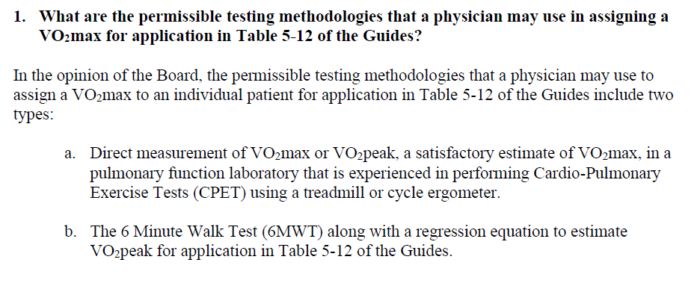
Six Minute Walk Test

Slide 3
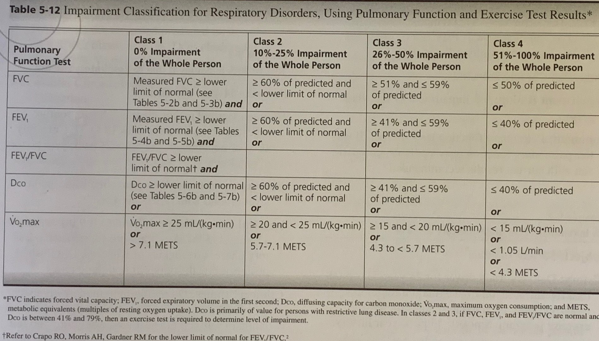
AMA Guides to Evaluation of Permanent Impairment, 5th Edition Table 5-12

Slide 4
6MWT
The 6MWT is a field test that is widely available, does not require specialized equipment, and can be performed safely in a typical medical office setting by most patients with pulmonary or cardiac compromise.
The ERS/ATS Technical Standard published by Holland et al. (2014) provides standardized instructions and quality assurance procedures for the 6MWT.

Slide 5
Six Minute Walk Test
The 6MWT has been well studied for patients with a variety of lung disorders and is reported to have acceptable repeatability, reproducibility, safety and precision to predict mean VO₂max of a group (Singh, 2014; Sood, 2014; Ross, 2010; Cahalin, 1995).
A systematic review by the European Respiratory Society / American Thoracic Society in 2014 concluded that the 6MWT is a valid, reliable, and “robust test of functional exercise capacity in adults with chronic respiratory disease” (Singh 2014).
3. The systematic review also concluded that the relationship
between 6MWD and either VO2peak or peak work on a
progressive incremental Cardiopulmonary Exercise Testing
(CPET) was moderate to strong and was consistent across
patient groups with chronic obstructive pulmonary disease and
interstitial lung disease.

Slide 6
Six Minute Walk Test
The 6MWT measures peak VO₂ (VO₂peak), which provides acceptable estimates of VO₂max when VO₂max is not clinically advisable or achievable. Both the CPET and the 6MWT would generally yield a VO₂peak rather than a VO₂max in most or all of these patients since individuals with significant lung disease can rarely achieve the maximal anaerobic level of exertion needed to generate a true VO₂max on the CPET.

Slide 7
Six Minute Walk Test
The best available method to estimate the VO₂peak in an individual patient is to use the equation published by Ross et al in 2010. This equation is:
Mean Peak VO2 (ml / kg /min) = 4.948 + 0.023* mean 6MWD (meters)
This regression equation was derived from pooled data taken from 11 studies conducted between 1996 and 2006 including a total of 1,083 patients with diverse cardiopulmonary disorders.
We recommend using this equation with the individual patient’s 6MWD in place of a group mean 6MWD.

Slide 8
Recommendation: 6MWT
The Board advises that the 6MWT is an entirely acceptable to measure the VO₂max for the purposes of impairment assessment.
The best valid and available method to estimate a value of VO₂max from the 6MWD for application in Table 5-12 of the AMA Impairment Guide is to use the equation derived by Ross et al (2010):
Mean Peak VO2 (ml / kg /min) = 4.948 + 0.023*6MWD (meters)

