Slide 1

THE OFFICE OF THE OMBUDSMAN FOR THE EEOICPA
JOINT OUTREACH TASK GROUP
Gallup, NM - September 10, 2024
Grants, NM - September 11, 2024
Albuquerque, NM - September 12, 2024

Slide 2



History and Duties of the Ombudsman
How We Can Help
Practical Information & Tips
Policy Updates
Contact Information
PRESENTATION OVERVIEW

Slide 3

History of the Office of the Ombudsman
October 2004 – Congress passed legislation creating the Office of the Ombudsman for the EEOICPA.

Slide 4
DUTIES OF THE OFFICE OF THE OMBUDSMAN

Slide 5
Provides information on the benefits available under the EEOICPA.
Provides guidance and assistance to claimants, be it general information about the program or case specific.

Slide 6
Submits an annual report to Congress which includes: 1) The number and types of complaints, grievances and requests for assistance received during the year. 2) An assessment of the most common difficulties encountered by claimants during the year. 3) Recommendations for the improvement of the EEOICPA program.

Slide 7
The Office of the Ombudsman is an INDEPENDENT OFFICE within the U.S. Department of Labor (DOL).
The Office of the Ombudsman is SEPARATE from the DOL Energy Program that makes decisions on your EEOICPA claims.
All communication with the Office of the Ombudsman is CONFIDENTIAL.

Slide 8

THE OMBUDSMAN’S OFFICE DOES NOT:
Make decisions on claims.
Serve as an Authorized Representative or advocate.
Ask Congress to change the law.

Slide 9
HOW WE CAN HELP YOU

Slide 10
We assist claimants, attorneys, lay representatives, health care providers, congressional staff and others.
We explain, review, and discuss the EEOICPA claim development and benefit processes.
We answer questions and provide assistance to individuals encountering difficulties with their claims.

Slide 11
We are available to speak to individuals on a one-on-one basis and we communicate with individuals by email.
We participate in outreach efforts to provide information to the public about the program.
We identify and discuss EEOICPA concerns in our annual report to Congress.

Slide 12
practical information & tips

Slide 13
Current and former employees may use the Claim for Benefits (Form EE-1) for the following reasons:
To file an initial claim.
To file a claim for new illnesses as they are diagnosed (e.g., additional cancers, or respiratory issues).

Slide 14
IMPORTANT TO NOTE
The filing date of the EE-1 form is used to establish the date of the entitlement to medical benefits.

Slide 15
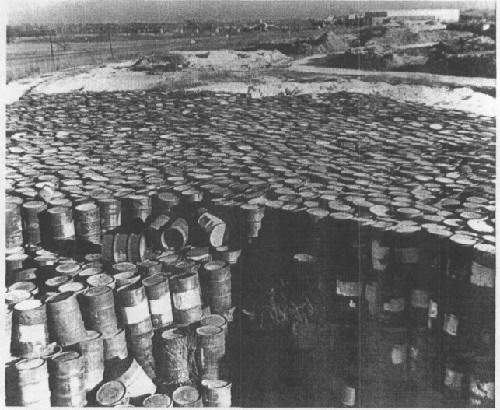
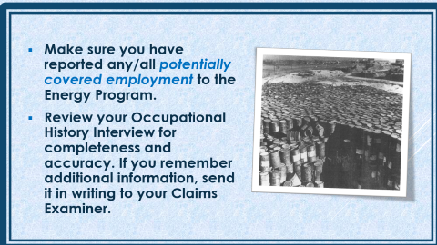
Make sure you have reported any/all potentially covered employment to the Energy Program.
Review your Occupational History Interview for completeness and accuracy. If you remember additional information, send it in writing to your Claims Examiner.

Slide 16
A “consequential condition” occurs when a covered illness or treatment for that covered illness, results in a new illness or injury. Medical benefits, impairment benefits, and wage-loss benefits are available for consequential conditions.
A new claim form must be filed for each and every consequential condition. The EE-1A form must be used to file a claim for a consequential condition.

Slide 17
If an employee’s claim is accepted for medical benefits under Part E of the Act, they can, using Form EN-11A (Impairment Benefits Response form), file a claim for impairment benefits.
A claim for impairment benefits may be filed every two years, or possibly sooner, if you have a newly accepted primary or consequential medical condition.

Slide 18

You may request a copy of your entire claim file at any time, even before the recommended decision is issued. You may also request a copy of any part of your claim file such as your employment and exposure records. The request must be in writing.

Slide 19
DEEOIC pays costs associated with obtaining medical records regardless of whether it has approved a claim for benefits. However, this reimbursement is payable only to a hospital, physician’s office, or other medical facility that charges a fee to produce records. The maximum allowable reimbursement is $100 per request.

Slide 20

Final decisions issued under the EEOICPA can be appealed by filing for reconsideration, reopening, or U.S. District Court appeal.
The deadline to file an appeal in U.S. District Court is sixty (60) days from the date of the final decision. Additional information regarding the U.S. District Court appeal process can be found under Section 7385s-6 of the EEOICPA.

Slide 21
POLICY UPDATES

Slide 22
1. The medical criteria for acceptance of beryllium sensitivity has been updated. A claim for beryllium sensitivity will be accepted under Part B based on evidence of three (3) borderline beryllium blood test results (BeLPT/BeLTT) over a period of 3 consecutive years.

Slide 23
2. The employment criteria for acceptance of hearing loss claims has been modified. An employee with any ten (10) year period of consecutive employment is potentially covered as long as they meet the toxic exposure and noise criteria.

Slide 24

Ways to
ELECTRONICALLY
Review your File and Submit Documentation

Slide 25
Electronic Document Portal (EDP)-allows claimants and authorized representatives to submit documents into the case file.
Employees’ Compensation Operations & Management Portal (ECOMP)-allows claimants and authorized representatives to review certain documents in the case file.

Slide 26
Medical Bill Processing Portal (for claimants and health care providers)
Pharmacy Bill Processing Portal (for claimants and pharmacy providers)

Slide 27

YOUR OPINION
AND
FEEDBACK MATTERS

Slide 28
The Department of Labor and Congress are interested in what you have to say.
The Energy program is constantly making program changes and updates. You can ask us questions or seek information from our office at any time.
If you have complaints, grievances, or requests for assistance, as well as complimentary things to say, we want to hear from you!

Slide 29
OFFICE of the OMBUDSMAN TEAM
Amanda Fallon, Ombuds
Curtis Johnson, Program Analyst
Tonya Taylor, Program Analyst
Betty Jo Fortune, Program Analyst
Cyril Pratt, Program Analyst
Susan Price, Program Analyst

Slide 30
OMBUDSMAN CONTACT INFORMATION
Mail: U.S. Department of Labor
Office of the Ombudsman
200 Constitution Avenue, NW, Room N-2454
Washington, D.C. 20210
Toll Free: 877-662-8363
Email: ombudsman@dol.gov
Website: https://www.dol.gov/agencies/ombudsman

