Slide 1
ELECTRONIC FORMS SYSTEM (EFS)
Guide to Using
EFS to Prepare the Form S-1 Report

Slide 2
ELECTRONIC FORMS SYSTEM (EFS) – Form S-1
EFS is a web-based system for completing and filing Form S-1 Surety Company Annual Report with this agency, the U.S. Department of Labor’s Office of Labor-Management Standards (OLMS).
This tutorial demonstrates basic features and functionality of the EFS-1 form. It does not contain instructions for what information should be provided on your report.
You can download a complete set of Form S-1 Instructions
from the OLMS website.

Slide 3
System Requirements and Settings
To access and use EFS, OLMS recommends that you use one of the following browsers:
  Microsoft Edge
  Google Chrome –Version 7.0 or higher

Slide 4
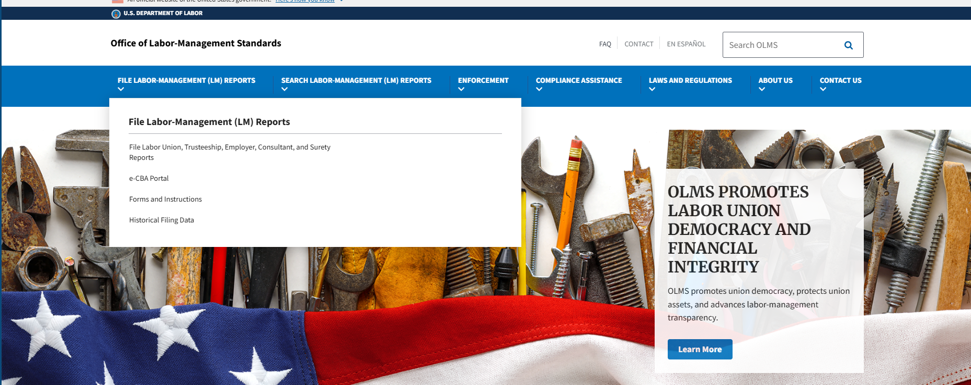
Accessing the System
Navigate to the OLMS Website and select File Labor-Management (LM) Reports From the drop-down menu, select the “File Labor Union, Employer, and Consultant Reports, and Surety Reports.

Slide 5
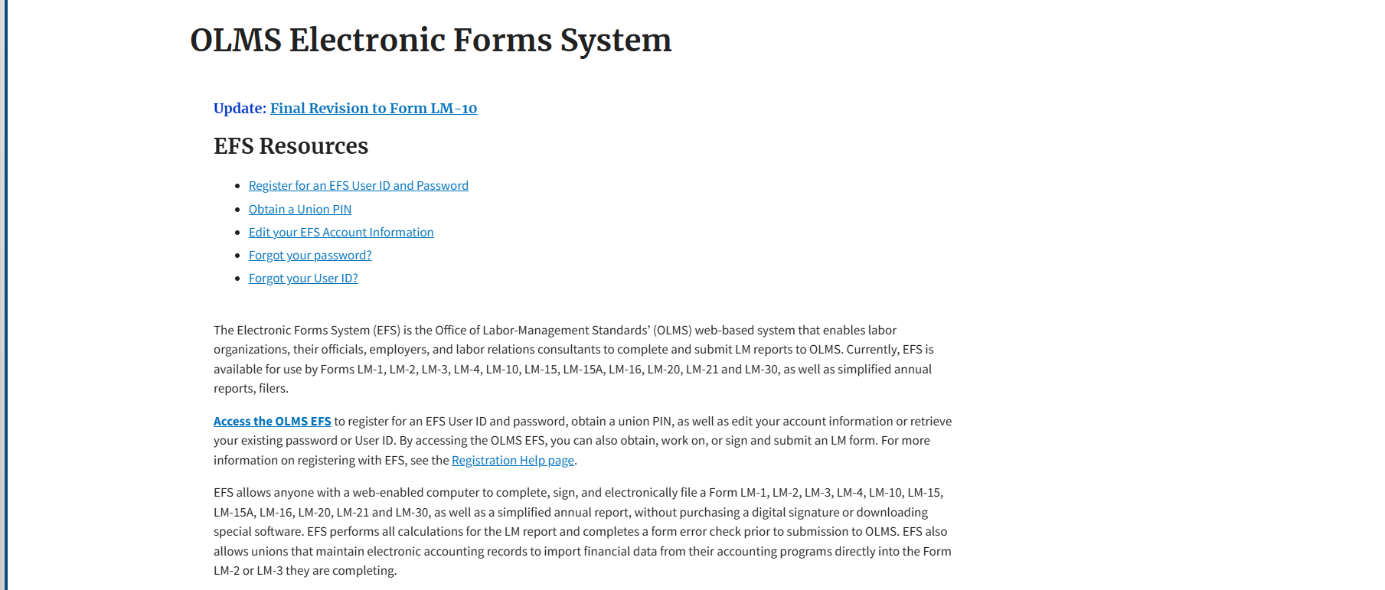
Accessing the EFS-Login Portal
From the EFS Introduction page, select on the “Access the OLMS EFS” link.

Slide 6
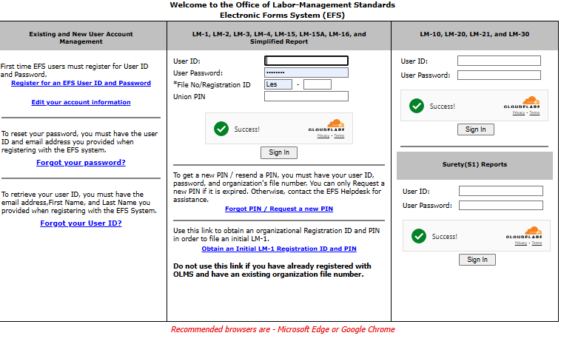
User Account- Registration
To access the Form S-1 in EFS, you must first register for an EFS User ID and Password.
If you already have an EFS user ID and password, you do not need to register again.

Slide 7
Accessing the System – Log In
Log into EFS using your user ID and password provided after the completion of your registration.

Slide 8
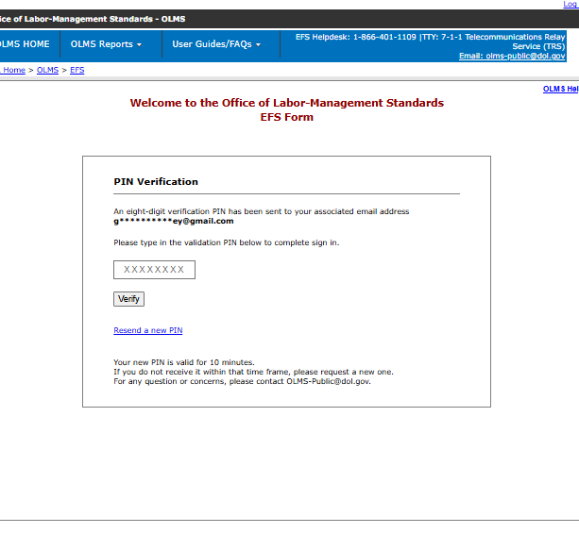
Multifactor Authentication- PIN Verification
After you select Sign In, you are taken to the PIN verification page. An eight-digit verification PIN will be sent to the email address associated with your account.

Slide 9
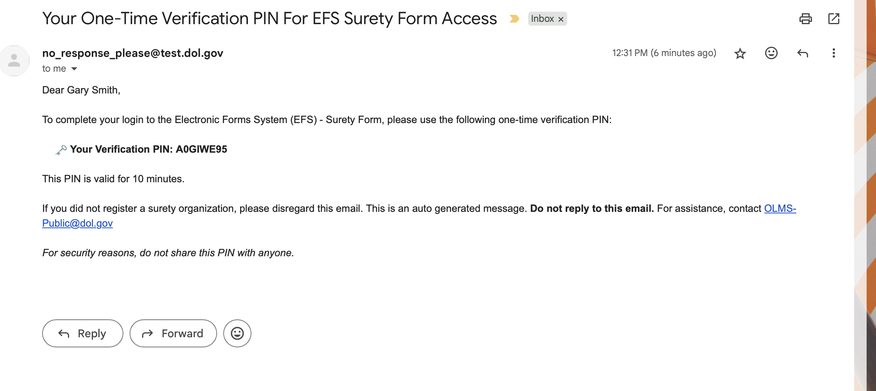
One-Time Verification PIN
Open your email and locate the message containing your one-time verification PIN.

Slide 10
PIN Verification
Enter the verification PIN in the field provided and select Verify to complete the sign-in process.
.

Slide 11
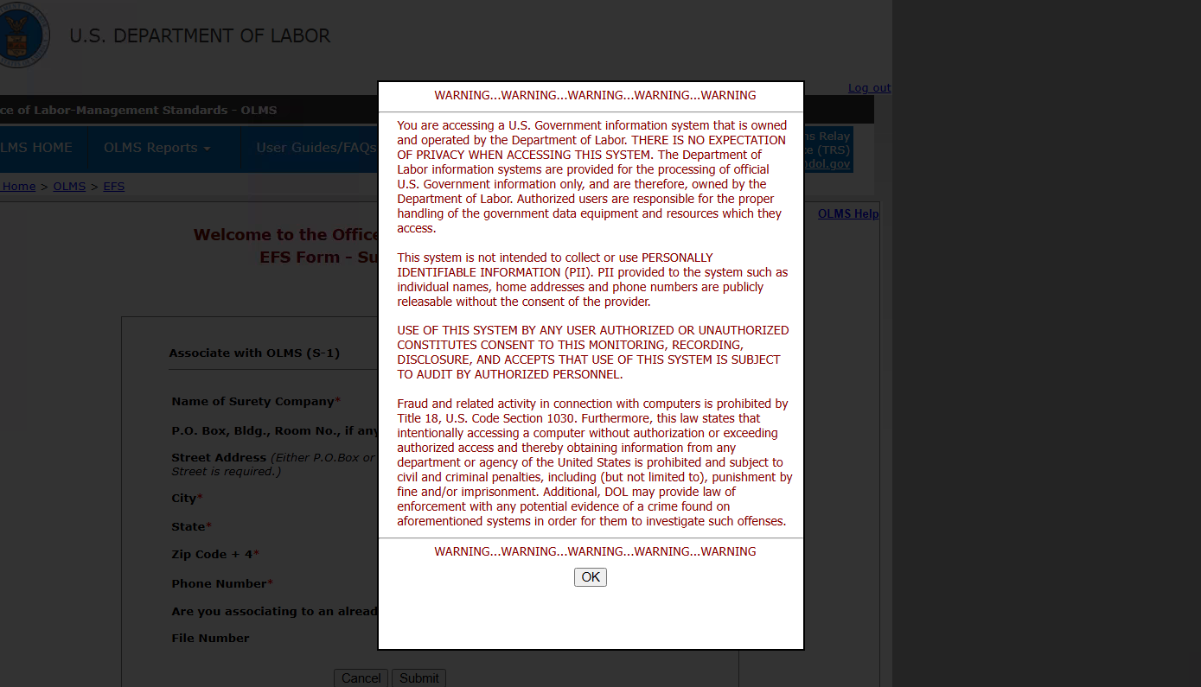
System Warning
After your PIN is verified, a warning message appears indicating that you are accessing a U.S. Government information system.

Slide 12
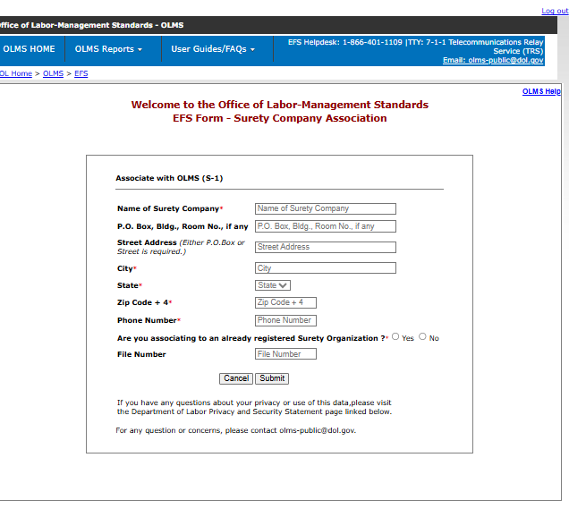
Registering or Associating your organization
Enter the required Surety Organization information, including the organization name, address, city, state, ZIP code, and phone number.

Slide 13
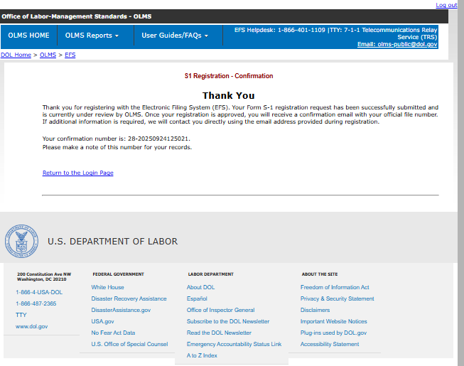
Confirmation Message
After your registration is submitted, a confirmation message appears indicating that your Form S-1 surety organization registration request has been successfully submitted.

Slide 14
Registration Pending Review
After receiving your registration approval, sign back in to the Electronic Filing System (EFS) using your User ID and Password.

Slide 15
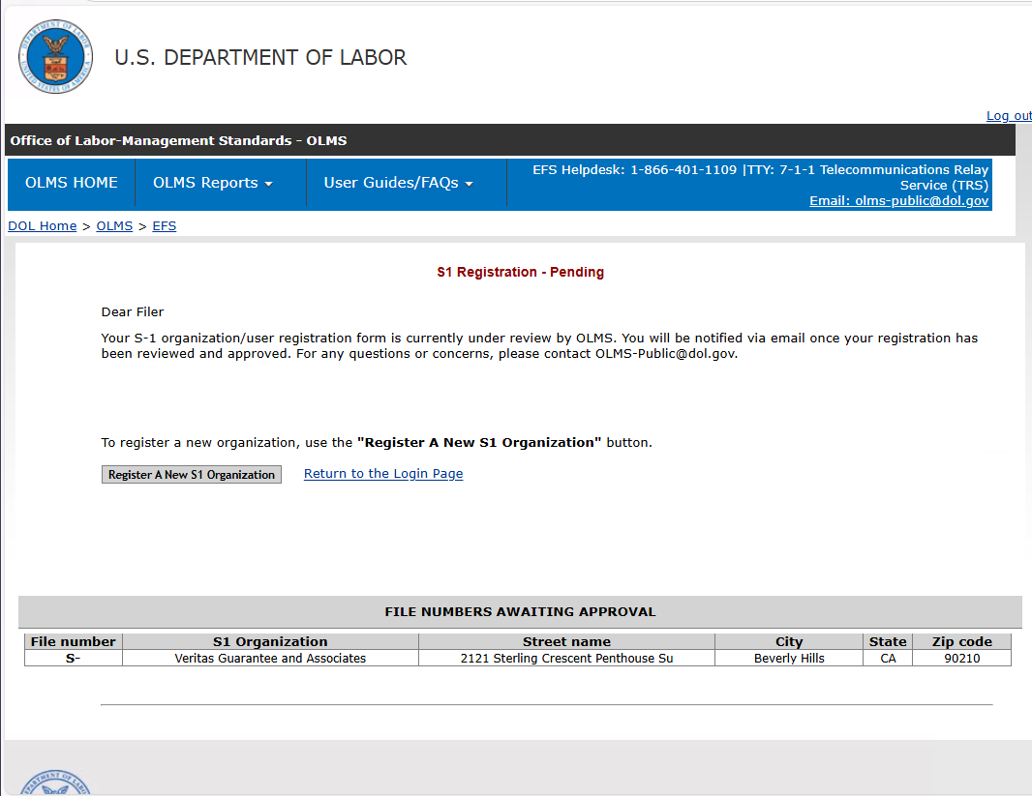
Registration Status
This page indicates that your S-1 Organization/User Registration Form is currently under review. Check your email for approval confirmation

Slide 16
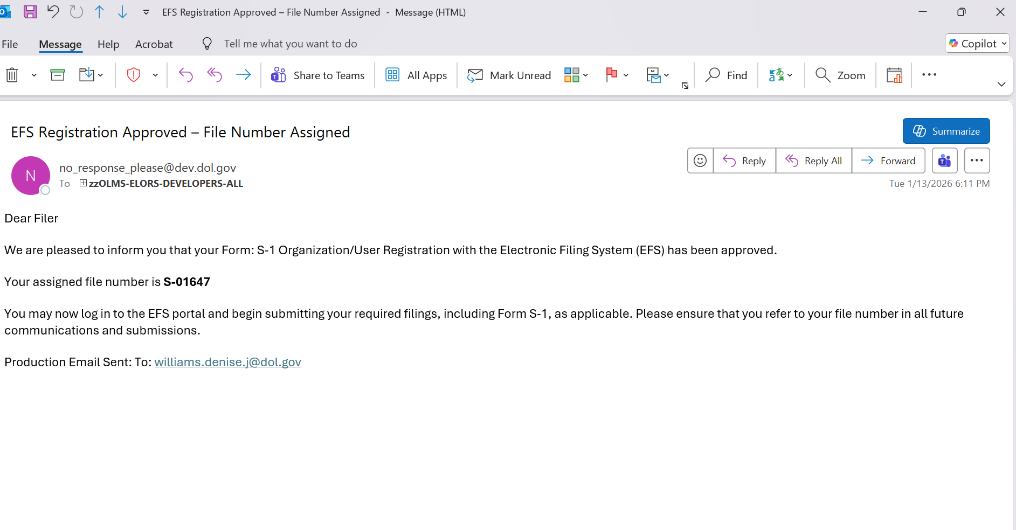
Registration Approval
After your registration is reviewed and approved, you will receive an email confirming that your EFS registration has been approved and that a file number has been assigned.

Slide 17
Starting the S-1 Report Submission
When you log back in, follow the same sign-in and verification steps described earlier, including Cloudflare verification and PIN verification.

Slide 18
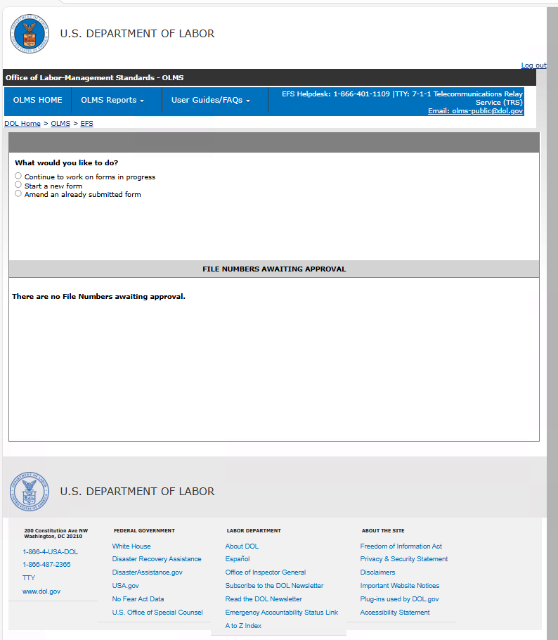
Beginning your S-1 Form
After signing in successfully, the What would you like to do? page appears. This page allows you to select how you want to continue.

Slide 19
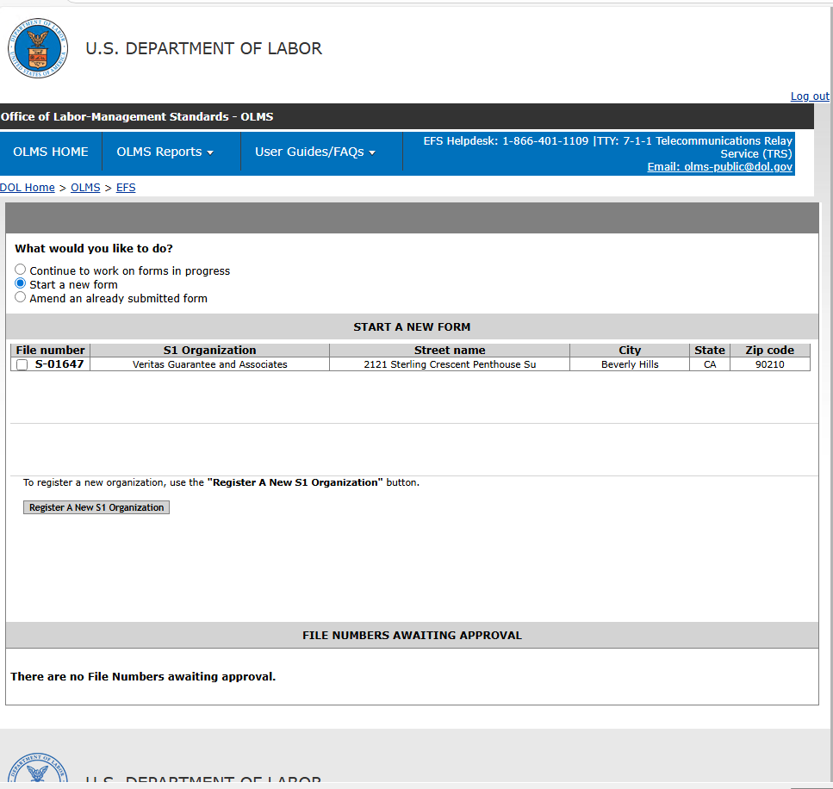
Start a New Form
Select Start a new form to begin a new Form S-1 Surety Company Annual Report.

Slide 20
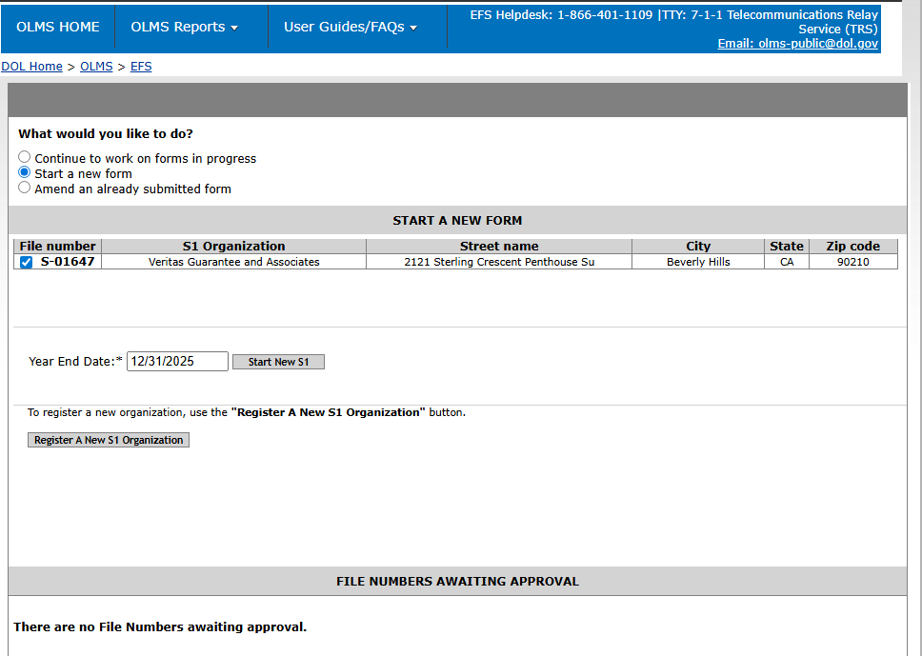
Start a New Form-Cont.
After selecting Start a new form, select the checkbox next to your assigned file number, enter the Year End Date, and select Start New S1 to open a new S-1 Annual Report.

Slide 21
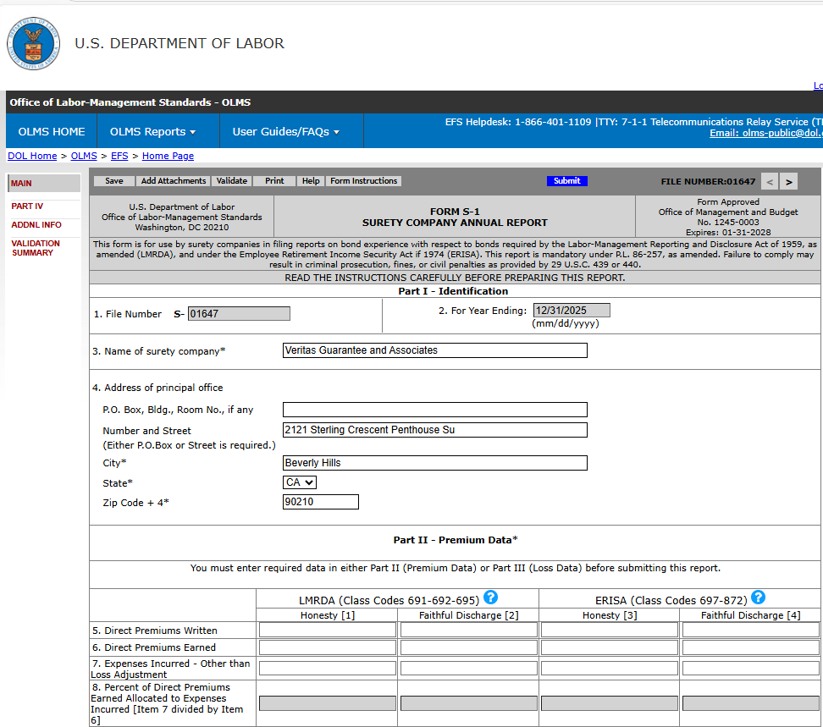
Completing Parts I & II
Carefully review the on-screen instructions before entering the required information into each section.

Slide 22
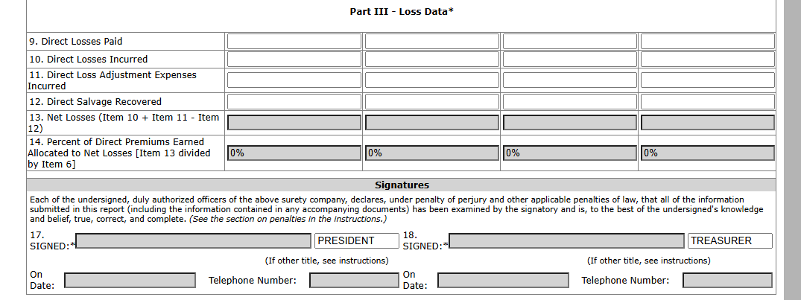
Completing Part III
After the Form S-1 Annual Report opens, read all on-screen instructions carefully before entering the required information.

Slide 23
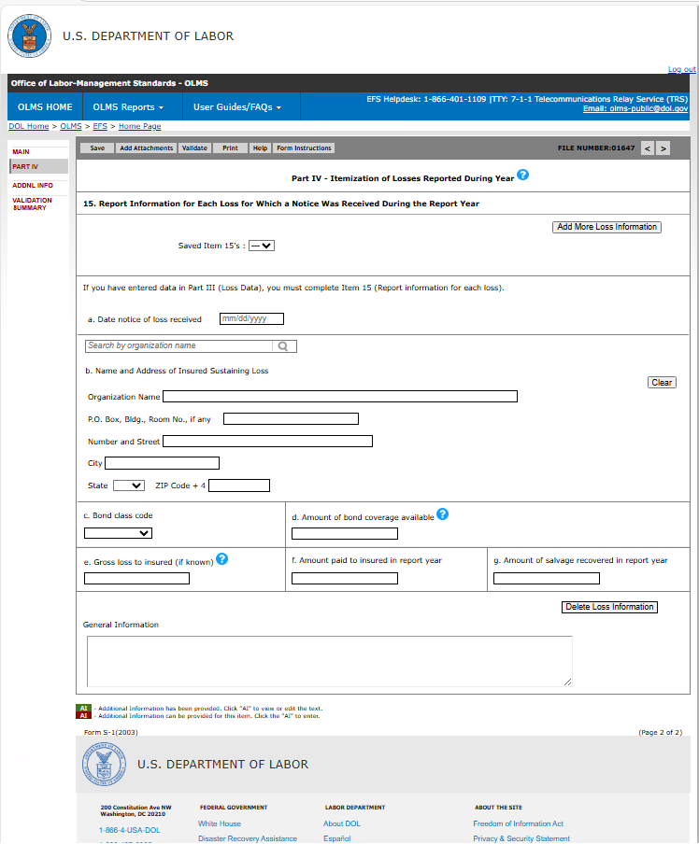
Completing Part IV
After the Form S-1 Annual Report opens, read all on-screen instructions carefully before entering information.

Slide 24
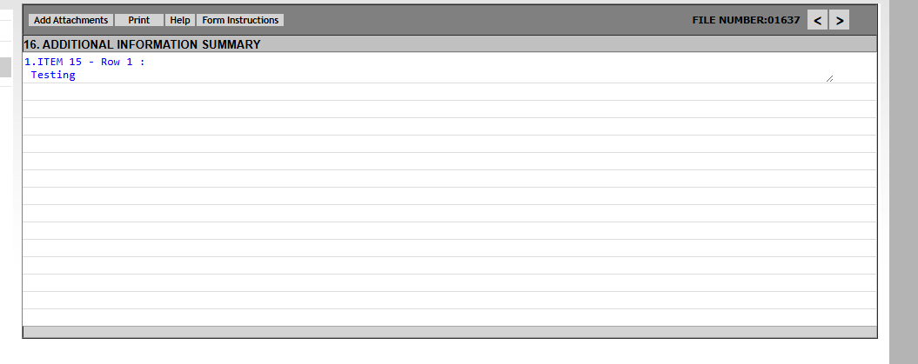
Additional Information - Summary
Provide any additional information needed to complete an item and specify the item to which the information applies.

Slide 25
Attachments
Attachments must be upload in PDF or .doc format only.

Slide 26
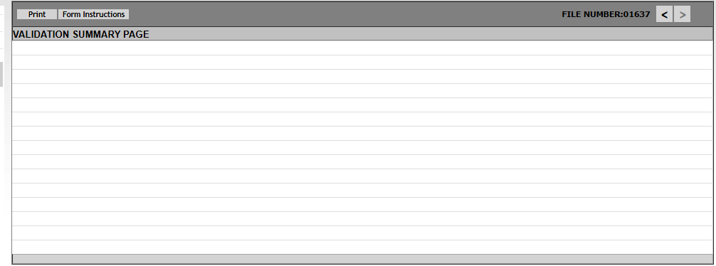
Validation – Form Level
Form Level Validations occur as a final check before the form can be submitted. You must select the Validate link on the top menu bar.
The system will open the Validation Summary Page containing a list of items that must be corrected.
You can select each item and be taken to the page where the item can be corrected. For more information on what should be provided for these items, consult the form instructions.

Slide 27
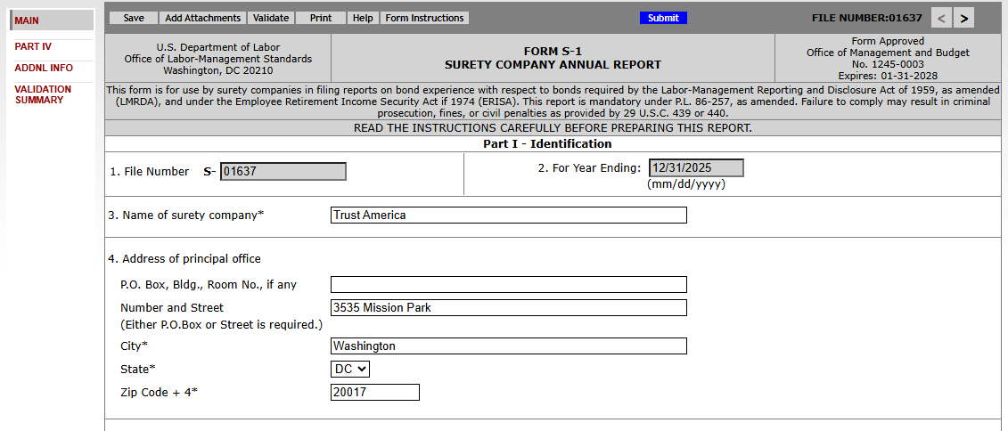

Slide 28
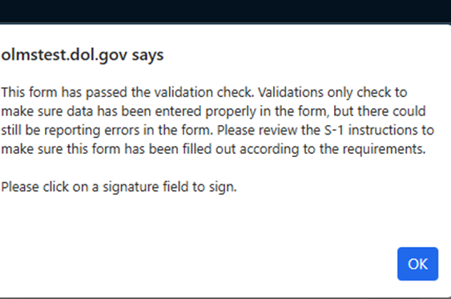
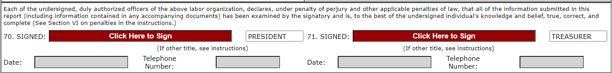
Validation & Signature Blocks
Once all the validation items have been corrected, the form is ready
to be signed.
The signature blocks will turn red, indicating the form can be signed.
Note: All officers who must sign the form must have established user accounts and must log into EFS with their account information to sign the form.

Slide 29
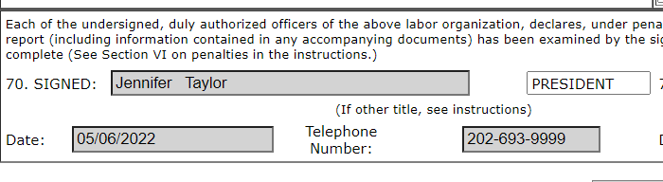
Signing the Form – Additional Signatures
A minimum of two signatures are required to submit the report. If there is a need to apply more signatures on the form, select the Add Additional Signatures link below the signature blocks to add two additional signature blocks.
Once the report has been signed, if any changes are made to any fields on the form, the signatures will be removed and the form must be validated and signed again.

Slide 30

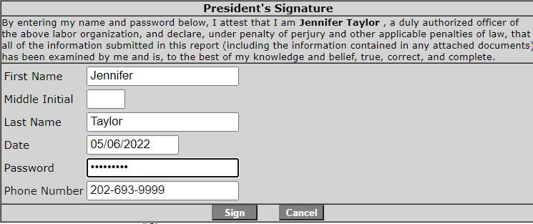
Signing the Form
You must re-enter your password to ‘sign’ the form. By doing so, you are legally attesting that you are the person identified by name in the signature block and a duly authorized officer of the surety company.

Slide 31
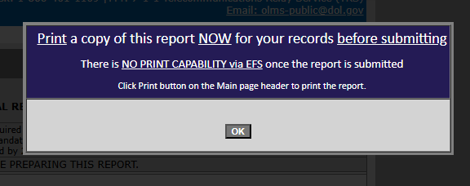
Printing or Saving the Form
Select the Print option to print the entire report or to save a signed copy of the report as a PDF to your computer. Do this before submitting the report.
Note: You can obtain a copy of the submitted report from the Online Public Disclosure site. Please see the next section for information on this.

Slide 32
Summitting the Form
To complete the submission process, select the blue Submit button to finalize your entry.

Slide 33
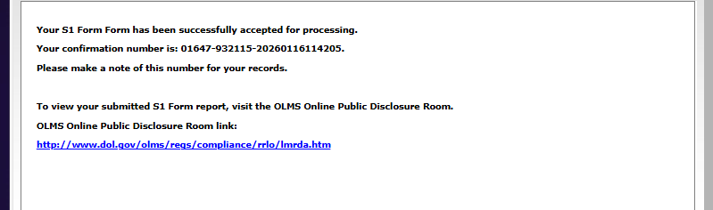
Submission Confirmation
Once the signatures have been applied, the form can be submitted.
Select the Submit button from the top menu bar. Once the form has been processed (this may take a few minutes) a confirmation message will display:
You can print this message by going to File→ Print or simply copy and paste the text from the page into an email or word processing document.
You should now be able to view your submitted report in the OLMS Online Public Disclosure Room, by using the link shown above.

Slide 34
Getting Help
If you experience difficulty using EFS, please contact OLMS Form Technical Support toll-free at: 1-866-401-1109.
This PowerPoint presentation and other information regarding EFS can be found on our website at the following URL: https://www.dol.gov/agencies/olms/regs/compliance/EFS/EFShelp
If you have additional questions or comments please contact OLMS: email OLMS at olms-public@dol.gov or call OLMS at (202) 693-0123.

