Slide 1
ELECTRONIC
FORMS SYSTEM (EFS)
Guide to
Using EFS Preparing Form LM-4

Slide 2
ELECTRONIC FORMS SYSTEM (EFS) LM-4
EFS is a web-based system for completing and filing Form LM-4 Labor Organization Annual Report.
This tutorial demonstrates basic features and functionality of the EFS LM-4 form. It does not contain instructions for what information should be provided on your report.
You can download a complete set of LM-4 Instructions from the OLMS website.

Slide 3
System Requirements and Settings
To access and use the EFS, OLMS recommends you use one of the following browsers:
  Microsoft Edge
  Google Chrome –Version 7.0 or higher

Slide 4
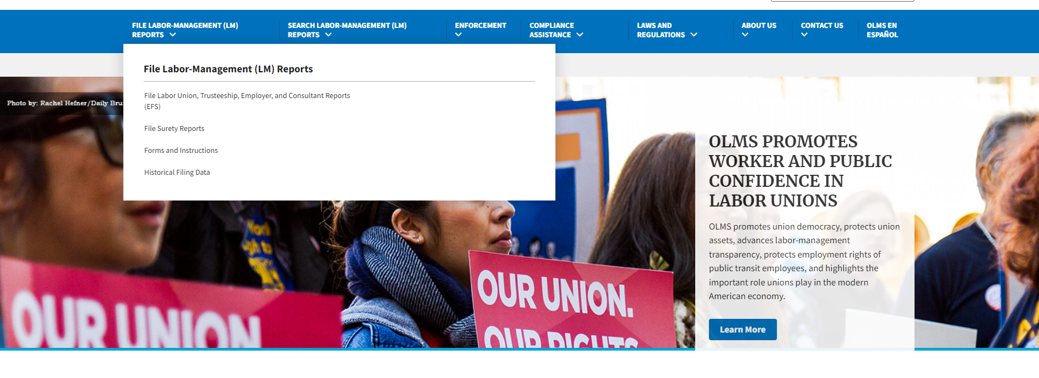
Accessing the System
Navigate to the OLMS Website and select FILE LABOR-MANAGEMENT REPORTS, then from the drop-down menu, select the “File Labor Union, Trusteeship, Employer, and Consultant Reports (EFS)” link.

Slide 5
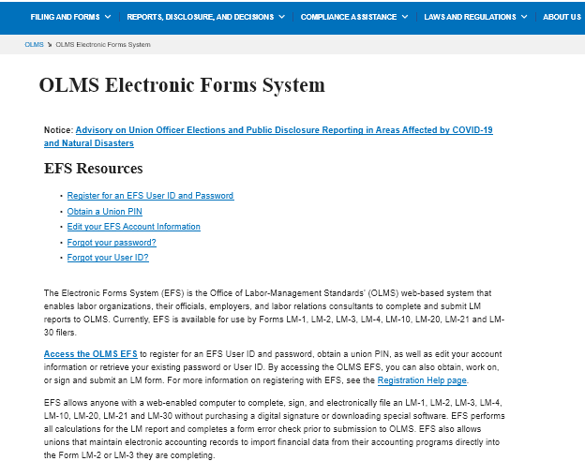
Access the OLMS EFS
From the EFS Introduction page, select on the “Access the OLMS EFS” link.

Slide 6
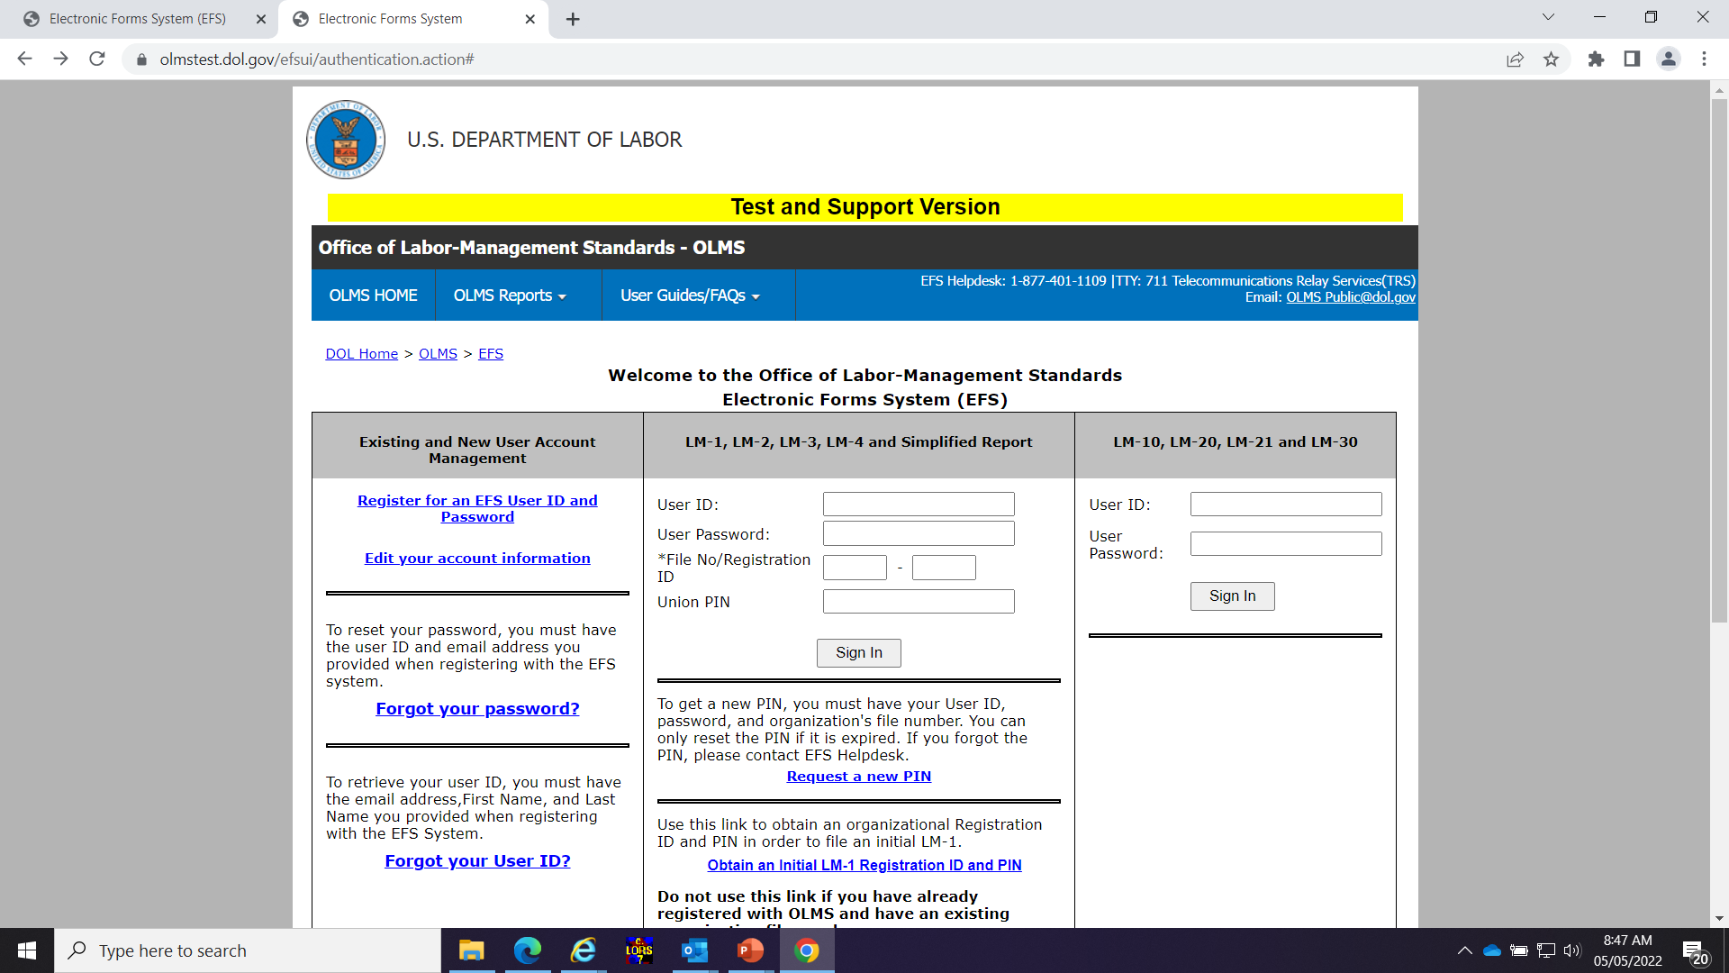
Accessing the System - Register
To access the Form LM-4 in EFS, you must first register with EFS and obtain a user ID and password.
If you already have an EFS user ID and password, you do not need to register again.

Slide 7
Accessing the System – Log In
Log into EFS using your user ID and password and the filing union’s six-digit file number and unique union PIN.

Slide 8
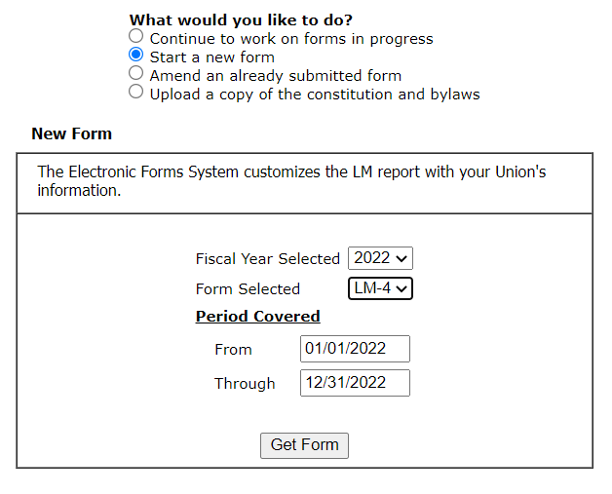
Accessing the System – Start a New Form
Select one of the options displayed on the screen.
(Please note that the only forms that you can amend in EFS are ones that were filed using EFS.)
Select LM-4 from the dropdown
Note: You must change the “period covered” dates before obtaining the form!

Slide 9
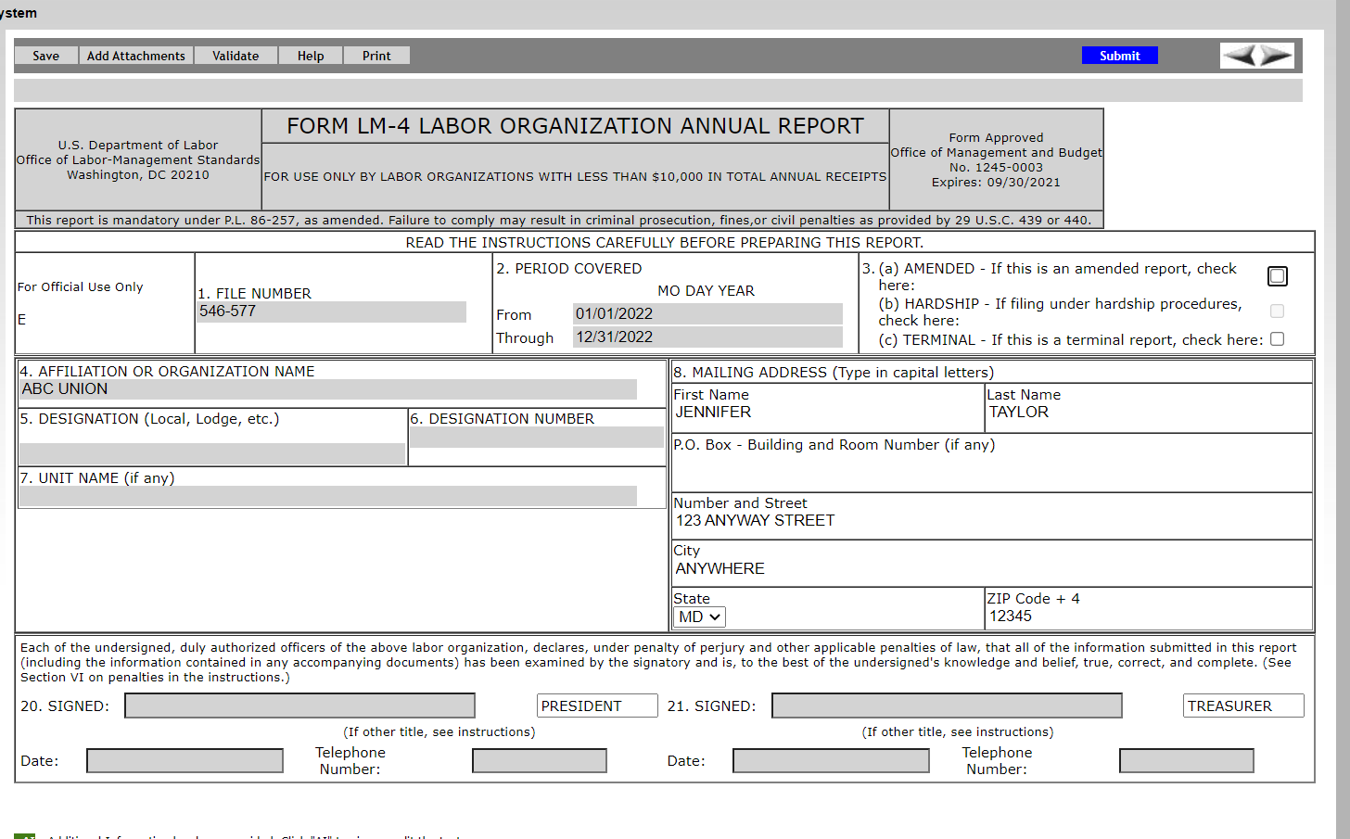
LM-4 Page 1
The EFS form looks similar to the old Adobe form. Your union information is pre-filled.

Slide 10

Navigation
You can easily move through the form by using the navigation links to the left to go directly to a page or by scrolling through pages using the arrows at the top.

Slide 11
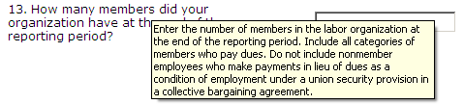
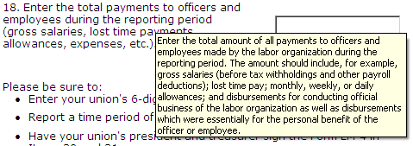
Getting Help Within the Form
The form has several built-in help functions.
Mouse-over text that displays information on what to report or how to enter data into a field is available on many items.

Slide 12
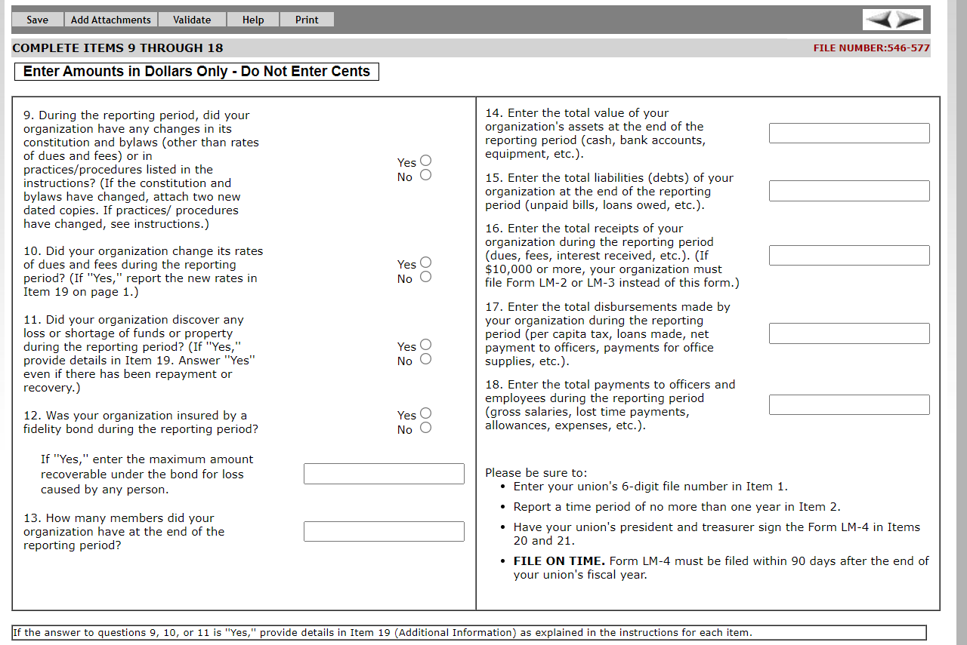
Getting Help Within the Form – Help Link
Click the Help link at the top of each page to open the form instructions for the current page in a new window.

Slide 13
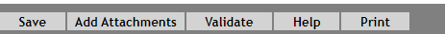
Menu Items
The menu across the top of the form contains the following items:
Save – Select this item to save the current page. It is important to click Save at regular intervals when entering data in the form. If you do not save, you will be prompted to do so when you navigate away from a page.
Add Attachments – Select this item to open the Add Attachments page where supplemental information (like a constitution and bylaws or audit report) can be uploaded. The uploaded data can then be submitted with the form.

Slide 14

Menu Items (cont’d)
The menu across the top of the form contains the following items:
Validate – Select this item to run the form validation routine, which checks the form for missing data. Each page has its own set of validations, and you will be prompted to fix these items before leaving the page if you wish. All validations must be satisfied before the form can be signed and submitted.
Help – Select this item to take you to page-specific instructions for completing the form. You can navigate through the instructions page by page, or download/print a copy from our website at: https://www.dol.gov/agencies/olms/reports/forms/lm-1-lm-2-lm-3-lm-4
Print – Select this item to open a facsimile of the electronically completed LM-4. You can save a copy of this report to your computer and share it with others who may need to prepare or review the document. You may save a copy of the final signed report prior to submission.

Slide 15
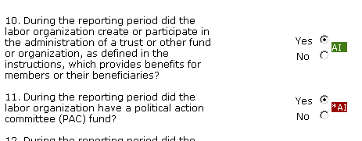
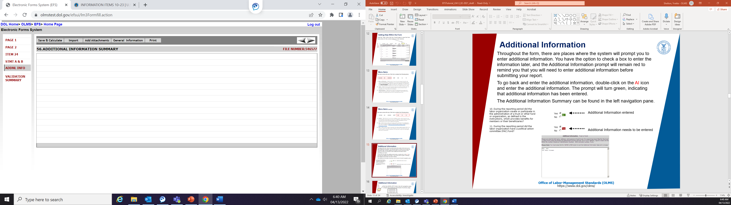
Additional Information
Throughout the form, the system will prompt you to enter additional information. You have the option to enter the information later, and the Additional Information prompt will remain red to remind you to enter additional information before submitting your report.
To enter the additional information, double-click on the AI icon and enter the additional information. The prompt will turn green, indicating that additional information has been entered.
The Additional Information Summary can be found in the left navigation pane.
AI
Additional Information entered
Additional Information needs to be entered

Slide 16
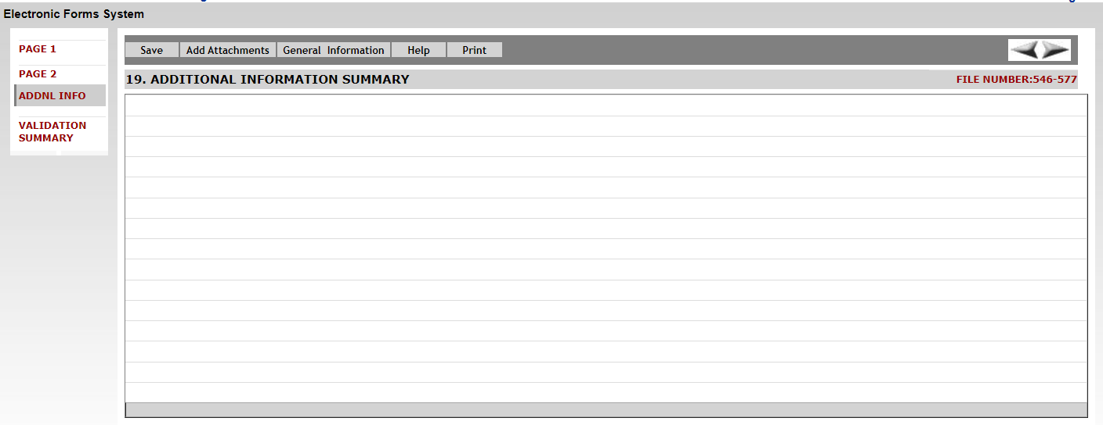
Additional Information Summary
Select the “ADDNL INFO” link in the left navigation pane to display the Additional Information Summary page.
To enter any other additional information required by the form instructions, click the General Information link.

Slide 17

Attaching Supplemental Data
As with the previous forms system, EFS allows you to attach data, such as constitutions and bylaws, that may be required to be submitted with the report.
To begin the process of adding an attachment, click the Add Attachments link on the top menu bar.
Note: While the system does not prevent them from being uploaded, certain file formats cannot be read by our system. The following file formats can be read:
  Adobe PDF
  Microsoft Word
  Microsoft Excel
  Rich Text Format
  HTML
  Standard Picture formats JPEG, BMP, GIF
  Text files

Slide 18
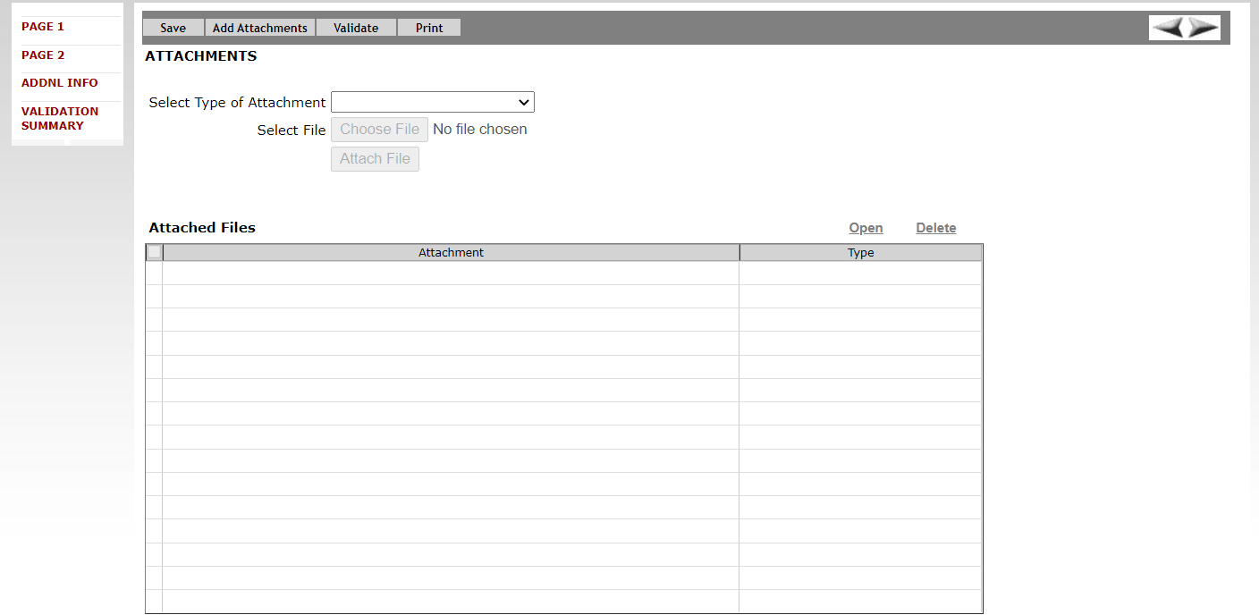

Attaching Supplemental Data – Reviewing
Bylaws and Other Attachments
Select the type of attachment you want to upload. Reviewers can view attachments by selecting the check box to the left of the attachment name and clicking the open link.

Slide 19
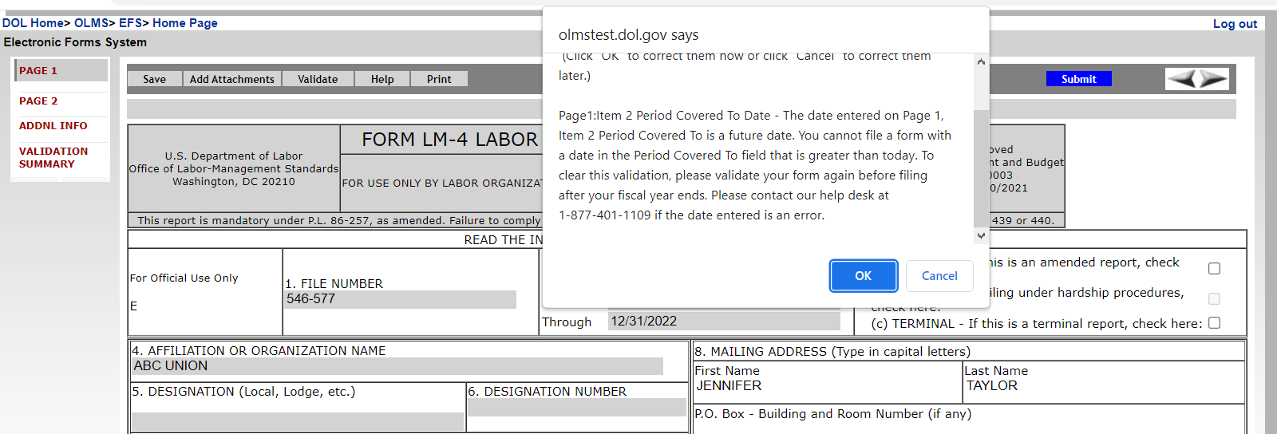
Validation – Page Level
There are two types of validations built into the form to help ensure that the correct data is being entered into the form: Page Level Validations and Form Level Validations.
Page Level Validations occur before you navigate away from a page. A pop up message will alert you of items that must be corrected before the form can be signed and submitted.
If you click OK you can correct the item before leaving the page.
If you click Cancel, you can correct the item later. You will be prompted to make the correction during form validation.

Slide 20
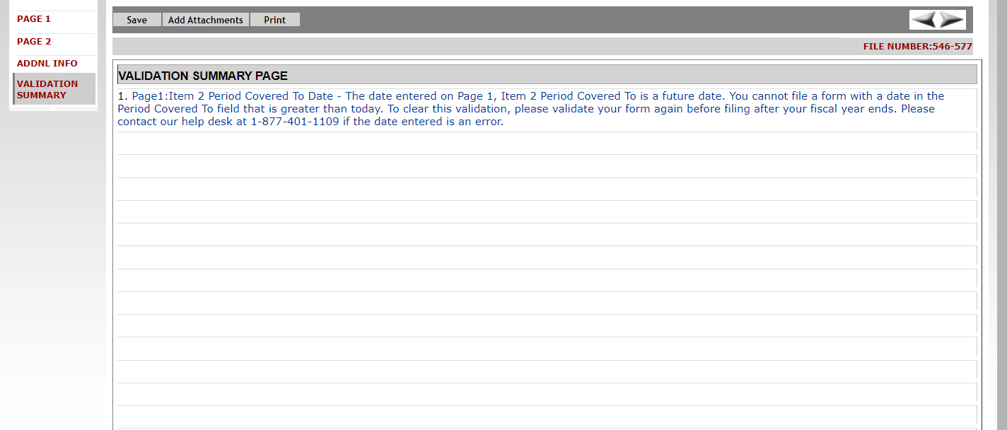
Validation – Form Level
Form Level Validations occur as a final check before the form can be submitted. You must click the Validate link on the top menu bar.
The system will open the Validation Summary Page containing a list of items that must be corrected.
You can select each item and be taken to the page where the item can be corrected. For more information on what should be provided for these items, consult the form instructions.

Slide 21
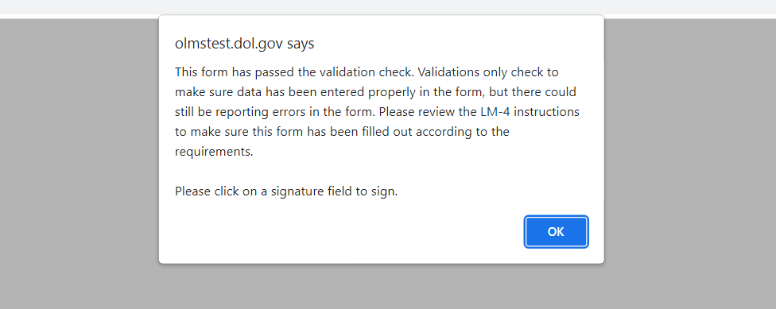
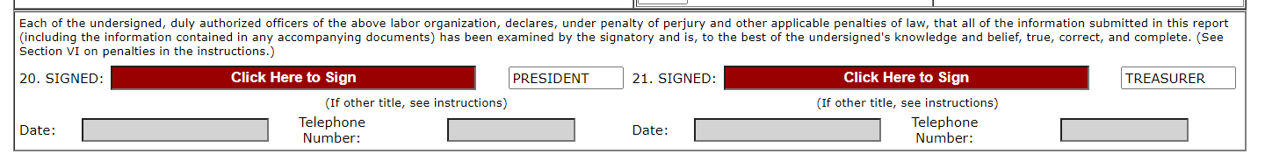
Signature Blocks
Once all of the validation items have been corrected, the form is ready to be signed.
The signature blocks will turn red, indicating the form can be signed.
Note: All officers who must sign the form must have established user accounts and must log into EFS with their account information to sign the form.

Slide 22
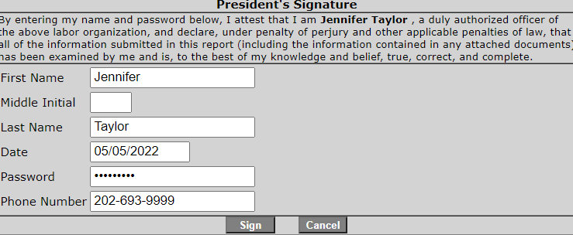
Signing the Form
A minimum of two signatures are required to submit the report.
Each officer will have to log in separately to sign the form.
Once the report has been signed, if any changes are made to any fields on the form, the signatures will be removed, and the form must be validated and signed again.

Slide 23
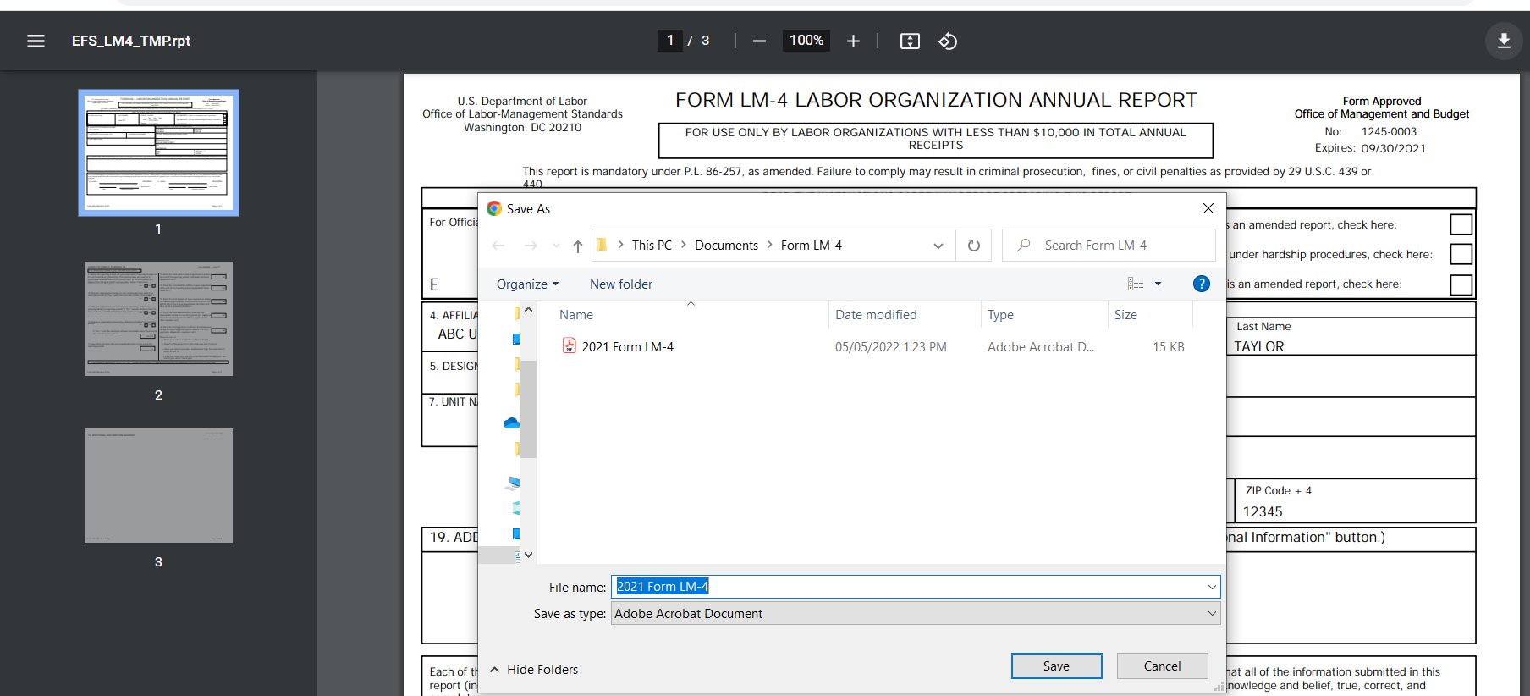
Save a Signed Copy
Select the Print item and click File→ Save As to save a signed copy of the report as a PDF to your computer. Do this before submitting the report.
Note: You can obtain a copy of the submitted report from the Online Public Disclosure site. Please see the next section for information on this.

Slide 24
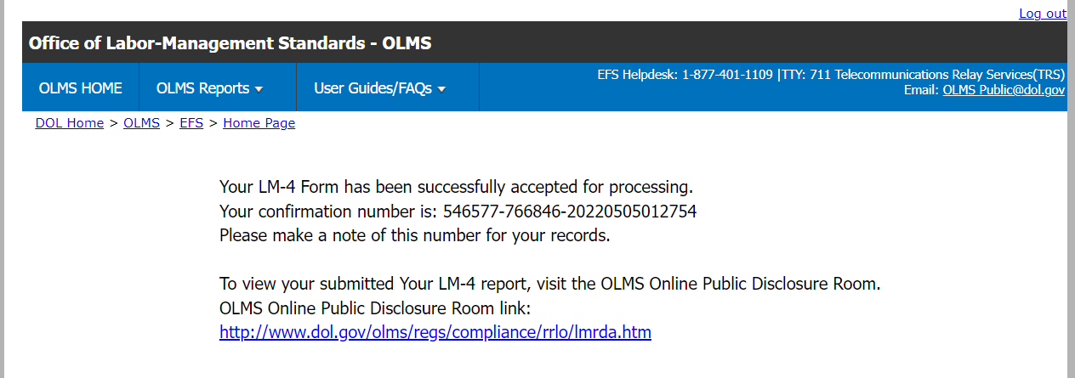
Submitting the Form
Once the signatures have been applied, the form can be submitted.
Select the Submit button from the top menu bar. Once the form has been processed (this may take a few minutes) a confirmation message will display:
You can print this message by going to File → Print, or simply copy and paste the text from the page into an email or word processing document.
You should now be able to view your submitted report in the Online Public Disclosure Room, by using the link shown above.

Slide 25
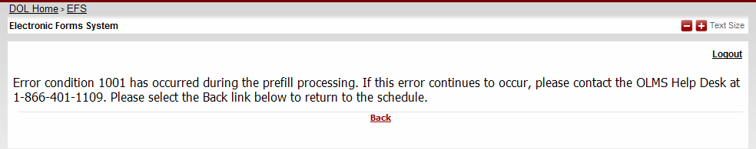
Troubleshooting
During peak filing periods, you may experience a slowdown in saving and validating the report.
During these busy periods, you may see an error that looks like this:
Please wait a few minutes and try again. However, if you continue to experience the problem, please contact our technical support desk. See the next page for information on how to get help.

Slide 26
Getting Help
If you experience difficulty using EFS, please contact OLMS Form Technical Support toll-free at: 1-866-401-1109
This PowerPoint presentation and other information regarding EFS can be found on our website by accessing the following URL: http://www.dol.gov/olms/regs/compliance/efs/efsintro.htm
If you have additional questions or comments please contact OLMS:
email OLMS at olms-public@dol.gov
or contact your local OLMS District Office

