Slide 1
Electronic
Forms System (EFS)
Guide to
Using EFS Preparing Form LM-30

Slide 2
ELECTRONIC FORMS SYSTEM (EFS) FORM LM-30
EFS is a web-based system for completing and filing forms required under the Labor-Management Reporting and Disclosure Act (LMRDA), including the Form LM-30 Labor Organization Officer and Employee Report.
This tutorial demonstrates basic features and functionality of the EFS Form LM-30 (revised in 2011). It does not contain instructions for what information should be provided on your report. Please consult the Form LM-30 instructions if you have questions about what information should be entered on the report.
You can download a complete set of Form LM-30 instructions from the OLMS website.

Slide 3
System Requirements and Settings
To access and use EFS, OLMS recommends that you use one of the following browsers:
  Microsoft Edge
  Google Chrome –Version 7.0 or higher

Slide 4
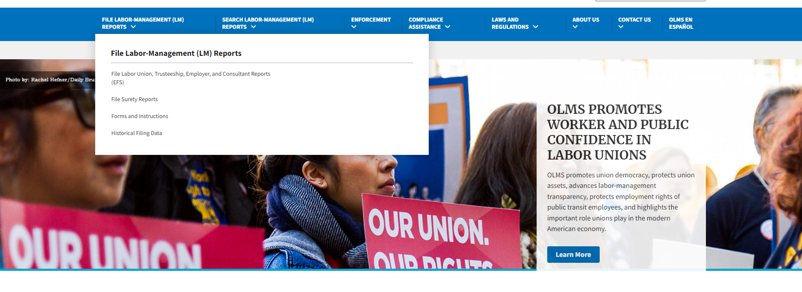
Accessing the System
Navigate to the OLMS Website and select FILE LABOR-MANAGEMENT REPORTS, then from the drop-down menu, select the “File Labor Union, Trusteeship, Employer, and Consultant Reports (EFS)” link.

Slide 5
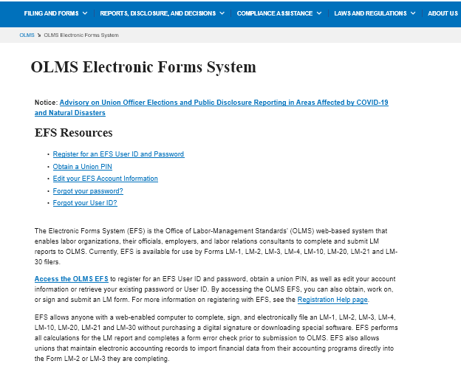
Access the OLMS EFS
From the EFS Introduction page, select on the “Access the OLMS EFS” link.

Slide 6
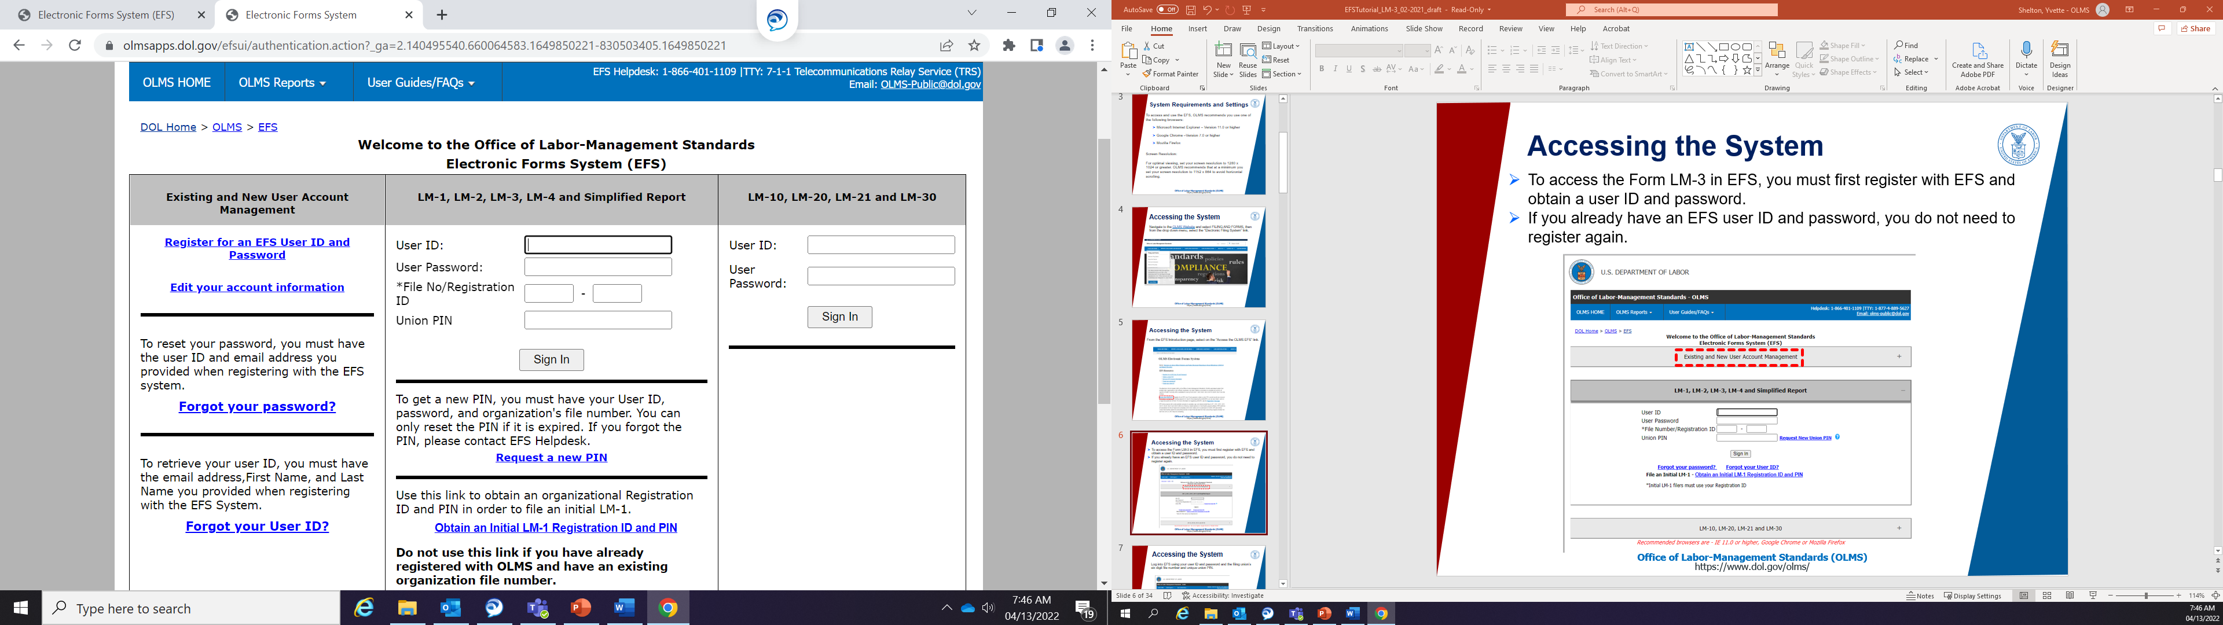
Accessing the System
To access the Form LM-30 in EFS, you must first register with EFS and obtain a user ID and password.
If you already have an EFS user ID and password, you do not need to register again.

Slide 7
Accessing the Form LM-30
Once you have a user ID and password, you will be able to access the Form LM-30 on the right side of the page.

Slide 8
Accessing the Form LM-30 – Sign In
Log into EFS using your user ID and password and select “Sign In”.

Slide 9
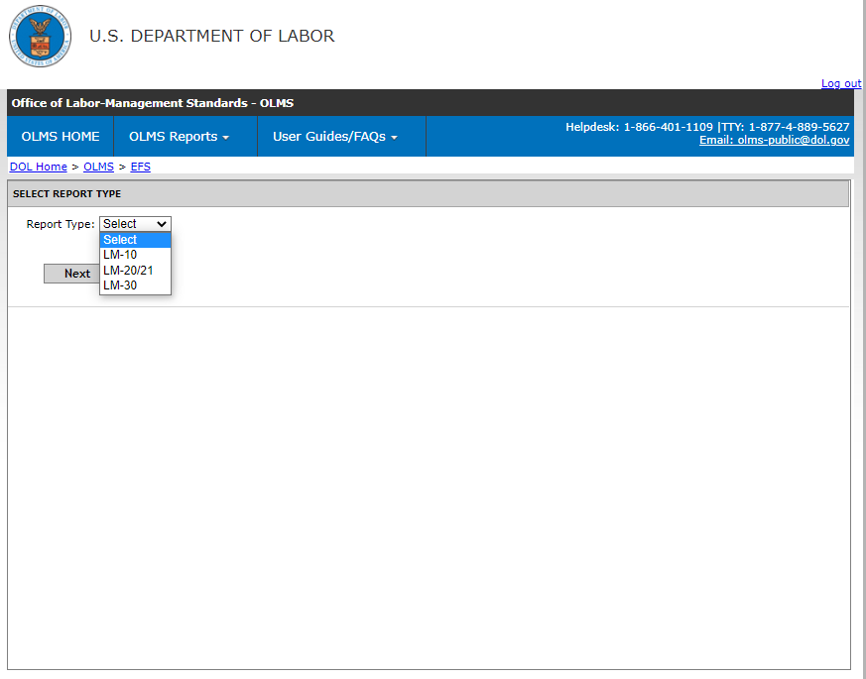
Select Report Type
You must choose the type of report you are filing. Select “LM-30,” then select Next.

Slide 10
Start a New Form LM-30
There are three different ways you can start a new form:
Using the File Number from a previously filed Form LM-30;
Entering your Name in the “Search By” fields; or
Entering your Zip Code, if you have never filed an LM-30 previously.
Each of these methods are described in more detail in the next slides.

Slide 11
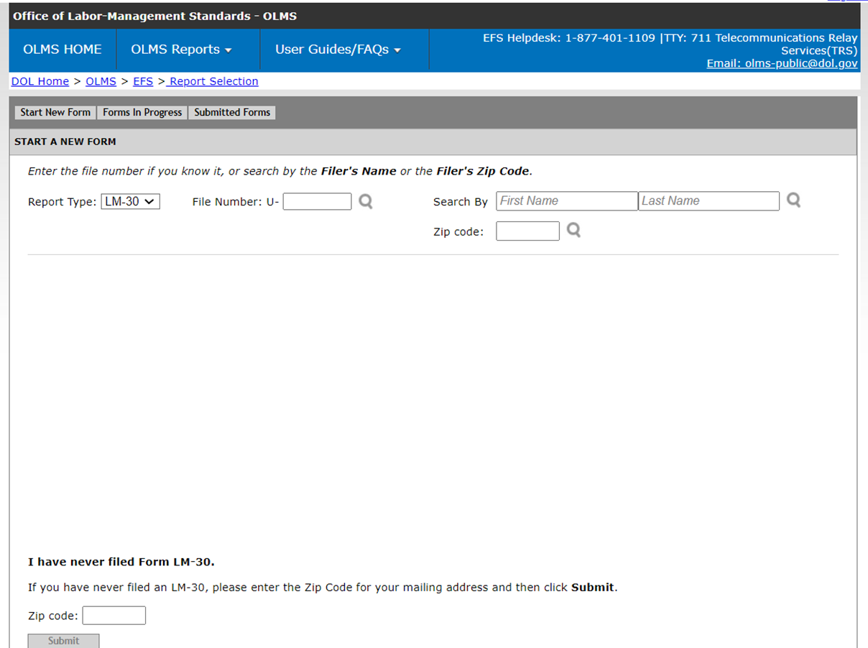
Start a New Form LM-30 – File Number
If you have previously filed a Form LM-30 report, enter the File Number in the File Number box, and then press enter.
File Numbers should be 5 digits and start with a U. This number can be found in box one of your previously filed Form LM-30.

Slide 12
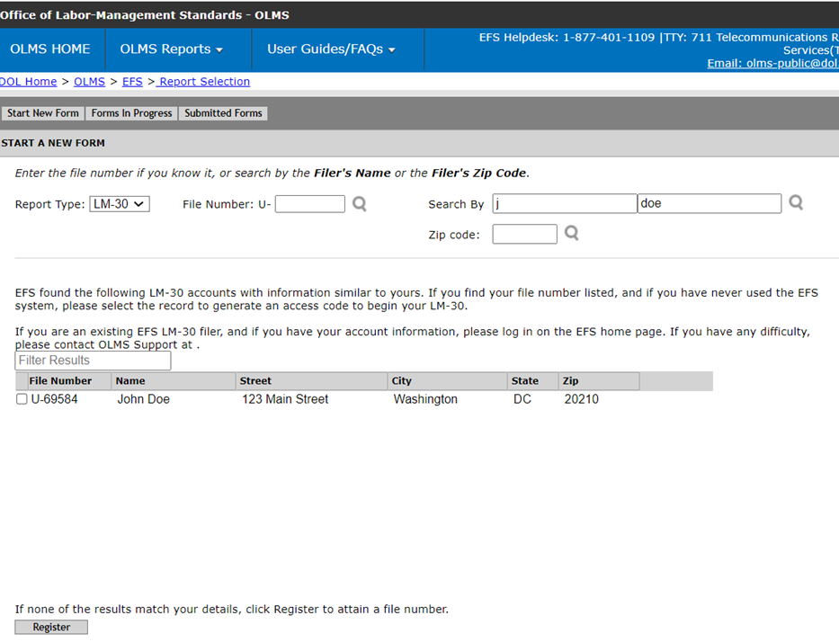
Start a New Form LM-30 – Search By
Search for your name in the Search By fields. You can do a partial search.
For example, you may enter just a last name and a first initial. Click the magnifying glass icon to search. If you locate your record, check the box to the left and click the Select button.

Slide 13
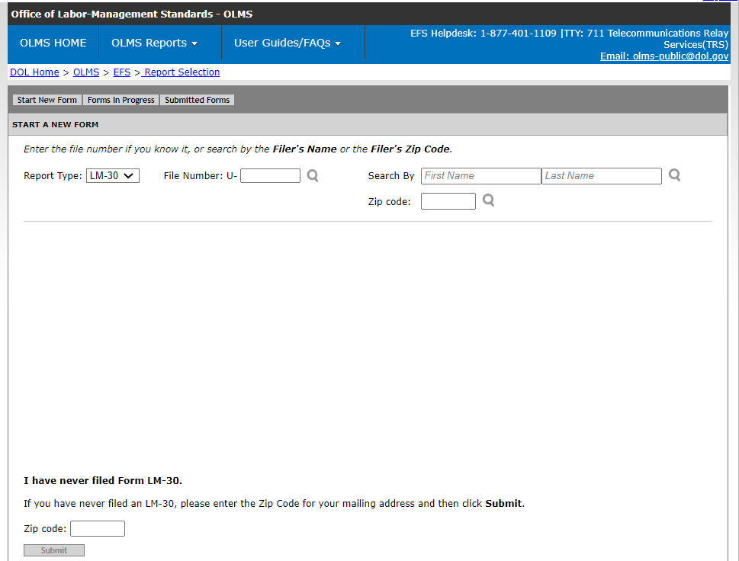
Start a New Form LM-30 – Zip Code
If you are sure, you have not previously submitted a Form LM-30 report,
enter the Zip Code and select the “Submit” button.
The system will generate a file number for you beginning with U-. Please make a note of this number.

Slide 14
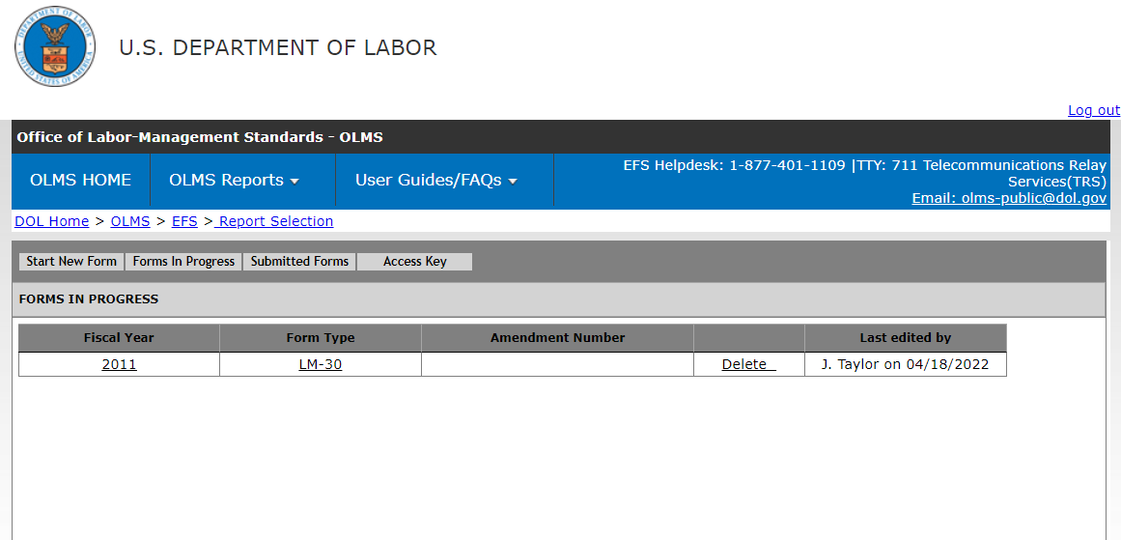
LM-30 Forms In Progress
If you have previously started a Form LM-30, select the “Forms In Progress” tab. Click the link for the fiscal year to open the form for editing.
NOTE: Click the delete button to delete the entire form

Slide 15
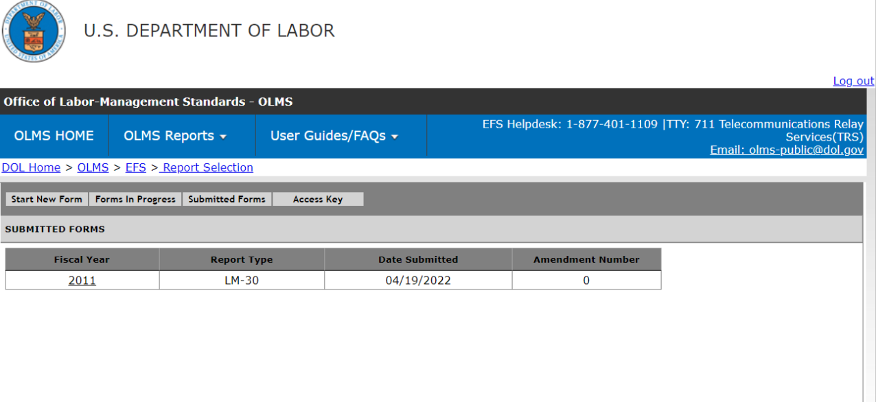
Form LM-30 – Submitted Forms
If you need to amend a Form LM-30 report that you previously submitted via EFS, select the Submitted Forms tab to view and retrieve it. You may then amend your report and submit it.
If you need to amend a Form LM-30 report that you originally submitted via mail, you may use EFS to file your amended report. However, you will have to start a new report and re-enter information on the form, since reports that were previously filed manually may not be viewed and retrieved in EFS.

Slide 16
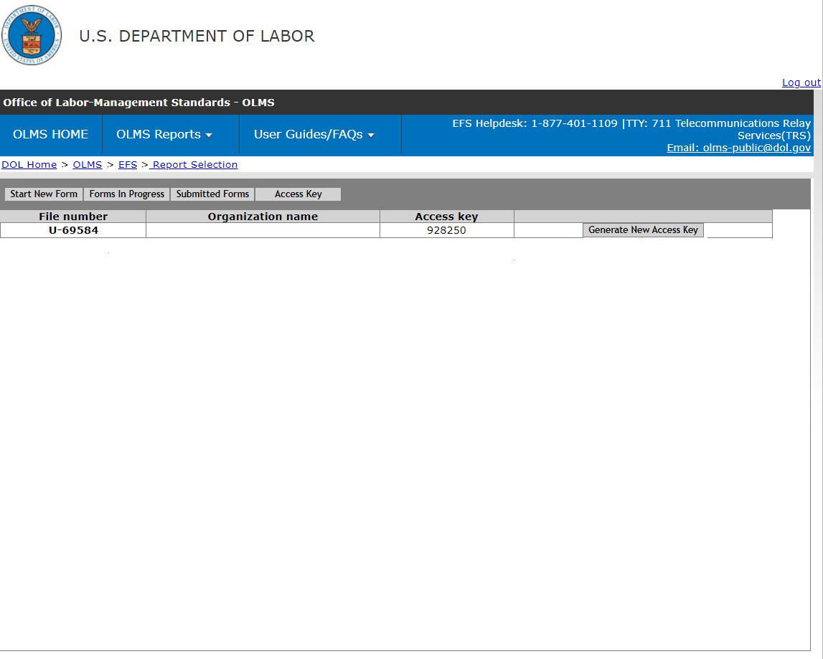
LM-30 Access Key – How To Share Forms
The Access Key is a private key that gives filers the ability to allow others to help prepare the Form LM-30 report. A preparer, such as an accountant, can log into the EFS system using his or her own user ID and password, and can use the filer’s Access Key to link up to the filer and view and edit reports. If forgotten, the Access Key can always be retrieved by clicking the Access Key tab.
A filer should only share this Access Key with individuals who are authorized to have access to the form. At no time should filers or preparers share their user name and password with anyone else. Every user of EFS should have his or her own user ID and password.

Slide 17
LM-30 Access Key – Resetting the Access Key
A filer may need to change the Access Key to prevent unauthorized access to reports. For example, if an accountant is no longer employed by the filer, the filer may wish to change the Access Key to prevent the accountant from having continuing access to his/her forms.
To do this, click the Generate New Access Key button under the Access Key tab.

Slide 18
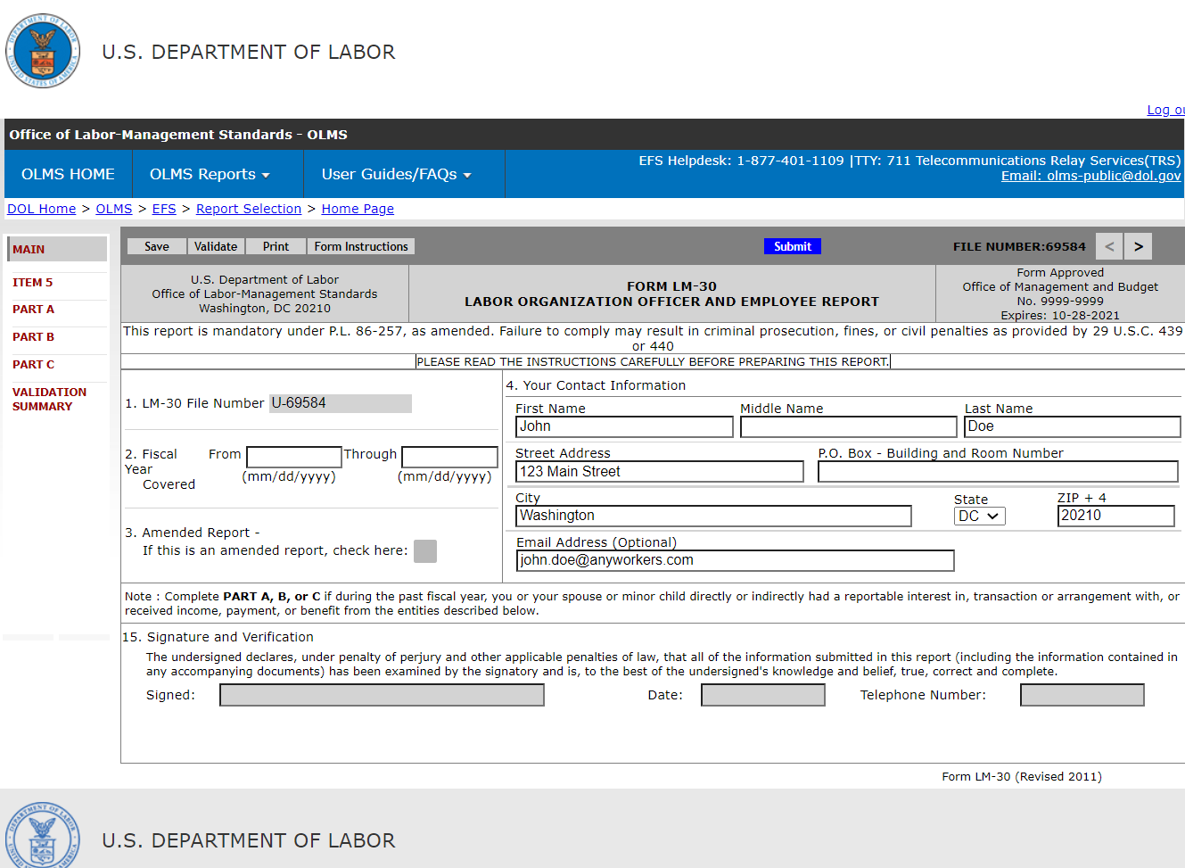
Navigating the Form LM-30 in EFS
Navigate forward and backward through the form by using the navigation arrows, or jump directly to a section by clicking on the page title on the left navigation pane.

Slide 19

Accessing Form LM-30 Instructions in EFS
While working on the Form LM-30 in EFS, you can click on the Form Instructions button to view the complete Form LM-30 instructions in a new window.

Slide 20

Entering Data into the Form LM-30 in EFS
Enter data in all fields. Fields that are “grayed out” indicate that you may not edit the data.
It is important to save your work often by clicking the Save button highlighted below. The form automatically saves your work when moving between pages.
The system will automatically log you out after 30 minutes of inactivity. If you do not save your work, you risk losing unsaved data.

Slide 21
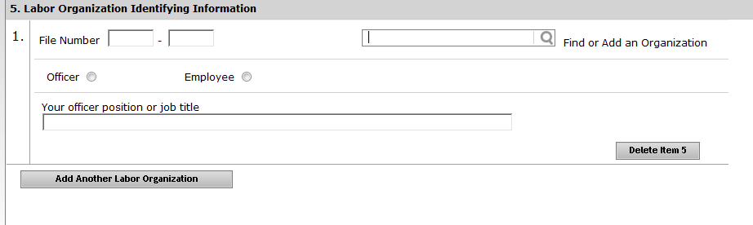
Entering Data into the Form LM-30, Item 5
Searching within the Form LM-30
Item 5 and Parts A, B, and C provide the ability to search and add already established entities (e.g., labor organizations, represented employers, businesses, other employers and labor relations consultants) into the form. This improves efficiency by eliminating the need to enter data that already exists in our database.
Item 5
If you know the labor organization’s 6-digit file number, you can enter it and then hit enter. Otherwise, use the search box to find the labor organization.

Slide 22
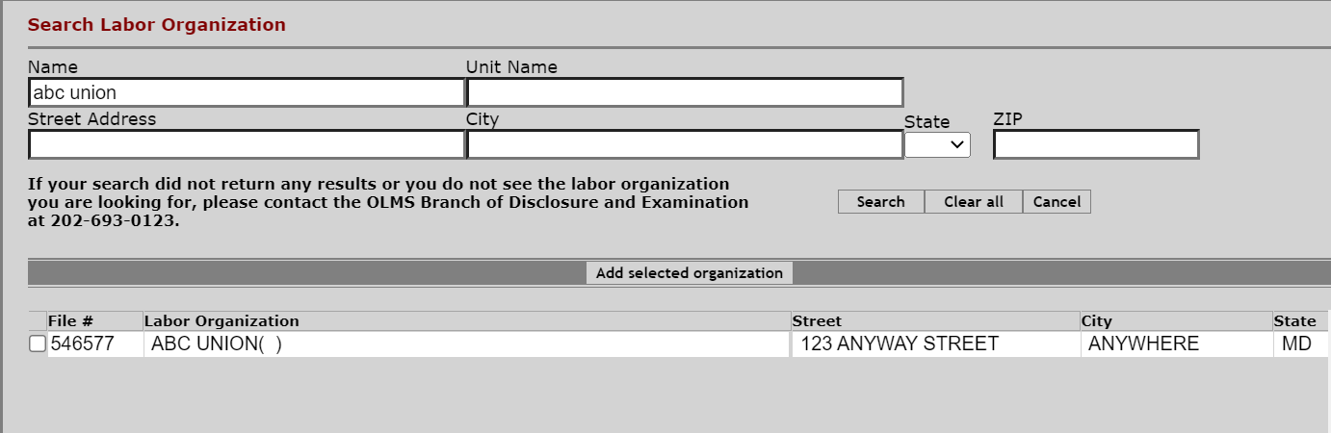
Entering Data into the Form LM-30
Searching within the Form LM-30
When you are searching within the Form LM-30, a box will pop up with a list of choices. You can refine the search by entering more data in the search fields. For example, here we added a city.
If you find the entity you are looking for, check the box on the left and click the “Add selected organization” button. If you have trouble finding the union, you can contact our help desk. Contact information can be found at the end of this presentation.

Slide 23
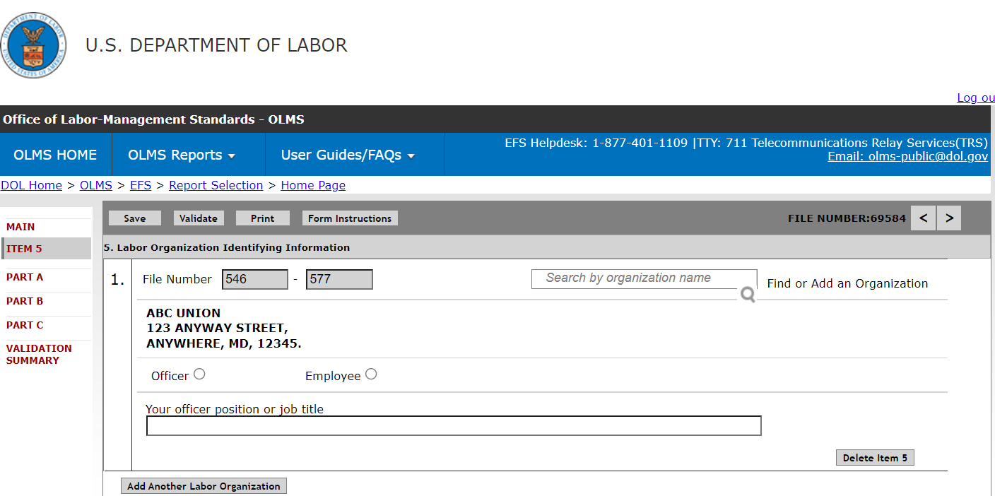
Entering Data into the Form LM-30 – Item 5
Item 5
If you are affiliated with more than one labor organization, you may add another Item 5 entry by clicking the highlighted button below.

Slide 24
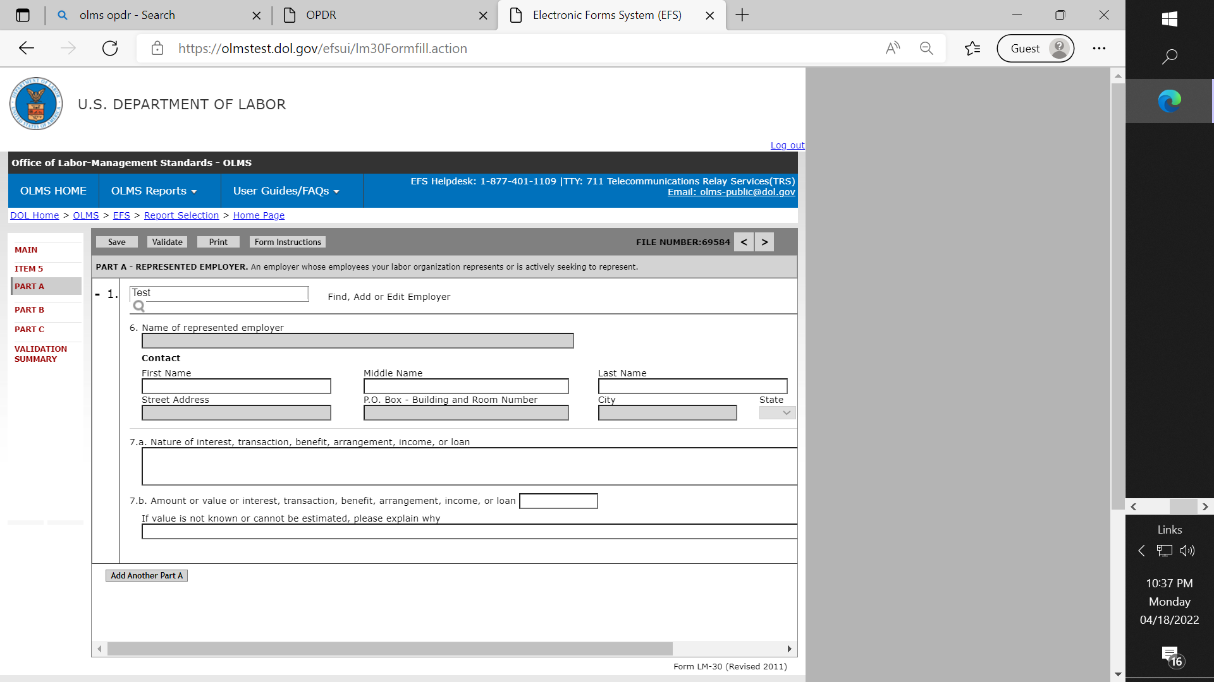
Entering Data into the Form LM-30 – Parts A, B & C
  Parts A, B & C
You must first search to determine if the represented employer, business, labor relations consultant, or other employer for which you are reporting exists in our database. Enter the name in the search box and click the magnifying glass icon. The name and address fields will be “grayed out” until you search.

Slide 25
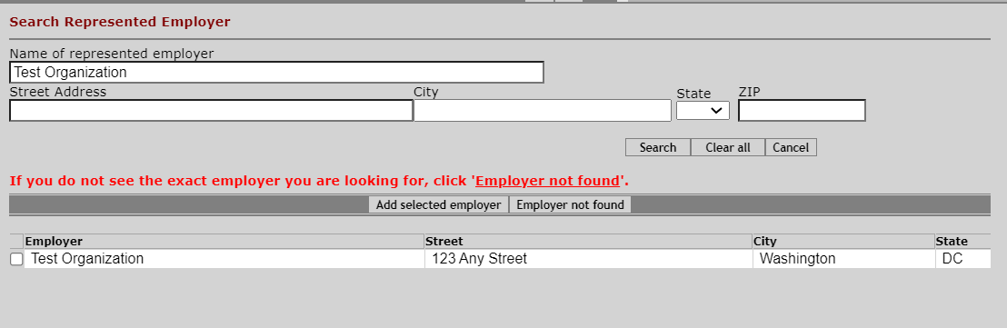
Entering Data into the Form LM-30 – Parts A, B & C (cont’d)
Parts A, B & C
Like in Item 5, searching for the entity (e.g., employer, business, etc.) in Parts A, B and C will generate a list of possible choices.
If you find the entity you are looking for, check the box on the left and click the “Add selected employer” button. If you are not sure of the organization, or if you do not see the one that you need, click the “Employer not found” button.

Slide 26
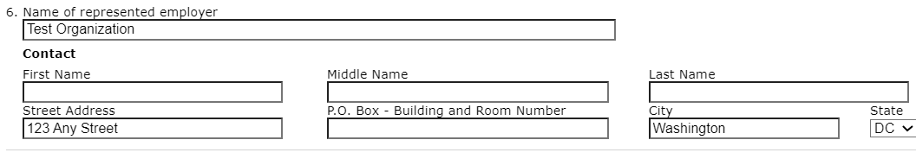

Entering Data into the Form LM-30 – Item 6
Parts A, B & C
If, after searching, you did not find an organization to select, you will now be able to enter information in Item 6. (You will see that the name and address fields are no longer
“grayed out.”)
If you selected an organization that appeared in your search results, the data will be pre-filled. You will only need to enter contact information in Item 6.
You cannot change the organization’s name and address data. If the address that pops up is incorrect, you can return to the search screen by clicking the magnifying glass icon, and
clicking “Employer Not Found.” Alternately, you may delete the record and start over.

Slide 27
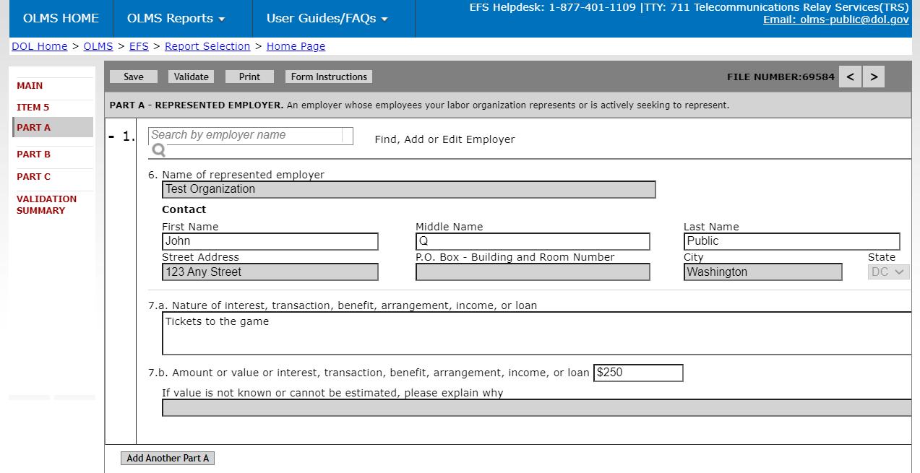
Entering Data into the Form LM-30 – Item 7b
Parts A, B & C
If you enter a value in Item 7.b., you do not need an explanation, and this field becomes “grayed out.” If you do not know the value, you must explain why. In this case, the value field becomes gray. If you make a mistake, clicking save will again allow entry in both fields.
If you have more Part A, B or C information to enter, you can add another Part by selecting the “Add Another Part” button.

Slide 28

Entering Data into the Form LM-30 – Add Another Part A, B or C
Parts A, B & C
When you add another Part A, B or C, the first Part A, B or C that you entered becomes minimized. Selecting the plus sign to the left of the Employer name will expand the part so you can see all the data again.

Slide 29
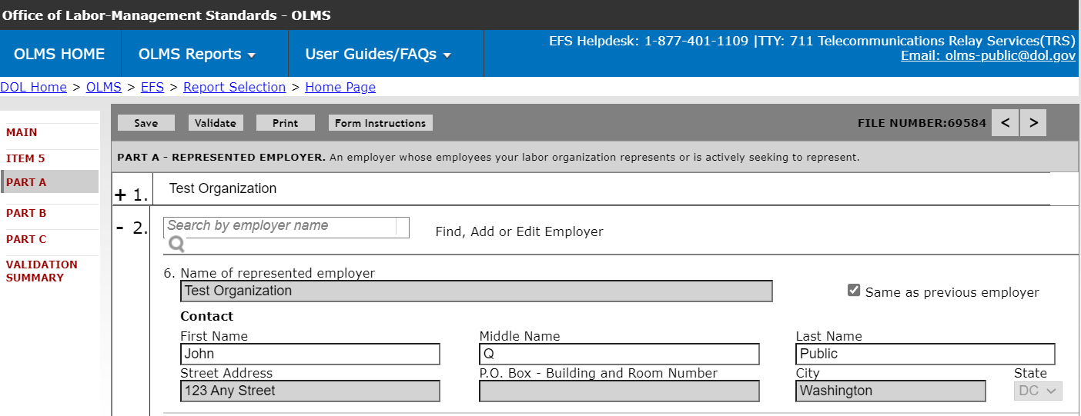
Entering Data into the Form LM-30 – Transfer Data
Parts A, B & C
If you have another transaction with the same employer, you can check the “Same as previous employer” box to automatically transfer Item 6 data. Please see the Form LM-30 instructions for how to enter data in this scenario.

Slide 30
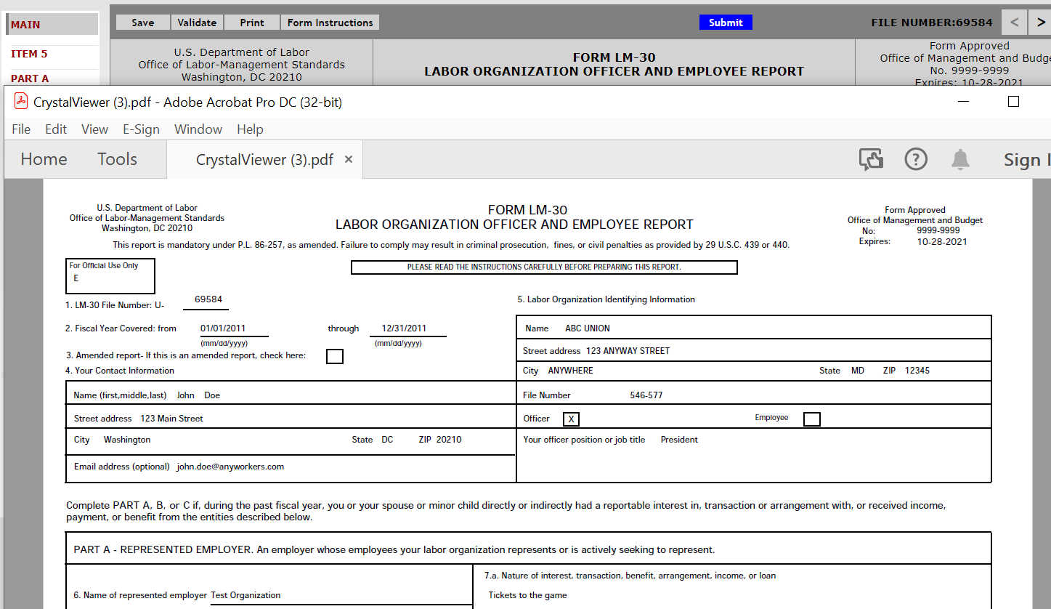
Printing the Form LM-30
You can print a copy of the Form LM-30 for review by clicking the Print button on the menu bar. A printable PDF copy of the report will then pop up. Note: You must have a PDF viewer like Adobe Reader installed on your machine to perform this function.

Slide 31
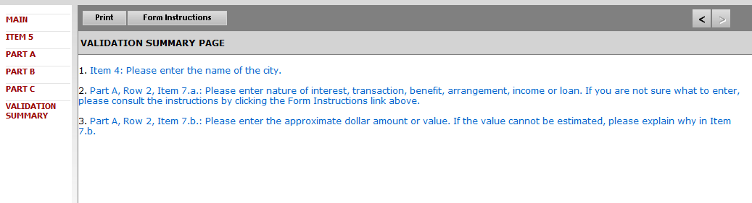
Form LM-30 Validation
The Form Validation process ensures that the form contains all required data. You must select the “Validate” button on the menu bar to perform an error check on the entire form.
The validation summary page shows the list of errors that must be corrected before you are able to sign and submit the Form LM-30 report.
Select the item to go directly to the page where the item can be corrected.
For more information on what should be provided for these items, consult the
Form LM-30 instructions.

Slide 32
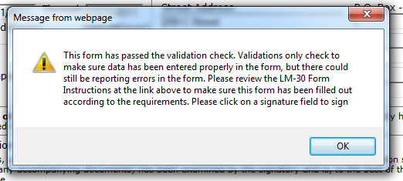
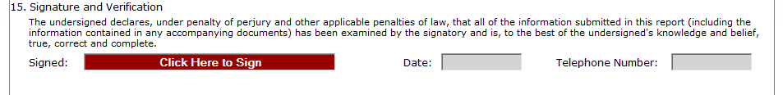
Signing the LM-30 Form
Once all of the validation items have been corrected, the form is ready to be signed.
The signature block will turn red, indicating the form can be signed.
Note: In order to sign the form, users must have an established user account
and must log into EFS with their account information to sign the form. Preparers cannot sign the form on behalf of filers.

Slide 33

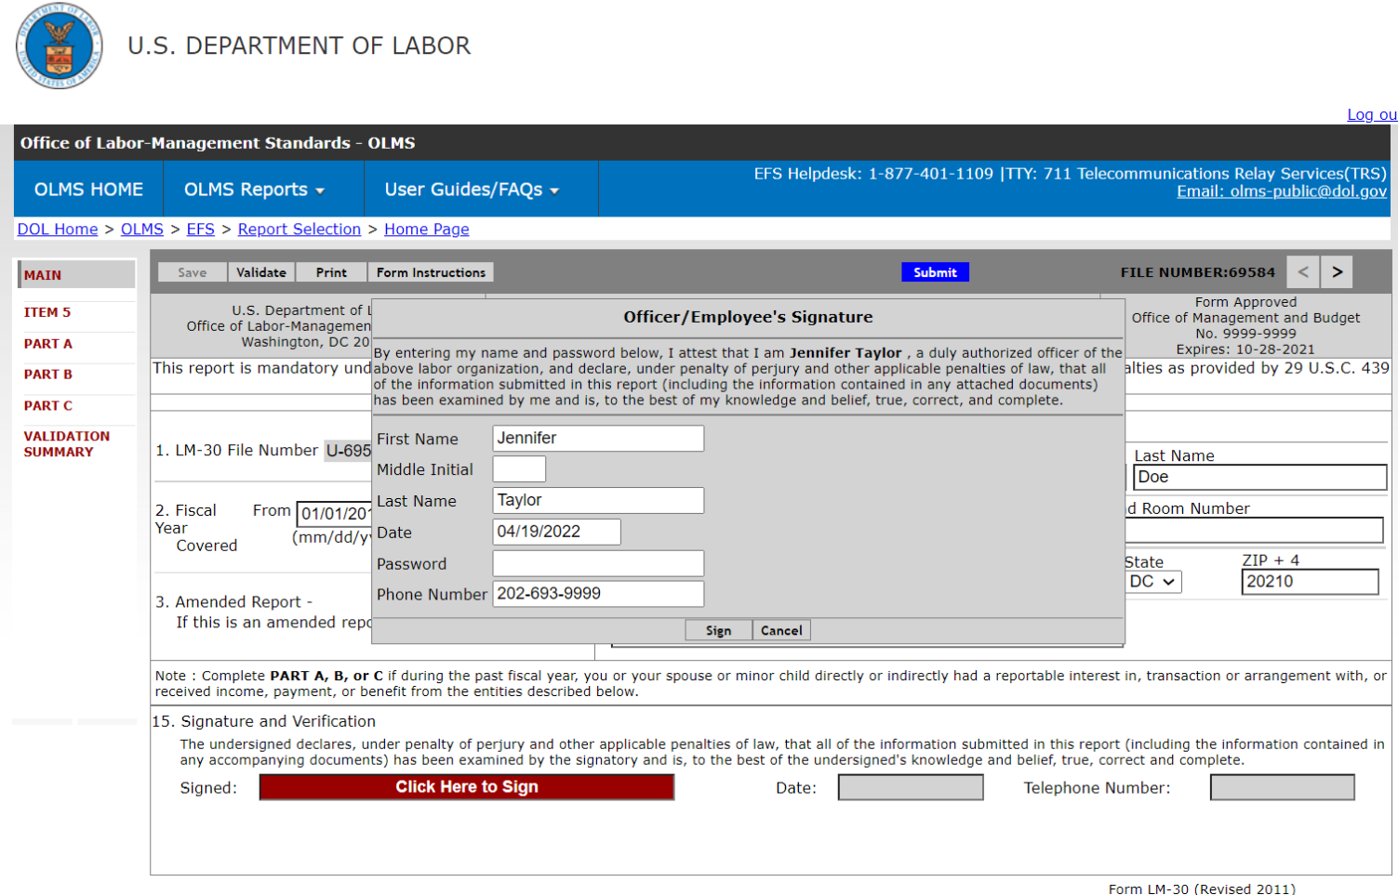
Signing the Form – Signature Block
You must re-enter your password to sign the form. By doing so, you are legally attesting that you are the person identified by name in the signature block. It is considered forgery to digitally sign a form as someone else.

Slide 34
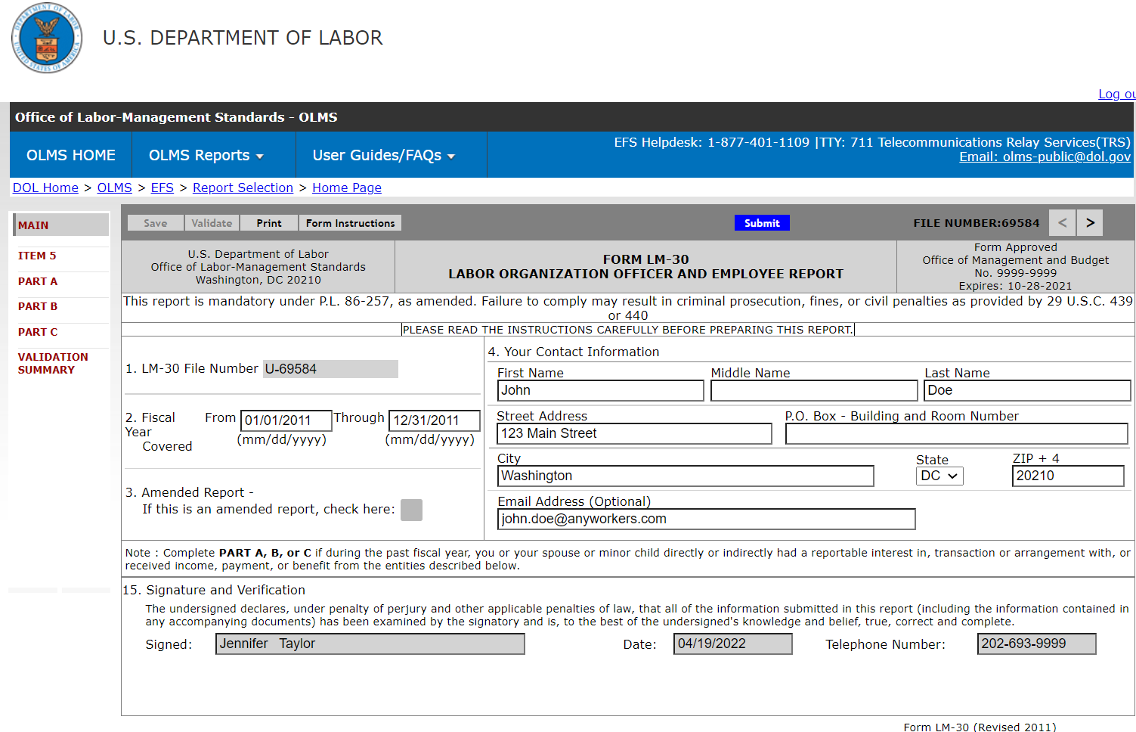
Signing the Form
Once the report has been signed, if any changes are made to any fields on the form, the signature will be removed, and the form must be validated and signed again.

Slide 35
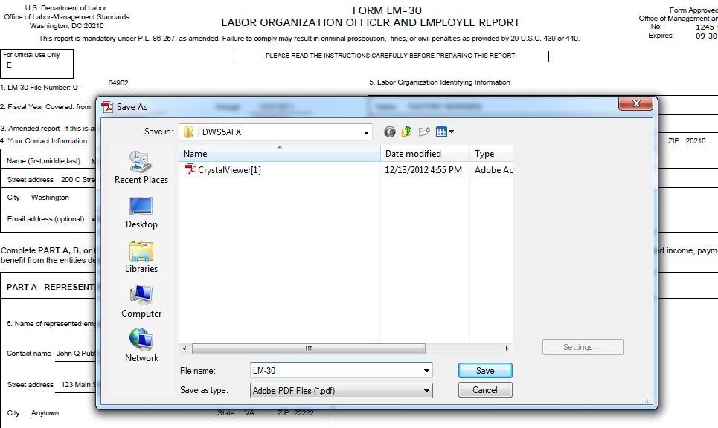
Save a Signed Copy of the Report before Submitting the Form
Click the Print button and click “File→ Save As” from the Adobe menu to save a signed copy of the report as a PDF to your computer.
Note: You can also obtain a copy of the submitted report from the OLMS Online Public Disclosure Room site. Please see the next slide for information on this.

Slide 36
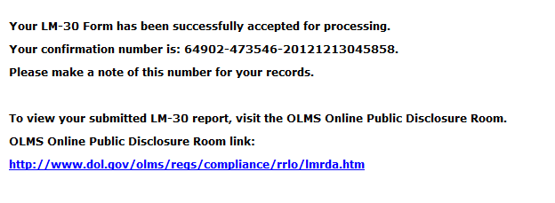
Submitting the Form
Once the signatures have been applied, the form can be submitted.
Click the Submit button from the top menu bar. Once the form has been processed (this may take a few minutes), a confirmation message will display:
You can print this message by using the print option on your browser, or simply copy and paste the text from the page into an email or word processing document.
You should now be able to view your submitted report in the Online Public Disclosure Room, by using the link shown above.

Slide 37
Getting Help
If you experience difficulty using EFS, please contact OLMS Form Technical Support toll-free at:
1-866-401-1109
This PowerPoint presentation and other information regarding EFS can be found on the OLMS EFS Help page.
If you have additional questions or comments, please contact OLMS email OLMS at olms-public@dol.gov or contact your local OLMS District Office.

