Slide 1
ELECTRONIC FORMS SYSTEM (EFS)
Guide to Using EFS to Prepare Form LM-15

Slide 2
ELECTRONIC FORMS SYSTEM (EFS) FORM LM-15
EFS is a web-based system for completing and filing forms required under the Labor-Management Reporting and Disclosure Act (LMRDA), including the Form LM-15 Trusteeship Report.
This tutorial demonstrates basic features and functionality of the EFS Form LM-15. It does not contain instructions for what information should be provided on your report. Please consult the Form LM-15 instructions if you have questions about what information should be entered on the report.
You can download a complete set of Form LM-15 instructions from the OLMS website.

Slide 3
System Requirements and Settings
To access and use EFS, OLMS recommends that you use one of the following browsers:
Microsoft Edge
Google Chrome –Version 7.0 or higher

Slide 4
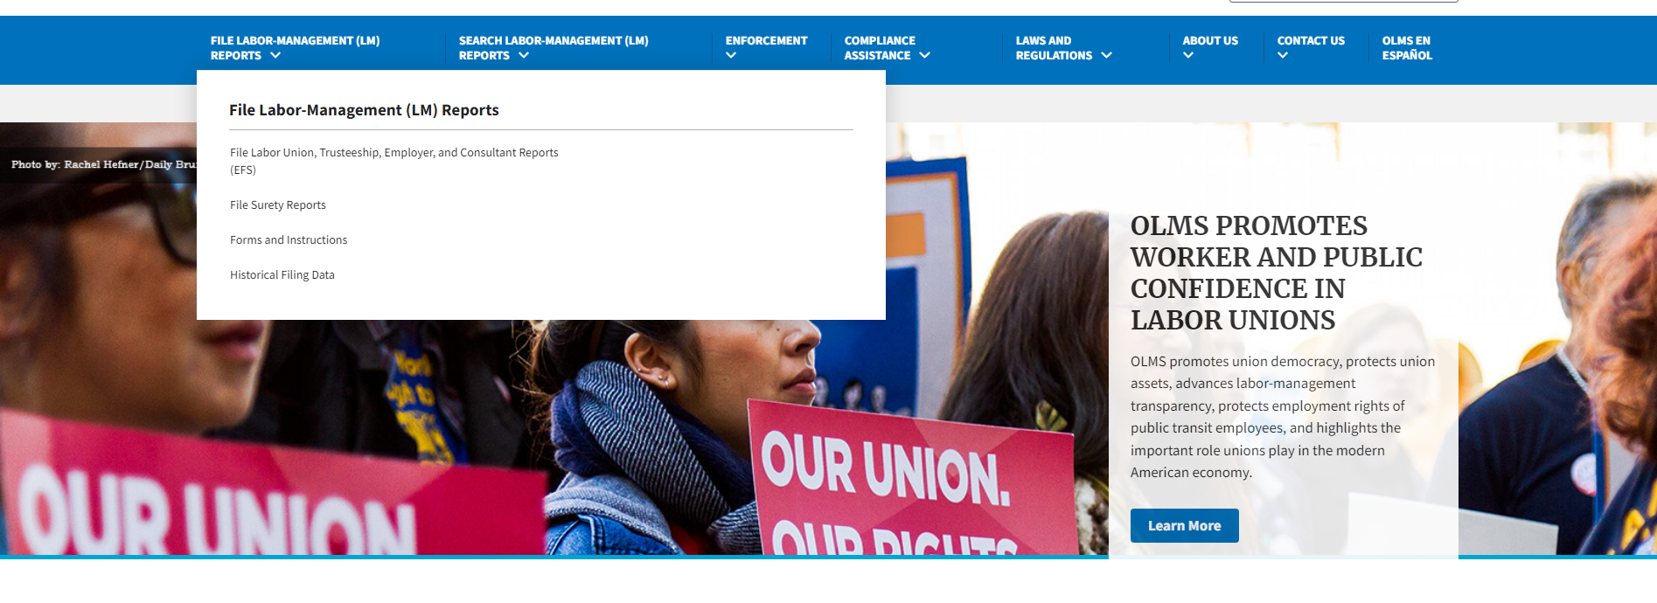
Accessing the System – OLMS Homepage
Navigate to the OLMS Website and select FILE LABOR-MANAGEMENT REPORTS, then from the drop-down menu, select the “File Labor Union, Trusteeship, Employer, and Consultant Reports (EFS)” link.

Slide 5
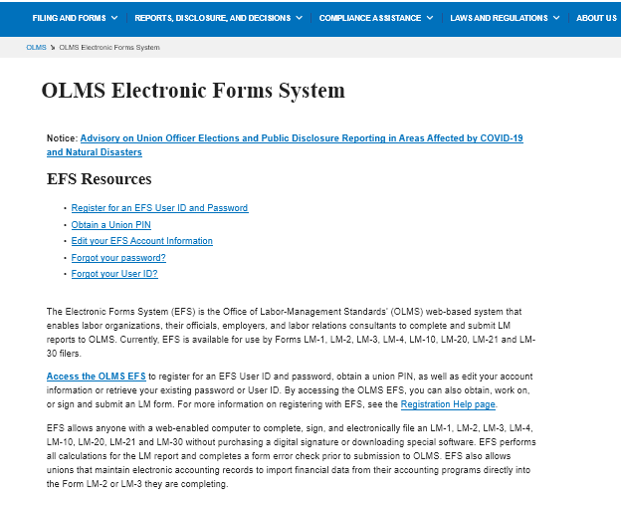
Accessing OLMS EFS
From the EFS Introduction page, select on the “Access the OLMS EFS” link.

Slide 6
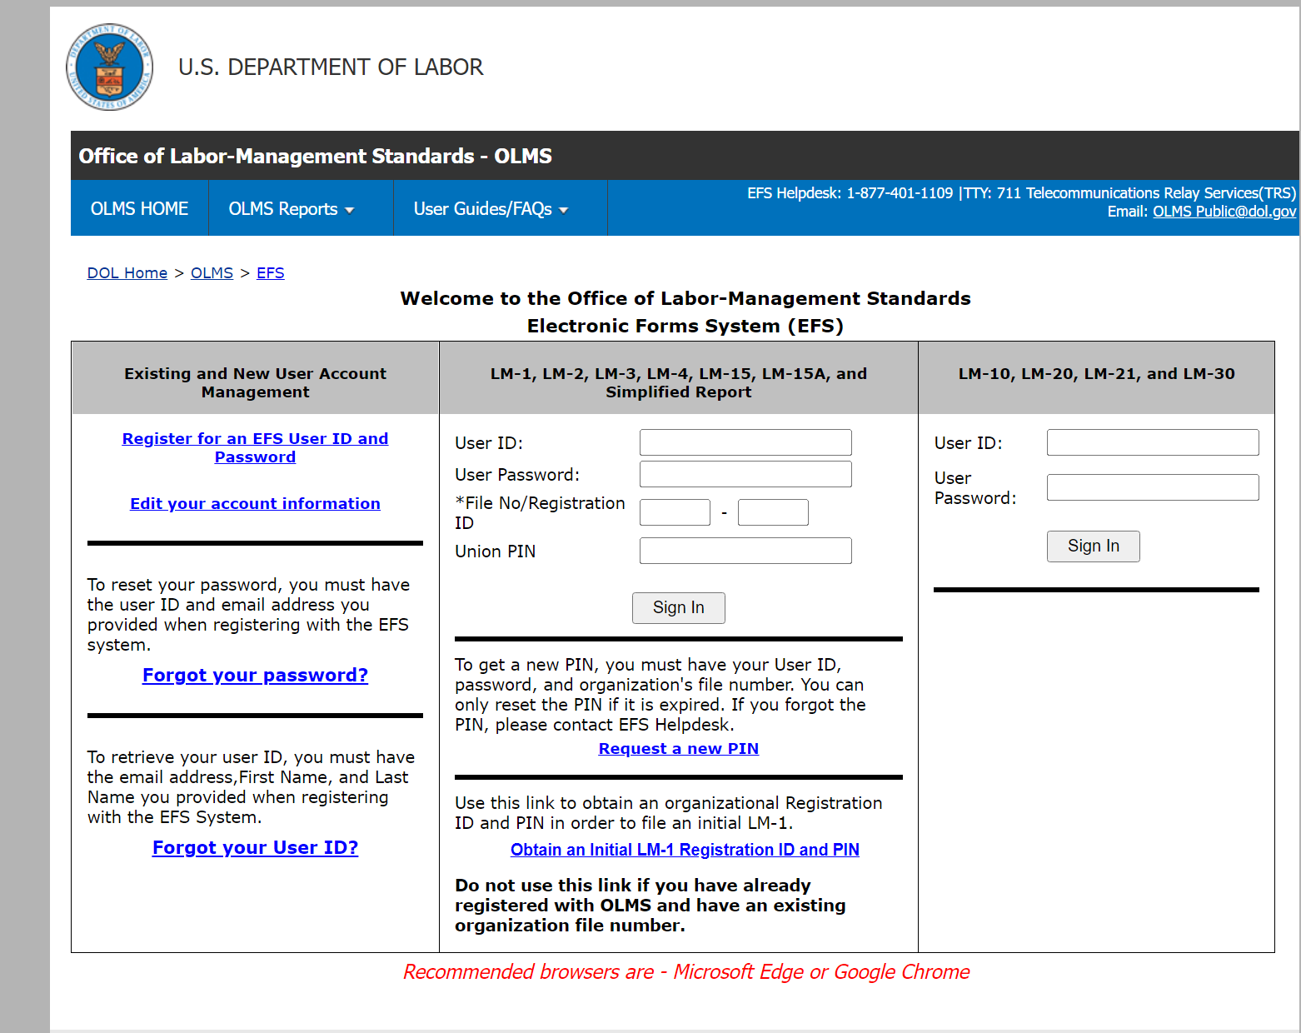
Accessing the System
To access the Form LM-15 in EFS, you must first register with EFS and obtain a user ID and password.
If you already have an EFS user ID and password, you do not need to register again.

Slide 7
Accessing the Form LM-15 Form
Once you have a user ID and password, enter the information under the LM-15 area in the center of the page and select Sign In.

Slide 8
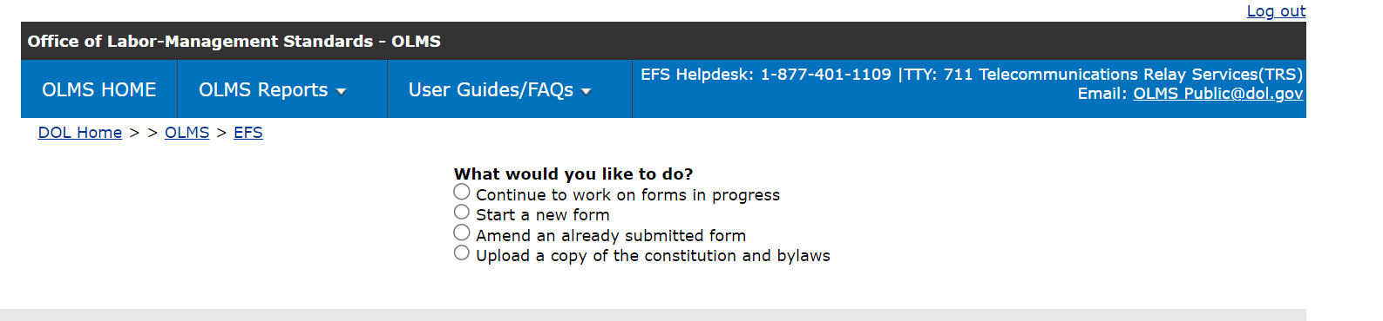
Accessing the Form LM-15
You can begin a new form, find a form in progress or amend a form already submitted.

Slide 9
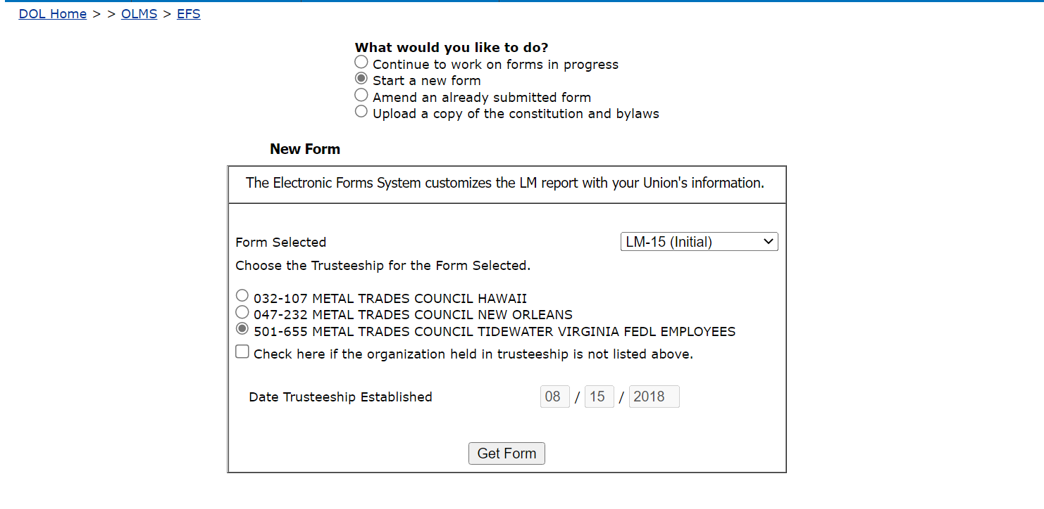
Select Report Type
You must select the type of report you are filing. Select “LM-15”,
then “Get Form”.

Slide 10
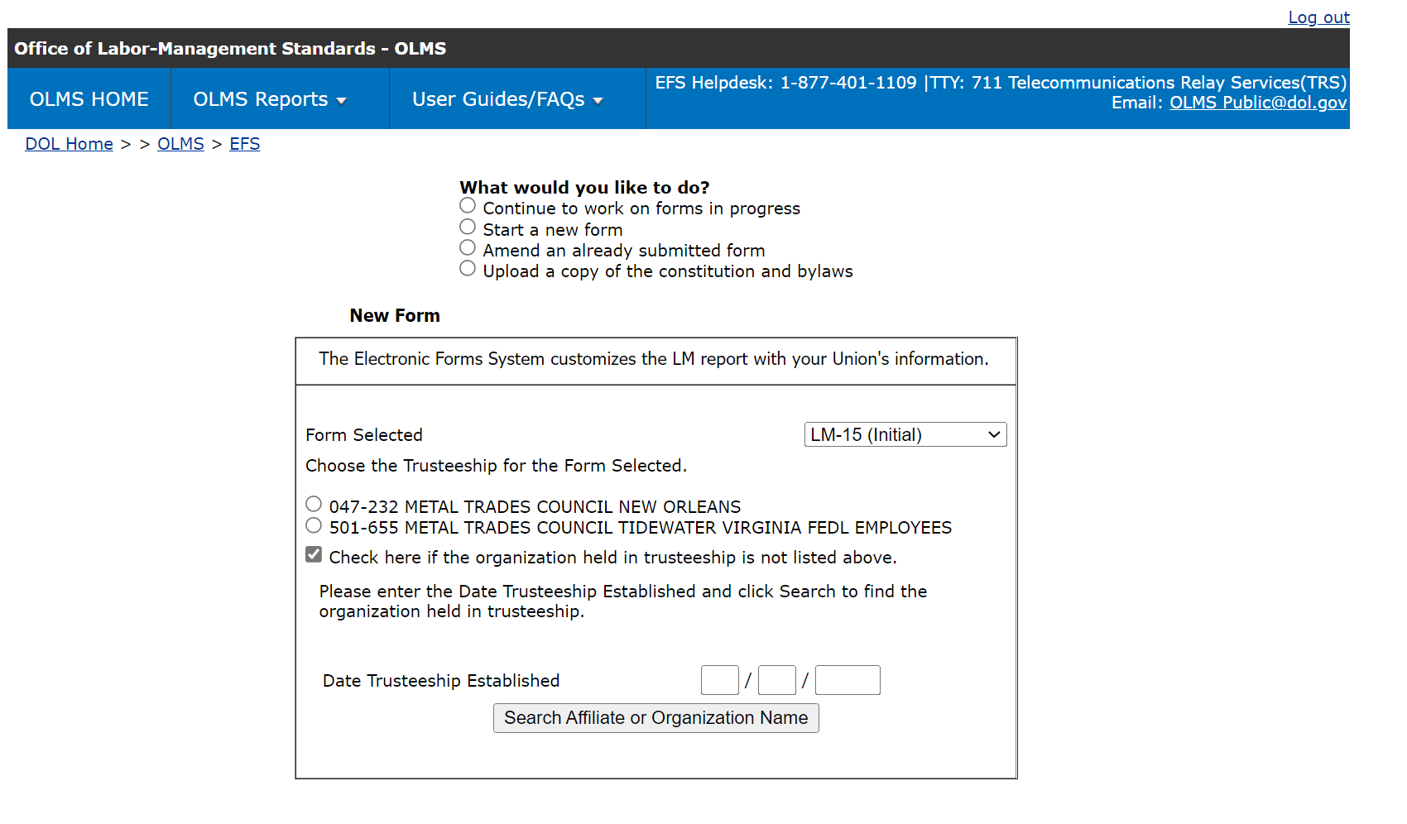
Select Organization for Form LM-15
If your organization is listed, select the circle next to the organization.
You must remember to enter date the trusteeship was established for your organization.

Slide 11
Organization Selection for Form LM-15
If you organization is not listed, select the box “Check here if the organization held in trusteeship is not listed above.”
You must remember to enter date the trusteeship was established for your organization.
Select “Search Affiliate or Organization Name.”

Slide 12
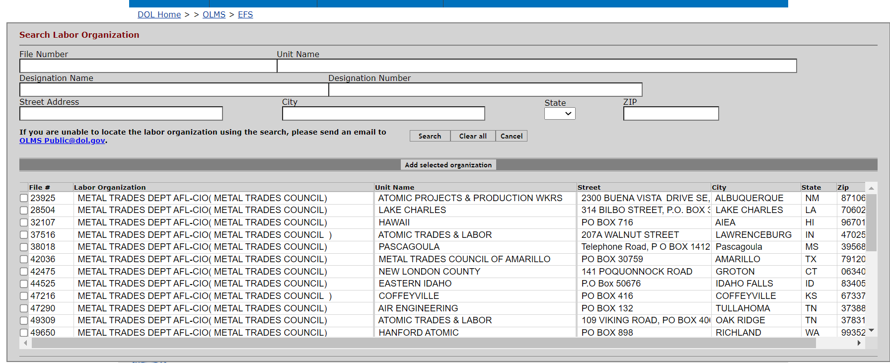
Search for Labor Organization
Locate your organization by entering file number, unit name, designation name or number, and address and select “search” to locate your organization.

Slide 13
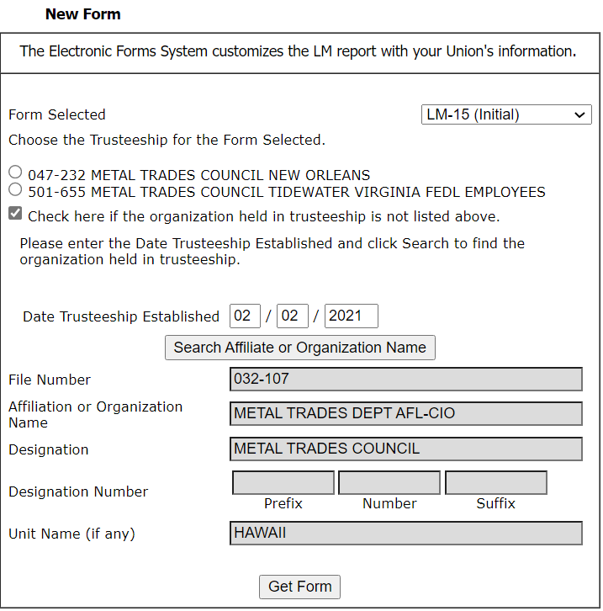
Start a New LM-15 – Registering the Organization
Once you have located your organization and completed the date trusteeship was established, select “Get Form.”

Slide 14
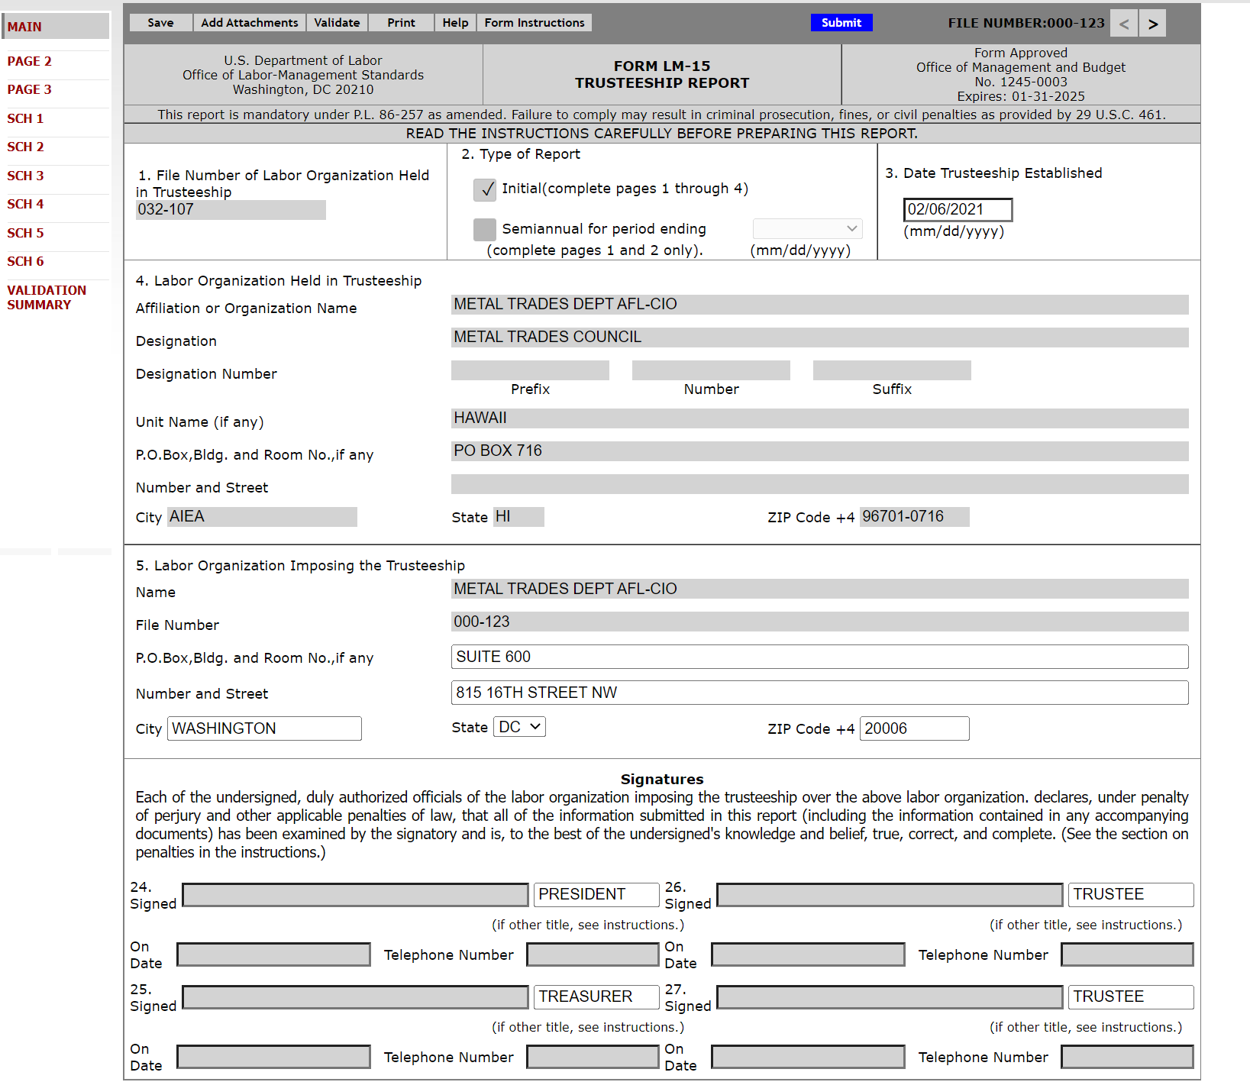
Navigating the Form LM-15 in EFS
Navigate forward and backward through the form by using the navigation arrows or jump directly to a section by clicking on the page title on the left navigation pane.

Slide 15
Accessing Form LM-15 Instructions in EFS
If you need assistance, select “Form Instructions” and the Form LM-15 Instructions will open.

Slide 16
Pre-populated Data Verification
While Items 1 through 5 are pre-populated, that information must be verified.

Slide 17
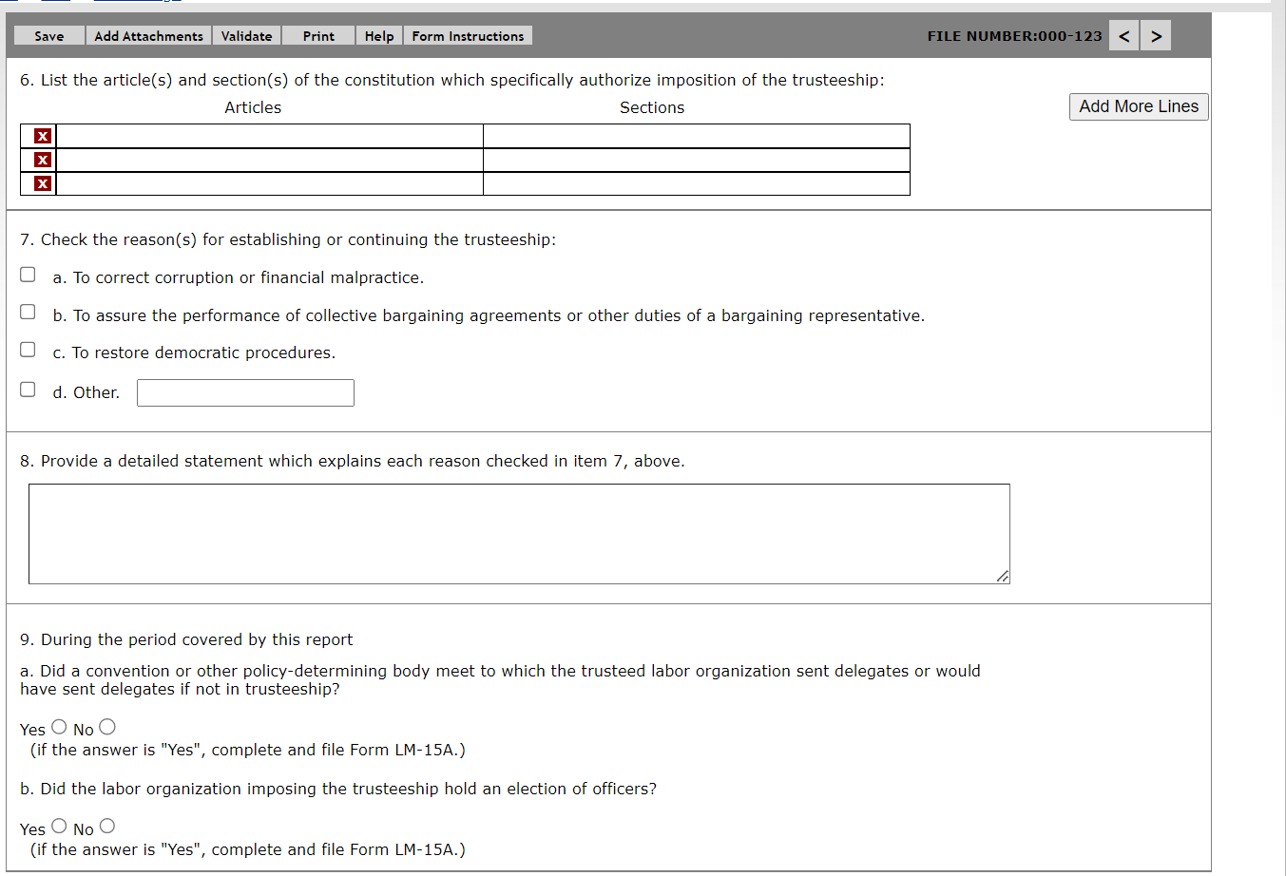
Entering Data – Item 6 through 9
Item 6: Enter Constitutional Authorization
Item 7: Reason for Trusteeship
Item 8: Detailed Explanation
Item 9: Convention and Election

Slide 18
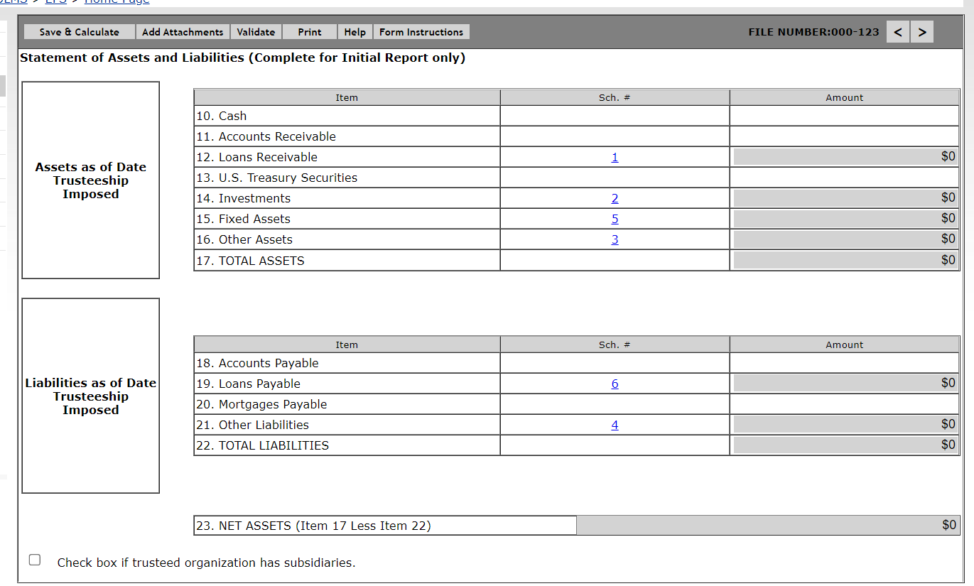
Entering Data – Items 10 through 23
Complete Items 10 thru 23 ( Assets and Liabilities )

Slide 19
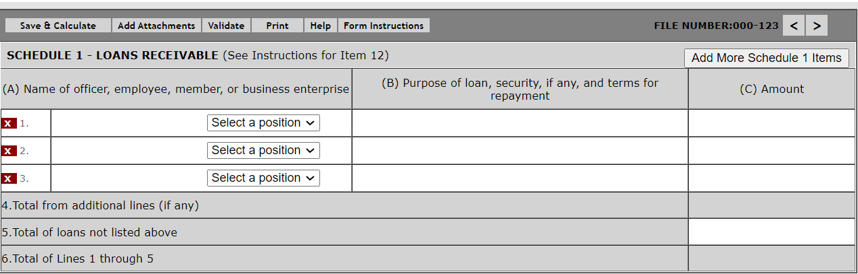
Entering Data – Schedule 1- Loans
Enter the name of each officer, employee, or member whose total loan indebtedness to the trusteed organization (including any subsidiary organization) exceeded $250.

Slide 20
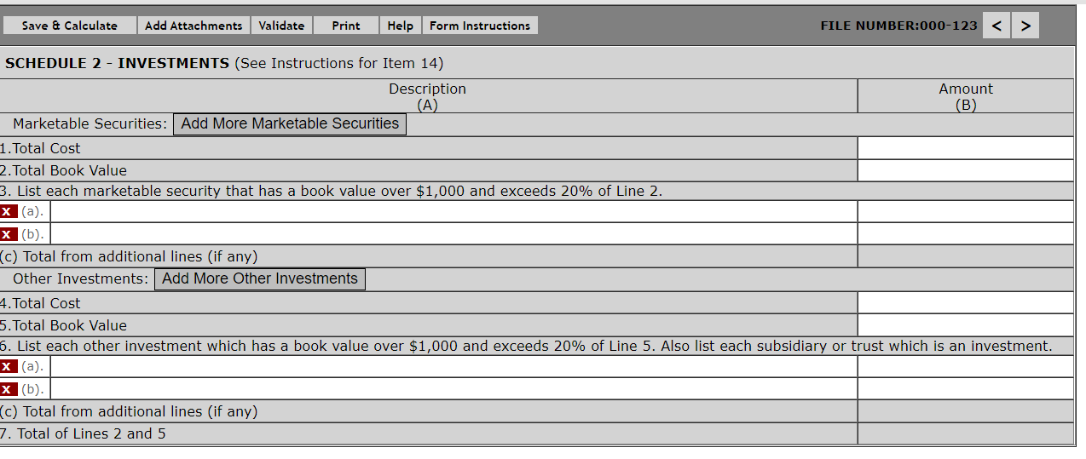
Entering Data – Schedule 2- Investments
Enter the total Book Value of all investments.

Slide 21
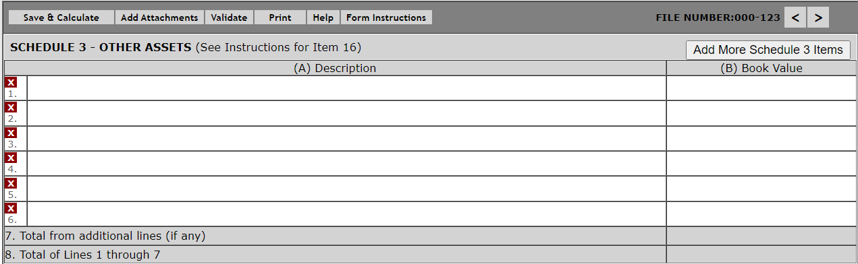
Entering Data – Schedule 3 Other Assets
You must describe the trusteed organization's other assets.

Slide 22
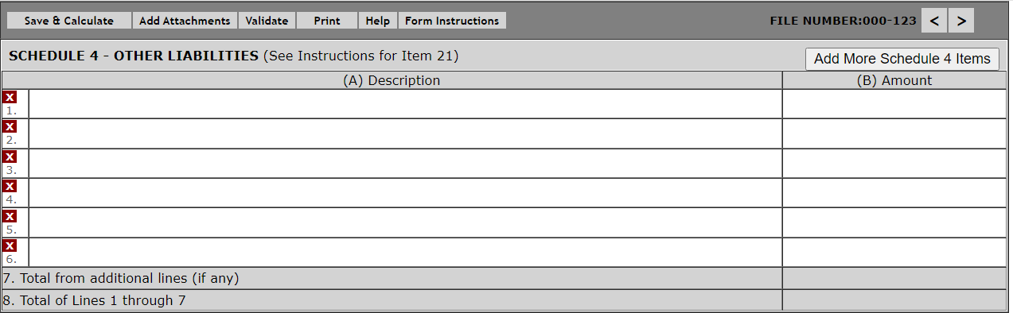
Entering Data – Schedule 4 Other Liabilities
You must describe the trusteed organization’s other liabilities.

Slide 23
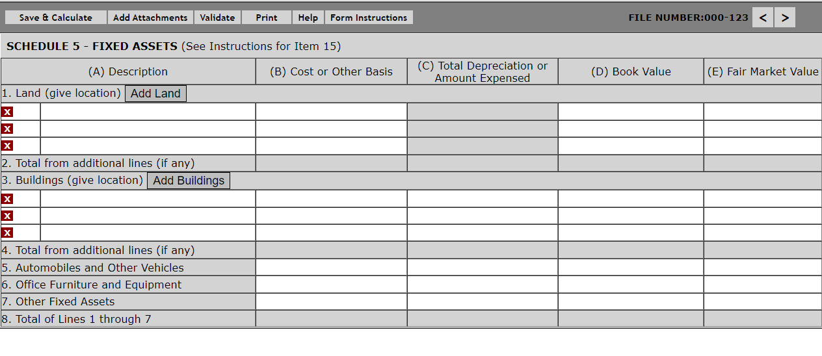
Entering Data – Schedule 5 Fixed Assets
Enter the total value of all fixed assets from the trusteed organization’s book.

Slide 24
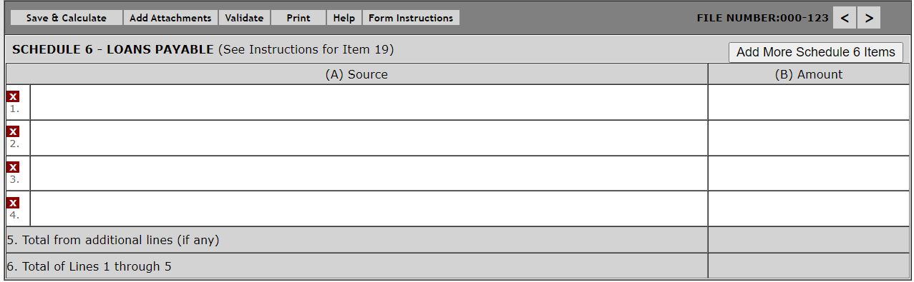
Entering Data – Schedule 6 Loans Payable
Enter the total of all loans payable by the trusteed organization.

Slide 25
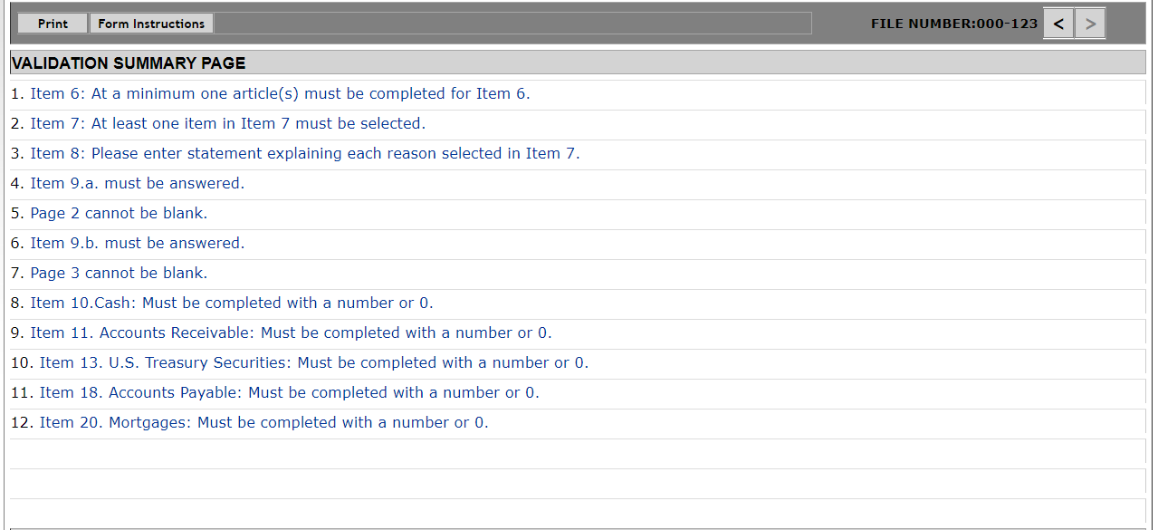
Form LM-15 Validation-Correction Errors
The Form Validation process ensures that the form contains all required data. You must select the “Validate” button on the menu bar to perform an error check on the entire form. The validation summary page shows the list of any errors that must be corrected before you are able to sign and submit the Form LM-15 report. You may select the error to make corrections.

Slide 26
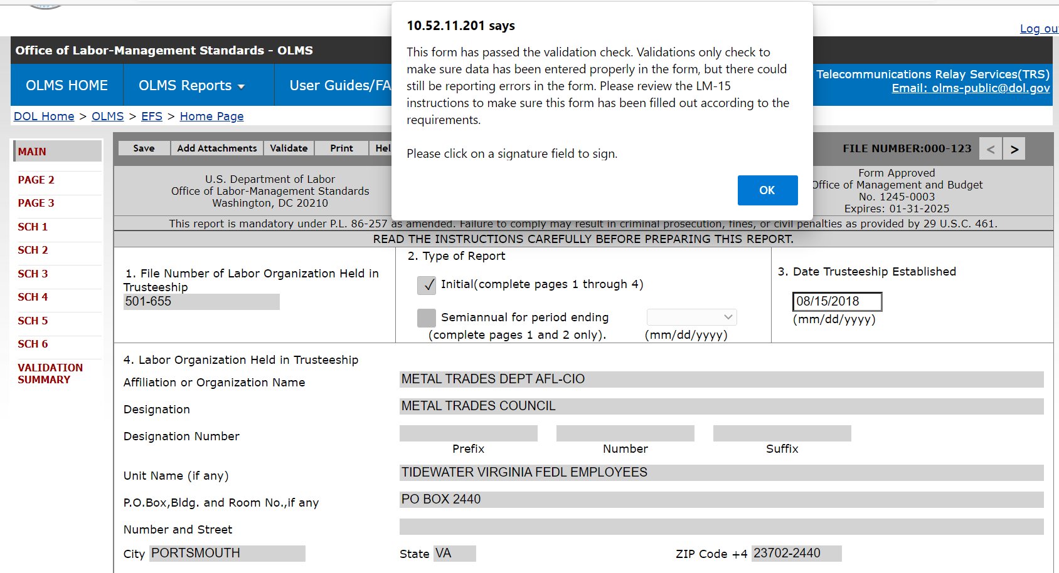
Form LM-15 Validation
If the form passes validation, you will receive a message indicating that All Page Validations are passed. Select “OK” to begin the signature process.

Slide 27
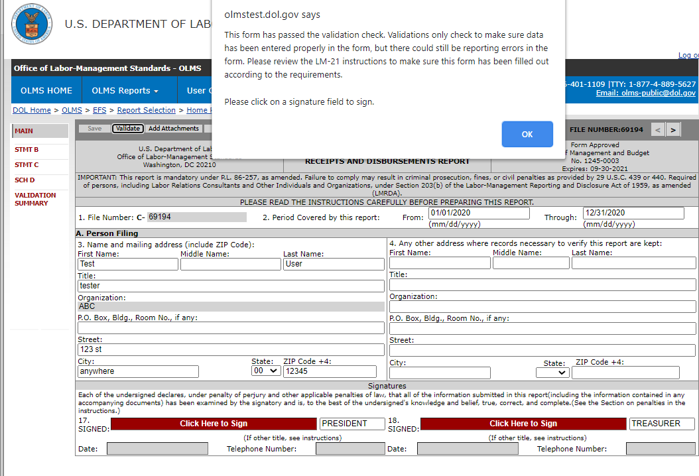
Signing the Form LM-15
Once all the validation items have been corrected, the form is ready to be signed. The signature block will turn red for signature. Select “OK” and select the red box indicating “Click Here to Sign”.

Slide 28
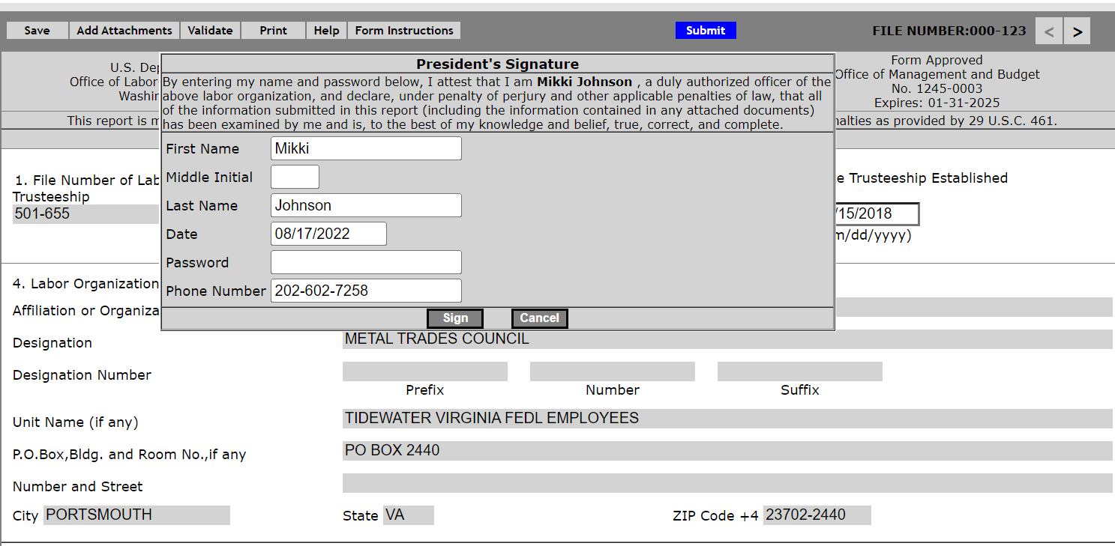
Signature Box
When the signature box appears, you must re-enter your password to sign the form.
Select “Sign”.
By signing this form via password, you are legally attesting that you are the person identified by name in the signature block. It is considered forgery to digitally sign a form as someone else.

Slide 29
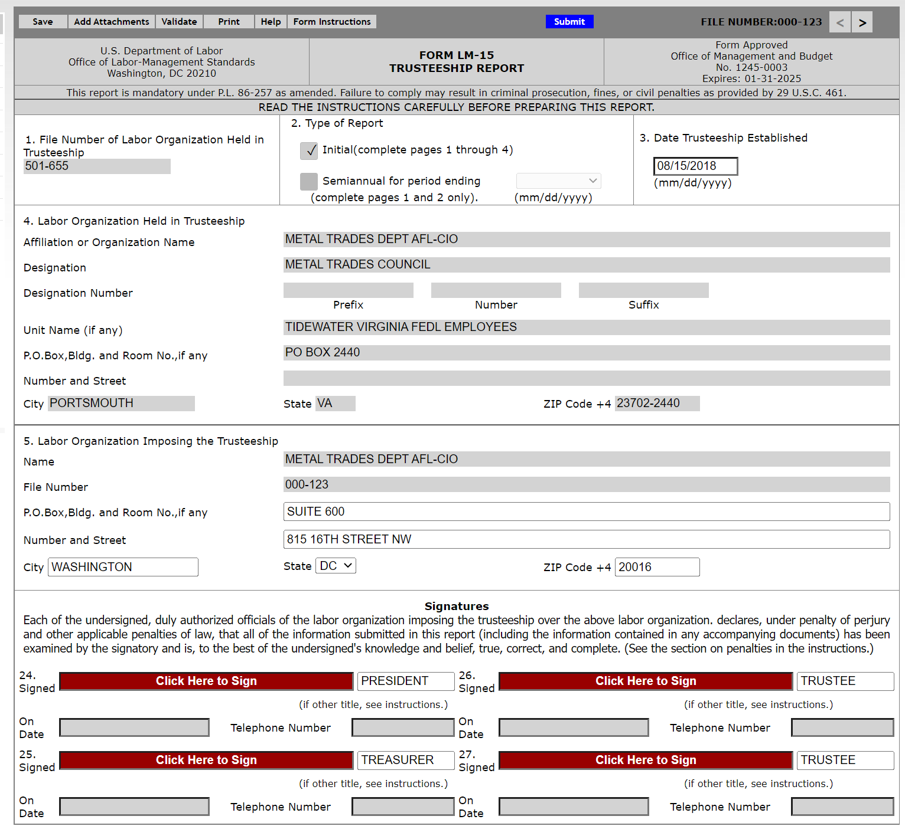
Updating Signature Titles
If the officers title needs to be updated, select the box with “President”, delete the title, and replace it with the correct title. Then you must save, revalidate, and resign the form.

Slide 30
Changes Made After Signing
Once the report has been signed, if any changes are made to any fields on the form, the signature will be removed, and the form must be validated and signed again.

Slide 31
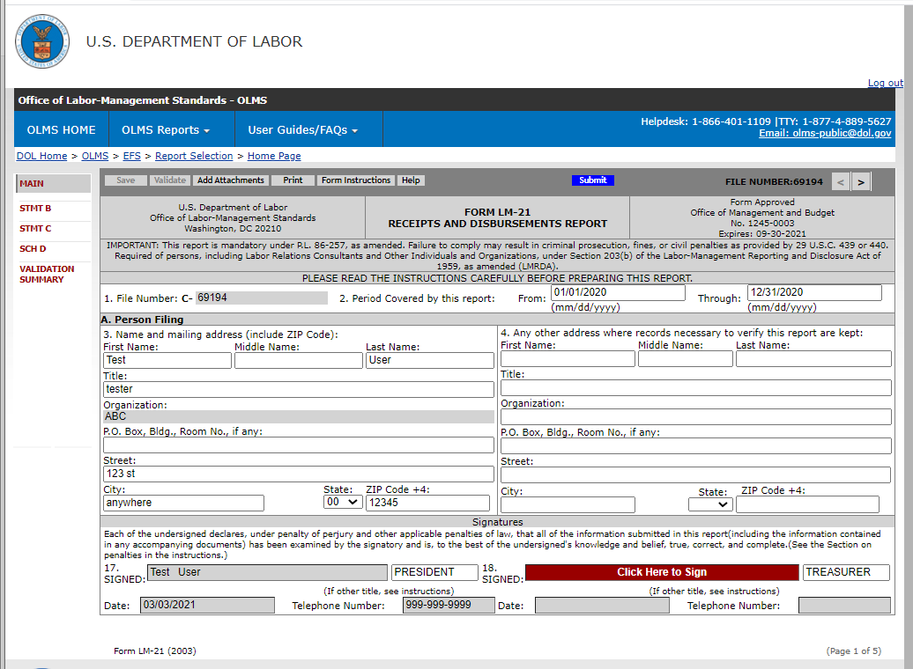
How to Print the Form LM-15
You should print a copy of the form for your records. Select the “Print” tab to save a copy of the form.

Slide 32
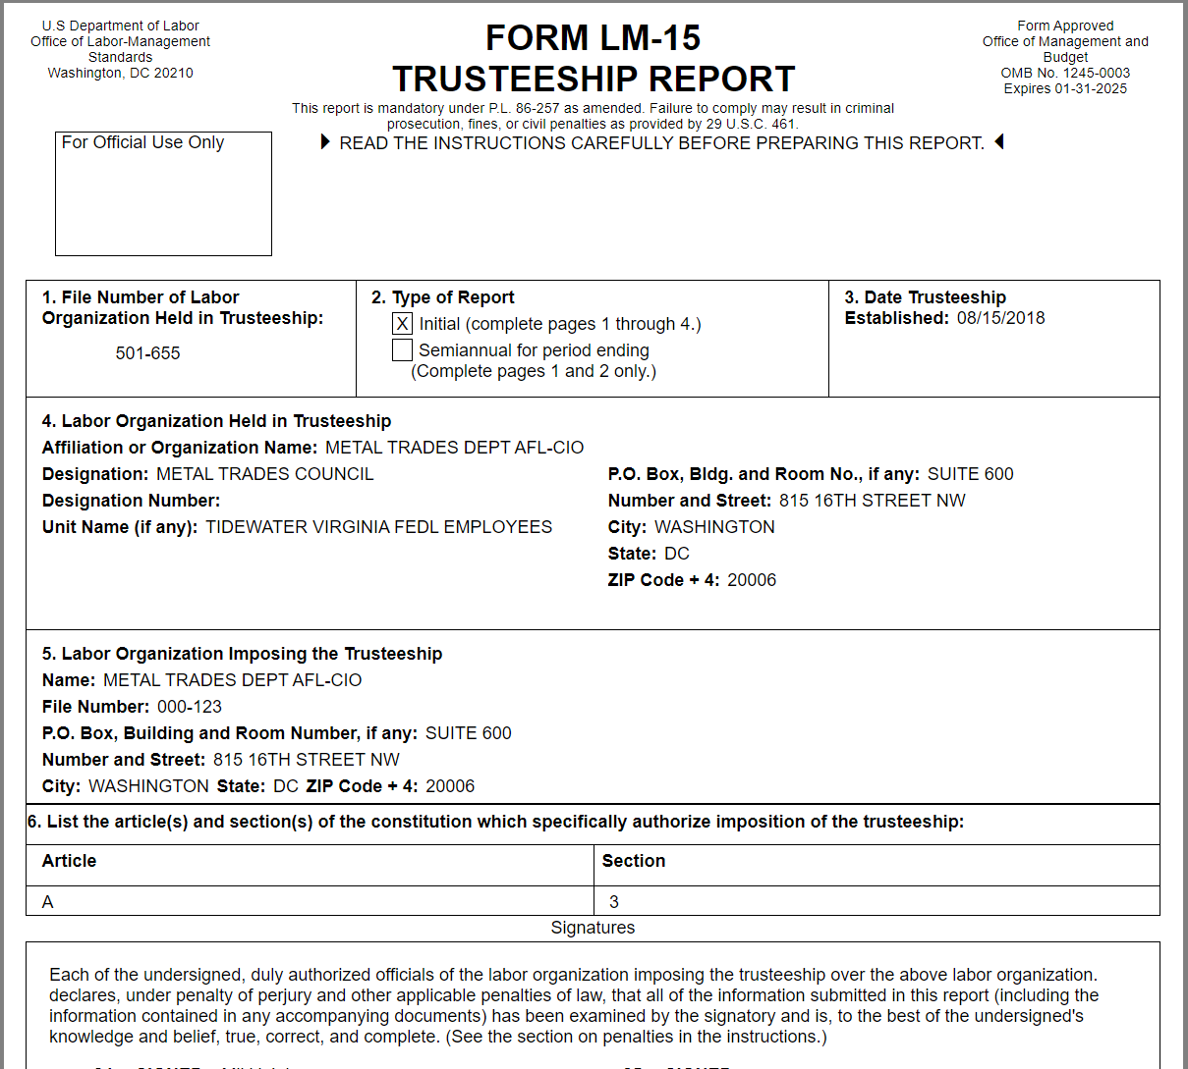
Printed Form LM-15
You can print a copy of the Form LM-15, in process, for review by selecting the Print button on the menu bar. An option to download and open a printable PDF copy of the report will pop up.

Slide 33
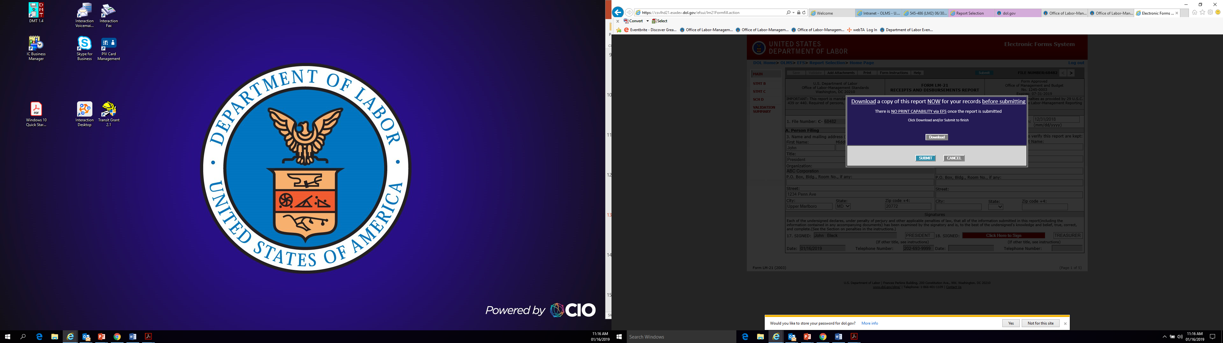
Download the Form LM-15
In order to print and/or save the form for your records, select the
“Download” tab to save and/or print your form.
EFS does NOT have an option to print once the form has been submitted.
After you have saved and/or printed your form, select the “Submit” tab.

Slide 34
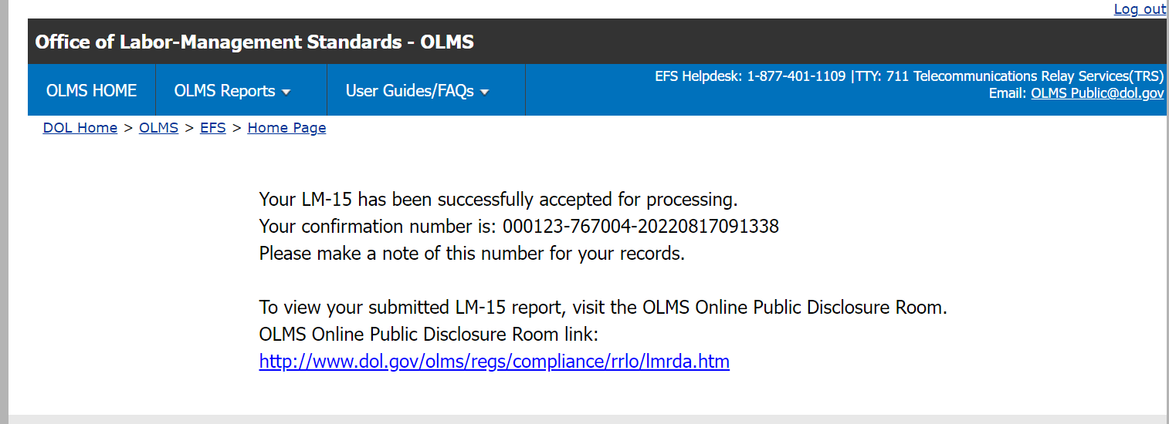
Confirmation Page
You can print this message for your records by using the print option on your browser.

Slide 35
Getting Help
If you experience difficulty using EFS, please contact OLMS Form Technical Support toll-free at:
1-866-401-1109
This PowerPoint presentation and other information regarding EFS can be found on our OLMS website.
If you have additional questions or comments, please contact OLMS E-mail OLMS at olms-public@dol.gov or contact your local OLMS District Office.

