Slide 1
ELECTRONIC FORMS SYSTEM (EFS)
Guide to Using EFS to Prepare Form LM-15A

Slide 2

BEFORE YOU PROCEED…
Please note the Form LM-15 must be filed prior to completing the Form LM-15A.
You will not be able to complete the Form LM-15A until the Form LM-15 been submitted.
You can download a complete set of Form LM-15 instructions from the OLMS website.

Slide 3
ELECTRONIC FORMS SYSTEM (EFS) FORM LM-15A
EFS is a web-based system for completing and filing forms required under the Labor-Management Reporting and Disclosure Act (LMRDA), including the Form LM-15A Report on Selection of Delegates and Officers.
This tutorial demonstrates basic features and functionality of the EFS Form LM-15A. It does not contain instructions for what information should be provided on your report. Please consult the Form LM-15A instructions if you have questions about what information should be entered on the report.
You can download a complete set of Form LM-15A instructions from the OLMS website.

Slide 4
System Requirements and Settings
To access and use EFS, OLMS recommends that you use one of the following browsers:
Microsoft Edge
Google Chrome –Version 7.0 or higher

Slide 5
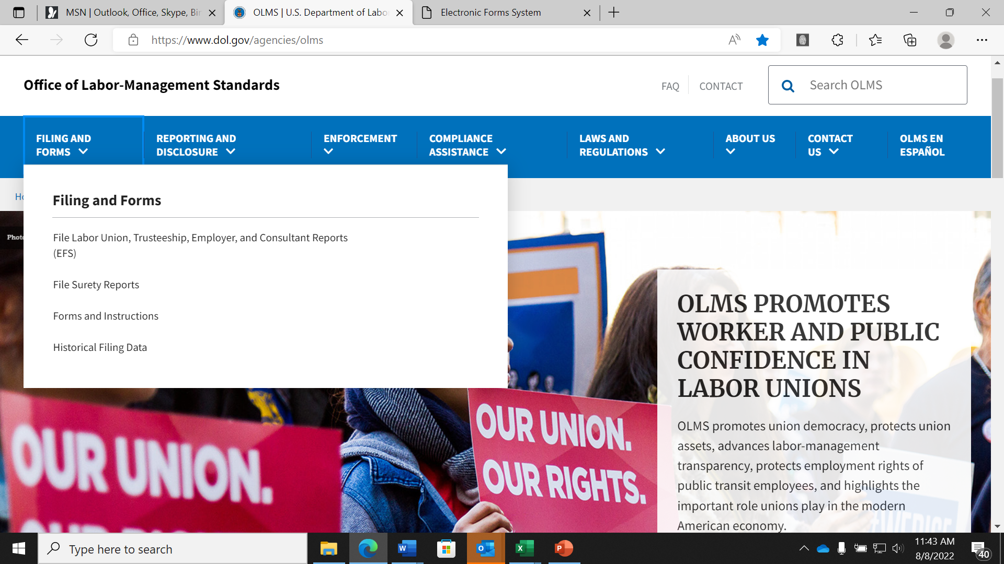
Accessing the System – OLMS Homepage
Navigate to the OLMS Website and select FILE LABOR-MANAGEMENT REPORTS, then from the drop-down menu, select the “File Labor Union, Trusteeship, Employer, and Consultant Reports (EFS)” link.

Slide 6
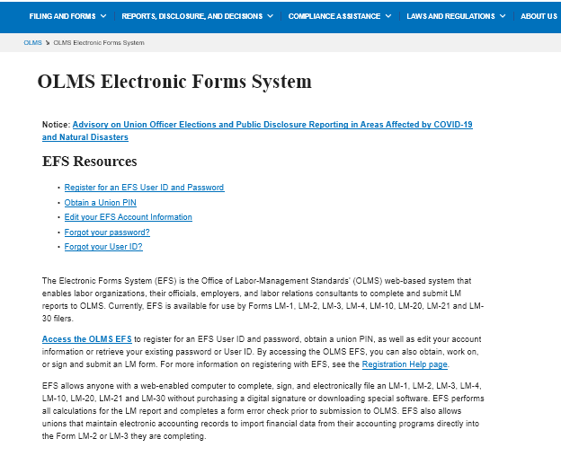
Accessing OLMS EFS
From the EFS Introduction page, select on the “Access the OLMS EFS” link.

Slide 7
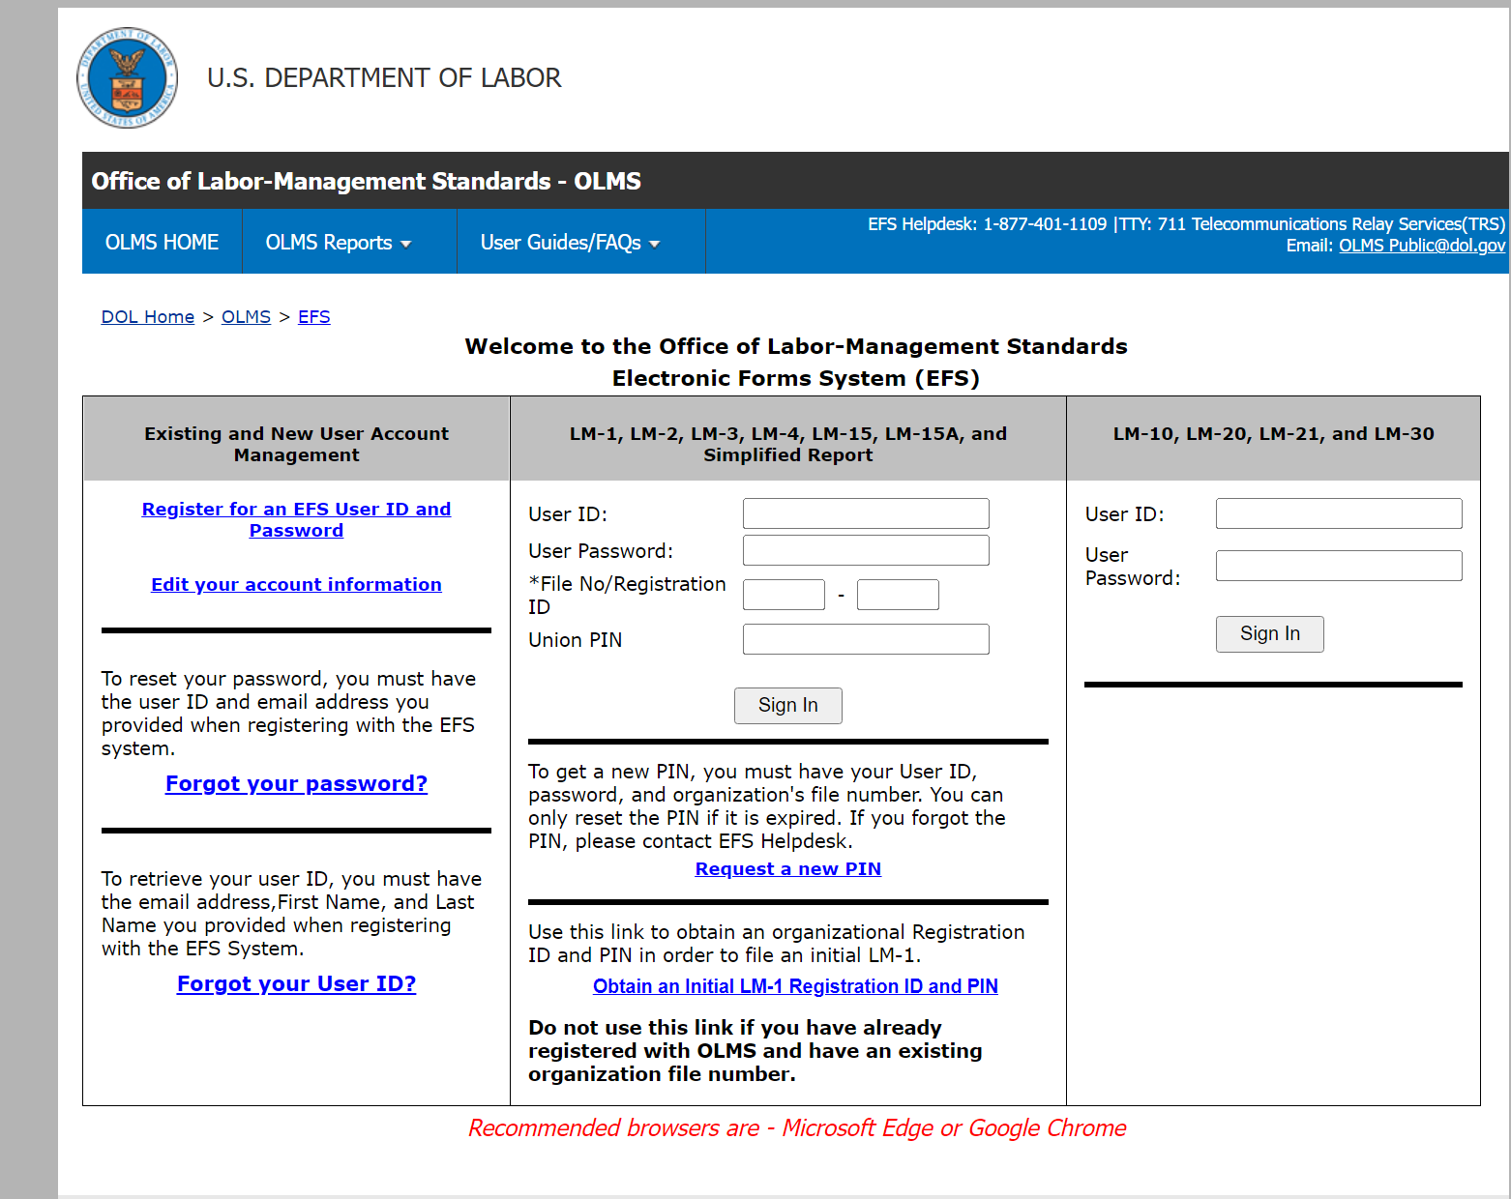
Accessing the System
To access the Form LM-15A in EFS use your EFS user ID and password.

Slide 8
Accessing the Form LM-15A Form
Once you have a user ID and password, enter the information under the LM-15A area in the center of the page and select Sign In.

Slide 9
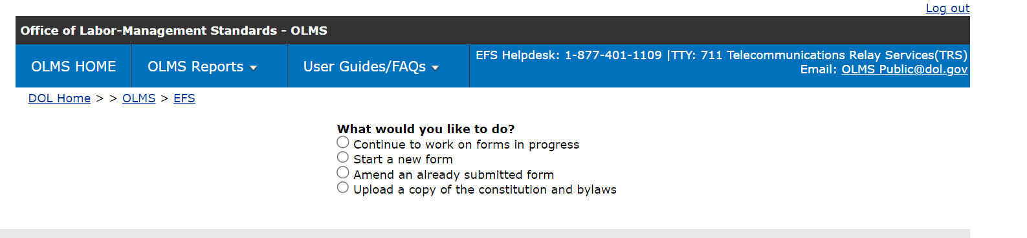
Accessing the Form LM-15A Form
You can begin a new form, find a form in progress, or amend a form already submitted.

Slide 10
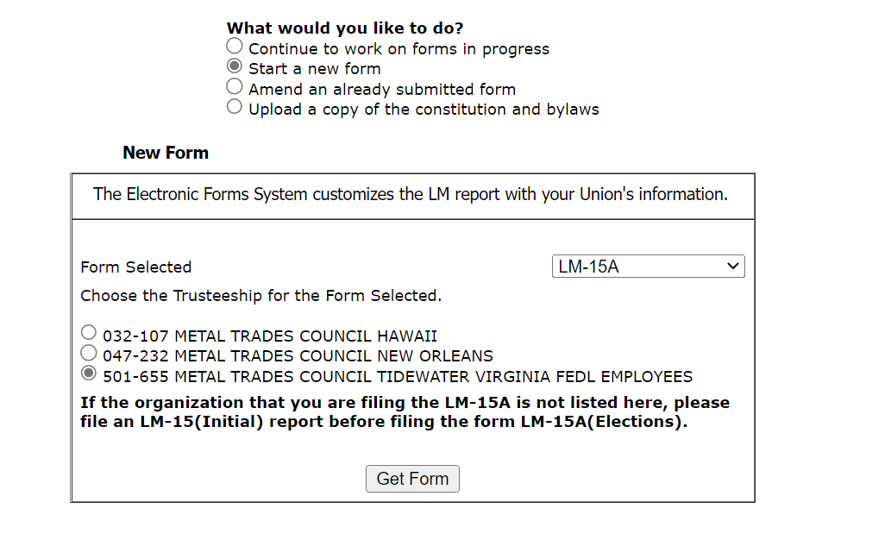
Select Report Type
You must select the type of report you are filing, continuing, or amending. Select “LM-15A”, then “Get Form”

Slide 11
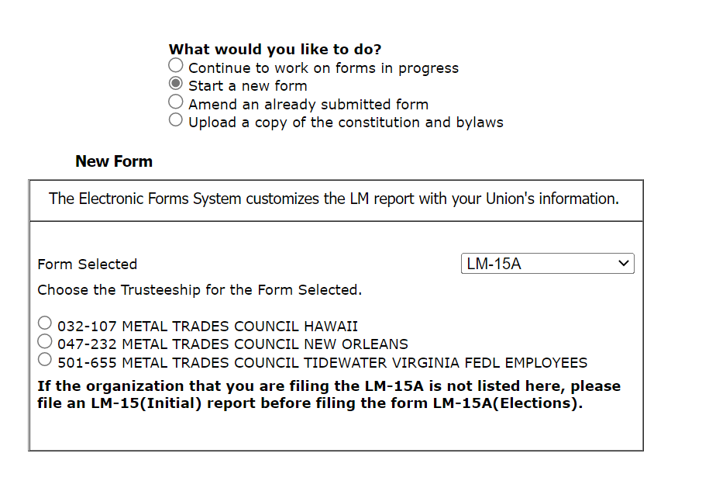
Organization Selection for Form LM-15
Select the circle next to your organization name.
If the organization for which you are filing the LM-15A is not listed here, please file an LM-15(Initial) report before filing the form LM-15A (Elections).

Slide 12
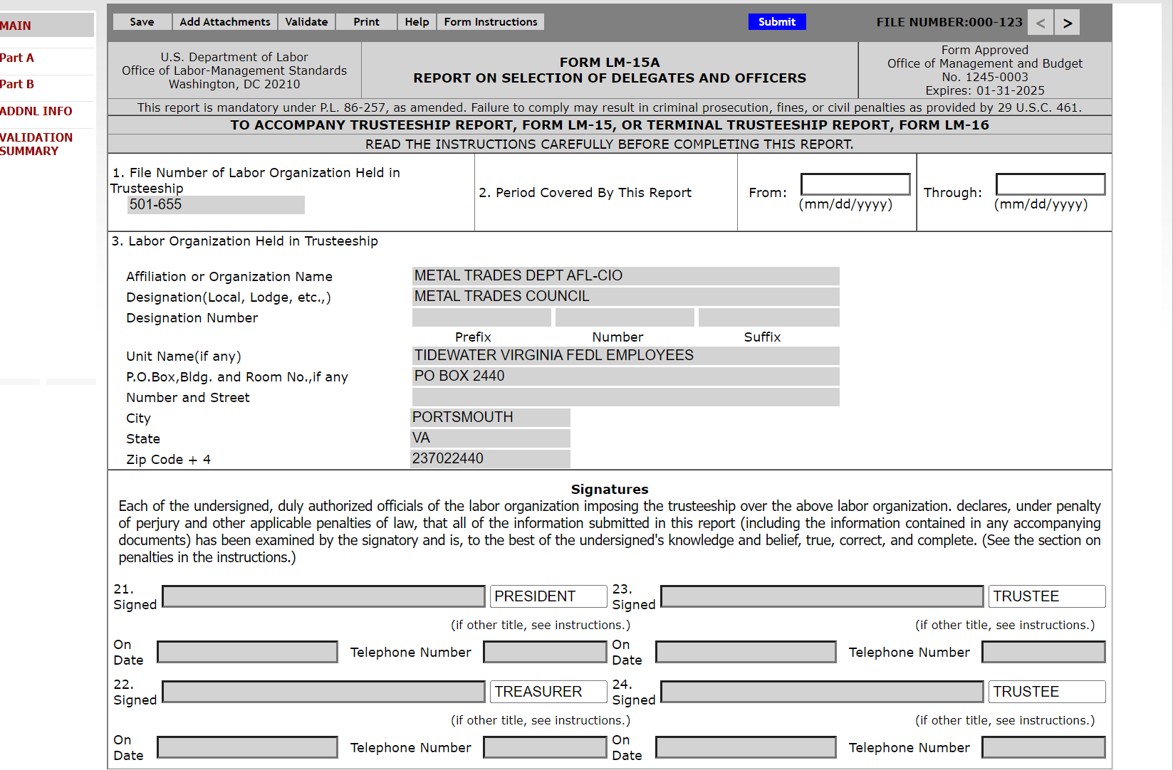
Navigating the Form LM-15A in EFS
Navigate forward and backward through the form by using the navigation arrows or jump directly to a section by clicking on the page title on the left navigation pane.

Slide 13
Completing Form LM-15A
Enter the beginning and ending dates of the period covered by the report.

Slide 14
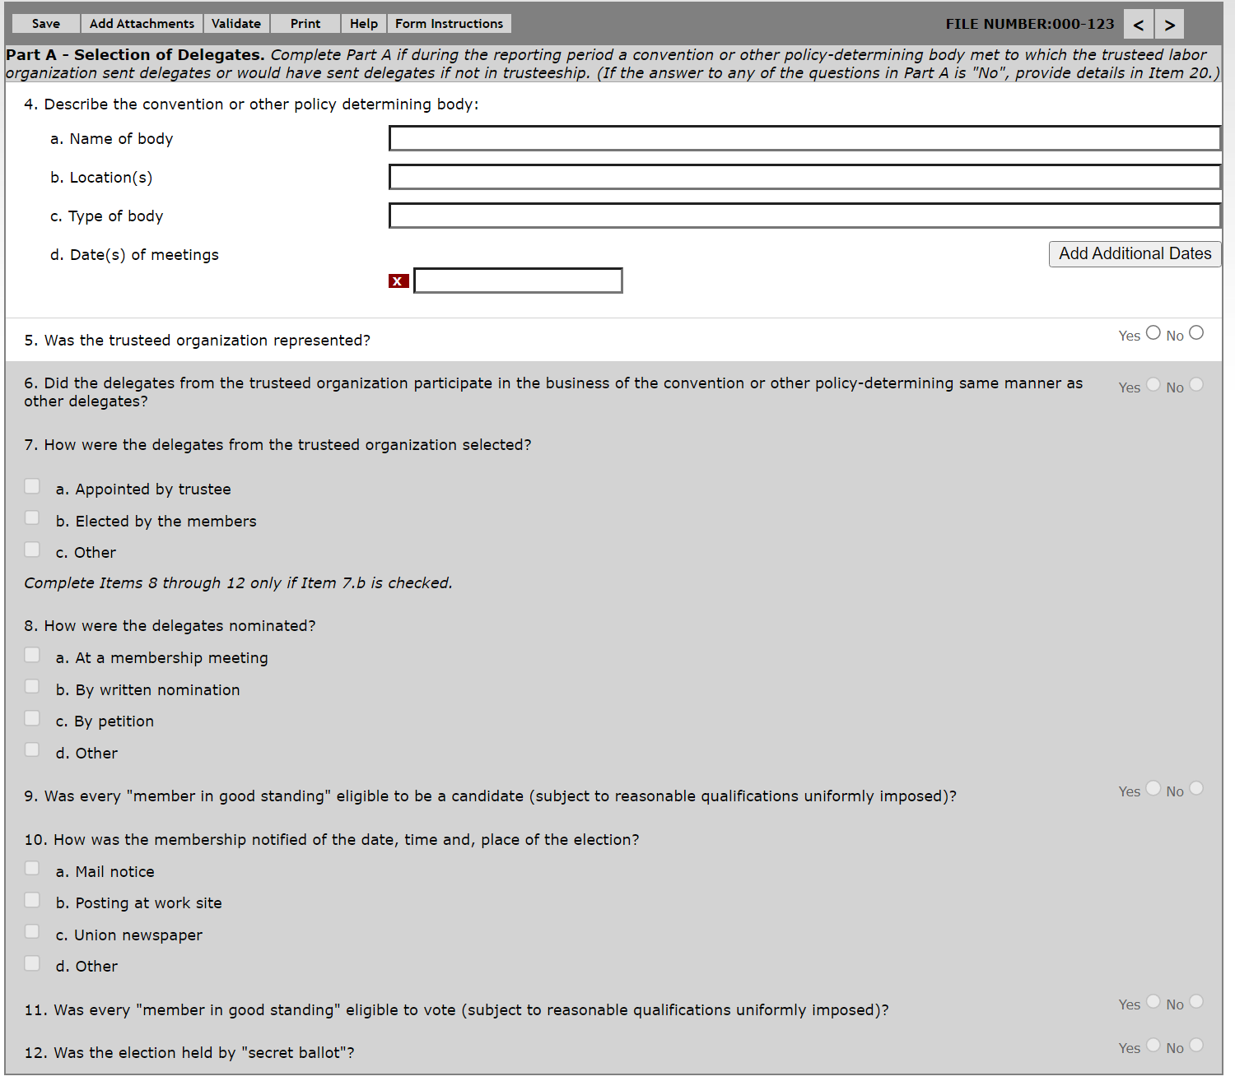
Entering Data – Items 4 through 7
Item 4: Describe the Convention or other Determining Body
Item 5: Representation of the Organization
Item 6: Delegate Participation
Item 7: Manner of Delegate Selection

Slide 15
Entering Data – Items 8 through 12
Item 8: Method of Nomination
Item 9: Candidate Eligibility
Item 10: Election Notification
Item 11:Voters Eligibility
Item 12: Secret Ballot Election

Slide 16
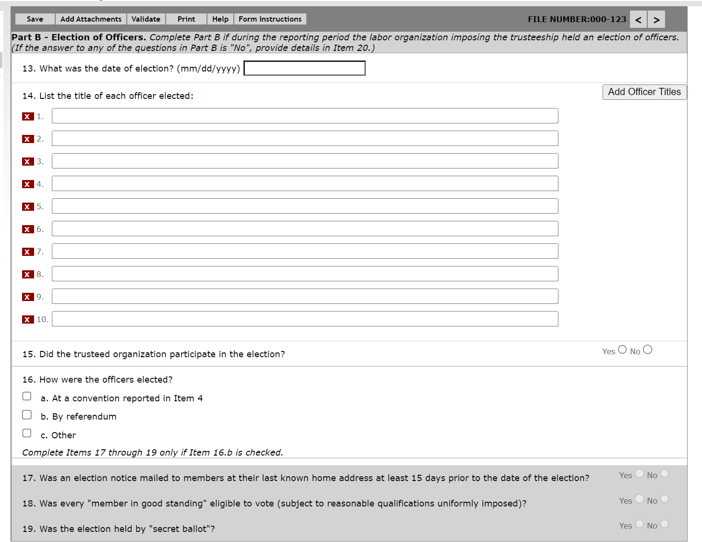
Entering Data – Items 13 through 15
Item 13: Date of Election
Item 14: Title of Officer Elected
Item 15: Did Trusteed Organization Participate in Election

Slide 17
Entering Data – Item 16
Item 16: Method of Election
Indicate whether officers were elected at convention, by referendum, or by another method.

Slide 18
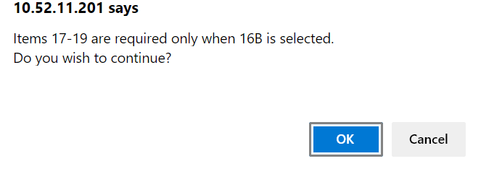
Entering Data – Items 17 through 19
Complete Item 17- through 19 only if you selected Item 16(b).

Slide 19
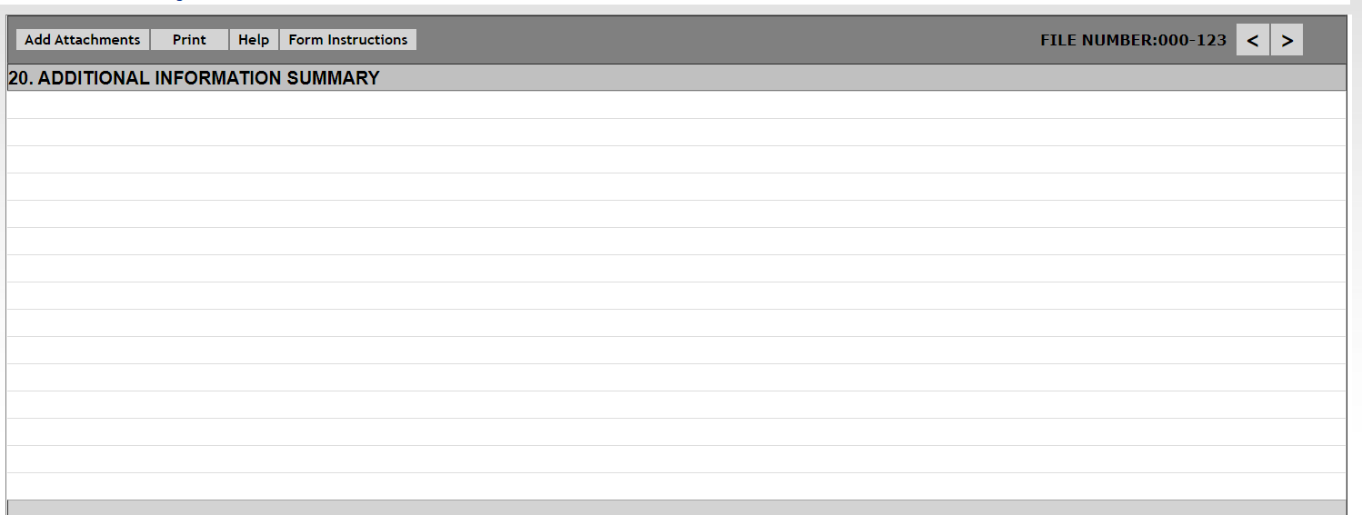
Additional Information
Enter the corresponding item number to which additional information relates.

Slide 20
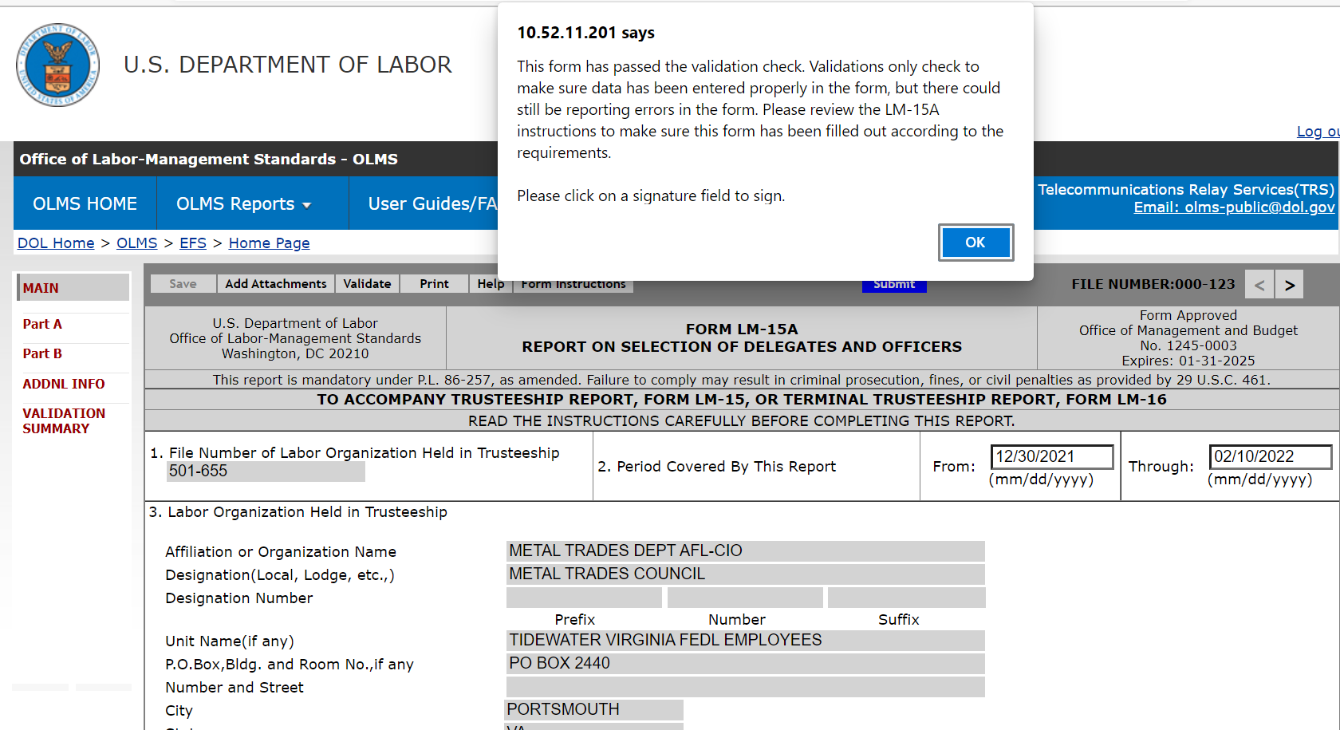
Form LM-15A - Validation
If the form passes validation, you will receive a message indicating
that All Page Validations are passed. Select “OK” to begin the
signature process.

Slide 21
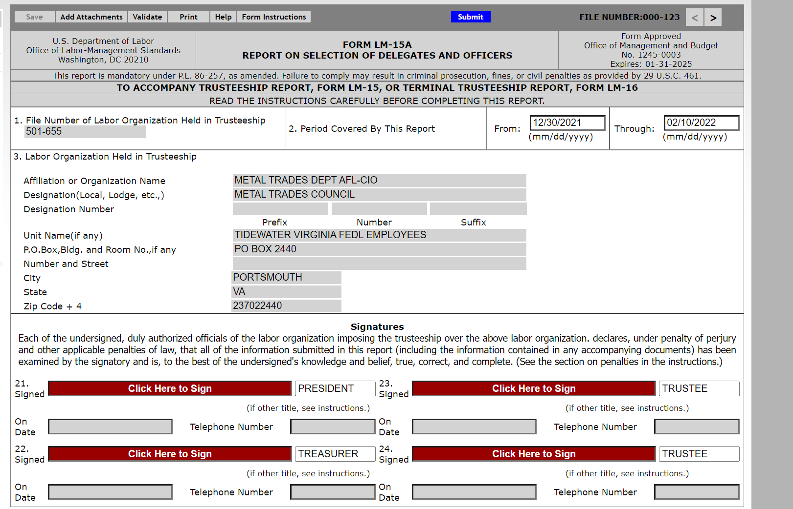
Signing the Form LM-15A
Once all the validation items have been corrected, the form is ready to be signed. The signature block will turn red for signature. Select “OK” and select the red box indicating “Click Here to Sign”.

Slide 22
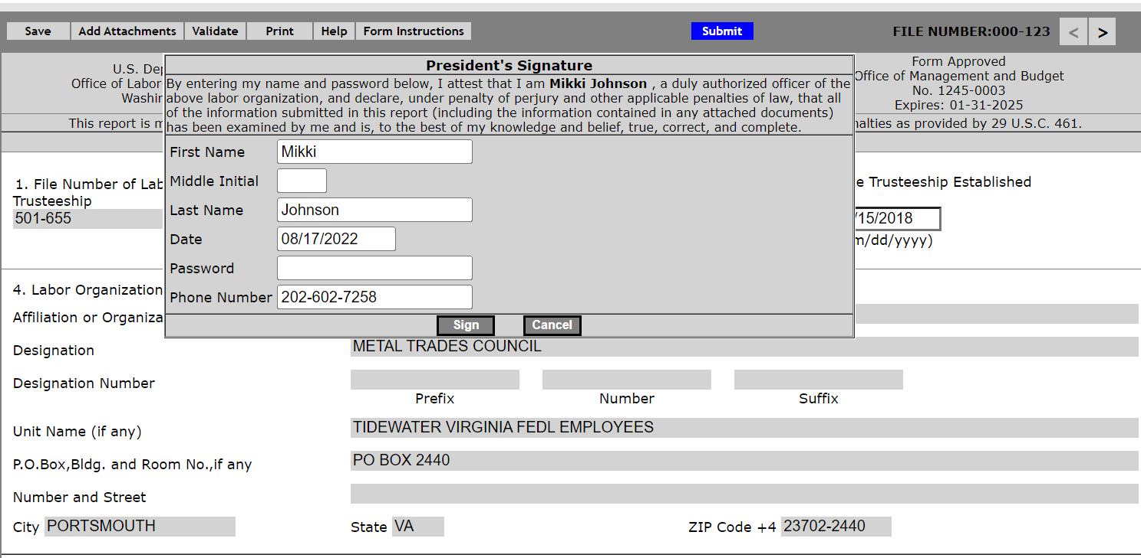
Signing the Form – Via Password
When the signature box appears, you must re-enter your password to sign the form.
Select “Sign”.
By signing this form via password, you are legally attesting that you are the person identified by name in the signature block. It is considered forgery to digitally sign a form as someone else.

Slide 23
Updating Signature Titles
If the officers’ title needs to be updated, select the box with “President”, delete the title, and replace it with the correct title. Then you must save, revalidate, and resign the form.

Slide 24
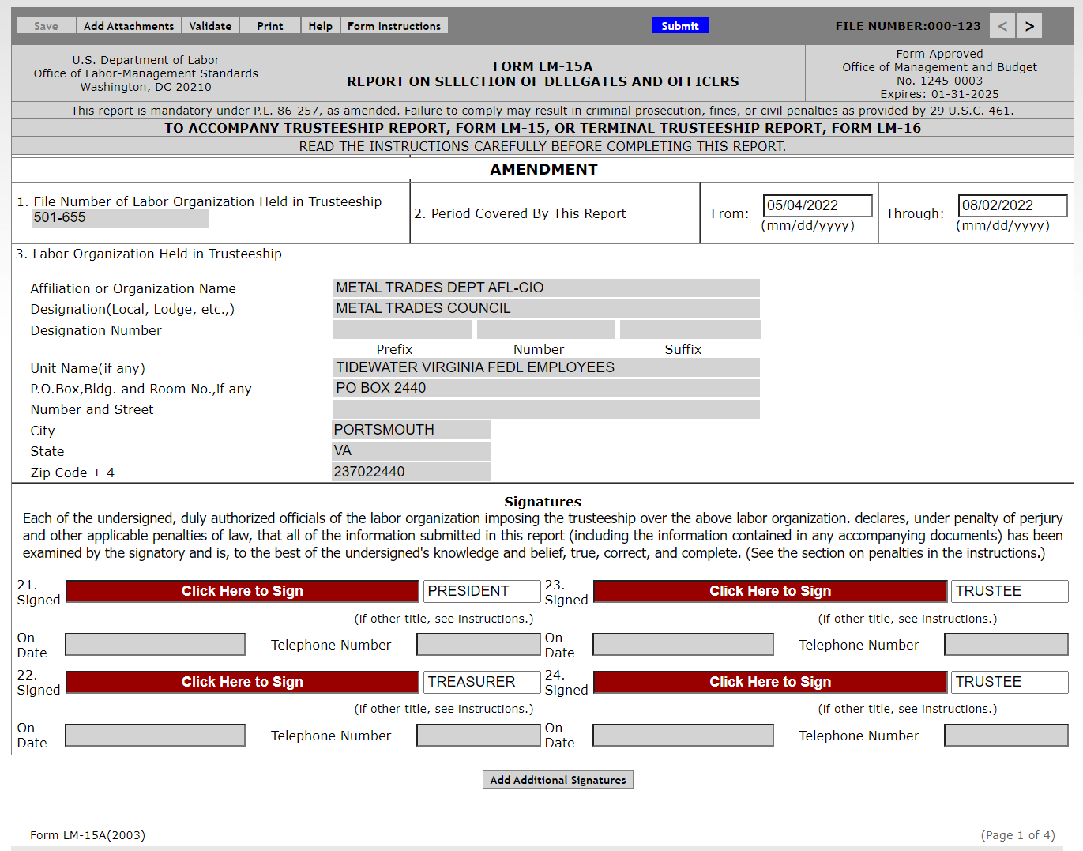
Changes Made After Signing the Form
Once the report has been signed, if any changes are made to any fields on the form, the signature will be removed, and the form must be validated and signed again.

Slide 25
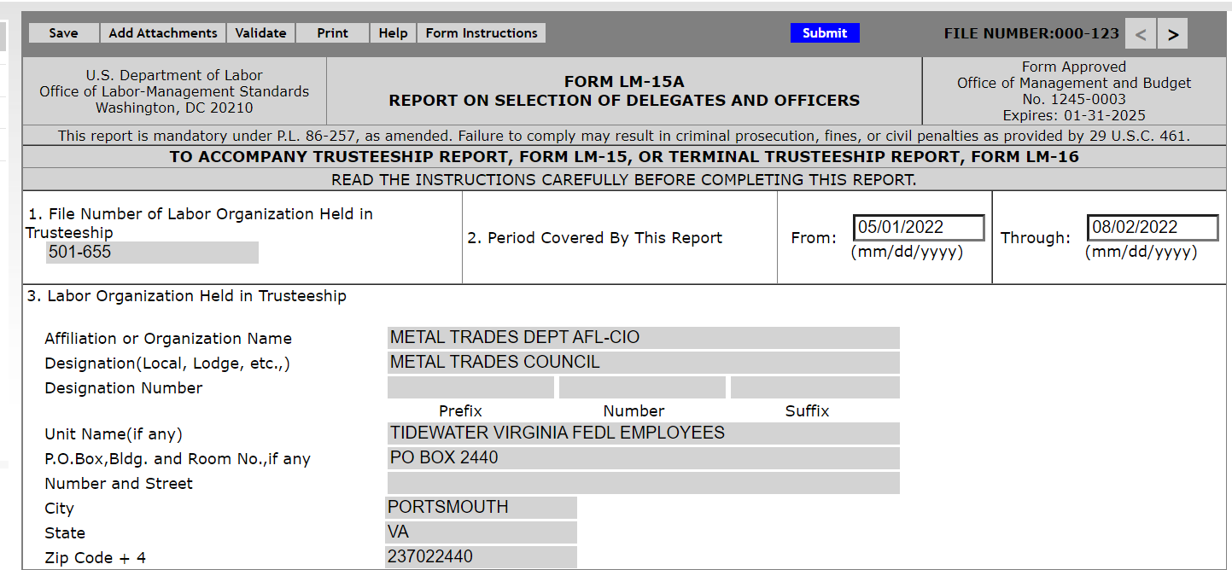
Print A Copy of the Form
You should print a copy of the form for your records. Select the “Print” tab to save a copy of the form.

Slide 26
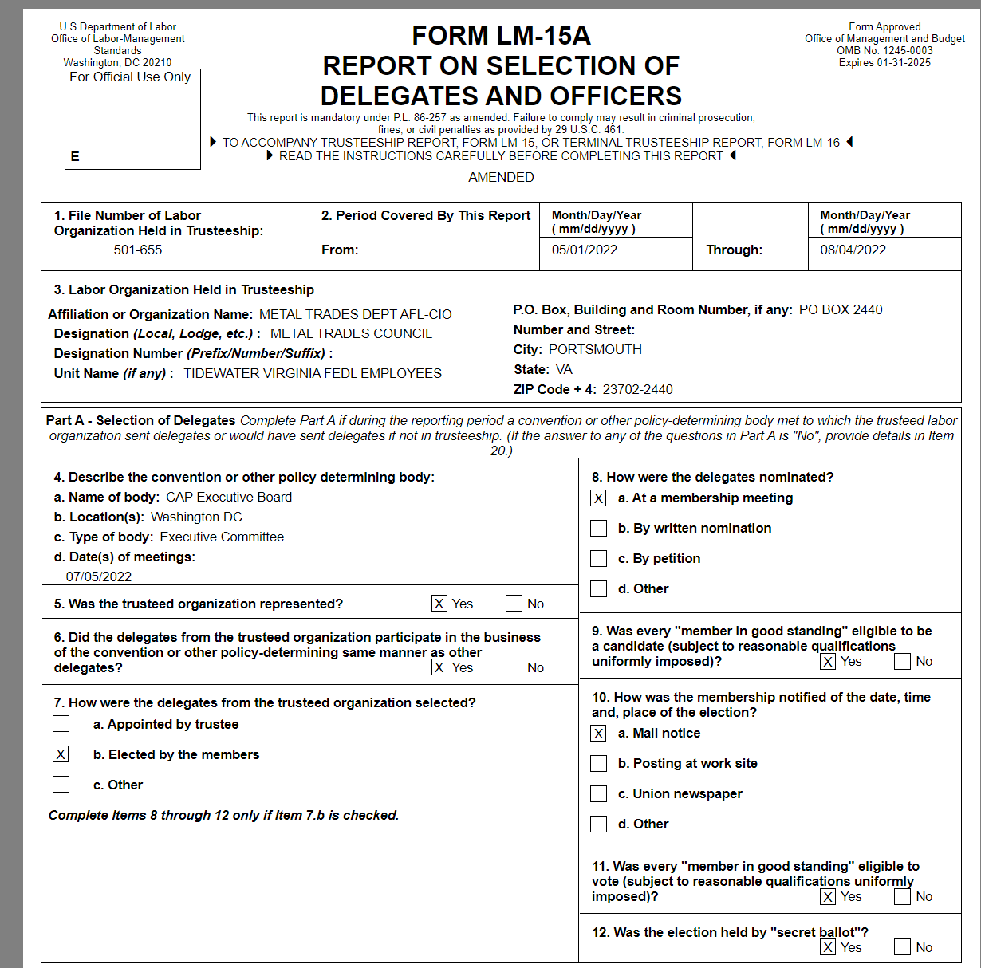
Printed Form LM-15A
You can print a copy of the Form LM-15A, in process, for review by selecting the Print button on the menu bar. An option to download and open a printable PDF copy of the report will pop up.

Slide 27
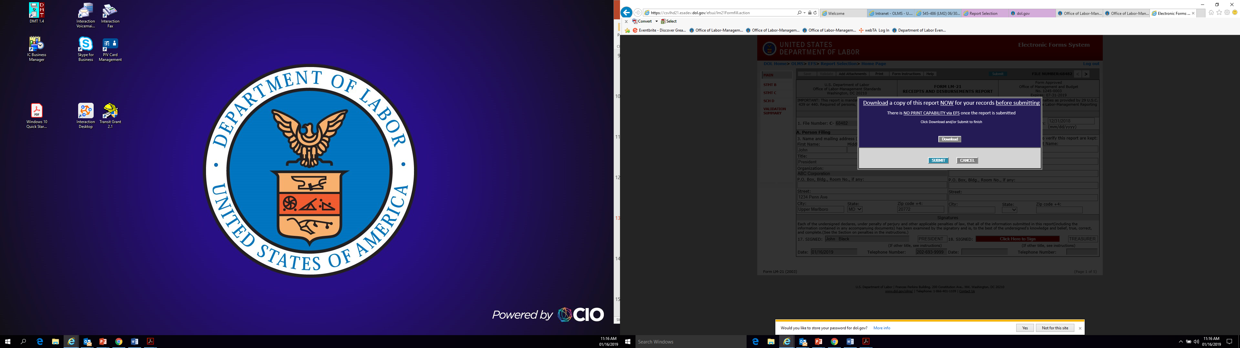
Printing and/or Saving the Form
In order to print and/or save the form for your records, select the
“Download” tab to save and/or print your form.
EFS does NOT have an option to print once the form has been submitted.
After you have saved and/or printed your form, select the “Submit” tab.

Slide 28
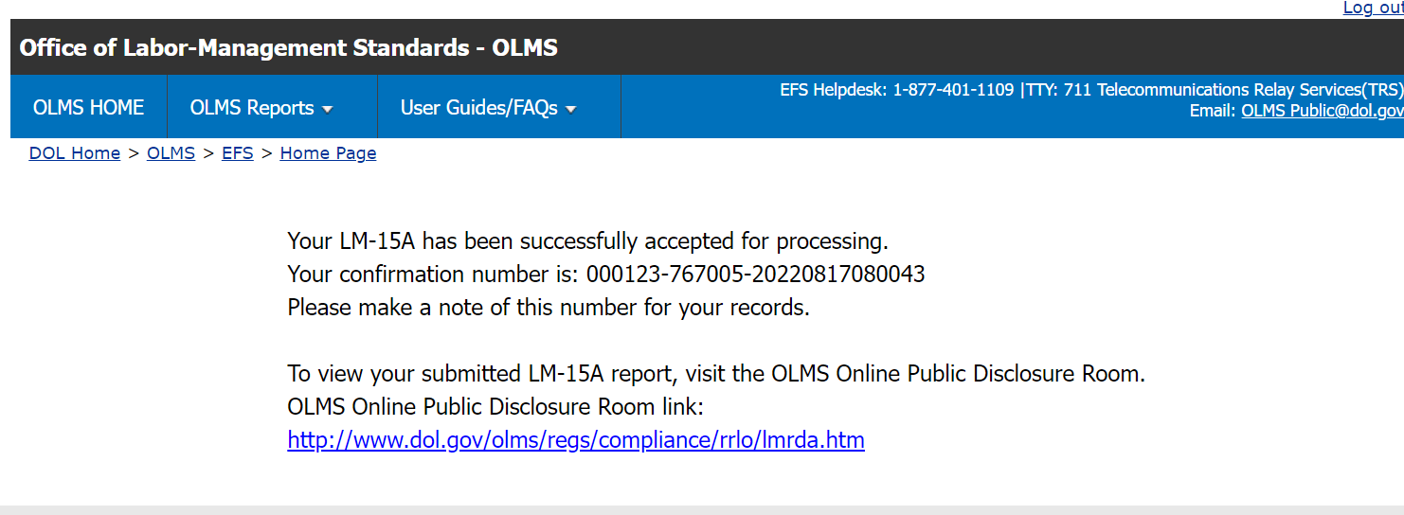
Confirmation Page
You can print this message for your records by using the print option on your browser.

Slide 29
Getting Help
If you experience difficulty using EFS, please contact OLMS Form Technical Support toll-free at:
1-866-401-1109
This PowerPoint presentation and other information regarding EFS can be found on our OLMS website.
If you have additional questions or comments, please contact OLMS E-mail OLMS at olms-public@dol.gov or contact your local OLMS District Office.

