Slide 1
ELECTRONIC FORMS SYSTEM (EFS)
Guide to Uploading
Union Constitutions and Bylaws into EFS

Slide 2
ELECTRONIC FORMS SYSTEM (EFS)
EFS is a web-based system for completing and filing LM Forms and uploading union constitution and bylaws.
This tutorial demonstrates how to upload an updated copy of a constitution and bylaws without having to file an amended report.

Slide 3
System Requirements and Settings
To access and use EFS, OLMS recommends that you use one of the following browsers:
  Microsoft Edge
  Google Chrome

Slide 4
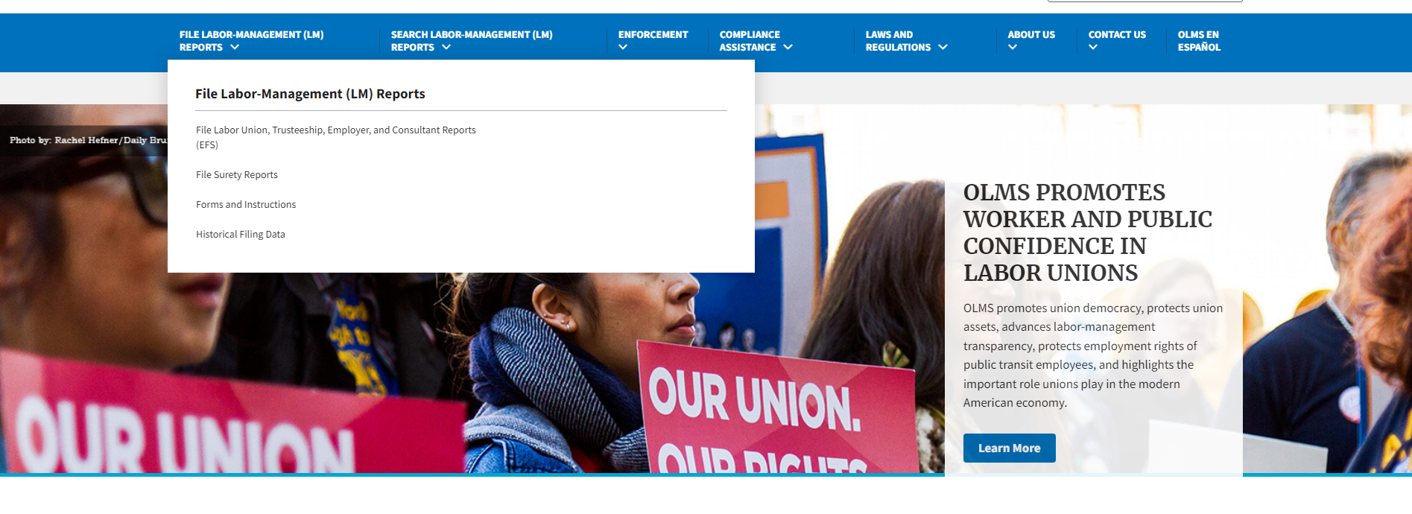
Accessing the System
Navigate to the OLMS Website and select FILE LABOR-MANAGEMENT LM REPORTS, then from the drop down menu, select the “File Labor Union, Employer, and Consultant Reports (EFS).”

Slide 5
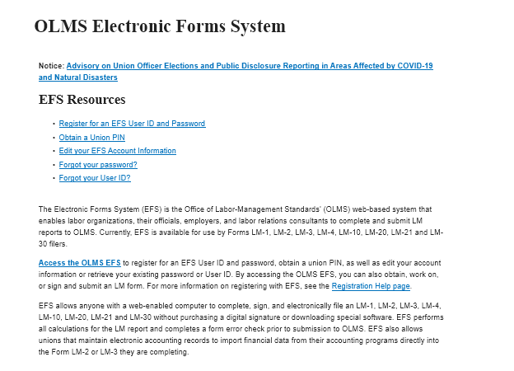
Accessing the System (cont’d)
From the EFS Introduction page, select the “Access the OLMS EFS” link.

Slide 6
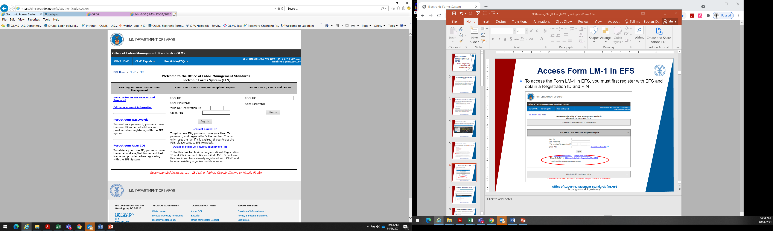
Accessing EFS to Upload Constitution and Bylaws
Log into EFS using your user ID, password, the union’s six-digit file number, and unique union PIN.

Slide 7
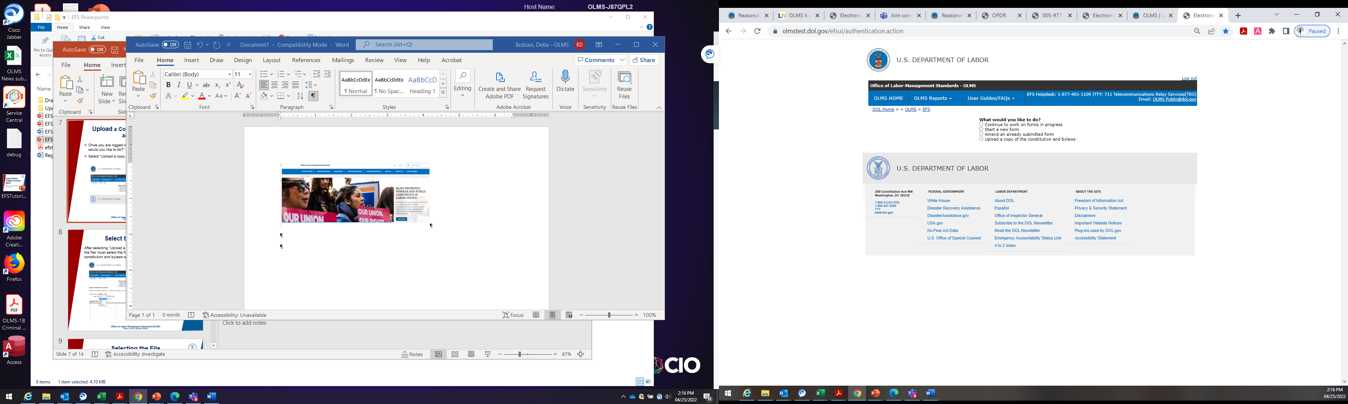
Upload a Copy of the Constitution and Bylaws
Once you are logged in, filers will navigate to the “What would you like to do?” page.
Select “Upload a copy of the constitution and bylaws.”

Slide 8
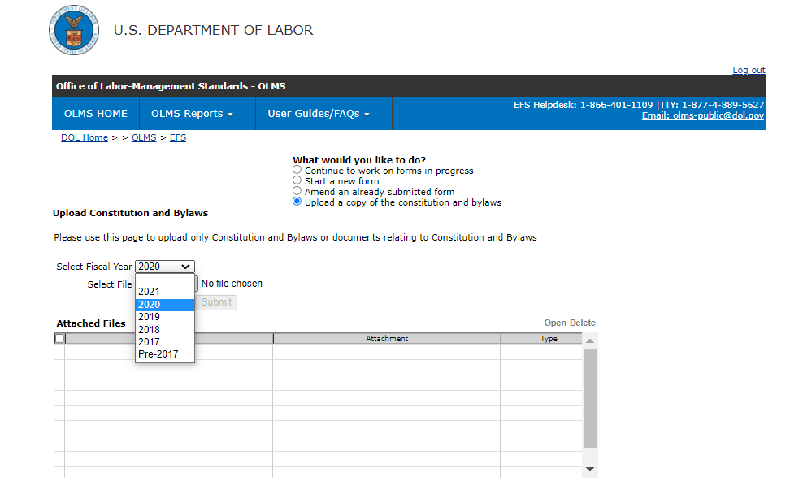
Select the Fiscal Year
After selecting “Upload a copy of the constitution and bylaws,” the filer must select the fiscal year in which the changes to the constitution and bylaws were made.

Slide 9
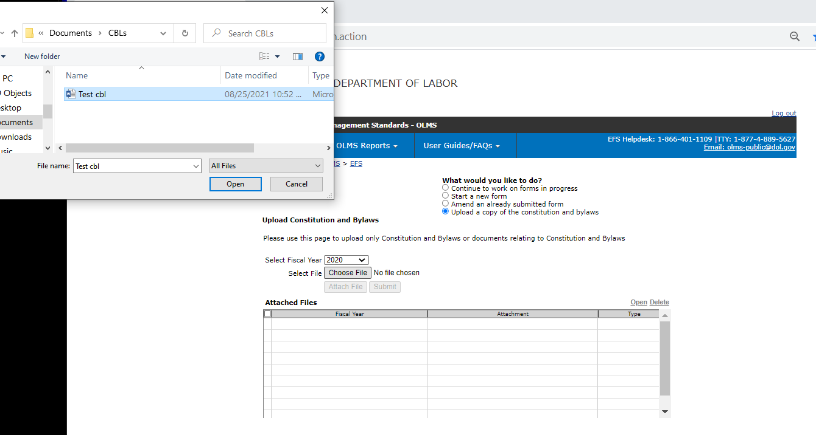
Selecting the File
The filer then selects “Choose File”
A window opens to locate and select the file (the updated constitution and bylaws)
Once the correct file is identified, select Open.

Slide 10
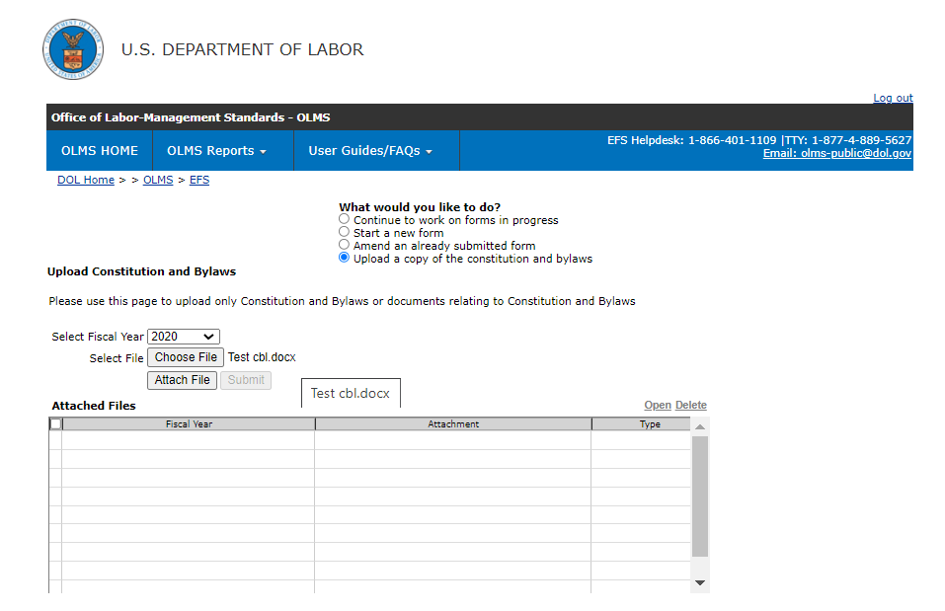
Attaching the File
After selecting “Open,” the filer must select “Attach File.”

Slide 11
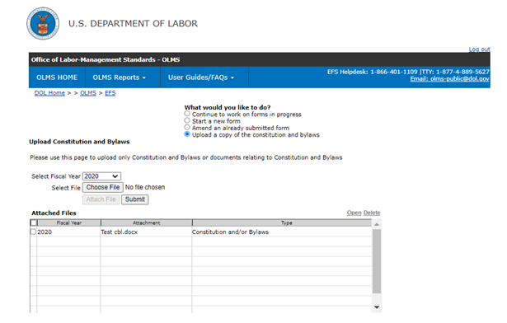
Submitting the File
The filer will see the file has been attached when it appears under the “Attached Files.”
The attached file is then submitted by selecting “Submit.”

Slide 12
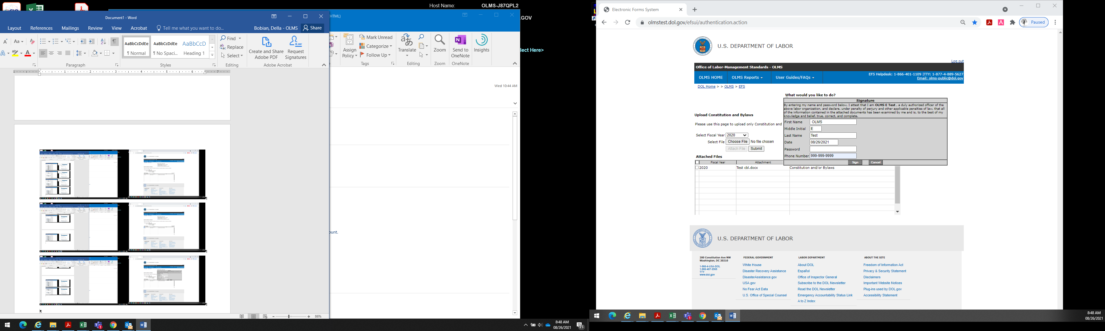
Submitting the File (cont’d)
After selecting “Submit,” the Signature screen opens.
The filer must enter their password and select “Sign.”

Slide 13
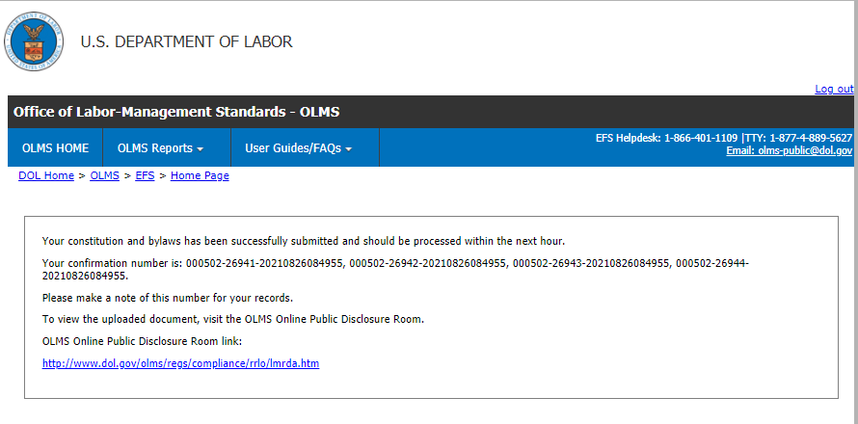
Submission Confirmation
EFS will display a message indicating that the constitution and bylaws were successfully submitted.
The constitution and bylaws should be available for viewing on the OLMS Online Public Disclosure Room within the hour.

Slide 14
Getting Help
If you experience difficulty using EFS, please contact the OLMS Form Technical Support toll-free at: 1-866-401-1109 or by emailing olms-public@dol.gov.
This PowerPoint presentation and other information regarding EFS can be found on our website at the following URL: http://www.dol.gov/agencies/olms/regs/compliance/efs/efshelp.
If you have additional questions or comments please contact OLMS: Email OLMS at olms-public@dol.gov or contact your local OLMS District Office.

