Slide 1
Searching the Workforce Recruitment Program (WRP) Talent Program for Candidates
USAJOBS

Slide 2
Background
The Workforce Recruitment Program (WRP) helps federal employers hire college students and recent graduates with disabilities for internships or permanent jobs. WRP candidates are eligible for the federal government's Schedule A Hiring Authority for Persons with Disabilities, which allows agencies to hire without posting a job announcement or going through the certification process. Candidates provide documentation to verify Schedule A eligibility when applying to the program. The WRP is a key tool that supports federal agencies in maintaining compliance with requirements of Section 501 of the Rehabilitation Act.
How WRP Can Help You Recruit Talent
Increase disability employment in your workplace by hiring job-ready candidates. The candidate database is renewed each December, and candidates can update their application throughout the year.
Streamline your searches for candidates with the customized search page. Filter candidates based on major, degree, job and location preference, keywords, and more.
Access relevant candidate information easily. Bookmark candidate applications and resumes for later viewing.
Expedite the hiring process by connecting with WRP candidates directly regarding job opportunities.
Source: https://www.wrp.gov/

Slide 3
Finding the WRP Talent Program

Slide 4
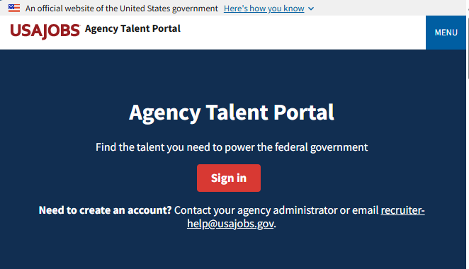

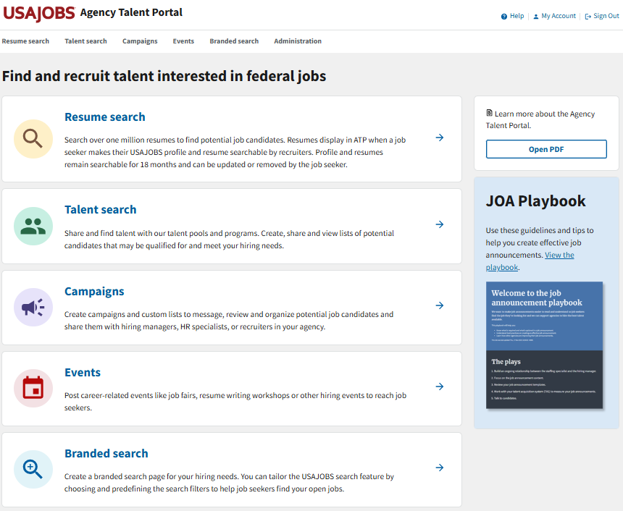
Log into ATP
To log into ATP, visit https://agencyportal.usajobs.gov/
Then select Sign in.
You can sign in using your CAC or PIV card, USA Staffing account (if applicable), or Login.gov.

Slide 5
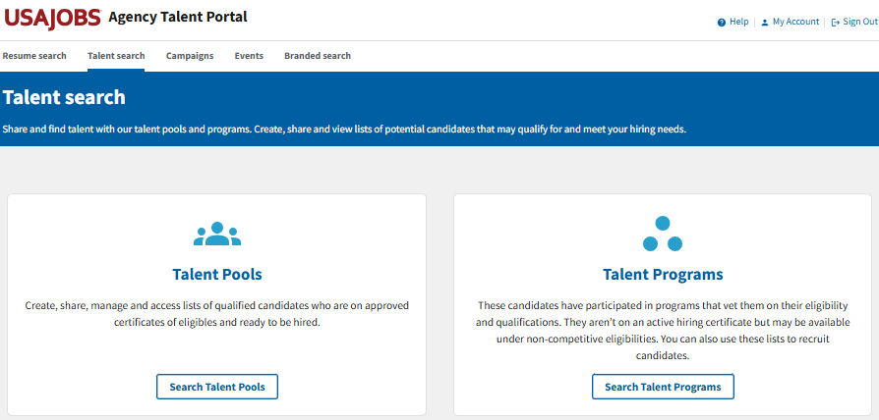
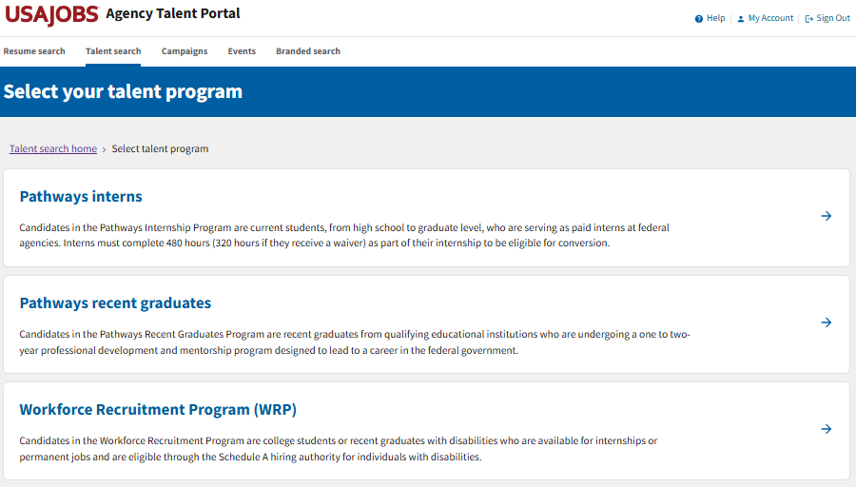

Go to Talent Programs
To navigate to the WRP Talent Program,
Select Talent search.
Then select Search Talent Programs.
Then select Workforce Recruitment Program (WRP).

Slide 6
Search and Filters

Slide 7
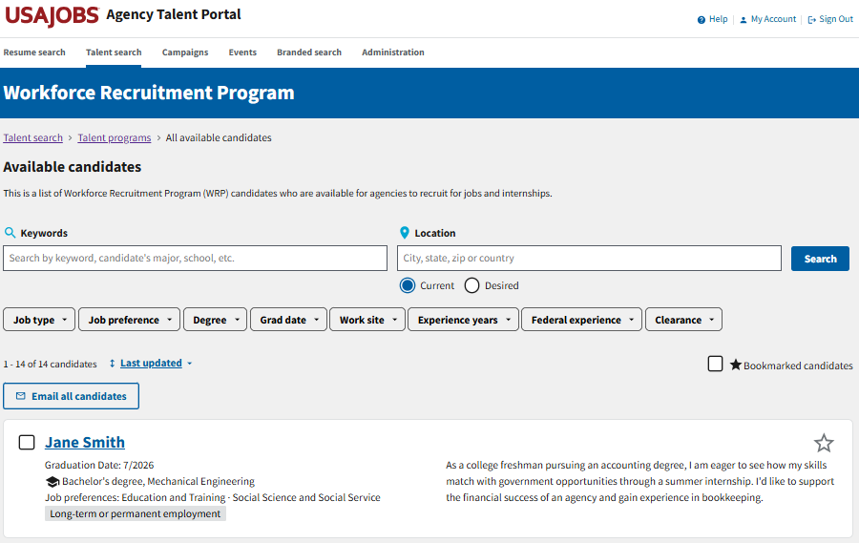

Available Candidates List
Here, you will find the full list of available candidates. You can narrow the candidate list using a keyword search, location search, and several job filters.
Filters

Slide 8
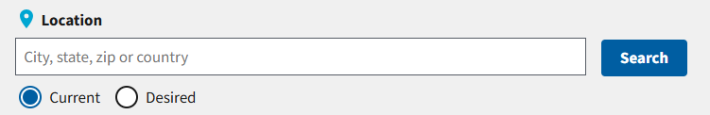
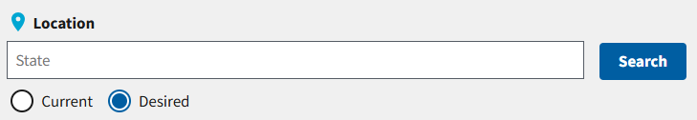
Location Search
For the Location search, you can search either the candidates’ current location or their desired work locations.
The search will default to current location. Enter the city, state, zip code, or country you want to search and select Apply to filter the candidate list.
In their WRP applications, candidates can list their desired work locations by state. To search their desired locations, select the Desired radio button, enter the state you want to search, and select Apply.
Current
Desired

Slide 9
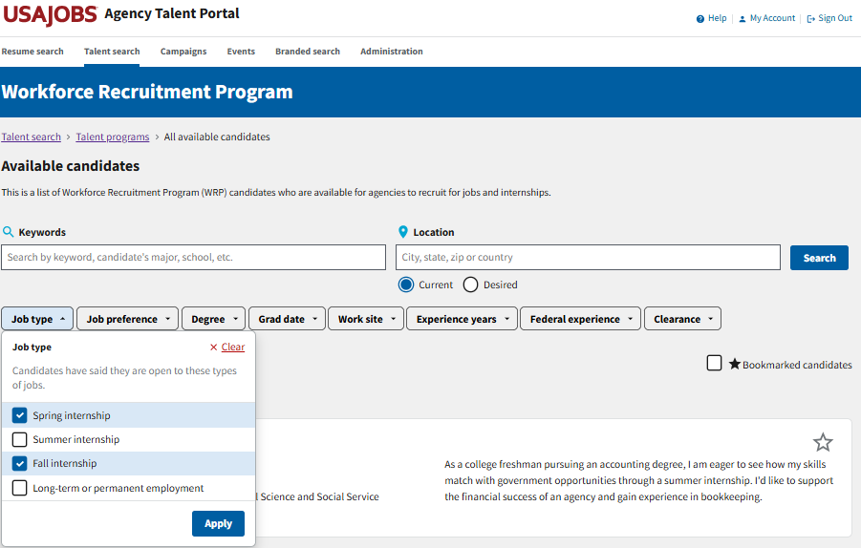

Job Type Filter
You can narrow your candidate list by the type of job candidates have expressed interest in.
Available job types include spring internship, summer internship, fall internship and long-term or permanent employment.
Select one or more checkboxes and then select Apply to filter the candidates.
If you want to clear the filter, select Clear in the upper-right corner.
Clear
Apply

Slide 10
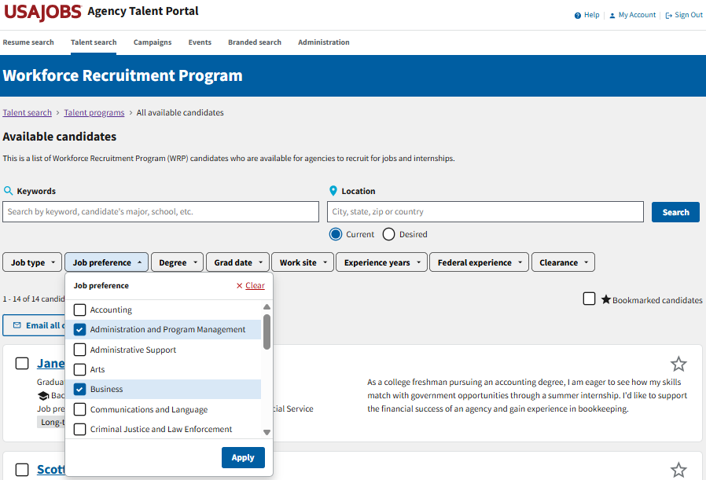
Job Preference Filter
You can narrow your candidate list by the candidates’ job preferences.
Several job preference categories are available to choose from.
Select one or more checkboxes and then select Apply to filter the candidates.
If you want to clear the filter, select Clear in the upper right corner.

Slide 11
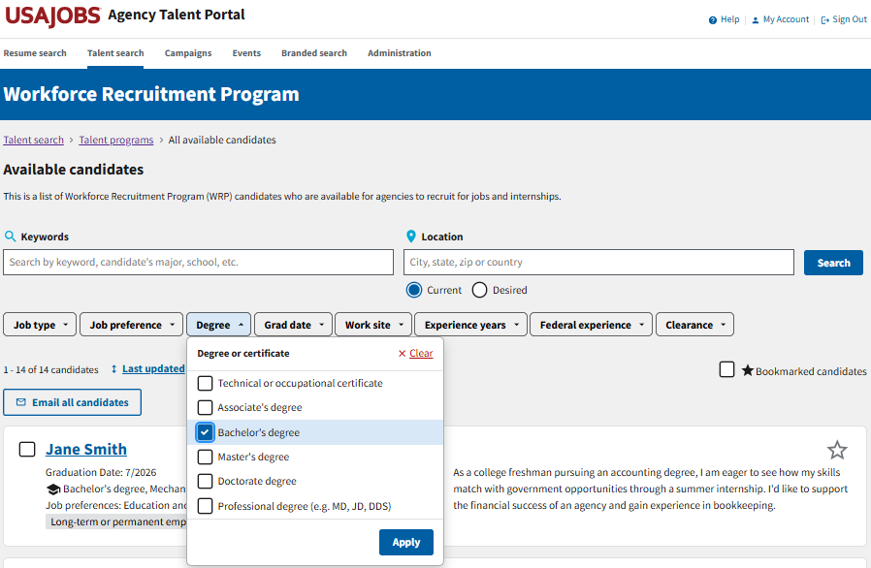
Degree Filter
You can narrow your candidate list by the candidates’ degree type.
Degree types include:
Technical or occupational certificate
Associate’s degree
Bachelor’s degree
Master’s degree
Doctorate degree
Professional degree (e.g., MD, JD, DDS)
Select one or more checkboxes and then select Apply to filter the candidates.
If you want to clear the filter, select Clear in the upper right corner.

Slide 12
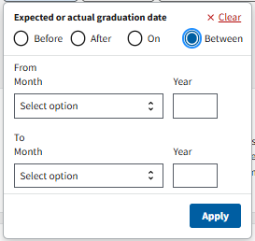
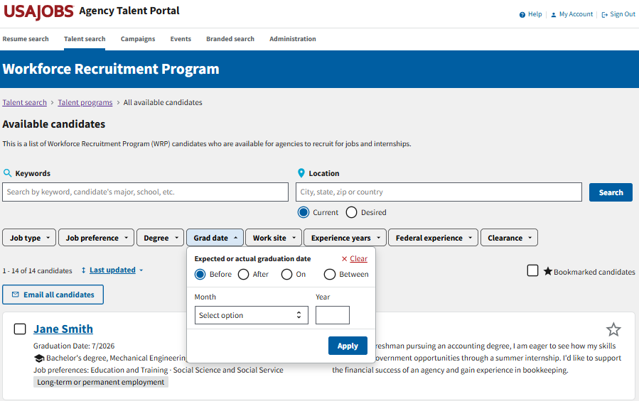
Grad Date Filter
If you select Between, you will be prompted to enter a date range.
You can narrow your candidate list by the candidates’ expected or actual graduation date.
Enter a month and year and then select whether you want to search before that date, after that date or on that date.
You can also search within a specified date range if you select between and enter the start and end dates.
Select Apply to filter the candidates.
If you want to clear the filter, select Clear in the upper right corner.

Slide 13
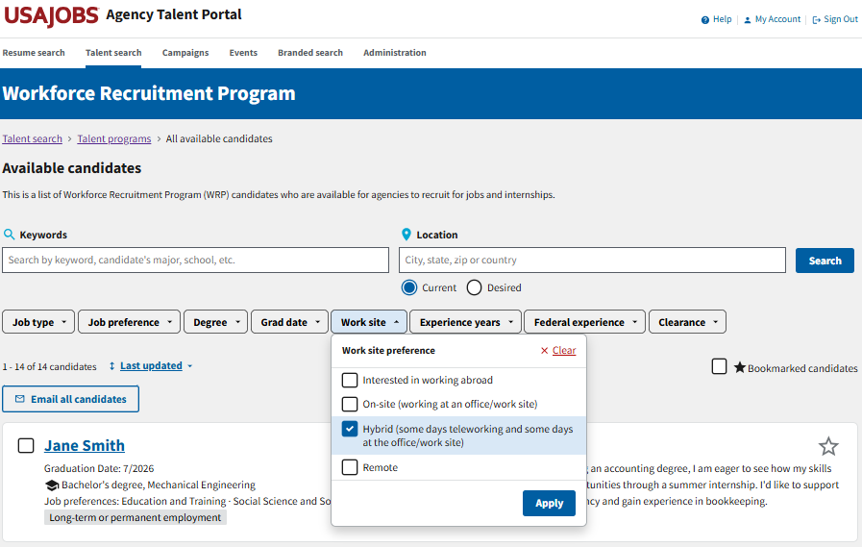
Work Site Filter
You can narrow your candidate list by the candidates’ work site preferences.
Work sites include:
Interested in working abroad
On-site (working at an office/work site)
Hybrid (some days teleworking and some days at the office/work site)
Remote
Select one or more checkboxes and then select Apply to filter the candidates.
If you want to clear the filter, select Clear in the upper right corner.

Slide 14
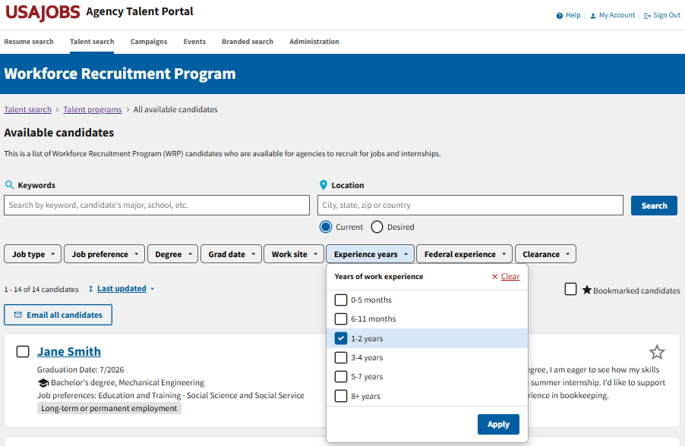
Experience Years Filter
You can narrow your candidate list by the candidates’ years of work experience.
Options include:
0-5 months
6-11 months
1-2 years
3-4 years
5-7 years
8+ years
Select one or more checkboxes and then select Apply to filter the candidates.
If you want to clear the filter, select Clear in the upper right corner.

Slide 15
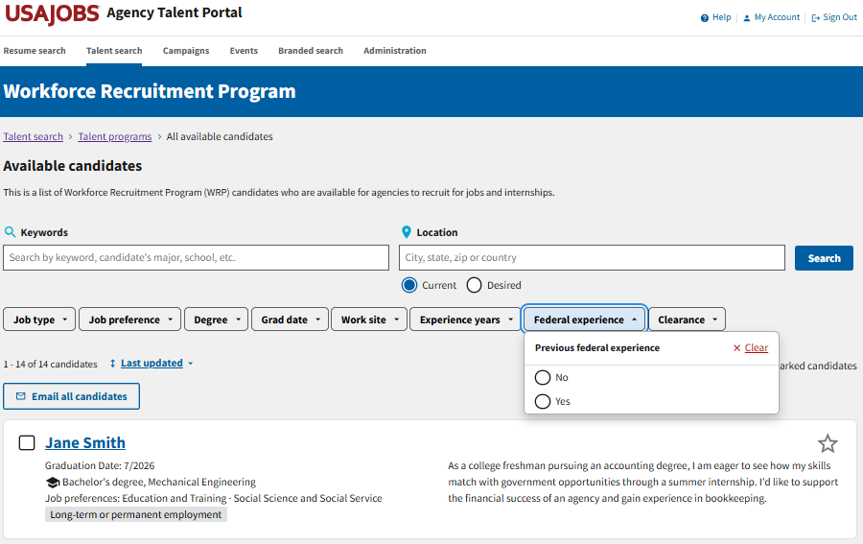
Federal Experience Filter
You can narrow your candidate list by the candidates’ previous federal experience.
Select either the yes or no radio button and the candidate list will automatically update with that filter applied.
If you want to clear the filter, select Clear in the upper right corner.

Slide 16
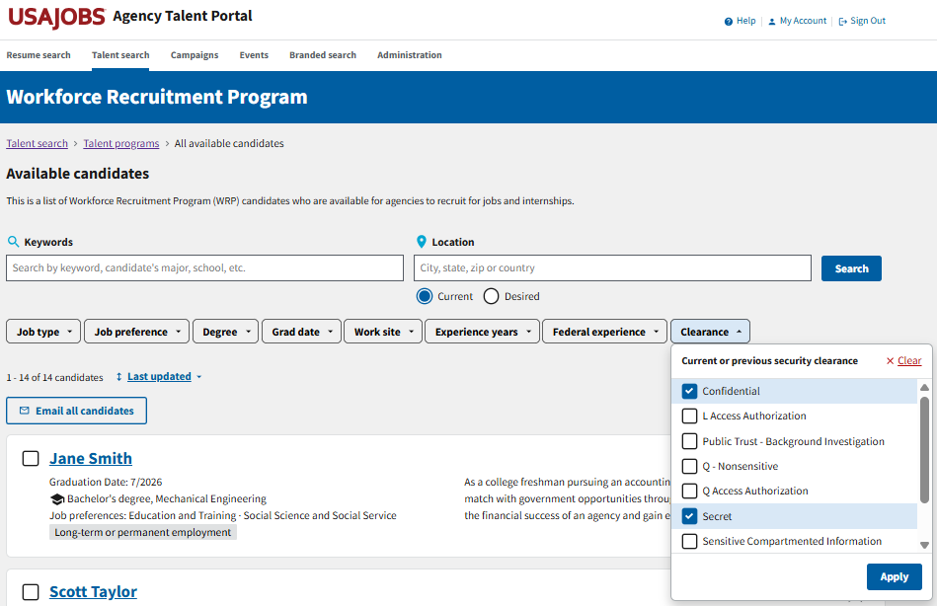
Clearance Filter
You can narrow your candidate list by the candidates’ current or previous security clearance.
Several clearance options are available to choose from.
Select one or more checkboxes and then select Apply to filter the candidates.
If you want to clear the filter, select Clear in the upper-right corner.

Slide 17
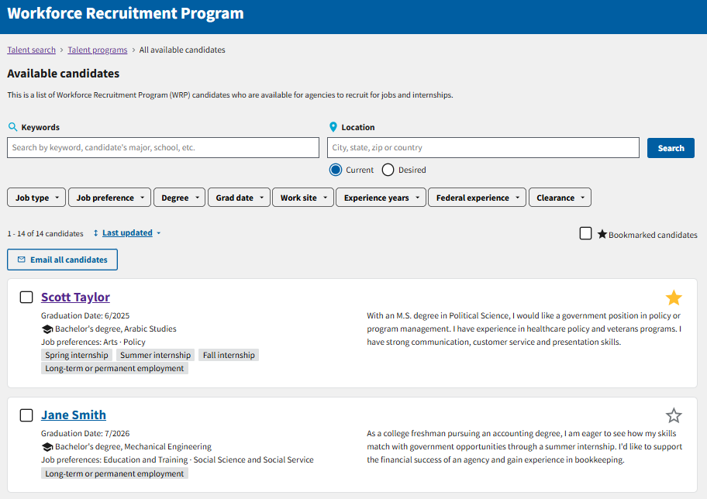

Bookmarked Candidates Filter
You can narrow your candidate list by the candidates you have bookmarked.
To bookmark a candidate, select the star in the upper-right corner of their candidate card.
To filter your bookmarked candidates, select the check box next to Bookmarked candidates.
Select the check box to filter your bookmarked candidates.
Select the star on a candidate card to bookmark them.

Slide 18
Candidate Information

Slide 19
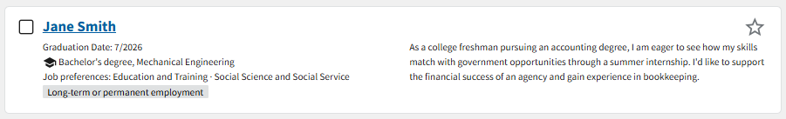
Candidate Overview
The candidate card provides a high-level overview of the candidate’s background and job preferences.
Select the star to bookmark candidates you’re interested in.
Select the candidate’s name to view additional details and a resume.
The candidate’s graduation date, degree type and major, job preferences and preferred job types are provided.
The career interest statement gives you a high-level overview of the candidates’ career interests.

Slide 20
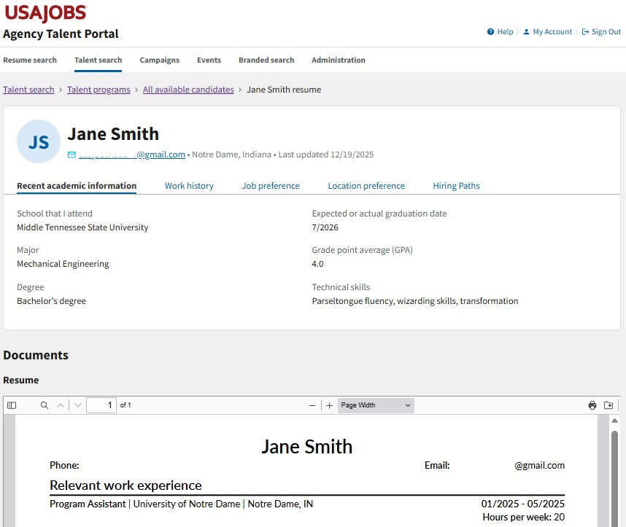
Candidate Information Page
The information the candidates submitted with their WRP applications can be found on the candidate information page, including:
Contact information and current location
The date their information was last updated
Recent academic information
Work history
Job preference
Location preference
Hiring paths
Resume

Slide 21
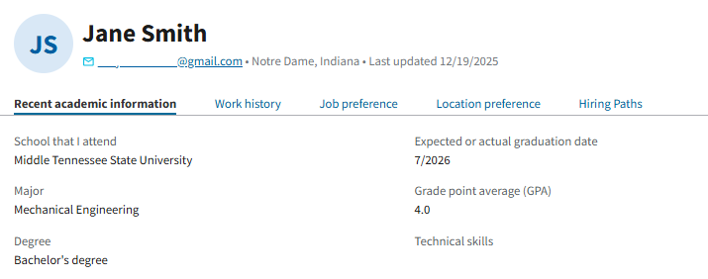
Recent Academic Information
Under the Recent academic information tab, you will find the candidate’s:
Most recently attended school
Major
Second major or minor (if applicable)
Degree type
Month and year of their expected or actual graduation date
GPA (if provided)
Technical skills, such as computer, technology, or language skills

Slide 22
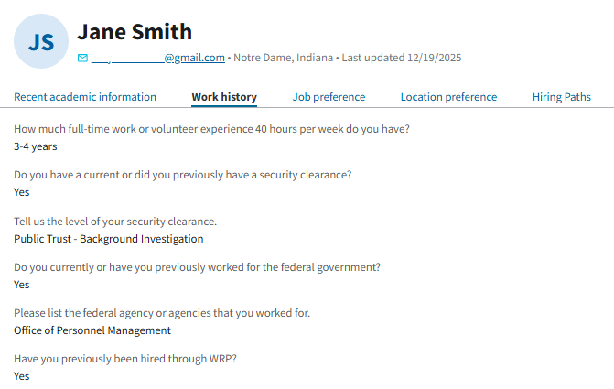
Work History
Under the Work history tab, you will find:
How much full-time work or volunteer experience the candidate has in months or years.
Whether a candidate has or previously had a security clearance and, if so, the level of that security clearance.
Whether the candidate currently or previously worked for the federal government. If so, up to five agencies may be listed.
Whether the candidate has previously been hired through WRP.

Slide 23
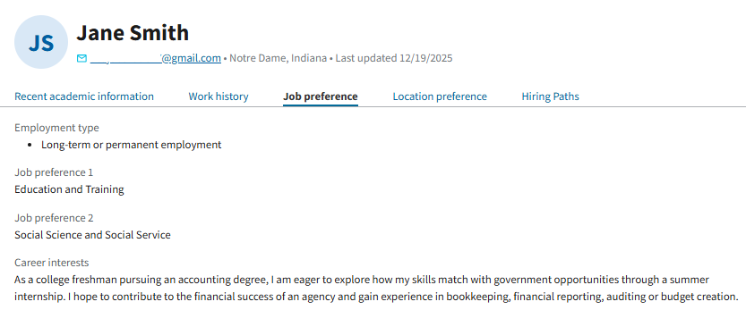
Job Preference
Under the Job preference tab, you will find the candidate’s:
Preferred employment type (internship or long-term/ permanent)
Date available to begin employment (if provided)
Up to two job preference categories based on their academic background and career interests
A short career interest statement indicating the types of opportunities they’re interested in

Slide 24
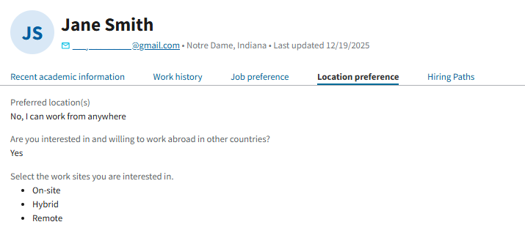
Location Preference
Under the Location preference tab, you will find the candidate’s:
List of preferred work locations, if specified
Information on a candidate’s willingness to work abroad
The work sites the candidate is interested in

Slide 25
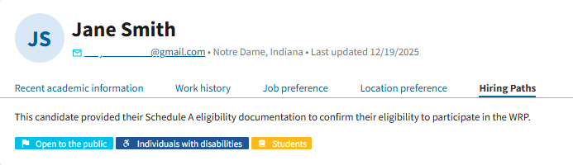
Hiring Paths
Candidates in the WRP Talent Program are eligible for the Schedule A hiring authority.
Under the hiring paths tab, candidates can indicate whether they are eligible for hiring under any other hiring paths.

Slide 26
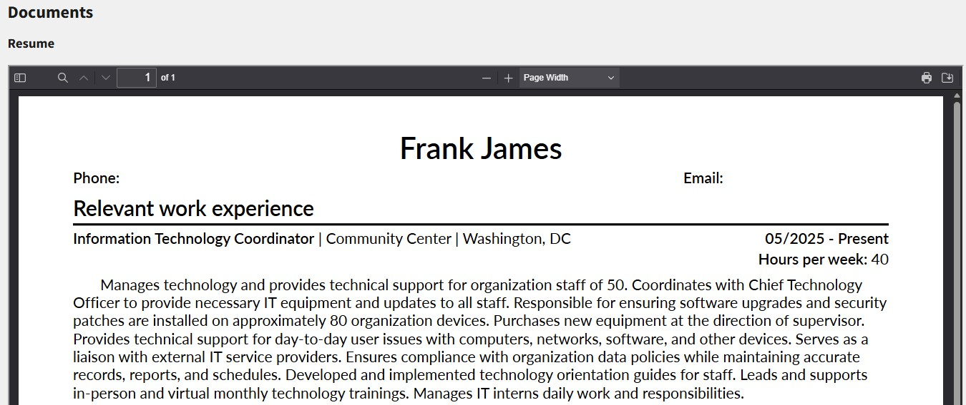
Resume
The candidate information page will also display the resume the candidate submitted with their WRP application.
You can view the entire resume on the page, or you can download or print the resume using the icons in the upper-right corner of the resume PDF.

Slide 27

Questions?
Review other user guides on the Workforce Recruitment Program Resources page.
For questions about the Workforce Recruitment Program (WRP), email wrp@dol.gov.
For technical assistance with the Agency Talent Portal (ATP), email recruiter-help@usajobs.gov.

