Slide 1
Requesting an ATP Account and Signing into Access the WRP Talent Program
USAJOBS

Slide 2
Background
The Workforce Recruitment Program (WRP) helps federal employers hire college students and recent graduates with disabilities for internships or permanent jobs. WRP candidates are eligible for the federal government's Schedule A Hiring Authority for Persons with Disabilities, which allows agencies to hire without posting a job announcement or going through the certification process. Candidates provide documentation to verify Schedule A eligibility when applying to the program. The WRP is a key tool that supports federal agencies in maintaining compliance with requirements of Section 501 of the Rehabilitation Act.
How WRP Can Help You Recruit Talent
Increase disability employment in your workplace by hiring job-ready candidates. The candidate database is renewed each December, and candidates can update their application throughout the year.
Streamline your searches for candidates with the customized search page. Filter candidates based on major, degree, job and location preference, keywords, and more.
Access relevant candidate information easily. Bookmark candidate applications and resumes for later viewing.
Expedite the hiring process by connecting with WRP candidates directly regarding job opportunities.
Source: https://www.wrp.gov/

Slide 3
Requesting an Agency Talent Portal (ATP) Account

Slide 4
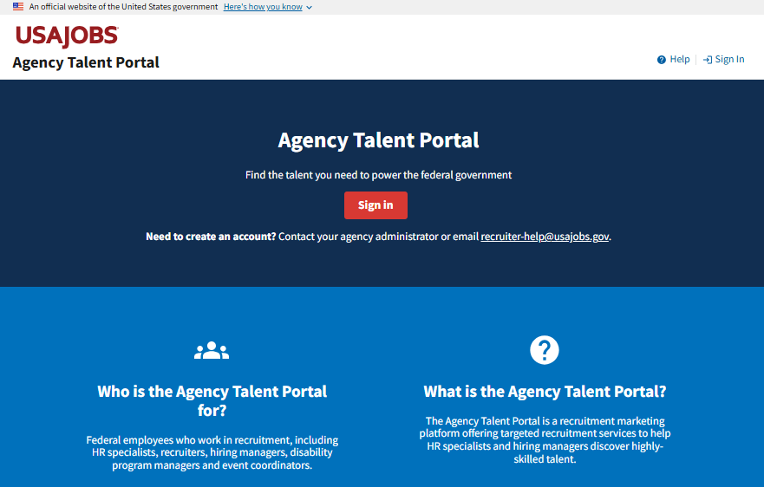
Create an ATP Account
To access the WRP talent program, you must first request an ATP account.
Email recruiter-help@usajobs.gov to request an account and include:
Your name
Federal email address
Agency and subagency or component (if applicable)
Reason for requesting access
Supervisor approval
If your agency has an ATP agency administrator, your request will be forwarded to them for processing. Otherwise, the ATP help desk will process your request.
Access to ATP is restricted to federal employees who work in recruitment and hiring.

Slide 5
Finding the WRP Talent Program

Slide 6
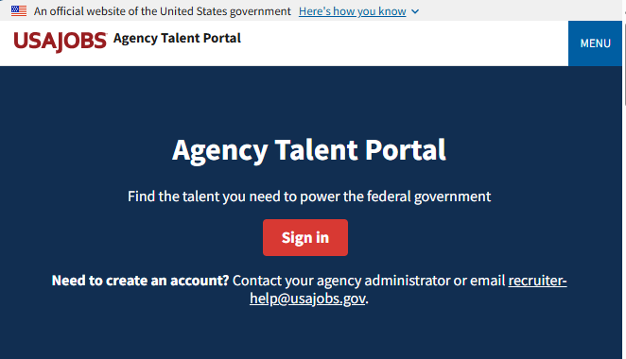

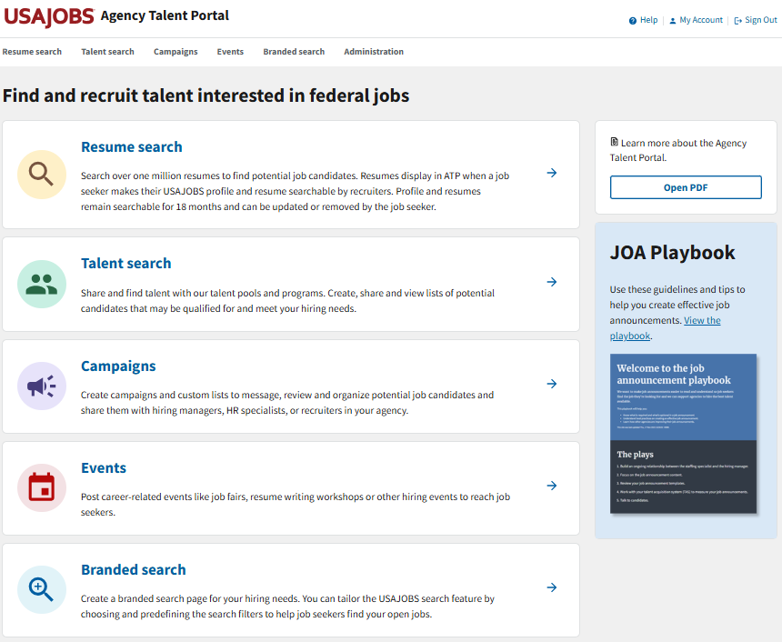
Log into ATP
To log into ATP, visit https://agencyportal.usajobs.gov/
Then select Sign in.
You can sign in using your CAC or PIV card, USA Staffing account (if applicable), or Login.gov.

Slide 7
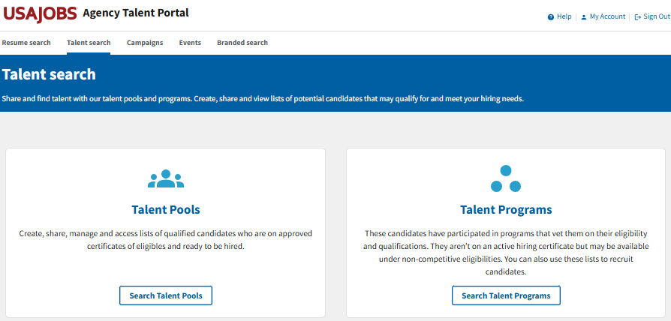
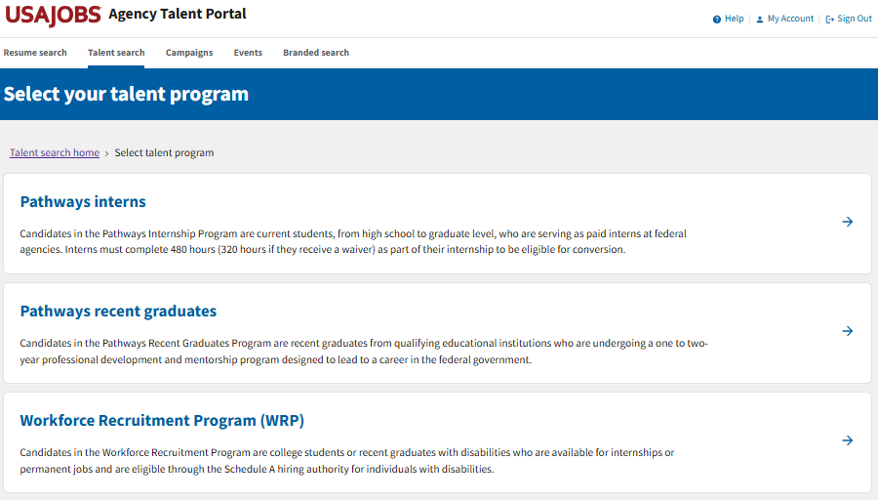

Go to Talent Programs
To navigate to the WRP Talent Program,
Select Talent search.
Then select Search Talent Programs.
Then select Workforce Recruitment Program (WRP).

Slide 8

Questions?
Review other user guides on the Workforce Recruitment Program Resources page.
For questions about the Workforce Recruitment Program (WRP), email wrp@dol.gov.
For technical assistance with the Agency Talent Portal (ATP), email recruiter-help@usajobs.gov.

