Slide 1
Contacting and Hiring WRP Candidates
USAJOBS

Slide 2
Background
The Workforce Recruitment Program (WRP) helps federal employers hire college students and recent graduates with disabilities for internships or permanent jobs. WRP candidates are eligible for the federal government's Schedule A Hiring Authority for Persons with Disabilities, which allows agencies to hire without posting a job announcement or going through the certification process. Candidates provide documentation to verify Schedule A eligibility when applying to the program. The WRP is a key tool that supports federal agencies in maintaining compliance with requirements of Section 501 of the Rehabilitation Act.
How WRP Can Help You Recruit Talent
Increase disability employment in your workplace by hiring job-ready candidates. The candidate database is renewed each December, and candidates can update their application throughout the year.
Streamline your searches for candidates with the customized search page. Filter candidates based on major, degree, job and location preference, keywords, and more.
Access relevant candidate information easily. Bookmark candidate applications and resumes for later viewing.
Expedite the hiring process by connecting with WRP candidates directly regarding job opportunities.
Source: https://www.wrp.gov/

Slide 3
Finding the WRP Talent Program

Slide 4
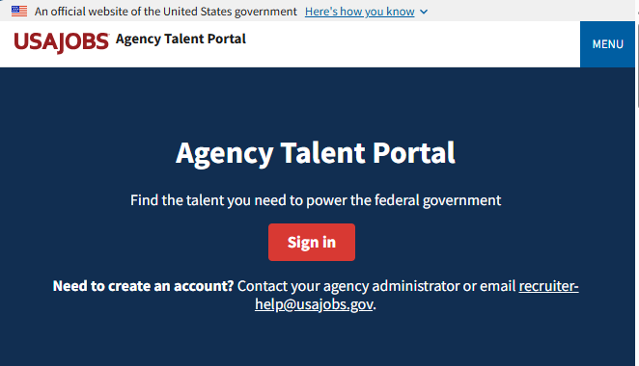

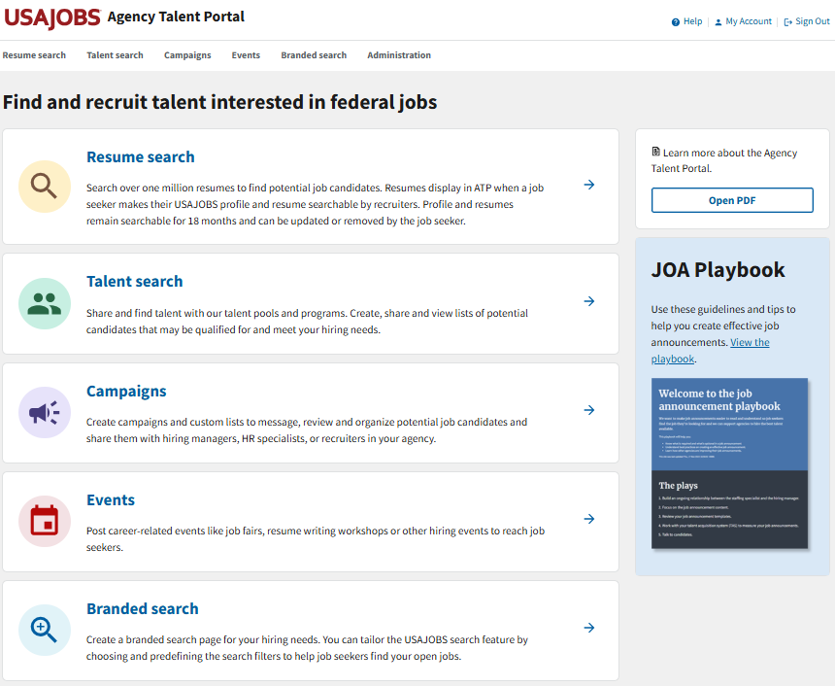
Log into ATP
To log into ATP, visit https://agencyportal.usajobs.gov/
Then select Sign in.
You can sign in using your CAC or PIV card, USA Staffing account (if applicable), or Login.gov.

Slide 5
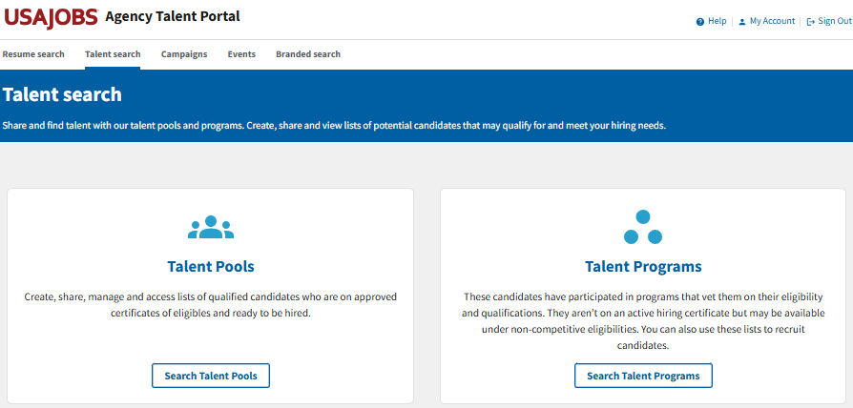
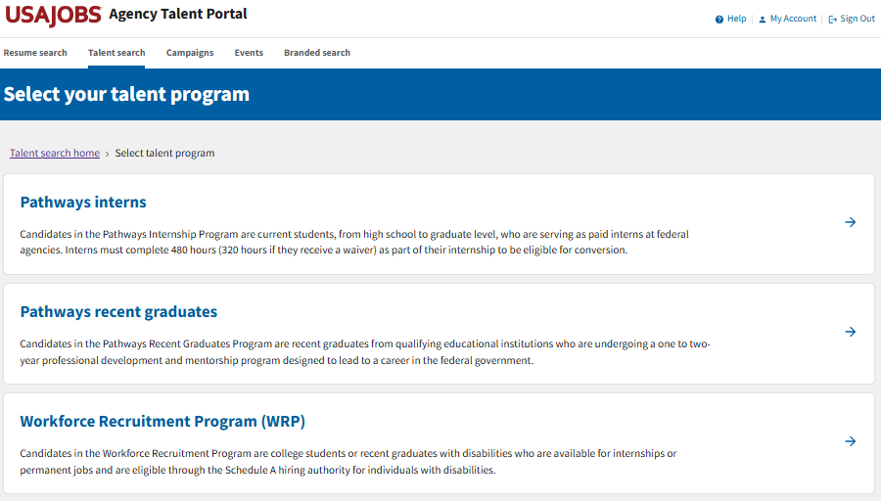

Go to Talent Programs
To navigate to the WRP Talent Program,
Select Talent search.
Then select Search Talent Programs.
Then select Workforce Recruitment Program (WRP).

Slide 6
Contacting Candidates

Slide 7
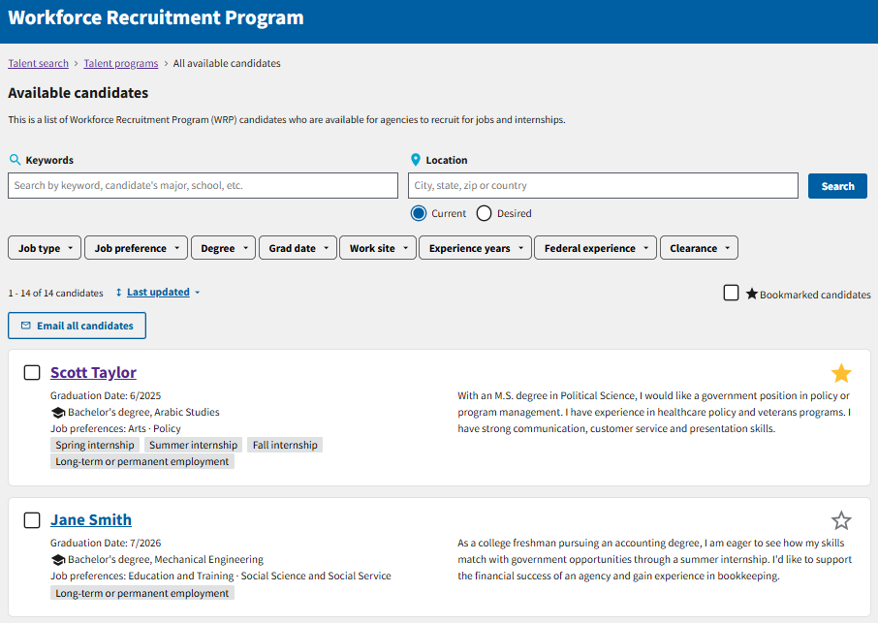
Email All Candidates
Once you have conducted a search, you have the option to email the resulting candidates by selecting Email all candidates at the top of the list.
This will generate a new email using your email client (e.g., Outlook) with all the candidates included in the blind copy (BCC) line.
You can only email 500 candidates at one time. If your search generates more than 500 candidates, the Email all candidates button will be disabled until you further narrow your search.

Slide 8
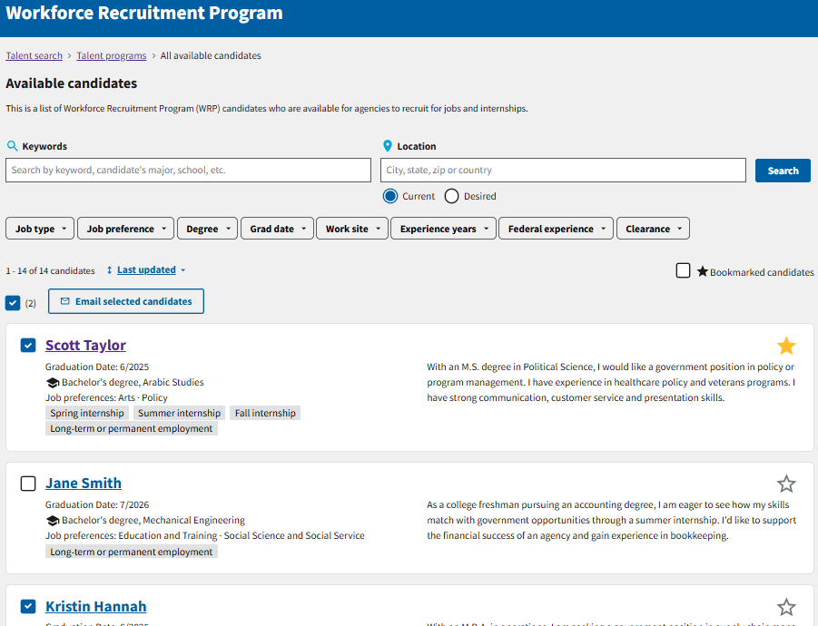
Email Select Candidates
If you want to email select candidates, check the box next to the name of each of the candidates you want to email and then select Email selected candidates at the top of the list.
Next to the Email selected candidates button, there is a number in parentheses indicating how many candidates you have selected.
A new email using your email client will generate with all the selected candidates included in the blind copy (BCC) line.

Slide 9
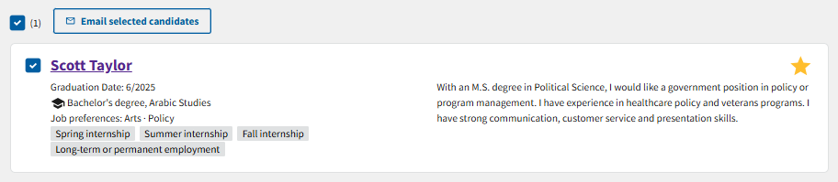
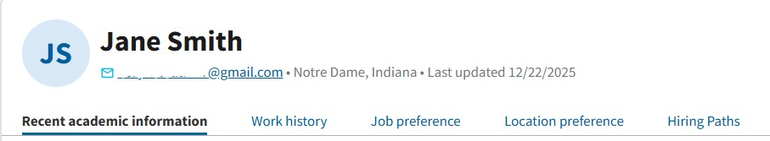
Email Individual Candidates
If you want to email an individual candidate, you have two options:
Option 1: Select the check box next to the candidate's name in the candidate list and then select Email selected candidates.
Option 2: On the candidate’s information page, select their email address under their name.
Both options will generate a new email using your email client with all the selected individual included in the blind copy (BCC) line.
Option 1
Option 2

Slide 10
Hiring a Candidate from the WRP Talent Program

Slide 11
Next Steps to Hire a WRP Candidate
Contact WRP candidates to schedule an interview
Follow your agency’s hiring procedures and coordinate with your HR contact or WRP Coordinator (if applicable)
HR will obtain a Schedule A letter from the candidate
You may use other hiring authorities to hire WRP candidates
Source: https://www.wrp.gov/

Slide 12
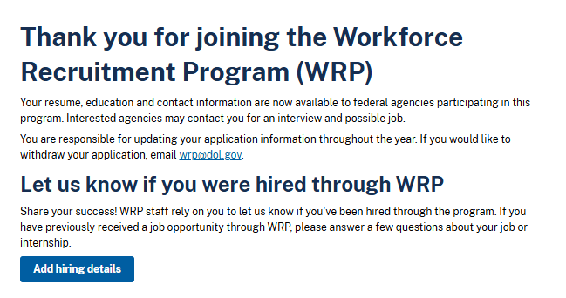
Candidate Reporting
Candidates will be prompted to let us know if they have been hired when they log into USAJOBS. They should submit the details of their opportunity in their USAJOBS profile.
It is important to email WRP@dol.gov to report any WRP candidates you have hired. Reporting hires is critical to the success of the WRP.
There are no additional actions you need to take in ATP to mark a candidate as hired.
Candidate View

Slide 13

Questions?
Review other user guides on the Workforce Recruitment Program Resources page.
For questions about the Workforce Recruitment Program (WRP), email wrp@dol.gov.
For technical assistance with the Agency Talent Portal (ATP), email
recruiter-help@usajobs.gov.

