Slide 1
Joining the WRP Talent Program

Slide 2
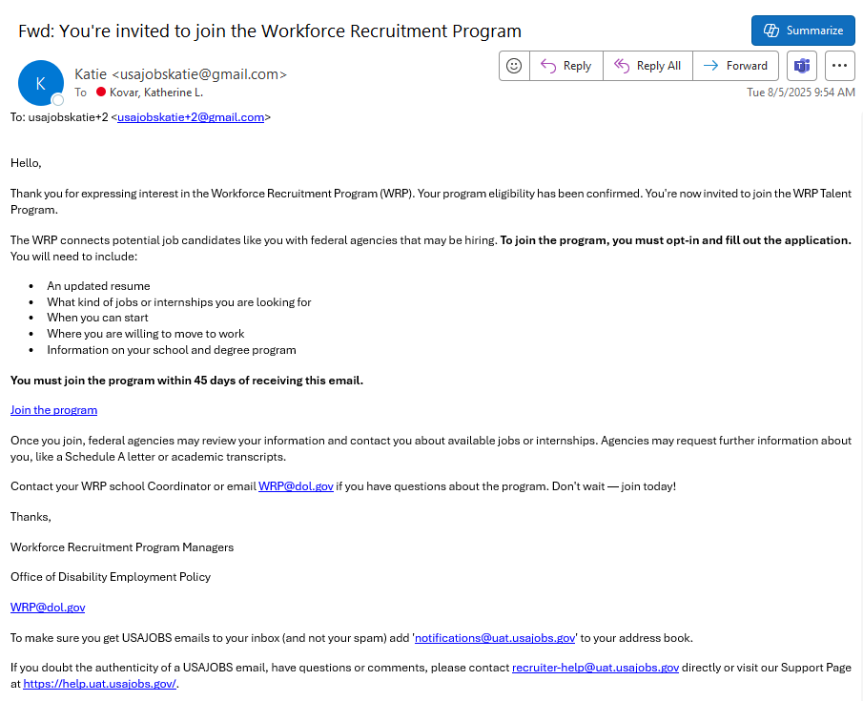

Join the Workforce Recruitment Program
You will receive an email from USAJOBS inviting you to join the Workforce Recruitment Program (WRP).
Select the Join the program link and log into your USAJOBS account.
You will be prompted to complete additional steps in USAJOBS.
Look for this email at the end of October! It will be sent to the email address you used to set up your USAJOBS account.

Slide 3
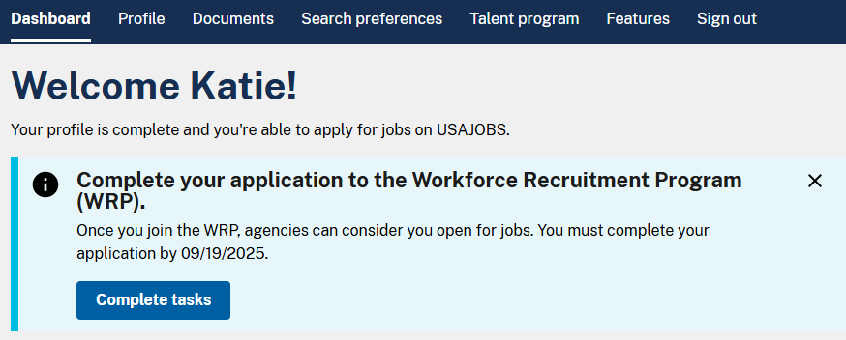
Complete Tasks in USAJOBS
When you log into your USAJOBS account, a blue banner appear at the top of your dashboard.
Select the Complete tasks button and follow the prompts to submit the information required to join the Workforce Recruitment Program.

Slide 4
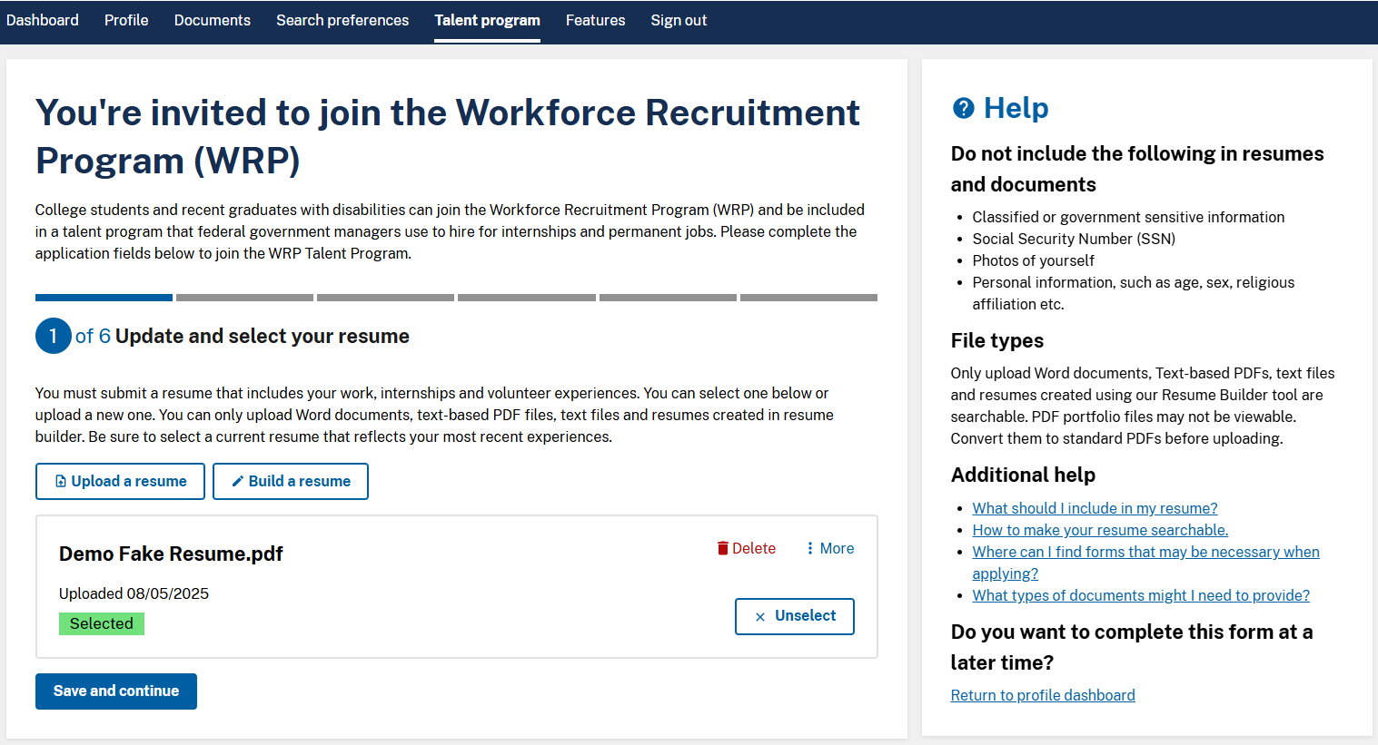
Select a Resume
IMPORTANT: Due to new federal hiring requirements, your resume must not be longer than 2 pages!
Select a resume to share with potential employers.
You can either:
Select a resume that is already saved to your USAJOBS profile;
Upload a new resume; or,
Build a resume using the USAJOBS resume builder tool.
Then select Save and continue.

Slide 5
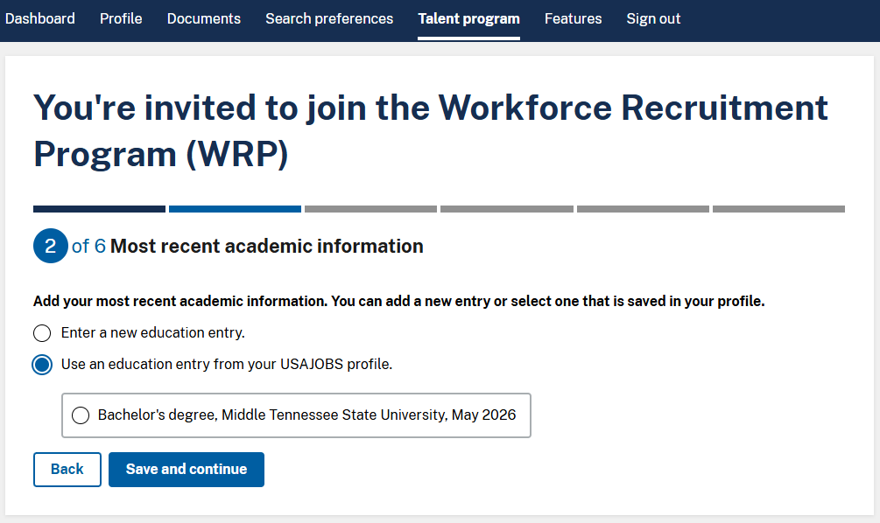
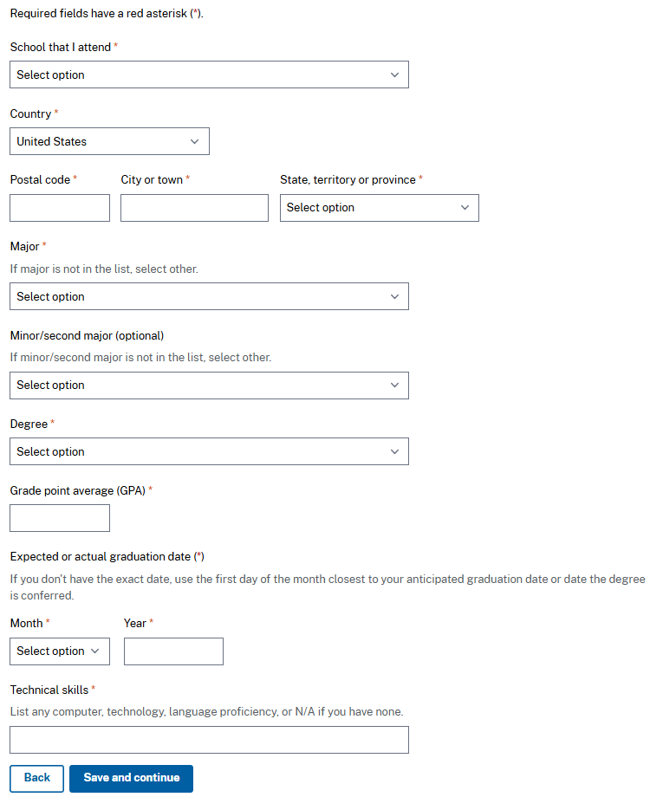
Add Academic Information
Add your most recent academic information.
You can either:
Enter a new education entry and type your responses into the required fields; or,
Use an existing education entry from your USAJOBS profile.
Then select Save and continue.
If you use an existing entry, you will still be able to review and update the information before continuing to the next page.

Slide 6
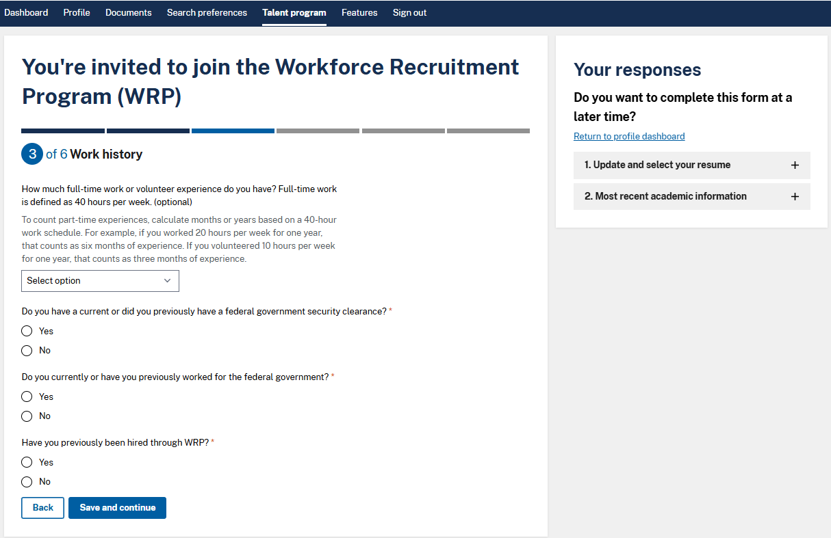

Update Work History
Answer questions about your work history.
Use the drop-down menu to indicate how much full-time work or volunteer experience you have.
For the remaining questions, respond by selecting either the yes or no radio button.
Then select Save and continue.
You can track your progress and saved responses on the right side of your screen. If you need to update a response, select the section you want to edit and then select Edit Information.

Slide 7

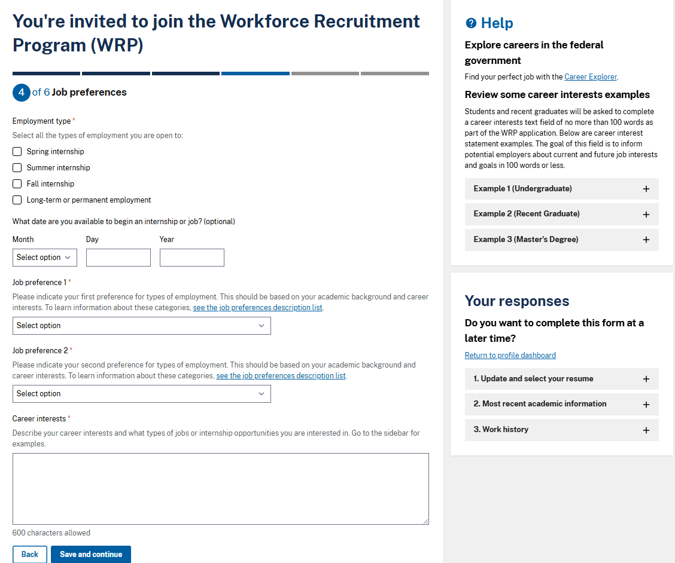

Indicate Your Job Preferences
If you are unsure what type of federal employment you’re interested in, the Career Explorer can help you identify career fields based on your interests!
Share your job preferences.
Select all check boxes that match employment types you are open to.
Enter the date you are available to begin work. This field is optional.
Use the drop-down menus to select two job preferences.
Write a short statement describing your career interests.
Then select Save and continue.
Review these career interest statement examples for guidance as you write your own.

Slide 8
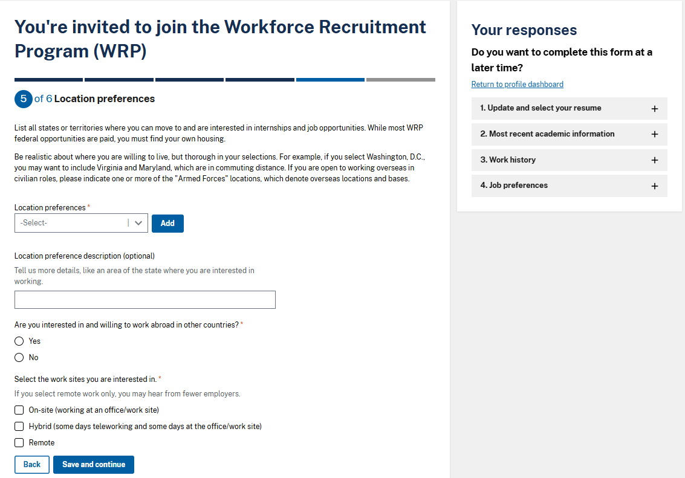
Indicate Your Location Preferences
List all states or territories where you can move and are interested in working.
  Select a location from the drop-down list and then select Add. You can add several locations to your list.
  You can share more detail about your location preferences in the optional comment box.
Select the Yes or No radio button to indicate your interest in working abroad.
Select all check boxes that match work sites you are interested in.
Then select Save and continue.

Slide 9
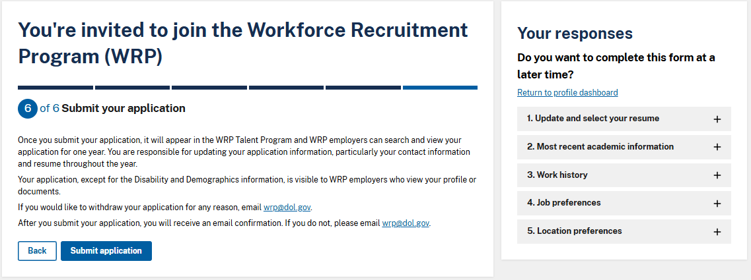
Submit Your Responses
Before submitting your application, review your responses using the menu on the right side of your screen.
Click on each section to review your saved responses and edit information as needed.
When you are ready, select Submit application!

Slide 10
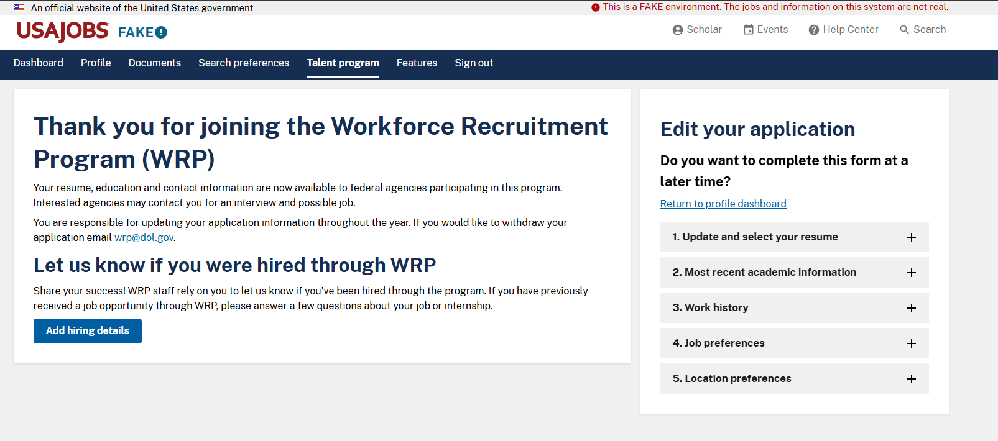
Success!
Congratulations!
You have successfully joined the Workforce Recruitment Program.
Let us know if you were hired! Log into USAJOBS and select Talent program in the top navigation bar. Then select Add hiring details to share your hiring details.
Remember to keep your contact information up to date so employers can reach you!

Slide 11

Questions?
Email wrp@dol.gov

