Slide 1
Find Candidates with the Workforce Recruitment Program (WRP) Talent Program
USAJOBS

Slide 2
Table of Contents
Background Slide 3
Requesting an Agency Talent Portal (ATP) Account Slide 4
Finding the WRP Talent Program Slide 6
Search and Filters Slide 9
Candidate Information Slide 21
Contacting Candidates Slide 30
Hiring a Candidate from the WRP Talent Program Slide 34

Slide 3
Background
The Workforce Recruitment Program (WRP) helps federal employers hire college students and recent graduates with disabilities for internships or permanent jobs. WRP candidates are eligible for the federal government's Schedule A Hiring Authority for Persons with Disabilities, which allows agencies to hire without posting a job announcement or going through the certification process. Candidates provide documentation to verify Schedule A eligibility when applying to the program. The WRP is a key tool that supports federal agencies in maintaining compliance with requirements of Section 501 of the Rehabilitation Act.
How WRP Can Help You Recruit Talent
Increase disability employment in your workplace by hiring job-ready candidates. The candidate database is renewed each December, and candidates can update their application throughout the year.
Streamline your searches for candidates with the customized search page. Filter candidates based on major, degree, job and location preference, keywords, and more.
Access relevant candidate information easily. Bookmark candidate applications and resumes for later viewing.
Expedite the hiring process by connecting with WRP candidates directly regarding job opportunities.
Source: https://www.wrp.gov/

Slide 4
Requesting an Agency Talent Portal (ATP) Account

Slide 5
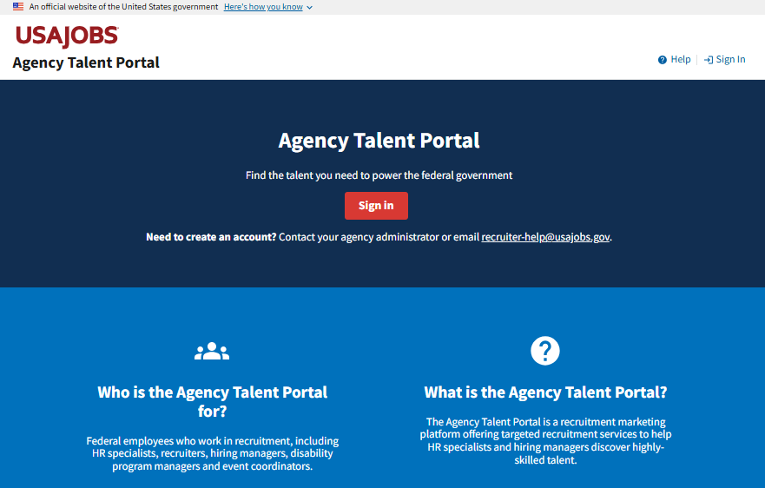
Create an ATP Account
To access the WRP talent program, you must first request an ATP account.
Email recruiter-help@usajobs.gov to request an account and include:
Your name
Federal email address
Agency and subagency or component (if applicable)
Reason for requesting access
Supervisor approval
If your agency has an ATP agency administrator, your request will be forwarded to them for processing. Otherwise, the ATP help desk will process your request.
Access to ATP is restricted to federal employees who work in recruitment and hiring.

Slide 6
Finding the WRP Talent Program

Slide 7
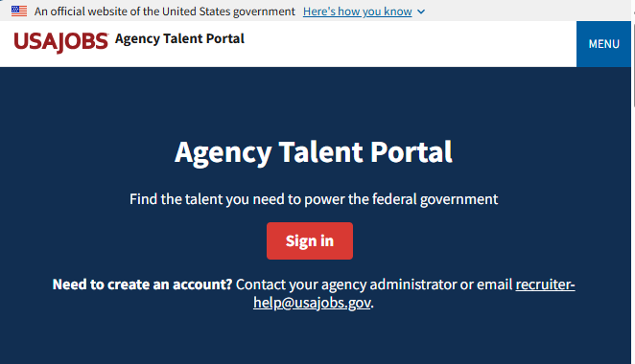

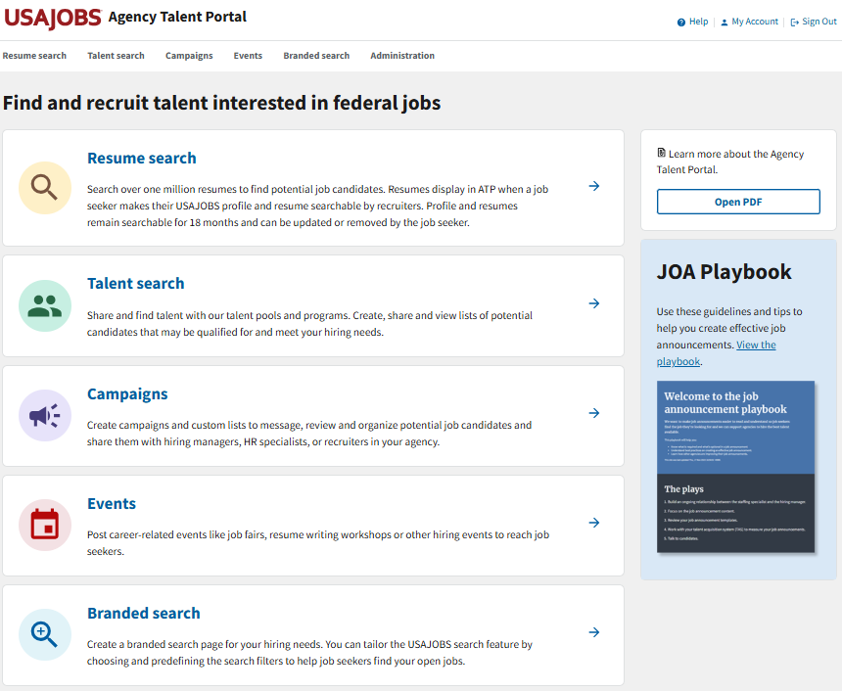
Log into ATP
To log into ATP, visit https://agencyportal.usajobs.gov/
Then select Sign in.
You can sign in using your CAC or PIV card, USA Staffing account (if applicable), or Login.gov.

Slide 8
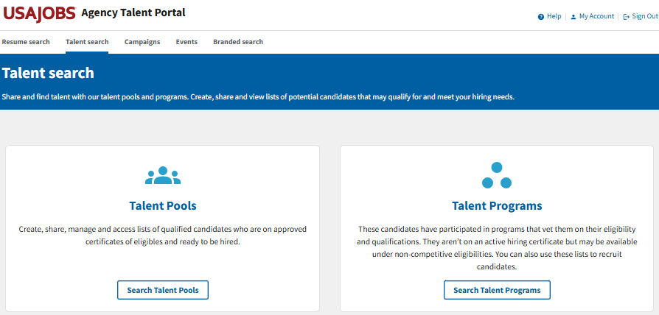
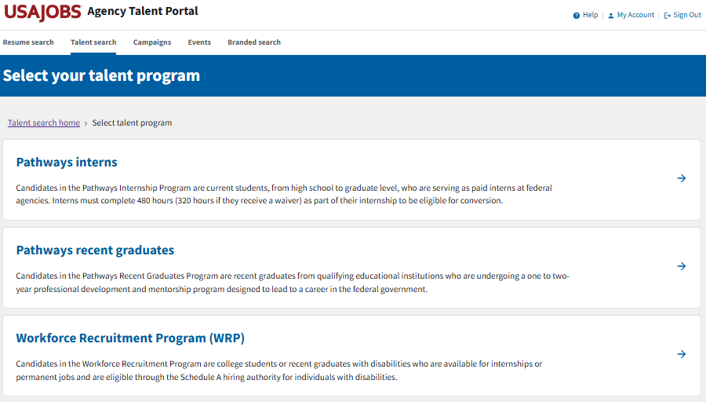

Go to Talent Programs
To navigate to the WRP Talent Program,
Select Talent search.
Then select Search Talent Programs.
Then select Workforce Recruitment Program (WRP).

Slide 9
Search and Filters

Slide 10
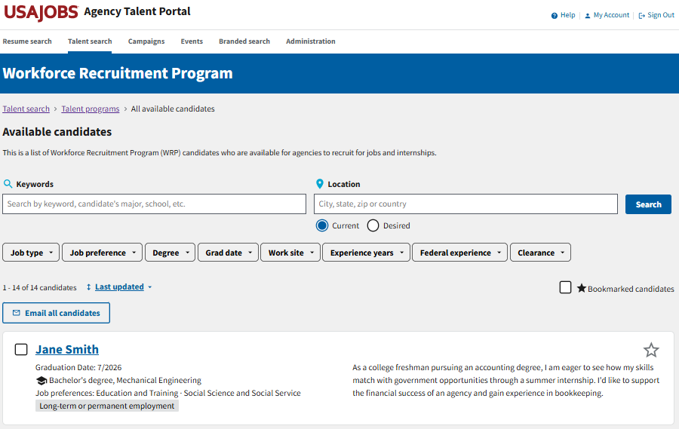

Available Candidates List
Here, you will find the full list of available candidates. You can narrow the candidate list using a keyword search, location search, and several job filters.
Filters

Slide 11
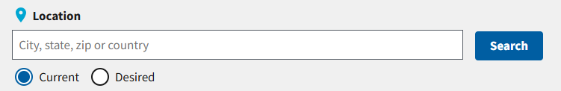
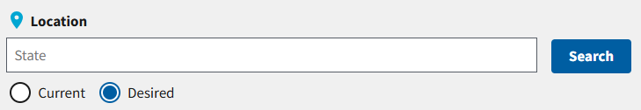
Location Search
For the Location search, you can search either the candidates’ current location or their desired work locations.
The search will default to current location. Enter the city, state, zip code, or country you want to search and select Apply to filter the candidate list.
In their WRP applications, candidates can list their desired work locations by state. To search their desired locations, select the Desired radio button, enter the state you want to search, and select Apply.
Current
Desired

Slide 12
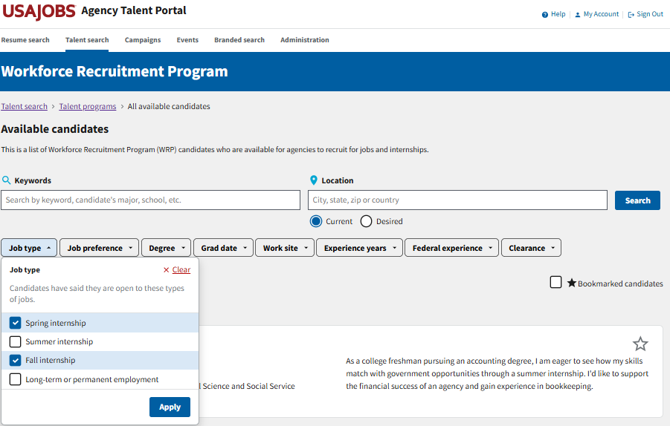

Job Type Filter
You can narrow your candidate list by the type of job candidates have expressed interest in.
Available job types include spring internship, summer internship, fall internship and long-term or permanent employment.
Select one or more checkboxes and then select Apply to filter the candidates.
If you want to clear the filter, select Clear in the upper-right corner.
Clear
Apply

Slide 13
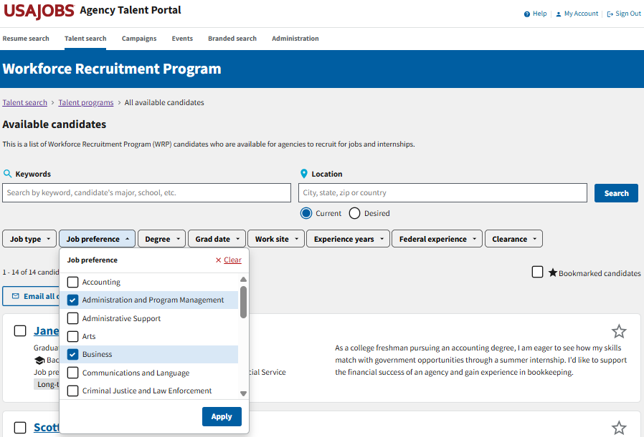
Job Preference Filter
You can narrow your candidate list by the candidates’ job preferences.
Several job preference categories are available to choose from.
Select one or more checkboxes and then select Apply to filter the candidates.
If you want to clear the filter, select Clear in the upper right corner.

Slide 14
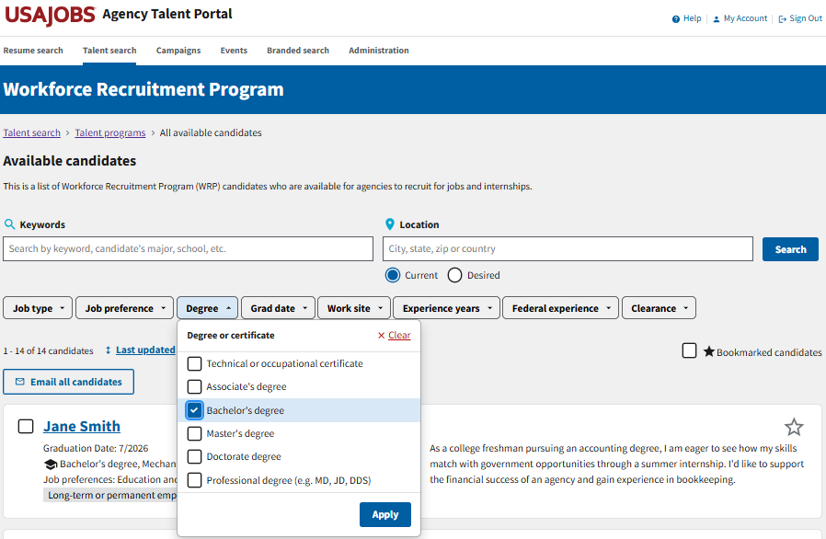
Degree Filter
You can narrow your candidate list by the candidates’ degree type.
Degree types include:
Technical or occupational certificate
Associate’s degree
Bachelor’s degree
Master’s degree
Doctorate degree
Professional degree (e.g., MD, JD, DDS)
Select one or more checkboxes and then select Apply to filter the candidates.
If you want to clear the filter, select Clear in the upper right corner.

Slide 15
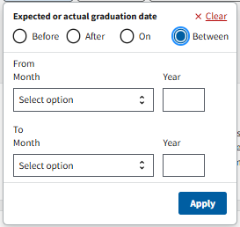
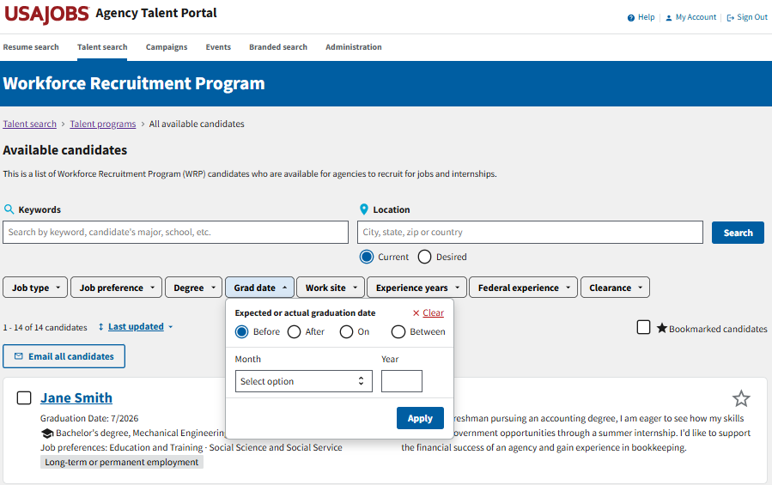
Grad Date Filter
If you select Between, you will be prompted to enter a date range.
You can narrow your candidate list by the candidates’ expected or actual graduation date.
Enter a month and year and then select whether you want to search before that date, after that date or on that date.
You can also search within a specified date range if you select between and enter the start and end dates.
Select Apply to filter the candidates.
If you want to clear the filter, select Clear in the upper right corner.

Slide 16
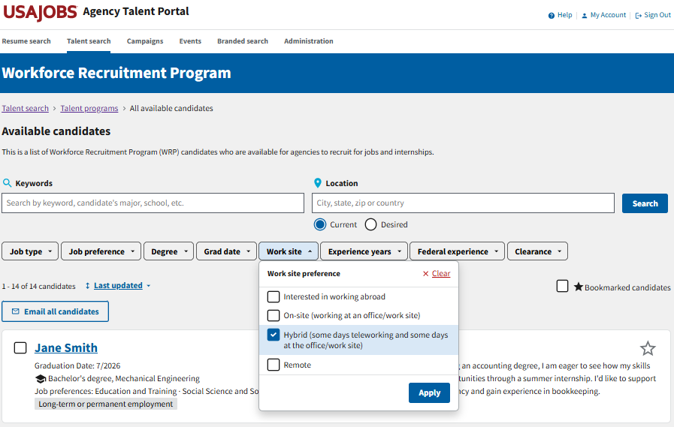
Work Site Filter
You can narrow your candidate list by the candidates’ work site preferences.
Work sites include:
Interested in working abroad
On-site (working at an office/work site)
Hybrid (some days teleworking and some days at the office/work site)
Remote
Select one or more checkboxes and then select Apply to filter the candidates.
If you want to clear the filter, select Clear in the upper right corner.

Slide 17
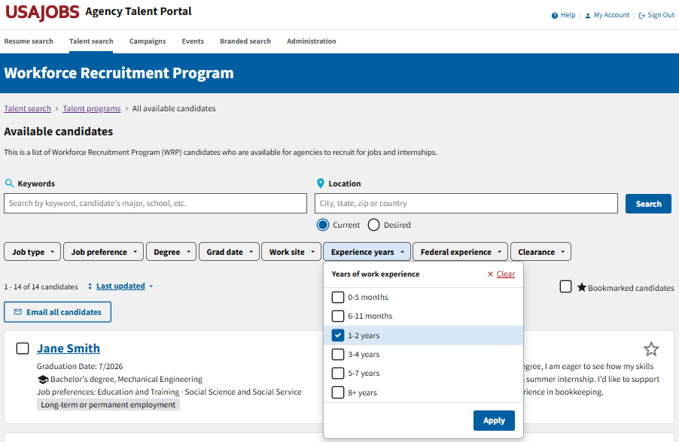
Experience Years Filter
You can narrow your candidate list by the candidates’ years of work experience.
Options include:
0-5 months
6-11 months
1-2 years
3-4 years
5-7 years
8+ years
Select one or more checkboxes and then select Apply to filter the candidates.
If you want to clear the filter, select Clear in the upper right corner.

Slide 18
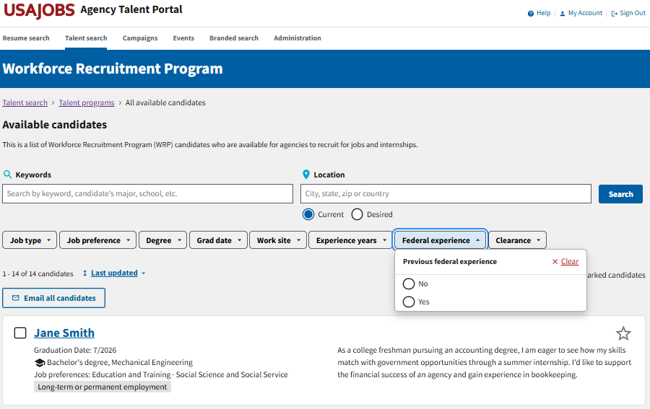
Federal Experience Filter
You can narrow your candidate list by the candidates’ previous federal experience.
Select either the yes or no radio button and the candidate list will automatically update with that filter applied.
If you want to clear the filter, select Clear in the upper right corner.

Slide 19
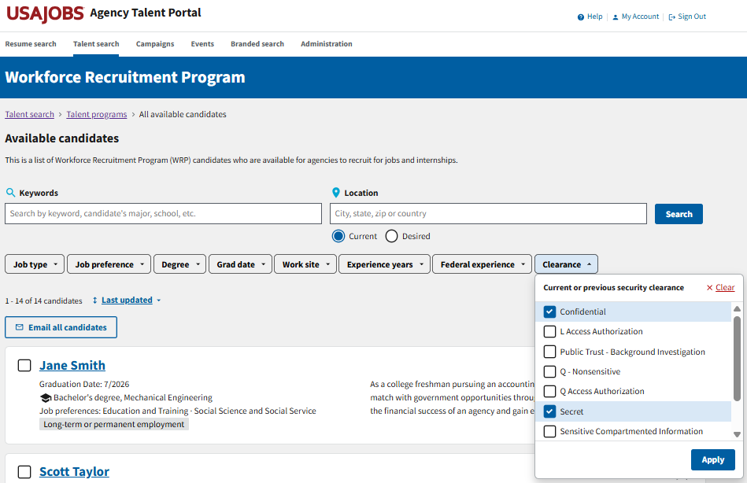
Clearance Filter
You can narrow your candidate list by the candidates’ current or previous security clearance.
Several clearance options are available to choose from.
Select one or more checkboxes and then select Apply to filter the candidates.
If you want to clear the filter, select Clear in the upper-right corner.

Slide 20
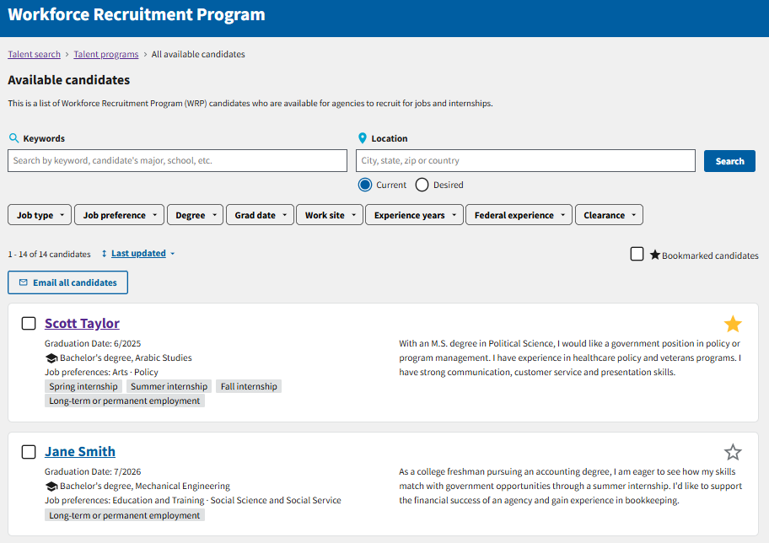

Bookmarked Candidates Filter
You can narrow your candidate list by the candidates you have bookmarked.
To bookmark a candidate, select the star in the upper-right corner of their candidate card.
To filter your bookmarked candidates, select the check box next to Bookmarked candidates.
Select the check box to filter your bookmarked candidates.
Select the star on a candidate card to bookmark them.

Slide 21
Candidate Information

Slide 22
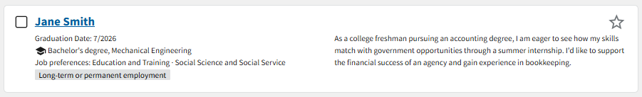
Candidate Overview
The candidate card provides a high-level overview of the candidate’s background and job preferences.
Select the star to bookmark candidates you’re interested in.
Select the candidate’s name to view additional details and a resume.
The candidate’s graduation date, degree type and major, job preferences and preferred job types are provided.
The career interest statement gives you a high-level overview of the candidates’ career interests.

Slide 23
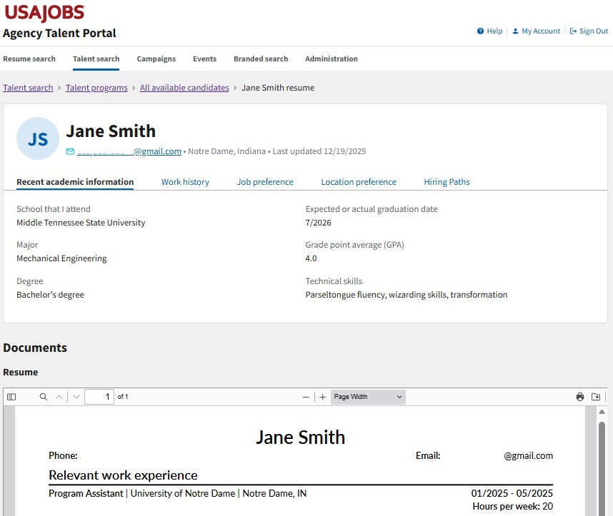
Candidate Information Page
The information the candidates submitted with their WRP applications can be found on the candidate information page, including:
Contact information and current location
The date their information was last updated
Recent academic information
Work history
Job preference
Location preference
Hiring paths
Resume

Slide 24
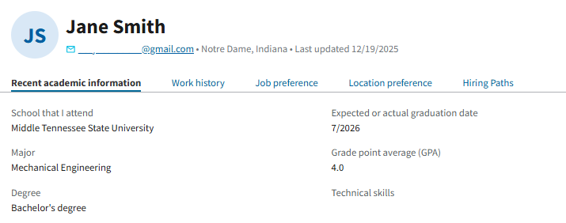
Recent Academic Information
Under the Recent academic information tab, you will find the candidate’s:
Most recently attended school
Major
Second major or minor (if applicable)
Degree type
Month and year of their expected or actual graduation date
GPA (if provided)
Technical skills, such as computer, technology, or language skills

Slide 25
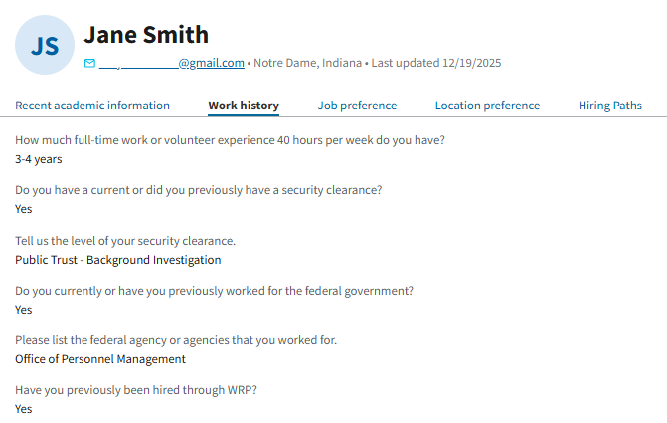
Work History
Under the Work history tab, you will find:
How much full-time work or volunteer experience the candidate has in months or years.
Whether a candidate has or previously had a security clearance and, if so, the level of that security clearance.
Whether the candidate currently or previously worked for the federal government. If so, up to five agencies may be listed.
Whether the candidate has previously been hired through WRP.

Slide 26
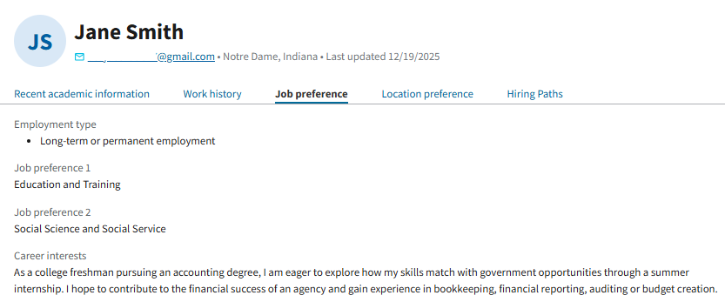
Job Preference
Under the Job preference tab, you will find the candidate’s:
Preferred employment type (internship or long-term/ permanent)
Date available to begin employment (if provided)
Up to two job preference categories based on their academic background and career interests
A short career interest statement indicating the types of opportunities they’re interested in

Slide 27
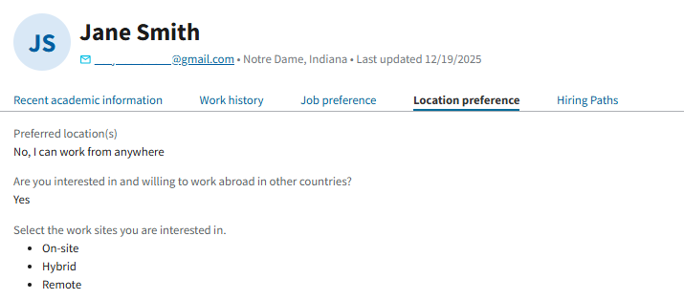
Location Preference
Under the Location preference tab, you will find the candidate’s:
List of preferred work locations, if specified
Information on a candidate’s willingness to work abroad
The work sites the candidate is interested in

Slide 28
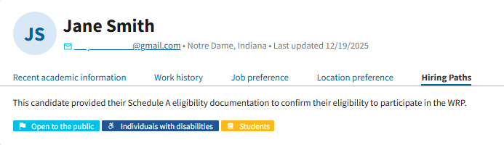
Hiring Paths
Candidates in the WRP Talent Program are eligible for the Schedule A hiring authority.
Under the hiring paths tab, candidates can indicate whether they are eligible for hiring under any other hiring paths.

Slide 29
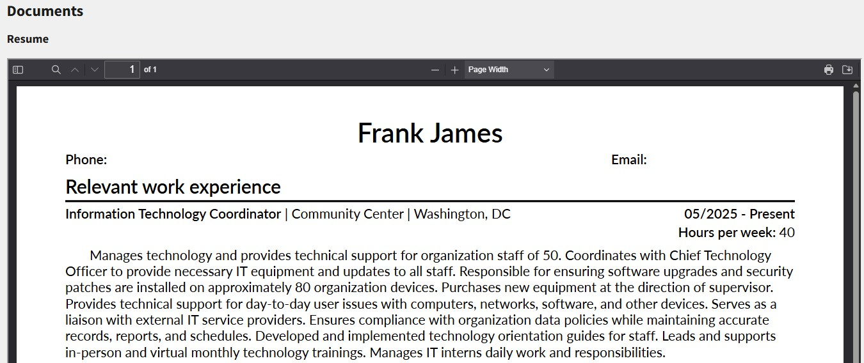
Resume
The candidate information page will also display the resume the candidate submitted with their WRP application.
You can view the entire resume on the page, or you can download or print the resume using the icons in the upper-right corner of the resume PDF.

Slide 30
Contacting Candidates

Slide 31
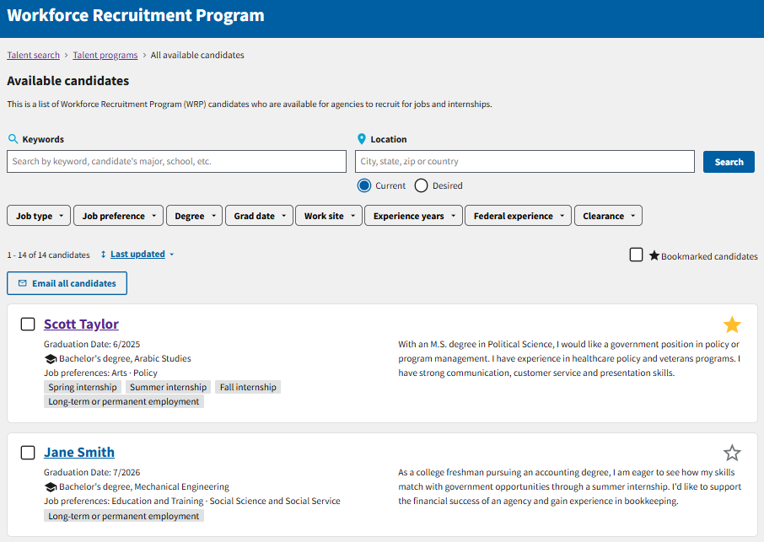
Email All Candidates
Once you have conducted a search, you have the option to email the resulting candidates by selecting Email all candidates at the top of the list.
This will generate a new email using your email client (e.g., Outlook) with all the candidates included in the blind copy (BCC) line.
You can only email 500 candidates at one time. If your search generates more than 500 candidates, the Email all candidates button will be disabled until you further narrow your search.

Slide 32
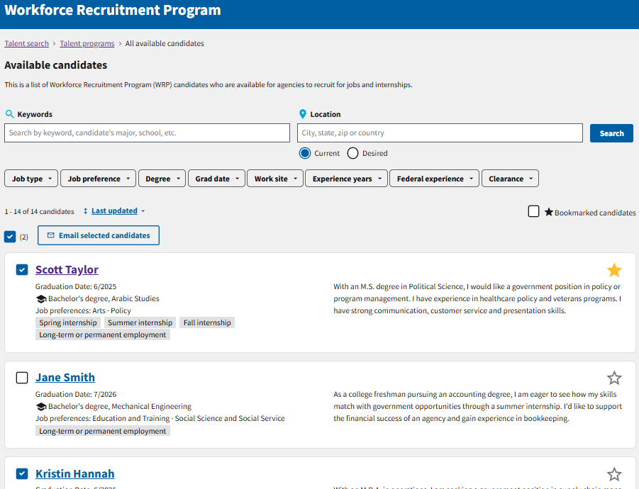
Email Select Candidates
If you want to email select candidates, check the box next to the name of each of the candidates you want to email and then select Email selected candidates at the top of the list.
Next to the Email selected candidates button, there is a number in parentheses indicating how many candidates you have selected.
A new email using your email client will generate with all the selected candidates included in the blind copy (BCC) line.

Slide 33
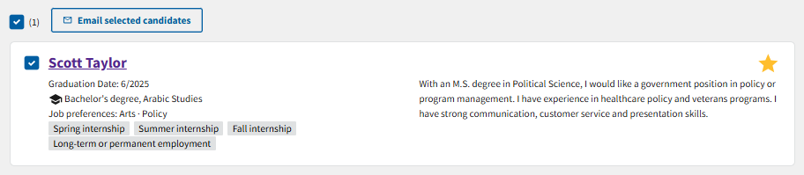
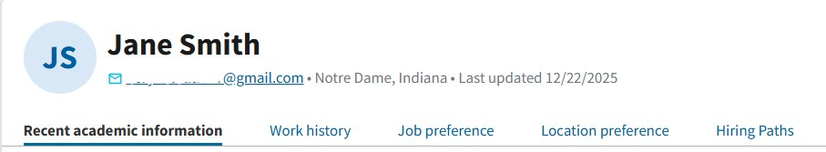
Email Individual Candidates
If you want to email an individual candidate, you have two options:
Option 1: Select the check box next to the candidate's name in the candidate list and then select Email selected candidates.
Option 2: On the candidate’s information page, select their email address under their name.
Both options will generate a new email using your email client with all the selected individual included in the blind copy (BCC) line.
Option 1
Option 2

Slide 34
Hiring a Candidate from the WRP Talent Program

Slide 35
Next Steps to Hire a WRP Candidate
Contact WRP candidates to schedule an interview
Follow your agency’s hiring procedures and coordinate with your HR contact or WRP Coordinator (if applicable)
HR will obtain a Schedule A letter from the candidate
You may use other hiring authorities to hire WRP candidates
Source: https://www.wrp.gov/

Slide 36
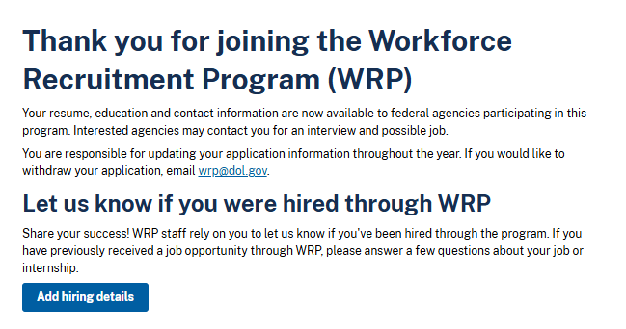
Candidate Reporting
Candidates will be prompted to let us know if they have been hired when they log into USAJOBS. They should submit the details of their opportunity in their USAJOBS profile.
It is important to email WRP@dol.gov to report any WRP candidates you have hired. Reporting hires is critical to the success of the WRP.
There are no additional actions you need to take in ATP to mark a candidate as hired.
Candidate View

Slide 37

Questions?
For questions about the Workforce Recruitment Program (WRP), email wrp@dol.gov.
For technical assistance with the Agency Talent Portal (ATP), email recruiter-help@usajobs.gov.

