Slide 1
Creating a USAJOBS Account

Slide 2
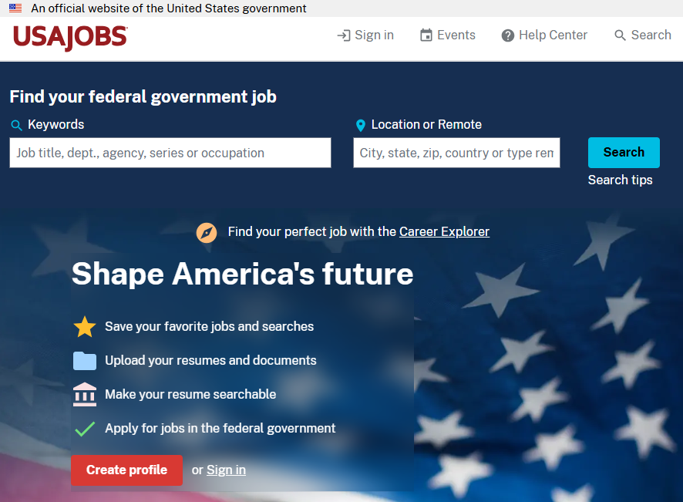
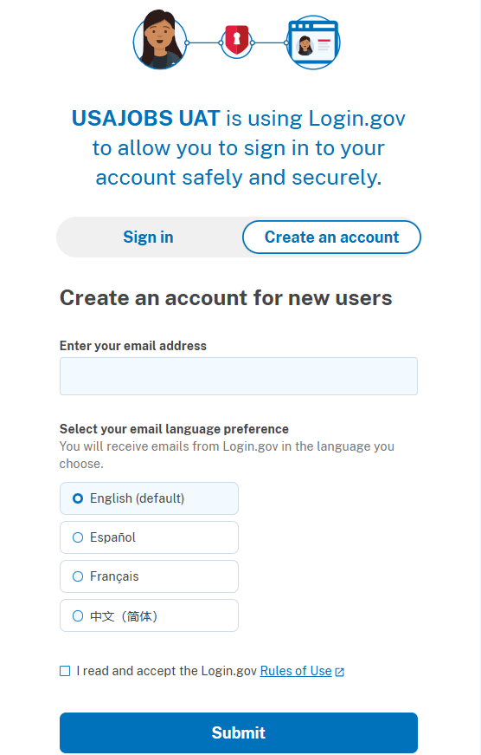

Create a USAJOBS Account
Use a personal email address to create your USAJOBS account! Do not use a school or work email address that you may lose access to.
To join the WRP Talent Program, you must first create a USAJOBS profile.
Select Create profile on the USAJOBS homepage.
Review the USAJOBS terms and conditions, then select Agree.
On the login page, select Create an account.
Enter your email address, select your language preference, and check the box to agree that you have read and accept the Login.gov Rules of Use.
Select Submit.

Slide 3
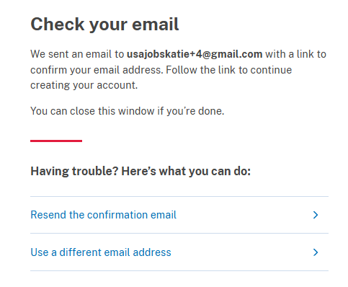
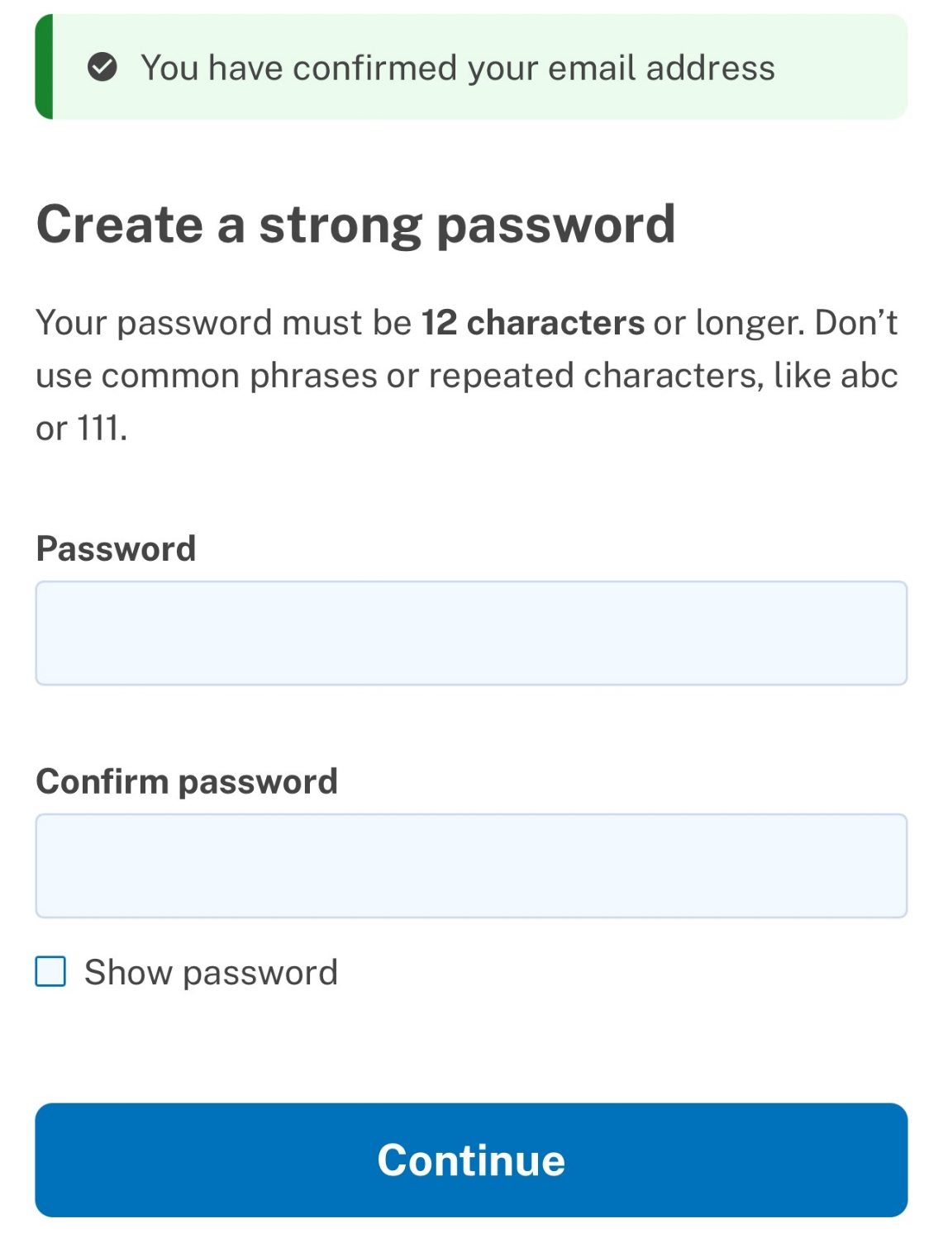
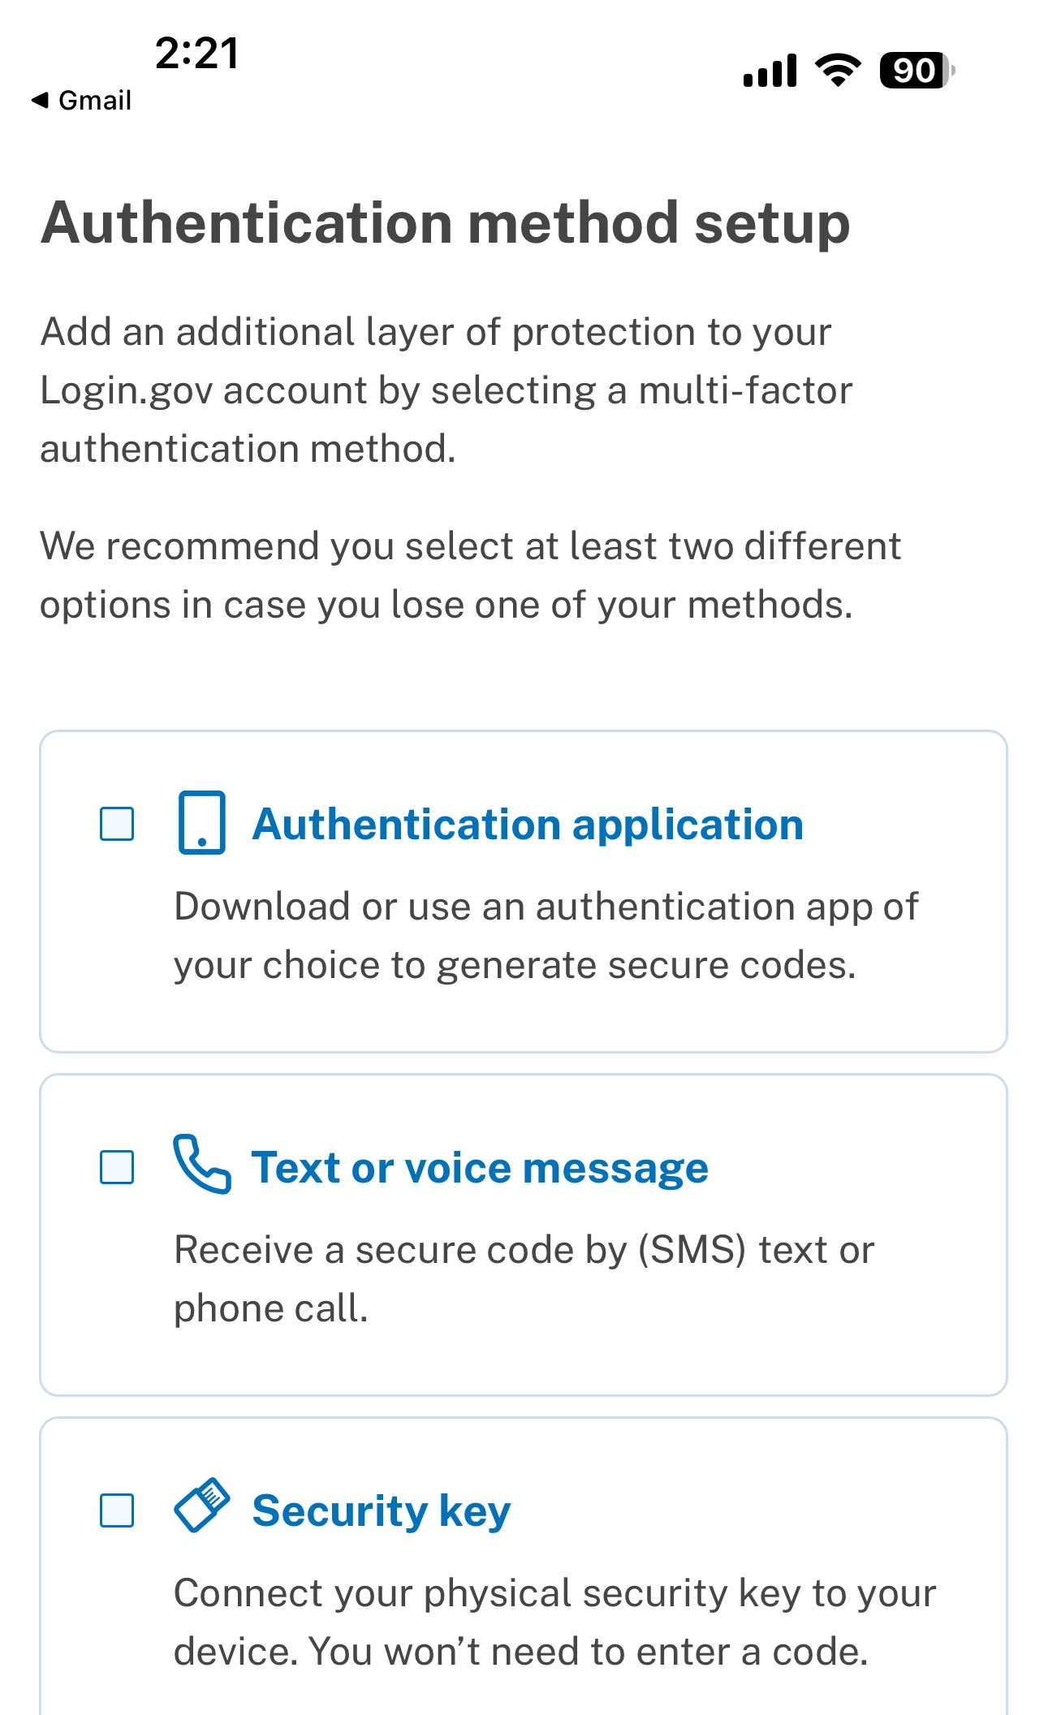
Create a USAJOBS Account, Next Steps
USAJOBS uses Login.gov to protect users’ personal data. Login.gov uses multifactor authentication to ensure it’s really you logging into your USAJOBS account.
Check your email! You will receive an email from Login.gov with a link to confirm your email address.
Once you confirm, create a strong password that is 12 characters or longer and select Continue.
Set up one or more authentication methods of your choosing.
Select Agree and continue to finish setting up your account.

Slide 4
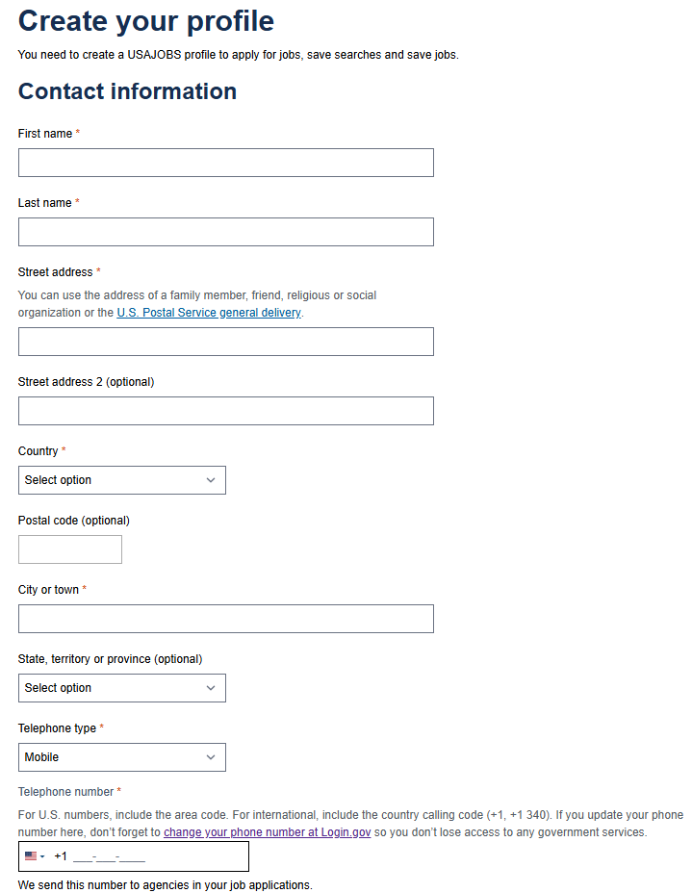
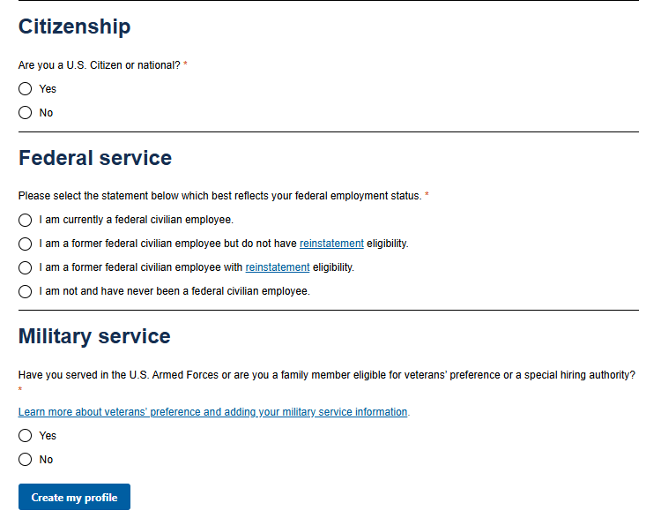
Complete Your USAJOBS Profile
YouTube Video Resources:
Creating a USAJOBS Profile
Creating a USAJOBS Profile (with audio descriptions)
After setting up your USAJOBS account, you need to create your USAJOBS profile.
Enter your contact information and citizenship and indicate any current or previous federal or military service.
Select Create my profile.
While not required, we recommend you complete your profile’s optional information, such as work experience, education, and languages. You can also upload and save your resume, transcript, and Schedule A letter to your profile.

Slide 5
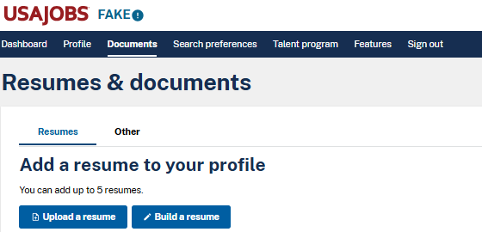
Add a Resume and Documents
You can store up to 5 resumes and 10 other documents in your USAJOBS profile.
Other documents include cover letters, Schedule A letters, academic transcripts, etc.
Important Notice!
Federal agencies will soon only accept resumes up to two pages in length to comply with Executive Order 14170 and the Merit Hiring Plan. By the end of September 2025, USAJOBS will not allow you to upload or build resumes longer than two pages and you will have to update the resumes you have in your profile.

