Slide 1
Applying to the Workforce Recruitment Program (WRP)

Slide 2
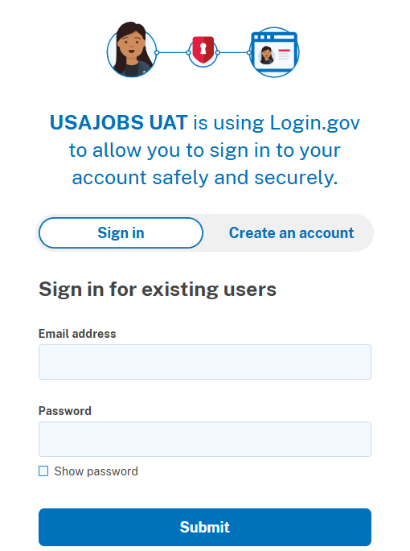

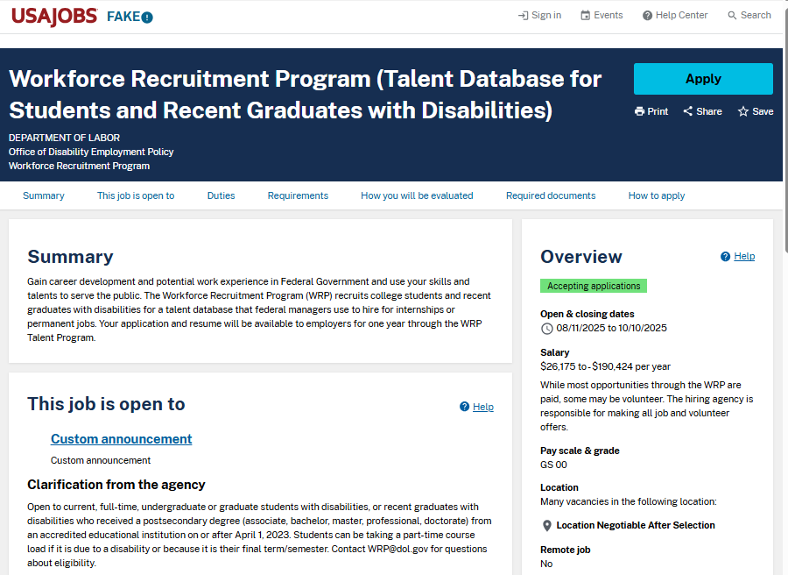
Starting Your Application
Before starting your application, review the information provided in the job announcement to inform yourself about program eligibility, qualifications, and requirements.
To begin your application, select Apply, agree to USAJOBS’ terms and conditions, and log into your USAJOBS account.

Slide 3
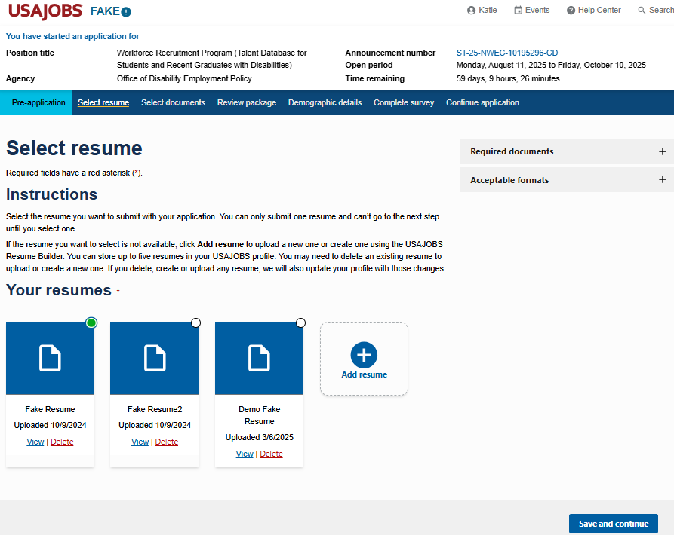
Select or Upload a Resume
Select the resume you want to include with your application.
If you have resumes saved to your USAJOBS profile, they will automatically appear as options to select from.
You can also upload a new resume by selecting Add resume.
Select Save and continue.

Slide 4
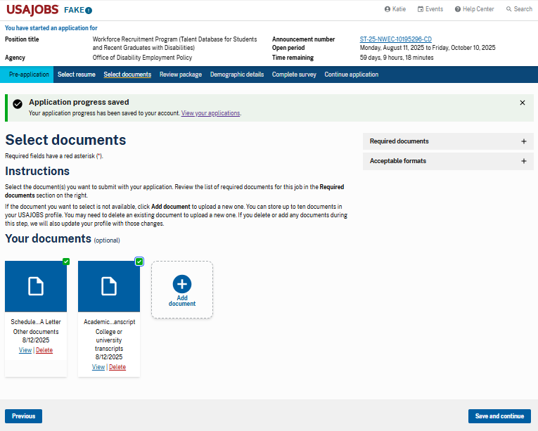

Select Documents
Select the documents you want to include with your application.
If you have documents saved to your USAJOBS profile, they will automatically appear as options to select from.
You can also upload new documents by selecting Add document.
Select Save and continue.
You can select Required documents to review the list of documents you must submit with your application.

Slide 5
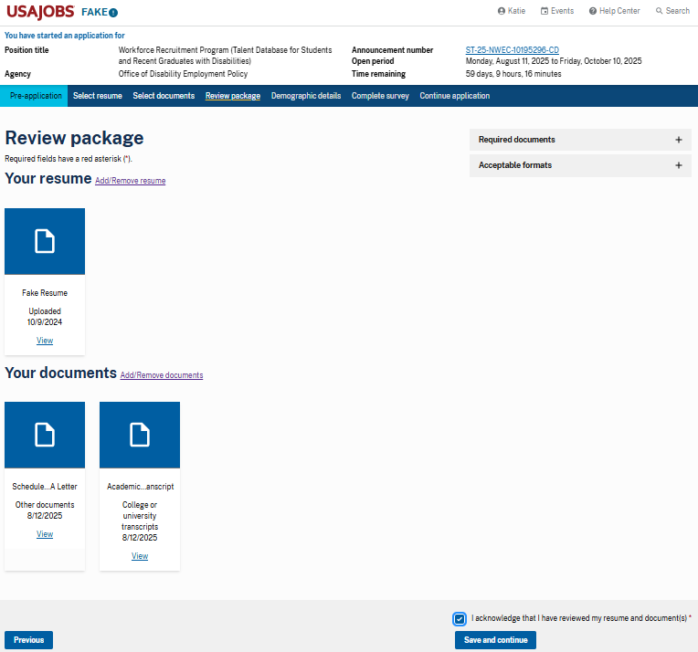
Review Your Documents
Review the documents you selected for your application to make sure you included all required documents.
Check the box to acknowledge that you have reviewed your resume and documents.
Then select Save and continue.

Slide 6
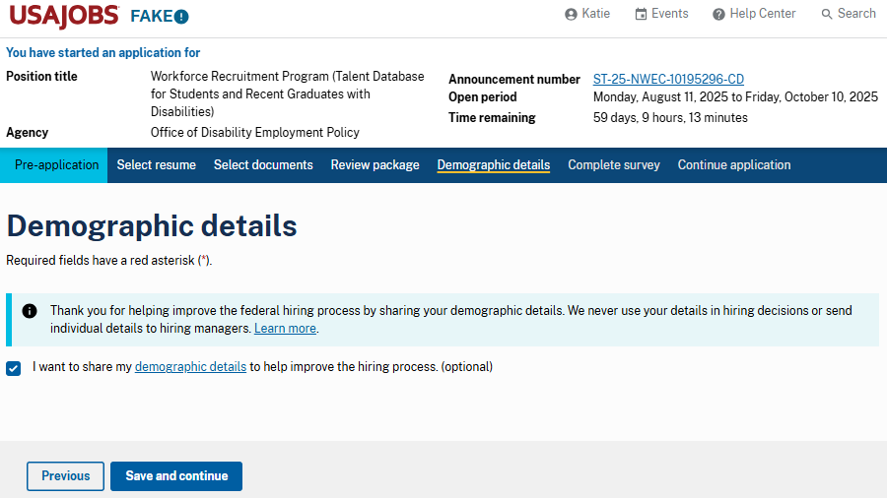
Optional Demographic Details
Check the box if you want to share your demographic details to help improve the hiring process.
If you do not want to share your demographic details, leave the box unchecked.
Then select Save and continue.

Slide 7
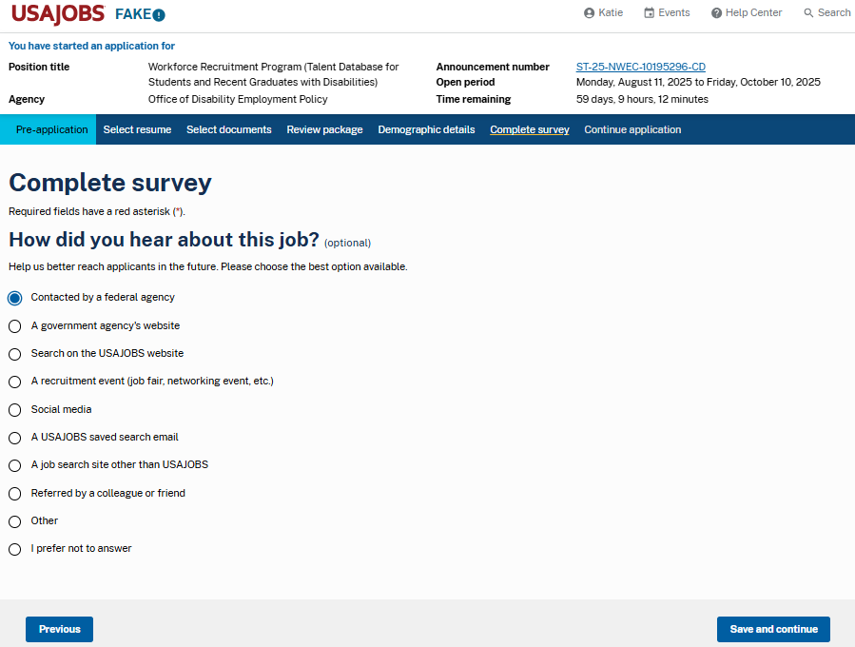
Optional Survey
Complete this optional survey to let us know how you heard about this job by selecting the appropriate radio button.
If you do not wish to share, select the radio button next to I prefer not to answer.
Then select Save and continue.

Slide 8
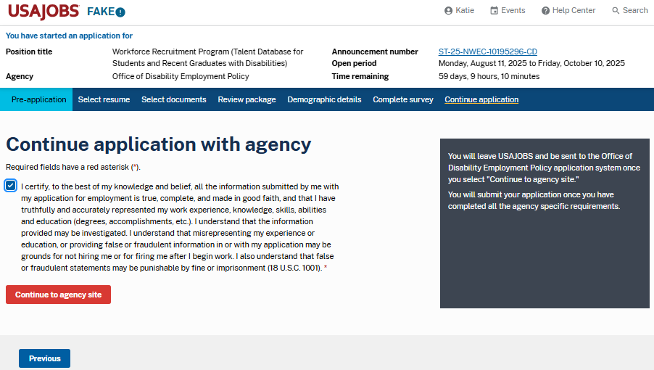
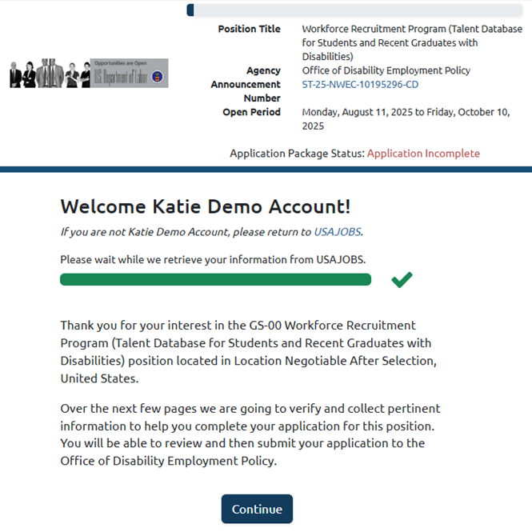
Continue to Agency Site
Check the box to certify that the information included in your application is true, complete, and made in good faith.
Then select Continue to agency site.
Your application package will be transferred to the agency site where you will complete your application.
Select Continue.

Slide 9
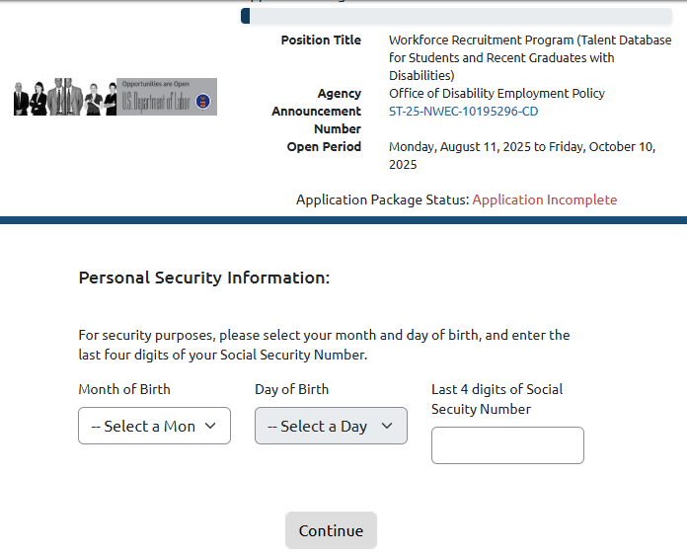
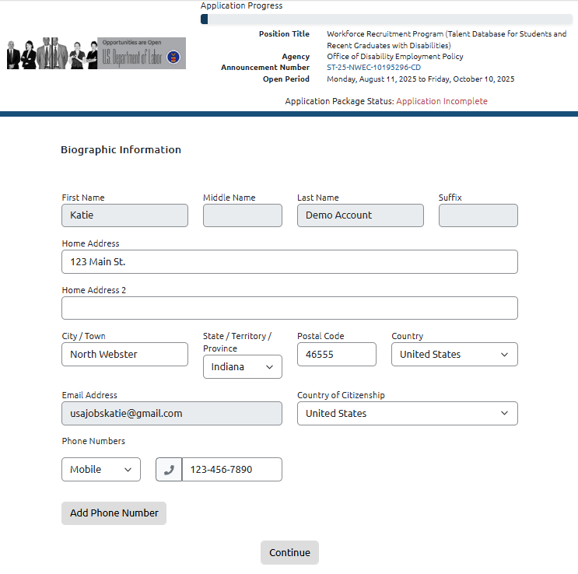
Confirm and Update Personal Information
For security purposes, enter your month and day of birth and the last 4 digits of your Social Security Number.
Then select Continue.
Confirm and update your Biographic Information.
Then select Continue.

Slide 10
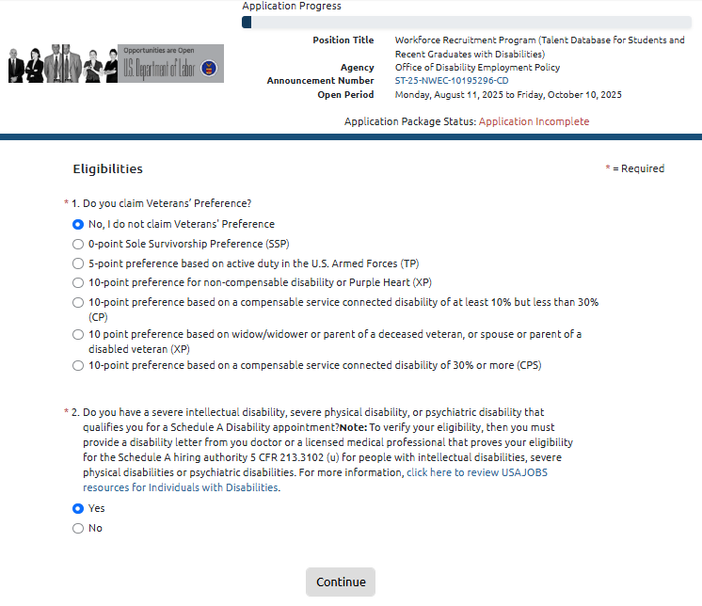
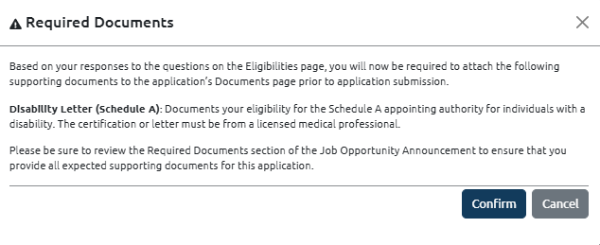
Eligibility
Select the appropriate radio button to indicate whether you are eligible for Veterans’ Preference.
Select the yes or no radio button to indicate whether you have a disability that qualifies you for Schedule A Disability hiring.
Then select Continue.
If you select yes for either question, a notice will appear to remind you of required supporting documents to submit.
Review and select Confirm.

Slide 11
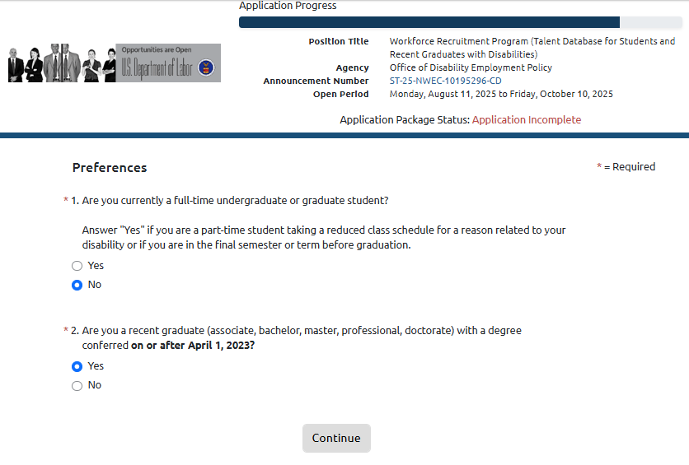
Preferences
Select the yes or no radio button to indicate whether you are currently a full-time undergraduate or graduate student.
Select the yes or no radio button to indicate whether you are a recent graduate.
Then select Continue.

Slide 12
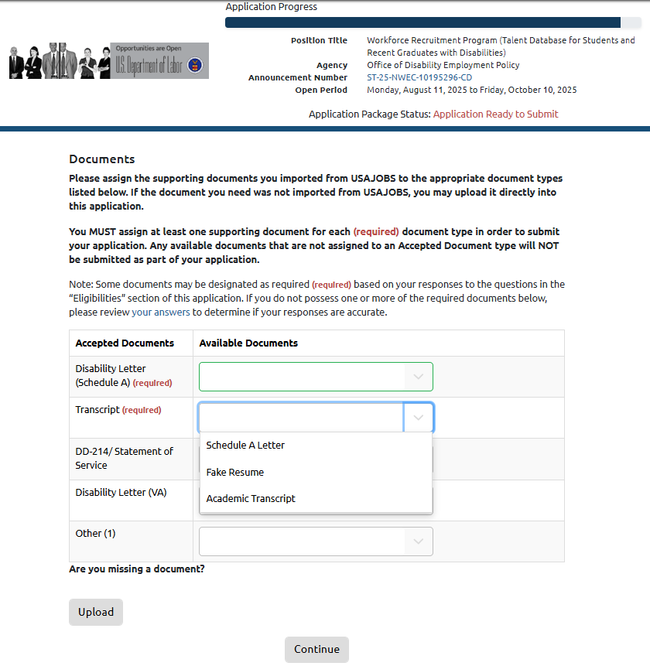
Documents
Assign the supporting documents you imported from USAJOBS to the appropriate document types in the list.
You must assign at least one document for each document type marked required.
You can choose a document from the drop-down list or upload a new one.
Then select Continue.

Slide 13
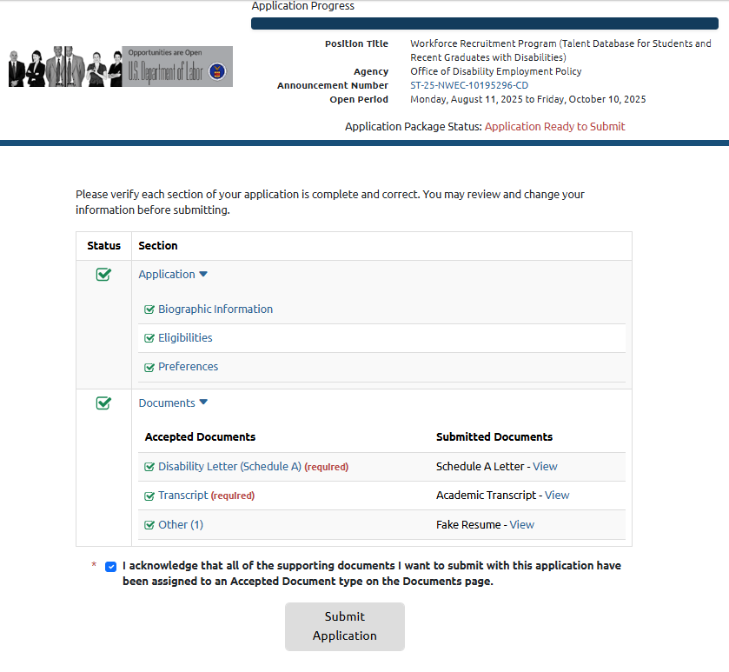
Review and Submit Application
Review your application to verify that each section is complete and accurate. You may make changes to your application before submitting.
When ready, check the box acknowledging that all documents have been included and assigned to a document type.
Then select Submit Application.

Slide 14
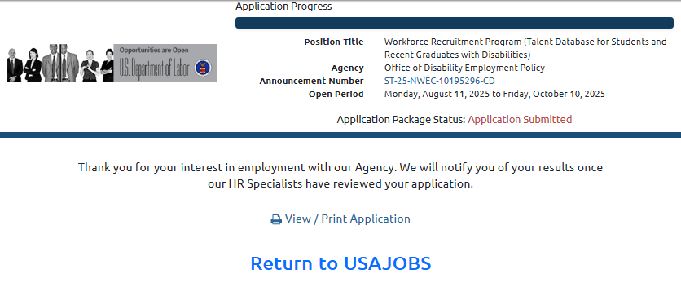
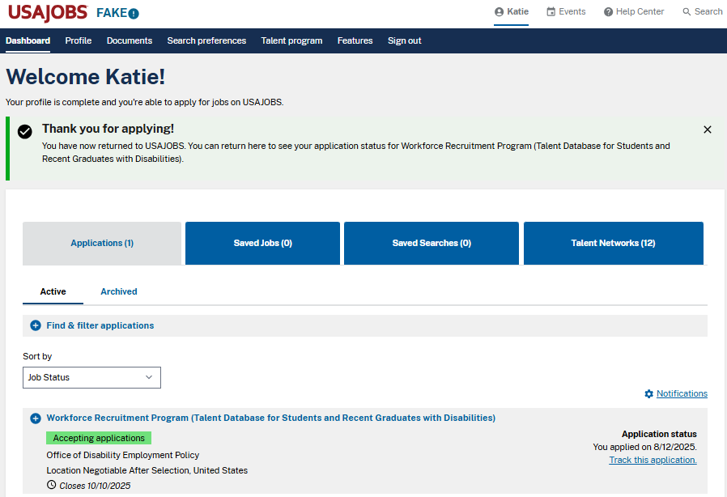
Success!
Congratulations! You submitted your application to the Workforce Recruitment Program!
Select Return to USAJOBS to go to the USAJOBS dashboard and see the application status and submission details.

Slide 15

Questions?
Email wrp@dol.gov

