Slide 1
M&E Concepts: Introduction to Results-Based Management
June 2022
Notes:
Welcome to the U.S. Department of Labor’s Introduction to Results-Based Management training course, part of the M&E Concepts series.

Slide 2
M&E Training Course Series
Six Courses
Introduction to Results-Based Management
2. Designing Results Frameworks
3. Designing and Defining Performance Indicators
4. Developing Data Collection Tools
5. Setting Baseline Values and Indicator Targets
6. Using Data For Project Improvement
Notes:
This is the first of six courses in the M&E Concepts training series for grantees offered by DOL’s Bureau of International Labor Affairs or ILAB. These courses are designed to improve understanding of the key monitoring and evaluation (M&E) concepts, tools and procedures that organizations are expected to use when managing an ILAB-funded project aimed at addressing child labor, forced labor and human trafficking.
This first course in the series provides an introduction to results-based management, the foundation for effective monitoring and evaluation.
Other courses in the M&E Concepts series will cover:
Designing results frameworks,
Designing and defining performance indicators,
Developing data collection tools
Setting baseline values and indicator targets
Using data for project improvement.

Slide 3
Training Objectives
At the end the training, participants will have increased their understanding of:
The key elements of results-based management (RBM).
The purpose and core components of a Comprehensive Monitoring and Evaluation Plan (CMEP).
Notes:
The training objectives of this course are increase participants’ understanding of:
the key elements of a results-based management system and
the purpose and core components of ILAB’s Comprehensive Monitoring and Evaluation Plan, which is required for all ILAB funded projects.

Slide 4

Agenda
Purpose and benefits of results-based management (RBM)
RBM steps
Overview of Comprehensive Monitoring and Evaluation Plan (CMEP)
Notes:
This course will take approximately 30 minutes to complete and will cover the following topics:
The purpose and benefits of results-based management
The six steps in the RBM process and
Overview of a CMEP

Slide 5
Introduction to Results Based Management (RBM)
Notes:
We begin with general Introduction to Results Based Management.

Slide 6
What is Results Based Management?
Management approach that focuses on results and not just activities
Provides a process and tools for monitoring and managing the implementation of a project strategy
  Theory of change (e.g., results framework, narrative)
  Indicators
  Performance monitoring plan (PMP)
Provides evidence for decision making (e.g., data)
Notes:
Results Based Management is a management approach that brings results to the center of the planning and decision-making process.
RBM focuses on results to be achieved, not just on project activities and outputs.
RBM provides a process and a set of tools that help improve the monitoring and manage of projects to improve performance.
This includes the development of a theory of change and accompany results framework and narrative, performance indicators, and performance monitoring plan.
All of these components will be explained in more detail in other courses in the M&E Concepts series.
In sum, RBM provides evidence for the decision-making through the regular collection of data that is aligned with the project’s strategy.

Slide 7
Results Based Management Benefits
Planning process
Building consensus and ownership
Communication with stakeholders
Management and reporting
Notes:
There are many benefits to using RBM.
Some of the key benefits include:
Improvements to the Project Planning Process
It helps building consensus and ownership by creating a shared understanding of the strategy and how performance will be measured.
Improvements to Communication with internal and external stakeholders and
Improved management and reporting capabilities.
On the next few slides we will discuss each of these benefits in more detail.

Slide 8

A Focus on Results Facilitates Better Planning
Project
Objective
Result 1
Result 2
Result
1.1
Result
1.2
Result
2.1
Result
2.2
?
?
Activity 1
Activity 2
Activity 3
Activity 4
Activity 5
Activity 6
Activity 7
Activity 8
Activity 9
Notes:
RBM improves the planning process by requiring projects to identify the results they intend to achieve and place them in a causal framework, such as the Results Framework.
In this way, the results a project intends to achieve are clearly stated and the project’s theory of change is articulated.
Having a strong theory of change with clear results the foundation for strong M&E over the life of the project.
Having a results framework also allows for alignment of planned activities to results.
On the screen we have an illustrative results framework that includes the project objective and a set of results and sub results that support it.
We also see the alignment of activities to lower level results. Notably, we see activities 8 and 9 do not align with any results in the framework.
By mapping planned activities to results during the planning process, managers are able to see where there might be gaps or misalignment before implementation begins.

Slide 9

Helps Build Consensus & Ownership
Shared understanding of:
  Results to be achieved
  How success will be measured
  How activities and outputs will drive the achievement of results in the strategy
  Roles of partners
Notes:
Another benefit of RBM is that it helps build consensus and ownership among key stakeholders.
The RBM process helps develop a shared understanding of the results to be achieved
How performance will be measured and
How activities and outputs will drive specific results in the strategy.
When developed in a participatory process, team members and partners are more likely to understand their role, support the strategy and feel a sense of ownership.

Slide 10

Increases the Effectiveness and Efficiency of Communication
Project
Outcome
Outcome 1
Sub Outcome
1.1
Sub Outcome 1.2
Outcome 2
Sub Outcome 2.1
Convey project intent and content in a “small package” to internal and external stakeholders
Notes:
RBM also supports effective and efficient communication through the use of key tools, such as a results framework that visually represents the project’s theory of change and performance indicators that convey how results will be measured.
The use of these tools enable grantee’s to convey the intent and content of their project in a clear and concise way.

Slide 11
Management and Reporting Benefits
Understand whether results are being achieved.
Make adjustments and adaptation based on evidence
Report on outcomes, not just activities and outputs
Performance is at or above expectation
Performance is below expectation
Notes:
The use of RBM also provides significant management and reporting benefits.
RBM improves understanding of progress within the context of the strategy by tracking progress towards each result.
It allows for evidence-based adjustments to implementation of activities or to the strategy itself.
Lastly it allows for improved reporting on achievement of results, in addition to standard reporting on activities and outputs.

Slide 12
RBM System: Six Steps
1.
Define
Results
(RF)
2.
Select
Performance
Indicators
3.
Develop a
Performance
Monitoring Plan
6.
Use Analysis to
Inform
Mgmt Decisions
5.
Analyze
Performance
Data
4.
Collect
Performance
Data
Notes:
Results based management uses a six-step process as shown on the slide. These six steps include:
Defining results through the development of a results framework
Selecting Performance indicators for monitoring progress
Developing a Performance monitoring plan to enable the consistent and reliable collection of data.
Collecting Performance data during implementation
Analyzing Performance data and
Using the analysis to make informed management decisions
Please also noted the dotted line from step 6 to step 1. This the feedback loop so that any learning and decisions from can be incorporated and used to revisit and refine the project’s strategy or implementation, as needed.
This process along with each of the steps will be explained in more detail in the next set of slides.

Slide 13
STEP 1: Define Results
Define the Project Objective.
Develop the theory of change and results framework.
Clarify the “if…then” relationships between activities, results and project objective.
Notes:
The first step is to define the results the project aims to achieve. This includes the project’s objective and the development of the theory of change in the form of a results framework.
In this process, projects define the “if-then” relationship between activities, results and ultimately the project objectives.
Note that throughout this course the word “results” is used an umbrella term that encompasses objectives, outcomes, sub outcomes and even outputs of the project.

Slide 14
Step 1: Place Results in a Results Framework
Project
Objective
Why?
Outcome 1
How?
Outcome 2
Sub Outcome
Sub Outcome
Sub Outcome
Activities
Activities
Activities
Activities
Necessary and Sufficient?
14
Notes:
When designing a project’s theory of change, the first step is typically the identification of the project’s highest level result, its project objective.
Once this project objective agreed upon, the next step is to identify the set of outcomes that need to be achieved.
In this example, two outcomes need to be achieved.
For each outcomes, we see that they are supported by sub outcomes. The activities the project implements are then aligned to results in the framework, typically the lowest level of results.
There are two ways to read a results framework from bottom up and from top down.
If reading from the bottom up, you ask yourself “Why?” For example, why are the suboutcomes important? Because they are necessary to achieve the higher level outcomes.
Why are the outcomes important to achieve? Because without them the Project Objective will not be achieved.
If reading a results framework from the top down, you ask yourself “How?” Typically, when designing a results framework, you begin with the Project Objective and ask “How will we achieve it?” What results or outcomes are necessary?
Continuing down the framework you ask how each of the Outcomes will be achieved.
Lastly it is important to note that all results at a level, are deemed to be both necessary and sufficient for achieving results at the next level up in the framework.
We will go into greater depth on the development of results frameworks in the second course in this M&E Concepts series.

Slide 15
Step 2: Identify Performance Indicators
Used to track progress towards each of a project’s results.
Performance indicators must meet a set of criteria to be useful in RBM:
      Direct
      Objective
      Adequate
      Practical
Other commonly used criteria is SMART and SMARTER:
  Specific, Measurable, Attainable, Reasonable, Time-bound, Evaluated and Reviewed.
Notes:
Step 2 is developing the performance indicators.
Performance indicators are used to monitor progress and signal whether the project’s results are being achieved.
A few examples of indicators are:
Number of people trained
Percentage of children in child labor
Number of adolescent youth employed in decent work.
Developing high quality indicators is critically important to ensure reliable data can consistently be collected when needed. DOL uses four criteria to help guide the development of a good indicators. High quality indicators are:
Direct measures of the result
Objective, such that it is unambiguous what will be measured
Adequate – collectively the indicators for each result should provide enough information to asses performance and providing required reporting to ILA.
Practical– grantees must be able to collect data consistently and reliably over the life of the project.
Each of these criteria will be further explained in the third course which focuses on developing indicators.
In addition to these criteria, another common set of criteria that may be used by grantees are SMART or SMARTER. These use similar principles.
Indicators must be Specific, Measurable, Attainable, Reasonable, Time-bound, Evaluated and Reviewed.

Slide 16
2. Performance Indicators
Reduced Incidence of Child Labor in targeted community
Project Level Objective
Outcome
Improved Labor practices
Increased Knowledge of community members
Sub-Outcome
Performance
Indicators for
Every Result
Trainees complete training
Output
Notes:
During this second step indicators are developed for each of the results in the results framework at each level to directly measure the result.
Often times, and especially for higher-level more complex results, it requires more than one indicator to fully measure the result.

Slide 17
Step 3: Develop PMP
For each indicator:
Definition of key terms
Numerator/denominator (if applicable)
Unit of Measure
Indicator Disaggregation
Data Collection Instrument
Frequency of collection and reporting and % verification
Position(s) responsible for collecting and assessing data
A performance monitoring plan (PMP) will:
  Facilitate the collection of comparable data on each result over time;
  Assist in managing the data collection process;
  Inform analysis of performance data;
  Provide a tool to plan, organize and manage the process of monitoring, analyzing and reporting.
Notes:
Step 3 is to develop the Performance Monitoring Plan, also referred to as the PMP.
The PMP is a tool to help plan, organize and manage the process of collecting, analyzing and reporting data throughout the life of a project.
The PMP helps ensure comparable data is collected overtime by describing important details of how data is collected and analyzed.
All the details in the Performance monitoring plan should be explicit and clearly stated so someone that may need to use it can pick it up and use it (in case of staff turnover or for use by a third-party evaluator).
The Performance monitoring plan lays out details for each indicator including:
Definition of key terms and words in the indicator that could be confusing.
Numerator/denominator, if applicable.
Unit of Measure.
Indicator Disaggregation, if applicable
Data Collection Instruments.
Frequency of collection and reporting and percentage of collected data to be verified.
Positions responsible for collecting and assessing data.

Slide 18
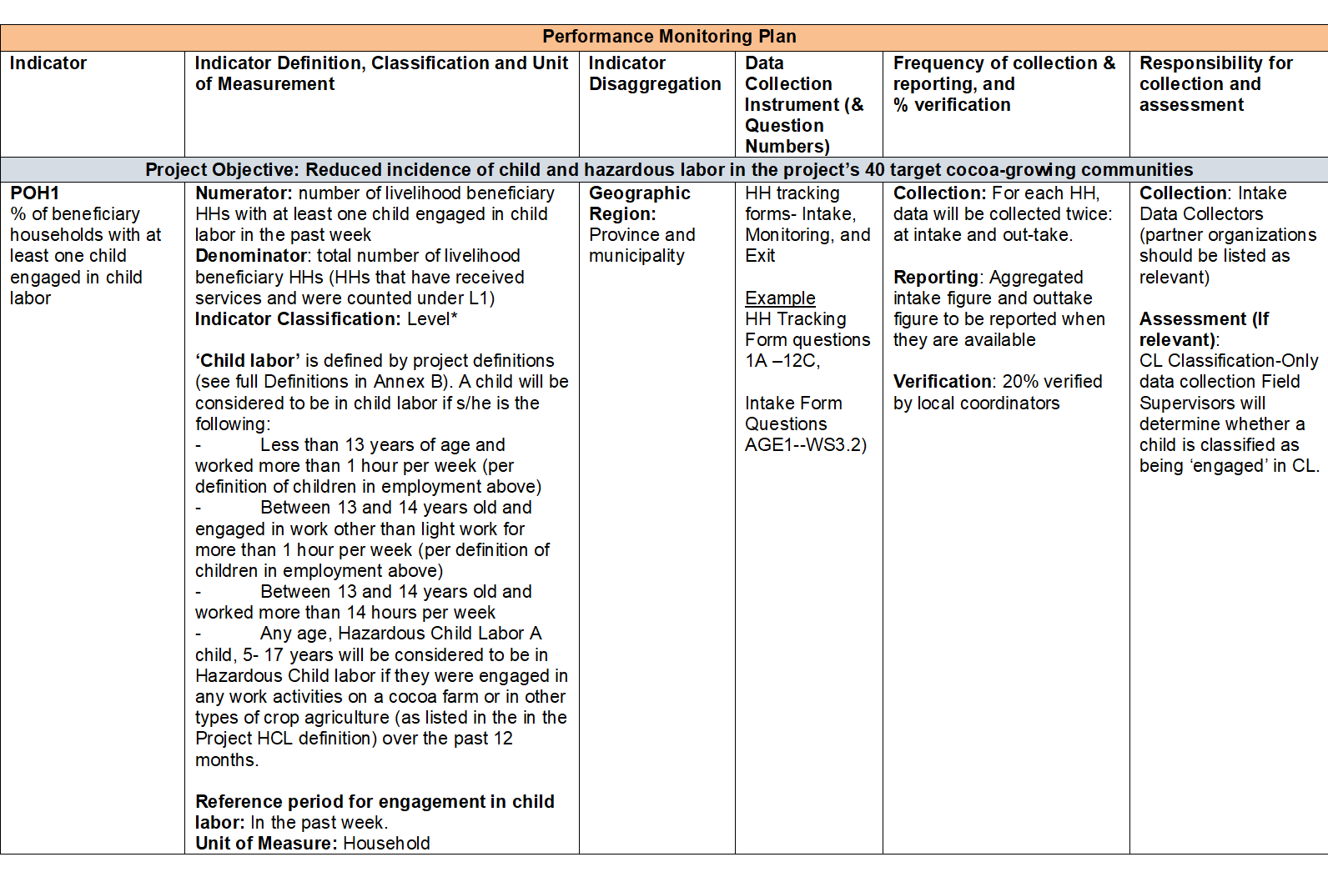
Step 3: Develop a Plan to Collect and Analyze Data
Notes:
This is an example of a PMP that shows the different types of information that are included to ensure data for each of the project’s performance indicators is collected in a uniform and consistent manner over the life of the project.
During the third course we will discuss the PMP in more detail and explain all the key elements.

Slide 19

Step 4: Collect Performance Data
Collect and collate primary data (e.g., surveys, interviews, focus groups, intake forms)
Procure from secondary sources
Collect only what you actually need
Data is reported in the Technical Progress Report (TPR) and Annex A Data Reporting Form
Notes:
Step 4 if the data collection stage.
Data should be collected regularly for each indicator, based on the timing laid out in the Performance monitoring plan.
Primary data can be collected through project surveys, key information interviews, focus groups, intake forms or other project documents.
In addition to primary data, the project can also rely on available secondary data to inform indicators. This could be data collected by other organizations or the government, including labor statistics.
Data collection should be planned based on what is needed to inform the indicators. Only data that is needed should be collected.
For ILAB, data is reported in the Technical Progress Report and Annex A, the Data Reporting Form.
Process for data collection will be discussed in more detail during course 4 - Developing Data Collection Tools.

Slide 20
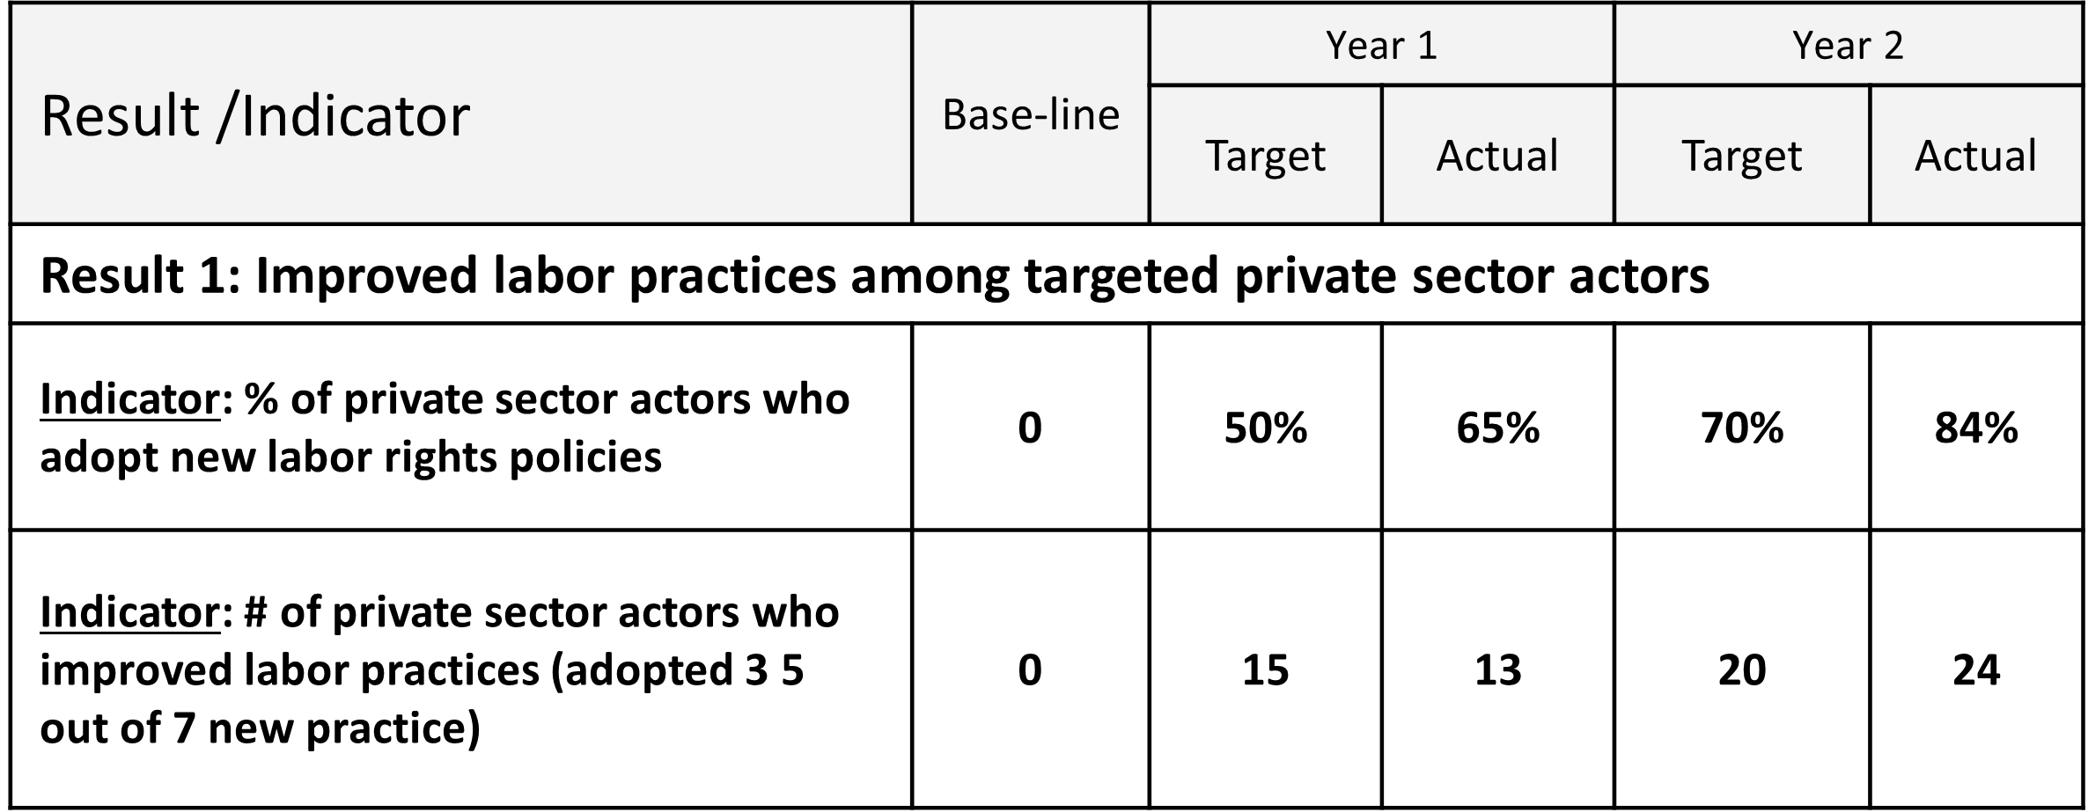
Step 5: Analyze Performance Data
Analysis of performance data should shed light on three initial questions:
  What is the level of performance?
  How does performance compare to expectations?
  Why is performance above or below expectations?
Actual
Expected
Baseline
Year 3
Notes:
Step 5 is the analysis of indicator data to help the project understand progress and assess performance.
The analysis helps to answer the 3 questions:
What is the level of performance?
How does performance compare to expectations?
Why is performance above or below expectations?
The analysis should be done regularly.
Analysis can be done for a particular indicator or a set of indicators for an individual result. In the slide we see a table with two indicators for a result that can be analyzed against the baseline data and targets
Some projects find it helpful to visualize their data to explore trends and communicate performance in their reports.
The slide includes an illustrative example of a line graph that plots performance against the baseline and targets over three years.
We will further explore the use of baseline and targets in course 5, Setting Baseline Values and Indicator Targets.

Slide 21
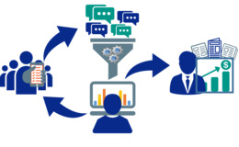
STEP 6: Make Management Decisions
The final step is to make decisions and take actions based on this information.
Consider mid-course corrections to:
  Project activities
  Resource allocations
  Strategy/Theory of change
  Indicators (if data is unreliable, not meaningful, etc.)
Notes:
The final step of the RBM system is using analysis to inform Management decisions.
This is one of the most important steps of the process.
Projects should plan to hold internal review sessions to explore the analysis and discuss progress. If progress is slower than expected or not occurring, this could be a flag that the project needs to change something in their approach or implementation.
This could also mean other mid-course corrections are needed on specific activities or interventions, resources allocation, or even the strategy or critical assumptions.
These reviews could also prompt changes to the indicators or data collection processes.
These review sessions should be held regularly, at least annually or every 6 months.
How to use data for decision making will be discussed further during course 6, Using Data For Project Improvement.

Slide 22
Using the RBM System
Using an RBM system helps the project to:
Understand progress and assess what is being achieved
Update project approaches and activities based on evidence
Communicate expectations and progress to stakeholders and partners
Streamline reporting to ILAB/DOL
Notes:
Using a result-based management system helps the projects to:
Reflect on progress and validate what is being achieve. It forces the project to take the time to review and reflect on progress while providing a systematic way to validate the progress.
It also guides projects in updating their approaches and activities based on evidence of what is working and what is not.
Lastly, RBM provides the tools to communicate expectations and progress to stakeholders and partners and streamlines reporting to DOL.

Slide 23
Overview of the Comprehensive Monitoring and Evaluation Plan (CMEP)
Notes:
We will now take a few minutes to understand the Comprehensive Monitoring and Evaluation Plan, also known as the CMEP.

Slide 24
What is a Comprehensive Monitoring and Evaluation Plan (CMEP)?
A tool to guide monitoring, evaluation and reporting by ILAB grantees
Part of the project’s start-up activities.
Promotes feedback, accountability, and learning.
Ensures grantee and ILAB/DOL agrees on project outcomes and measurements.
A living document.
Notes:
The CMEP is a tool grounded in the principles of results-based management. It integrates the project’s expected results and theory of change with the process of monitoring, evaluating, and reporting.
The development of the CMEP is one component of a project’s start-up activities and is a required deliverable that needs to be drafted and submitted by the project.
It should reflect the project design contained in the technical proposal that was submitted as part of the project’s application.
It promotes a strong link between project monitoring and evaluation activities, including establishing timelines for monitoring and evaluation activities so that they inform and build on one another and provide a full feedback loop for project decision making.
The CMEP helps ensure that grantees, their partners, and DOL are in agreement in terms of the project’s envisioned outcomes and how they will be achieved, measured, and documented.
The CMEP is a living document that should be updated as needed. Changes to strategies, indicators, targets and schedule may be required during the life of a project but good monitoring helps us know if and when those changes are needed.
DOL engages closely with grantee in the development of the CMEP, but the grantee has primary ownership of the development and implementation of the CMEP as well as updates to the CMEP as needed with DOL approval.

Slide 25

Why is a CMEP Important?
Tool to document what will be monitored, and ensure data is collected, analyzed and reported against project results
Recognized good practice for engaging stakeholders
Recognized good practice for identifying areas of improvement
Notes:
The CMEP is more than a monitoring and evaluation deliverable that is required by DOL; it is a critical tool for projects to measure and track project progress. The CMEP consists of a series of elements that enable grantees and partners to track and share progress made toward the completion of a project objective and provides evidence of the link between different levels of results, including activities, outputs, and outcomes.
The CMEP is an important tool for stimulating discussion among grantee team members, with partners and with DOL about what the project will achieve, how it will achieve its desired results and how it will collect and report on progress.
The development of the CMEP provides an early opportunity for grantees to include stakeholders in project design and start-up, build buy-in for project activities, and enhance ownership of project results by external stakeholders.
The CMEP also enables prompt identification of implementation shortcomings and adoption of corrective measures, thereby providing a unique opportunity for learning, adapting and maximizing project resources.

Slide 26
Components of a CMEP
Results Framework
Activities Mapping
Performance indicators
Performance Monitoring Plan (PMP)
Planned Evaluations and Studies
Implementation and Management of CMEP
Data Analysis Plan
Project-level Child Labor and Forced Labor definitions
Routine Data Quality Assessment Checklist
Data reporting form for TPR
Data Collection Instruments
Notes:
DOL has a template to guide the development and content of the CMEP. The template lays out each of the required CMEP sections and describes what should be included in each.
Key components of a CMEP include:
Results Framework visual representing the theory of change and an accompany a narrative description.
Activities Mapping, which shows the linkages between activities the project will carry out and the specific results they support in the framework.
Performance Monitoring Plan, which documents how data will be collected and reported by the project.
Planned Evaluations and Studies.
Implementation and Management of CMEP, including key M&E roles and responsibilities of the project staff.
Data Analysis Plan.
Project-level Child Labor and Forced Labor definitions.
Routine Data Quality Assessment Checklist.
Data reporting form for TPR.
Data Collection Instruments.
Links to resources are provided at the end of the session. Also feel free to reach out to your ILAB contacts and they can share the ILAB templates and guidance.

Slide 27
CMEP Development Process
Step 1: CMEP Kickoff
ILAB conducts introductory and planning calls with grantee.
ILAB provides M&E related training materials and resources.
Grantee attends orientation meeting.
Step 2: Theory of Change Refinement
ILAB works with grantee to refine:
Grantee holds working sessions with ILAB and key stakeholders to refine CMEP components.
results framework (visual)
theory of change (narrative),
activity mapping,
critical assumptions from proposal.
Notes:
There are 4 general steps to the CMEP process.
Note that the CMEP development for each project will look different, depending on each project’s unique circumstances such as scope, funding amount, duration, and prior USDOL CMEP experience.
Step 1: CMEP Kickoff – ILAB will plan introductory and planning calls with the grantee to discuss and review the general project approach and provide M&E related resources.
The grantee will also attend the orientation meeting after award. Usually held in the spring and can be in person or virtual.
Step 2: Theory of Change Refinement – The grantee will then take the lead on developing and refining different sections of the CMEP including the results framework, activities mapping and critical assumptions.
The refinements may be done through virtual working sessions or in person workshops.
During the "refinement period" in the first six months after the award grantees have the opportunity to carry out additional in-country needs assessments and consultations with partners and relevant stakeholders to assess, refine, and/or validate the proposed theory of change, design, and strategies of the project. All refinements will be subject to approval by USDOL.

Slide 28
CMEP Development Process
Step 3: Putting the CMEP together
Grantee
Step 4: CMEP and Project Document Integration
Update all project documents to reflect any changes to theory of change made during the refinement period.
holds working sessions with ILAB and key stakeholders to develop the remaining sections of CMEP
Finalize CMEP for ILAB approval.
develops definitions of key terms relevant to the project
completes and submits draft CMEP (including Annex A).
Notes:
Step 3: Putting the CMEP together – Based on the working sessions or work shop the grantee will finish the other sections of the CMEP such as the project-level definitions, PMP, and data collection instruments
As needed additional working sessions will be held.
At the conclusion of this step, the grantee submits the first draft of the CMEP for review.
Step 4: CMEP and Project Document Integration – the grantee will update all project documents to reflect any changes to theory of change made during the refinement period and work to finalize the CMEP for ILAB approval.

Slide 29
Maintaining and Using the CMEP
Update as needed and share with ILAB/DOL to approve changes.
Submit the Technical Progress Reports (TPR) of the CMEP every six months.
Use CMEP data to assess progress and make decisions to improve performance in consultation with ILAB DOL.
Notes:
Throughout the life of the project, the CMEP should be updated as needed. Updates might be needed if the project adjusts its strategy, changes to indicators, data collection methods, or other activities that impact the CMEP. Any changes should be reviewed and approved by ILAB.
Grantees should use the Technical Progress Report from the CMEP to submit their reports every 6 months. Tt should include performance data as identified in the CMEP.
Grantees should use the CMEP and data from it to assess progress, learn and make decisions to improve project performance in consultation with ILAB.

Slide 30
Knowledge Check
Notes:
We have covered a lot of information. Let’s do a brief knowledge check.

Slide 31
Question 1: RBM
What does RBM stand for?
Results based monitoring
Resources based management
Results based management
Notes:
Question 1: What does RBM stand for?
Results based monitoring
Resources based management or
Results based management
Pause the recording to answer the question. Once you have your answers press play.
The Answer is: Results based management

Slide 32
Question 2: RBM Six Steps
What are the six steps in the RBM System?
1.
Define
Results
(RF)
2.
Select
Performance
Indicators
3.
Develop a
Performance
Monitoring Plan
6.
Use Analysis to
Inform
Mgmt Decisions
5.
Analyze
Performance
Data
4.
Collect
Performance
Data
Notes:
Question 2: What are the six steps in the result-based management system?
On the screen we have the see the six blank boxes.
Pause the recording to answer the question. Once you have your answers press play to see the correct answers revealed.
The six steps are:
Defining results (e.g., developing a results frameworks)
Selecting Performance indicators
Developing a Performance monitoring plan (PMP)
Collecting Performance data
Analyzing Performance data
Using analysis to inform management decisions

Slide 33
Question 3: CMEP
Which two statements accurately describe a CMEP?
The CMEP is drafted at the start of the project.
Once a CMEP is approved it should not be updated or changed.
A CMEP outlines the project’s work plan.
A CMEP should be developed based on a template provided by ILAB/DOL.
Notes:
Question 3: Which two statements accurately describe a CMEP?
The CMEP is drafted at the start of the project.
Once a CMEP is approved it should not be updated or changed.
A CMEP outlines the project’s work plan.
A CMEP should be developed based on a template provided by ILAB/DOL
Pause the recording to answer the question. Once you have your answers press play to see the answers.
The correct answers are:
The CMEP is drafted at the start of the project
A CMEP should be developed based on a template provided by ILAB/DOL

Slide 34
Question 4: RBM
Which of the following are benefits of RBM?
(select all that apply)
Improve communications with stakeholders
Provide data and analysis for decision making
Eliminate the need to monitor activities
Build consensus and ownership
Improve the planning process
Notes:
Question 4: Which two statements accurately describe a CMEP?
The CMEP is drafted at the start of the project.
Once a CMEP is approved it should not be updated or changed.
A CMEP outlines the project’s work plan.
A CMEP should be developed based on a template provided by ILAB/DOL
Pause the recording to answer the question. Press play to reveal the correct answers.
The correct answers are:
The CMEP is drafted at the start of the project
A CMEP should be developed based on a template provided by ILAB/DOL

Slide 35
Question 5: CMEP
List three components that should be included in the CMEP?
Results Framework
Activities Mapping
Performance Monitoring Plan (PMP), including indicators
Planned Evaluations and Studies
Implementation and Management of CMEP
Data Analysis Plan
Project-level Child Labor and Forced Labor definitions
Routine Data Quality Assessment Checklist
Data reporting form for TPR
Data Collection Instruments
Notes:
Now list at least three components that should be included in the CMEP?
Pause the recording to record your answers. When ready, press play to hear the answers.
Components of the CMEP are:
Results Framework
Activities Mapping
Performance Monitoring Plan, including indicators
Planned Evaluations and Studies
Implementation and Management of CMEP
Data Analysis Plan
Project-level Child Labor and Forced Labor definitions
Routine Data Quality Assessment Checklist
Data reporting form for TPR
Data Collection Instruments

Slide 36
Conclusion
Notes:
Before we conclude this session, we will summarize what we have learned and provide some resources you can use to learn more about RBM and ILAB’s comprehensive monitoring evaluation plans.

Slide 37
Course Summary
The six RBM steps:
  Define the results
  Selecting performance indicators
  Developing a performance monitoring plan (PMP)
  Collecting performance data
  Analyzing performance data
  Using analysis to inform management decisions
The key benefits of RBM: Planning, management, communication, building consensus and ownership and reporting
Notes:
During this session we discussed the six RBM steps:
Define the results
Selecting Performance indicators
Developing a Performance monitoring plan (PMP)
Collecting Performance data
Analyzing Performance data
Using analysis to inform management decisions
We also discussed the Key benefits of using RBM including :
Enhancing the Planning Process by putting a focus on results and the cause-and-effect linkages
Building consensus and ownership through providing a shared understanding of a documented strategy and plan on how success is measured and achieved
Improving Communication through conveying the project’s intent and content to internal and external stakeholders
And supporting management and reporting

Slide 38
Course Summary (continued)
CMEP
  An M&E plan based on ILAB’s specific guidance and requirements
  Used by grantees to guide monitoring, evaluation and reporting on progress towards achieving intended results and outcomes
  Composed on the key components of the M&E system: results framework, PMP, indicators, evaluations, etc.
  Developed at the begin of a project and updated as needed
  Developed in collaboration with ILAB and other key stakeholders
Notes:
We also discussed the CMEP
A CMEP is an M&E Plan used by grantees to plan and manager their projects using performance data.
It iss based on ILAB’s specific guidance and requirements.
It includes key components of the RBM system, such as results framework, PMP, indicators, evaluations, etc.
It is developed at the begin of a project and updated as needed.
The CMEP should be developed in collaboration with ILAB/DOL and other key stakeholders in a participatory manner that builds ownership and buy-in.
Projects should use the ILAB/DOL CMEP template.

Slide 39
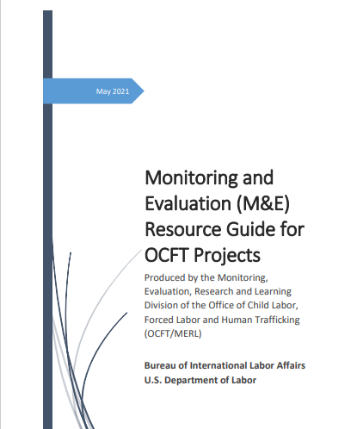
Resources – RBM and CMEP
US DOL: Monitoring and Evaluation (M&E) Resource Guide for OCFT Projects: https://www.dol.gov/sites/dolgov/files/ILAB/MandE-Resource-Guide-for-OCFT-Projects-508-Compliant-Version.pdf
  Includes links to templates for RF, PMP, activity mapping
The World Bank, Ten Steps for a Results-Based Monitoring and Evaluation System (Jody Zall Kusek and Ray C. Rist):
The United Nations Development Group, Results-Based Management Handbook: UNDG-RBM-Handbook-2012.pdf
Notes:
Here are a few resources you can access to learn more about results-based management and DOL CMEPs. The M&E resources guide is particularly important to review. It includes guidance and templates for grantee and can be found on DOL’s website www.dol.gov
Other useful resources include:
The World Bank’s Ten Steps for a Results Based Monitoring and Evaluation System and the United Nations Development Groups’ Results Based Management Handbook.
Thank you for your participation in this first course in DOL’s M&E Concept Series.

Slide 40
THANK YOU
Notes:
Thank you for your participation in this first course in the M&E Concept Series.

