Slide 1
Workforce Information Advisory Council
Michael Horrigan
Associate Commissioner
Office of Employment and
Unemployment Statistics
July 13, 2016

Slide 2
Outline
Data needs and the Workforce Innovation and Opportunity Act (WIOA) 2014
The world of LMI
How can BLS help?

Slide 3
Data needs and the Workforce Innovation and Opportunity Act 2014

Slide 4
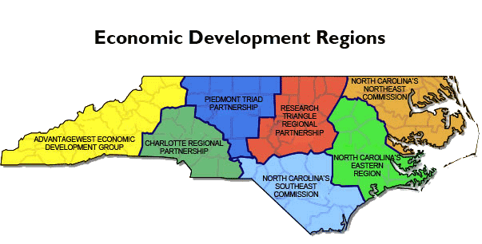
Identify labor market areas
Economically integrated geographic areas within which individuals can reside and find employment within a reasonable distance
Criteria set by BLS or the Governor
Section 3(30)

Slide 5

Support regional planning
Local workforce boards and chief elected officials develop regional sector initiatives for:
  Identifying in-demand industries and occupations
  Collecting and analyzing regional labor market data
  Section 106

Slide 6
Data required for planning and performance
In-demand industry/occupation data
Labor market projections
Employer needs
Skill/workforce gaps
Sections 3(23), 102, 106, 107, 108, 116 and 412

Slide 7
Alignment of training needs and training providers
Identify eligible providers’ program alignment with in-demand industries and occupations
Training services are to be responsive to in-demand and emerging industries by providing training services for those industries
Section 122

Slide 8
The world of LMI

Slide 9
ETA
State Labor Market Information Offices
BLS
WIAC
LMI CUSTOMERS
Businesses
Job seekers
Career counselors
Students
Education planners
Job training providers
Labor unions
Welfare / Vocational Rehabilitation Planners
Economic Development
Policy makers
Media

Slide 10
ETA
WIAC
State Labor Market Information Offices
PMP
Projections Managing Partnership
NASWA
National Association of State Workforce Agencies
ARC
Analyst Resource Center
O*NET
LEWIS
Local Employment and Wage Information System
LMI Institute
Longitudinal Employer -Household Dynamics LED
NCSC
National Crosswalk Service Center

Slide 11
ETA
State Labor Market Information Offices
BLS
WIAC
BLOC
BLS Labor Market Information
Oversight Council
BLS Federal / State
Policy
Councils

Slide 12
How can BLS help?

Slide 13
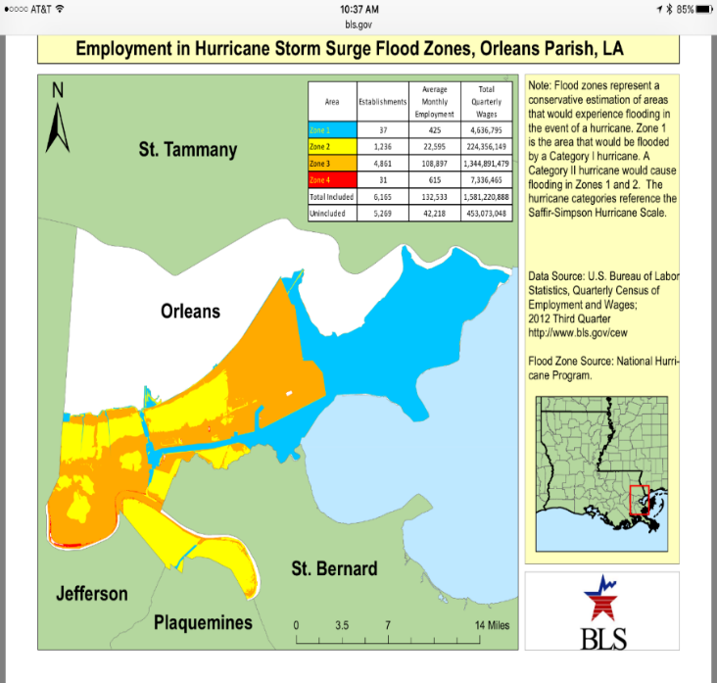
Quarterly Census of Employment and Wages
Employment and wages for every establishment in the U.S.
Geography detail
Industry detail
Updated quarterly
Potential to create lists of current in-demand industries data by workforce board areas using combined county level data

Slide 14
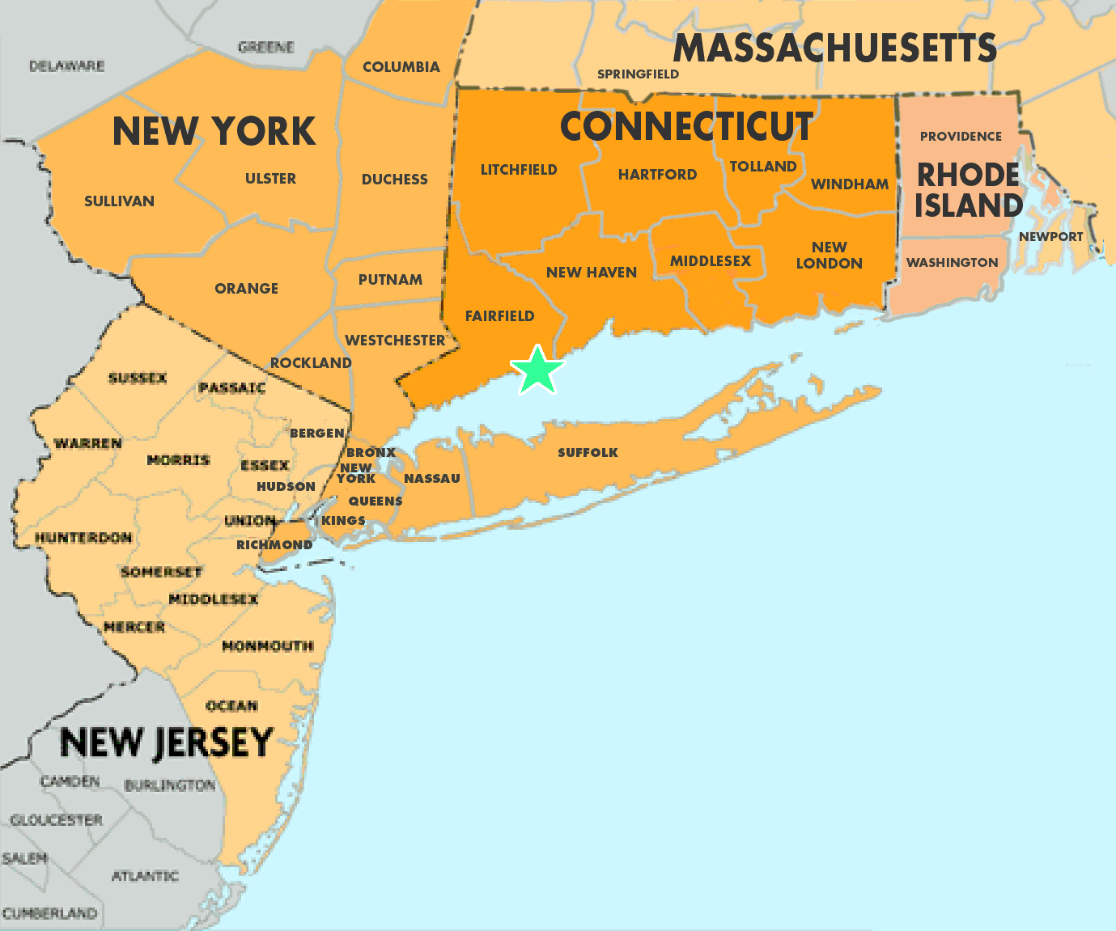
Current Employment Statistics
Timely monthly employment, wage and hours data
Principal Federal Economic Indicator
Data for all employees, women, production and nonsupervisory
Hourly and weekly earnings
Weekly and overtime hours
Nation, 50 states, territories and MSAs

Slide 15
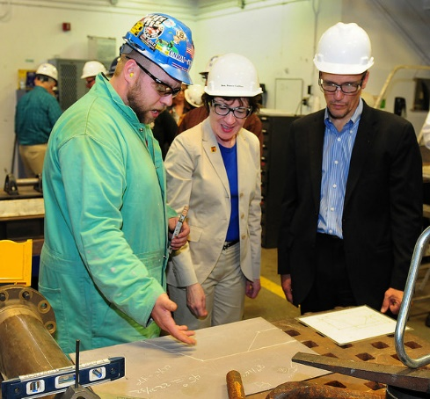
Local Area Unemployment Statistics
Unemployment rates, labor force status
  All states, DC, and Puerto Rico
  Metropolitan Areas & Divisions
  Micropolitan Areas
  Counties and county equivalents
  Cities and towns in New England
  Cities and towns with populations >25,000
  7,500 areas in total

Slide 16
LAUS data are used to allocate funds for many
Federal Assistance Programs
Agency Program Funding (2015)
ETA Worker Training $ 4 Billion
FEMA Food and Shelter $130 Million
Commerce- Public Works $144 Million
EDA Programs
Grand Total, All Programs: $ 83.8 Billion
Notes:
American Recovery and Reinvestment Act (ARRA)
EDA stands for Economic Development Administration.
See “LAUS administrative uses” document on the web at http://www.bls.gov/lau/lauadminuses.pdf for a complete overview of administrative uses of LAUS data.
Featured three (in order of interesting/easy to explain factors—point out diff criteria types):
2-FEMA
Geography is cities, counties, balances of counties.
Reference period is most recent 12-month average.
Allocation criteria: Meet one of: 13,000 unemp AND unemployment rate (UR) > 4.3%, 300-12,999 unemp with UR at least 6.3 %l, OR, 300 or more unemp with poverty rate ≥ 11.0%
3-EDA
Geography is any geographic/political boundary (e.g. city, Indian reservation).
Reference period: most recent 24-month avg.
Allocation criteria: Meet one of: UR > national by at least 1 % point, per capita income 80% or less of national, OR, there is a special need as determined by the EDA (e.g. actual or potential threat of high UR due to expected economic conditions.
1-ETA worker training – This is sum of two pieces, both from WIA Title I chapter 5: Adult Employment and Training (861.5 mill) and “plain” DW Employment and Training (1464.7 mill). Both use ASU (Area of Substantial Unemployment) areas as geography, primarily use most recent July-June as reference period.
Funding criteria are slightly different. For the larger, it is 1/3 on relative # unemployed, 1/3 relative excess number of unemployed (excess meaning # in excess of 4.5% of labor force), and final 1/3 on relative number of unemployed that are unemployed ≥ 15 weeks (use calendar yr ref for this), plus no more than 0.25% of the pot is allocated to outlying areas. For the smaller DW piece, the third 1/3 is relative number of economically disadvantaged adults 22-72, same outlying area component plus some other min/max provisions.

Slide 17
Occupational Employment Statistics
Employment and wages for:
Over 800 occupations
Over 450 industries
Average and median wages
and by decile
Geography – nation, states, regions, MSA
State partners produce workforce development regions based on county level data

Slide 18
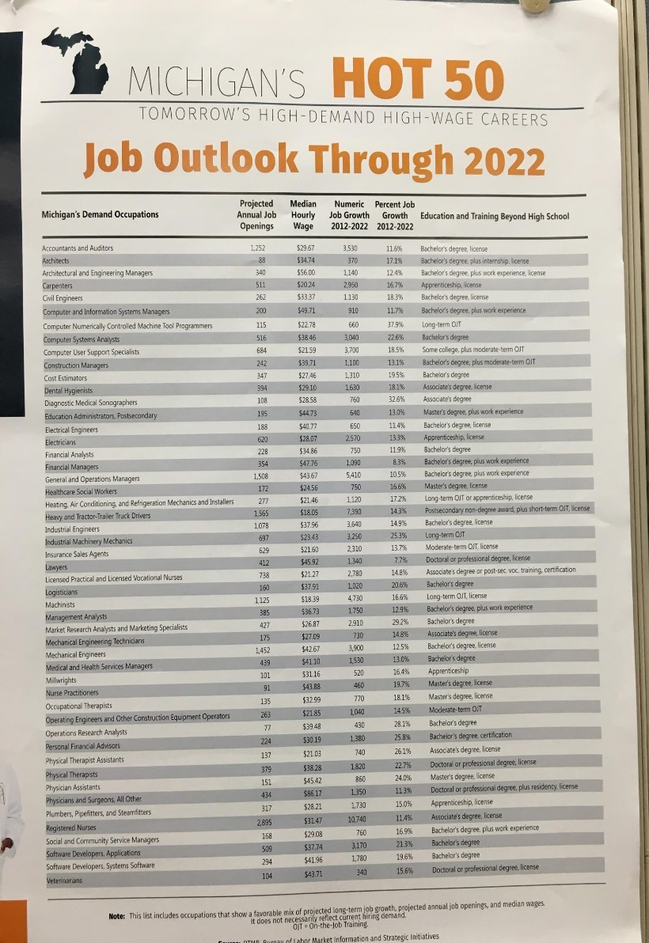

Potential to expand OES to create:
Consistent data driven lists of current in-demand occupations for every Metropolitan Statistical Area in the U.S.

Slide 19

Occupational Projections
2014-2024 projections
Long-term horizon
Identify occupations that are
projected to grow the fastest
and the ones adding the most jobs
Estimates of occupational separations
Entry level education and training requirements
Detailed occupational profiles for over 300 occupations
Critical input to state projections supported by ETA

Slide 20


Development of new and innovative products: New potential surveys
Survey of Employer Provided Training
Quick response surveys of establishments

Slide 21
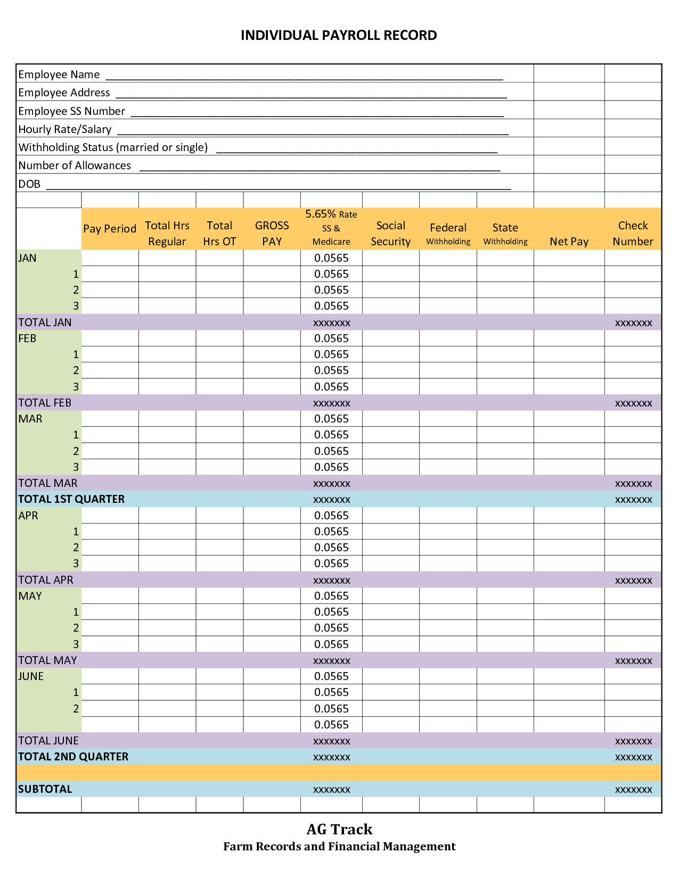
Development of new and innovative ‘big data’ products: Wage records
Wage record pilot
UI non-filers study
Resurrect the Mass Layoff Survey
Model JOLTS to the state level

Slide 22
Michael W. Horrigan
Associate Commissioner
Office of Employment and
Unemployment Statistics
202-691-5735
horrigan.michael@bls.gov

