Slide 1
Workforce Information Advisory Council
Michael Horrigan
Associate Commissioner
Office of Employment and
Unemployment Statistics
June 22, 2017

Slide 2
Outline
BLS Budget
BLOC Vision
Joint BLOC-PC meeting
BLOC projects
Communications

Slide 3
BLS Budget

Slide 4
BLS Budget – FY 2017
The FY 2017 President’s budget proposed $641 million in funding for BLS, an increase of $33.2 million over the FY 2016 final enacted level
  A large share of this request was to cover higher costs due to inflation, including $13 million not provided in the FY 2016 enacted level
  It also included 3 new initiatives:
    Employer Training Survey ($3 million)
    CPS supplement ($1.6 million)
    Supplemental Poverty ($2.5 million)

Slide 5
BLS Budget – FY 2017
  On May 5 the President signed the Consolidated Appropriations Act. This keeps the BLS funding level for this year at the FY 2016 appropriated level of $609 million
  In order to maintain current production and core programs, at this funding level, the BLS has been curtailing spending on data improvements, and development and research projects. In addition, the BLS has cancelled particular trainings, including program-wide training of staff and state partners
  This included the cancellation of the BLS-LMI Conference, fed/state cooperative program national conferences and Policy council meetings

Slide 6
BLS Budget – FY 2018
On May 23, the President submitted to Congress his 2018 Budget
The 2018 President’s Budget proposes $607.8 million in funding for the BLS. This request is a decrease of $1.2 million from the FY 2016 final enacted level
Within this level, the BLS will continue the production of core data series, as well as, take on select projects that will improve the products provided to our data users

Slide 7
BLS Budget – FY 2018
  The BLS will consider efficiencies and changes in our operations, including changes to some programs that may be necessary in order to reallocate funding to the production of core data series
  The plan for FY 2018 also includes reversible non-permanent programmatic reductions that may temporarily affect the quality and quantity of select BLS products

Slide 8
BLS Budget – FY 2018
OEUS planned reversible cuts
  QCEW $2.4 million
    Eliminate state contribution of $1 million to QUEST
    Coding requirement changes $1.4 million
  OES $1.2 million
    Reduce sample by 6.5% (26,000)
    Most metropolitan divisions would not be published and some small balance of state areas will be combined with other areas

Slide 9
BLS Budget – FY 2018
OEUS reversible cuts
  LAUS reduction $500,000
    Eliminate 441 New England Minor Civil Divisions with populations less than 1,000
  CES reduction $400,000
    Eliminate two specific deliverables: annual summary of state contributions to the benchmark, and delivery of information to BLS on local events in the analysis of estimates
OEUS total planned reversible cuts affect all of OEUS programs, not just fed/state

Slide 10
Vision

Slide 11
Vision
Prioritizing closing major data gaps
Measuring jobs in demand
Expanding local detail
  Increased use of modelling
  Increased use of visualization
The future of data collection
Creation of new products

Slide 12
Vision – prioritizing closing data gaps
What industries are temporary help workers being placed in?
How firms produce their products or provide their services
  Types of labor – W&S, temporary help, contract, self-employed, among others
  Purchased inputs
  Offshoring
  Employer provided training

Slide 13
Vision – prioritizing closing data gaps
Globalization and enterprise based data collection
  Factoryless goods production
  Global supply chains
  Value added trade
Occupational, industry and product classification systems

Slide 14
Vision – measuring jobs in demand
New way to measure jobs in demand
Develop time series of occupational employment changes
  Develop thresholds for employment change over time
  Identify high-wage occupation thresholds
  Sort by educational attainment generally required for entry into the occupation
  Set other thresholds such as size of occupation, number of new jobs created, etc

Slide 15
Vision – measuring jobs in demand
OES time series
  New way to measure jobs in demand
  Short-term complement to using long-term projections
  Impute OES back to the QCEW to provide local detail and better estimates

Slide 16
Vision – Expanding local detail
Increased use of modelling
  Modelling JOLTS to the state level
  Develop OES time series estimates down to lower levels of geography
  Blending data through ratio allocation and modelling to create more local detail
    Use of Mean Squared Error reduction as a measurement objective

Slide 17
Vision – Expanding local detail
Increased use of visualization
  Creating local profiles by combining data across BLS and other data sets
  Mapping technology

Slide 18
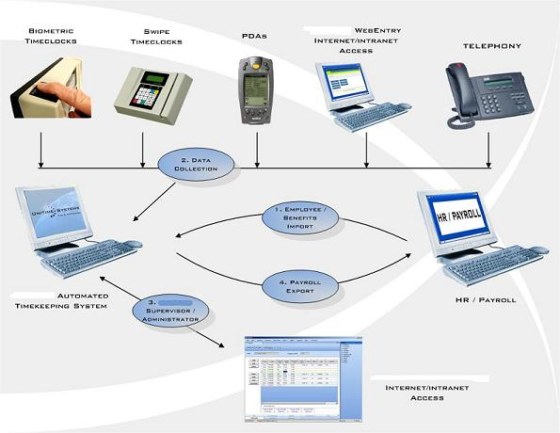
Vision - Modernization of data collection and lowering response burden
Elimination of long forms in OES and autocoding
ARS to email and to QBS
Expansion of EDI
Payroll providers
Wage records and OES

Slide 19
Vision - Leveraging corporate data
A large share of collected information in our establishment surveys comes from a small share of total establishments owing to the size concentration of economic activity
The Current Employment Statistics Survey (CES) collects data from 88 corporations at the Electronic Data Interchange Center in Chicago, IL
  Accounts for nearly 10% of total weighted employment
  Respondents submit electronic files in BLS formats

Slide 20
Vision - Leveraging corporate data
In 2012, of the known value of U.S. exports that could be matched to specific companies:
  the top 50 companies contributed nearly 31% of known value
  the top 100 nearly 40%
  the top 250 just over half
  and the top 2000 nearly 78%

Slide 21


Vision - Development of new and innovative products: New potential surveys
Survey of Employer Provided Training
Quick response surveys of establishments

Slide 22
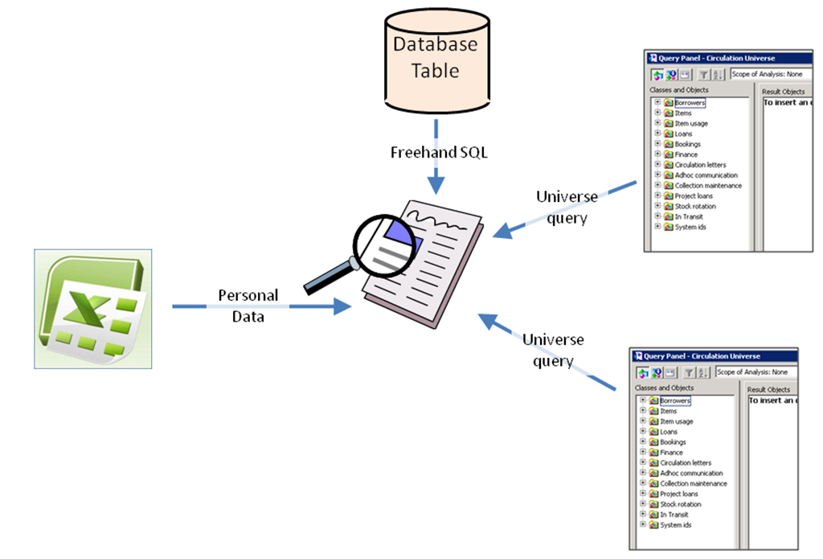
Vision: Development of new and innovative products: Matching
QCEW-Nonprofit
QCEW-FDI
QCEW-OES
QCEW-SOII-OES
QCEW-Customs Exports-OES

Slide 23
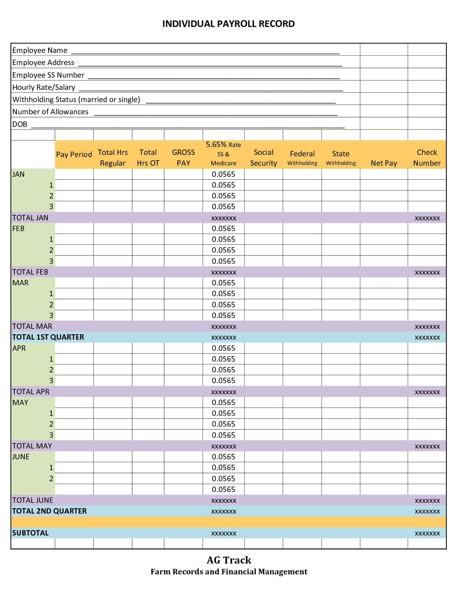
Vision: Development of new and innovative ‘big data’ products: Wage records
Wage record pilot
Resurrect the Mass Layoff Survey
Model JOLTS to the state level
UI non-filers study
OES

Slide 24
Vision - Development of new and innovative products
Cross-program products
  Local profiles
Videos
Infographics
Training and software

Slide 25
Joint BLOC – Policy Council Meeting

Slide 26
Joint BLOC – PC meetings:
Cross-program topics
Managing state level staffing
  Best practices - hiring, training, management challenges, innovative practices
Declining trends in response rates
  Response rate improvement projects, federal, and state perspectives
Annual Refiling Survey
  Review current test of moving the quarterly state deliverable up by one week, impact on programs, and review of state concerns

Slide 27
Cross-program topics
Cross-program product development
  Sharing examples of approaches to creating new innovative products – combining data from multiple sources, infographics, matching administrative and survey data, among others
Wage records
  State experiences with sharing and enhancing wage records, best practices, lessons learned, future opportunities

Slide 28
BLOC projects

Slide 29
BLOC projects
Wage records
Examination of the adequacy of budget resources for fed/state programs
Strategic planning
Jobs in demand

Slide 30
Wage records
BLS Pilot
  Texas, Louisiana, Utah, Washington, Oregon, and Idaho
  Testing sharing protocols and IT requirements using ‘fake’ data
  Creating sharing agreements
WRAWG
  OMB, Census, DOL, BLS, and Ed joint effort

Slide 31
BLOC budget subgroup
Evelina Loescher, Carrie Mayne, Mark Watson, Mike Horrigan, Tom Shaffer, Charlene Peiffer, Brent Hill
Develop an analytical approach to determining if the BLS fed/state programs are adequately funded
Meets every two weeks
Development of an analytical approach that we will discuss with the BLOC

Slide 32
Strategic Planning: Vision buckets
Ken Robertson, Julie Hatch, Evelina Loescher, Carrie Mayne
  Achieve and maintain high data quality
  Provide excellent customer service
  Close high priority data gaps
  Leverage opportunities for new products
  Improve fed/state coordination
  Conduct high quality research
  Provide high quality data driven resource management
  Provide high quality program oversight

Slide 33
Jobs in demand
Rebecca Rust
Pathways project
  Too much heterogeneity
Focus on skills
  Survey of LMI Directors on how states measure jobs in demand

Slide 34
Communication

Slide 35
Challenge to the BLOC and PCs
Budget shortfalls are necessitating the cancellation of the BLS LMI conference and various BLOC, Policy Council, and program national conferences for the remainder of the year
We hope to resume the normal practice of holding these meetings in FY 18
  3 BLOC and 3 Policy Council meetings
  BLS National LMI conference and fed/state program national conferences

Slide 36
New communication channels
Create a new WebEx series for meetings on broad topics of interest for all LMI directors
  Budget updates
  Major BLOC projects
  OEUS annual planning memo
  Major Policy Council projects
  fed/state research studies
More frequent ‘virtual’ meetings in-between in-person

Slide 37
Michael W. Horrigan
Associate Commissioner
Office of Employment and
Unemployment Statistics
202-691-5735
horrigan.michael@bls.gov

