Slide 1
PERM/LCA Prevailing Wage and Surveys: Concepts and Filing Tips
National Prevailing Wage Center
Office of Foreign Labor Certification
Employment and Training Administration
April 19, 2022

Slide 2
Disclaimer
This presentation is intended for training use only and does not carry the force of legal opinion.
The Department of Labor is providing this information as a public service. This information and any related materials are presented to give the public access to information on the Department of Labor programs. You should be aware that, while we try to keep the information timely and accurate, there will often be a delay between official publications of the materials and the modification of these pages. Therefore, we make no express or implied guarantees. The Federal Register and the Code of Federal Regulations remain the official source for regulatory information published by the Department of Labor. We will make every effort to keep this information current and to correct errors brought to our attention.

Slide 3
Presenters
Lindsey Baldwin, Center Director, National Prevailing Wage Center (NPWC)
Cheryl Beasley, Occupational Employment and Wage Statistics (OEWS) Supervisor, NPWC
Paul Gotte, Non-OEWS Supervisor, NPWC
Kisa Hyman, Senior Immigration Program Analyst, NPWC
Shaun Joykutty, Senior Immigration Program Analyst, NPWC
Thomas Konrad, Senior Immigration Program Analyst, NPWC
Frank Latin, Senior Immigration Program Analyst, NPWC

Slide 4
Discussion Topics
General filing tips
9141 and 9089
General reminders
9141
Wage Survey Concepts
Authorities and Tips
Who to Survey…
Where to Survey…
Notes:
Include appropriate information to be entered

Slide 5

Part 1: Filing Tips/Reminders
General Filing Tips
General Reminders

Slide 6
General Filing Tips Validity Period
No more than 365 days
No less than 90 days
July 1st thru April 1st – End on June 30th
April 2nd thru June 30th – End 90 days later
The first day of the validity period is the day the PW determination is issued.

Slide 7
General Filing Tips Validity Period Examples
July 1st, 2021
April 2nd, 2022
Sept. 28th, 2022
June 30th, 2022
July 1st, 2022
07/01/2021 365 day 06/30/2022
08/15/2021 319 days 06/30/2022
04/02/2022
90 days
07/01/2022
05/10/2022
90 days
08/08/2022
06/30/2022
90 days
09/28/2022

Slide 8
General Filing Tips Form ETA-9141
When submitting requests for Prevailing Wage Determinations (PWDS) the filer should:
Ensure the Form ETA-9141 mandatory fields are complete
Ensure job duties provided are detailed and include as much specificity as possible
Ensure supervision tasks are detailed and include the occupations being supervised
Ensure the correct wage source in Section E is selected (e.g., ACWIA, DBA, SCA, or Survey)
Ensure the application does not include irrelevant information such as the nature of the employer, working conditions, etc. (e.g., “Must walk substantially (up to 15 miles daily), also stoop, bend while carrying a pack (up to 50lbs) through rough terrain (non-trail). Attention to detail; complete work tasks timely. Outdoors, exposed to weather.”)
Notes:
Include H-2b tasks

Slide 9
General Filing Tips Vague job tasks
Please remember that vague job tasks may overlap with other occupations. Thus, it is imperative to provide the specifics on the following:
Types of products being sold. (e.g., technical vs. non-technical)
Types of projects or services being managed. (e.g., sales)
Specific course(s) that will be taught
Type of clinical care that will be provided.(e.g., pediatrics)
Type of products or processes that will be worked on

Slide 10
General Filing Tips Conflict of experience
The Form ETA-9141 may not contain conflicting experience requirements. The experience requirements listed in Section F.b.4 or F.c.4 (minimum and alternative experience requirements) of the form refers to any experience required for the job opportunity
Therefore, if the employer selects “no” experience is required in Section F.b.4 or F.c.4, but Section F.b.5 or F.c.5 (special requirements) includes experience, this would be a conflict. An RFI will be sent to the employer to clarify the experience requirements
The employer’s RFI response should confirm the experience indicated on the Form ETA-9141. If the employer fails to provide the information, the application will be returned unprocessed
Notes:
Employer’s RFI response should match information and if not, the case will be returned

Slide 11
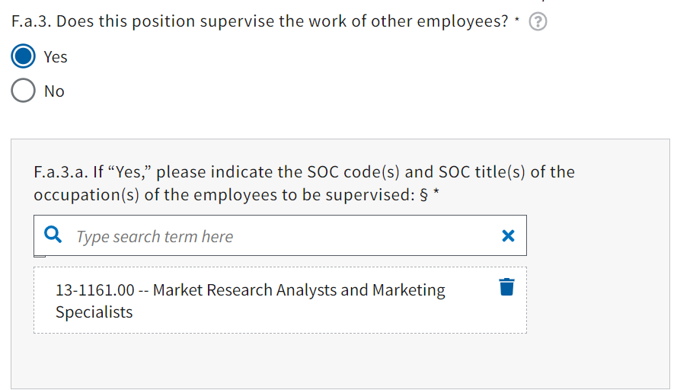
General Filing Tips Supervised occupations
When submitting applications that include supervisory tasks it is important to provide the occupations that are being supervised. Employers are now able to select up to ten O*NET occupations from the drop-down menu in FLAG in Item F.a.3.a on the Form ETA-9141 (see illustration below). This information will allow NPWC to ensure that the assigned wages are reflective of the supervisory tasks as well
Notes:
I included that up to ten occupations may be added

Slide 12
PERM Labor Certification General Reminders Form ETA-9089 (also seen as ETA Form-9089)
Ensure travel, certifications, licenses and other special requirements from the Form ETA-9141 are listed on the Form ETA-9089
Ensure there are no typographical errors regarding the validity dates listed on the Form ETA-9089 (e.g., Form ETA-9141 validity date is 3/5/2020 to 6/30/2020; Form ETA-9089 validity date is 3/5/2020 to 6/30/2000)
Verify date and year
If skills or other requirements are entered on the Form ETA-9141 they must also appear on the Form ETA-9089
Ensure that the correct PWD number is entered on the Form ETA-9089
Verify the correct employer
Verify the job opportunity
May use a PW with PERM or any LCA visa in A.1, but not H-2B.
Enter the following classification symbol to indicate the type of visa supported by this application: “H-2B,” “H-1B,” “H-1B1 Chile,” “H-1B1 Singapore,” “E-3 Australian,” “PERM”
Notes:
Include ANPC validity date example

Slide 13
General Reminders

Slide 14
General Reminders RFIs
NPWC may send a Request for Further Information (RFI) if the following is unclear:
Vague job duties
Conflicting education and experience requirements
Occupations being supervised
Missing documents (e.g., ACWIA, survey, etc.)
Incorrect worksite information

Slide 15
General Reminders RFIs
Please take note of the following RFI reminders:
If you receive an RFI pertaining to job duties in question, you may provide details about job duties or elaborate on the duties; however, please NOTE that the original submitted job duties cannot be removed
The request for removal of job duties may lead to the case being returned un-processed; thereby, causing the employer to submit a new Form ETA-9141
Ensure the RFI response confirms that NPWC has permission to correct the applicable section of the form
*Note: The job duties in section F.a.2 contains a 4,000 – character limit. Therefore, when submitting additional information, the original job duties and RFI response will need to fit in this section
Notes:
Please be mindful of the 4,000-character limitations when submitting job duties

Slide 16
General Reminders Revised Form ETA-9141
The revised Form ETA-9141 included the following updates:
New Section for Attorney or Agent Information (Section D)
Employers may select which ACWIA provision they are covered under and notify NPWC if there was a change in ACWIA status (Section E.1.a)
Supervised occupations from the O*NET database
Additional fields have been added for the following requirements: license/certification, foreign language, residency/fellowships and other special skills or requirements
Alternative Requirements (Section F.c)
Notes:
Include special skills in the additional fields- these are specific fields for requirements that do not need to be repeated in the special skills section. The center may start to send a RFI to move requirement to specific field

Slide 17
General Reminders Employer and Attorney Information
Section B of the Form ETA-9141:
The General Instructions for Section B of Form ETA-9141 state that the employer point of contact must be an "employee of the employer" and also state that "[T]he employer point of contact information in this Section, specifically the name, telephone number, and email address, must be different from the attorney/agent information listed in Section D, except when an attorney listed in Section D is an employee of the employer
Section D of the Form ETA-9141:
The General Instructions for Section D of Form ETA-9141 must be completed if an attorney or agent is filing the application on behalf of the employer
Note: If the employer’s point of contact and the attorney/agent information is the same, NPWC will send an RFI to request clarification, except when an attorney listed in Section D is an employee of the employer

Slide 18
General Reminders Alternative Requirements
The revised Form ETA-9141 includes a section for the alternative requirements:
Section F.c. should be filled out when an employer requires alternative requirements
If the application states “no” to alternative requirements in F.c, but alternative requirements are listed else where on the form, NPWC will send an RFI for clarification
The equivalency of the alternative requirements to the minimum requirements will not be evaluated and wages will be assessed for the minimum and alternative requirements separately
The minimum and alternative requirements are stand alone requirements. Therefore, the employer may not enter “see minimum requirements” in the alternative requirements section
If the employer requires more than one set of alternative requirements, the employer should submit an additional prevailing wage application
Notes:
Add bullet –both of the requirements stand independent of each other. Employers should not list see minimum requirements. For a third set of requirements a new PWD needs to be submitted

Slide 19
General Reminders Other Degree Requirements
Education Section F.b.1 “Other Degree” and F.1.b.a fields:
The General Instructions for Section F.1 of Form ETA-9141 states to identify the minimum U.S. diploma or degree required for the job opportunity
When “Other Degree” is selected in Item F.b.1, the employer must enter a formal credential issued by a U.S. educational institution (Example: a professional degree such as J.D., M.D., D.D.S., etc.) in Item F.b.1.a.
If the application includes other certifications, training or courses listed in the “Other Degree” field that are not professional degrees (as identified above), NPWC will send an RFI to request permission to move the requirements to the special requirement sections (F.b.5 or F.c.5).

Slide 20
General Reminders Job Duties
Item F.a.2 Job Duties
The Form ETA-9141 General Instructions for Item F.a.2 (job duties) states, the employer should include a detailed description of the job duties to be performed with as much specificity as possible
Therefore, when the job duties do not provide the actual tasks that will be performed but rather the abilities for the position, NPWC will send an RFI for clarification
Job duties are the tasks that are essential to the performance and responsibility of the position. Whereas the job requirements are the education, experience, and training qualification(s) necessary to have for the position
Illustrative example:
Job Duty: Take blood pressure using cuff and stethoscope
Requirement: Ability to take blood pressure using a cuff and stethoscope; may be gained through training or experience

Slide 21
General Reminders Character Limitations
Character Limitations for free text fields in FLAG:
When the information entered exceeds the maximum number of characters allowed, NPWC will not be able to review all the requirements for the job opportunity
FLAG displays a 200-character limitation for Sections F.b.1.b (Major and/or field of studies) and F.b.4.b (Occupation required)
Employers should enter additional information in Sections F.b.5 or F.c.5 (special requirements) as these fields have a 4,000-character limitation

Slide 22
General Reminders Pertinent Information
Section F.b.1.b/ F.c.2.b (Major and/or field of studies)
Employers should enter the major(s) and/or field of studies required for the job opportunity (e.g., Education, Social Work, etc.)
Section F.b.4.b (Occupation required)
Employers should list the occupations in which experience is required by the employer for the job opportunity (e.g., related occupation, Marketing Manager, Health Manager, etc.)
The number of months of experience required for the job opportunity should not be restated in this field

Slide 23


General Reminders Pertinent Information
Section F.b.1.b
(Major and/or field of studies)
Section F.b.1.b
(Major and/or field of studies)
Notes:
Illustration for correct vs. incorrect information

Slide 24
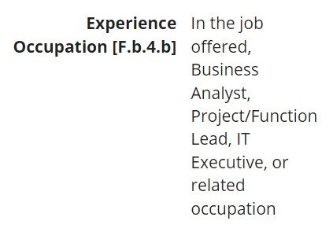
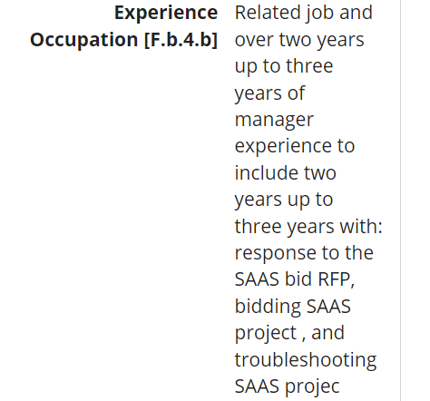
General Reminders Pertinent Information
Section F.b.4.b
(Occupation required)
Section F.b.4.b
(Occupation Required)
Notes:
Illustration for correct vs. incorrect information

Slide 25
Questions

Slide 26
Short Break
Starting again in 5 minutes.

Slide 27
Part 2: Wage Survey Concepts
Authorities and Tips
Who to Survey: Similarly Employed
Where to Survey: Area of Intended Employment
What to Survey: Job Duties
Pay/Wage Data

Slide 28
Authorities

Slide 29
Non-OEWS Wage Source Notes
If there is a CBA, it must be used. No other wage source can be requested.
Cannot ask for CBA, SCA, DBA, and Survey on same application.
There is no order of precedence between SCA, DBA, and Survey.
DBA is for construction trades only.
SCA and DBA are not available to ACWIA covered employers.

Slide 30
Overview of Regulatory Requirements
Employer-provided wage information.
(1) If the job opportunity is not covered by a CBA, or by a professional sports league's rules or regulations, the NPC will consider wage information provided by the employer in making a PWD. An employer survey can be submitted either initially or after NPC issuance of a PWD derived from the OES survey. In the latter situation, the new employer survey submission will be deemed a new PWD request.
(2) In each case where the employer submits a survey or other wage data for which it seeks acceptance, the employer must provide the NPC with enough information about the survey methodology, including such items as sample size and source, sample selection procedures, and survey job descriptions, to allow the NPC to make a determination about the adequacy of the data provided and validity of the statistical methodology used in conducting the survey in accordance with guidance issued by the OFLC national office.
(3) The survey submitted to the NPC must be based upon recently collected data.
(i) A published survey must have been published within 24 months of the date of submission to the NPC, must be the most current edition of the survey, and the data upon which the survey is based must have been collected within 24 months of the publication date of the survey.
(ii) A survey conducted by the employer must be based on data collected within 24 months of the date it is submitted to the NPC.

Slide 31
FRN December 4, 2009 https://www.dol.gov/sites/dolgov/files/ETA/oflc/pdfs/E928963_120409.pdf
i. The name of the published survey, when appropriate;
ii. The publication schedule for the survey, when appropriate. This should include the publication date of the requested survey, the date of the previous version of the survey and the date of the next release of the survey (actual or anticipated);
iii. When the data was collected;
iv. A description of the job duties or activities used in the survey;
v. The methodology used in the survey;
A. How the universe is defined;
B. How the sample size was determined;
C. How the participants were selected; and
1. The number of employers surveyed for the occupation in the area;
2. The number of wage value responses (employees) for the occupation in the area;
D. A list of employer participants or explanation of how the cross industry nature of the survey was maintained;
E. How the presented wage was determined and if it is mean or median;
F. Any other appropriate information on the survey’s methodology;
G. The area covered by the survey or relevant portion and an explanation of any expansion of the area beyond normal commuting distance, when applicable;

Slide 32
Prevailing Wage Determination Policy Guidance Nonagricultural Immigration Programs Revised November 2009
II,C
Factors relating to the nature of the employer, such as whether the employer is public or private, for profit or nonprofit, large or small, charitable, a religious institution, a job contractor, or a struggling or prosperous firm, do not bear in a significant way on the skills and knowledge levels required and, therefore, are not relevant to determining the prevailing wage for an occupation under the regulations at 20 CFR 655.10 and 20 CFR 656.40. As noted above, the relevant factors are the job, the geographic locality of the job, and the level of skill required to perform independently on the job.
Appendix F
Obtain a valid directory of employers in the area of intended employment (or expanded area) that would most likely employ the occupation to be surveyed.
Count (or estimate) the number of employers in the applicable area.
Decide how many employers must be contacted to produce usable wage results from at least three employers and at least 30 workers. Results for 30 workers is the minimum acceptable sample; for most occupations there should be wage data for many more workers.
Divide the number of employers to be contacted (the sample) by the number of employers in the applicable industry[s] (the universe). Use the number calculated in this last step to methodically select a random sample of employers to contact. For example, if the number is one ­tenth, select every tenth employer in the universe or listing of employers in the industry.

Slide 33
Survey Documents Needed
Same survey, same edition
Methodology
Survey Position Description
Leveling Info if appropriate
Wage Data:
Number of Employers used to get wage
Number of Workers used to get the wage
Evidence of cross industry:
Methodology
List of participants
Evidence of most recent
When the wage data was collected
Publication Date – Includes posting to online database

Slide 34
Survey Documents – Tips
To allow us to select the most appropriate wage based upon the information on the 9141 compared to the survey criteria:
Include wage information from;
all survey wage levels
similar survey occupations
Survey Geographic Coverage:
Explanation of where the surveyed employers are located
More specific than just a city name
Example: Pittsburgh
Incorporated area only?
City plus select suburbs?
OMB defined MSA?

Slide 35
Survey Documents – Tips (continued)
Where the survey provides larger areas, an explanation of those as well
Provide wage data for each area
An explanation of why the surveyed area is larger than the area of intended employment

Slide 36
Who to Survey: Similarly Employed

Slide 37
20 CFR 656.40(d)
Similarly employed. For purposes of this section, similarly employed means having substantially comparable jobs in the occupational category in the area of intended employment, except that, if a representative sample of workers in the occupational category can not be obtained in the area of intended employment, similarly employed means:
(1) Having jobs requiring a substantially similar level of skills within the area of intended employment; or
(2) If there are no substantially comparable jobs in the area of intended employment, having substantially comparable jobs with employers outside of the area of intended employment.

Slide 38

Survey Documents – Tips (continued)
Provide survey information for the most detailed occupation. While the regulations, under the definition of similarly employed, do allow a more general occupation, only if the occupation does not have enough workers in the AIE
Only if Expansion
Normal Use
The examples provided are for illustration, are not an endorsement, and do not reflect the Department's approval or endorsement of any one particular product.

Slide 39
Where to Survey: Area of Intended Employment

Slide 40
20 CFR 656.3 “Area of intended employment”
Area of intended employment means the area within normal commuting distance of the place (address) of intended employment. There is no rigid measure of distance which constitutes a normal commuting distance or normal commuting area, because there may be widely varying factual circumstances among different areas (e.g., normal commuting distances might be 20, 30, or 50 miles). If the place of intended employment is within a Metropolitan Statistical Area (MSA) or a Primary Metropolitan Statistical Area (PMSA), any place within the MSA or PMSA is deemed to be within normal commuting distance of the place of intended employment; however, not all locations within a Consolidated Metropolitan Statistical Area (CMSA) will be deemed automatically to be within normal commuting distance. The borders of MSA's and PMSA's are not controlling in the identification of the normal commuting area; a location outside of an MSA or PMSA (or a CMSA) may be within normal commuting distance of a location that is inside (e.g., near the border of) the MSA or PMSA (or CMSA). The terminology CMSAs and PMSAs are being replaced by the Office of Management and Budget (OMB). However, ETA will continue to recognize the use of these area concepts as well as their replacements.

Slide 41
Area of Intended Employment (AIE)
The geographic area within normal commuting distance of the place of intended employment (worksite address).
There is no rigid measure of distance that constitutes a normal commuting distance or normal commuting area.
The borders of Metropolitan Statistical Areas (MSA) are not necessarily controlling but any place within an MSA is deemed to be within normal commuting distance.
OMB Bulletin No. 20-01, Revised Delineations of Metropolitan Statistical Areas, Micropolitan Statistical Areas, and Combined Statistical Areas, and Guidance on Uses of Delineations of These Areas
https://www.whitehouse.gov/wp-content/uploads/2020/03/Bulletin-20-01.pdf (MSA, µSA, CSA)
https://www.bls.gov/oes/current/msa_def.htm#A (MSA, non-MSA)

Slide 42
Area of Intended Employment (AIE)
Metropolitan Statistical Areas (MSA):
Have at least one urbanized area of 50,000 or more population, plus adjacent territory that has a high degree of social and economic integration with the core as measured by commuting ties
Defined in terms of whole counties (or equivalent entities)
May have Metropolitan Divisions
Those that contain a single core with a population of 2.5 million or more may be subdivided to form smaller groupings of counties referred to as Metropolitan Divisions
Micropolitan Statistical Areas (µSA):
Have at least one urban cluster of at least 10,000 but less than 50,000 population, plus adjacent territory that has a high degree of social and economic integration with the core as measured by commuting ties
Defined in terms of whole counties (or equivalent entities)

Slide 43
Area of Intended Employment (AIE)
Combined Statistical Areas (CSA)
A CSA may comprise two or more MSAs, and MSA and a µSA, two or more µSAs , or multiple MSAs or µSAs that have social and economic ties as measured by commuting but at lower levels than are found among counties within MSAs or µSAs.
Combinations for adjacent areas with an employment interchange of 25 percent or more are automatic.
Combinations for adjacent areas with an employment interchange of at least 15 percent but less than 25 percent are based on local opinion as expressed through the Congressional delegations.

Slide 44
Area of Intended Employment (AIE)
Non-Metropolitan Area:
Not an OMB Area
Created for the Occupational Employment Statistics (OES) program
Each state may have up to six
The State Workforce Agency (SWA) Labor Market Information Units work with the Bureau of Labor Statistics (BLS) to establish names and counties
Need not be contiguous
Do not represent a commuting area
May contain a µSA
https://www.bls.gov/oes/current/msa_def.htm#A

Slide 45
AIE Examples
Maryland:
MSA
µSA
non-MSA
Nebraska:
MSA
µSA
non-MSA
Worksite Near the Border of MSA

Slide 46
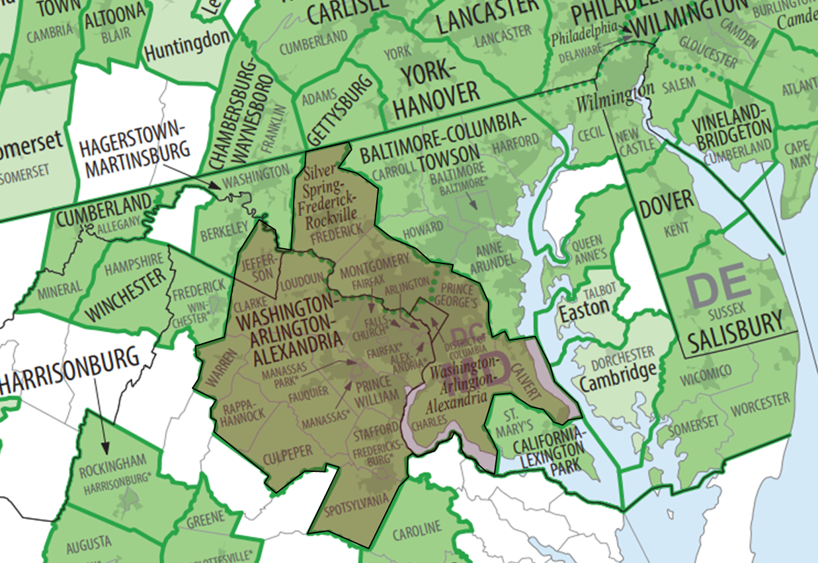
Maryland Example: MSA

Slide 47
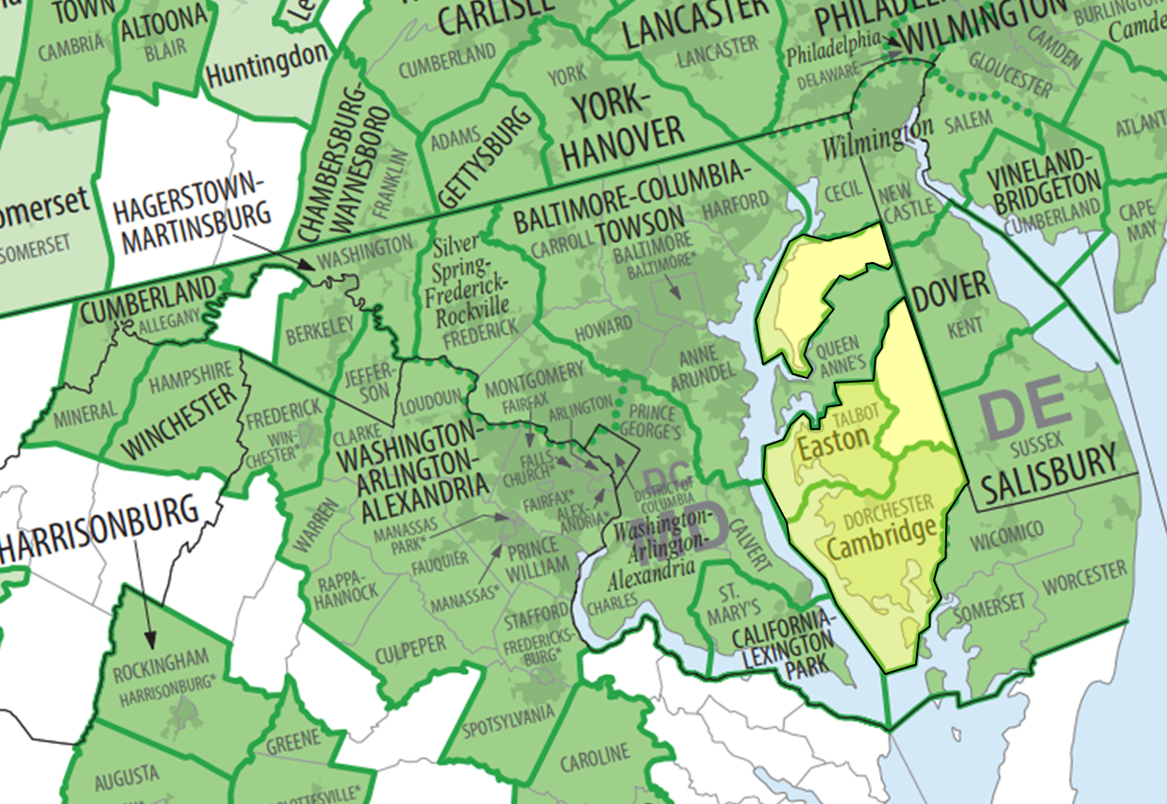
Maryland Example: non-MSA

Slide 48
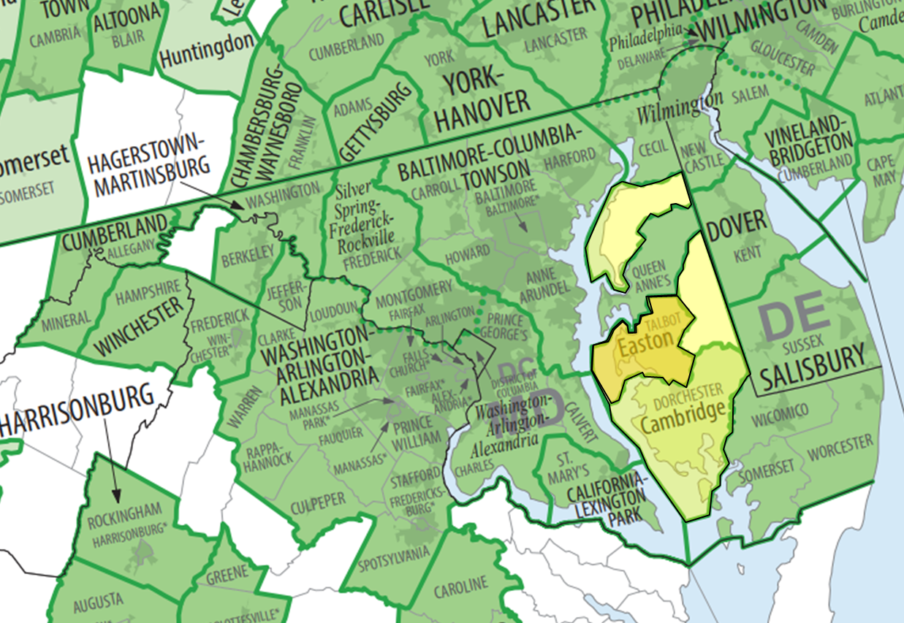
Maryland Example: µSA

Slide 49
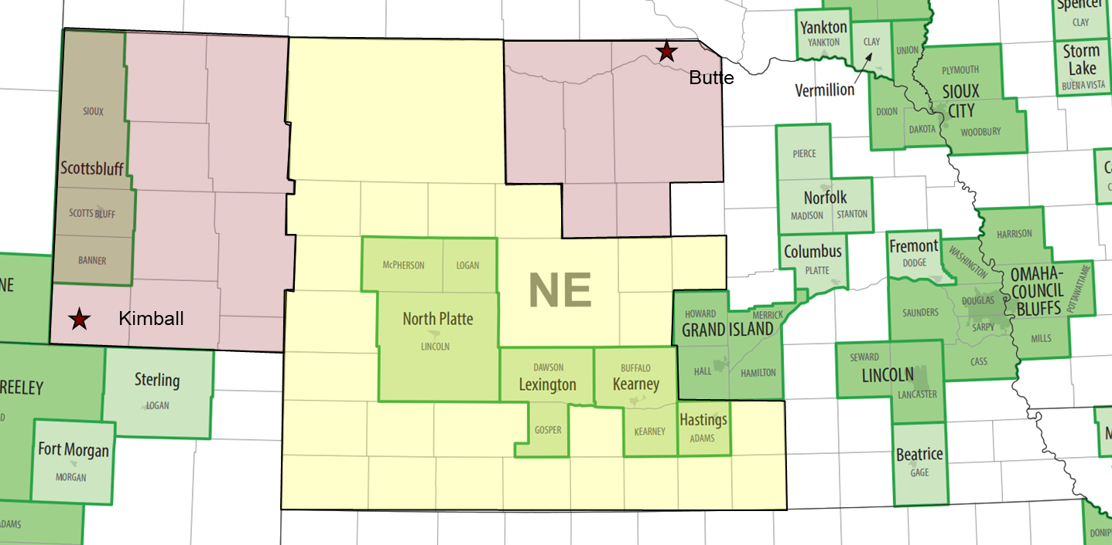
Nebraska Example: MSA, non-MSA, µSA

Slide 50
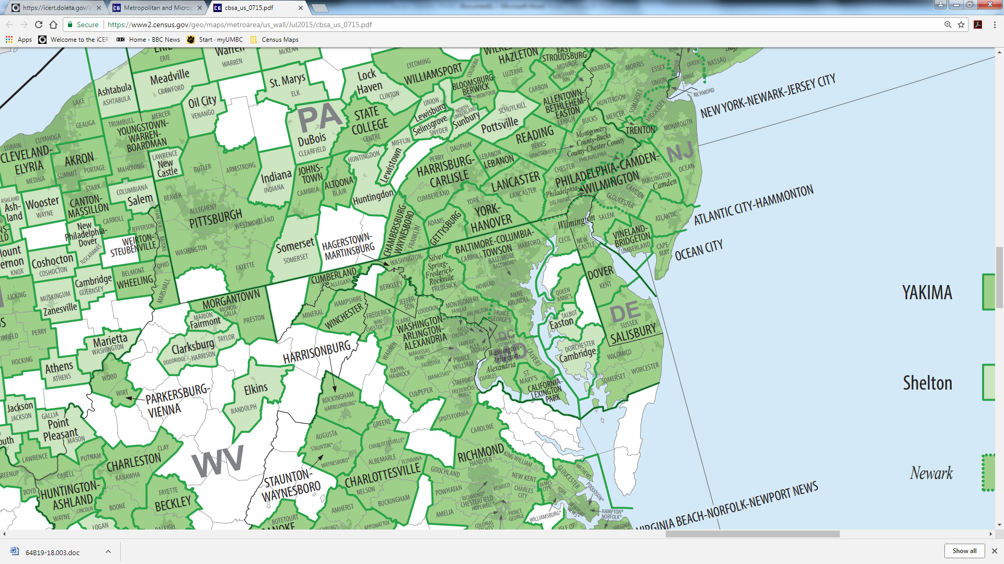
Example: Worksite Near Border of MSA
Depending on the location of the worksite, area(s) outside the MSA may also be considered to be within normal commuting distance.
MSA + additional areas within normal commuting distance = AIE
Important Note: This is not authorization to use this as the AIE.

Slide 51
Prerequisites for Expanding Survey Beyond AIE
The surveyor must first attempt to gather wage data from within the AIE.
The geographic area surveyed may be expanded beyond the AIE if the survey of the AIE includes wage data from:
Fewer than 30 workers wages; or
Fewer than 3 employers.
If expansion is permitted, the survey area may expand only as necessary to include wage data from:
At least 30 workers; and
At least 3 employers.

Slide 52
Guidelines for Expansion of Survey Area
Smallest area to meet standards.
Contiguous area (areas with economic and commuting ties have priority).
May cross state lines.
For work locations in one of the OMB CSAs, this is usually the most appropriate first expansion direction.

Slide 53
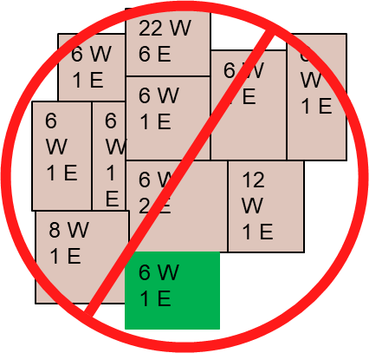
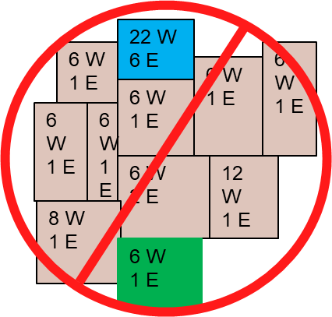
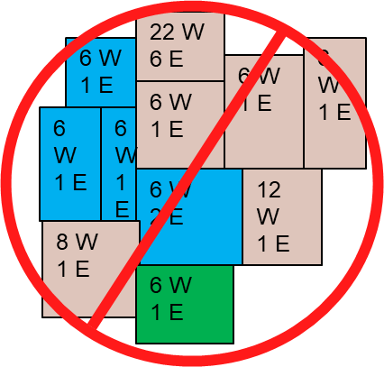
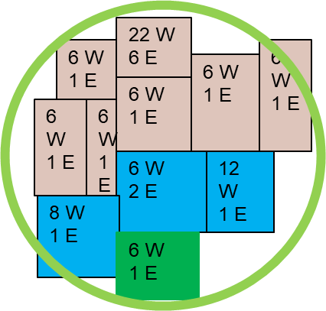
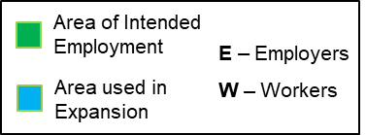
Examples: Survey Area Expanded Beyond AIE
Area does not meet standards
Area not contiguous
Area is not smallest
Area meets standard (contiguous & smallest)

Slide 54
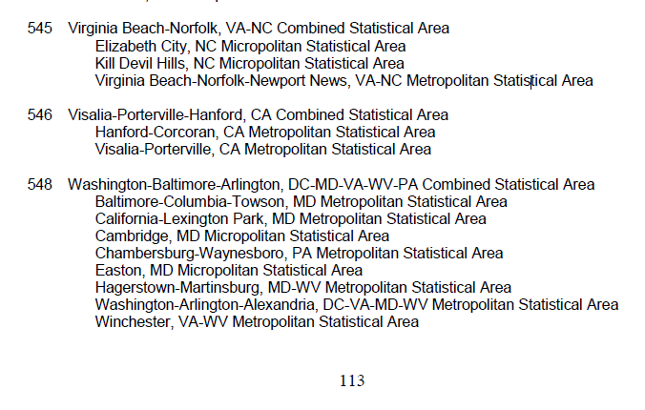
CSA Example: Maryland µSA

Slide 55
Questions

