Slide 1
Strategic Engagement: Discussion with
U.S. Departments of Labor and Housing and Urban Development
Public and Indian Housing, EnVision Centers, and Job Corps Scholars

Slide 2
Moderator and Presenters
Michelle Mills-Ajayi, US Department of Labor, Office of Job Corps (Moderator)
Debra A. Carr, US Department of Labor, Office of Job Corps, Administrator
Felicia Gaither, US Department of Housing and Urban Development,
Deputy Assistant Secretary, Office of Field Operations, Office of Public and Indian Housing
Rommel Calderwood, US Department of Housing and Urban Development, Office of Field Policy and Management
Frances “Fran” Parent, Director of Perkins Basic Grant, Lee College, TX
Joyce Young, Executive Director, Baytown Housing Authority, TX
Lance L. Wise, Director of Grants Management, Atlanta Technical College, GA

Slide 3
Agenda
Welcome and Opening Remarks
  U.S. Department of Labor, Job Corps Administrator, Debra A. Carr
  U.S. Department of Housing and Urban Development, Deputy Assistant Secretary for Field Operations, Office of Public and Indian Housing, Felicia Gaither
EnVision Centers Overview
  U.S. Department of Housing and Urban Development, Office of Field Policy and Management, Rommel Calderwood
Job Corps Scholars Program Overview
  U.S. Department of Labor, Office of Job Corps, Michelle Mills-Ajayi
Job Corps Scholars Grantees and Public Housing Authority
  Lee College, Director of Perkins Basic Grant, Fran Parent
  Baytown Housing Authority, Executive Director, Joyce Young
  Atlanta Technical College, Director of Grants Management, Lance L. Wise
Questions and Answers
Adjourn

Slide 4
Debra A. Carr
Administrator
Office of Job Corps
U.S. Department of Labor

Slide 5
Felicia Gaither
Deputy Assistant Secretary,
Office of Field Operations, Office of Public and Indian Housing, U.S.
Department of Housing and Urban Development

Slide 6
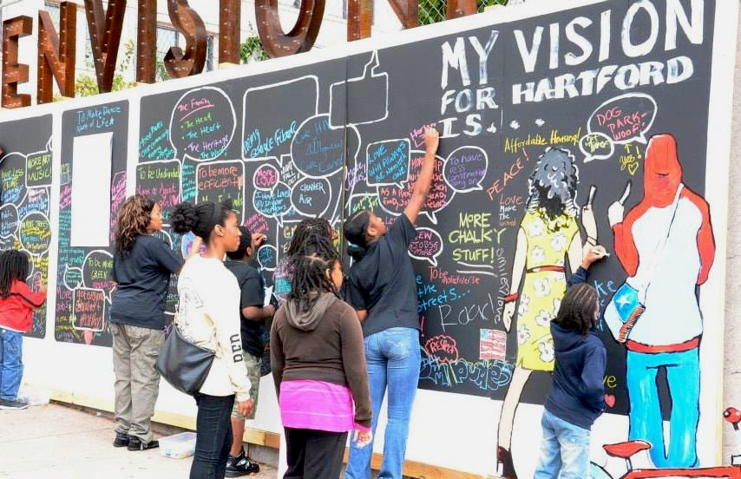


EnVision Centers
Vision
Centralized hubs to support the four pillars of
self-sufficiency within their communities
(Not limited to HUD-assisted residents or PHAs)
Target Communities
Dynamic local leadership (i.e., personal commitment by mayor, tribal official, and/or PHA director)
Existing place-based programs (e.g., ConnectHome, Opportunity Zones)
Benefits to EnVision Centers
Assistance from HUD staff in meeting EnVision Centers’ objectives to help low-income residents
Assistance with Federal Agencies who support community development initiatives
Assistance reaching a national nonprofit support network
Coordination with a national EnVision Center peer-to-peer network
Notes:
Additional resources to share:
Executive Order 13853 White House Opportunity and Revitalization Council: https://www.federalregister.gov/documents/2018/12/18/2018-27515/establishing-the-white-house-opportunity-and-revitalization-council

Slide 7
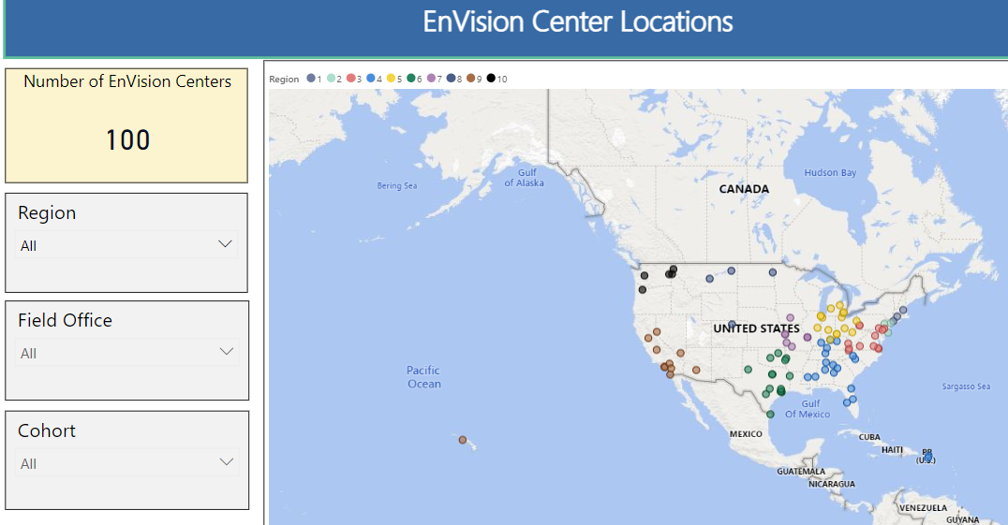
Current EnVision Centers
Visit www.hud.gov/envisioncenters for interactive map

Slide 8
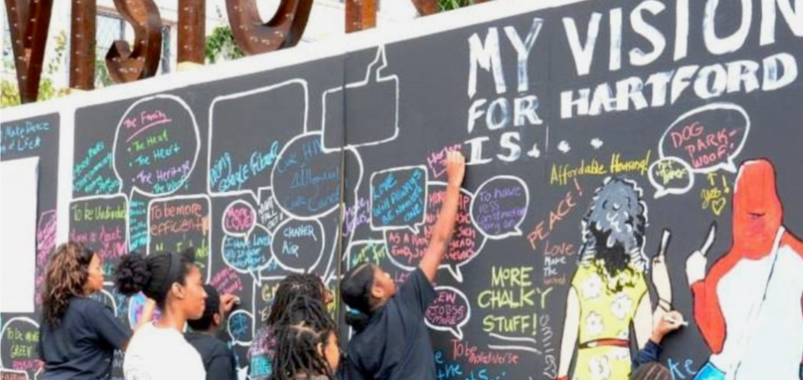

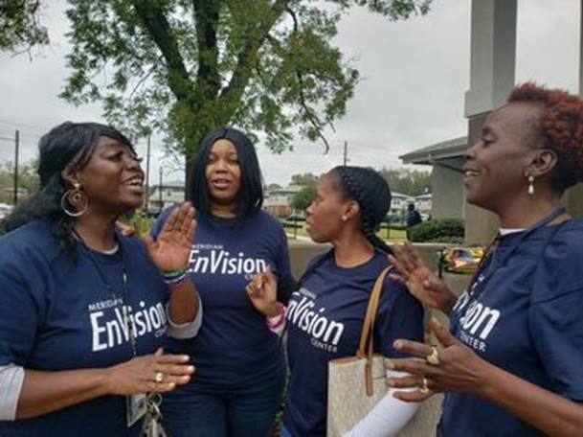


Successes to Date
Hartford, CT EnVision Center
St. Louis, MO EnVision Center
Meridian, MS EnVision Center
Designated 100 EnVision Centers
Engaged 22 Federal Partners
Engaged 9 National Nonprofits
Co-hosted 14 Federal Partner Webinars
Notes:
These successes were accomplished with federal programming and negotiating with federal partners to streamline resources, without preference points or dedicated congressional appropriation.

Slide 9









Current Federal Partners Commitments
Consumer Financial Protection Bureau
Held “Your Money, Your Goals” toolkit training
ConnectHome USA
Collaborating in promotion of affordable and accessible internet to sites
Census Bureau
Promoted and recruited for temporary census workers at EnVision Center sites
Federal Deposit Insurance Corporation
Offered free “Money Smart” financial education program
Centers for Disease Control and Prevention
Grant awarded to Hartford EnVision Centers
Department of Agriculture
Food Nutrition Services delivering presentation on available food waivers for COVID-19 response and promoted its Child Nutrition programs
AmeriCorps
Signed MOU to deploy Volunteers in Service to America (VISTAs) at EnVision Center sites. Nearly 24 VISTA grants have been awarded to EnVision Centers
Federal Trade Commission
Delivering virtual anti-fraud and anti-scam programming

Slide 10







Current Federal Partners Commitments
Department of Labor
Grantees offering career-related training, such as through American Job Centers and Job Scholars Program
Small Business Administration
Host small business roundtables and workshops
Health and Human Services
Matched Federally Qualified Health Centers with 15 EnVision Centers and PHAs, and co-hosted webinar series on telehealth best practices
Social Security Administration
Provided webinar training and computer access to its programs; launching a pilot for video-conferencing with EnVision Centers in Gary, IN and San Antonio, TX.
Internal Revenue Services
Offering free tax counseling and designating sites as VITA and TCE sites, helping clients with tax returns.
e.g. Choctaw Nation: submitted 65 tax returns resulting in $110,811 in Federal and $11,498 in State refunds; estimated $19,500 total saved/returned to Tribal members.
US Interagency Council on Homelessness
Agreed to amplify EnVision Center sites programs to their interagency partners
Veterans Affairs
Exploring delivering benefits information and services virtually and in-person.

Slide 11
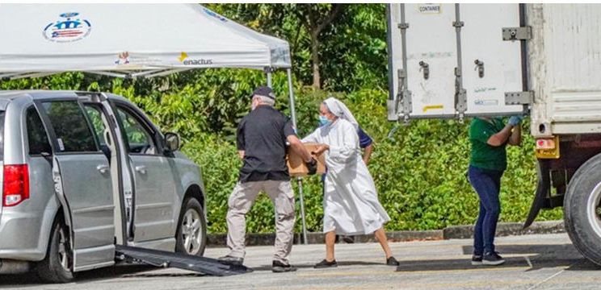
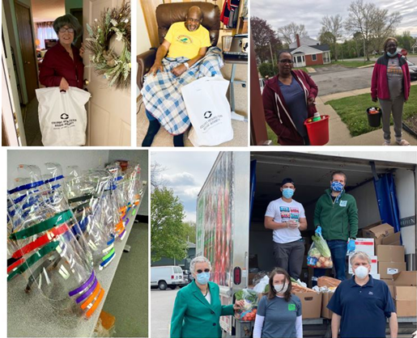
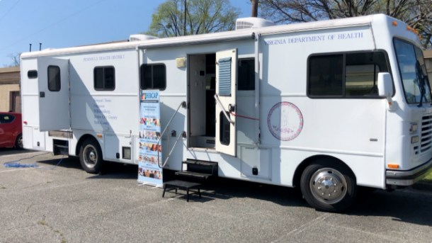
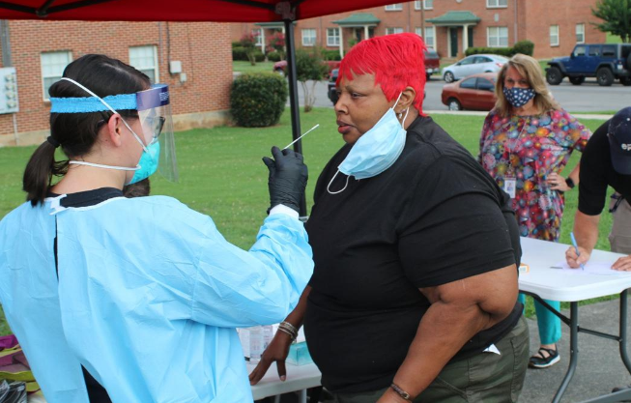
COVID-19 Response
Ponce, PR EnVision Center
Cincinnati Metropolitan Housing Agency
EnVision Center
Newport News, VA EnVision Center
Testing sites – 9 EnVision Center sites are COVID-19 testing sites
Vaccination events – 8 EnVision Center sites are providing COVID-19 vaccinations
Personal protective equipment – 28 EnVision Center site provided personal protective equipment (PPE)
Free meals and groceries – 21 EnVision Center sites are providing free meals and groceries
Other support – 23 EnVision Center sites implemented other innovative support, such as virtual tutoring, free hot spots, wellness checks via phone, online telehealth, virtual tax counseling, etc.
Rome, GA EnVision Center

Slide 12
Job Corps Scholars Program Overview
Approximately $24 million awarded to 26 grantees – public colleges and universities
Awarded in March 2020, Period of Performance (POP) – 39 months
Each grantee must serve at least 80 Job Corps eligible youth during the POP
Grantees must provide the following services under the grant:
  Up to 12 months of career technical training
  Up to 12 months of career and personal counseling
  Up to 12 months of employment counseling
Desired Program Outcomes:
  2,000 Job Corps-eligible youth served within a POP of 39 months.
  Job Corps Scholars students secure any/all of the following: 1) job, 2) enter an apprenticeship program, or 3) join the armed services.

Slide 13
Eligibility Criteria for Job Corps Eligible Youth
Number | Job Corps Eligibility Criteria
1 | U.S. Citizen/Legal Resident/Deferred Action Status
2 | Age
3 | Low Income
4 | Barriers to Education and Employment
5 | Selective Service Registration
6 | Education and Training Needs
7 | Group Participation
7 a) | Interference with other Students’ Participation
7 b) | Maintenance of Sound Discipline and Positive Center Culture
7 c) | Community Relations
8 | Understanding and Agreeing to Comply with the Rules
9 | Disqualifying Convictions
10 | Court Involvement and/or Agency Supervision
11 | Child Care
12 | Authorization for Use and Disclosure of Health Information
13 | Parental Consent

Slide 14
Program Flexibilities
Co-enrollment and Leveraged Resources Policy
Disability Waiver
Recruitment of Veterans
50% of Participants Allowable Outside of Zip Code
LMI Informed Program Offerings (colleges offer their CTT available programs)

Slide 15
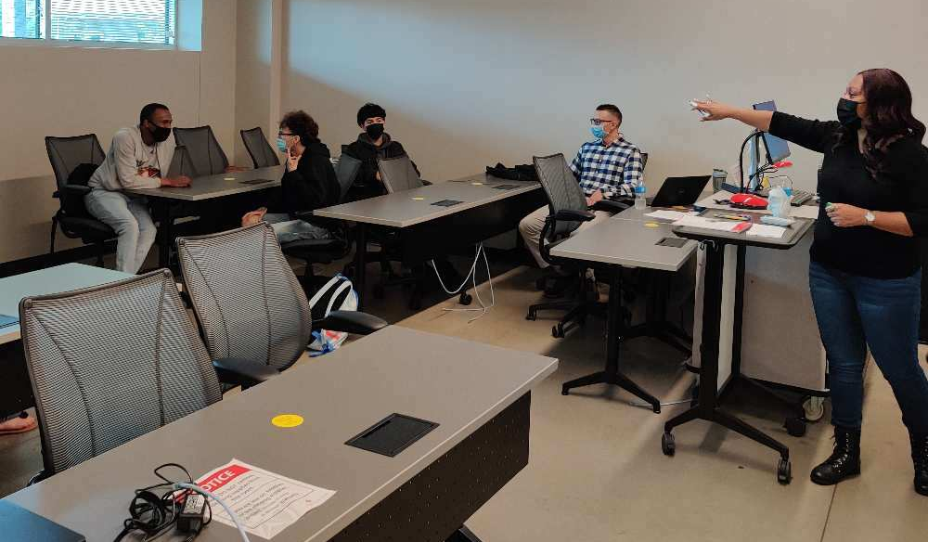
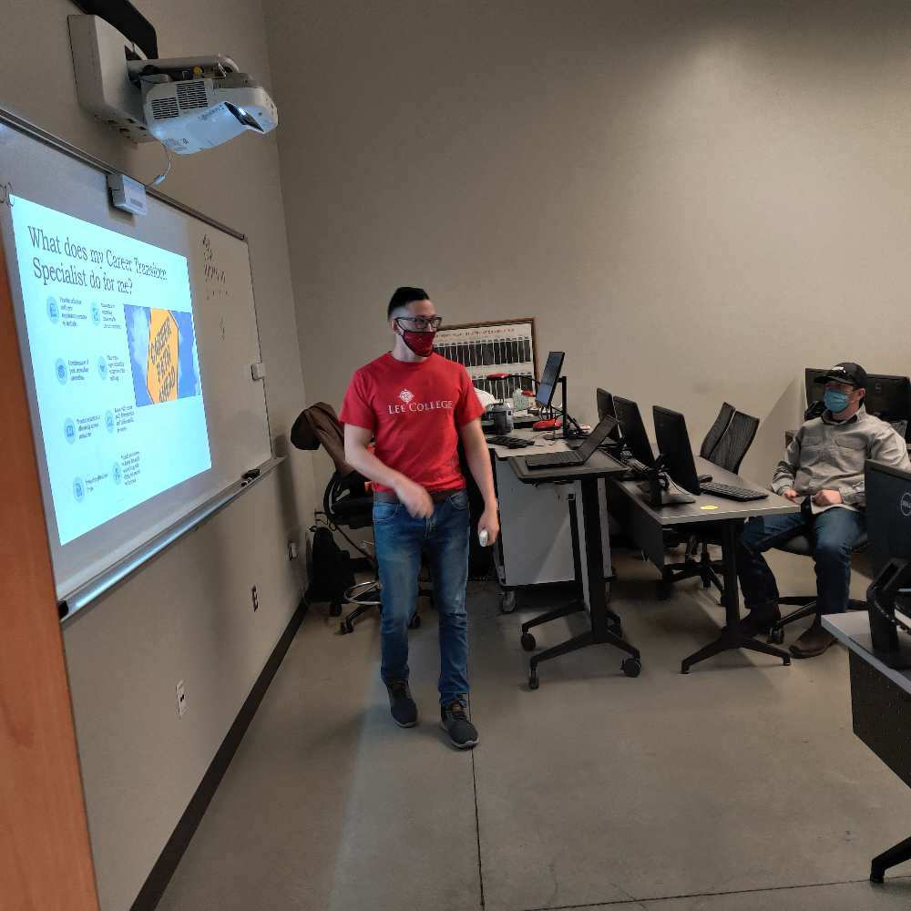
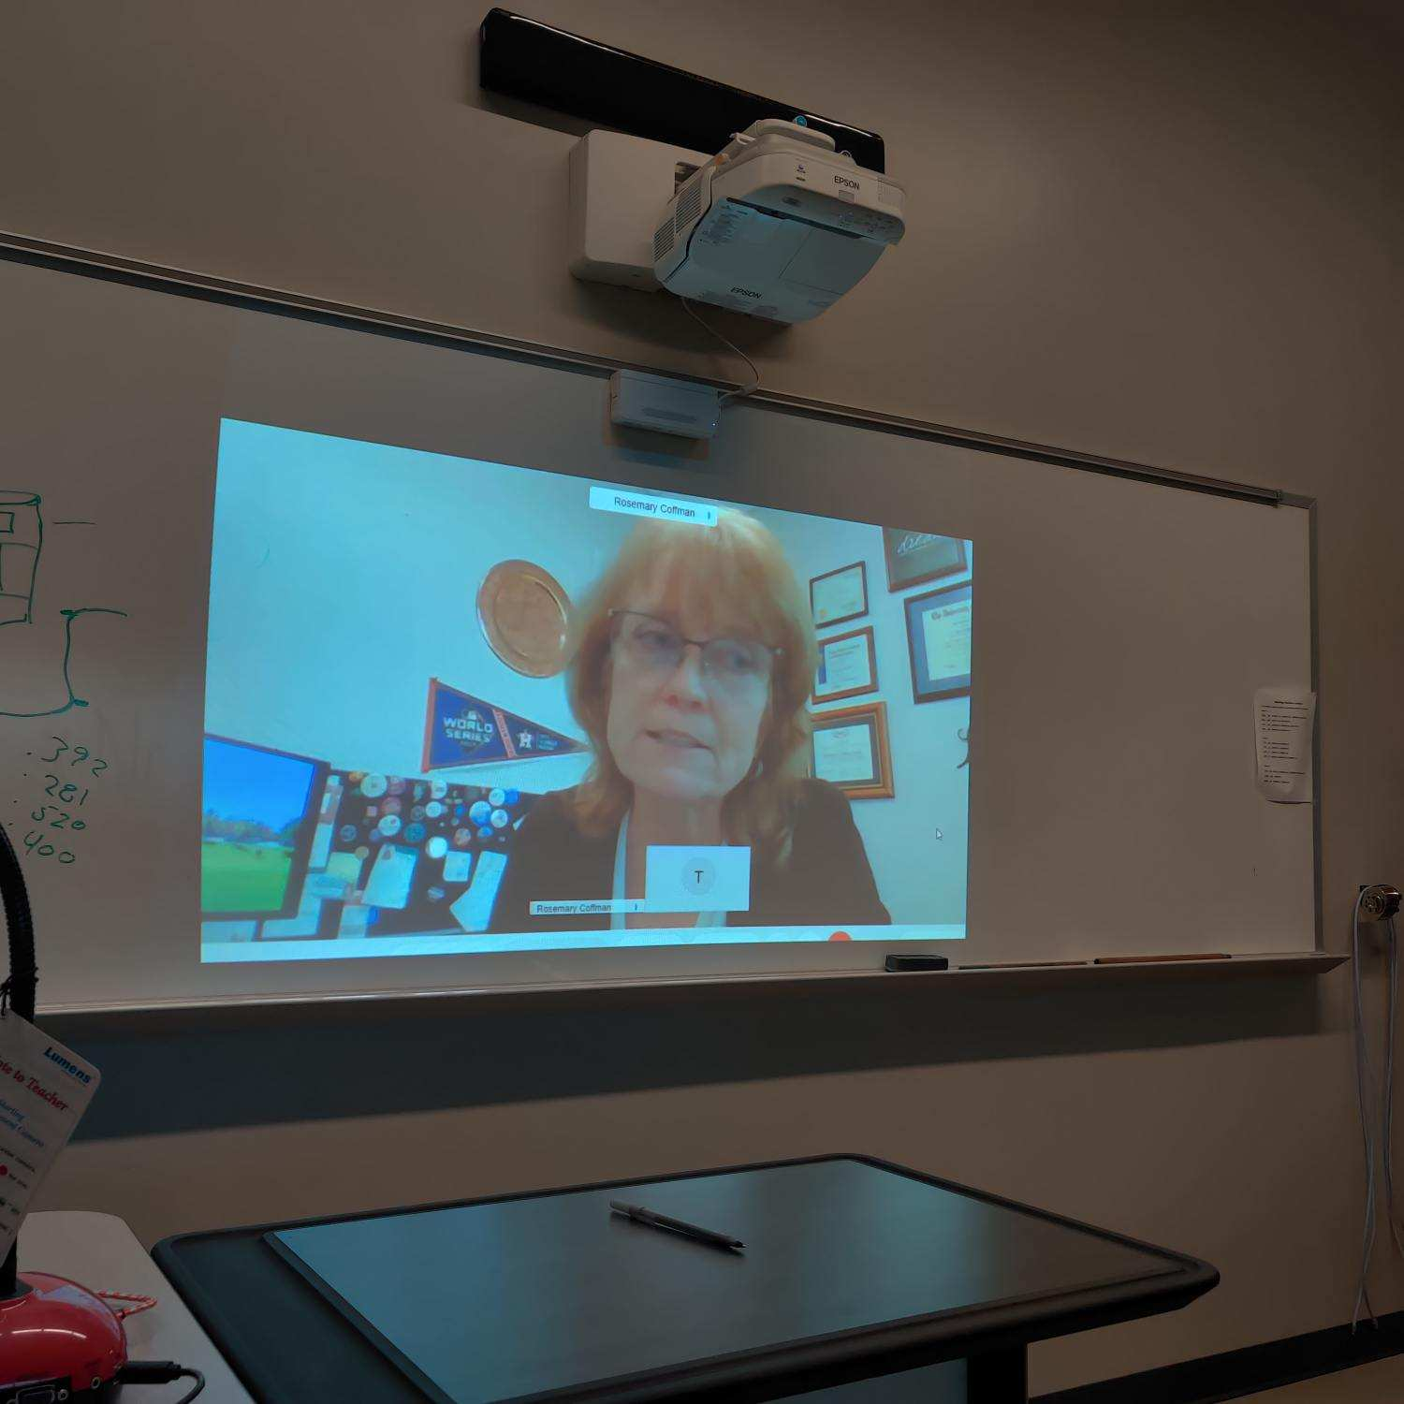
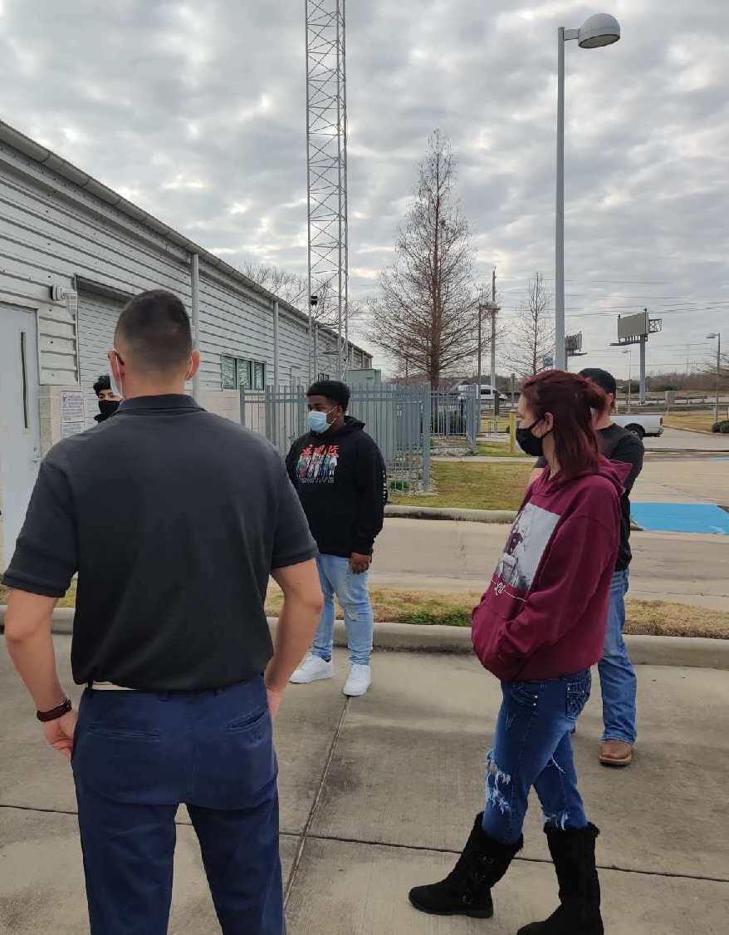

The Job Corps Scholars Grant Program
Awarded $1,182, 574 to provide certificate training in high-skill, high-growth jobs
Provide at risk youth and young adults with
  Job skills training
  Educational opportunities
  Individualized employment counseling
Ages: 16 – 24
13 Eligibility requirements
Notes:
Introduce Joyce and myself
Stats for College
Brief description of the grant,
Types of programs offered
Talk about the week long orientation – subjects covered
Program design
Fast Track or Regular semester
Recruitment & Retention advisors
Career and Transition Specialist
Cohort groups
Type of Subjects Covered
Community Service Projects

Slide 16

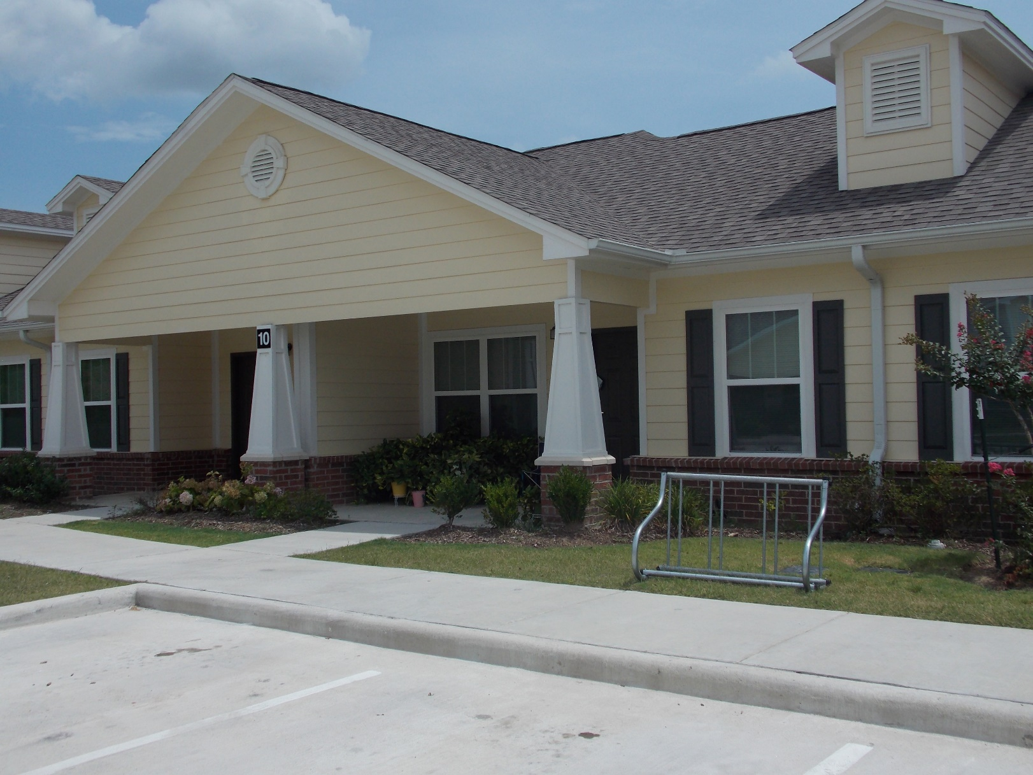





Our Partnerships
The Job Corps Scholar’s Grant Program
Strengthen our current Partnerships
Network with local organizations, agencies, and educational facilities
  WorkSource Solutions
  25 United Way Agencies
  16 School Districts
  Civic Clubs
  Faith Based Organizations
Implement a Mentoring program
Develop Apprenticeships with local Businesses
Expanding the CTE Advisory Boards to include all levels of the workforce
Local Industries
  Petroleum Companies
  Contractor Companies
Alexander Place, Baytown, TX
Notes:
Talk about the different Partnership Groups
Technical training and advisory members
Business Support
Non-profit support services
Our United Way partners provide many services to our students
Financial (support & planning)
Shelter (Homeless & rental assistance)
Food, Clothes, Transportation

Slide 17
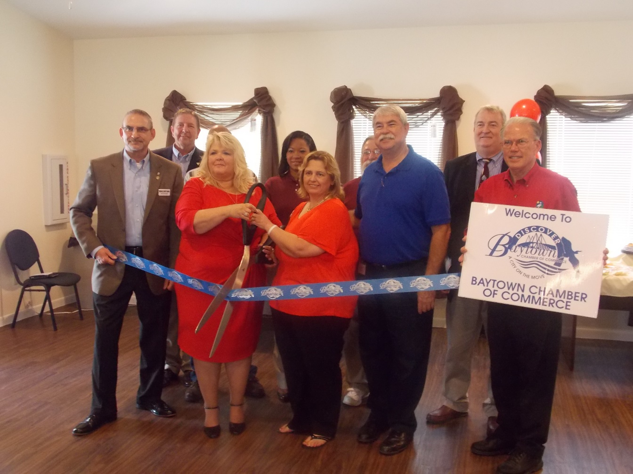
Sharing Resources
Joint Commitment
Recruitment
Highlight successful student to BHA residents and community partners
Identification of Barriers
Collaboratively seek solutions
Lee College
29 Educational Programs
Tuition, Fees, Books, Training equipment,
Transportation (Gas Card, Bus tickets, etc.
Technology Equipment, WIFI access
Childcare
Cohort Meeting
  A few topic
Instructors that are embedded in local industry
  Up to date on latest technology
  Refer students to job opportunities
Baytown Housing Authority
Community Center for Outreach services
  Available Computers & Tables
Marketing the JCSP Program to residents and community
  Offer information flyers and PHA locations and HCV through email and BHA’s Website
BHA Staff Support
Notes:
Joyce introduce the partnership
Give your background
Joyce and Fran’s involvement in the community

Slide 18
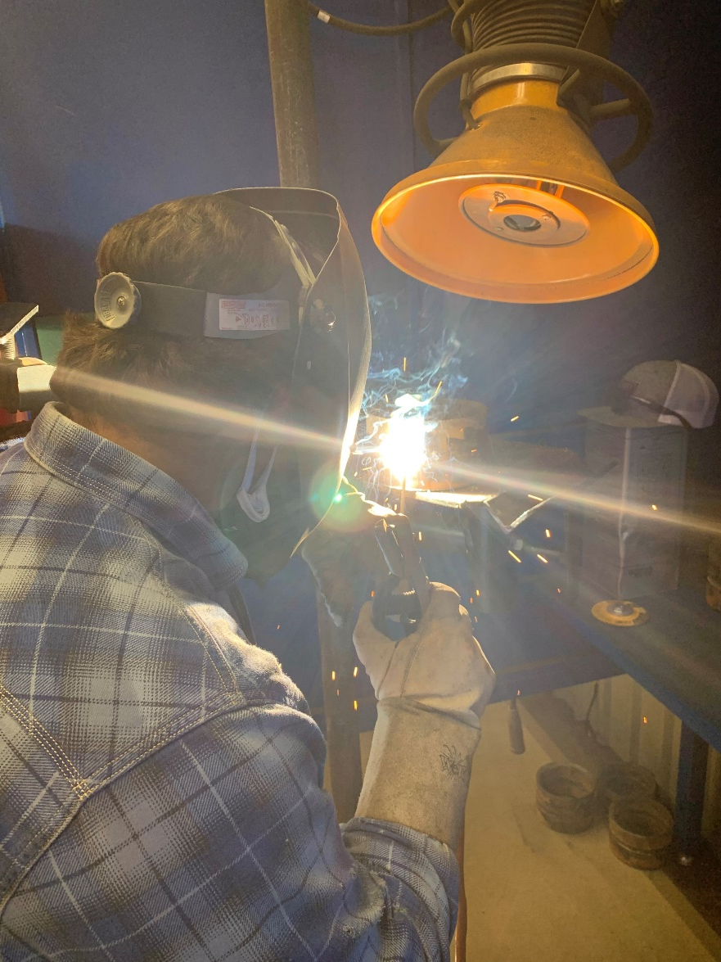
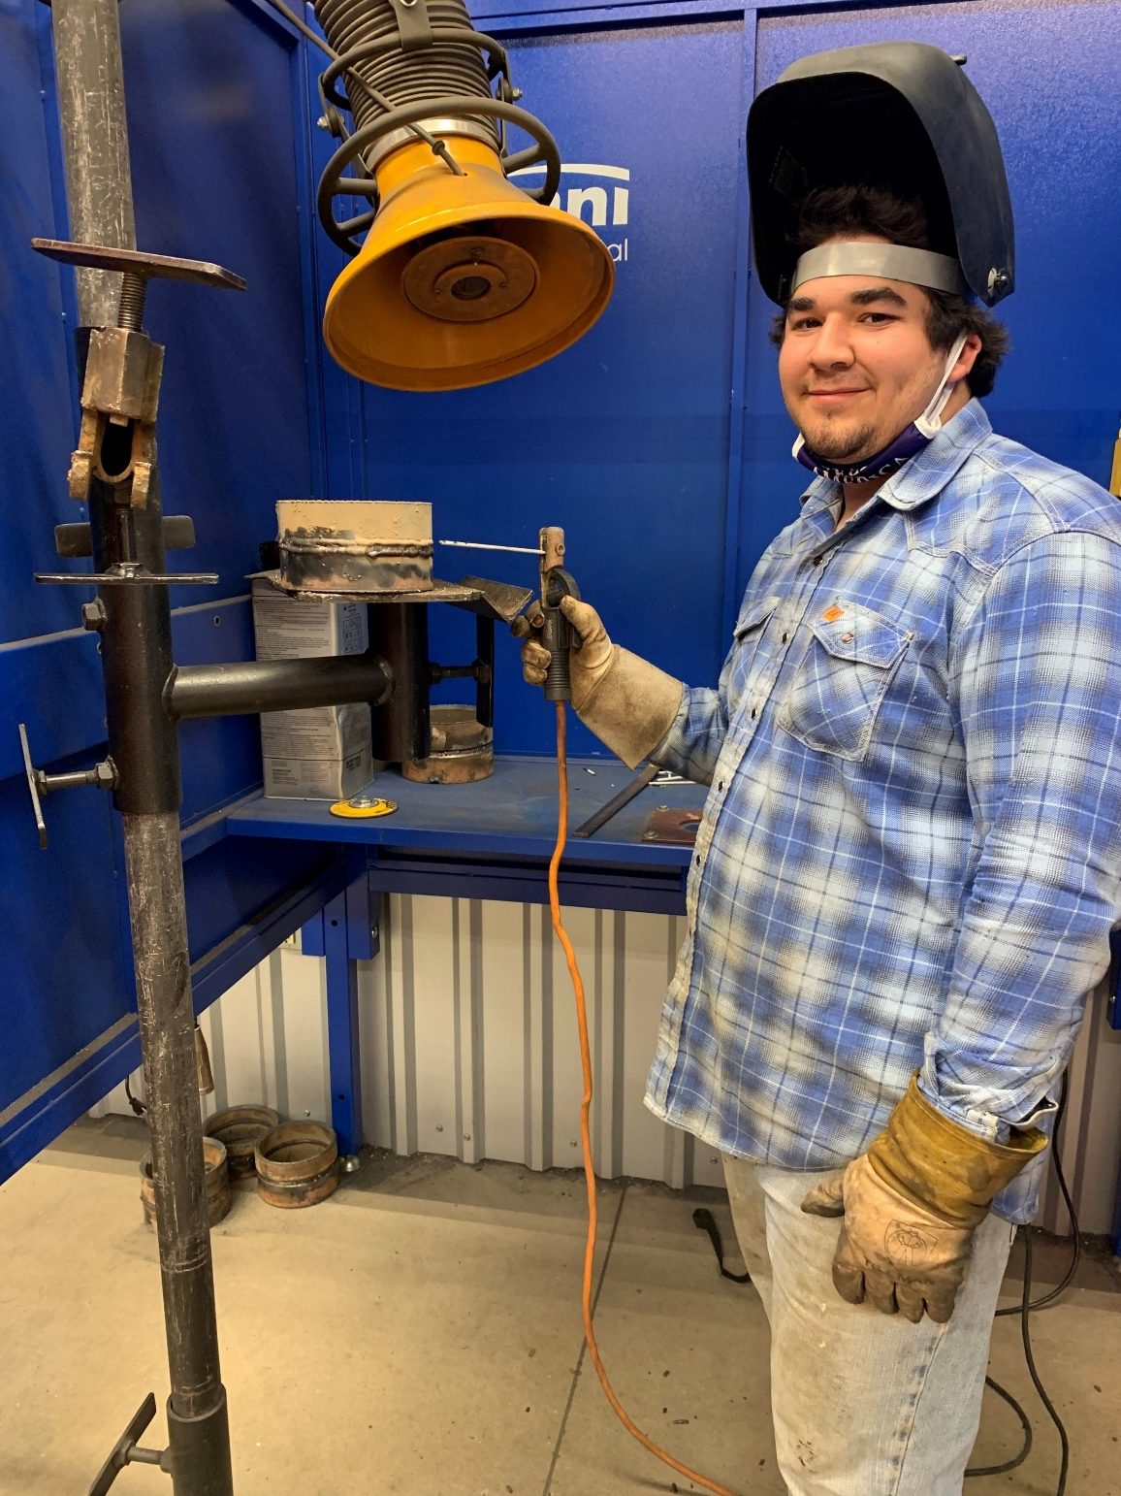
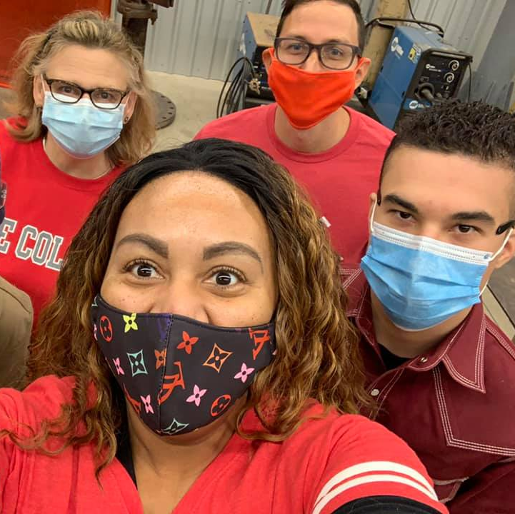
Success Stories
Brian – Age 20
Welding Student
Secured a Welding Helper position at $14.00 hour at KNCS Industrial
Work Schedule
7:00 am – 4:00 pm
Classes Monday – Thursday, 6:00 pm – 9:55 pm
Aaron – Age 19
Welding Student
Welding at a G6 Level
Continuing his Lee College Welding Certification

Slide 19


Atlanta Technical College CWI Pipeline Partners
March 11, 2021

Slide 20
Why are we here?
Context
The Atlanta Committee for Progress commissioned McKinsey to do a benchmarking study comparing Atlanta to other major cities. The study found that Atlanta had key areas for improvement in workforce development including:
The worst inequality (9 points above the median)
The second highest poverty rate (representing a quarter of citizens and 5% above the median)
Significant unmet labor demands in key industries including technology; instillation, maintenance, and repair; and transportation and logistics representing >53,000 unmet jobs
To reach the economic median, Atlanta would need to train and place at least 10,000 incremental graduates into living-wage jobs
If you believe:
Then you can believe:
No one entity has the capacity to scale to meet Atlanta’s entire demand
No one entity meet every customer’s need
The need exists for greater coordination and collaboration of services
The need exists to build Pipeline Partners
3

Slide 21
Atlanta performs worse than peers on measures of economic inclusion
Best in region
Inequality – City level
95/20 ratio¹
Atlanta |  | 18
Austin | 8
Charlotte | 8
Dallas | 11
Houston | 10
Miami | 12
Raleigh | 7
Southern
median²
Poverty – City level
% of people below poverty line
Atlanta
25
Austin
18
Charlotte
17
Dallas
24
Houston
22
Miami
28
Raleigh
Southern median²
16
20
1 The Brookings 95/20 ratio is aggregate income of 95th percentile divided by aggregate income of 20th percentile 2 Excludes Atlanta for comparison purposes
SOURCE: U.S. Census Bureau, 2011-2015 American Community Survey City-level 5-Year Estimates
4

Slide 22
What is the goal of the Pipeline Partnership, and how are we going to get there?
Goal of the Pipeline Partnership: A world-class workforce development ecosystem for Atlanta that creates:
A network of seamless mutual referrals to increase access to all of our resources and give customers multiple pathways to sustainable employment leading to economic mobility.
A coordinated community effort that supports the customer holistically they integrate into and progress within the workforce.
Identify the top partnership opportunities
Map the processes for each opportunity to benefit the customer
Track referrals, evaluate progress, and identify process improvements

Slide 23

Goal #1: A network of seamless mutual referrals to improve the customer’s experience in our partnership
Referred for:
Additional supportive services
Initial training or education services
Benefit:
Benefit:
Higher number of customers served and greater community impact
Increased enrollment and number of graduates entering the workforce
Pipeline Partners
Referred for:
Technical Education
Sustainable and/or advancing employment

Slide 24








Goal #2: A coordinated community effort that supports the customer holistically as they integrate into and progress within the workforce.
ILLUSTRATIVE
5A) Youth receives a job with a Home Depot construction Pro
3B) Youth receives an internship then job with SunTrust in network repair
4A) Youth continues upskilling at ATC-CWI after completing Construction Ready program
2B) Youth receives support while in school.
1B) Youth enroll in ATC directly to receive TCC or diploma approved under JCSP
3A) Youth exposed to skilled trades through CEFGA K- 12; Receives initial training through Construction Ready
1A) Atlanta Housing Authority identifies family with youth 16-24 to enroll in the Job Corps Scholars Program (JCSP).
2A) Youth's family connected with YMCA for discounted health and activity services.
To help facilitate this coordination ATC-CWI will:
Host Pipeline Partner fairs on-campus to connect you all with the community
Joint marketing efforts both on campus and in the community
Notify CWI students about your services through AdmitHub text campaigns
Explore dedicating space on-campus for your teams to regularly use
Offer enrollment days at your facilities and communities
Discussion panels where CWI faculty/students talk about vocational education with your customers/students
Mutual website listings to drive customer journey traffic

Slide 25
Questions and Answers
Let Us Hear From You!

Slide 26
Resources
¶
Job Corps Scholars Program Website - https://www.dol.gov/agencies/eta/jobcorps/job-corps-scholars
Program Manager for Job Corps Scholars– Michelle Mills, mills.michelle.v@dol.gov
Federal Project Officer for Job Corps Scholars – Angela Dayton, dayton.angela@dol.gov
Job Corps Scholars Mailbox to submit inquiries – JobCorpsScholars@dol.gov

Slide 27
Thank You!

