Slide 1


Employees’ Compensation Operations and Management Portal (ECOMP)

Slide 2
ECOMP Contacts at DFEC
Christopher Revenaugh – ECOMP Agency Liaison
Derek Tukenmez – ECOMP Agency Liaison
Julia A. Tritz – Chief, Technical Assistance

Slide 3
ECOMP Overview
ECOMP is a web-based application accessible via the DOL public Internet site. Through this portal, federal workers and their employers may:
  Electronically file OSHA 301s, CA-1s, CA-2s, CA-7s and CA-6s;
  Track the exact status of any form or document submitted via ECOMP (e.g., Pending Supervisor Approval, with Agency Reviewer, Received by OWCP, etc.); and
  Electronically upload and submit documents to DFEC’s case files.

Slide 4
ECOMP Advantages
Provides a solution for filing forms electronically with no cost to users or employing agencies
Supports the submission of attachments by employees, witnesses, supervisors, medical providers, etc.
Publicly Accessible on the web, requiring no special downloads
ECOMP will assist users in completing forms
Ensured support for form or process changes, since OWCP manages the site.

Slide 5
Who Benefits from ECOMP
Agencies
  Those without electronic filing capability can now participate at no cost
  ECOMP will notify authorized agency personnel of form inactivity using email blasts. This will assist agencies in tracking their POWER Initiative performance.
Claimants
  Claims will be delivered more quickly and with supporting evidence, allowing for faster case-creation, adjudication, benefit delivery and improved customer service.
  They can get the status of their forms directly from ECOMP instead of contacting OWCP or their employer for updates
DFEC
  Reduction in contractor costs for data entry during case creation
  Reduction in handling of paper
  Attachments will allow DFEC to potentially adjudicate cases without any development
  Quicker adjudication of claims promotes faster intervention in cases requiring disability management.

Slide 6
Starting the Process – The MOU
DOL and the agency enter into a Memorandum of Understanding (MOU) which establishes an agreement for the transferring of data between ECOMP and iFECs.
All or part of an agency may participate in ECOMP; however, sub-agencies may not enter into an MOU unless sanctioned by their parent agency.
MOU must be signed by your agency’s Designated Approval Authority (DAA)
OWCP Acting Director Gary Steinberg is DOL’s DAA

Slide 7
ECOMP MOU
MOU Steps:
  Request MOU from Julia Tritz, TA Branch Chief (Tritz.Julia@dol.gov)
  Review and respond with any comments or requested revisions
  Once approved, two copies of MOU signed by Mr. Steinberg will be sent
  Return one copy signed by your DAA, keep one copy for your records

Slide 8
ECOMP MOU
Post-MOU:
  You will be contacted for assistance with initial setup of Agency Maintenance functions
  You will be provided with access to the ECOMP training site
  Agency Toolkit will be provided to introduce ECOMP to your agency
  Designated OWCP staff will be available to support you

Slide 9
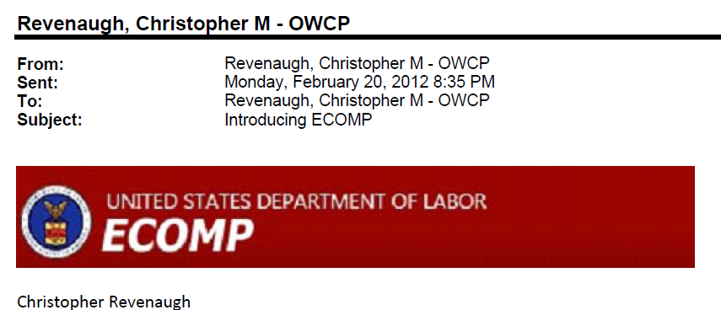



Agency Toolkit

Slide 10
ECOMP Training Modules
Training modules are available on the ECOMP home page
Printable text instructions
Narrated videos demonstrating how to perform functions in ECOMP
Modules available for all users from the injured worker filing a form to the National Workers’ Compensation Program Manager managing ECOMP for the agencyand everyone in between

Slide 11
ECOMP Training Modules
Self- guided training modules provide detailed instructions to users
  Claimants and Supervisors receive instructions on how to file and track forms.
  Safety and workers’ compensation staff are provided training on how to review forms and track work flow
  National Program Managers are provided with instructions on how to structure ECOMP to best manage the agency’s workers’ compensation program

Slide 12
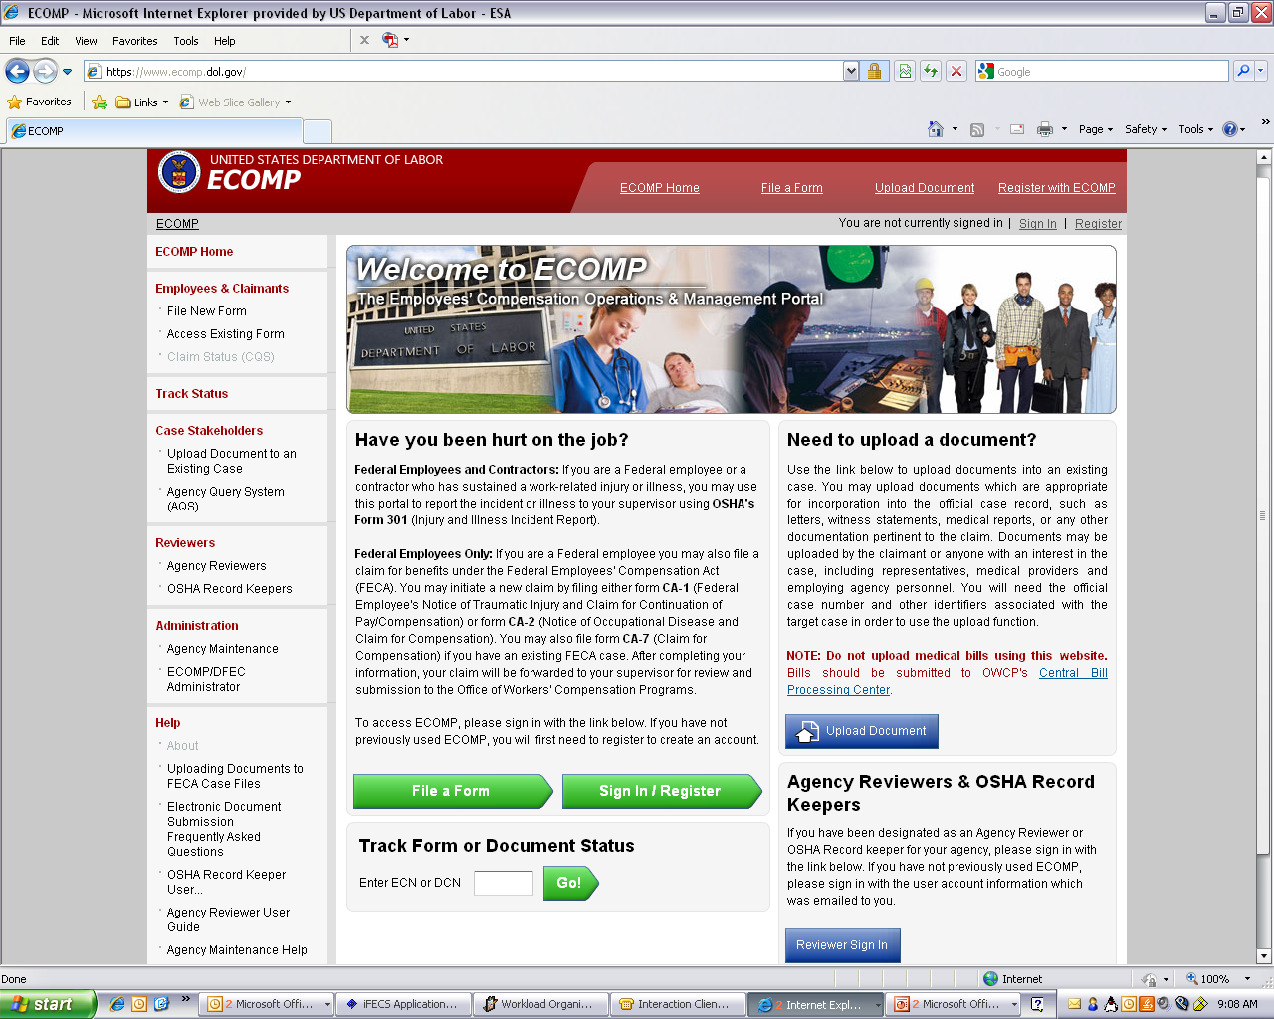
ECOMP Training Modules

Slide 13
ECOMP Test Drive
Once the structure is completed, the agency hierarchy is loaded into a special version of the ECOMP system.
This “playground” is identical to the production version of ECOMP in every way
Allows agency users to become familiar with the look, feel, and function of ECOMP before having to work with live data.
Once you are comfortable with the system and have fine-tuned your structure and settings, the structure and settings are loaded into production (test data is not).
This unique approach ensures that when you go live, the system responds exactly the way you want it to respond.

Slide 14
Setting up your Agency Hierarchy
ECOMP provides agencies with the flexibility to customize your agency hierarchy in ECOMP with 2 benefits:
  This allows you to provide meaningful geographical job site information to the claimants without changing your agency chargeback structure in iFECS
  You can assign safety and workers’ compensation management functions to appropriate staff for their assigned areas/locations

Slide 15
Agency Hierarchy in ECOMP
Department
  Agency Group
    Agency
      Division
        Duty Station
Agency Groups are created to manage sub-organizations with similar needs
Structure will vary depending on size of department/agency

Slide 16
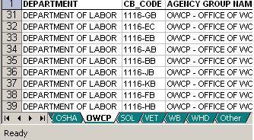
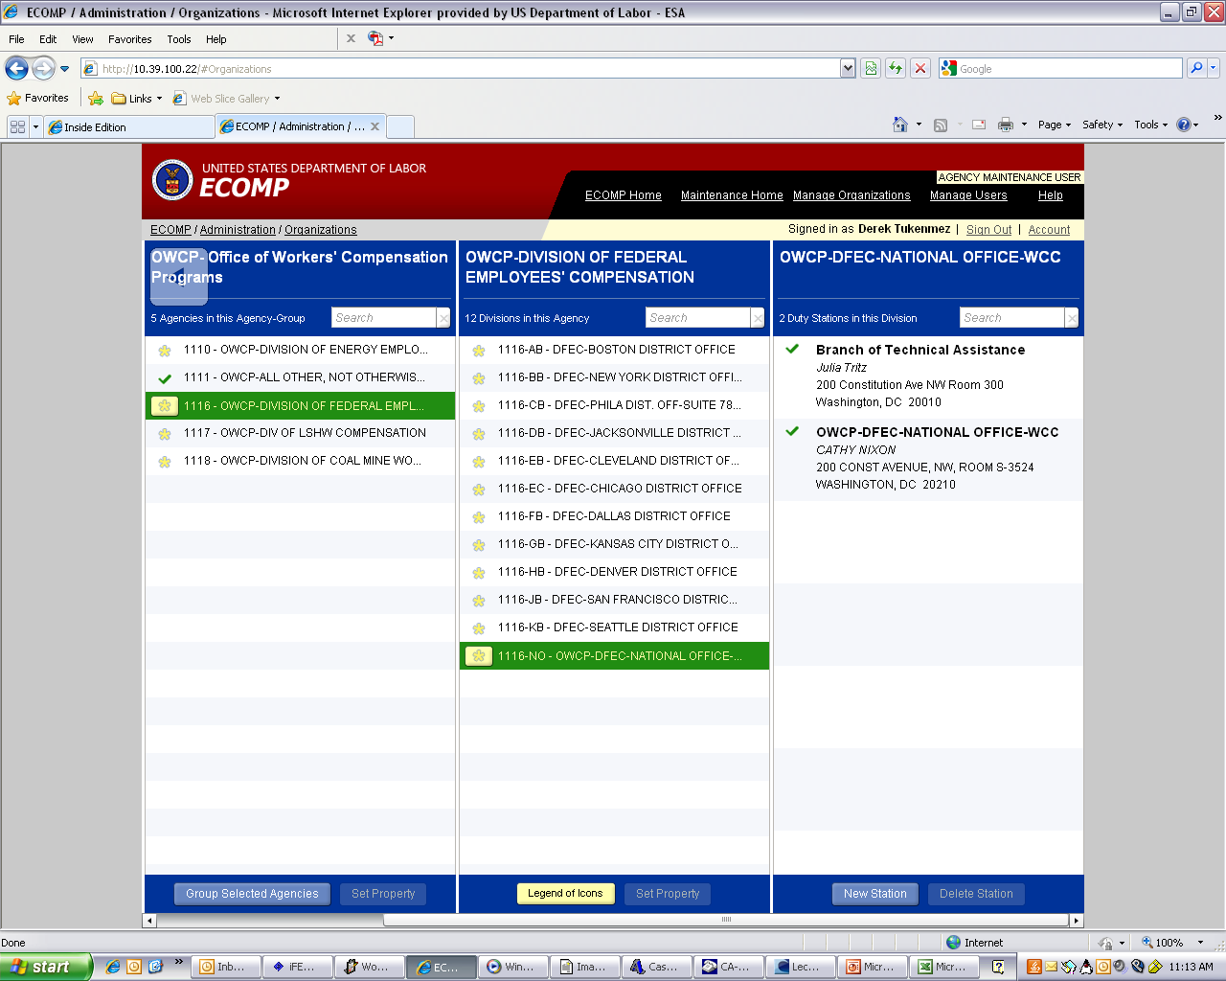
Agency Hierarchy in ECOMP

Slide 17
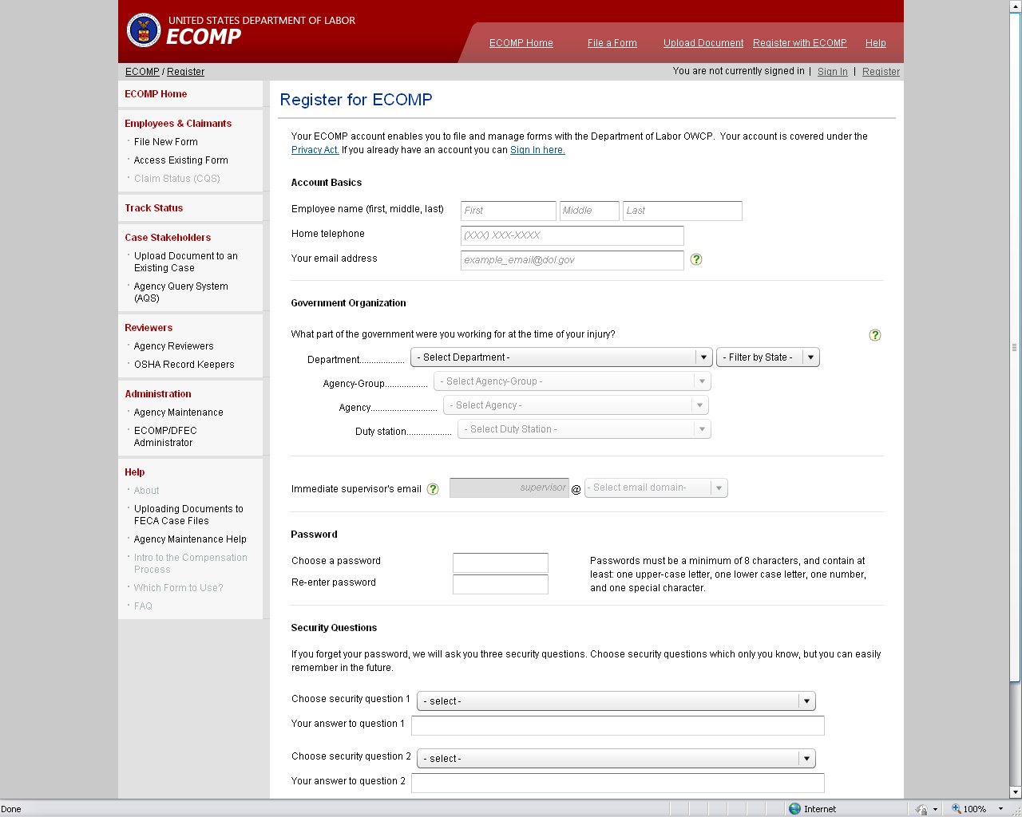
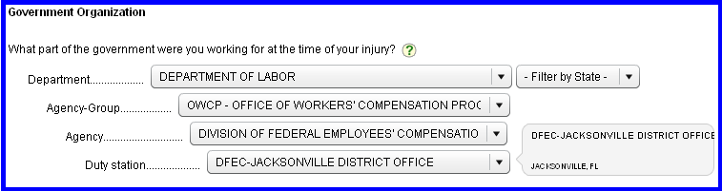
Agency Hierarchy – Employee Registration

Slide 18
User Roles in ECOMP
Agency Maintenance User – ECOMP Power User at the Agency
Agency Reviewer – Injury Compensation Specialist at the Agency
OSHA Record Keeper – Safety staff at the Agency responsible for OSHA reporting
Employee – Manages own account and registration
Supervisor – No account needed

Slide 19
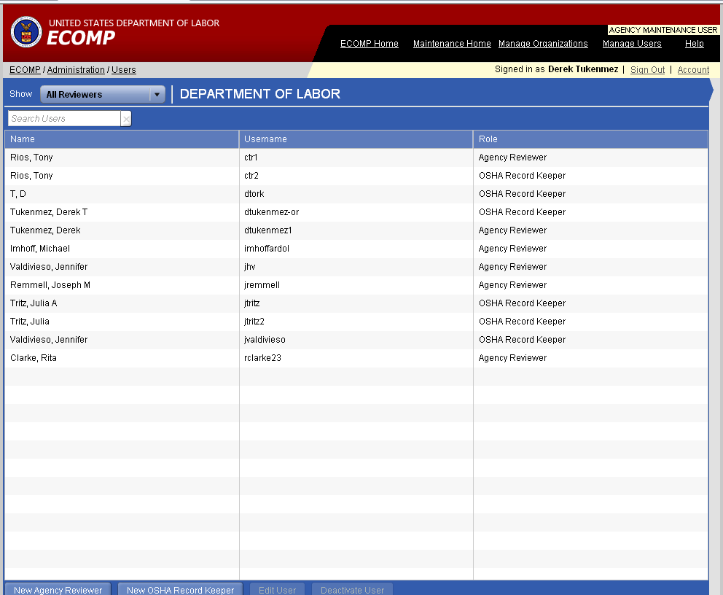
User Management

Slide 20
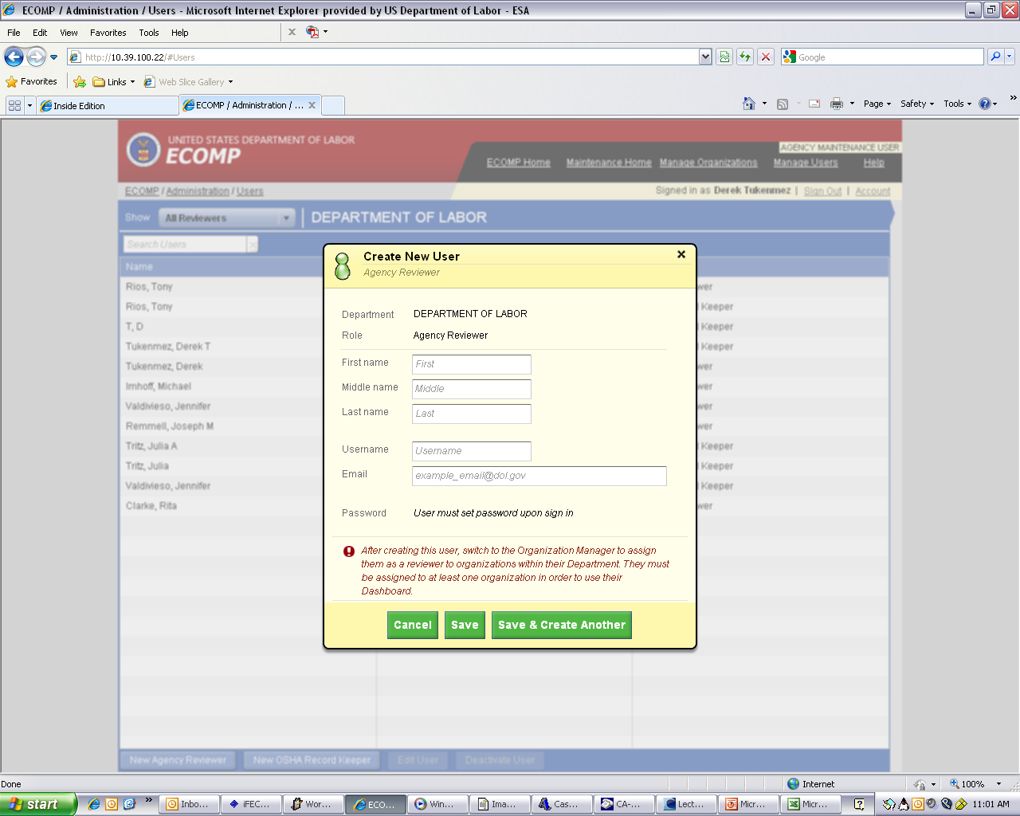
Adding a User

Slide 21
Assigning Users
Once you have created your agency hierarchy and created accounts for the ARs and ORKs, you can create settings for you Department/Agency Group/Agency, etc.
This includes choosing what forms can be filed, when you would like notifications to be sent on form status, and the ARs and ORKs responsible for each agency.

Slide 22
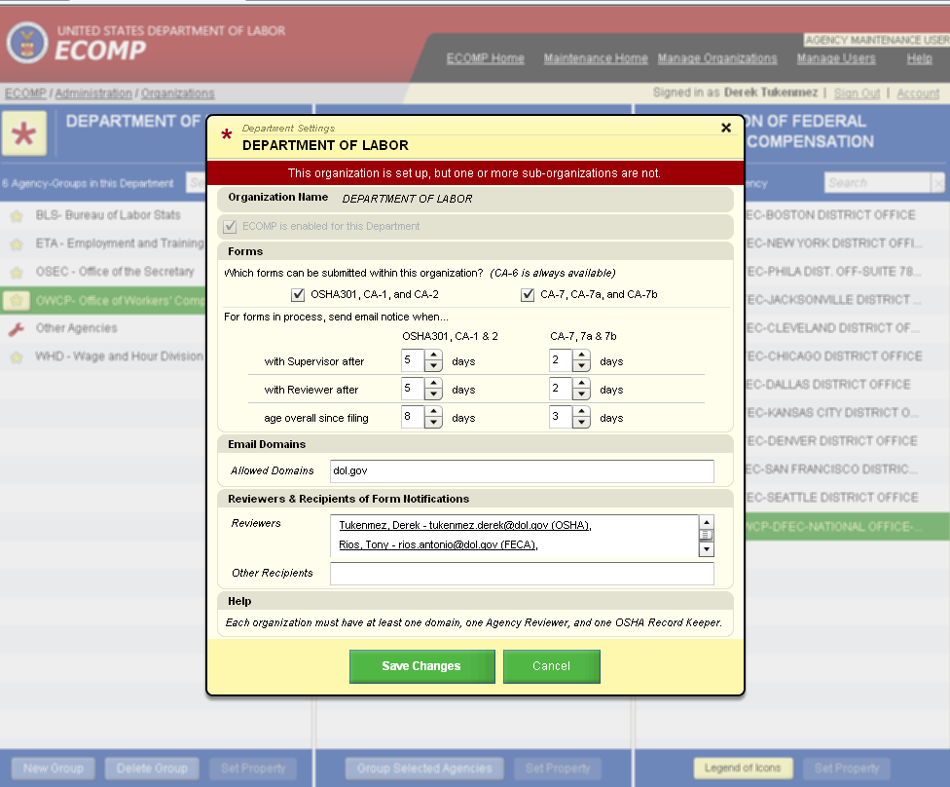
Agency Maint. / Dept. Settings

Slide 23
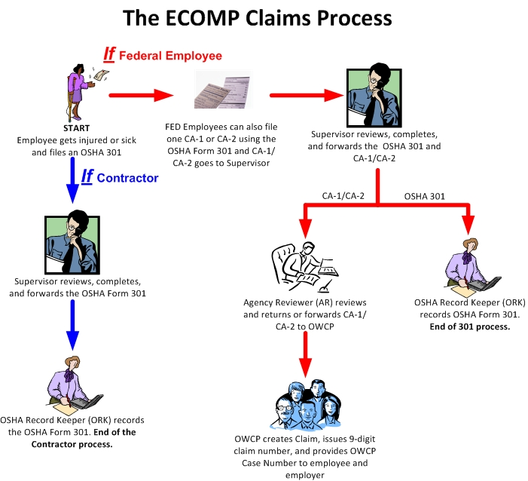
ECOMP’s Workflow

Slide 24
AR Workflow Management
In addition to the email notifications, you will have access to an Agency Reviewer Dashboard. You can log in each morning and view:
  Claims awaiting your review
  Claims awaiting Supervisor Review
  Claims you filed on behalf of the injured worker
  Claims rejected by DFEC
  All claim forms

Slide 25
Coming Enhancements
In the next phase of ECOMP, additional forms will be available for electronic submission:
  CA-7a: Time Analysis Form
  CA-7b: Leave Buy Back
  CA-6: Report of Employee Death

Slide 26
Coming Enhancements
The next phase of ECOMP will also include report functionality:
  OSHA 300/300a Injury and Illness logs
    Will be populated from information entered on OSHA 301 forms
    May be edited by ORK
  Injury and Occupational Disease Trends
  Real-time POWER Timeliness reports
    CA-1 and 2 and CA-7 real-time submission timeliness
    Can be run for specific Bureaus or locations (based on Chargeback code)

Slide 27
Coming Enhancements
ECOMP will continue to evolve and be enhanced based on our experiences and feedback received from our customers
Any changes to FECA procedures, forms, etc. will be implemented in ECOMP by OWCP

Slide 28
ECOMP User Testing
ECOMP has undergone several weeks of User Acceptance Testing
  Four agencies participated in the testing: Department of Labor, Department of Justice, Department of Homeland Security (ICE), and the Federal Bureau of Investigation
  The first agency slated to go live with filing forms in ECOMP is the FBI. To talk briefly about ECOMP from an agency’s point of view, please welcome Michael Huff.

