Slide 1
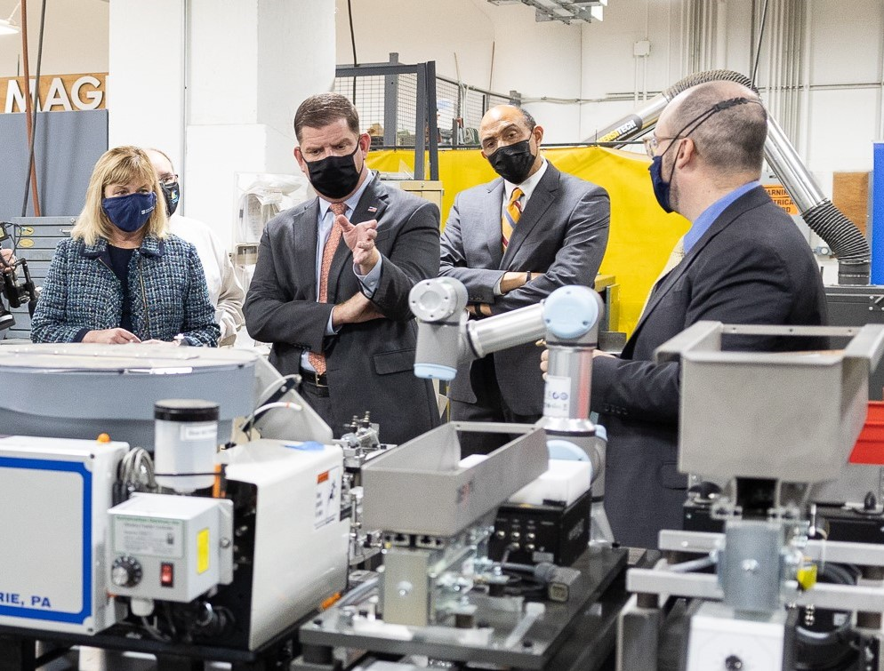
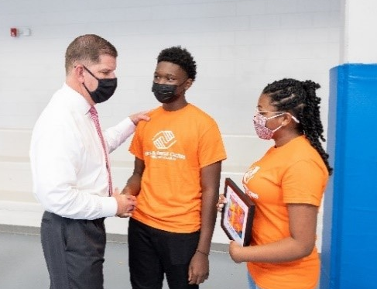
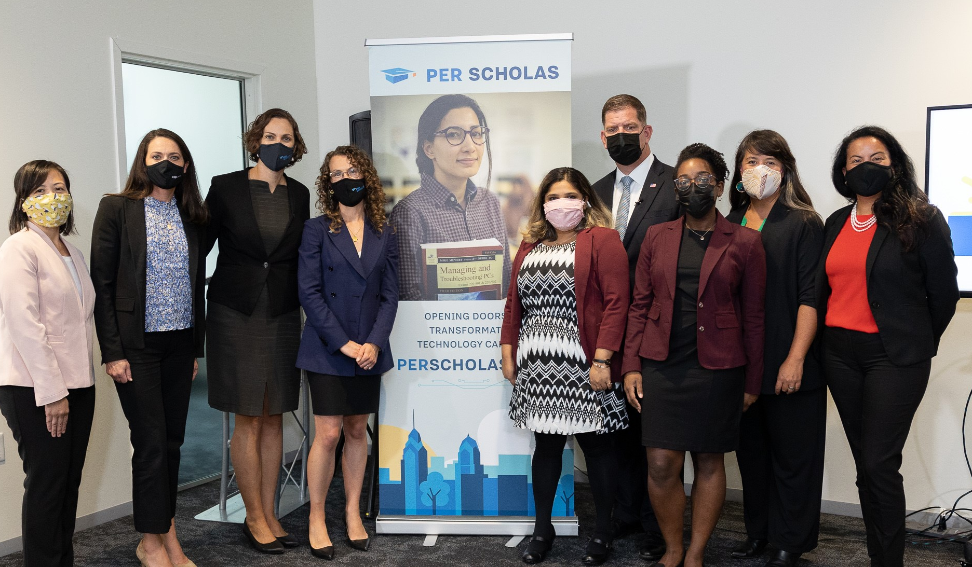
Grants and Funding Opportunities
WHAT THEY ARE. WHO THEY SERVE. HOW TO GET CONNECTED.
Information as of August 9, 2022

Slide 2
Empowering All Workers

Slide 3
Who You Will Hear From Today:
Employment and Training Administration
International Labor Affairs Bureau
Women’s Bureau
Office of Disability Employment Policy
Veterans’ Employment and Training Service
Occupational Safety and Health Administration
Mine Safety and Health Administration
Office of Grants Management
Protect. Connect. Train. Support. Empower.

Slide 4
Employment and Training Administration
YouthBuild
Strengthening Community Colleges
Re-Entry Programs (Youth and Adults)
Workforce Pathways for Youth
WIOA Indian and Native American Programs, Employment and Training Grants
Workforce Opportunities for Rural Communities
Apprenticeship Grants – Apprenticeship Building America
Others
Empowering Workers – Morning, Noon, and Night

Slide 5
Bureau of International Labor Affairs
Strengthening global labor standards and enforcing labor commitments among trading partners
Combating international child labor, forced labor, and human trafficking
Empowering Workers – Morning, Noon, and Night

Slide 6
Women’s Bureau
Women in Apprenticeship and Non-Traditional Occupations (WANTO)
Fostering Access, Rights, and Equity Grant (FARE)
Empowering Workers – Morning, Noon, and Night

Slide 7
Office of Disability Employment Policy
Leadership for the Employment and Economic Advancement of People with Disabilities (LEAD) - LEAD CENTER
Center for Advancing Employment for Youth (CAPE-Youth) -CAPE YOUTH
Retaining Employment and Talent after Injury/Illness Network (RETAIN) -RETAIN
Job Accommodation Network (JAN) - ASK JAN
Employer Assistance and Resource Network on Disability Inclusion (EARN) - ASK EARN
Partnership on Employment & Accessible Technology (PEAT) - PEAT WORKS
Empowering Workers – Morning, Noon, and Night

Slide 8
Veterans’ Employment and Training Service
Homeless Veterans' Reintegration Program (HVRP)
Empowering Workers – Morning, Noon, and Night

Slide 9
Occupational Safety and Health Administration
Susan Harwood Training Grants
Targeted Topic Training
Training and Educational Materials Development
Capacity Building Developmental
Empowering Workers – Morning, Noon, and Night

Slide 10
Mine Safety and Health Administration
Brookwood Sago Grant – Mine Safety Training
Empowering Workers – Morning, Noon, and Night

Slide 11
Frequently Asked Questions
How Do I Apply?
How Do I Know If My Organization is Eligible for This Grant?
What Are Common Pit-Falls?
Do I Need A Letter From My Representative?
If I Am Not Ready This Year, Can I Apply In Future Years? What Can I do today to ready myself?
Can I get feedback on my application?
Is there technical assistance that can help me apply?
My organization is a small, grass-roots organization that may not have the capacity to manage a large DOL grant. Can I partner with other, larger organizations? How do I find partners for whom I could be a sub-grantee?
The work of my organization doesn’t exactly fit the grant programs covered today. Is there 'open funding'?
Stay Connected:
DOL GRANTS
Contact:
Ogm@dol.gov

Slide 12
Thank You. For more resources and information on future funding opportunities: DOL GRANTS
Protect. Connect. Train. Support. Empower.

Slide 13
For More Information on a Specific Program:
Workforce and Training Grants (ETA):
Contact: ogm@dol.gov
International Grants (ILAB):
Contact: ILABinformation@dol.gov
Women’s Bureau Grants:
Contact: Daniel.Reeba@dol.gov
and humphrey.pat@dol.gov
Veterans’ Employment and Training Service Grants:
Contact: Mills.Michelle.V@dol.gov
Harwood Safety & Health Training Grants (OSHA):
Contact: Harwoodgrants@dol.gov
Mine Safety and Health Administration Grants:
Contact: Frazier.Ursula@dol.gov
Office of Disability Employment Policy Grants:
Contact: Parenteau.Lydia.L@dol.gov
Office of the Assistant Secretary for Policy – Research Grants:
Contact: chiefevaluationoffice@dol.gov
Protect. Connect. Train. Support. Empower.

