Slide 1
Section 14(c) of the Fair Labor Standards Act
The Payment of subminimum Wages to Workers with Disabilities
Wage and Hour Division
U.S. Department of Labor

Slide 2
The Wage and Hour Division (WHD)
It is the responsibility of WHD to carry out a vigorous, consistent, and effective compliance program with respect to employment of workers with disabilities under this provision

Slide 3
Disclaimer
The presentation is intended as general information only and does not carry the force of legal opinion.
The Department of Labor is providing this information as a public service. This information and related materials are presented to give the public access to information on Department of Labor programs. You should be aware that while we try to keep the information timely and accurate, there will often be a delay between official publications of the materials and the modification of these pages. Therefore, we make no express or implied guarantees. The Federal Register and the Code of Federal Regulations remain the official sources for regulatory information published by the Department of Labor. We will make every effort to keep this information current and to correct errors brought to our attention.

Slide 4
Topics of Discussion
Section 14(c) Provisions
Establishing Coverage
The Employment Relationship
Determining Hours Worked
The Certification Process
The Process to Determine SMW
Record & Notice Requirements
Interaction with Related Federal Laws
WIOA, SCA, & Executive Orders
Common Errors

Slide 5
Section 14(c) Provisions
Statute
Key Terms
Regulations

Slide 6
Section 14(c) of the FLSA
Authorizes the employment of workers with disabilities at subminimum wages when their disabilities impair their productivity
for the work being performed
See 29 U.S.C. 214(c)

Slide 7
Subminimum Wage (SMW)
A SMW can be paid to workers with disabilities when their disability impairs their productive and earning capacities for the work being performed
SMW must be commensurate with the workers’ productivity as compared to the wage and productivity of experienced workers who are not disabled for the work
SMW can only be paid when authorized by a certificate issued to the employer by DOL

Slide 8
Worker With a Disability
Worker whose earning or productive capacity is impaired (by age, physical, intellectual/ developmental, or psychiatric disability, or by injury) for the work to be performed
Although a disability may affect a worker’s earning or productive capacity for one type of work, the same disability may have no impact on that worker’s ability to perform another kind of work
Employers remain responsible for compliance with all other labor laws, including the Americans with Disabilities Act and the Rehabilitation Act

Slide 9
Community Rehabilitation Program (CRP)
Provides rehabilitation services, day treatment,
training, and/or employment opportunities
to individuals with disabilities
CRPs commonly refer to workers with disabilities who are employed pursuant to a section 14(c) certificate as “consumers”

Slide 10
Regulations 29 CFR Part 525
Set forth the conditions and terms governing
the employment of workers with disabilities
at subminimum wages

Slide 11
Key FLSA Concepts
Coverage
Employment Relationship
Hours Worked

Slide 12
FLSA Enterprise Coverage
A firm with at least a $500,000 annual dollar volume (ADV) of sales or business done that has at least two employees handling, selling or otherwise working on goods or materials moved in or provided for commerce
O R
A for-profit or nonprofit firm engaged in the operation of a:
hospital;
nursing home/group home;
school for children with physical, intellectual/developmental, or psychiatric disabilities;
public or private elementary or secondary school or institution of higher education; or
preschool
A Federal, State, or local government agency

Slide 13
FLSA Individual Coverage
An employee is covered individually if he or she is engaged in:
Interstate commerce
OR
The production of goods for interstate commerce
OR
Work that is closely related and directly essential (CRADE) to such production
But only for the workweek in which those covered activities occur

Slide 14
An Employee Under the FLSA
FLSA Definitions
Employee = “any individual employed by an employer”
Employ = “to suffer or permit to work”
Time spent by an individual at a CRP receiving services does not have to be paid under the FLSA

Slide 15
Patient Worker
An individual with a disability who receives treatment at a hospital or residential care facility and is employed by that same hospital or residential care facility
Treatment may be received on an inpatient or outpatient basis
A patient undergoing evaluation or training is not considered to be an employee during the first three months spent in work activities, if certain criteria are met

Slide 16
Patient Worker (continued)
Whether an employment relationship exists depends in part on whether the work performed is of any consequential economic benefit to the institution
Examples of work frequently done that are of consequential economic benefit include building maintenance, office work, and janitorial work
An employment relationship does not exist when the patient volunteers to perform services that the institution would not pay for if performed by someone other than the patient, such as helping another patient in a wheelchair get around, or tending a vegetable garden for the patient’s own use

Slide 17
Participants in Substance Abuse Programs
An individual enrolled in a substance abuse recovery program may be classified as a patient worker if employed by the facility providing the treatment
An employment relationship under the FLSA will not exist for the first four weeks (28 consecutive calendar days) of residence at the facility so long as the individual does not engage in activities that provide a consequential economic benefit to the facility
Special provisions apply to participants in programs that are placed in “family setting” style residential care facilities

Slide 18
Volunteers
Workers with disabilities may volunteer to perform certain tasks for the not-for-profit CRP without creating an employment relationship if:
The worker is legally competent to freely volunteer (or, when appropriate, his or her parent or guardian approves)
The task performed is substantially different from work that the individual performs during duty hours
The task is performed outside normal duty hours
The task is of the type that would normally be classified as “volunteer” work
The task is not part of the business or commercial activities of a non-profit organization

Slide 19
Hours Worked
The FLSA concept of hours worked – determining when an employee is performing work for which he or she must be compensated – applies to workers with disabilities who receive subminimum wages
All time spent at a CRP by an individual may not be compensable (such as the time he or she spends in counseling, personal care, recreation, etc.)

Slide 20
Down Time
Workers with disabilities are required to be paid for down time when the worker with a disability is on the job but is not producing because of factors not within his or her control, including:
lack of work
equipment breakdowns

Slide 21
Extended Down Time
Rehabilitation services provided to individuals during periods of extended down time, need NOT be considered compensable when:
The services provided are not primarily for the purpose of increasing job productivity
The services are provided away from the production area
Time is clearly identified, recorded, and segregated on time records

Slide 22
Work Samples and Work Simulations
Work samples and work simulations are types of rehabilitation activities structured to resemble the work performed in the employer's facility and need not be considered compensable when:
Performed away from the production area
Completed product is not used to fulfill any of the employer's contracts
The employer does not derive any economic benefit from the product
Supervised by non-production personnel
They are a specific part of a well-defined program of rehabilitation
None of the products enter into commerce by being intermingled with the normal production of the employer

Slide 23
Travel Time
Time spent to and from the work site and home at the beginning and end of the day is not considered hours worked
This principle applies even when the transportation is provided by the employer for the benefit of workers with disabilities
Time spent in transportation between job sites during the course of the workday is considered hours worked and the employee must be compensated for that time

Slide 24
Rest Periods and Breaks
The FLSA does not require rest periods or breaks
Breaks between 5 and 20 minutes are considered to be primarily for the benefit of the employer and are considered hours worked and are compensable
Workers with disabilities who are paid on an hourly basis must be compensated for such breaks
Worker with disabilities who are paid piece rates are NOT required to be compensated for such breaks, when the piece rate calculation includes a sufficient allowance for personal time, fatigue, and unavoidable delays (PF&D)

Slide 25
Recording Hours Worked
The FLSA requires employers to keep records of both the daily and weekly hours worked
29 CFR Part 516
The employer must clearly distinguish in its records non-compensable hours from hours that would be considered hours worked

Slide 26
The Certification Process

Slide 27
14(c) Certification
Only employers who have applied for and received a certificate from the Wage and Hour Division may choose to pay SMWs to workers who are disabled for the work being performed
The granting of a certificate is NOT a statement of compliance by the Wage and Hour Division
Certificates will NOT be issued retroactively

Slide 28
Types of Establishments
WHD issues 14(c) Certificates to:
Community Rehabilitation Programs (CRPs)
2 year certificates
Establishments that employ patient workers
2 year certificates
Business establishments
1 year certificates
School Work Experience Programs (SWEPs)
1 year certificates

Slide 29
Establishments that Employ Patient Workers
If the facility operates a work center, it must apply for a separate certificate for the work center
If the facility places patients in jobs at business establishments in the community, it must either obtain a work center certificate or ensure that the business establishments have their own certificate

Slide 30
Business Establishments
If an individual with a disability is placed at a business by a CRP, is supervised by CRP staff, and is carried on the CRP’s payroll (e.g., supported employment worksites, enclaves) the business establishment need not obtain a certificate
The authorization to pay SMWs will stem from the certificate held by the CRP

Slide 31
School Work Experience Programs (SWEP)
Schools with SWEP programs place students with disabilities at work sites in the community
The community-based employer may pay students with disabilities SMWs if the school has a current section 14(c) certificate
Certificates are issued to the schools administering the SWEP, not the businesses at which the students are placed

Slide 32
How to Apply for a Certificate
Employers wishing to obtain a section 14(c) certificate must either:
Complete WHD forms WH-226 & WH-226A and mail to the Certification Team in Chicago, or
Complete the online application.
Instructions are included with the forms and in the online application system for help in understanding the data collection required.

Slide 33
https://section14c.dol.gov/

Slide 34
Online Certificate Applications
Users can submit a new application and see the account’s online application history
Applications can be started and progress saved to continue at another time
Based on answers provided, the system will determine what information is required for a complete application
A “review and submit” screen will identify any required fields left blank
Upon submission, the user will receive an on-screen and email confirmation of the submission

Slide 35
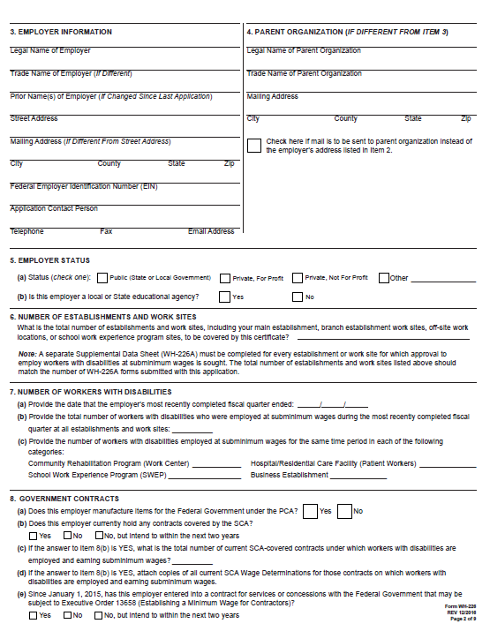
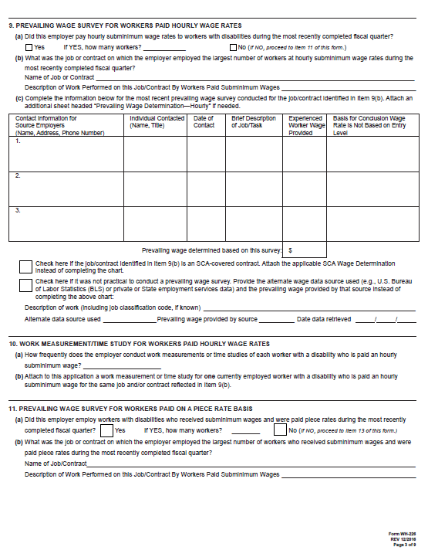
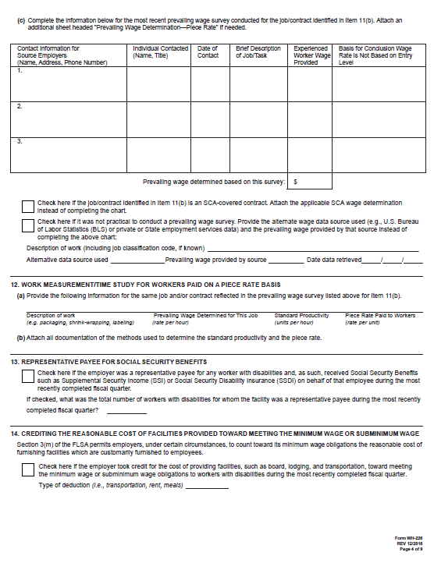
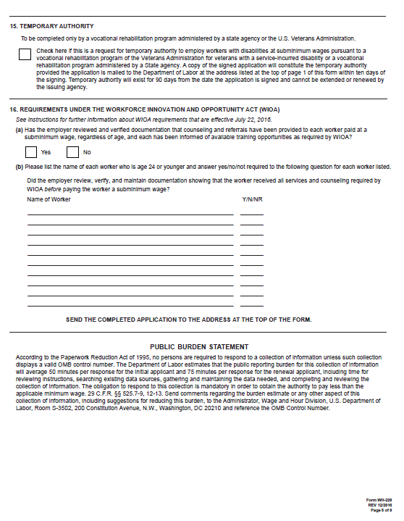
WH-226

Slide 36
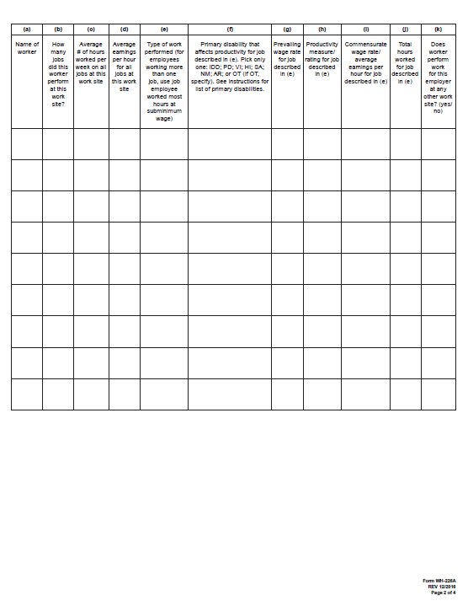
WH-226A

Slide 37
Paper Form Certificate Applications
Employers wishing to apply by mail must complete both forms WH-226 and WH-226A
WH-226: application
WH-226A: supplemental sheet for each physically-separate location or worksite where workers with disabilities will be employed at subminimum wages
Completed applications should be mailed to:
U.S. Department of Labor, Wage and Hour Division 230 South Dearborn Street, Room 514 Chicago, Illinois 60604-1591

Slide 38
Certification Attestations
Every applicant must attest that:
The employer has read the application form and to the best of his or her knowledge and belief, all answers and information given in the application and attachments are true
The representations set forth in support of the application to obtain or continue the authorization to pay workers with disabilities at subminimum wage rates are true
The authorization to pay SMWs, if issued or continued, is subject to revocation in accordance with the provisions of 29 CFR 525
Workers employed (or who will be employed) under the authority in 29 CFR 525 have disabilities for the work to be performed
Wage rates paid (or which will be paid) to workers with disabilities under the authority in 29 CFR 525 are commensurate with those paid experienced workers, who do not have disabilities that impair their performance, in industry in the vicinity for essentially the same type, quality and quantity of work

Slide 39
Certification Attestations (continued)
The operations are (or will be) in compliance with the FLSA, the Walsh-Healey Public Contracts Act (PCA), the McNamara-O’Hara Service Contract Act (SCA) and the Contract Work Hours and Safety Standards Act (CWHSSA), an overtime statute for Federal contract work
No deductions will be made from the commensurate wages earned by a patient worker to cover the cost of room, board or other services provided by the facility
Records required under 29 CFR 525 with respect to documentation of disability, productivity, time studies or work measurements, and prevailing wage surveys will be maintained
The wage rates of all hourly rated employees paid in accordance with FLSA section 14(c) will be reviewed at least every six months
Wages paid to all employees under FLSA section 14(c) will be adjusted at periodic intervals, at least once a year, to reflect changes in the prevailing wage paid to experienced workers employed in the vicinity for essentially the same type of work

Slide 40
Application Processing
To expedite the certification process, employers should:
Designate an individual within their organization who understands both the certification and compliance principles of FLSA section 14(c) to oversee the completion and submission of the application
Submit a complete, accurate, and timely application that includes all the required supporting documentation
Communicate with the WHD Certification Team as needed before, during, and after the submission of the application

Slide 41
Application Processing (continued)
WHD Wage Specialists review each application for completeness, accuracy, and compliance with the provisions of section 14(c)
Once the review is complete, a certificate will be issued or denied
Issuance of a certificate is not a statement by the Wage and Hour Division that the employer is in compliance with the provisions of the applicable Acts and does not provide the employer with a good faith defense should violations later be found

Slide 42
Denial of Application
A certificate will be denied if the application is incomplete, contains false statements, or does not include the proper supporting documentation and attestations
If denied, the applicant will be advised in writing and told the reasons for the denial, as well as the right to petition for review

Slide 43
Certificate Expiration
Certificates are issued with both an effective date and an expiration date
Certificates, along with the employer’s authorization to pay SMWs, expire on the indicated date unless the employer properly files an application for renewal with the Wage and Hour Division before the expiration date

Slide 44
Certificate Renewal
The employer is responsible for filing a proper and timely renewal application prior to the expiration of its certificate.
Renewal applications are submitted in the same manner as an initial application but require additional information
.

Slide 45
Certificate Revocation
A certificate may be revoked by the Administrator of WHD for the following reasons:
It is found that false statements were made or facts were misrepresented in obtaining the certificate. If this is the case, the certificate may be revoked back to the date of issuance.
It is found that the certificate holder violated any of the provisions of the FLSA or the terms of the certificate. If this is the case, the certificate may be revoked back to the date the violations began.
It is determined that the certificate is no longer necessary to prevent the curtailment of employment opportunities for workers with disabilities. If this is the case, the certificate will be revoked as of the date of the employer revocation notice.
A petition for review may be filed with the Administrator within 60 days of the action

Slide 46
Certification Questions
Contact the Certification Team at
(312) 596-7195

Slide 47
DETERMINING A SUBMINIMUM WAGE
Develop a Job Description
Determine the Prevailing Wage
Define the Work
Establish the Standard
Measure the Worker
Calculate and Implement Rate of Pay

Slide 48
Develop a Job Description

Slide 49
Job Description
A job description is important when determining the prevailing wage and when setting the standard upon which the subminimum wage will be based
A detailed job description should:
Define the specific job duties, responsibilities, and tasks
Identify the types of equipment and supplies used to perform the tasks
List the types of skills, education, or experience levels required
Indicate the location and days and times of the week the work will be performed
Define and establish the minimum acceptable levels of quantity (how much production must be accomplished) and quality (how well the job must be performed)

Slide 50
Determine the Prevailing Wage

Slide 51
Prevailing Wage Definition
A wage paid to an experienced worker who does not have a disability that impairs his/her ability to do the work and who performs essentially the same type of work in the vicinity
An experienced worker is a worker who has learned the basic elements or requirements of the work to be performed, ordinarily by completing a probationary or training period
Vicinity means the geographic area from which the labor force of the community is drawn
May not be lower than the federal minimum wage, or where applicable, a higher state minimum wage

Slide 52
Prevailing Wage Source
An employer may determine the prevailing wage for a job by:
Surveying a representative number of comparable firms in the vicinity that employ primarily workers who do not have disabilities and who perform similar work

Slide 53
Prevailing Wage Source (continued)
Where surveys are not practical, the employer may obtain wage information from other sources such as the Bureau of Labor Statistics or private or State employment services
Employer must document and detail reasons why a survey could not be done
Employment services which only provide entry level wage data are not acceptable as sources for prevailing wage information

Slide 54
How to Conduct a Prevailing Wage Survey
Solicit wage data from comparable businesses in the vicinity, preferably in writing
Document and maintain the following information for each survey conducted:
Date of contact
Name, address, and phone number of firm or other source contacted
Name and title of individual contacted at each firm or other source
The wage rate information provided and the basis for concluding that each rate submitted was not based upon an entry-level position
A description of work for which wage information was collected
This information must be retained for at least three years

Slide 55
The Prevailing Wage
Special situations where prevailing wage survey would not be required:
An employer whose workforce primarily consists of workers without disabilities may choose to use its established rate paid to experienced workers
A subcontractor may choose to use the wage rate the prime contractor pays experienced workers performing the same work in essentially the same way and with the same type of equipment

Slide 56
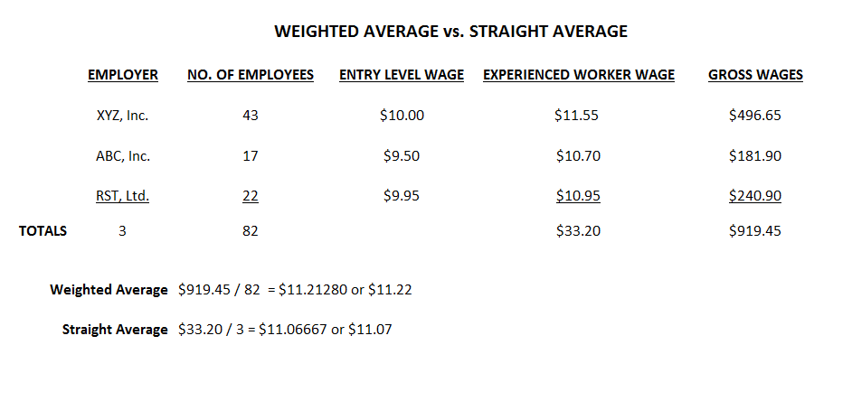
Sample Prevailing Wage Calculation

Slide 57
Calculating a Prevailing Wage
Note that in the straight average example, the prevailing wage rate of $11.06667 is rounded up to $11.07 per hour.
WHD will accept the practice of carrying out computations to the fifth decimal point and then rounding up to the fourth decimal place

Slide 58
Frequency of the Prevailing Wage Survey
The prevailing wage survey must be conducted prior to paying a subminimum wage
It must be reviewed and updated at least once a year
More frequently when a change in the prevailing wage has most likely occurred, such as when the FLSA minimum wage or a state minimum wage has been increased
Although some certificates remain in effect for two years, the prevailing wage surveys must be conducted no less frequently than once a year

Slide 59
Minimum Wage Increase
Whenever the minimum wage increases:
Employers will have to review all prevailing wage rates
Employers may have to conduct new prevailing wage surveys OR adjust old prevailing wage rates to accommodate for the increase in the minimum wage

Slide 60
De-Skilling
De-skilling means arbitrary downward adjustments made in prevailing wage rates to account for differences in duties, methods, equipment and responsibilities between the work of the worker with disabilities and the work of employees who do not have disabilities
De-skilling is NOT permitted by the Wage & Hour Division

Slide 61
Define the Work
Developing a task analysis

Slide 62
Task Analysis
A task analysis identifies:
Tasks and subtasks to be performed
Methods and procedures to accomplish task
The specific area where the work will be performed
Supplies and equipment necessary to perform the work
A definite start and stop point for the job/task
Environmental considerations
Minimum acceptable quality and quantity standards
The written analysis must match the methods used by the workers to complete the job/task
“Standard procedures”

Slide 63
Establish the Standard

Slide 64
Work Measurement Standard
Determine the time it takes a worker who does not have a disability for the work to perform the job as set out in the task analysis
Time becomes the “standard” against which the productivity of the worker with a disability is compared to determine the hourly commensurate wage
The commensurate wage rate will be proportionate to the prevailing wage based on productivity differences
The employer is responsible for demonstrating the standard has been properly established

Slide 65
Work Measurement Standard (continued)
Must be performed by a qualified, competent worker who does not have a disability for the work being performed and who possesses the necessary skill and training required to perform the job
Must be completed at a pace that can be maintained over an entire shift
Must make allowance for personal time, fatigue and unavoidable delays if used to set a piece rate

Slide 66
Work Measurement Standard (continued 2)
Work measurements must be conducted prior to paying a subminimum wage
As long as the job (and the equipment) remains the same, new work measurements are not required
It is good practice to periodically review and confirm performance standards

Slide 67
Setting the Standard
Employer must use an accepted method of industrial work measurement to determine the standard
Stopwatch time studies
Methods-Time Measurement (MTM)
Modular Arrangement of Predetermined Time Standards (MODAPTS)
The work measurement accurately measures the quality and quantity of the same work when performed by workers who do not have disabilities

Slide 68
Setting the Standard (continued)
Select an individual to conduct the study (the observer)
Select worker(s) without a disability for the job being measured to be timed (standard setters)

Slide 69
Setting the Standard (continued 2)
The standard setter must be:
Allowed to practice the work until he/she is comfortable, familiar and can perform the work without hesitation
Capable of maintaining a consistent, efficient pace

Slide 70
Setting the Standard (continued 3)
The observer must:
Assure that the standard setter performs the task exactly as it will be performed by the worker with a disability as specified on the task analysis
Compare the standard setter’s actions to the written procedures
Structure the study to avoid “lost time” situations
Time the standard setter’s work using the same starting and stopping point identified in the task analysis

Slide 71
Setting the Standard (continued 4)
The observer must:
Read the stopwatch and make recordings
Document the standard measurement (quality and quantity)
If the minimum standards are not met, the worker is advised of the shortcoming(s) and the study will resume with the worker performing rework
Conduct the study three times and determine average time

Slide 72
Work Measurements for Piece Rate
Similar to procedures for hourly wages:
Need accurate description of work to be performed
Need to select a standard setter
Need to conduct a work measurement of individual(s) who do not have disabilities that will evaluate their performance of the work being measured
Need to consider both quantity and quality of production

Slide 73
Work Measurements for Piece Rate (continued)
Different from work measurements for hourly:
The worker with a disability is not observed/evaluated – only the standard setter
Standard setter must be measured for a period long enough to ensure pace may be sustained throughout the day
Must make an allowance for personal time, fatigue, and unavoidable delays (PF&D)

Slide 74
Personal Time, Fatigue and Unavoidable Delays (PF&D)
PF&D must be taken into consideration when determining piece rates to account for certain nonproductive time
Breaks, cleanup time, unavoidable delay time, fatigue, etc.
An allowance of at least 15% (9-10 minutes per hour) must be used
9 minute PF&D = a 51-minute hour
10 minute PF&D = a 50-minute hour

Slide 75
Measuring PF&D – Method 1
Conduct time studies of the standard setters for 25 minutes, and then multiply the number of completed units by 2
Averaged results will yield the standard and will include a properly computed 10-minute PF&D
Verify accurate SMW by multiplying the standard “units per hour” by the established “piece rate” to ensure that the results equal or exceed the full prevailing wage

Slide 76
PF&D – Method 1 Example
Prevailing wage = $10.00
25 minute time studies resulted in an average of 40 units produced
Standard = 40 units × 2 = 80 units
Piece rate = $10.00 ÷ 80 units = $0.13

Slide 77
Measuring PF&D – Method 2
Multiply the standard time by an allowance factor of 1.20* to incorporate a 10-minute PF&D
*Using an allowance factor of 1.1764705 will provide a 9-minute PF&D
Verify accurate SMW by multiplying the standard “units per hour” by the established “piece rate” to ensure that the results equal or exceed the full prevailing wage

Slide 78
PF&D – Method 2 Example
Prevailing wage = $10.00; 20 minute time studies resulted in an average of 25 units produced
Time to produce a single unit = 20 minutes × 60 seconds ÷ 25 units = 48 seconds
Time with 10-minute PF&D: 48 × 1.20 = 57.6 seconds/unit
Standard = 1 hour (3600 seconds) ÷ 57.6 seconds/unit = 62.5 → 62 units
Piece rate = $10 ÷ 62 units = $0.1612903 = $0.1613

Slide 79
Measuring Hourly Paid Workers

Slide 80
Evaluating Productivity
Each hourly paid worker with a disability must:
be evaluated within the first month of initial employment
be evaluated at least every six months thereafter, or whenever there is a change in the methods used or materials used or whenever the worker changes jobs
perform the same tasks and use the same equipment as the standard setter
Evaluation should not be done if:
the worker is not familiar with the job
the worker is fatigued
conditions are different than normal

Slide 81
Rework
If quality and quantity standards have been met, the time as recorded is then compared to that of the standard setter
The percentage yielded is applied to the prevailing wage in order to determine the SMW
If the minimum standards are not met, the worker is advised of the shortcoming(s) and the study will resume with the worker performing rework
The clock will be started again and continue while the worker corrects/completes the work to that point where it meets the minimum acceptable standards
The time spent during the initial study and rework are then added together and compared to that of the standard setter

Slide 82
Calculate and Implement the Hourly Commensurate Wage

Slide 83
Calculate Hourly Commensurate Rate
Evaluate EACH worker’s productivity within first month after employment (or beginning a new job)
The productivity is compared to the established standard to calculate a percentage
Prevailing wage is multiplied by worker’s productivity percentage
The worker’s productivity must be re-evaluated every six months at a minimum
Must not be done when worker is fatigued
Recommend worker be timed on three different occasions and the results averaged

Slide 84
Section 14(c) Online Calculators
Thirteen (13) calculators available for use on WHD website to enable employers to accurately calculate the prevailing wage, piece rate, and commensurate wage
Website address:
https://www.dol.gov/whd/sec14c/calculators/

Slide 85
Thirteen Online Calculators
Prevailing Wage
Straight Average
Weighted Average
Hourly Wage Calculators
Weighted Tasks w/ Standard Weight Factor
Weighted Tasks w/ Worker with Disability Weight Factor
Rework
90/10 – Variable Time
90/10 – Variable Units
Piece Rate
Fixed Units, Variable Time w/ 9 minute PF&D
Fixed Units, Variable Time w/ 10 minute PF&D
Fixed Time, Variable Units w/ 9 minute PF&D
Fixed Time, Variable Units w/ 10 minute PF&D
Piece Rate
Minimum Wage Increase

Slide 86
Recordkeeping, Notification, and Posting Requirements

Slide 87
Records
The following must be maintained:
Records that document that the workers who are paid SMWs have disabilities that impair their productivity
Medical, psychiatric, psychological tests that support nature of disability
Records that document the accuracy and timeliness of the employer's establishment of prevailing wages
Contact between the employer and the businesses surveyed
The wage rate information provided by the comparable employers and the basis for concluding that each rate submitted was not based upon an entry-level position
A description of work for which wage information was collected

Slide 88
Records (continued)
Records of the time measurements the employer conducted to establish the standard for each job for which workers with disabilities are paid subminimum wages
Records of the productivity ratings of the workers with disabilities that document that the ratings were conducted properly and in a timely manner and that employee wages were adjusted accordingly by the end of the next pay period
Records identifying time spent by employees with disabilities at the employer’s establishment or in transit that are not considered hours worked and not compensable, such as receiving vocational or life skills training, receiving medical treatment, home-to-work travel, and performing simulated work

Slide 89
Notification Requirements
Each worker with a disability and, when appropriate, the parent or guardian of such a worker,
shall be informed orally and in writing
by the employer of the terms of the certificate
under which such a worker is employed

Slide 90
Posting Requirements
FLSA Minimum Wage Poster
Notice to Workers with Disabilities Paid at SMW
Family and Medical Leave Act Poster (if covered)
Notice to Employees Working on Government Contracts (if subject to SCA or PCA)
Employee Polygraph Protection Act Poster

Slide 91
Interaction with Related Federal Laws

Slide 92
Workforce Innovation and Opportunity Act (WIOA)
limitations on the payment of subminimum wages to individuals with disabilities

Slide 93
Workforce Innovation and Opportunity Act
Enacted July 22, 2014
Effective July 22, 2016
Amended Title V of the Rehabilitation Act by adding new “section 511”
Section 511 is codified at 29 USC 794g

Slide 94
WHD Enforcement Authority
Section 511 of the Rehabilitation Act
Section 11 of the FLSA
Department of Education also has authority under section 511

Slide 95
Scope of Section 511 Requirements
The section 511 service requirements apply to employees who are paid commensurate wages that are less than the FLSA Federal minimum wage
The section 511 service requirements do not apply to commensurate wages paid under the SCA and Executive Order 13658 when those wages are above the FLSA Federal minimum wage

Slide 96
Section 511’s Two New Requirements
Pre-Subminimum Wage Employment – Youth with a disability
During Subminimum Wage Employment – Any subminimum wage employee

Slide 97
Youth with a Disability (Pre-SMW Employment)
Individual who is age 24 or younger (youth)
Youth employed after July 22, 2016
Youth employed as of July 22, 2016, may be “grandfathered in”

Slide 98
Youth with a Disability (Pre-SMW Employment) – Requirement #1
Youth with disabilities employed at a subminimum wage after July 22, 2016, must complete and produce documentation indicating the completion of all three of the following actions:
Pre-employment transition services under the Rehabilitation Act or transition services under the Individuals with Disabilities Education Act (IDEA)

Slide 99
Youth with a Disability (Pre-SMW Employment) – Requirement #2
Application for Vocational Rehabilitation (VR) services with either one of two results:
Found ineligible for services, OR
Determined to be eligible,
Had an individualized plan for employment (IPE),
Worked toward an employment outcome specified in the IPE for a reasonable time without success, and
Their VR case was closed

Slide 100
Youth with a Disability (Pre-SMW Employment) – Requirement #3
Provided with career counseling, and information and referrals to Federal and State programs and other resources in the geographic area that offer employment-related services and supports
Services cannot be for employment at a subminimum wage or directly result in employment at a subminimum wage.

Slide 101
Any Subminimum Wage Employee (During SMW Employment)
Career counseling, and information and referrals
Provided by Designated State Unit (DSU)
Information about self-advocacy, self-determination, and peer mentoring training opportunities.
Provided by Employer (14(c) certificate holder)
Employer with fewer than 15 employees can refer employee to DSU

Slide 102
Any Subminimum Wage Employee (During SMW Employment) – Frequency
Once every six months for the first year of the individual’s employment at a subminimum wage
and
Annually thereafter

Slide 103
Any Subminimum Wage Employee (During SMW Employment) – Timing
All employees employed at SMWs prior to July 22, 2016 should have received both career counseling and training opportunities within one year of the effective date, i.e., by July 22, 2017
Services must then be received annually thereafter for the duration of SMW employment
The deadline for these employees to receive the required services remains July 22 of each year regardless of the actual date the career counseling and information about training opportunities are provided

Slide 104
Any Subminimum Wage Employee (During SMW Employment) – Timing (continued)
Employees receiving SMWs who were hired on or after July 22, 2016 must receive both career counseling and information about training opportunities once every six months for the first year of subminimum wage employment
Services must then be received annually thereafter, for the duration of SMW employment
The deadline for these employees to receive services is based on the anniversary of the date of their employment at an SMW

Slide 105
Section 511 Records
Employer must maintain documentation that an individual age 24 or younger has received required services
Employer must verify that all individuals employed at a subminimum wage have received the required services and provide information to these workers

Slide 106
Section 511 Restrictions on Schools
A local or State educational agency is prohibited from entering into a contract or other arrangement with a 14(c) certificate holder for the purpose of operating a program for individuals who are age 24 or younger to work at a subminimum wage
Contracting enforced by the Department of Education

Slide 107
Section 511 Resources
U.S. Department of Labor’s WHD Employment of Workers with Disabilities website:
https://www.dol.gov/whd/workerswithdisabilities/
Field Assistance Bulletins 2016-2 and 2019-1
Fact Sheet 39H
U.S. Department of Education’s Rehabilitation Services Administration website:
https://rsa.ed.gov/

Slide 108
McNamara-O’Hara Service Contract Act (SCA)
Prevailing Wage and Fringe Benefits

Slide 109
Service Contract Act & Section 14(c)
SCA allows employers who hold a section 14(c) certificate to pay service employees with disabilities a SMW less than the prevailing wage required by the wage determination
Employers MUST pay full fringe benefits, or the equivalent cash payment in lieu of providing the benefits

Slide 110
Service Contract Act & Section 14(c) (continued)
FLSA section 6(e) generally requires prime contractors or subcontractors on SCA contracts to pay all employees even if they are not working on or in connection with the service contract - at least the FLSA MW wage for all hours worked
Employers who have obtained a section 14(c) certificate may pay a SMW to SCA service employees and other employees not working on the contract who have disabilities for the work being performed

Slide 111
Executive Order 13658
Establishing a minimum wage for contractors

Slide 112
Executive Order 13658 Coverage
Establishes a minimum wage to be paid to workers performing on or in connection with a covered contract with the Federal Government
Workers covered by this Executive Order and due the full Executive Order minimum wage include workers with disabilities whose wages are calculated pursuant to certificates issued under section 14(c)

Slide 113
Executive Order 13658 & Section 14(c)
Certificate holders may continue to pay commensurate wages to workers with disabilities, as permitted by section 14(c), who are employed on or in connection with Executive Order covered contracts only if the commensurate wage rate is higher than the Executive Order minimum wage

Slide 114
Executive Order 13658 Application
Other staff employed by a certificate holder may also be covered by the Executive Order
The Executive Order minimum wage protections apply to all workers who directly perform the specific services called for by the contract’s terms
The Executive Order minimum wage protections also apply to FLSA-covered employees who are performing work activities that are necessary to the performance of a covered contract but who are not directly engaged in performing the specific services called for by the contract itself if at least 20% of their hours worked in a given workweek are in support of a covered contract

Slide 115
Executive Order 13658 Resources
Please see the following website for detailed information on Executive Order 13658 and its impact on section 14(c)
http://www.dol.gov/whd/flsa/eo13658/index.htm
Fact Sheet
Frequently Asked Questions

Slide 116
Executive Order 13706
Paid sick leave for
federal contract workers

Slide 117
Executive Order 13706 Coverage
Provides that workers performing on or in connection with a covered contract with the Federal Government must have access to up to 56 hours of paid sick leave
Workers entitled to leave under this Executive Order include workers with disabilities whose wages are calculated pursuant to certificates issued under section 14(c)

Slide 118
Executive Order 13706 Provisions
Employees accrue 1 hour of paid sick leave for every 30 hours worked on or in connection with a covered contract
Unused sick leave can be carried over into the next accrual year, however, employees can be limited to having 56 hours of paid sick leave available at any point in time
Instead of tracking time on covered contracts week by week, contractors can “frontload” leave at the beginning of the accrual year by giving employees 56 hours of paid sick leave in a lump sum
Where leave is frontloaded, employees can carry over up to 56 hours of unused paid sick leave into the next accrual year, and they still receive an additional 56 new hours of leave

Slide 119
Executive Order 13706 Provisions (continued)
Employees may use paid sick leave for
A physical or mental illness, injury, or medical condition
Obtaining diagnosis, care, or preventive care from a health care provider
Caring for a family member, or someone who is the equivalent of family
An issue related to domestic violence, sexual assault, or stalking of the employee or the employee’s family member, or someone who is the equivalent of family

Slide 120
Executive Order 13706 Usage
The employee can make an oral or written request to the contractor when paid sick leave is needed.
The contractor can require that the employee provide proof of the need for paid sick leave only if the employee is absent for 3 or more consecutive, full workdays and the employee is informed of this requirement before returning from leave.

Slide 121
Executive Order 13706 Resources
Please see the following website for detailed information on Executive Order 13706 https://www.dol.gov/whd/govcontracts/eo13706/
Fact Sheet
Frequently Asked Questions
Poster
Regulations

Slide 122
Common Errors To Avoid

Slide 123
Common Errors
Use of entry level rates or minimum wage for prevailing wage rates
Failure to conduct prevailing wage survey at least every year
Failure to maintain an accurate task analysis
Failure to evaluate the worker with a disability at least every 6 months.
Use of behavioral factors to establish hourly commensurate wages for workers with disabilities

Slide 124
Common Errors (continued)
Use of incorrect personal time, fatigue, and unavoidable delays (PF&D) allowance factor in calculating piece rates
Improper rounding
Failure to use correct wage determination rate for SCA work classification or pay full fringe benefits
Continuing to pay SMW after a section 14(c) certificate expires

Slide 125
Subscribe for 14(c) News Updates

Slide 126
Questions?
Visit the WHD homepage at:
http://www.dol.gov/whd
Call the WHD toll-free information and helpline at:
1-866-487-9243

